Slide 1
Object Oriented Programming

Slide 2
Object Oriented Programming
Object-oriented programming (OOP) is a set of techniques to design and build software in which the relevant entities of the system are identified and characterized as classes of objects that are linked to their own methods (functions) and attributes (variables).
OOP is a programming style that creates an architecture for software based on classes and objects. An object is an instance of a class. Every object is a type of a class.
There is a very famous analogy that compares a class with a cookie cutter and an object as a cookie you cut using said cutter. The objects created from the classes have all the same “shape” of the class. Just like all the cookies you cut with the same cutter look alike. In object-oriented programming that means that objects will have the same methods and attributes of the class they belong to.

Slide 3
Classes and Objects
A class is a template. It is a definition for all the methods and attributes that objects of that class will hold. A class is a shape that the objects will have. This shape defines functions and variables that will belong to each object instantiated in the program.
An object is a particular instance of a class. The class contains only the definition. The object contains the real values of the variables and executes the functions that were defined in the class.

Slide 4
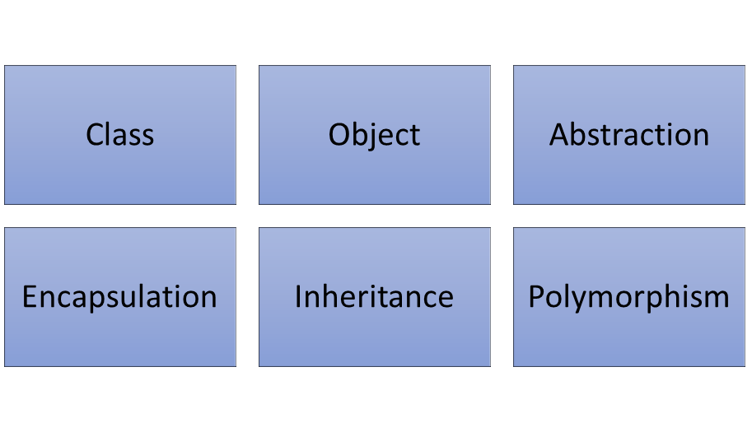
Object Oriented Programming Concepts

Slide 5
Thank you! ☺

