Slide 1
Object Oriented Programming

Slide 2
Abstraction
Abstraction is a fundamental concept in Computer Science that is independent of the technology or programming language.
You can use abstraction in many different programming languages like JavaScript, Java, C++ or Python because the concept is independent of the technology.
Abstraction itself does not appear alone in computer programming or software engineering but works together with other concepts like object-oriented programming, classes, objects, encapsulation and others.
Encapsulation means to tie together in a class the data and properties that are relevant to the entities in the models of our system. A class is like a building block for our system.

Slide 3
Object Oriented Programming
Object-oriented programming (OOP) is a style of programming independent of a programming language. Some old programming languages did not support OOP.
These programming languages supported only the procedural style of programming (creation of functions only).
(OOP) is characterized by the definition of classes and the creation of objects that have their own methods (functions) and are associated to the class that the object belongs to.
The four basic concepts of OOP are: encapsulation, abstraction, inheritance and polymorphism. These elements are programming language independent.

Slide 4
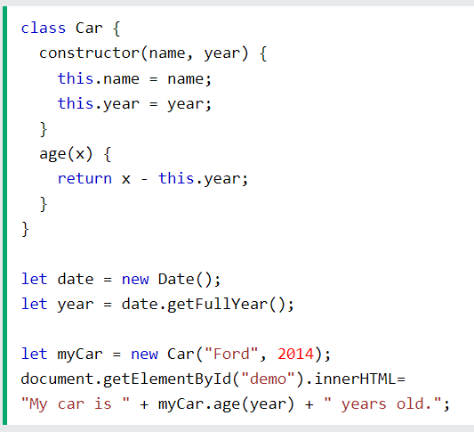
Class in JavaScript

Slide 5
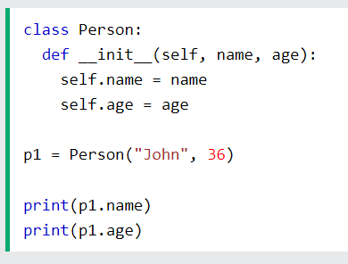
Class in Python

Slide 6
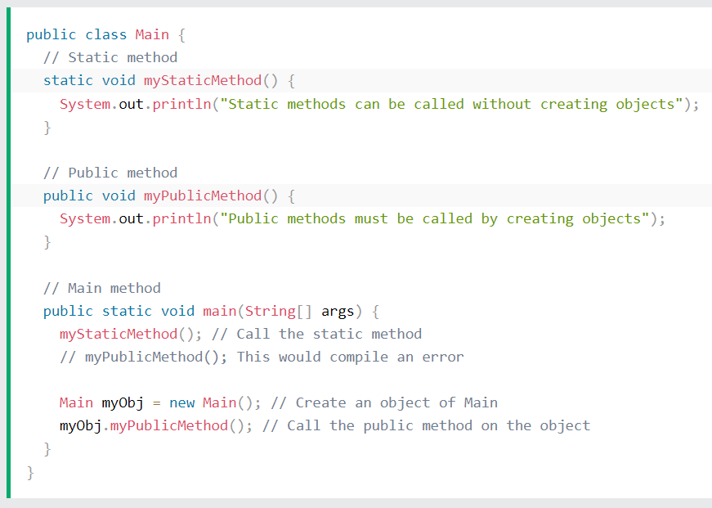
Class in Java

Slide 7
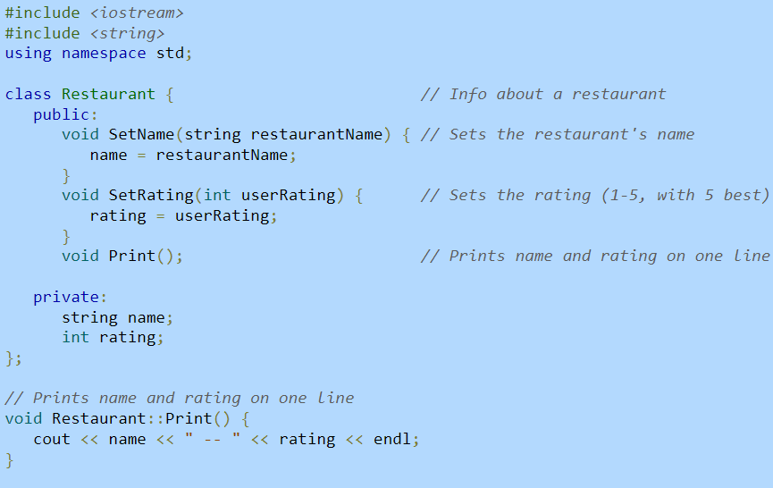
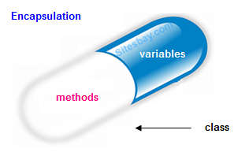
Encapsulation
Encapsulation involves the hiding of information for each class. Encapsulation in C++ is implemented as a class that ties data and the functions for each class operating on this data together for all objects created.

Slide 8
Abstraction
Abstraction is the OOP concept that focuses only on relevant data and methods for a class. It hides the background details and emphasizes the essential data points for reducing the complexity and increase efficiency.
Abstraction allows to retain only information that is relevant for the specific system processes. Abstraction mainly focusses on the idea instead of actual functioning.
Abstraction is different from encapsulation. Encapsulation is achieved through classes, accessors, mutators, and private/protected/public members. Abstraction is achieved by ignoring irrelevant data and methods for the classes in the system. Abstraction is adding to the system only what is relevant in our program.

Slide 9
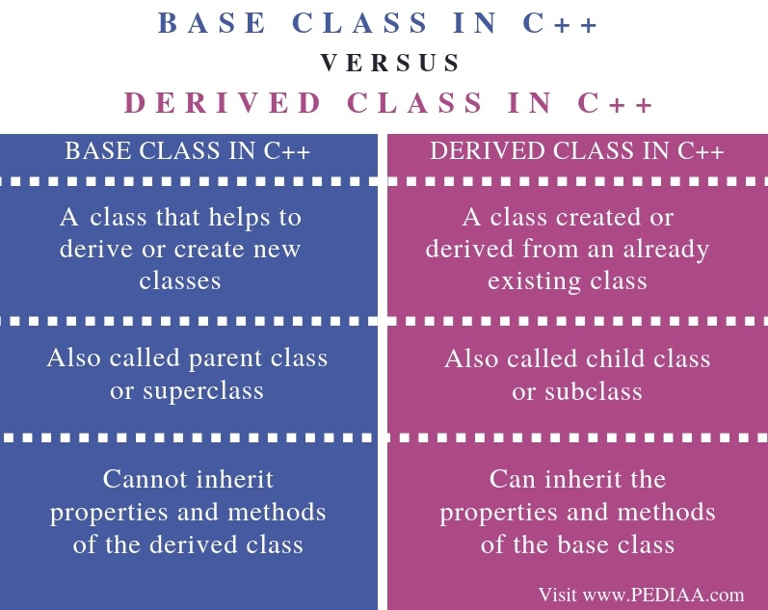

Slide 10
Thanks! ☺

