Slide 1
EV Charging Station Siting Analysis
Applied Data Science Capstone by IBM/Coursera
Author: Rubenka Bandyopadhyay

Slide 2
Background:
This code was written as part of the requirements of the IBM/Coursera Data Science Professional Career Track Specialization. Students were asked to choose a problem and utilize skills acquired during this specialization to solve the selected problem.

Slide 3
Business Problem
The objective is to try to come up with a siting analysis for public EV charging station installations - preferably close to local shops and restaurants
One of the indirect benefits of EV charging that is often talked about is contribution to the local economy - i.e. people tend to spend money on nearby shops when waiting on charging their EVs
Algorithm used is the k-means clustering method
The area of interest is an area where I currently live - within a 100 km radius of downtown Raleigh in North Carolina. This approximately covers the towns of Durham, Raleigh and Chapel Hill
As of 2020, the population of the larger Raleigh-Durham-Chapel Hill Combined Statistical Area (CSA) is estimated at 2.03 million
Hailed as a technological hub within the state, the mean age of residents range between 26 to 35 years

Slide 4
Target Audience
This project is primarily aimed at any one interested in Data Science applications in the Energy sector, but I hope that other Data Science enthusiasts will also find ways to repurpose the code. Data Science techniques and/or Machine Learning Algorithms often continue to remain abstract ideas until we apply them to problems. I hope this project provides some insight into translating abstract ideas into specific outputs that could aid decision making in business ventures.

Slide 5
Data Sources:
API Foursquare - This database provides information on locations of popular restaurants. Link: https://foursquare.com/
AFDC Database - This database provides information on preexisting EV charging locations. Link: https://afdc.energy.gov/fuels/electricity_locations.html#/find/nearest?fuel=ELEC

Slide 6
Methodology: k-means clustering algorithm
Step 0:
Import relevant Python libraries
Step 1:
Read in the data from AFDC and Foursquare API
Next up - identification of trending spots in the Raleigh...
There are a few different ways of identifying trending spots. For purposes of this project we consider two specific Foursquare categories:
(a) 'Food', and (b) 'Shops & Services'.
Refer to API Foursquare List of Venue Categories for full list of categories
Step 2:
Now that we have the geographic coordinates of businesses in the area, let us determine the distance between each venue obtained from the foursquare API and each EVSE outlet location:
Procedure to calculate the distance has been obtained from this article in medium: Finding the distance between two lists of geographic coordinates by Dana Lindquist. The distance computed here is a haversine distance. This assumes the earth is a true sphere which makes for a relatively fast computation. The sklearn computation assumes the radius of the sphere is 1, so to get the distance in miles we multiply the output of the sklearn computation by 3959 miles, the average radius of the earth. To get the distance in kilometers this number would be 6371 km.
Step 3:
Now let's count the number of EVSE Stations that are at distance which is less than or equal to 5 km from the prospective venues
Step 4:
Let us now cluster those locations to create centers of zones containing good locations. Those zones, their centers and addresses will be the final result of our analysis.
Finally, let's reverse geocode those k-means clustering centers to get the addresses which can be presented to stakeholders.

Slide 7
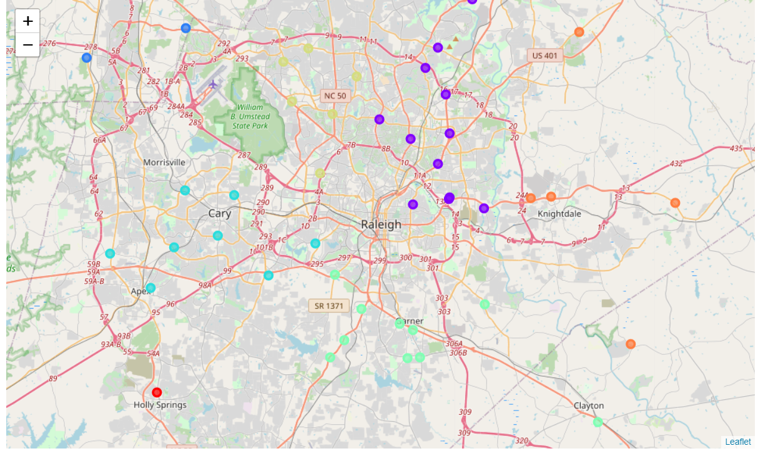
Results
Following map should locations of retail outlets that could benefit from EVSE installations closeby.
Retail locations within the same geographic group is coded in the same color

Slide 8
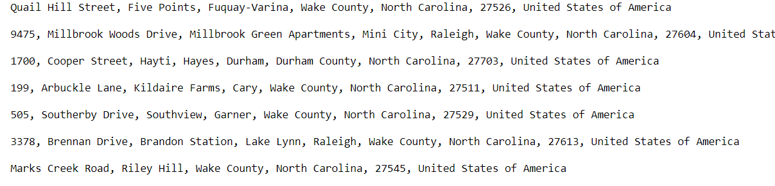
Results
Demonstrates list of addresses in the neighborhood that could be suitable locations
for EVSE installations

Slide 9
Discussion
While this project does a good job demonstrating how data science can be used to inform energy infrastructure siting decisions, the analysis could be improved in many different ways. A few are listed here but should not be considered an exhaustive list: (a) Socio-economic as well as demographic factors need to be considered when prioritizing siting locations. Here is an excellent article summarizing policies and actions being taken to expand access to electric transporation among low income groups and apartment dwellers (b) Siting analysis may need to take into considerations the practicality of EV charging installations - zoning permits, transmission capacity to support supply of electricity for EV charging etc. are some factors that could affect EV charging installations (c) Demand for EV charging is another really important factor. If there are not enough EVs driving through the region that need to stop and charge - there may not be any incentive for installation of EV chargers. North Carolina DMV has recently started releasing EV registration data in NC counties . This could indicate how many EV owners currently reside in NC. Market research could also be performed to explore the out-of-state EV traffic passing through NC.

Slide 10
Conclusion
This project provides a simple example of utilization of k-means clustering technique in the clean energy sector. Data cleaning and manipulation, application of algorithms, and subsequent data visualization are the primary steps involved in any problem that needs to be solved using data analytics. I hope that this notebook provides a source of reference for those starting to explore data-driven solutions to their business problems.

