Slide 1

CSC/CPE 138 - Computer Network Fundamentals
Transport Layer
The presentation was adapted from the textbook: Computer Networking: A Top-Down Approach 8th edition Jim Kurose, Keith Ross, Pearson, 2020

Slide 2
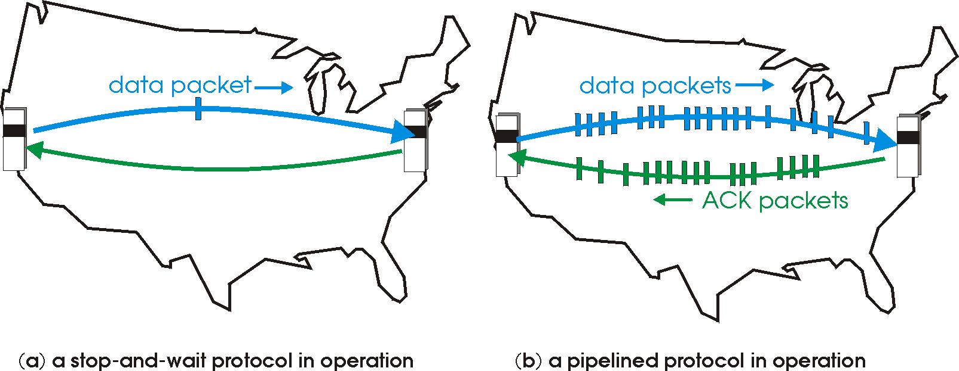

rdt3.0: pipelined protocols operation
pipelining: sender allows multiple, “in-flight”, yet-to-be-acknowledged packets
range of sequence numbers must be increased
buffering at sender and/or receiver

Slide 3
Pipelining: increased utilization
sender
receiver
first packet bit transmitted, t = 0
last bit transmitted, t = L / R
first packet bit arrives
RTT
last packet bit arrives, send ACK
last bit of 2nd packet arrives, send ACK
last bit of 3rd packet arrives, send ACK
ACK arrives, send next
packet, t = RTT + L / R
3-packet pipelining increases
utilization by a factor of 3!
Notes:
two generic forms of pipelined protocols: go-Back-N, selective repeat

Slide 4
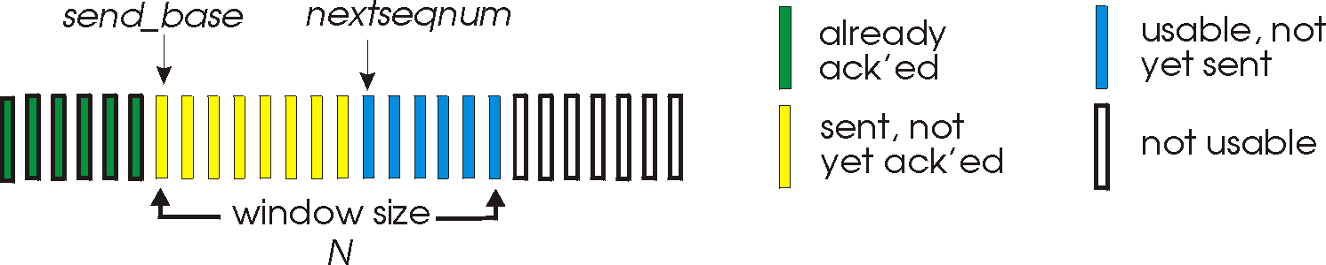
Go-Back-N: sender
sender: “window” of up to N, consecutive transmitted but unACKed pkts
k-bit seq # in pkt header
cumulative ACK: ACK(n): ACKs all packets up to, including seq # n
on receiving ACK(n): move window forward to begin at n+1
timer for oldest in-flight packet
timeout(n): retransmit packet n and all higher seq # packets in window
Notes:
window size of 14, 8 have been sent but are not yet ackowledgedm 6 sequence numbers are available for us. In woindow, but no calls from above to use them.
Note – we’ll skip the Go-Back-N FSM specification you can chack that out in powerpoitn slides or book)
TCP uses cumulative ACK

Slide 5
Go-Back-N: receiver
ACK-only: always send ACK for correctly-received packet so far, with highest in-order seq #
may generate duplicate ACKs
need only remember rcv_base
on receipt of out-of-order packet:
can discard (don’t buffer) or buffer: an implementation decision
re-ACK pkt with highest in-order seq #
Receiver view of sequence number space:
received and ACKed
…
…
Out-of-order: received but not ACKed
rcv_base
Not received
Notes:
Note – we’ll skip the Go-Back-N FSM specification (actually it’s

Slide 6

Go-Back-N in action
sender window (N=4)
sender
receiver
0 1 2 3 4 5 6 7 8
send pkt0
send pkt1
send pkt2
send pkt3
(wait)
0 1 2 3 4 5 6 7 8
receive pkt0, send ack0
receive pkt1, send ack1
receive pkt3, discard,
(re)send ack1
0 1 2 3 4 5 6 7 8
X
0 1 2 3 4 5 6 7 8
loss
0 1 2 3 4 5 6 7 8
rcv ack0, send pkt4
0 1 2 3 4 5 6 7 8
rcv ack1, send pkt5
receive pkt4, discard,
(re)send ack1
ignore duplicate ACK
receive pkt5, discard,
(re)send ack1
pkt 2 timeout
0 1 2 3 4 5 6 7 8
send pkt2
send pkt3
send pkt4
send pkt5
0 1 2 3 4 5 6 7 8
0 1 2 3 4 5 6 7 8
rcv pkt2, deliver, send ack2
rcv pkt3, deliver, send ack3
rcv pkt4, deliver, send ack4
rcv pkt5, deliver, send ack5
0 1 2 3 4 5 6 7 8
Notes:
Let’s skip FSM specification for GBN – check out the book or ppt – and let’s watch GBN sender and receivers in action.
Let assume a window size of 4. at t=0, sender sends packets 0, 1, 2 3, 4, and packet 2 will be lost
At the receiver:
Packet 0 received ACK0 generated
Packet 1 received ACK1 generated
Packet 2 is lost, and so when packet 3 is received, ACK 1 is sent – that’s the cumulative ACK, re-Acknowledging the receipt of packet 1. and in this implementation packet 3 is discarded

Slide 7
Selective repeat
receiver individually acknowledges all correctly received packets
buffers packets, as needed, for eventual in-order delivery to upper layer
sender times-out/retransmits individually for unACKed packets
sender maintains timer for each unACKed pkt
sender window
N consecutive seq #s
limits seq #s of sent, unACKed packets
Notes:
An important mechanism of GBN was the use of the cumulative acknowledgements, and as we mentioned, cumulative ACKs are used in TCP
An alternate ACK mechanism would be for the receiver to indiviually acknowledge specific packets as they are received. This mechanism is at the heart of the Selective repeat protocol.

Slide 8
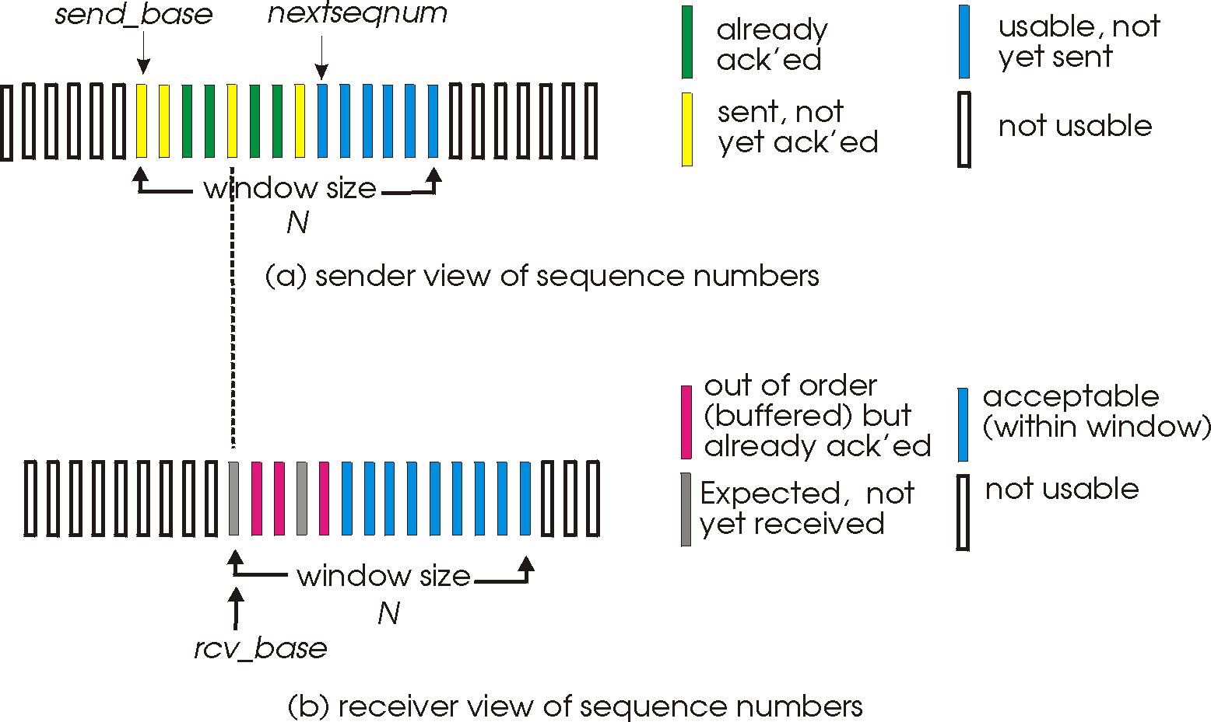
Selective repeat: sender, receiver windows

Slide 9
Selective repeat: sender and receiver
sender
receiver
data from above:
if next available seq # in window, send packet
timeout(n):
resend packet n, restart timer
ACK(n) in [sendbase,sendbase+N-1]:
mark packet n as received
if n smallest unACKed packet, advance window base to next unACKed seq #
packet n in [rcvbase, rcvbase+N-1]
send ACK(n)
out-of-order: buffer
in-order: deliver (also deliver buffered, in-order packets), advance window to next not-yet-received packet
packet n in [rcvbase-N,rcvbase-1]
ACK(n)
otherwise:
ignore
Notes:
If the packet is in order, its data will be delivered, as will any buffered data that can now be delived in order

Slide 10
Selective Repeat in action
sender window (N=4)
sender
receiver
0 1 2 3 4 5 6 7 8
send pkt0
send pkt1
send pkt2
send pkt3
(wait)
0 1 2 3 4 5 6 7 8
receive pkt0, send ack0
receive pkt1, send ack1
receive pkt3, buffer,
send ack3
0 1 2 3 4 5 6 7 8
X
0 1 2 3 4 5 6 7 8
loss
0 1 2 3 4 5 6 7 8
rcv ack0, send pkt4
0 1 2 3 4 5 6 7 8
rcv ack1, send pkt5
receive pkt4, buffer,
send ack4
record ack3 arrived
receive pkt5, buffer,
send ack5
pkt 2 timeout
0 1 2 3 4 5 6 7 8
send pkt2
(but not 3,4,5)
0 1 2 3 4 5 6 7 8
0 1 2 3 4 5 6 7 8
rcv pkt2; deliver pkt2,
pkt3, pkt4, pkt5; send ack2
0 1 2 3 4 5 6 7 8
Q: what happens when ack2 arrives?

Slide 11
Selective repeat: a dilemma!
sender window
(after receipt)
receiver window
(after receipt)
0 1 2 3 0 1 2
pkt0
0 1 2 3 0 1 2
pkt1
0 1 2 3 0 1 2
0 1 2 3 0 1 2
pkt2
0 1 2 3 0 1 2
example:
seq #s: 0, 1, 2, 3 (base 4 counting)
window size=3
0 1 2 3 0 1 2
0 1 2 3 0 1 2
pkt3
X
0 1 2 3 0 1 2
pkt0
will accept packet
with seq number 0
(a) no problem
0 1 2 3 0 1 2
pkt0
0 1 2 3 0 1 2
pkt1
0 1 2 3 0 1 2
0 1 2 3 0 1 2
pkt2
X
0 1 2 3 0 1 2
X
0 1 2 3 0 1 2
X
timeout
retransmit pkt0
0 1 2 3 0 1 2
pkt0
will accept packet
with seq number 0
(b) oops!

Slide 12

Selective repeat: a dilemma!
sender window
(after receipt)
receiver window
(after receipt)
0 1 2 3 0 1 2
pkt0
0 1 2 3 0 1 2
pkt1
0 1 2 3 0 1 2
example:
seq #s: 0, 1, 2, 3 (base 4 counting)
window size=3
0 1 2 3 0 1 2
pkt2
0 1 2 3 0 1 2
0 1 2 3 0 1 2
0 1 2 3 0 1 2
pkt3
receiver can’t see sender side
receiver behavior identical in both cases!
something’s (very) wrong!
X
0 1 2 3 0 1 2
pkt0
will accept packet
with seq number 0
(a) no problem
Q: what relationship is needed between sequence # size and window size to avoid problem in scenario (b)?
pkt0
0 1 2 3 0 1 2
0 1 2 3 0 1 2
pkt1
0 1 2 3 0 1 2
0 1 2 3 0 1 2
pkt2
X
0 1 2 3 0 1 2
X
0 1 2 3 0 1 2
X
timeout
retransmit pkt0
0 1 2 3 0 1 2
pkt0
will accept packet
with seq number 0
(b) oops!

Slide 13
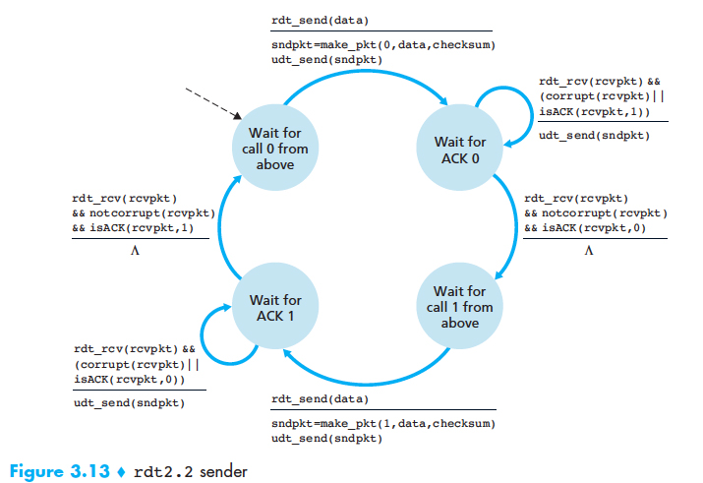
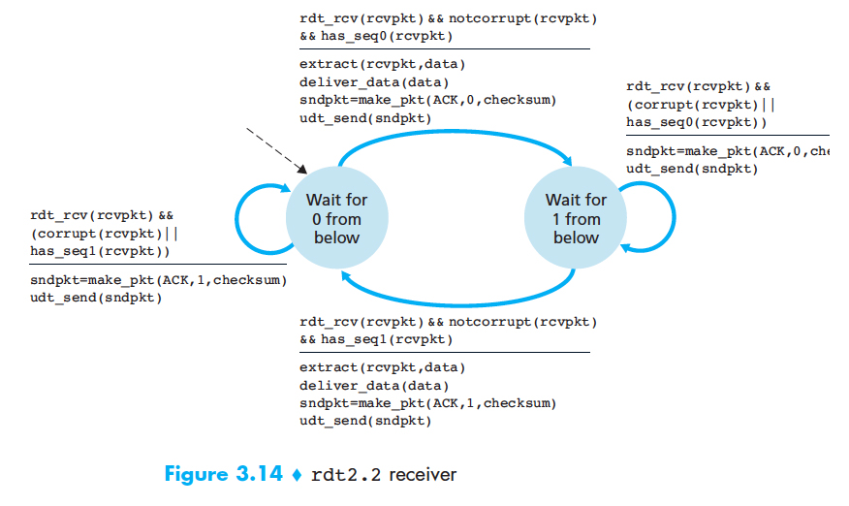
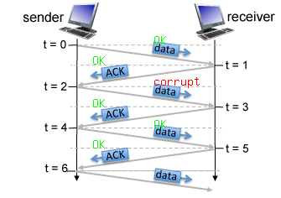
Exercise 1 RDT 2.2
1. At time t=0, the sender state is:
2. At time t=0, the receiver state is: 3. At time t=0, the sequence # is: 4. At time t=1, the sender state is: 5. At time t=1, the receiver state is: 6. At time t=1, the ACK # is: 7. At time t=2, the sender state is: 8. At time t=2, the receiver state is: 9. At time t=2, the sequence # is: 10. At time t=3, the sender state is: 11. At time t=3, the receiver state is:
12. At time t=3, the ACK # is:
Wait for ACK 0
Suppose that the channel connecting the sender and receiver can corrupt but not lose or reorder packets. Now consider the figure below, which shows four data packets and three corresponding ACKs being exchanged between an rdt 2.2 sender and receiver. The actual corruption or successful transmission/reception of a packet is indicated by the corrupt and OK labels, respectively, shown above the packets in the figure below.
Wait for 0 from below
0
Wait for ACK 0
Wait for 1 from below
0
Wait for ACK 1
Wait for 1 from below
1
Wait for ACK 1
Wait for 1 from below
0

Slide 14
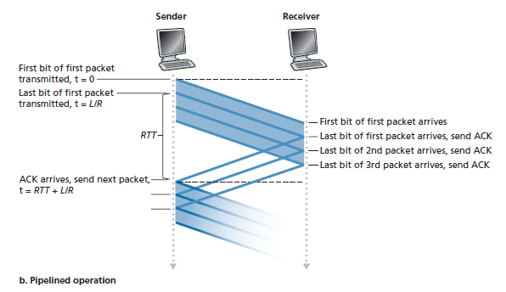
Exercise 2
Consider the cross-country example shown in Figure, with a 10 Gbps link and 15 ms propagation. How big would the window size have to be for the channel utilization to be greater than 98 percent? Suppose that the size of a packet is 1,500 bytes, including header fields and data.
The time it takes to transmit the packet:
L
1500*8 bits
D_{trans} =
=
=
1.2 microsecs
R
10*10⁹ bits/sec
(L/ R)*n
U_{sender}
=
approximately 24501 packets.
RTT
+ L / R

Slide 15
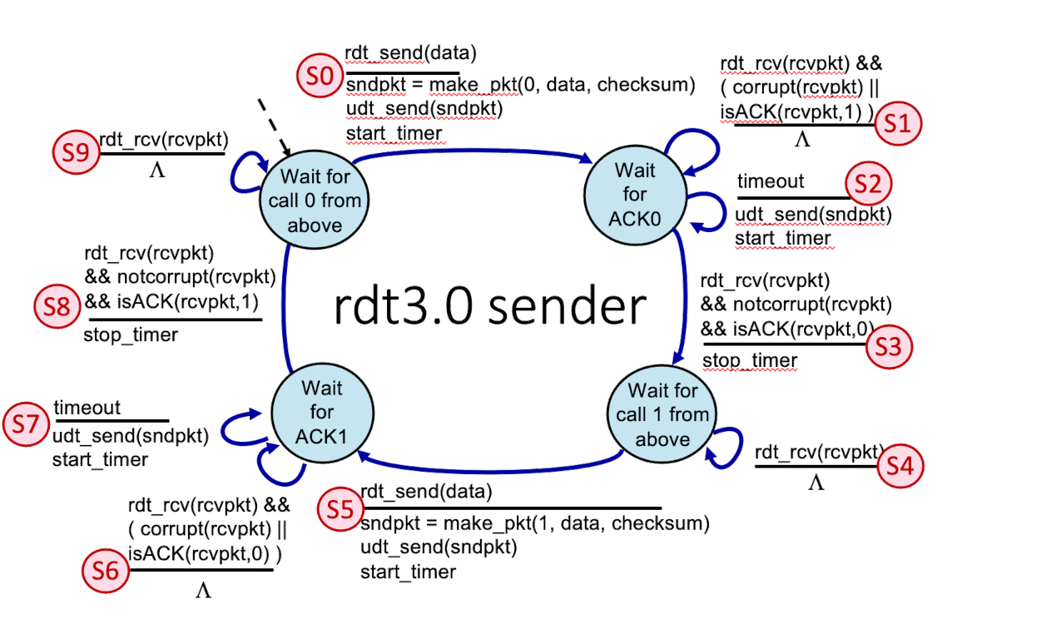
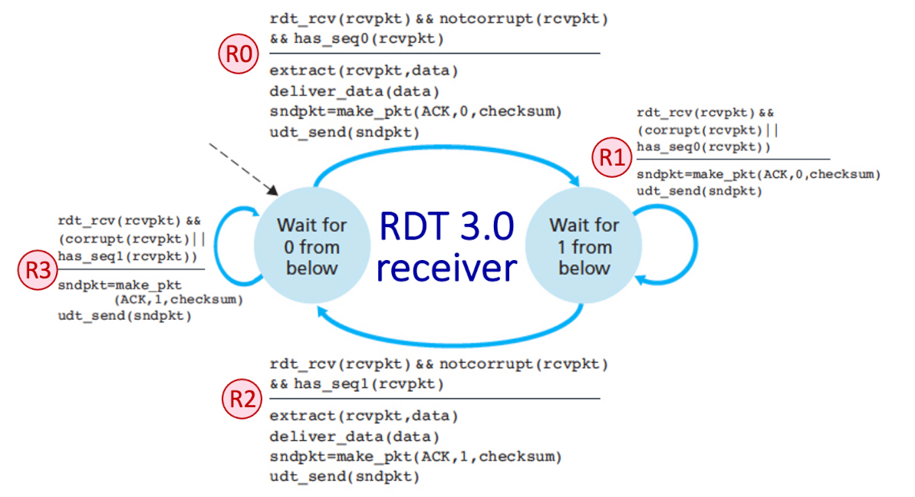
Exercise 3 RDT 3.0
Consider the RDT 3.0 protocol, for reliably communicating data from a sender to receiver over a channel that can lose or corrupt packets in either direction, and when the maximum delay from sender to receiver and back is not known. The FSMs for the sender and receiver are shown below, with their transitions labeled as SX and RY, respectively.
Now let’s consider the sequence of sender and receiver transitions that would happen when one or more of the following complications occur: a packet (data or ACK) is lost, a timer times out (prematurely or not), or a message is corrupted. One or more of these events has occurred to produce the sequence of transitions below. In the sequence below, one transition has been omitted and replaced with a "*".
Transition Sequence: S0, R0, S3, S5, *, S8 ->
R2

