Slide 1


Department of Computer Science and Engineering
Plant Leaf Disease and Severity Classification using Deep Learning
Mrs. Divya M
Department of CSE Rajalakshmi Enginnering College
L Ruben Raj -220701230

Slide 2
Problem Statement and Motivation
Plant diseases, especially in rice, significantly reduce crop yield.
Manual detection methods are slow, inaccurate, and require experts.
This project uses deep learning (CNN) for automatic rice leaf disease detection.
It classifies disease type and severity using a labeled image dataset. A progress tracking feature helps monitor disease over time for timely action.

Slide 3
Existing System
The current method for identifying rice leaf diseases relies on manual inspection by agricultural experts or farmers.
Visual observation is used to detect symptoms, which can be subjective and inaccurate.
This process is time-consuming, especially over large fields, and not scalable.
Some digital tools exist, but they often lack accuracy, severity detection, or progress tracking.
Most existing automated systems do not integrate deep learning with severity-based classification or offer disease monitoring.

Slide 4
Objectives
To develop an automated system that detects rice leaf diseases from images using deep learning.
To classify the type of disease and assess its severity level accurately.
To utilize a CNN model trained on the Severity-Based Rice Leaf Diseases Dataset.
To provide a user-friendly interface for uploading and analyzing leaf images.
To implement a progress tracking feature for monitoring disease development over time.

Slide 5
Abstract
Plant diseases pose a serious threat to global food security, particularly affecting staple crops like rice. Early and accurate detection is essential for preventing yield loss and improving crop health. Traditional methods of disease identification involve manual inspection, which is time-consuming, subjective, and often impractical for large-scale farming.
This project proposes a deep learning-based approach using a Convolutional Neural Network (CNN) to automatically detect and classify rice leaf diseases from images. The system leverages the "Severity-Based Rice Leaf Diseases Dataset" to identify both the type of disease and its severity level. In addition, a progress tracking feature is integrated to monitor the disease over time, enabling farmers and agricultural professionals to make timely, informed decisions. This solution aims to enhance agricultural productivity through automation, precision, and ease of use.

Slide 6
Proposed System
A CNN model will detect rice leaf diseases from images.
The system will classify both disease type and severity.
It uses the "Severity-Based Rice Leaf Diseases Dataset".
A simple interface will allow users to upload leaf images.
It includes disease progress tracking for better crop monitoring.

Slide 7
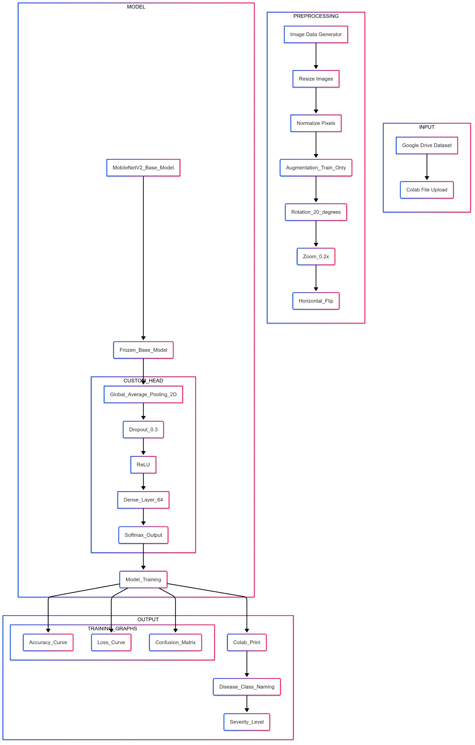
System Architecture

Slide 8
List of Modules
Data & Viz: numpy, pandas, matplotlib.pyplot, seaborn
Image Preprocessing: tensorflow.keras.preprocessing.image.ImageDataGenerator
Deep Learning Framework: tensorflow (and keras)
Model Architecture: tensorflow.keras.applications.MobileNetV2, keras.layers
Training Utilities: keras.callbacks.EarlyStopping, keras.callbacks.ReduceLROnPlateau

Slide 9
Functional Description for each modules with DFD and Activity Diagram
Image Data Generator: Prepares & augments image data.
MobileNetV2 (Base Model): Pre-trained CNN for feature extraction.
Custom Head: Adapts features for classification.
Model Training: Model learns from data to predict.
Output & Evaluation: Shows predictions and model performance.

Slide 10
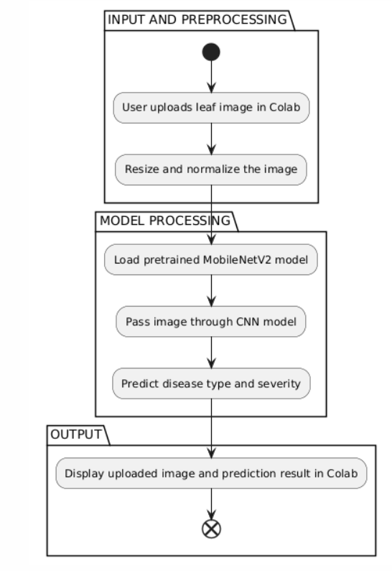
Activity Diagram

Slide 11
Implementation & Results of Module
Implementation:
Our project uses a pre-trained MobileNetV2 CNN for plant disease and severity detection. We employed ImageDataGenerator for image preprocessing (resizing, normalization) and augmentation (rotation, zoom, flip) to train the model. A custom classification head with pooling, dropout, and dense layers was added and frozen, allowing the model to leverage MobileNetV2's features. The model was trained for 5 epochs using the Adam optimizer and categorical cross-entropy loss.
Results:
We observed increasing training and validation accuracy and decreasing loss, indicating effective learning and generalization. The model successfully predicts the disease type and severity for new leaf images, demonstrating its capability in classifying plant diseases and their severity.

Slide 12
Conclusion & Future Work
This project developed a lightweight, real-time rice plant disease detection and progress tracking system using a Random Forest classifier in a Streamlit web app. It accurately predicts disease type and severity from uploaded or live-captured images. The app is efficient, user-friendly, and suitable for low-resource environments. Limitations include a small dataset and limited disease classes.
Future improvements include dataset expansion, CNN integration, multi-crop support, and real-time streaming.

Slide 13
References
H. Too et al., "A Comprehensive Review of Machine Learning Approaches for Plant Disease Detection," Computers and Electronics in Agriculture, vol. 185, 2021.
N. H. Y. Lim et al., "A Review on the Challenges and Solutions in Automatic Plant Disease Detection," Computers and Electronics in Agriculture, vol. 185, 2021.

Slide 14
Thank You

