Slide 1


Comparative Analysis: TensorFlow vs PyTorch
ITAI-2376 Deep Learning Artificial Intelligence | Group: AI AIchemists | Team Members: Ruben Valenzuela, Daedra Minigan, Benjamin LaCount II

Slide 2

01. Framework Introduction
Importance of deep learning frameworks and why TensorFlow vs PyTorch comparison matters.
02. Background Analysis
Origins, development history, and design philosophy of both frameworks from Google and Meta.
Agenda
03. Features & Applications
Key technical features, real-world implementations, and industry adoption patterns for each framework.
04. Comparative Conclusion
Comprehensive analysis, performance comparison, and recommendations for different use cases and scenarios.

Slide 3



Introduction: Deep Learning Frameworks Landscape
Why Framework Selection Matters
Deep learning frameworks serve as the foundation for AI development, providing essential tools for model creation, training, and deployment across diverse applications and industries.
Market Leadership
Innovation Drivers
Community Impact
TensorFlow and PyTorch dominate the deep learning ecosystem, collectively representing over 70% of framework adoption in both research and industry applications.
Both frameworks continuously push boundaries in AI development, offering unique approaches to model design, training optimization, and production deployment strategies.
Large developer communities, extensive documentation, and robust ecosystems make these frameworks the go-to choice for researchers and practitioners worldwide.

Slide 4
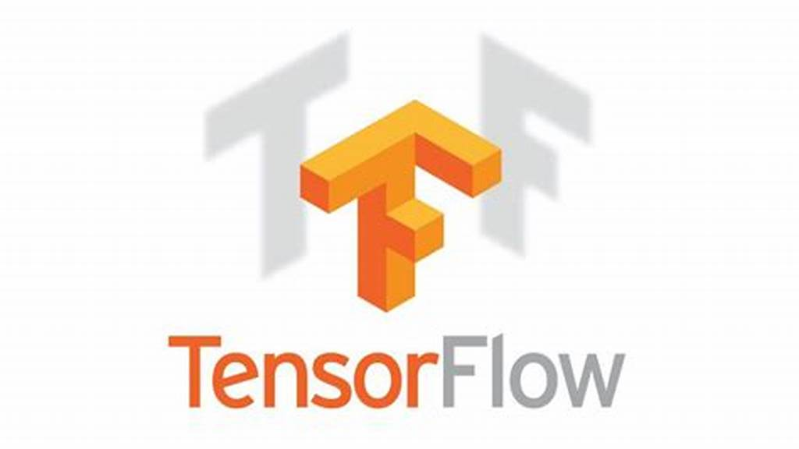


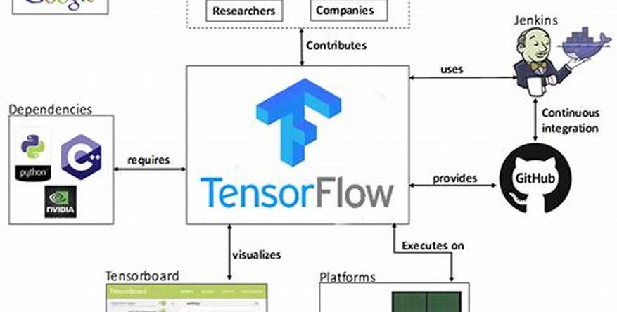
Background: TensorFlow Framework Overview
Google's Deep Learning Pioneer
TensorFlow, launched by Google Brain in 2015, revolutionized the deep learning landscape with its scalable, production-ready architecture designed for enterprise deployment and large-scale applications.
Production Focus
Ecosystem Strength
Built with enterprise scalability in mind, TensorFlow excels in industrial environments requiring robust deployment, monitoring, and maintenance of AI models at scale.
Backed by Google's infrastructure and supported by both academic and corporate communities, creating a comprehensive ecosystem for AI development and deployment.

Slide 5
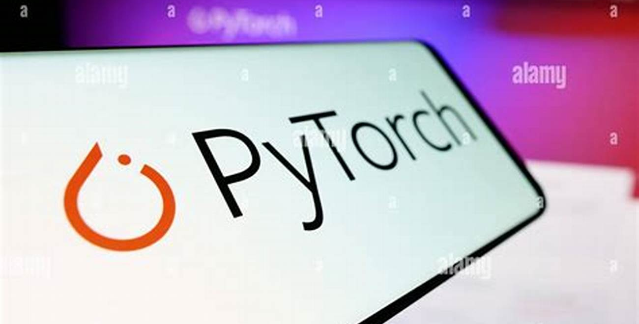



Background: PyTorch Framework Overview
Meta's Research-First Approach
PyTorch, developed by Facebook AI Research in 2016, prioritizes flexibility and intuitive design, enabling rapid experimentation and prototyping with its dynamic computational graph architecture.
Research Excellence
Pythonic Design
Designed for fast experimentation, PyTorch dominates academic research with 80% adoption in NeurIPS 2023 papers, making it the preferred choice for cutting-edge AI research.
Features intuitive, Python-native syntax and dynamic computation graphs that allow developers to modify networks on-the-fly, enhancing debugging and development speed.

Slide 6
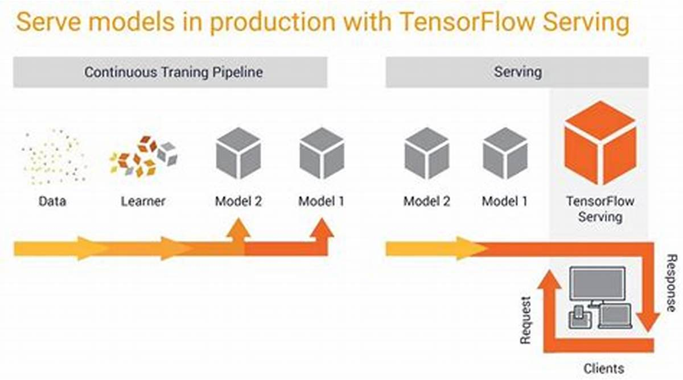
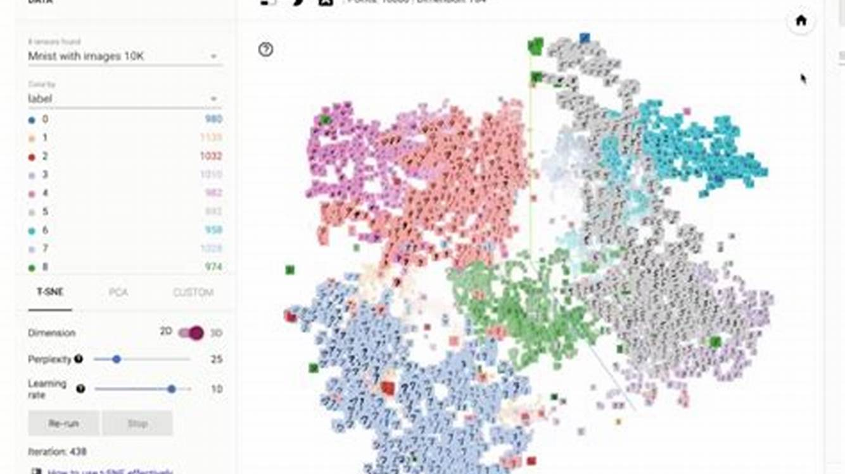
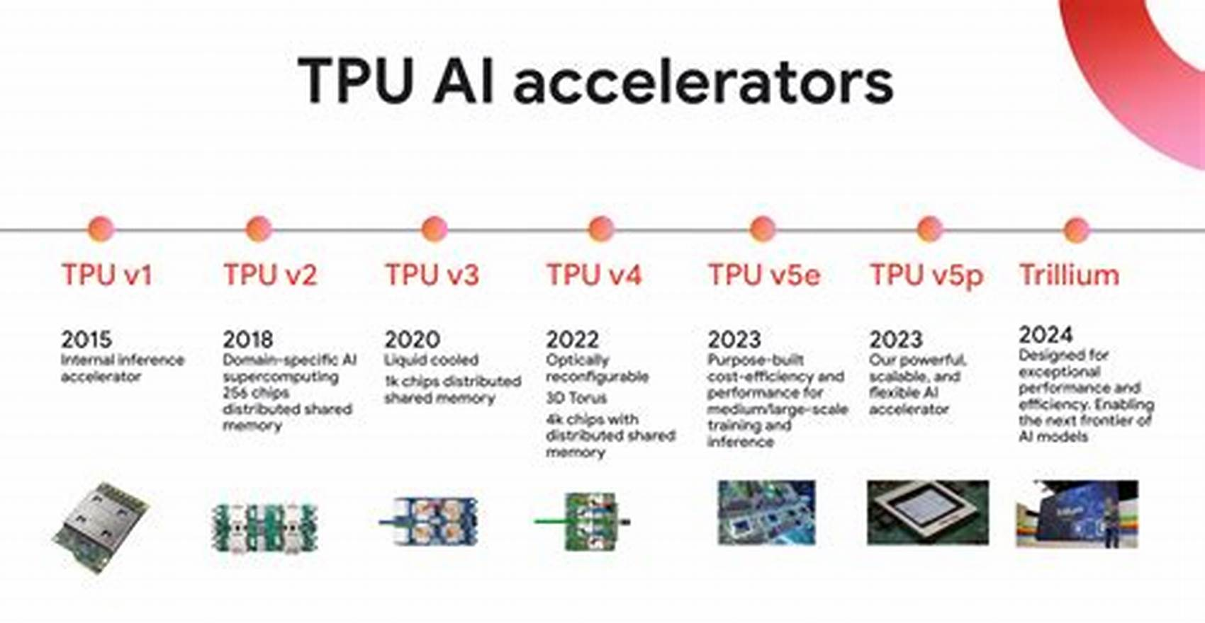
TensorFlow: Key Features and Capabilities
Enterprise-grade scalability for production environments and large-scale deployments.
Rich ecosystem of integrated tools and libraries for comprehensive development.
Advanced optimization capabilities and specialized hardware integration support.
Production Scalability
Comprehensive Ecosystem
Hardware Optimization
●
TensorFlow Serving for model deployment infrastructure.
●
Keras integration provides high-level API simplicity.
●
Native TPU support for accelerated training.
●
TensorFlow Lite optimized for mobile applications.
●
TensorBoard for advanced model visualization tools.
●
Graph optimization for improved performance efficiency.
●
Distributed training across multiple GPUs clusters.
●
TFX pipeline for end-to-end MLOps workflows.
●
Cross-platform deployment from cloud to edge.

Slide 7
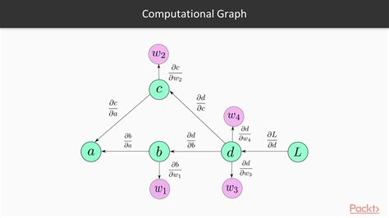
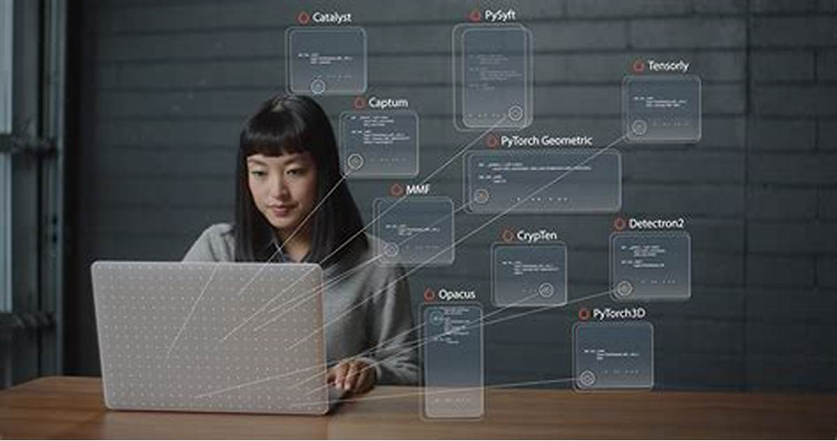
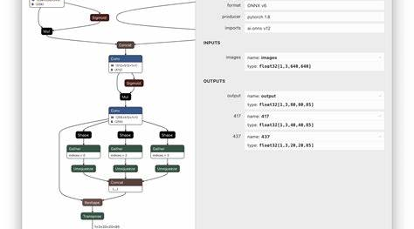
PyTorch: Key Features and Capabilities
Intuitive development experience with Python-native design and dynamic execution.
Optimized for rapid experimentation and iterative research development processes.
Growing production capabilities with improved deployment and optimization tools.
Developer Experience
Production Evolution
Research Excellence
●
TorchScript enables model compilation and optimization.
●
Pythonic coding style for natural development workflow.
●
Fast prototyping capabilities for experimental models.
●
TorchServe provides scalable model serving solutions.
●
Strong adoption in academic research communities.
●
Dynamic computation graphs enable runtime modifications.
●
ONNX support ensures broad deployment compatibility.
●
Flexible architecture supports novel AI approaches.
●
Seamless debugging with standard Python debugging tools.

Slide 8
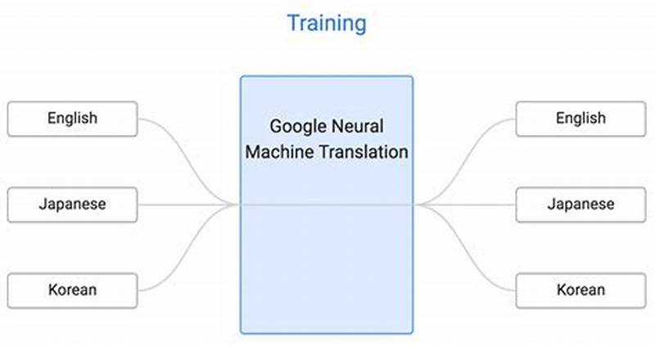
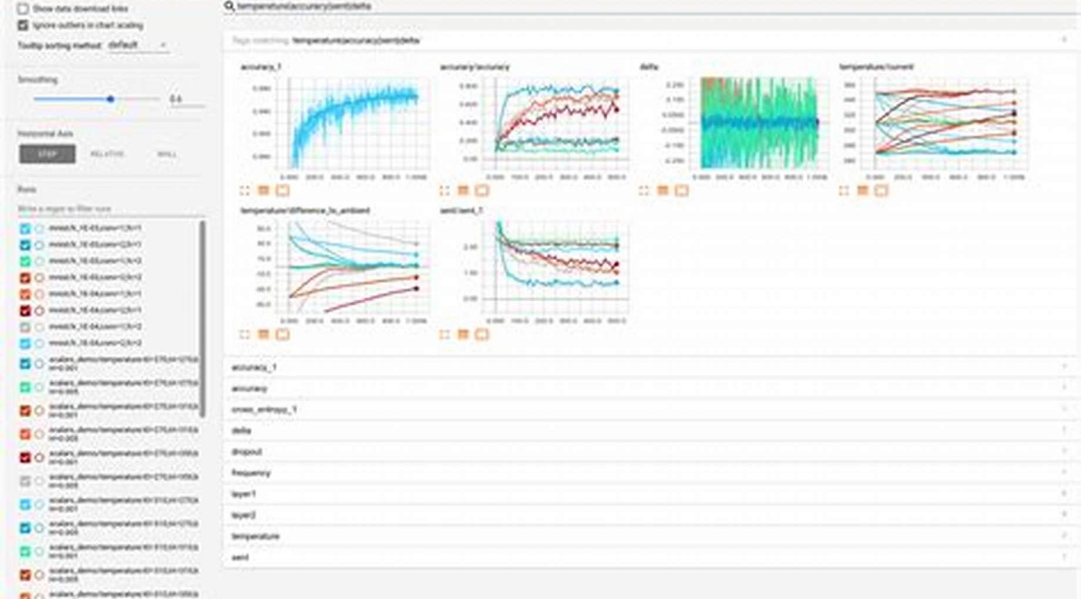
TensorFlow: Real-World Applications and Industry Impact
Google's Core Products
Enterprise Adoption
Google Translate processes billions of translations daily using advanced transformer models.
Major corporations including Airbnb, Coca-Cola, and Twitter rely on TensorFlow infrastructure.
YouTube's recommendation system leverages TensorFlow for personalized content delivery algorithms.
Production-grade deployments handle millions of daily predictions across diverse industry sectors.

Slide 9
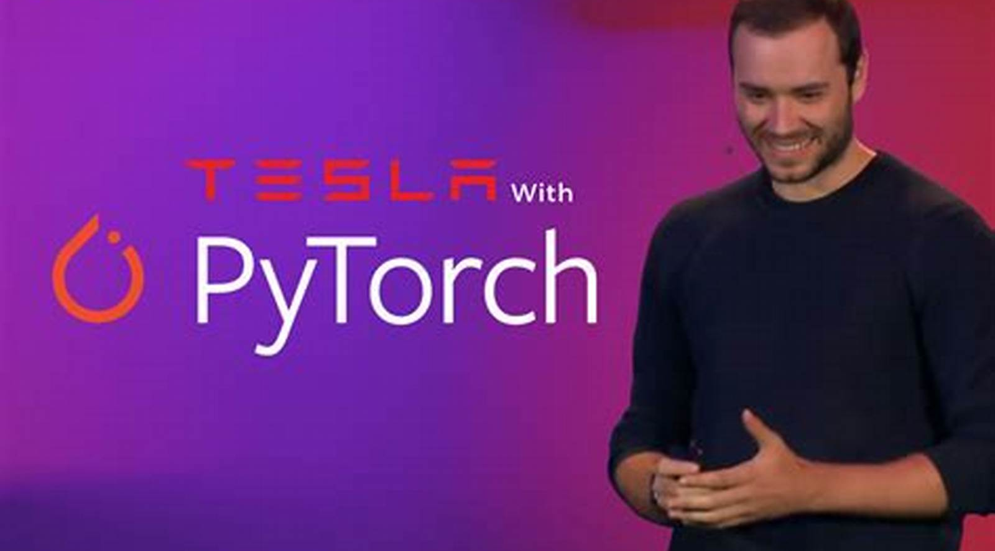
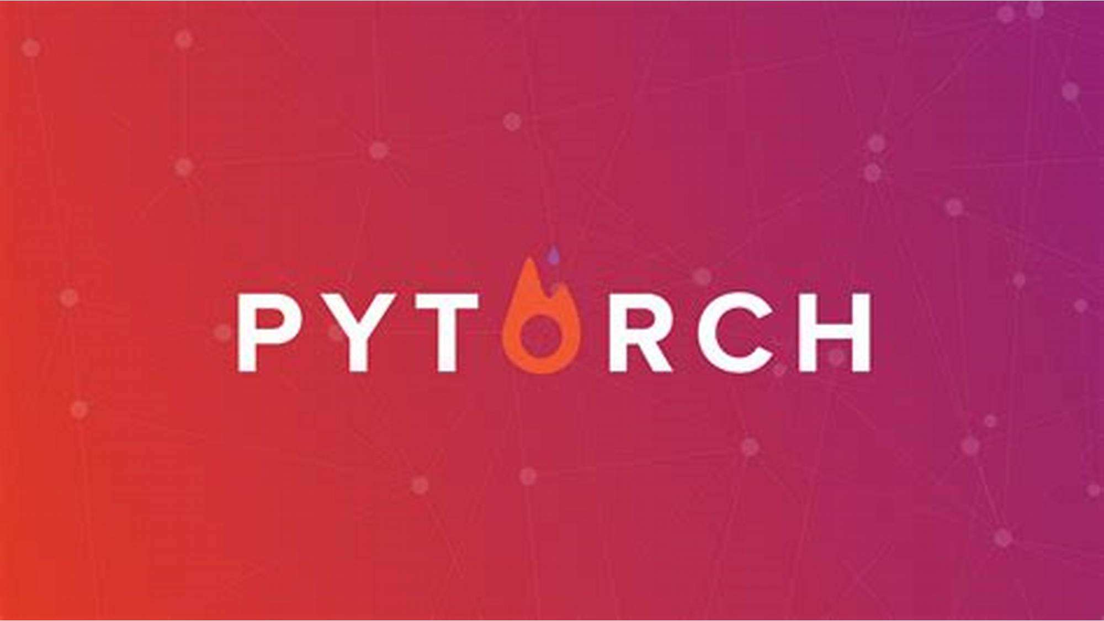
PyTorch: Real-World Applications and Research Leadership
Cutting-Edge Innovation
Research Dominance
OpenAI's GPT models and advanced language systems built on PyTorch architecture.
80% of NeurIPS 2023 papers utilized PyTorch for model development and experimentation.
Tesla's Autopilot system utilizes PyTorch for real-time computer vision processing.
Leading research institutions prefer PyTorch for NLP and Computer Vision breakthroughs.

Slide 10
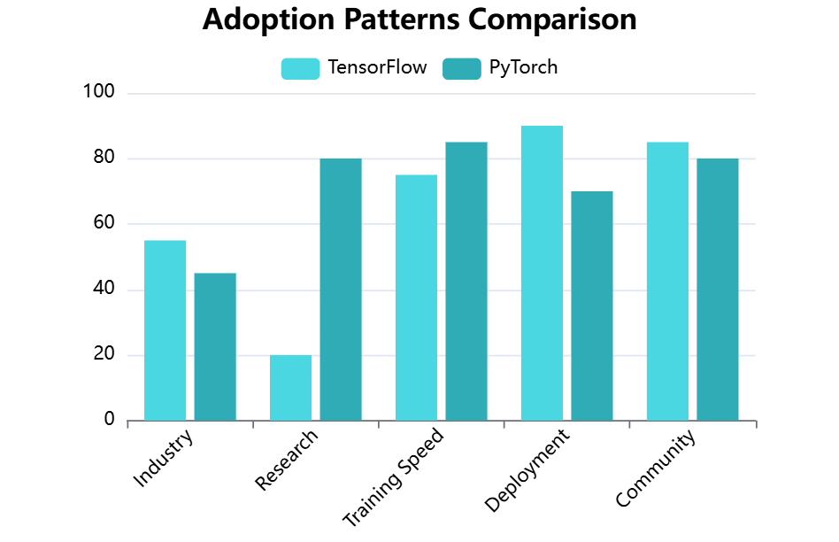

Comparative Analysis: Framework Performance and Adoption
Usage Distribution
TensorFlow leads in industry deployment while PyTorch dominates research environments with distinct user preferences.
Performance Trade-offs
PyTorch shows 25% faster training times while TensorFlow excels in large-scale production optimization scenarios.

Slide 11
Detailed Framework Comparison: TensorFlow vs PyTorch
Comprehensive Feature Analysis
Side-by-side comparison of key characteristics, performance metrics, and adoption patterns to guide framework selection for specific project requirements and organizational needs.
Criteria
TensorFlow
PyTorch
Winner
Usability
Moderate learning curve, Keras integration
Intuitive, Pythonic design
PyTorch
Performance
Optimized for large-scale production
Faster training, lower overhead
Mixed
Deployment
Mature ecosystem (TF Serving, TF Lite)
Growing tools (TorchScript, TorchServe)
TensorFlow
Research Adoption
20% of recent papers
80% of NeurIPS 2023 papers
PyTorch
Industry Usage
55% enterprise adoption
45% enterprise adoption
TensorFlow
Community Support
Large, established ecosystem
Rapidly growing, research-focused
Tie
Scalability
Excellent TPU support, distributed
Good multi-GPU, improving
TensorFlow

Slide 12
Conclusion: Framework Selection Recommendations
No Absolute Winner
Both TensorFlow and PyTorch excel in different scenarios, with choice depending on specific project requirements, team expertise, and organizational priorities rather than universal superiority.
Choose PyTorch For
Choose TensorFlow For
●
Academic research and rapid prototyping projects
●
Large-scale production deployments and enterprise solutions
●
Teams prioritizing development speed and flexibility
●
Projects requiring extensive mobile or edge deployment
●
Projects requiring frequent model architecture experimentation
●
Organizations with established MLOps infrastructure needs
Future Outlook
Industry Trend
Recommendation
Both frameworks continue evolving toward feature convergence.
Multi-framework compatibility increasingly becoming the standard practice.
Learn both frameworks to maximize career opportunities.

Slide 13
References and Sources
Academic and Research Sources
Industry Reports and Analytics
Peer-reviewed publications and official documentation providing authoritative insights into framework capabilities, performance benchmarks, and adoption trends.
Professional analyses from technology organizations and surveys providing real-world usage statistics and enterprise adoption patterns.
●
Stack Overflow Developer Survey (2023). Framework usage statistics among professional developers worldwide.
●
Alawi, Z. B. (2025). A Comparative Survey of PyTorch vs TensorFlow for Deep Learning. ArXiv preprint.
●
Kaggle Machine Learning Survey (2024). Practitioner preferences and framework selection criteria analysis.
●
TensorFlow Official Documentation (2025). Google AI Platform and TensorFlow Developer Resources.
●
Viso.ai Deep Learning Framework Analysis (2025). Comprehensive comparison of PyTorch vs TensorFlow capabilities.
●
PyTorch Official Documentation (2025). Meta AI Research and PyTorch Community Guidelines.
●
NeurIPS 2023 Conference Proceedings. Framework adoption analysis in recent machine learning publications.
●
OpenCV Foundation Blog (2024). Performance benchmarks and scalability analysis for AI frameworks.

Slide 14

Thank You For Your Attention
Questions and Discussion Welcome | Contact: AI AIchemists Team - Ruben Valenzuela, Daedra Minigan, Benjamin LaCount II

