Slide 1
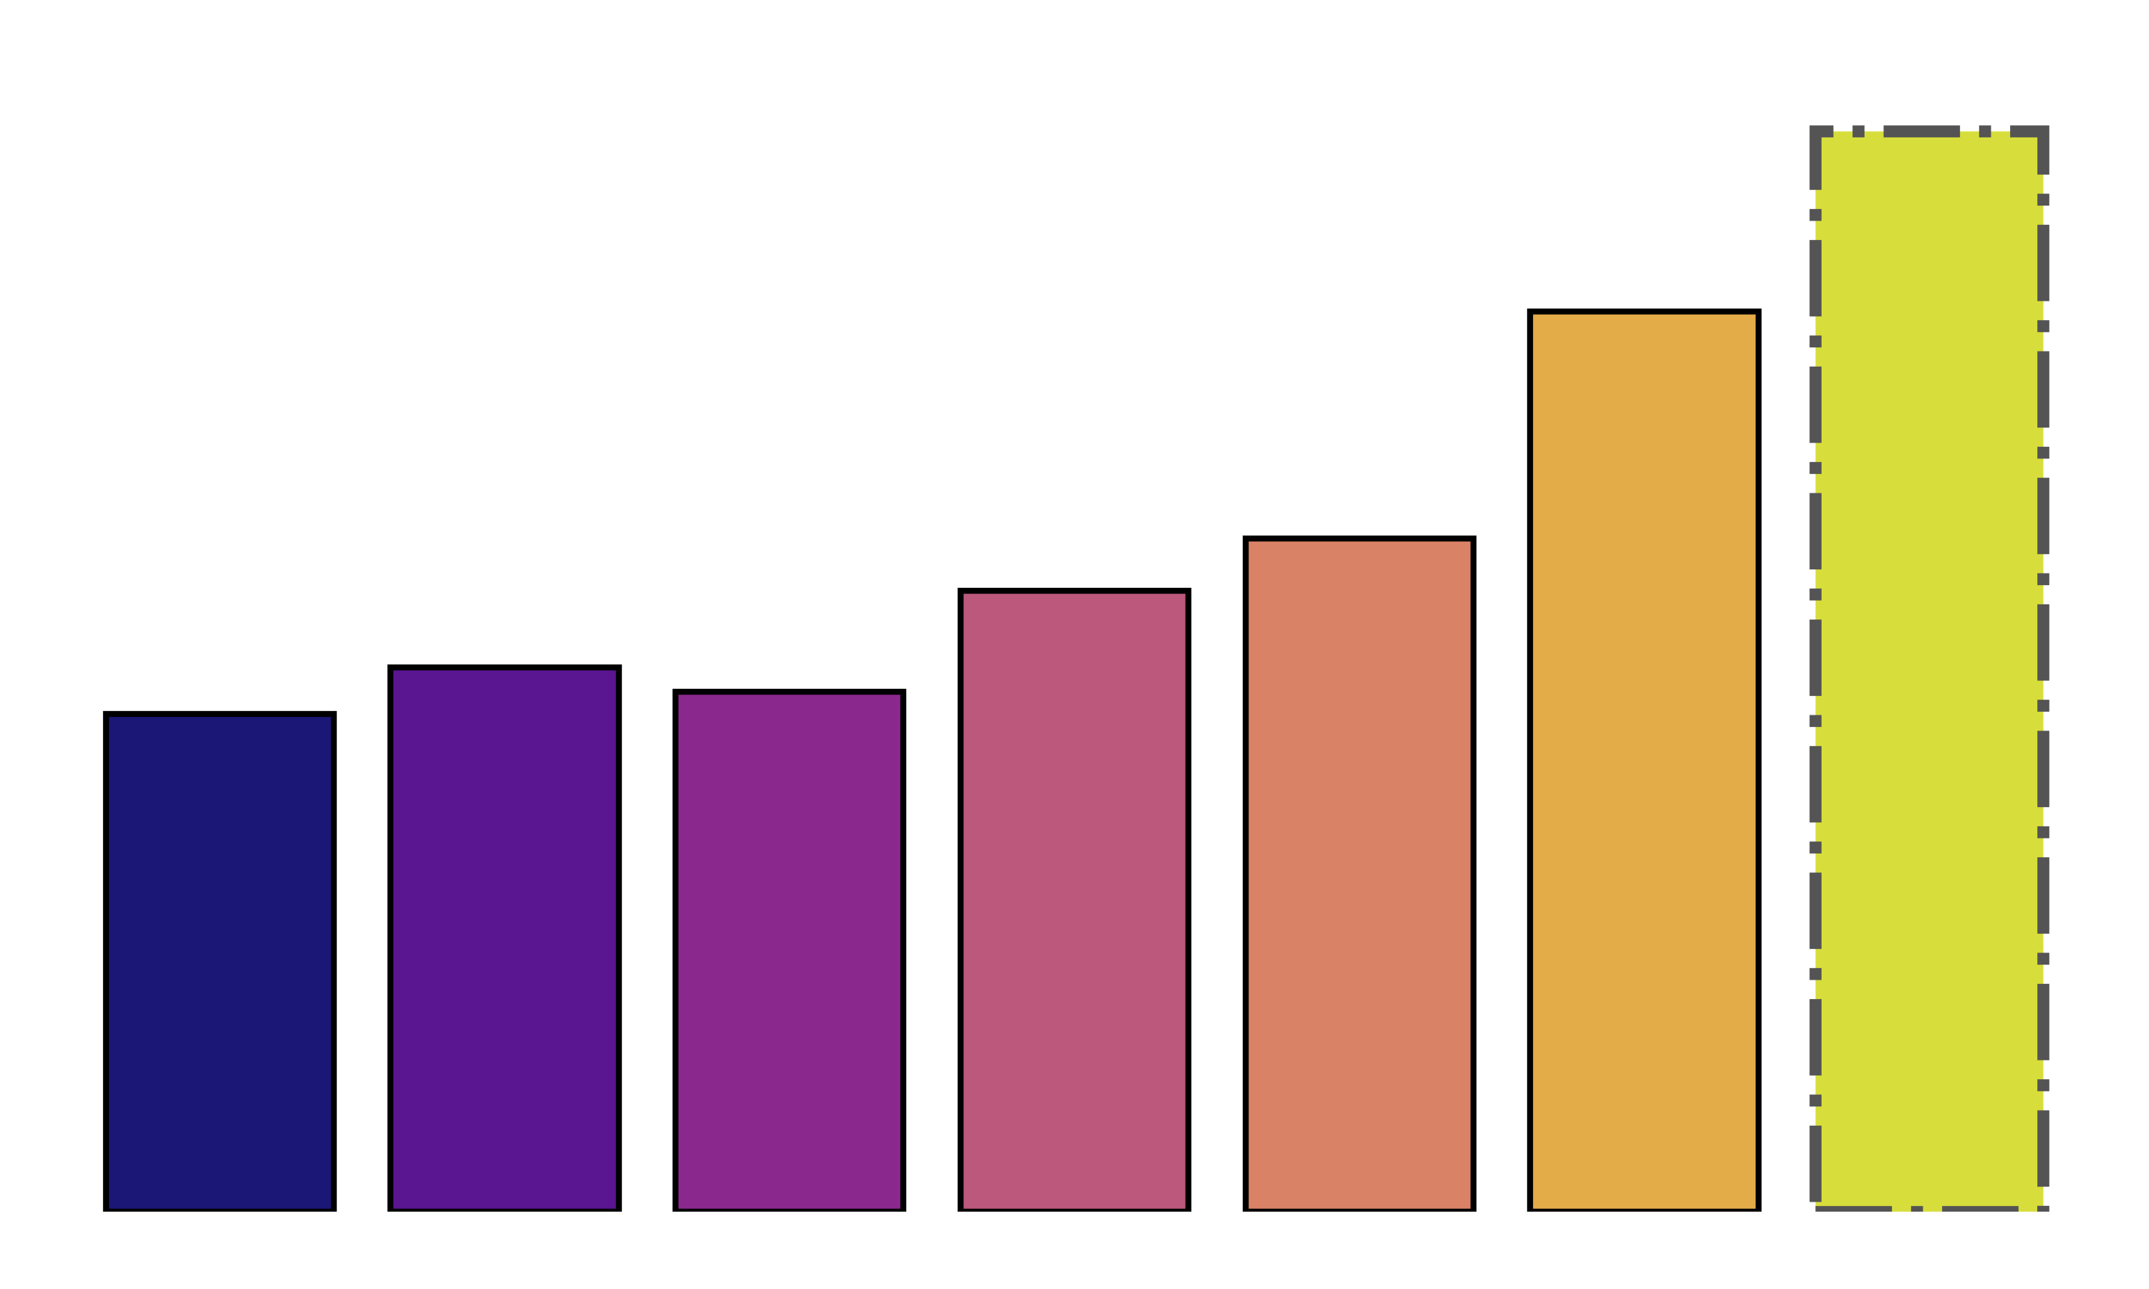
New Sales Method Revenue Analysis and Recommendations
Data-Driven Insights for Maximizing Revenue
By Rubén Valverde

Slide 2
Objetive
Six weeks ago a new line of office stationery was launched with 3 different sales method:
Email: Customers received 1 email when the product was launched and another 3 weeks later
Call: Customers received a call with an average of thirty minutes.
Email and call: Customers received 1 email when the product was launched and a 10 min call 3 weeks later
The goal is to analyze the number of customers and revenue of each method and overall.

Slide 3
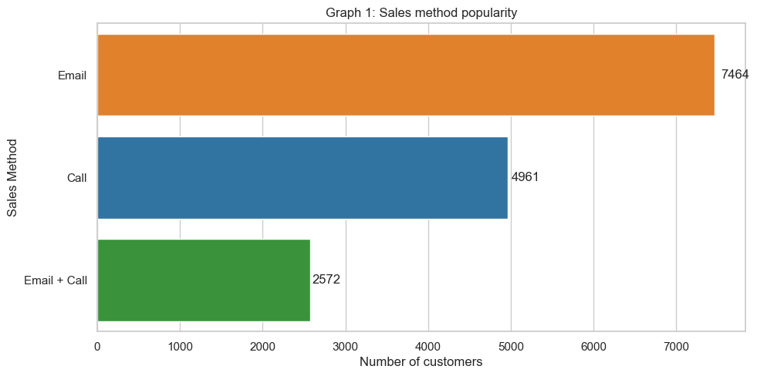
Engagement
Total number of customers: 14.997

Slide 4
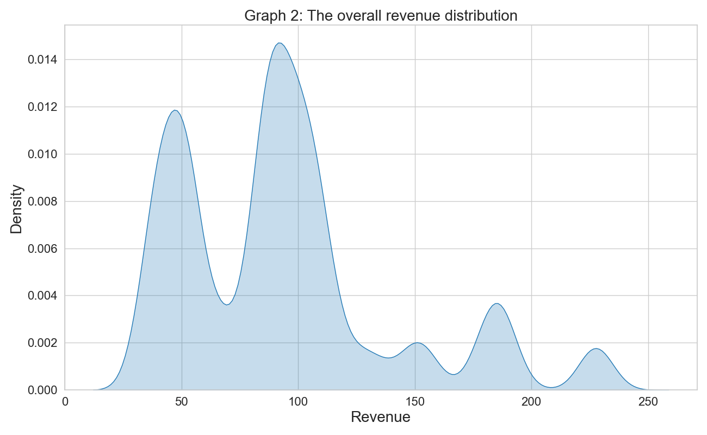
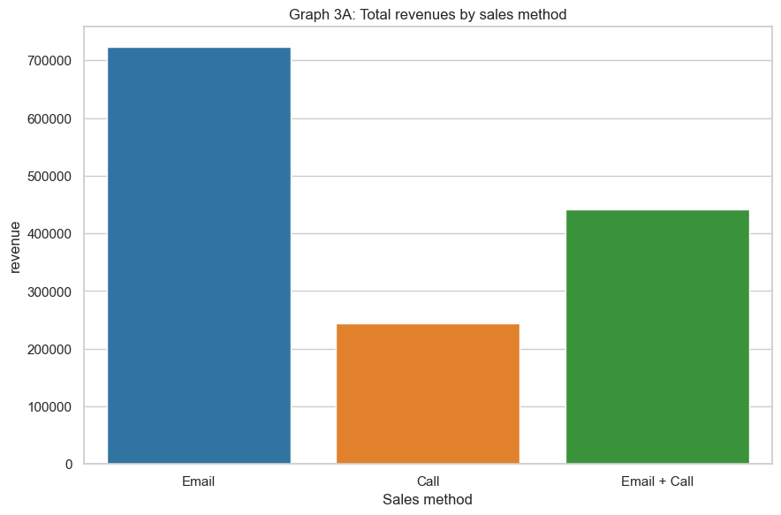
Total Revenue Distribution

Slide 5
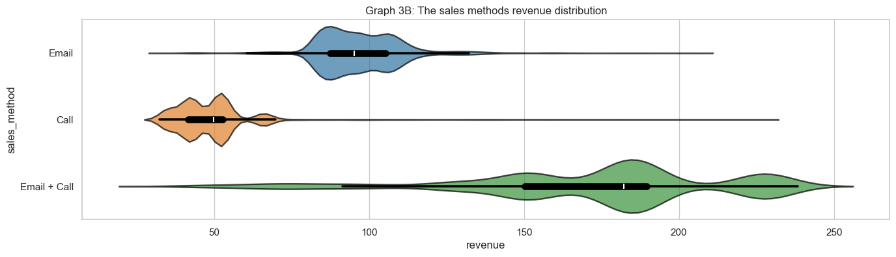
Method-Specific Insights
Method | Skewness | Median | IQR
EMAIL | Right | 95,34 | 17,92
CALL | Right | 49,83 | 11,32
EMAIL + CALL | Left | 182,22 | 39,31

Slide 6
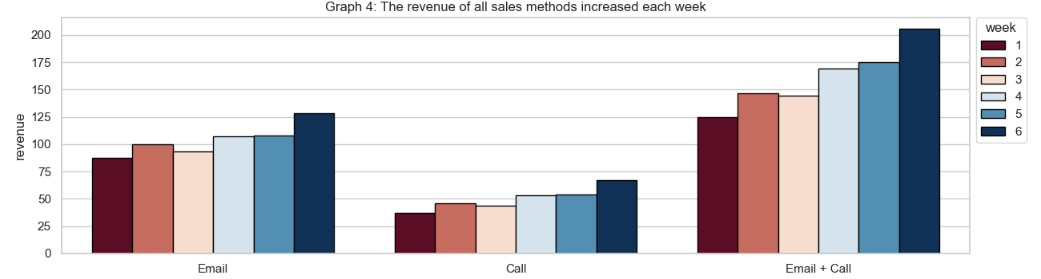
Revenue Trends Over Time
Method | Week 1 Revenue | Week 6 Revenue | Increase
Email | $88 | $128 | 45%
Call | $37 | $37 | 81%
Email + Call | $125 | $205 | 64%

Slide 7
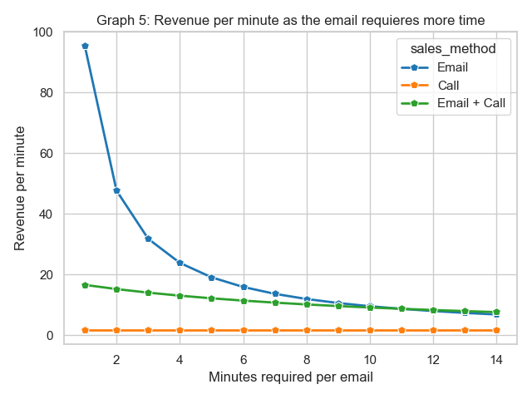
Average Revenue per Minute (ARM)
Email: Ranges from $95 to $32
Call: $1.66
Email + Call: Ranges from $14 to $16.5

Slide 8
Recomendations
Continuation of Email + Call
Retention of Email Method
Discontinuing the Call Method
Highest revenue generation
Potential for substantial growth (Graph 4)
Cost effective
Complements revenue generating efforts
Resource-intensive (30 minutes per customer)
Low revenue performance
Redirect resources to more lucrative strategies
Metric Selection
Data Collection Improvement
Adopt ARM as a key performance metric else Average Revenue per Customer
Both provide a clear indicator of sales success
Investigate root causes of missing revenue values (1074 missing entries)
Measure average time for each method to acquire a new customer
Improve data quality for future analysis

Slide 9
Conclusion
Revenue Trend: All methods presented an increase in the time period of 6 weeks.
Email + Call Method: Highest revenue generation, recommended for continued use.
Email Method: Cost-effective, high ARM, should be retained.
Call Method: Resource-intensive, low revenue, consider discontinuation.
Metric: If possible use average revenue per minute to evaluate sales performance, else average revenue per customer.
Data Quality: Improve data collection, especially for missing revenue values.
Recommendation: Focus on Email + Call and Email methods to maximize revenue while optimizing resource allocation.

