Slide 1


Digital Portfolio
STUDENT NAME:
RUBESHWER S
REGISTER NO AND NMID: FE02922F381DA49912F4631A6FFAAC31 DEPARTMENT: Bachelor Of Computer Application COLLEGE/UNIVERSITY: Prince Shri Venkateshwara Arts
and Science College
1

Slide 2

PROJECT TITLE
Personalized Learning & Digital Portfolio — By RUBESHWER S
2

Slide 3




AGENDA
1.Problem Statement 2.Project Overview 3.End Users 4.Tools and Technologies 5.Portfolio design and Layout 6.Features and Functionality 7.Results and Screenshots 8. Conclusion 9.Github Link
3/21/2024 Annual Review
3

Slide 4


PROBLEM STATEMENT
•In themodern digital era, personalizedlearning is
no longer a luxury — it has become a necessity.
•Many students and professionals struggle to find platforms that adapt to their unique learning styles, pace, and career goals. •The project, “Naan Mudhalvan”, addresses this gap by creating an interactive, AI-assisted, and learner- friendly platform. •It ensures skill-building, career development, and continuous learning in a structured yet flexible way.
4

Slide 5

PROJECT OVERVIEW
•This portfolio represents a complete digital learning ecosystem. •It is designed to analyze learner progress and suggest the best path for improvement. •Focuses on user-centric design, making it suitable for all age groups. •Uses cutting-edge technologies to provide a seamless, engaging, and future-ready learning environment. •The ultimate vision is to empower individuals with knowledge and skills that are relevant to the fast-changing job market.
5

Slide 6

WHO ARE THE END USERS?
•Students – Looking for academic growth and exam preparation •Graduates & Job Seekers – Preparing for competitive jobs and interviews •Professionals – Upskilling in advanced technologies •Lifelong Learners – Exploring new hobbies, personal development, and certifications
6

Slide 7


TOOLS AND TECHNIQUES
•Frontend: HTML, CSS, JavaScript (Responsive & Interactive UI) •Backend: Node.js (Server) & MongoDB (Database) •Cloud: AWS (Scalable hosting & storage) •AI/ML: Personalized recommendations, Adaptive quizzes, Progress analytics •Version Control: GitHub
7

Slide 8

POTFOLIO DESIGN AND LAYOUT
•Clean,modern&minimal design
•Intuitive navigation system with easy access to content •Visual highlights like charts, badges, and screenshots for better impact •Designed with a professional outlook that attracts both recruiters and academic evaluators
8

Slide 9
FEATURES AND FUNCTIONALITY
♦
Personalized LearningPaths—Customstudy
plans for each learner ♦Interactive Quizzes — Boost memory & skills through gamified tests ♦ Real-Time Progress Tracking — Visual graphs, dashboards, and leaderboards ♦ Resource Hub — Videos, tutorials, blogs, and case studies

Slide 10
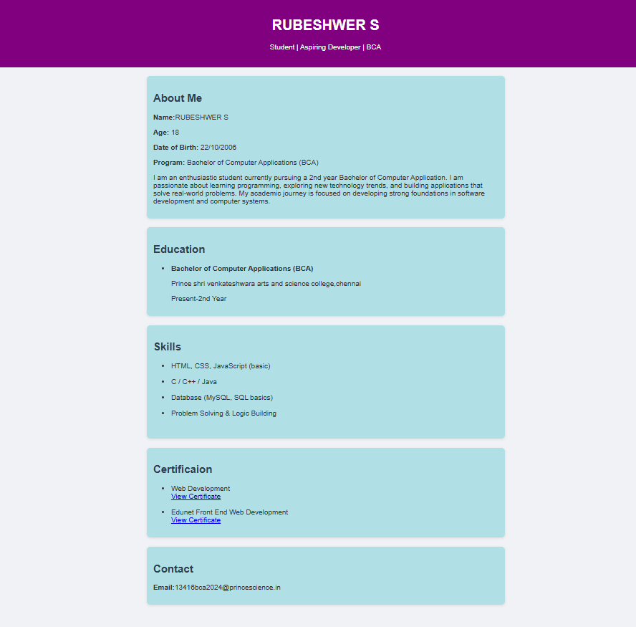

RESULTS AND SCREENSHOTS
3/21/2024 Annual Review
10

Slide 11
CONCLUSION
→Thisproject is notjust a portfolio — it’s avision of future learning.
→ It successfully bridges the gap betweentraditional education and modern technology. → By continuously upgrading with AI,gamification, and cloud integration, it ensures learners are always future-ready.
11

