Slide 1
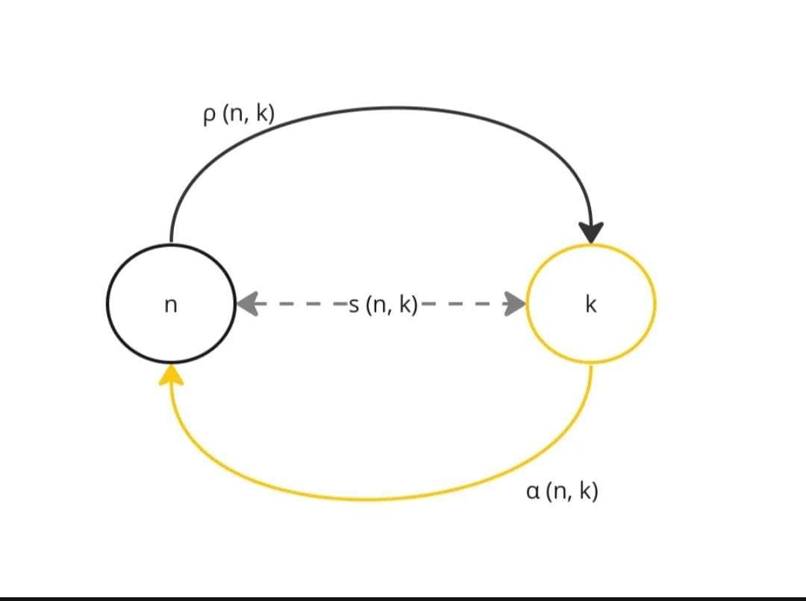
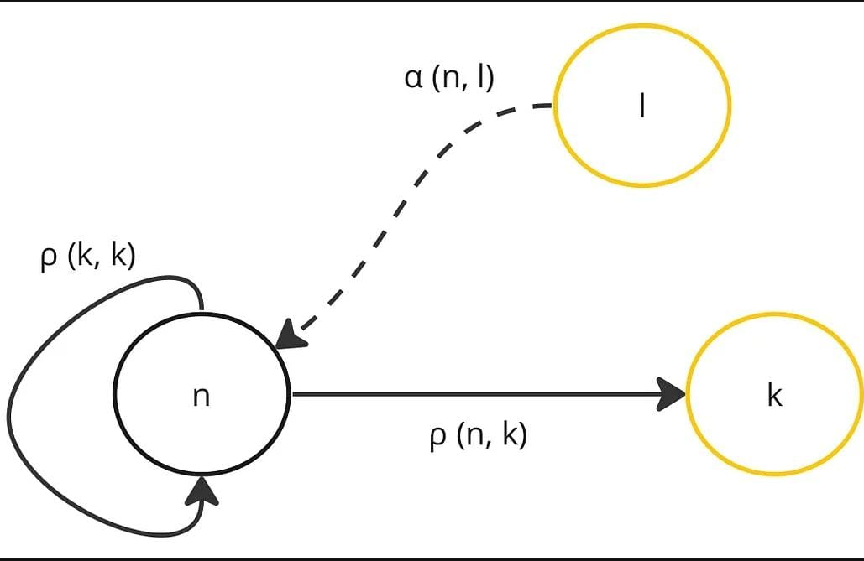
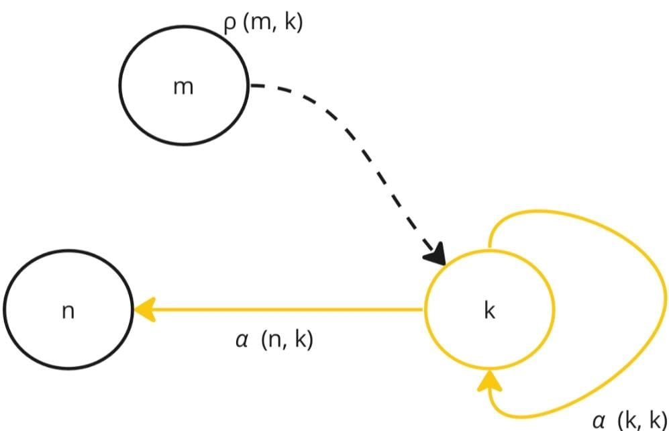
Affinity Propagation Clustering Algorithm
Initialize each data point as a potential exemplar
Measure similarity b/w data points using
euclidean distance, similarity measures etc.
Iteratively update responsibility and
availability matrices.
Exemplar selection
Cluster Assignment
Convergence check and finalization
Similarity b/w data points
Responsibility b/w data points
Availability b/w data points

Slide 2
Affinity Propagation Clustering Algorithm
Advantages
Automatic cluster determination
Discovery of exemplars
Handles non-linear relationships
Drawbacks
Computationally expensive
Not suitable for high dimensional data
Applications
Social Network Analysis
Market Based Analysis
Medical Imaging
Speech Recognition

Slide 3
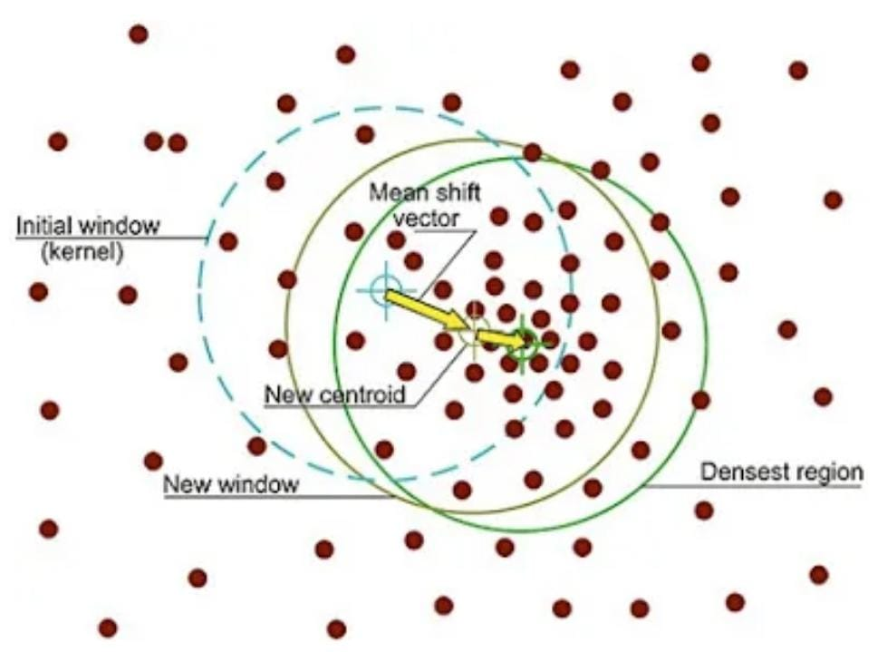
Mean Shift Clustering Algorithm
Initialize data points
Estimate density
Calculate Mean Shift
Move towards higher density
Iterates until the data points converge
Assign clusters

Slide 4
Mean Shift Clustering Algorithm
Advantages
Handles arbitrary data shapes
and sizes
Parameter-free
No prior knowledge of the no. of clusters
Drawbacks
Computationally expensive
Not suitable for high dimensional data
Applications
Object Tracking
Remote Sensing
Customer Segmentation

Slide 5
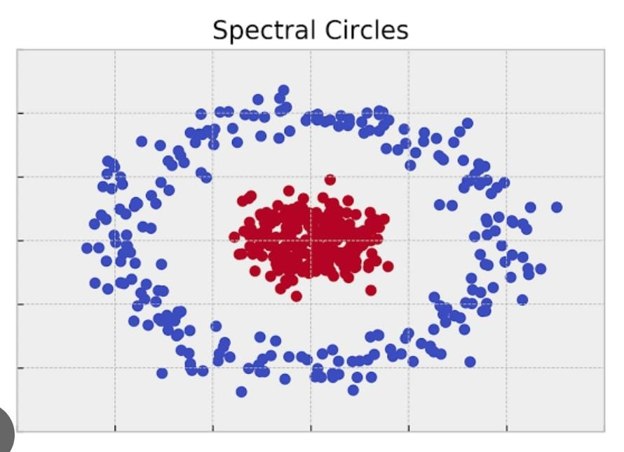
Spectral Clustering
Create similarity matrix
Graph construction
Compute Laplacian matrix
L=D(diagonal matrix)-W(adjacency matrix)
Compute eigenvectors and eigenvalues
Cluster Assignment

Slide 6
Spectral Clustering
Advantages
No assumptions in the shape or size
Handles Non-linear data
Drawbacks
Computationally expensive
Applications
Image Segmentation
Document Clustering
Anomaly Detection
Graph-based clustering

Slide 7
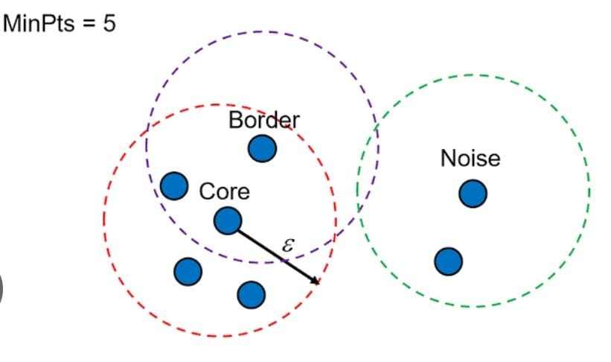
Density Based Spatial Clustering of Applications with Noise
Start with an unvisited point
Identify nearby points within a certain distance(Epsilon)
Mark it as core point if enough
` neighbors (minpts)
Expand clusters
Include density reachable points
Detect Noise and label it (not enough neighbors)
Cluster formation

Slide 8
Density Based Spatial Clustering of Applications with Noise
Advantages
Robust to Noise
Identify arbitrary shapes
Efficient
Disadvantages
Parameters sensitivity
Struggles in identifying clusters of different densities
Applications
Anomaly Detection
Image segmentation
Fraud Detection
Customer Segmentation

Slide 9
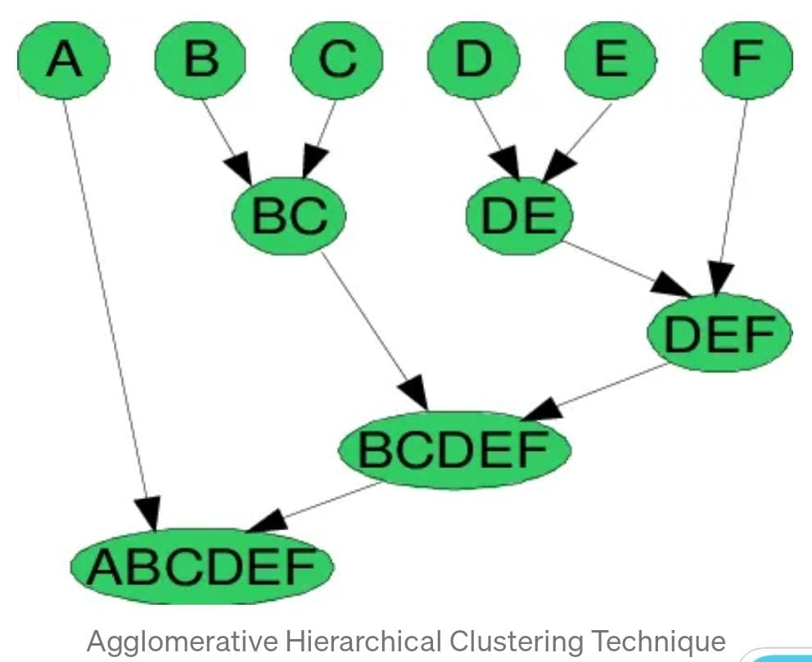
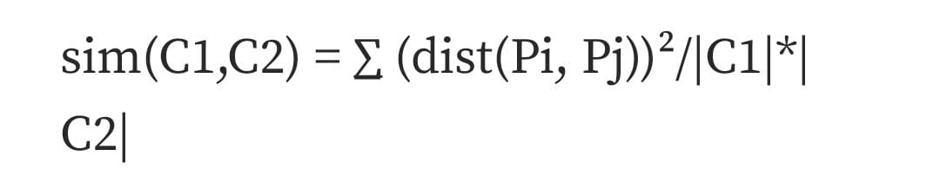
Ward Hierarchical Clustering
Initialize each data point as clusters.
Calculate distance b/w clusters using distance metric,
Identify clusters with minimum increase in variance when merged
Merge clusters (reduces the total no.of clusters by one)
Update distance
Repeat until all datapoint belong to a single cluster.

Slide 10
Ward Hierarchical Clustering
Advantages
Minimizes Variance
Produces balanced clusters
Sensitive to cluster shapes
Drawbacks
Sensitive to outliers
Computational complexity
Difficulty in determining the no. of clusters
Applications
Marketing
Image segmentation
Finance
Medicine

Slide 11
Thank You

