Slide 1
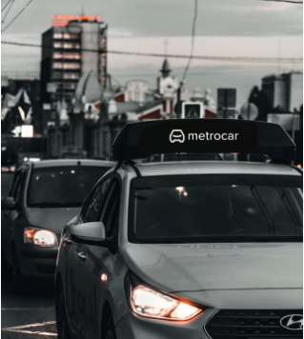
METROCAR
By Reuven Bermant | 10/12/23

Slide 2

Presentation Subjects
Revenue Growth
Our Funnel
Problem 1 & consequences
Problem 2
Preserve Point
Conclusions

Slide 3
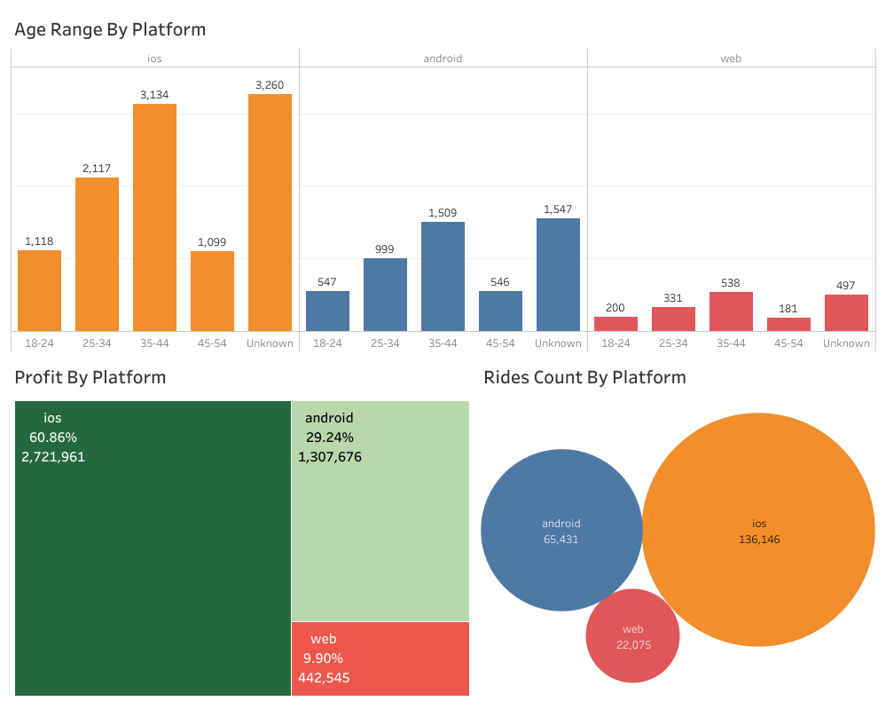
Revenues
iOS dominating across all platforms supported by metrocar.
iOS generated 2,721,961$ that’s 60.86% of total revenue generated.
Android generated 1,307,676$ that’s 29.24% of total revenue generated.
Web generated 442,545$ that’s 9.90% of total revenue generated.
Recommend To invest 50% on iOS 35% on Android , 15% on Web.

Slide 4
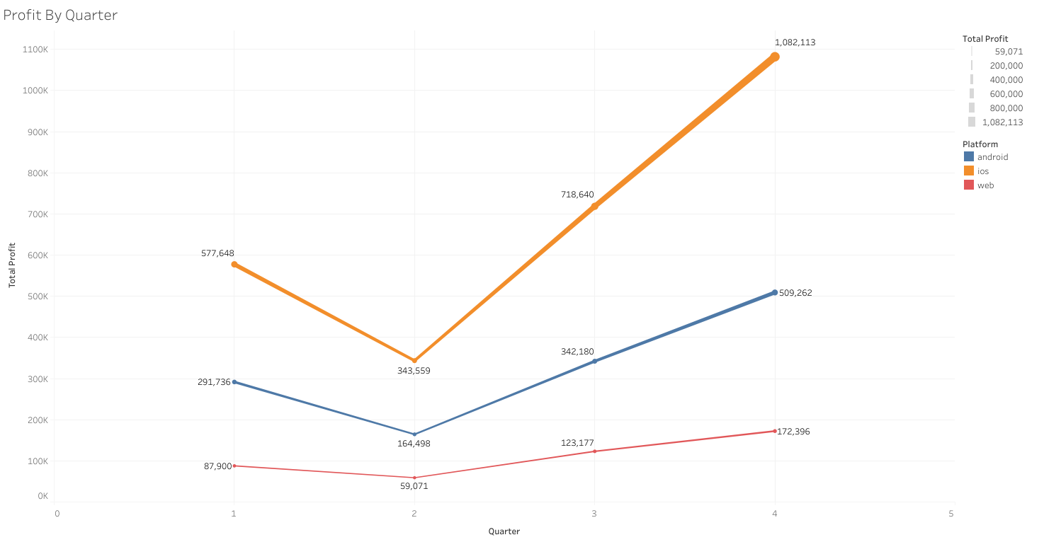

Slide 5
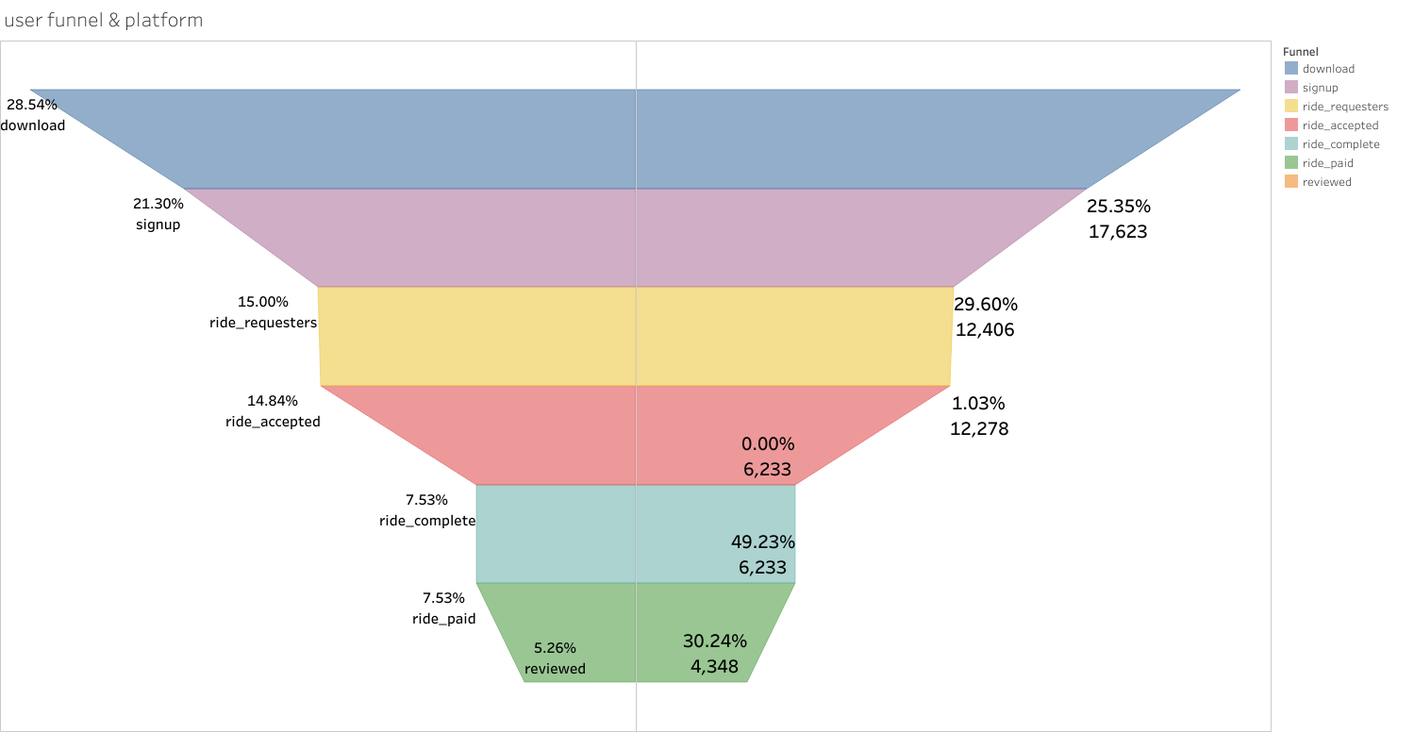
The Funnel
Funnel steps: download , signup, ride request, ride accept , ride complete, ride paid , review
Biggest drop off Ride accept – to complete 49.23%
12,203 users got accepted 6,233 user completed ride

Slide 6
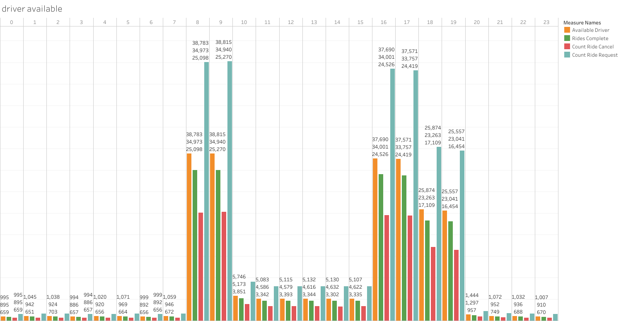
Problem 1
Lack of drivers at peak hours.
50% rate of availability at busy hours
Couse almost 50% drop of users manage to complete the critical stage of the funnel. Ride accepted – Ride complete.

Slide 7
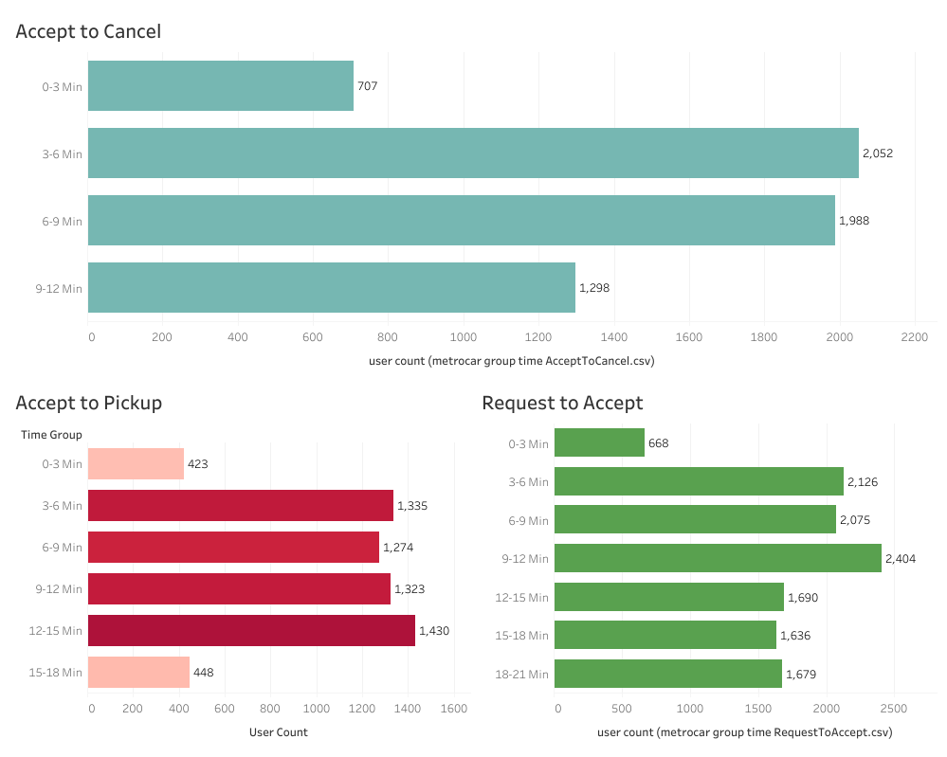
Problem 1 Consequence
Cancel ride rate by time
Longer wait time has more chance for user to cancel his ride
Shorter wait time has great impact on users complete their ride.

Slide 8
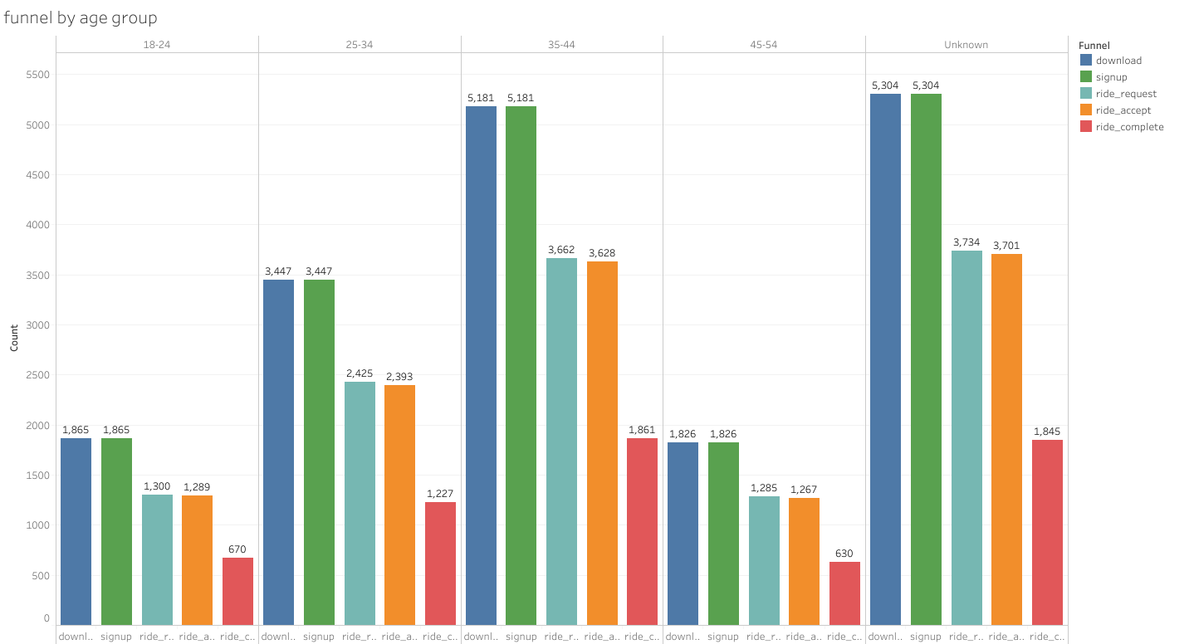
Problem 2
No versatility in age groups.
Limited interaction with younger and older age group among users.
Major data loss by not knowing 37% of users
Recommend to add more marketing on specific age groups 18-24 and 45-54.

Slide 9
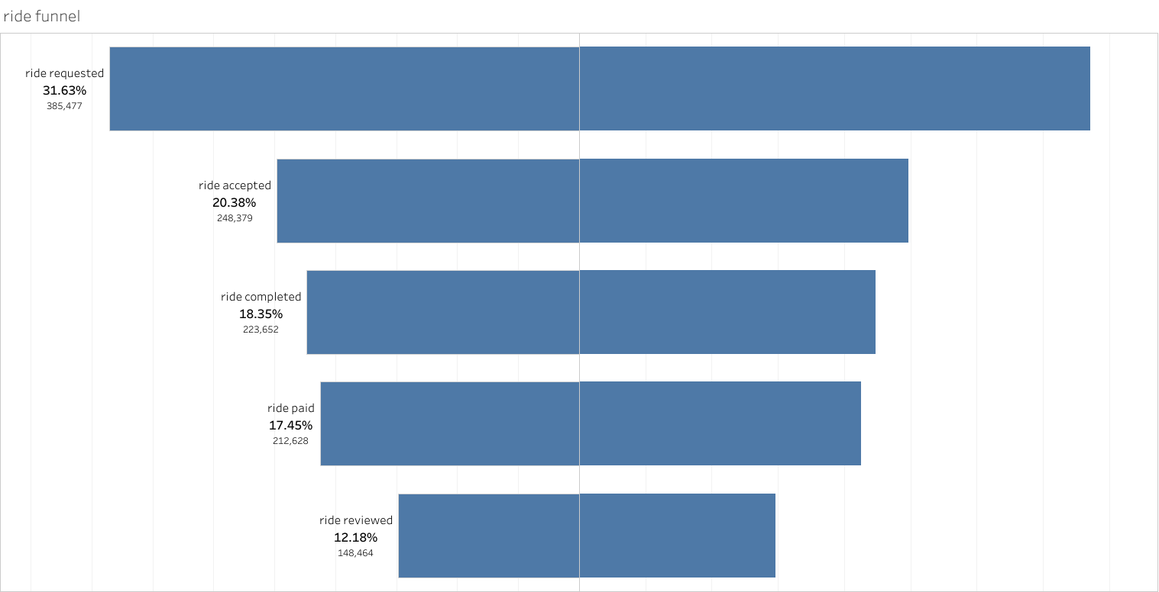
Preserve Point
Although 49% of users do not complete ride, 58% of rides do complete.
Most of the rides accepted, are completed.

Slide 10

Conclusion & What next
The company performs good in revenues and conversion rate.
Increase number of drivers at peak hours.
Make age a must fill information.
Budget priority towards iOS
Might consider price surging

Slide 11
Thank you for listening

