Slide 1
🛡
ShieldChat
AI-Powered Secure Enterprise Chat Application with Data Loss Prevention
Python Flask · Flask-SocketIO · SQLite · Google Gemini API
Piyush Tiwatne (TH3313) · Kedar Bhaskar (TH3314)
Guide: Mrs Rajashree Khadke
Department: CDS · MIT ACSC · Academic Year 2026-27
Notes:
Good morning. We are Piyush and Kedar. Our project is ShieldChat: an internal company chat app, like WhatsApp for employees, that stops sensitive data such as card numbers, Aadhaar, PAN and bank details from being shared, discourages copying data outside the organisation, and uses Google Gemini AI to suggest more professional wording.

Slide 2
THE PROBLEM
Chat is where company data leaks
💳
📋
😠
Sensitive data in chat
Data walks out the door
Unprofessional tone
Employees paste card numbers, Aadhaar, PAN and bank details to colleagues, often without thinking.
Copy-paste into personal email, printing, screen-sharing and screenshots move data outside the organisation.
Rude or aggressive messages damage teamwork and can become HR and harassment issues.
Why it matters: India's DPDP Act 2023, RBI card-data rules and PCI-DSS all require organisations to protect personal and financial data, including inside internal tools.
🛡 ShieldChat · Secure Enterprise Chat with DLP
2 / 18
Notes:
Companies moved from email to chat because it is fast. But speed means people paste things without thinking. Example: a support employee pastes a customer's card number to a colleague. Now it sits on chat servers, visible to everyone, easy to forward. That can breach the DPDP Act 2023, RBI rules and PCI-DSS. Data also leaves by copy-paste, printing and screenshots, and rude messages create HR problems.

Slide 3
OUR SOLUTION
ShieldChat: WhatsApp for employees, with a security guard
A real-time internal chat app that blocks sensitive data before it is sent, discourages copying, and uses Google Gemini AI to keep communication professional.
🔐
🛡
🚫
📊
Secure Login
2-Layer DLP
Anti-Exfiltration
Admin Monitoring
Hashed passwords
Company-domain only
Lockout after 5 failures
Layer 1: local regex + checksums
Layer 2: Gemini AI context check
Copy & print blocked
User watermark
Privacy blur
Live incident dashboard
Masked values only
Role-protected
Plus: an AI tone assistant that suggests a polite rewrite (it never blocks).
🛡 ShieldChat · Secure Enterprise Chat with DLP
3 / 18
Notes:
Our answer has four pillars. Secure login so only employees get in. A two-layer DLP engine that checks every message: Layer 1 runs locally with patterns and checksums; Layer 2 uses Gemini AI for things patterns cannot see, and also suggests polite wording. Anti-exfiltration controls discourage copying and make leaks traceable. And a live dashboard for the security team.

Slide 4
HOW IT IS BUILT
Technology stack
FRONTEND
BACKEND
HTML · CSS · Vanilla JavaScript
Python Flask + Flask-SocketIO
No framework, no build step
Real-time messaging (threading mode)
DATABASE
AI
SQLite
Google Gemini API (google-genai)
Users, messages, incidents in one file
Model: gemini-3.5-flash-lite (from .env)
SECURITY
TESTING
Werkzeug scrypt · python-dotenv
pytest
Password hashing, secrets in .env
28 automated tests, all passing
🛡 ShieldChat · Secure Enterprise Chat with DLP
4 / 18
Notes:
We kept the stack simple so it runs on any Windows laptop. No React, no build step: plain HTML, CSS and JavaScript. Flask is the Python web framework; Flask-SocketIO gives real-time two-way messaging, in threading mode so it works on Windows without extra servers. SQLite is a single-file database. The AI is Google Gemini through the official google-genai SDK, model gemini-3.5-flash-lite: stable, free tier, and fast.

Slide 5
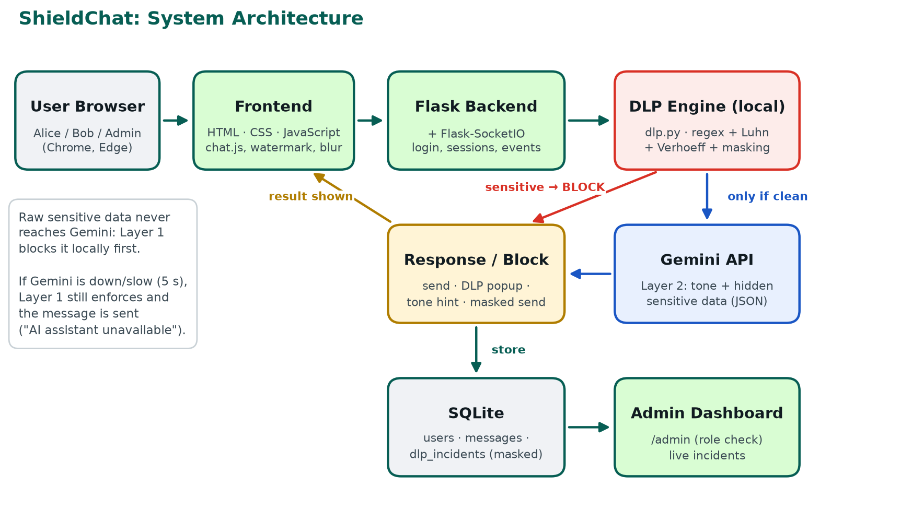
DESIGN
System architecture
Key design rule
Raw sensitive data never leaves our server.
Layer 1 DLP blocks it locally before any AI call.
Only clean messages are sent to Gemini.
🛡 ShieldChat · Secure Enterprise Chat with DLP
5 / 18
Notes:
Browsers talk to one Flask server over Socket.IO. Every message goes to the DLP engine first; it runs on our own server. Only if the message is clean do we call Gemini. The result is either delivered, blocked with a popup, or returned with a tone suggestion. Everything is stored in SQLite, and incidents are pushed live to the admin dashboard. The key point: raw sensitive data never reaches Gemini.

Slide 6
MESSAGE FLOW
What happens when you press Send
1
2
3
4
5
Type & Send
Who sent it?
Layer 1 DLP
Layer 2 AI
Decision
Browser emits the text over Socket.IO
Identity from the signed session, not the browser
Local regex + Luhn / Verhoeff scan
One Gemini call, strict JSON (only if clean)
Send · Block · Suggest
✅ Clean & professional
⛔ Sensitive data found
💡 Unprofessional tone
Saved to SQLite and delivered instantly to the receiver.
Blocked. Red popup, masked incident logged, admin alerted live.
Not blocked. Yellow hint with a polite rewrite to choose from.
If Gemini is down, slow (> 5 s) or has no key: Layer 1 has already run, the message is sent, and the user sees "AI assistant unavailable".
🛡 ShieldChat · Secure Enterprise Chat with DLP
6 / 18
Notes:
Step by step: the browser sends the text over Socket.IO. The server takes the sender's identity from the signed session, never from the browser. Layer 1 scans locally. If it finds something, block and log a masked incident. If clean, one Gemini call returns JSON. Then there are three outcomes: send, block, or suggest. If Gemini is down, we still send. Layer 1 has already protected us.

Slide 7
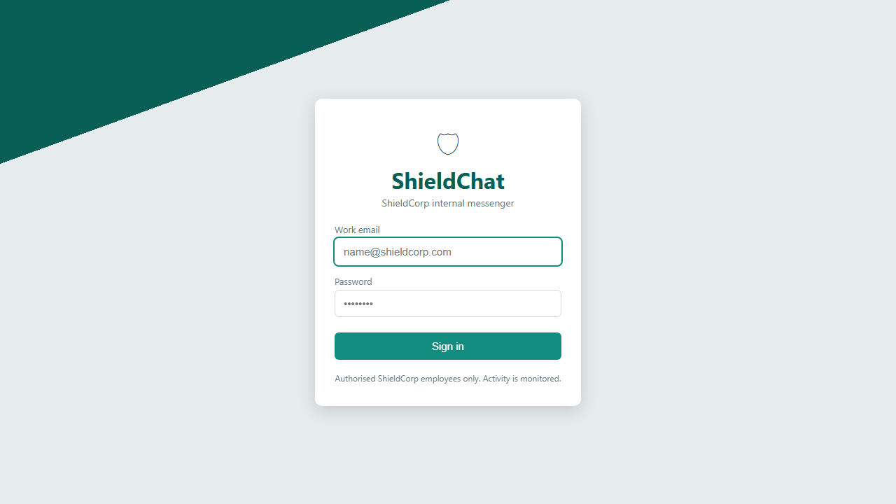
FEATURE 1 · AUTHENTICATION SECURITY
Only employees get in
• Password hashing: salted scrypt via Werkzeug. A one-way blender: we can check a password but never recover it.
• Domain restriction: only @shieldcorp.com emails, checked on the server.
• Account lockout: 5 wrong passwords → locked for 2 minutes. Stops brute-force guessing.
• Every failure logged: FAILED_LOGIN and LOCKOUT incidents appear on the admin dashboard.
• Secure session cookie: signed with a secret key from .env, HttpOnly and SameSite.
ShieldChat login page
gmail.com → "Access denied" (employees only)
5th wrong password → "Account locked for 2 minutes"
🛡 ShieldChat · Secure Enterprise Chat with DLP
7 / 18
Notes:
Passwords are hashed with scrypt and a random salt: a one-way blender, so even if the database is stolen the passwords are not exposed. Only shieldcorp.com emails can sign in, checked on the server. Five wrong passwords lock the account for two minutes, which stops brute force; every failure is logged for the admin. Sessions use a signed cookie that JavaScript cannot read.

Slide 8
FEATURE 2 · THE STAR FEATURE
DLP Layer 1: pattern + checksum detection
Data type | How we detect it | Masked as
Credit / debit card | 13–19 digits + Luhn checksum + network from prefix + expiry date | XXXX XXXX XXXX 7352
Aadhaar | 12 digits, first digit 2–9 + Verhoeff checksum | XXXX XXXX 0124
PAN | 5 letters · 4 digits · 1 letter (any case) | XXXXX1234X
IFSC | 4 letters · 0 · 6 letters/digits | XXXXXXX3456
Bank account | 9–18 digits only near 'account', 'bank', 'a/c' or an IFSC | XXXXXXXX9012
Runs on our server, works offline
If Layer 1 finds anything, the raw text is never sent to the AI.
Why the bank-account context rule?
Otherwise every phone number and order ID would be blocked (false positives).
🛡 ShieldChat · Secure Enterprise Chat with DLP
8 / 18
Notes:
Think of it as an airport X-ray for messages. Regular expressions find the shape of the data, and checksums confirm it is real, so random numbers are not flagged. Bank accounts are the tricky one: 9 to 18 digits also matches phone numbers and order IDs, so we only flag them when words like 'account' or an IFSC code are nearby. Every finding is masked to the last four characters, and only the masked value is stored.

Slide 9
HOW WE AVOID FALSE ALARMS
Checksums: a spelling check for numbers
Luhn: cards
Verhoeff: Aadhaar
→ From the right, double every 2nd digit
→ If the result > 9, subtract 9
→ Add all digits. A valid card's total ends in 0
→ Uses 3 fixed tables (multiply, permute, inverse)
→ Catches EVERY single-digit error and EVERY swap of neighbouring digits (Luhn misses some)
→ UIDAI uses it for Aadhaar's 12th digit
Test card: 4485 3647 3952 7352
double: 4 8 3 4 3 5 7 5
→ 8 7 6 8 6 1 5 1 = 42
others: 4 5 6 7 9 2 3 2 = 38
total = 42 + 38 = 80 ✓ ends in 0
→ valid Visa (starts with 4) → BLOCK
Result:
A random 12-digit or 16-digit number (order ID, tracking no.) is almost never flagged.
Our test Aadhaar is fake, generated with Verhoeff.
🛡 ShieldChat · Secure Enterprise Chat with DLP
9 / 18
Notes:
A checksum is like a spell-check for numbers: the last digit is calculated from the others, so a random number usually fails. Luhn: from the right, double every second digit, subtract 9 if over 9, add everything; a valid card total ends in zero. Our Visa test number totals 80, so it is valid. Verhoeff is stronger: it catches every single-digit mistake and every swap of neighbouring digits. UIDAI uses it for Aadhaar.

Slide 10
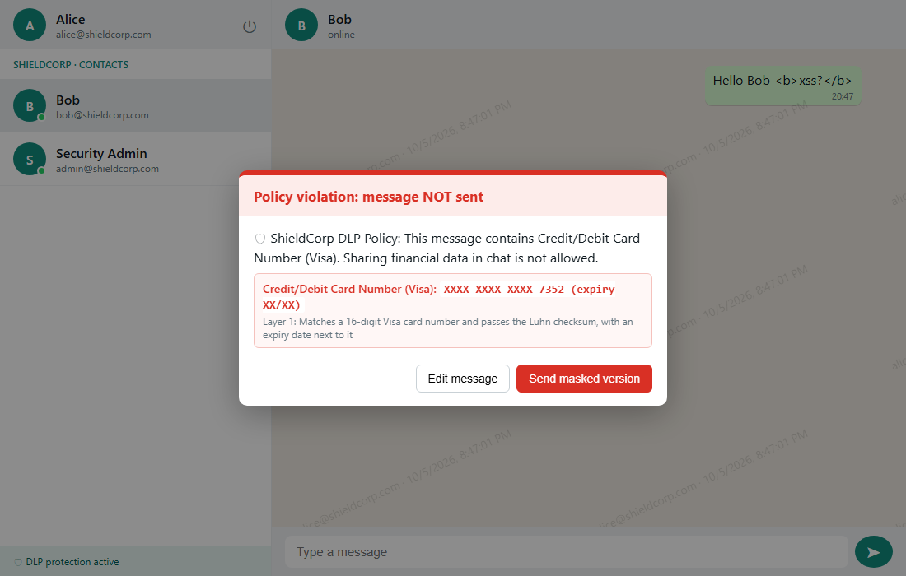
LIVE RESULT
DLP in action: card number blocked
Alice typed:
Hi Bob, here is the client card: Visa: 4485 3647 3952 7352 Expires: 2/2009
Bob received (masked):
Hi Bob, here is the client card: Visa: XXXX XXXX XXXX 7352 Expires: XX/XX
• Visa identified from the leading 4
• Expiry date caught too
• Incident logged with masked value
🛡 ShieldChat · Secure Enterprise Chat with DLP
10 / 18
Notes:
This is a real screenshot. Alice typed the client's Visa number with its expiry date. The message was blocked before it reached Bob. The popup names the policy, shows only the masked value and the reason. Alice can edit the message, or send the masked version, which Bob receives as XXXX XXXX XXXX 7352 with the expiry masked too. The raw message was never sent to Gemini.

Slide 11
FEATURE 3 · AI INTEGRATION
Gemini AI: Layer 2 DLP + tone assistant
Tone assistant (never blocks)
// One Gemini call → strict JSON
{
"is_unprofessional": true,
"tone": "aggressive",
"suggestion": "Could you please share
the report when you get a chance?",
"sensitive_detected": false,
"sensitive_reason": ""
}
"Send me the report now, why are you always so slow?"
💡 Hint: This message can be conveyed in a more polite and professional way.
Could you please share the report when you get a chance?
Catches what patterns miss:
Use suggestion
Send original anyway
Edit
• Numbers written in words ("four four eight five…")
• Passwords, PINs, salary details
• Confidential project or customer information
Illustration of the in-app hint card
Fail-closed for security: Layer 1 always runs, even offline.
Fail-open for convenience: if Gemini fails or takes over 5 s, the message is still sent.
🛡 ShieldChat · Secure Enterprise Chat with DLP
11 / 18
Notes:
Patterns can't read meaning. 'Four four eight five...' has no digits, and 'the password is...' has no fixed format. So clean messages go to Gemini once, and we force a strict JSON answer using the SDK's structured output. If sensitive_detected is true, we block like a DLP finding. If is_unprofessional, we show a yellow hint: the user can use the suggestion, send the original, or edit. We never block for tone. Fail-closed for security, fail-open for convenience.

Slide 12
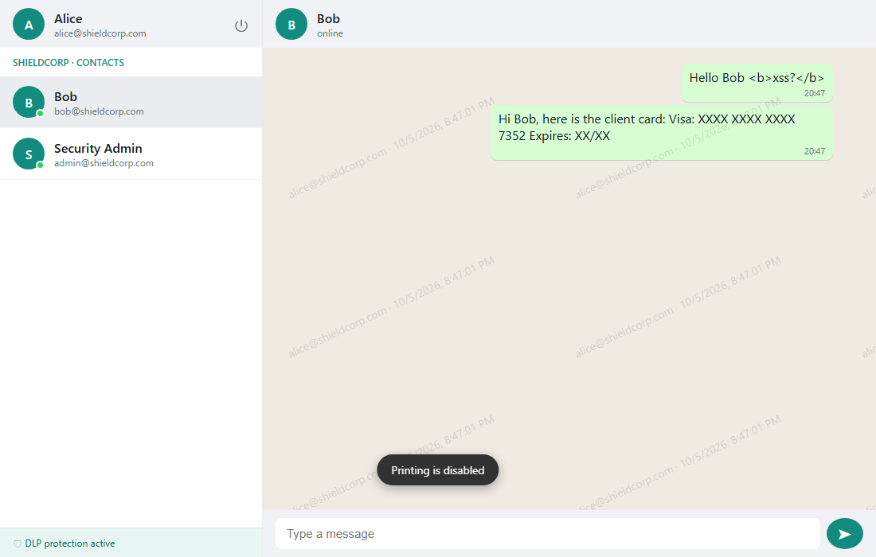
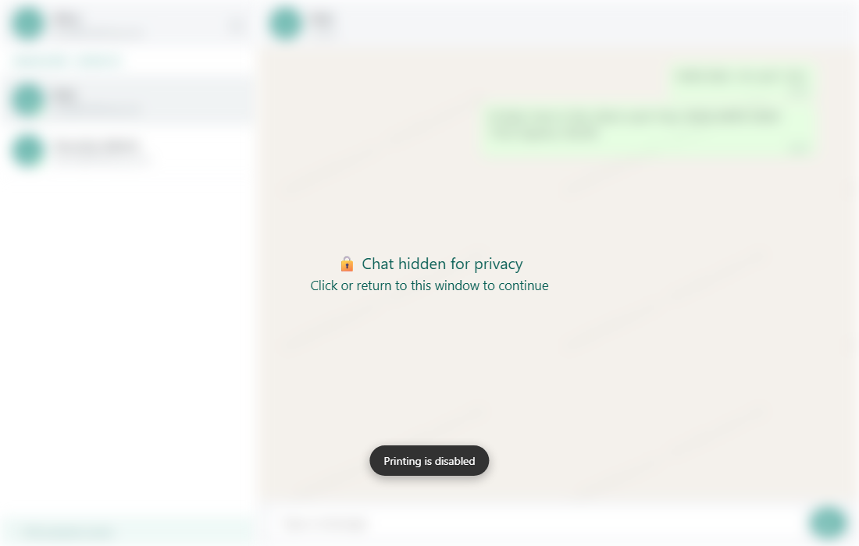
FEATURE 4 · ANTI-EXFILTRATION
Stopping data from walking out
• Copy / cut / right-click blocked in the message area → toast + COPY_ATTEMPT log
• Bulk paste (> 200 chars) allowed but logged (size only)
• Dynamic watermark: email + date/time on every screen
• Privacy blur when the window loses focus
• Printing disabled: page prints blank
Watermark + "Printing is disabled"
Blurred when the window loses focus
Honest limitation
A web app cannot stop a phone camera or an OS screenshot.
These are deterrents + traceability: the watermark shows who leaked it, and when.
🛡 ShieldChat · Secure Enterprise Chat with DLP
12 / 18
Notes:
Copy, cut, right-click and text selection are disabled in the message area; each attempt shows a toast and is logged. Large pastes over 200 characters are allowed but logged. A faint watermark with the user's email and the time covers the chat, like a name stamped on photocopies, so any photo of the screen is traceable. The chat blurs when you switch away, and printing gives a blank page. We are honest: a phone camera can't be stopped; these are deterrents plus an audit trail.

Slide 13
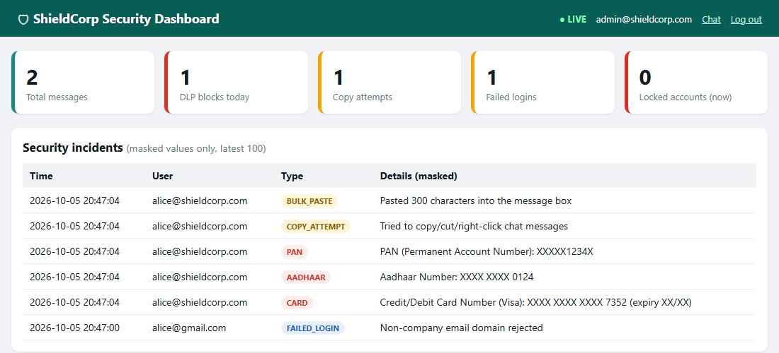
FEATURE 5 · MONITORING
Security Admin dashboard: incidents live
• Live: pushed instantly via Socket.IO (+ 5 s refresh backup)
• Cards: messages, DLP blocks today, copy attempts, failed logins, locked accounts
• Masked only: the log never stores raw values
• Server-side role check: employees get 403 Forbidden
🛡 ShieldChat · Secure Enterprise Chat with DLP
13 / 18
Notes:
The admin sees totals and every incident in real time: Socket.IO pushes each new incident, with a 5-second refresh as a backup. Notice the details column shows only masked values; storing the real card number would make the log itself a data leak. The page is protected on the server: if Alice types /admin, she gets 403.

Slide 14
QUALITY
Built securely and tested
💉
🧪
28 / 28
SQL injection
XSS
Parameterised queries (?) everywhere. Input is data, never SQL.
textContent, never innerHTML. <script> shows as plain text.
automated pytest tests passing
• Visa sample detected; Luhn valid/invalid
• Fake Aadhaar generated with Verhoeff
• PAN, IFSC, bank account with/without context
• Phone number NOT flagged
• Raw card never reaches the AI
• Gemini timeout falls back safely
• Non-admin gets 403
🖥
🔑
Server-side checks
Secrets
DLP, roles and identity enforced on the server, not in JavaScript.
API key and SECRET_KEY in .env, excluded by .gitignore.
🛡 ShieldChat · Secure Enterprise Chat with DLP
14 / 18
Notes:
Beyond the features, we followed secure coding rules. Every SQL query uses parameter placeholders, which prevents SQL injection. Messages are displayed with textContent, never innerHTML, so a script tag shows as plain text; you can see that in the earlier screenshot. Every security decision is made on the server. The API key lives in .env, which is excluded from git. And 28 automated tests pass.

Slide 15
EVALUATION
Advantages and limitations
✅ Advantages
⚠ Limitations
• Privacy-first DLP: sensitive data blocked locally, never sent to the AI; checksums keep false alarms low.
• Works offline: chat, login security, Layer 1 DLP and monitoring need no internet.
• Accountability: watermarks, masked logs and a live dashboard make leaks traceable.
• Screenshots: a phone camera or OS screenshot can't be fully blocked.
• Creative formats: split numbers, images or other languages can slip past regex.
• AI dependence: needs the internet, may misjudge tone, and free-tier inputs may be used by Google.
🛡 ShieldChat · Secure Enterprise Chat with DLP
15 / 18
Notes:
Advantages: privacy-first layered DLP, works offline, and full accountability. Limitations, honestly: screenshots and phone cameras can't be fully blocked, regex can miss creative formats like numbers split across messages or inside images, and the AI needs the internet and can misjudge tone. Also, on Gemini's free tier Google may use inputs to improve its products, which is another reason sensitive data never goes to the AI.

Slide 16
WHAT'S NEXT
Future enhancements
🖼
🏢
📱
OCR scanning
Enterprise integration
Mobile + multilingual
Detect card numbers and IDs inside shared images and documents.
Active Directory / Entra ID single sign-on and Microsoft Purview DLP policies.
Android / iOS apps and tone checks in Hindi, Marathi and more.
🛡 ShieldChat · Secure Enterprise Chat with DLP
16 / 18
Notes:
Next steps: OCR to read sensitive data inside shared images; integration with Microsoft Active Directory for single sign-on and Microsoft Purview for central DLP policies; and a mobile app with tone checks in Hindi, Marathi and other languages.

Slide 17
SUMMARY
Conclusion
ShieldChat shows that internal chat can be both fast and secure: sensitive data is stopped before it is shared, AI keeps communication professional without ever seeing raw sensitive values, and every incident is traceable.
🔐
🛡
🤖
🚫
📊
Secure login
2-layer DLP
Gemini AI
Anti-exfiltration
Live monitoring
🛡 ShieldChat · Secure Enterprise Chat with DLP
17 / 18
Notes:
To conclude: ShieldChat shows that internal chat can be fast and secure at the same time. Local DLP blocks sensitive data before it is shared, Gemini adds context-aware detection and polite wording without ever seeing raw sensitive values, and login security, anti-exfiltration and live monitoring complete the picture. It is a small model of how real enterprise tools like Microsoft Purview protect communication.

Slide 18
Thank you
Questions? · Live demo
Piyush Tiwatne (TH3313) · Kedar Bhaskar (TH3314)
Guide: Mrs Rajashree Khadke · CDS, MIT ACSC · 2026-27
Notes:
Thank you. We are happy to take questions, and we can show the live demo now.

