Slide 1
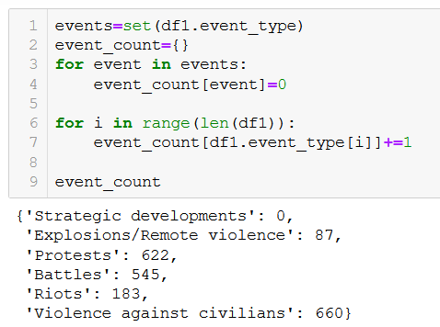
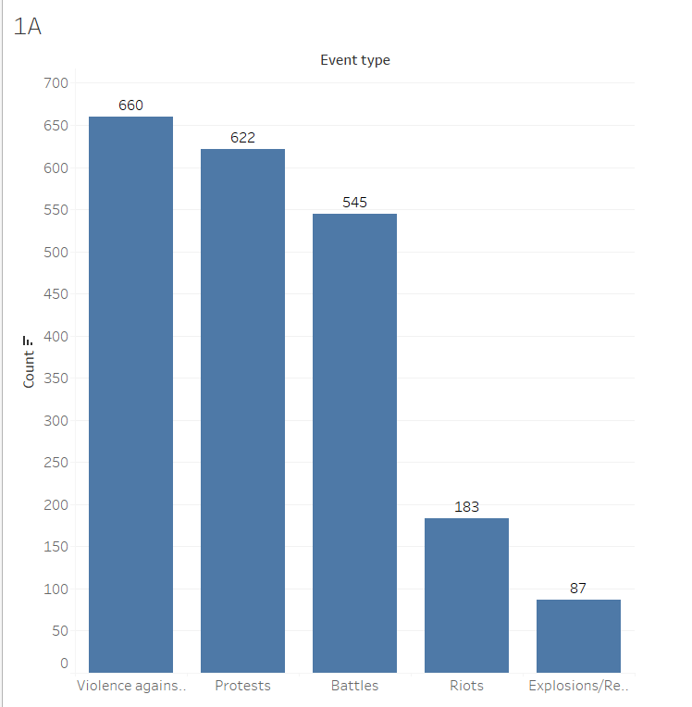
Q.1A
Violence against civilians, protests, and Battles are the 3 most common events in Nigeria. Riots and Explosions occur to a much lesser degree.
To identify the most common event types in Nigeria involving political violence, I created a dictionary with a starting value 0 for each possible event type. While iterating through the dataframe, I incremented the counter for each event type by 1 whenever a row contained a that specific event. The only thing left to do was to convert the dictionary to a dataframe and then to a csv whichmade it easy to visualize in Tableau.

Slide 2
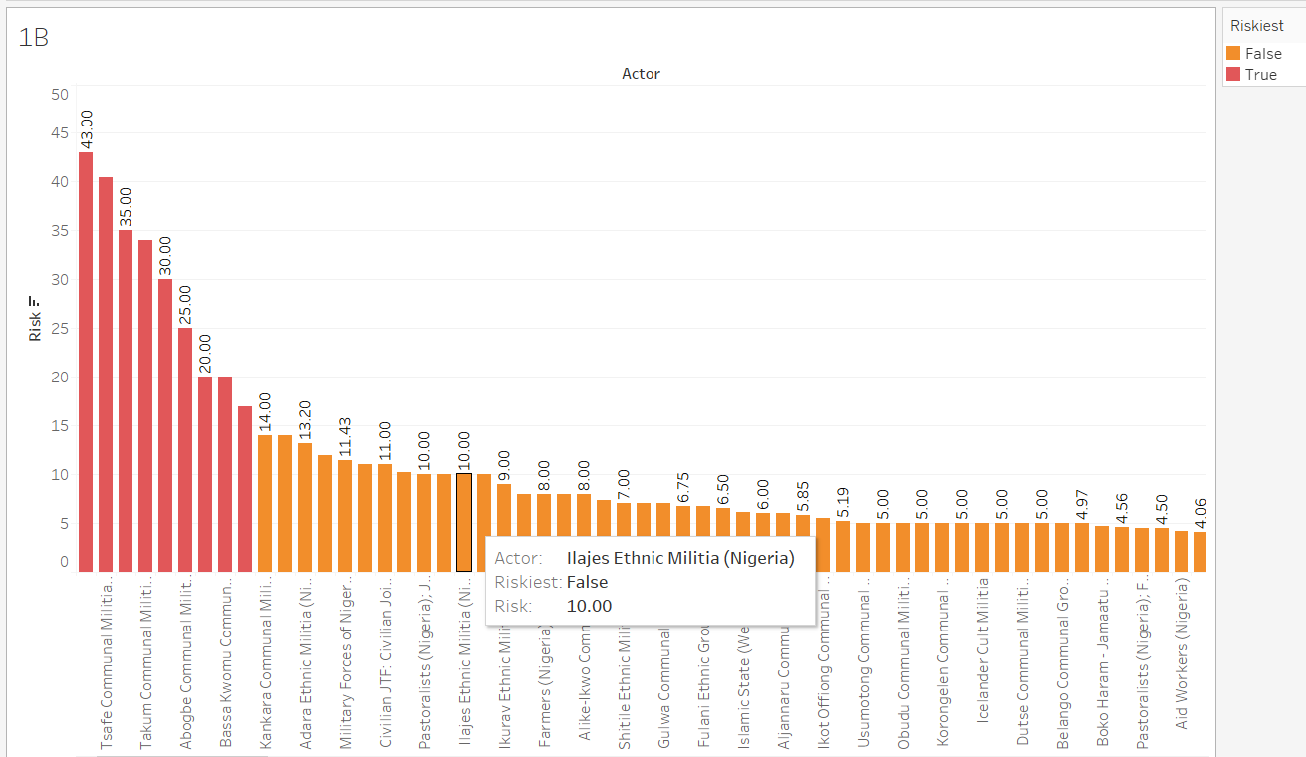
Q.1B

Slide 3
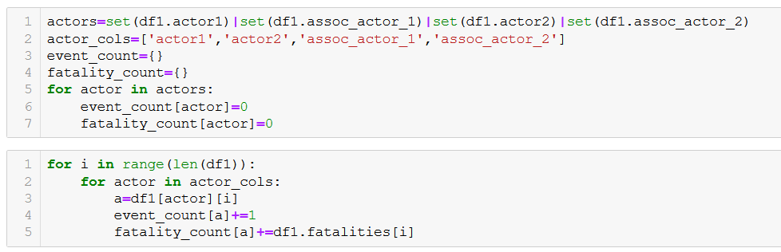
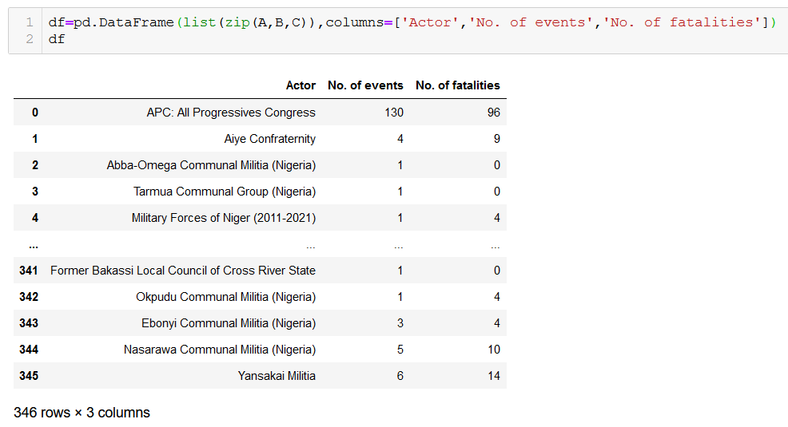
The Tsafee, Takum and few other militia groups are the highest risk actors thanks to having the highest ratio of involved fatatilities to events.
An assumption I had to make here was that I assigned all fatalities in a certain event to all of the involved actors since there was no way of determining which of those fatalities belonged to which actors.
If there way of deducing the exact actors for each fatality, it would lead to much more accurate results regarding the highest risk actors.

Slide 4
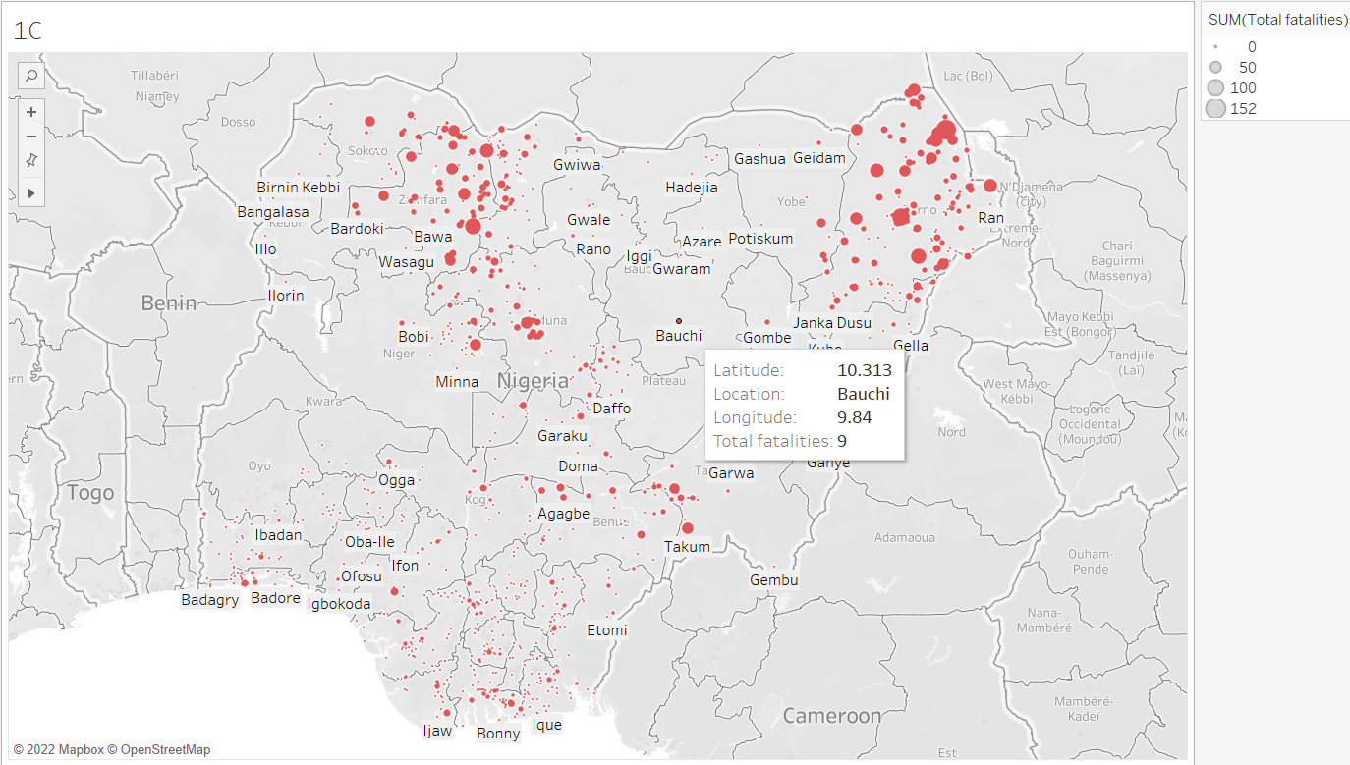
Q.1C

Slide 5
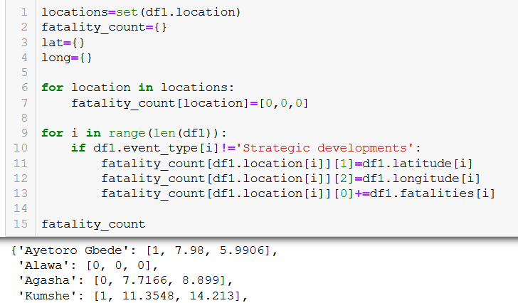
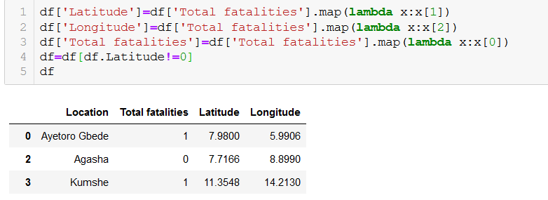
Maiduguri, Danjibga, and Baga stand out as having an astounding number of fatalities over all events; more than 100 fatalities each. Despite there being 901 locations in consideration, a measly 1% of the those accounted for nearly 20% of total fatalities. A practical application of this information is that it’s useful in directing military or humanitarian aid to regions that need it the most. It can also be key in developing strategies.
It also serves to demonstrate how widespread violence is in Nigeria, with larger points representing larger concentrations of fatalities.
Thanks to Tableau’s flexibility with gragraphical data, I was able to plot locations on a map of Nigeria. In this context, it made the most sense to present the data on a map, with each datapoint conveying the number of fatalities for the location.

Slide 6
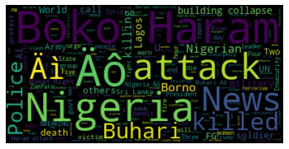
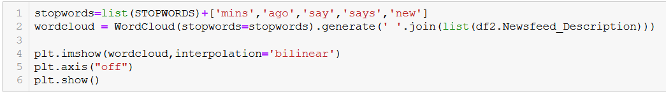
Q.2
Based on the newsfeed dataset, the most meaningful (though perhaps not most scientific) way of conveying trending themes is through a word cloud. It is obvious from the image that Boko Haram, Buhari, and the police are huge factors in the political scene in Nigeria as expected. The above wordcloud was generated from long desciptions of 24000 news articles.
The words killings, deaths, and people are also key in conveying the sentiment in the news in Nigeria.

Slide 7
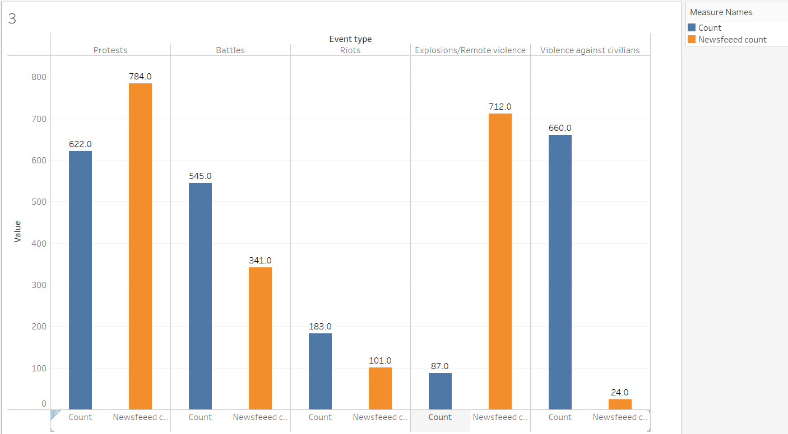
Q.3
In the plots, ‘count’ refers to the total number of occurence of those events in Nigeria. On the other hand, ‘newsfeed_count’ refers to the number of times that event type has been referenced in the news.
Newsfeeds and political violence events have an extremely weak correlation between them. By running the actual numbers using various types of correlation such as the Pearson coefficient, it is observed that the correlation factor is approximately 0.14, indicating that the two are barely correlated. However, there seems to be be a good relation between newsfeeds and actual events when it comes to protests, battles, and riots, with a weaker correlation in the latter two.

Slide 8
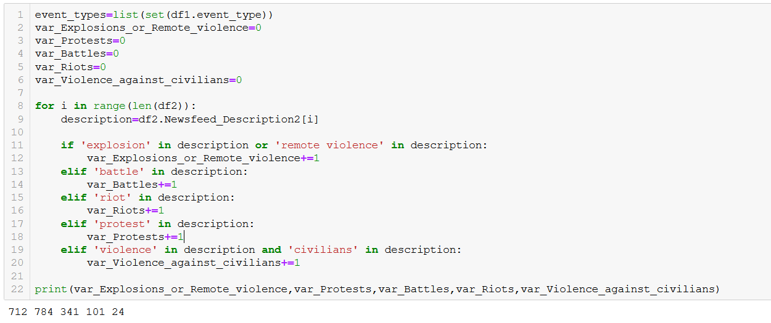
I collected the number of times the event types were mentioned in the newsfeeds in order to correlate them with the actual number of event occurences. In my opinion, the purpose of this process is to get an idea of whether or not the news is representative of actual events. As you can see from the plot, protests, battles, or riots have adequate news coverage to ensure word reaches the masses of frequently occuring events. However, violence against civilians and explosions/remote violence have either too little coverage or too much.

Slide 9
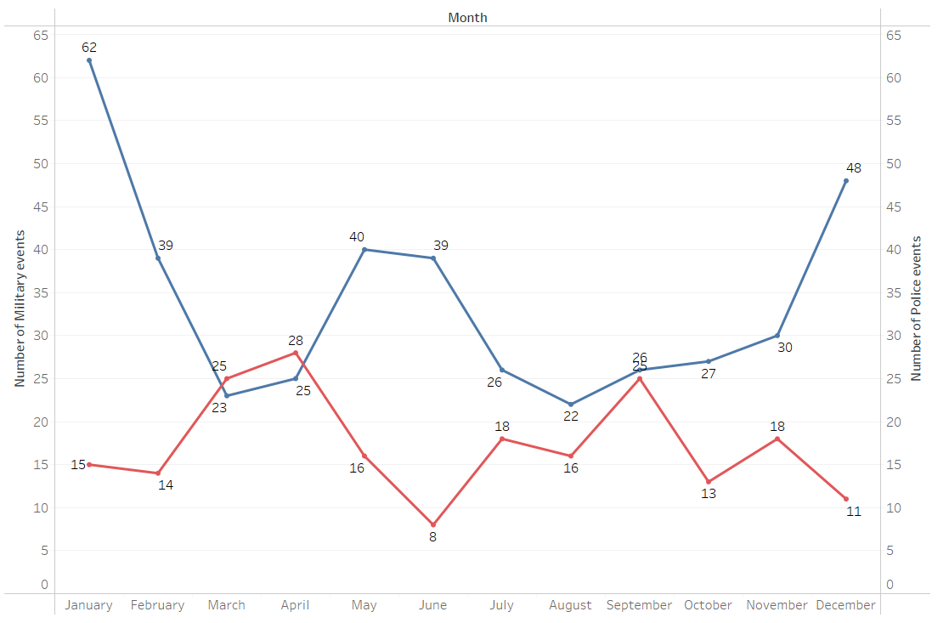
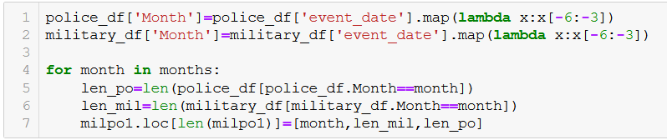
Q.4
This visualization compares the presence of the two primary ‘Peacekeeping’ forces : the Nigerian Military and Police forces throughout the year. ‘Presence’ is measured by counting the number of events that each actor is involved in.
For the most part, the Military is found to be invloved much more than the police in the affairs of the country. The total events that the Military is involved in is nearly twice that of the Police. This is expected, since the Military undoubtedly has more personnel and more resources at its disposal.
The snippet of code show the primary logic used to aggregate the data into a format more convenient for visualization.

Slide 10
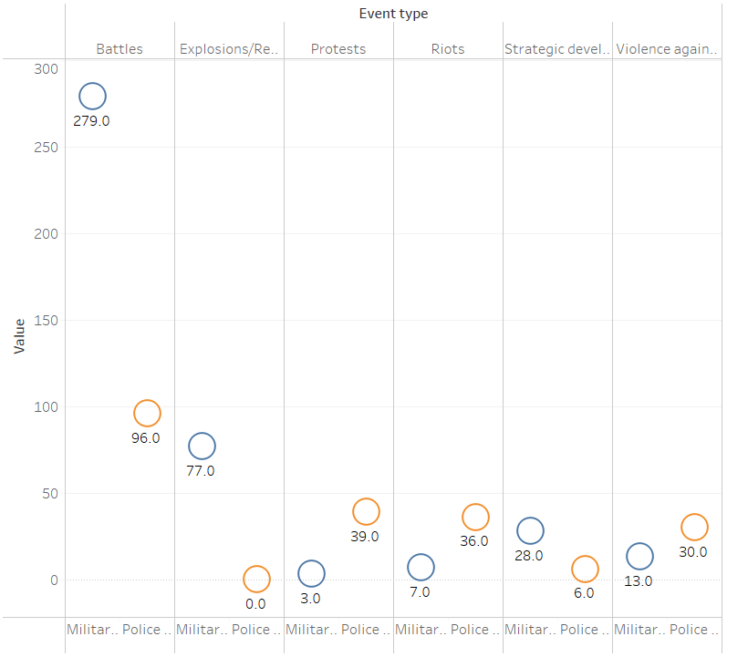
A similar logic was used to create this plot. This time, we are comparing the Military’s and Police’s ‘presence’ in the primary event types. Like before, the Military has a significantly larger presence due to the reasons mentioned before.
However, that is not to say that the Police is any less important. For events that are comparatively peaceful, such as protests and strategic developments, the Police involvement is notable.
This serves to prove that the Police is a much needed force in the region and is a complement to the Military. Both forces go hand in hand and are essential for the region.

