Slide 1
INTRODUCTION
1
MOVIE RECOMMENDATION SYSTEM

Slide 2
What should I watch when I come home from work?

Slide 3
Information filtering tools that aspire to predict the rating for users and items, predominantly from big data to recommend their likes.

Slide 4
Its primary objective is to suggest a movie through data clustering and computational intelligence.

Slide 5
This makes recommender systems essentially a central part of websites and e-commerce applications.

Slide 6
PROBLEM DEFINITION
2
MOVIE RECOMMENDATION SYSTEM

Slide 7
The recommendation system is an implementation of the machine learning algorithms.

Slide 8
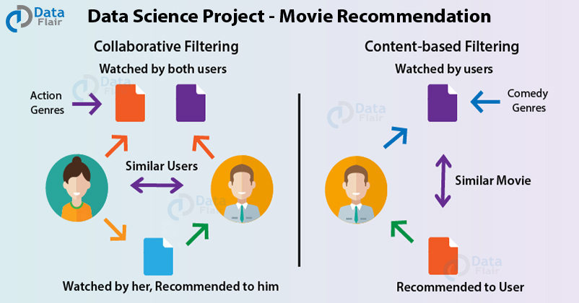

Slide 9
The dataset that we are working with is MovieLens, one of the most common datasets that is available on the internet for building a Recommender System.

Slide 10
DOMAIN
3
MOVIE RECOMMENDATION SYSTEM

Slide 11
Content-based: A popular, recommended product has similar characteristics to what a user views or likes.
Cluster: Recommended products go well together, no matter what other users have done.
Collaborative: Other users, who like the same products as another user views or likes, will also like a recommended product.

Slide 12
You can represent data about ratings or interactions as a set of matrices, with products and users as dimensions.

Slide 13
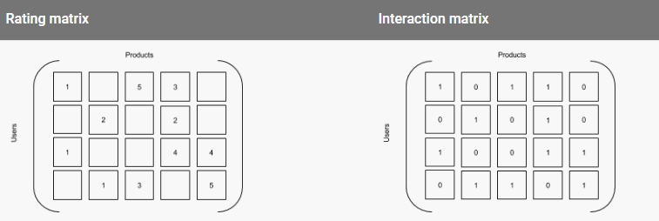

Slide 14
We use K-Nearest algorithm, Jaccard’s coefficient, Dijkstra’s algorithm, cosine similarity to better relate the data sets of people for recommending based on the rating or product.

Slide 15
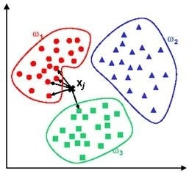

Slide 16
NEED
4
MOVIE RECOMMENDATION SYSTEM

Slide 17
– They help the user find items of their interest – Helps the item provider to deliver their items to the right user – To identify the most relevant products for each user – Showcase personalised content to each user – Suggest top offers and discounts to the right user – Websites can improve user-engagement – It increases revenues for business through increased consumption.

Slide 18
Another objective of the recommendation system is to achieve customer loyalty by providing relevant content and maximising the time spent by a user on your website or channel.
This also helps in increasing customer engagement.

Slide 19
On the other hand, ad budgets can be optimized by showcasing products and services only to those who have a propensity to respond to them.

Slide 20
SCOPE
5
MOVIE RECOMMENDATION SYSTEM

Slide 21
Neural Networks and Deep Learning have been all the rage the last couple of years in many different fields, and it appears that they are also helpful for solving recommendation system problems.

Slide 22
Amazon has been talking about building recommender systems using Recurrent Neural Networks and Deep Learning.

Slide 23
Deep Learning, can utilize Recurrent Neural Networks which are specifically designed for time and sequence data.

Slide 24
Incorporating time into a recommender system is important, because there are often preference seasonal effects.

Slide 25
At times, customers can be recommended something that does not seem like the best option, just to see how the customer reacts which will improve the learning in the long-term.

Slide 26
Some of the applications include being able to anticipate seasonal purchases based on recommendations, determine important purchases, and give better recommendations to customers which can increase retention and brand loyalty

Slide 27
APPLICATIONS
6
MOVIE RECOMMENDATION SYSTEM

Slide 28
A well-built recommender system can lead to an excellent customer experience.

Slide 29
The two most popular ways in which recommendations are done are:
Item-based : Content-based filtering
Customer-based : Collaborative filtering

Slide 30
Recommender systems could also combine these two methods into a hybrid approach which can benefit from the strengths of both item-based and customer-based methods.

Slide 32
FILTERING TECHNIQUES
MOVIE RECOMMENDATION SYSTEM

Slide 33
Content Based Filtering
A common approach when designing recommender systems is content-based filtering. Content-based filtering methods are based on a description of the item and a profile of the user's preferences. These methods are best suited to situations where there is known data on an item (name, location, description, etc.), but not on the user. Content-based recommenders treat recommendation as a user-specific classification problem and learn a classifier for the user's likes and dislikes based on an item's features.
In this system, keywords are used to describe the items and a user profile is built to indicate the type of item this user likes. In other words, these algorithms try to recommend items that are similar to those that a user liked in the past, or is examining in the present. It does not rely on a user sign-in mechanism to generate this often temporary profile. In particular, various candidate items are compared with items previously rated by the user and the best-matching items are recommend

Slide 34
K-means Clustering algorithm -

Slide 35
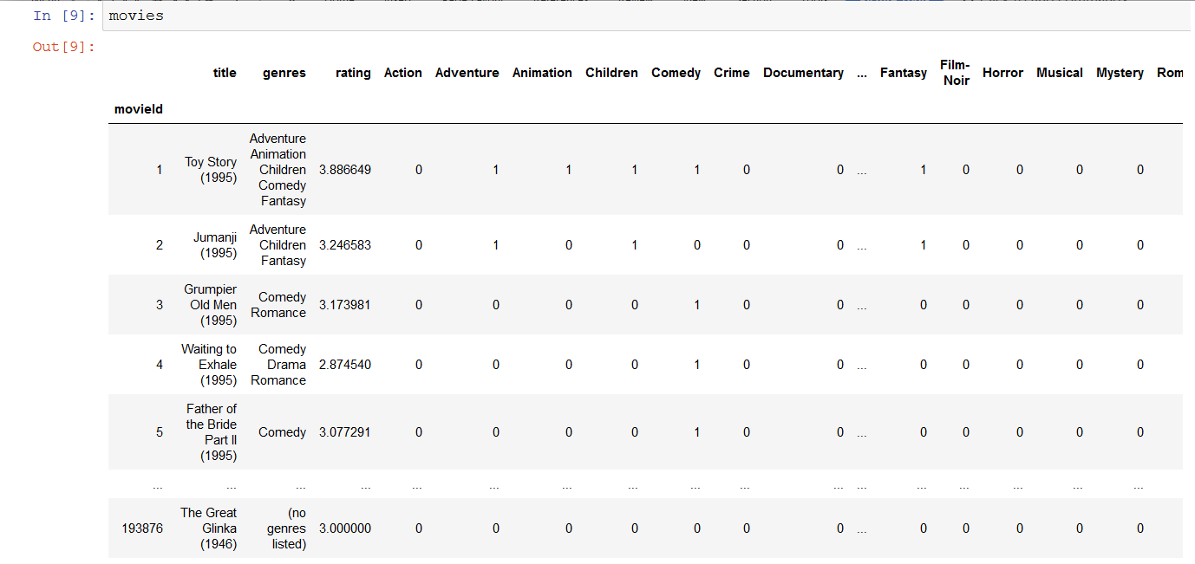
Why we need to transform data into numerical values -

Slide 36
Why we need to transform data into numerical values -
Since K-means algorithm work based on numerical data, it cannot make sense of sets of strings and thus fails to compare them. Thus, we need to convert the genres into a form that can be understood by the K-means algorithm.
One hot encoding is one way of doing this. It creates a separate column for each genre and marks it with '1' if the movie fits in the genre, otherwise marks it '0'. Now, the algorithm can make calculations between a 'Action - Comedy' movie and a movie that is 'Adventure - Comedy'

Slide 37
Why we need to transform data into numerical values -
It may seem easier to simply assign a number to each genre in this case. For example, if Action was assigned 1, Adventure was assigned 2, etc. However, this will give us incorrect results. To understand this problem, consider the following example -
Suppose a supermarket has an inventory dataset and each fruit is given a number : Apples -1, oranges - 2, and grapes - 3.
What this system fails to convey is that apples are no more similar to oranges than thry are to grapes i.e. apples are equally dissimilar to oranges amd grapes.
Because the algorithm works on numerical values, it will form the understanding that it's supposed to avoid. It will that oranges are somewhere between apples and grapes because the mean of 1 and 3 is 2.

Slide 38
Need for One Hot Encoding
1 Red
2 Green
3 Blue
will be encoded as -
Red Green Blue
1 1 0 0
2 0 1 0
3 0 0 1

Slide 39
Elbow Method
Now that our data is in numerical format, the next thing K-means needs is the number of clusters 'k'. 'k' is found using the elbow method. In cluster analysis, the elbow method is a heuristic used in determining the number of clusters in a data set. The method consists of plotting the explained variation as a function of the number of clusters, and picking the elbow of the curve as the number of clusters to use. The same method can be used to choose the number of parameters in other data-driven models, such as the number of principal components to describe a data set.

Slide 40
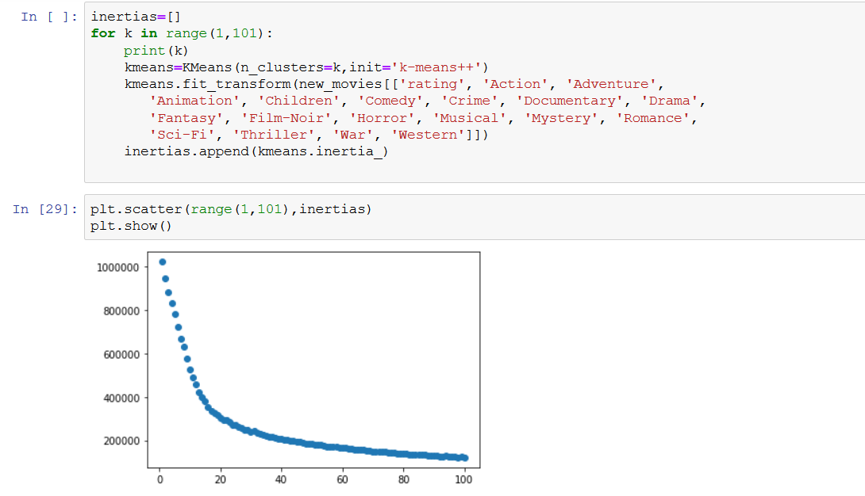
Elbow Method

Slide 41
Elbow Method
The graph has an 'elbow' at k=29. This means that creating more clusters than 29 will have additional costs that outweigh the benefits. Therefore, K-means will be applied with k=29.
Hence, each movie in the data set will be assigned to a cluster containing other similar movies. Often, k is taken to be sqrt(n)/2.

Slide 42
Advantages of K-means -
Relatively simple to implement.
Scales to large data sets.
Guarantees convergence.
Can warm-start the positions of centroids.
Easily adapts to new examples.
Generalizes to clusters of different shapes and sizes, such as elliptical clusters.

Slide 43
Disadvantages of K-means -
Being dependent on initial values - For a low k, you can mitigate this dependence by running k-means several times with different initial values and picking the best result. As increases, you need advanced versions of k-means to pick better values of the initial centroids (called k-means seeding).
Clustering data of varying sizes and density - k-means has trouble clustering data where clusters are of varying sizes and density. To cluster such data, you need to generalize k-means as described in the Advantages section.
Clustering outliers - Centroids can be dragged by outliers, or outliers might get their own cluster instead of being ignored. Consider removing or clipping outliers before clustering.

Slide 44
Disadvantages of K-means -
Scaling with number of dimensions - As the number of dimensions increases, a distance-based similarity measure converges to a constant value between any given examples. Reduce dimensionality either by using PCA on the feature data, or by using “spectral clustering” to modify the clustering algorithm.
Choosing k manually - Use the “Loss vs. Clusters” plot to find the optimal (k).

