Slide 1

RLL Project Title : OpenMRS
Presented
-By Group6

Slide 2
Project Objective and Description
Objective:
In this RLL project we are creating multiple test scripts to automate various test scenarios and generate the reports for a demo Hospital Management Website.
Description:
During this project we are implementing various technologies like Java Selenium WebDriver and Jenkins along with Cucumber-Java to automate the test scenarios.

Slide 3
Contents
Technologies used
Modules
-Login as Inpatient ward
-Register a Patient
-Find Patient Record
-Manage service types
-Manage appointments
-Manage appointment blocks
-Capture vitals for patients
-Edit Patient Details
Extent Reports

Slide 4
Technologies Used
Selenium web Driver
TestNG
Cucumber – Java
Java
Maven

Slide 5
Explanation of Technologies:
Selenium:
Selenium definition:
Selenium is a free (open-source) automated testing framework used to validate web applications across different browsers and platforms. We can use multiple programming languages to create and automate Selenium Test Scripts.
Uses of Selenium:
Selenium is used to:
Users can test their websites functionally on different browsers.
Users can perform cross browser testing to check if the website functions consistently across different browsers like chrome, Firefox etc.

Slide 6
Implementation of Selenium:
Setup: Setting up selenium WebDriver by adding maven dependencies in pom.xml file.
Initialization: Create a WebDriver instance (e.g., Chrome Driver, Firefox Driver) in the test setup method.
Writeup: Writing test cases using TestNG Annotations (@Test, @AfterTest, @BeforeTest)
Locators: Use WebDriver commands to find elements on the page (e.g., by ID, by name, by XPath) and interact with them
Assertions: Using assertions (assertEquals) to match expected and actual output.
Cleanup: Close the WebDriver instance in the teardown method

Slide 7
TestNG
Definition:
TestNG is a testing framework for the Java programming language inspired by JUnit and NUnit. It is an open-source framework designed to make testing easier, more flexible, and more powerful. TestNG stands for "Test Next Generation" and provides many additional features.
Uses:
TestNG provides several annotations to organize the test cases
TestNG can be used to group and prioritize test cases
It supports data-driven testing using Data Providers.
It can generate HTML test reports
It supports parallel execution.
Logs can be generated.

Slide 8
Implementation of TestNG
Set Up Eclipse
Create a Maven Project
Add TestNG Dependency
Create Test Classes
Test Methods : You can use various TestNG annotations like @BeforeClass, @AfterClass, @BeforeMethod, @AfterMethod, etc.
Run through TestNG
View test Results

Slide 9
Configuration Annotations
@BeforeSuite : Runs before suite execution starts
@AfterSuite : Runs after all tests are executed
@Before Test : Runs before first test in a <test> tag is executed
@After Test : Runs after all the tests in a <test> tag are executed
@BeforeGroups : Runs before first test method of the group(s) is executed
@After Groups : Runs after all the test methods of the group(s) are executed
@BeforeClass : Runs before first test in a class is executed
@After Class : Runs after all the tests in a class are executed
@BeforeMethod : Runs before each test in class is executed
@Aftertrethod : Runs after each test is executed

Slide 10
Cucumber- Java
Definition:
Cucumber is a popular open-source tool used for behavior-driven development (BDD).
Cucumber for Java is an implementation of Cucumber that allows developers to write and automate test scenarios using Java. It integrates with popular testing frameworks like JUnit and TestNG to execute tests and generate reports.
Uses:
It is a software development approach that encourages collaboration between developers, QA engineers, and business stakeholders.
Cucumber allows teams to write automated acceptance tests in a natural language format that is easily understandable by non-technical stakeholders.
Cucumber with Java is used for behavior-driven development (BDD), enabling automated acceptance testing, integration testing, regression testing, cross-functional collaboration, documentation, and integration into CI/CD pipelines

Slide 11
Implementation of Cucumber-Java
Set Up Eclipse
Create a Maven Project
Add cucumber-Java Dependency
Create Feature File
Step definitions
Test runner class
View test result

Slide 12
Java
Definition:
Java is a high-level, object-oriented programming language. It is a widely-used programming language for coding web applications.
It has been a popular choice among developers for over two decades, with millions of Java applications in use today.
Uses:
Desktop Application
Cloud computing
Artificial Intelligence
Internet of Things
Machine Learning

Slide 13
Implementation of Java
Install Java Development Kit (JDK)
Set up Environment Variables
Choose an Integrated Development Environment (IDE)
Create Maven/Java project in Eclipse
Write Java Code
Compile Java Code
Run Java Program

Slide 14
Maven
Definition:
Maven is an open-source build automation and project management tool widely used for Java applications. As a build automation tool, it automates the source code compilation and dependency management, assembles binary codes into packages, and executes test scripts.
Uses:
Dependency management
Project structuring
Build Automation
Project Reporting
Cross-Platform compatability

Slide 15
Implementation of Maven
Set Up Eclipse
Create a Maven Project
Add Dependencies
Create packages and classes when ever required
Run the project

Slide 16
Login as Inpatient ward
Here, we are logging into the OpenMRS website by putting a proper URL in any of the installed browsers.
We are putting correct username and password and giving location as Inpatient Ward.
By logging in, we can perform administrative works like registration, editing patient details, making appointments, and capturing patient vitals.
Also we can surf through the details of the Hospital management website.

Slide 17
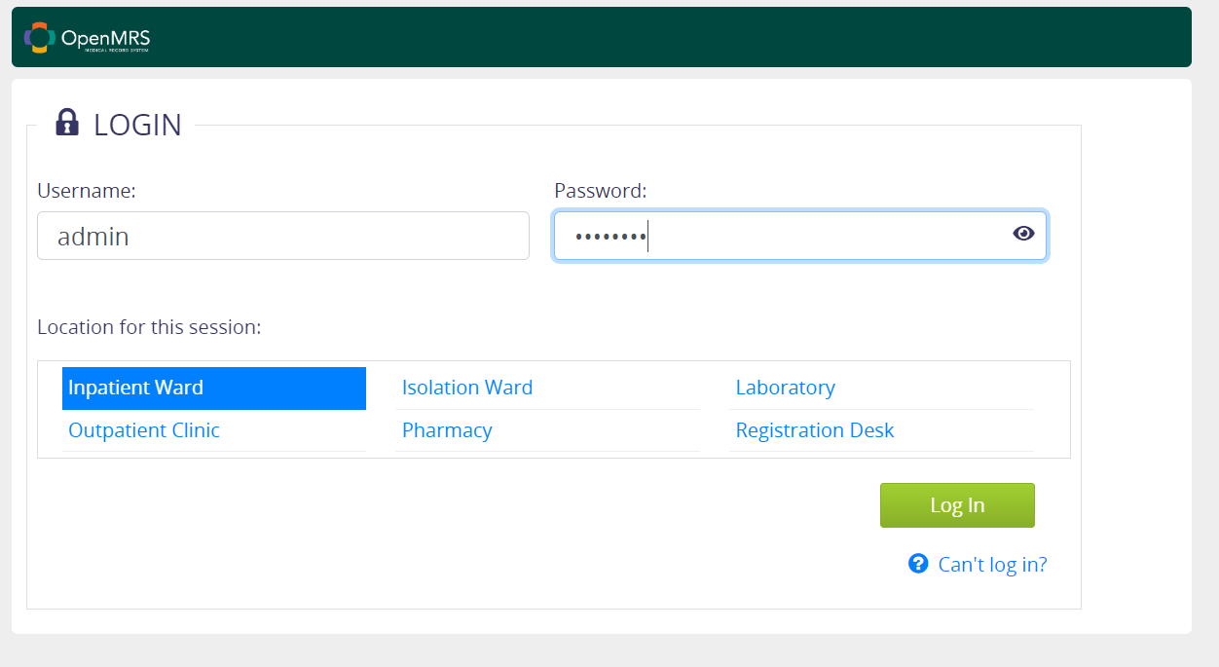

Slide 18
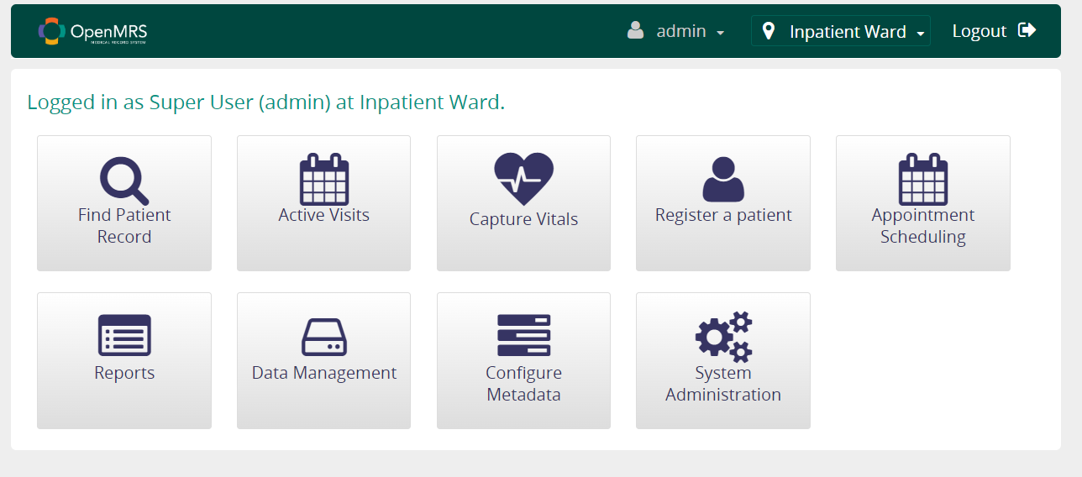

Slide 19
Steps to Automate
Go to the OpenMRS demo url : https://demo.openmrs.org/openmrs/login.htm
Enter valid credentials, choose location and click on the login button
After login, it will redirect to Home Page

Slide 20
Register a Patient
Registering for OpenMRS involves creating an account on the OpenMRS platform, which allows users to access various features and functionalities related to electronic medical records (EMRs) and healthcare management.
Users can typically access the registration page by visiting the OpenMRS website or platform. The registration page may be accessible directly from the homepage or through a dedicated "Sign Up" or "Register" link.

Slide 21
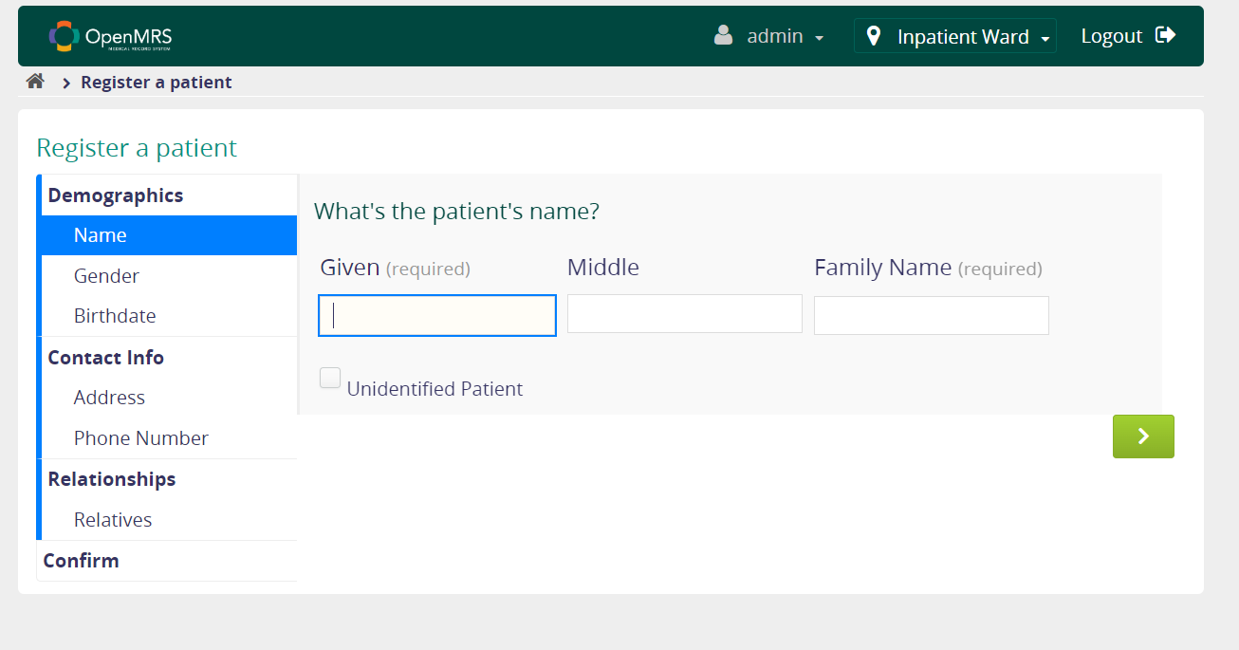

Slide 22
Steps to Automate
Go to the OpenMRS demo url : https://demo.openmrs.org/openmrs/login.htm
Enter valid credentials, choose location and click on the login button
After login, it is redirected to Home Page
Click on Register a patient
Enter name, gender, date of birth, contact number, address and relatives
Click on confirm button

Slide 23
Find Patient Record
Overview:
This module enable users to search for patient records quickly and accurately by providing options to search using patient’s name or Id.
It improves user experience by offering a user-friendly search interface and displaying search results in a clear and understandable format.
Ensure the accuracy and integrity of patient data by implementing robust search functionalities that retrieve the correct patient records based on the provided search criteria.

Slide 24
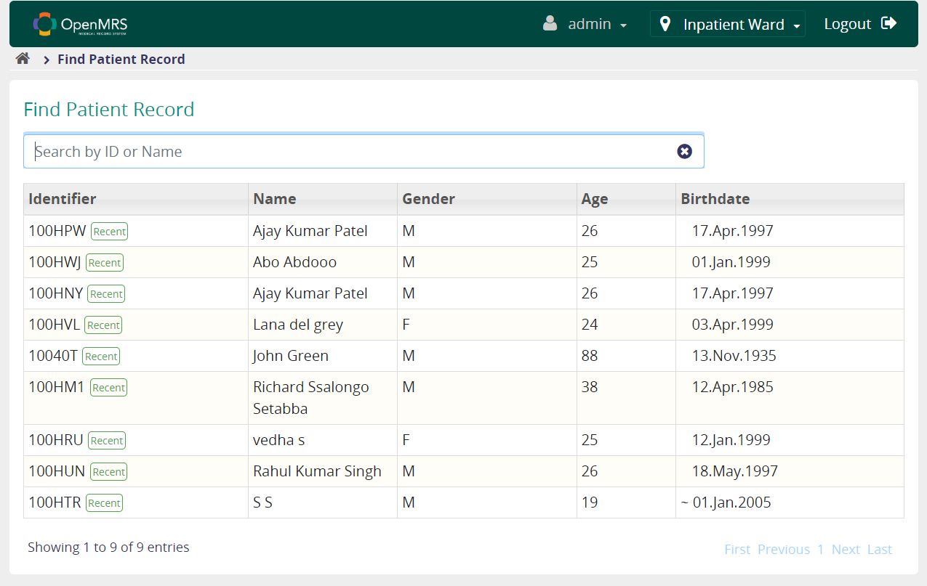

Slide 25
Steps to Automate:
Go to the OpenMRS demo url : https://demo.openmrs.org/openmrs/login.htm
Enter valid credentials, choose location and click on the login button
After login, it is redirected to Home Page
Click on "Search Patient Record"
Enter Patient name or id in search tab
Click on Search Result
View patient Record

Slide 26
Manage service types
Service types can include medical consultations, diagnostic tests, surgical procedures, therapeutic treatments, and preventive healthcare services, among others.
Each service type is typically associated with specific attributes, such as a name, description, code, duration, and cost.

Slide 27
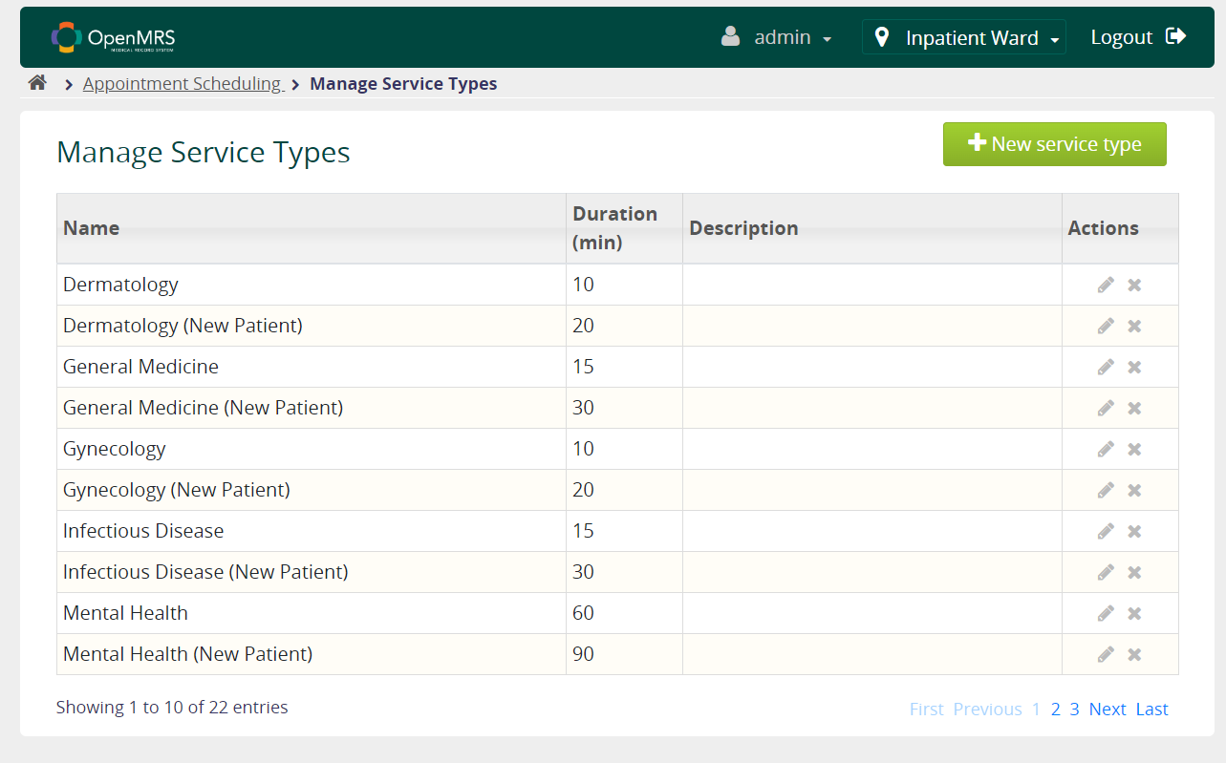

Slide 28
Steps to Automate
Go to the OpenMRS demo URL: https://demo.openmrs.org/openmrs/login.htm
Enter valid credentials, Choose location and click on the login button
Then navigated to Home Page Click on the "Appointment Scheduling“
Click Manage service types
Click on new service types
Enter Name
Click on Duration (20 min)
Click on save

Slide 29
Manage appointments
Managing appointments in OpenMRS involves creating, scheduling, updating, and managing appointments for patients.
The module allows healthcare providers to view, edit, and manage scheduled appointments. Providers can easily access appointment details, update appointment statuses, and reschedule or cancel appointments as needed.

Slide 30
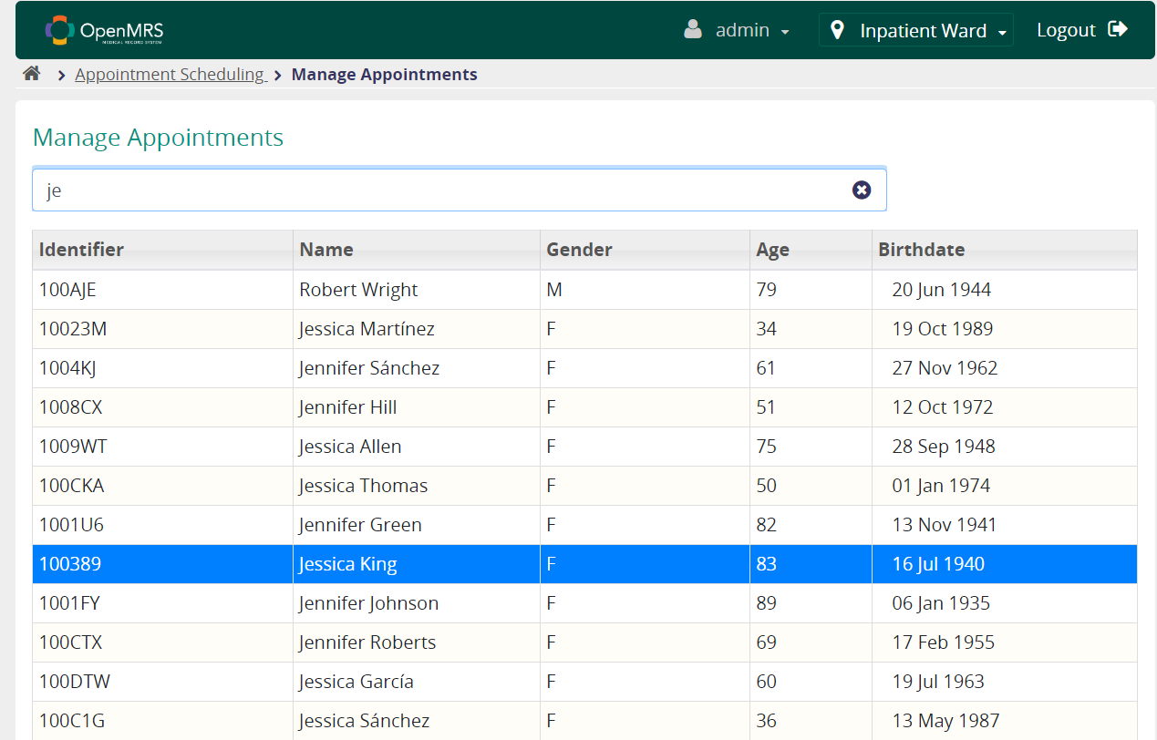

Slide 31
Steps to Automate
Go to the OpenMRS demo URL: https://demo.openmrs.org/openmrs/login.htm
Enter valid credentials, Choose location and click on the login button
Then navigated to Home Page Click on the "Appointment Scheduling"
Click on "Manage Appointments"
Enter patient name in search box
Select the particular patient
Perform patient appointments

Slide 32
Manage appointment blocks
Overview:
Managing appointment blocks is to efficiently organize and schedule appointments or meetings within a given timeframe, ensuring optimal utilization of resources such as time, personnel, and facilities.
Key objectives for managing appointment blocks effectively,
-Optimizing Scheduling Efficiency
-Enhancing Resource Utilization
-Facilitating Effective Time Management
-Improving Coordination and Communication
-Flexibility and Adaptability

Slide 33
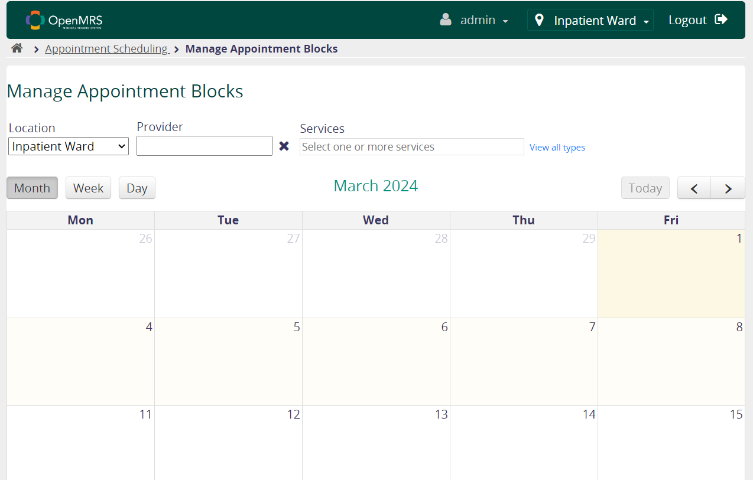

Slide 34
Steps to Automate:
Go to the OpenMRS demo URL: https://demo.openmrs.org/openmrs/login.htm
Enter valid credentials, Choose location and click on the login button
Then navigated to Home Page Click on the "Appointment Scheduling"
Click on the "Manage Provider Schedule"
Then choose the date when you want create the provider schedule
Fill the required form's fields : Like start time and end time, types of services
Click on the save button

Slide 35
Capture vitals for patients
Vital signs play a crucial role in patient care, providing essential information about a person's health status.
Vital signs include measurements such as body temperature, heart rate, respiratory rate, blood pressure, and oxygen saturation.

Slide 36
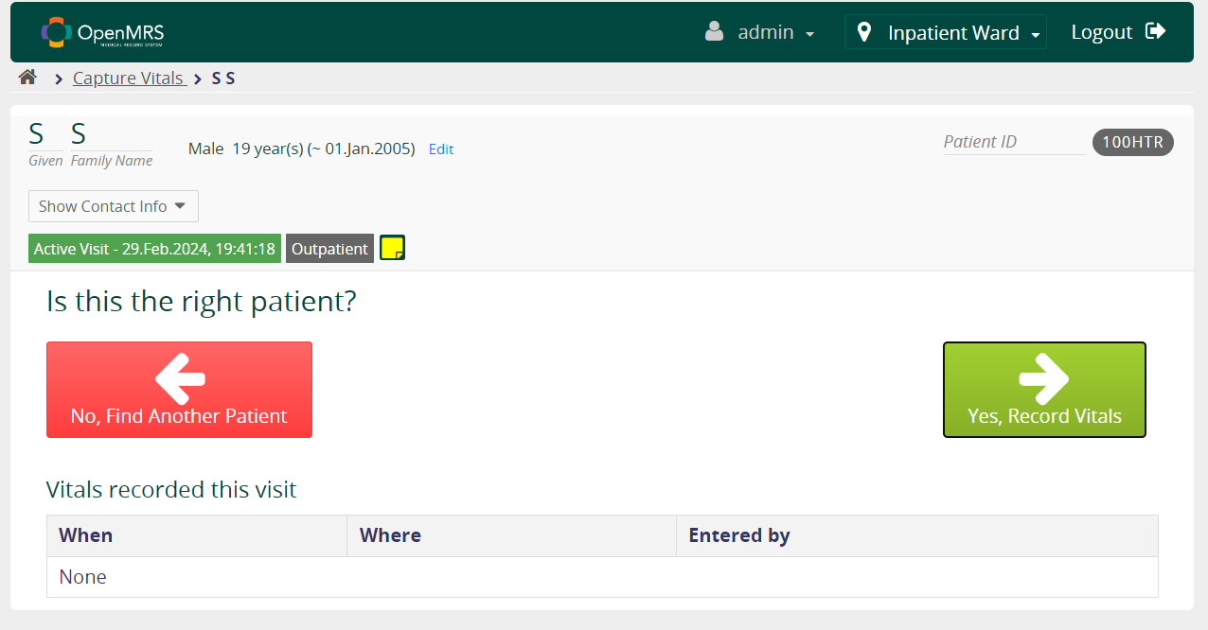

Slide 37
Steps to Automate
Go to the OpenMRS demo URL: https://demo.openmrs.org/openmrs/login.htm
Enter valid credentials, Choose location and click on the login button
Click on Capture Vitals
Select any Patient name
Click on record vitals
Enter the values of Height (cm) Weight (kg) (Calculated) BMI Temperature (c) Pulse Respiratory rate Blood Pressure Arterial blood oxygen saturation (pulse oximeter)
Click confirm vitals

Slide 38
Edit Patient Details
Editing patient details on the OpenMRS page involves accessing the patient's electronic health record (EHR) and making changes to their demographic and clinical information as necessary.

Slide 39
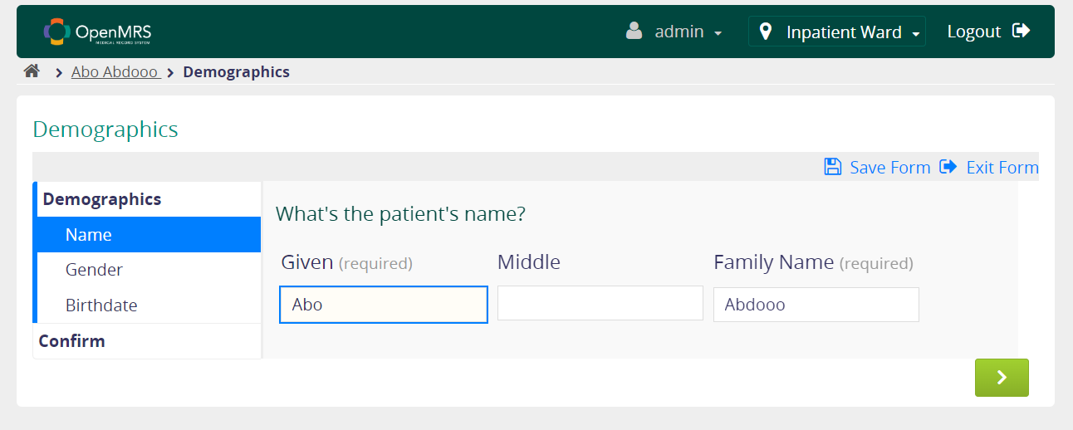

Slide 40
Steps to Automate
Go to the OpenMRS demo url : https://demo.openmrs.org/openmrs/login.htm
Enter valid credentials, choose location and click on the login button
After login, it is redirected to Home Page
Click on "Search Patient Record"
Enter Patient name or id in search tab
Click on Search Result
Click Edit Button
Add name, gender, birth date and click on next
Click on confirm

Slide 41
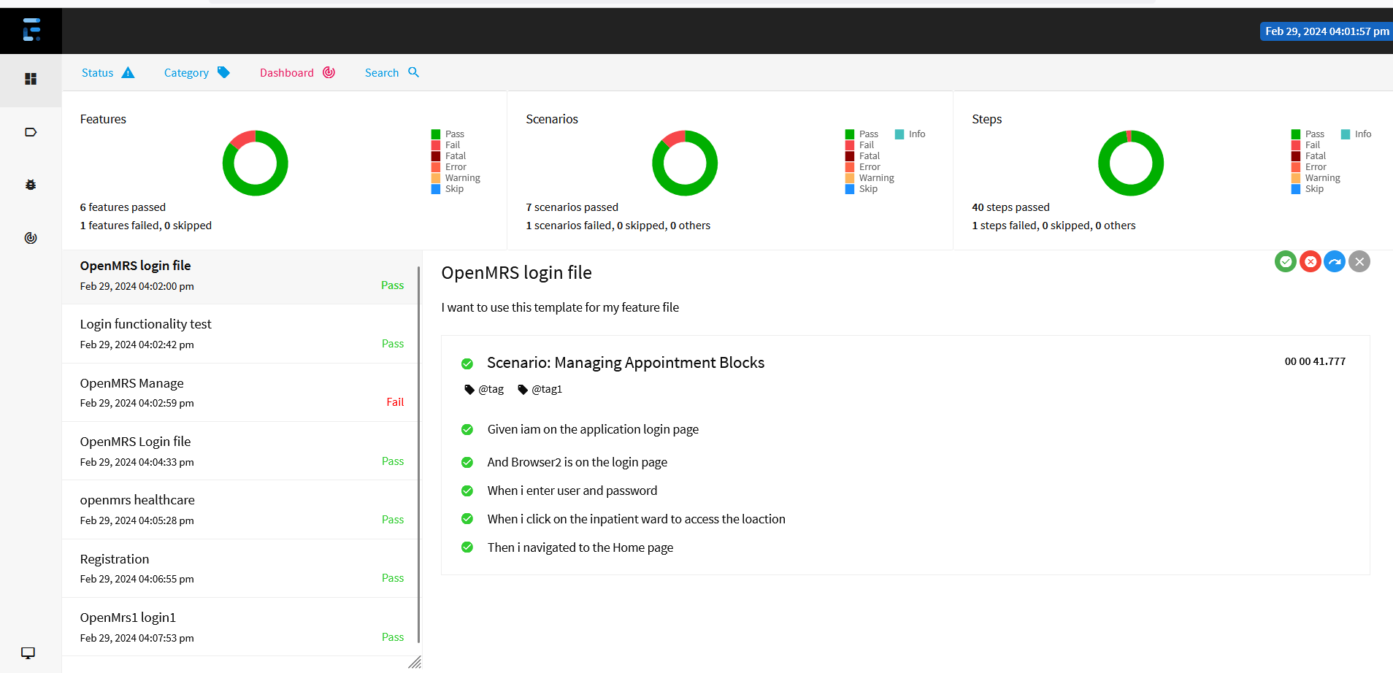
Extent Report:

Slide 42
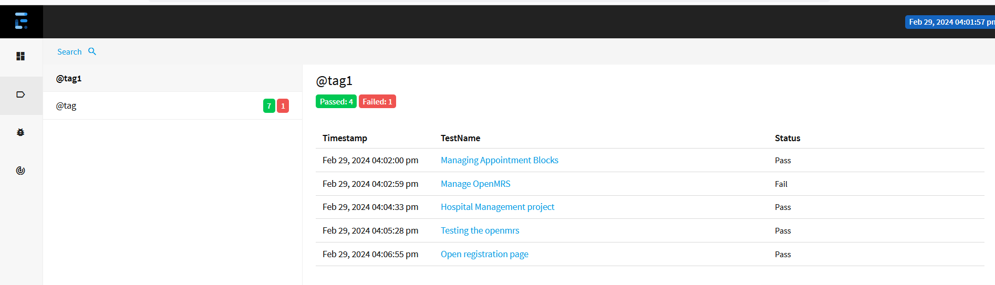

Slide 43
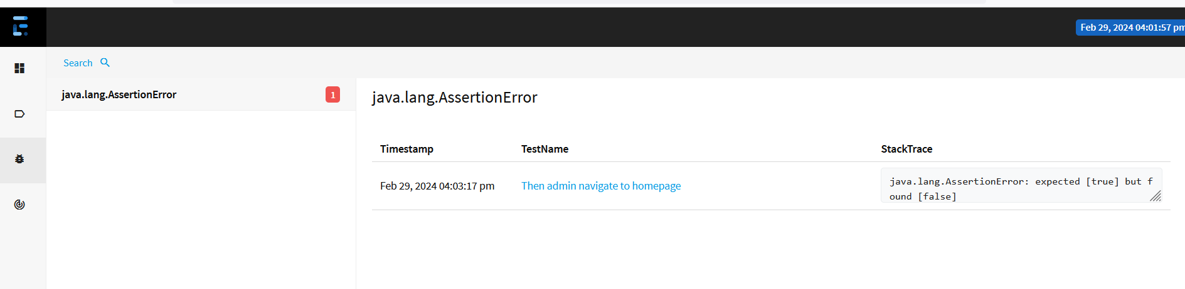

Slide 44
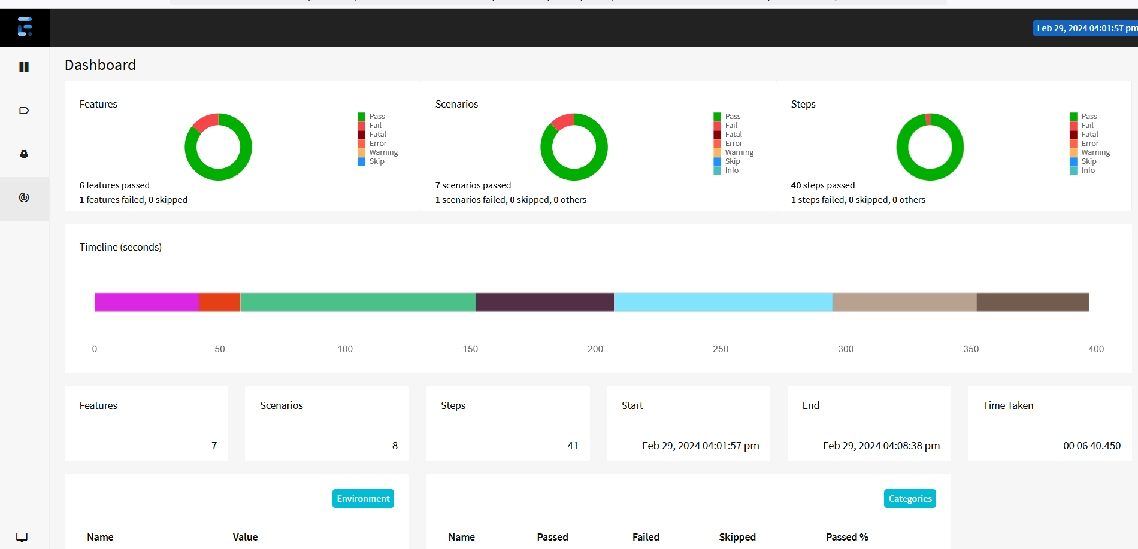

Slide 45
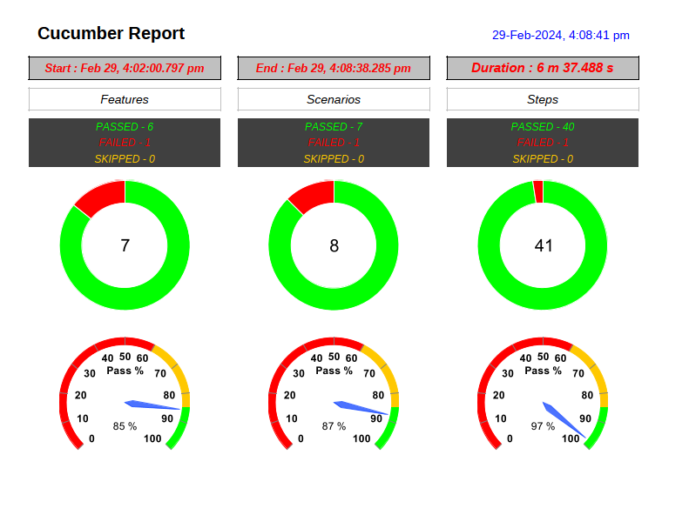

Slide 46
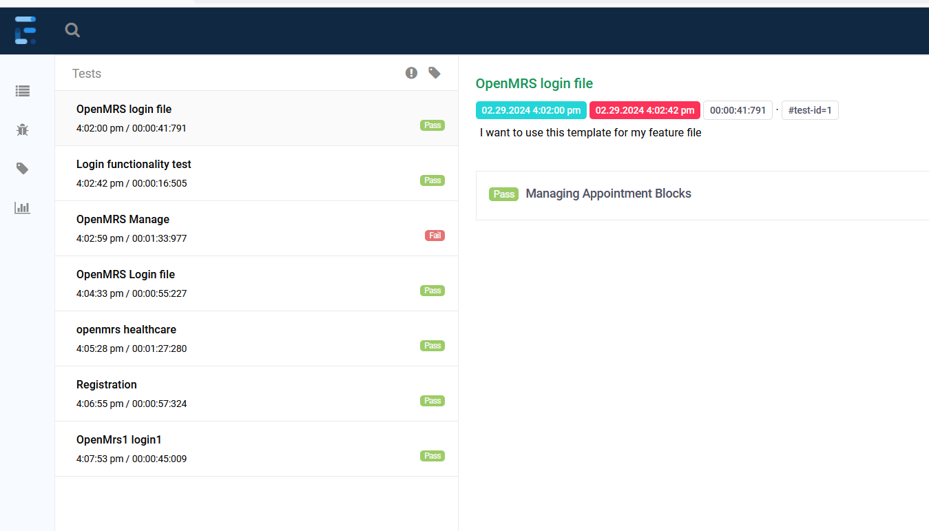

Slide 47
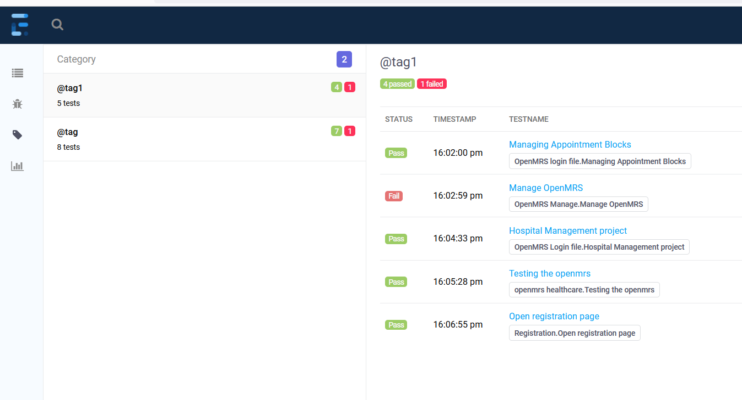

Slide 48
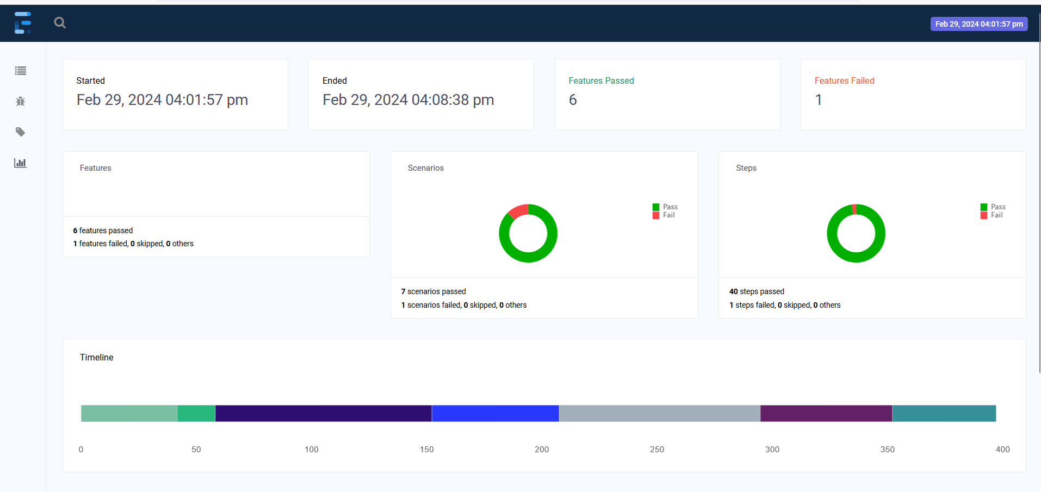

Slide 49
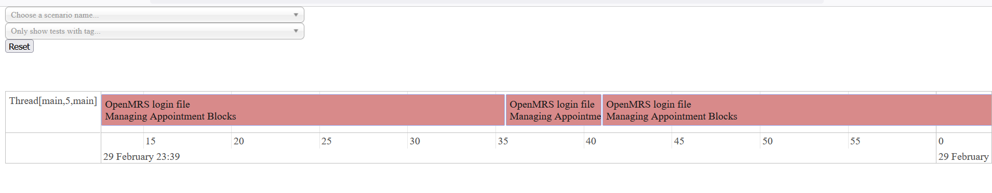

Slide 50
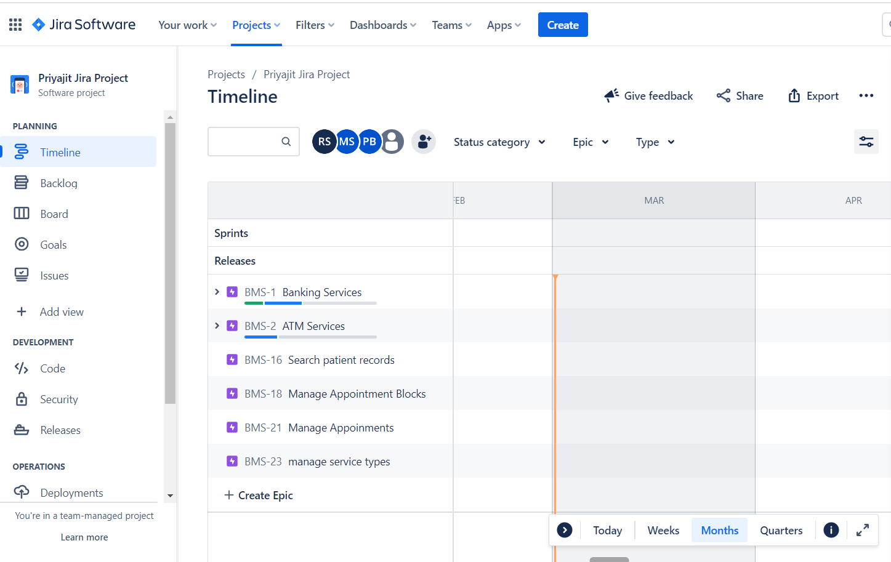

Slide 51
Conclusion:
The project met the specified requirements and was running successfully in eclipse.
All the test scenarios are verified Including positive and negative cases.
The project has successfully generated Extent reports and captured screenshots.
JIRA was utilized for Test Management Lifecycle.
Here, we have merged all the test scenarios in one Git hub repository.

Slide 52


