Slide 1

Secure your pipeline with vault
Jiming Chen

Slide 2


Slide 3
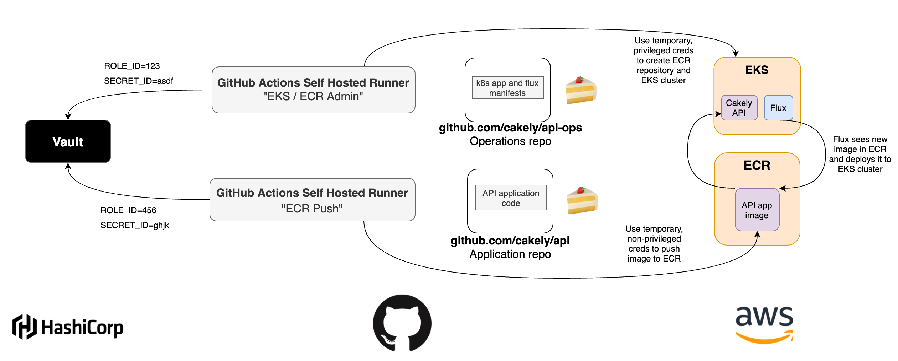

Slide 4
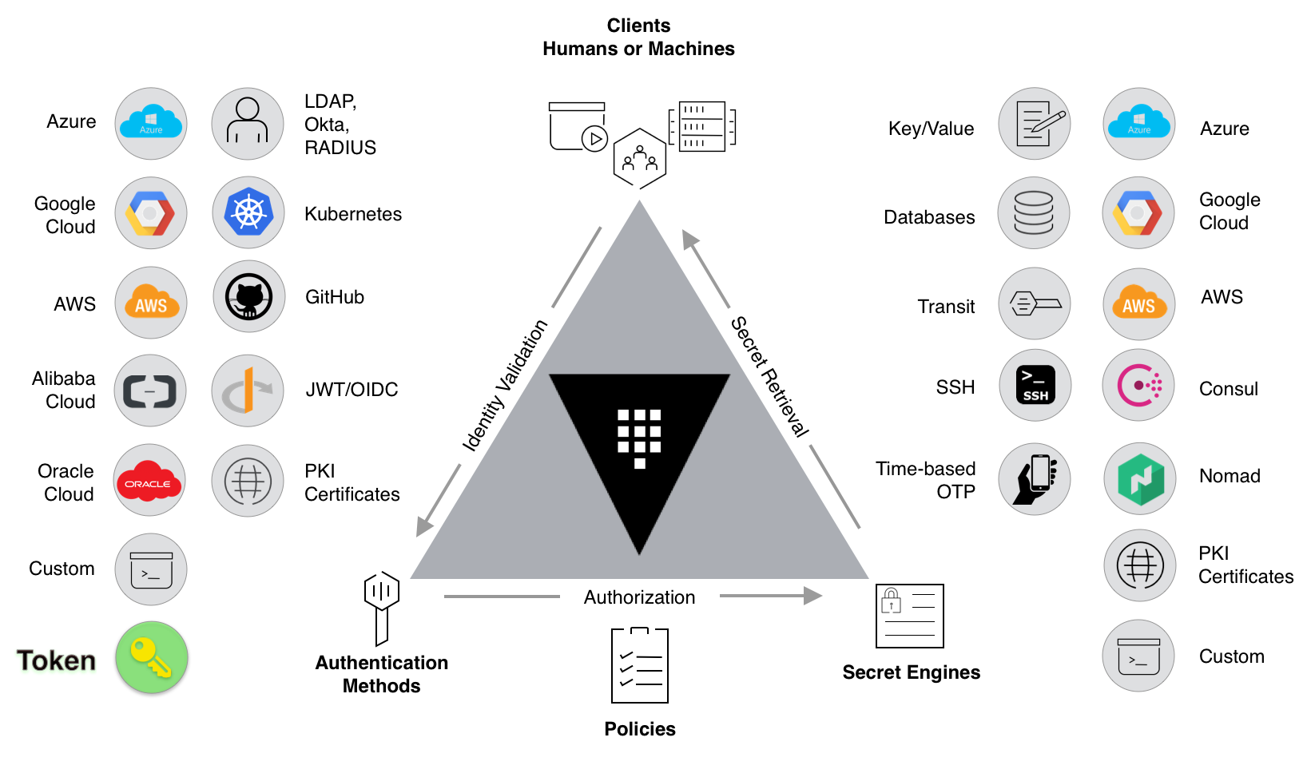
HashiCorp Vault

Slide 5
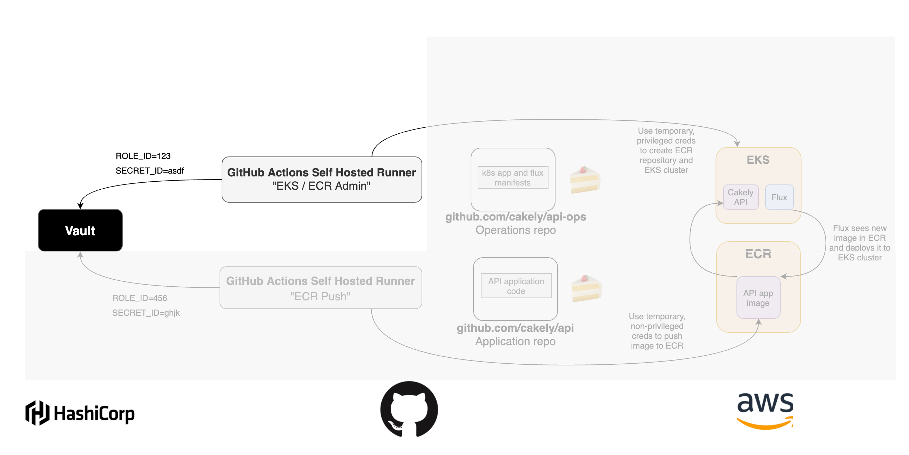

Slide 6
I want to access aws/sts/eks-ecr-admin;
Here is role id and secret id
Permission granted, let me retrieve a key from aws for you
Github Action Self Hosted Runner
Vault
AWS
AWS_ACCESS_KEY_ID
AWS_SECRET_ACCESS_KEY

