Slide 1
Knowledge editing → the consistency seam
a trajectory
Walkthrough for Arnab · 2026-08-25 · Saif Ul Islam
Notes:
~6 min spoken (the CORE), then a LIVE walkthrough of results/. Slow, honest, invite steering. Deck is a backstop, not a script.

Slide 2
§1 · THE DIRECTION (agreed Aug 2)
⏱ 1m
Does representational geometry predict edit propagation?
● The thread we agreed on: does the representational geometry between an edited fact and its logically-entailed neighbours predict whether an edit actually propagates to them?
– Resolved across entailment hops (paraphrase / 1-hop / 2-hop), measured causally (IIA) — not just behaviourally — comparing raw-distance vs. structured-geometry vs. alignment predictors.
● Stakes: editing fails ripple today — ROME-edited GPT-J answers only 7.6% of MQuAKE multi-hop.
● Homework first (Asta + literature incl. NDIF corpus): the hop-resolved causal comparison looked unclaimed (dense: SLAQ, Kim/Jeong, Nishi shattering, RAVEL).
Consistency seam · a trajectory
02 / 24
Notes:
1m. Ground everyone in the AGREED direction (the email, Aug 2). This is the shared starting point before I show where running it led.

Slide 3
§ · WHAT I'D LOVE FROM TODAY
⏱ 30s
Pressure-test where it stands
● Is the direction still sound? — I have results that reframed it; check my logic.
● What am I missing? — pointers, prior work, blind spots.
● Attack the hard questions — I've written them down (last slide); try to break them.
● How do we scale it — compute + collaboration toward sharper outcomes.
Consistency seam · a trajectory
03 / 24
Notes:
30s. Then ~5 min of trajectory, then results live. Frame Arnab's role as the adversarial reviewer (Natalie's framing) — the hard-questions slide is for him.

Slide 4
§2 · THE PHENOMENON
⏱ 1m
Editing propagation collapses — and over-propagates — with hop
● Reproduced the ripple failure (random RippleEdits, n=397): correct propagation collapses beyond paraphrase — 1-hop mostly stale (61%), 2-hop mostly broken (81%) [E-014].
● Over-propagation is the mechanism — of broken cases, target-bleed rises with hop: 0% → 25% → 58% (the edit's value spills into farther neighbours).
● Non-cherry-picked + reproducible; FT baseline shows the same hop-decay [E-012]. (Locality not yet measurable — needs a capable model.)
Consistency seam · a trajectory
04 / 24
Notes:
1m. The phenomenon (E-014). Figure next. Keep to the research finding — the deployment angle is the coda, later.

Slide 5
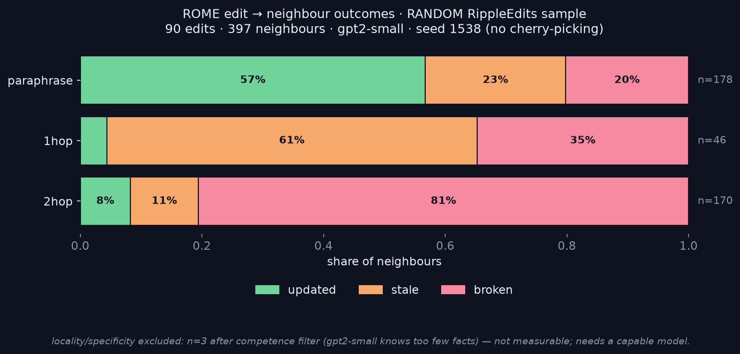
§2 · THE DISTRIBUTION
⏱ 30s
ROME edit → neighbour outcomes (no cherry-picking)
90 random edits · 397 neighbours · gpt2-small · seed 1538 — reproducible from results/final/
Consistency seam · a trajectory
05 / 24
Notes:
Let the figure carry it: paraphrase 57% updated; 1-hop 61% stale; 2-hop 81% broken. Locality excluded (n=3, not measurable). Anti-cherry-pick payoff — the clean landmark story (5/5) becomes 57% at scale.

Slide 6
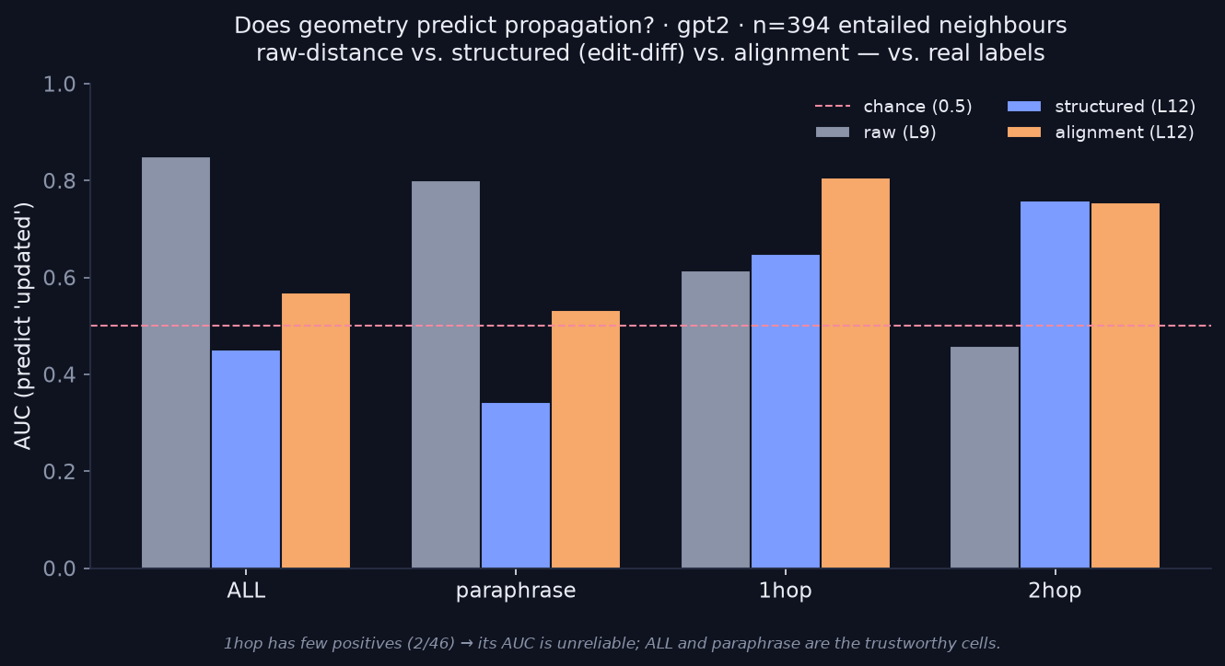
§3 · DOES GEOMETRY PREDICT IT?
⏱ 1m
Yes — but which geometry depends on the hop
raw distance predicts NEAR (paraphrase AUC 0.80 [0.74,0.86]) but fails FAR (2-hop 0.46, spans chance); structured/alignment capture the FAR signal (~0.75, CI >0.5) [E-015]. Bootstrap CIs confirm the crossover (1-hop uninterpretable, 2 pos). ALL-column is type-confounded → per-hop is honest.
Consistency seam · a trajectory
06 / 24
Notes:
1m. The predictor-by-hop crossover. This is the agreed direction's core comparison (raw vs structured vs alignment), against the real 397-row labels.

Slide 7
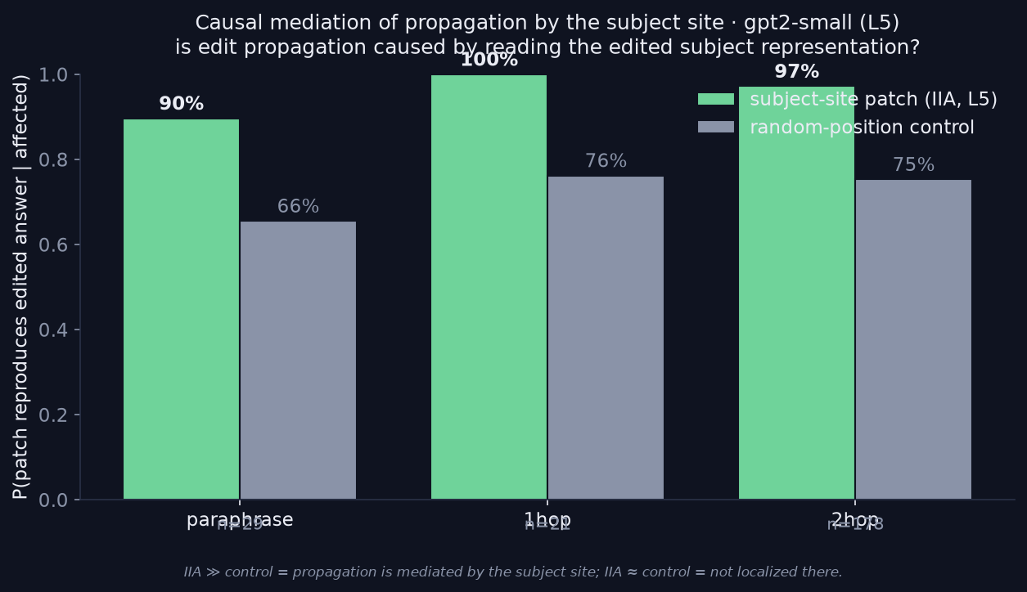
§4 · IS IT CAUSAL? (E-016)
⏱ 1m
Subject site carries weight — but propagation isn't cleanly localized
Interchange (n=228 affected): subject-site patch reproduces the edit 90–100%, ~20pts above a random-position control [E-016] — real causal weight (clear at 2-hop, n=178). BUT control is high (66–76%) → the edit's rep is broadly readable, not localized; and no near/far hop-differential. Suggestive, not clean — next: a tighter intervention (path-patching).
Consistency seam · a trajectory
07 / 24
Notes:
1m. HONEST result: partial causal signal (subject beats random ~20pts, clear at 2-hop) but high control = not clean localization, and no hop-crossover. Do NOT overclaim. This is exactly what to hand Arnab — a diagnosed inconclusive with a concrete fix (clean-vector control / path patching / attention knockout).

Slide 8
§5 · WHAT THE DATA SAYS
⏱ 1m
Entailment neighbours drift from representational neighbours with hop
● Logical neighbours are not uniformly representational neighbours — closeness (and, we test, causal readability) decays with hop.
● That one fact explains both failures: at distance the edit can't reach the neighbour (stale) or reaches the wrong slot (over-propagation).
● The two graphs — logical entailment vs. the model's causal-read graph — look like they align near the edit, diverge with hop [T-006] — behaviourally + predictively.
– Causal leg (E-016) is not clean yet: the subject site carries weight (beats random ~20pts) but the edit's rep is broadly readable (control ~75%), no hop-differential → a targeted intervention is the next step, not a claim yet.
Consistency seam · a trajectory
08 / 24
Notes:
1m. Honest, data-led. The behavioural (E-014) + predictive (E-015) arcs support the two-graphs picture; the first causal probe is suggestive but inconclusive. Present the causal leg as an open, well-diagnosed next step — that's rigor.

Slide 9
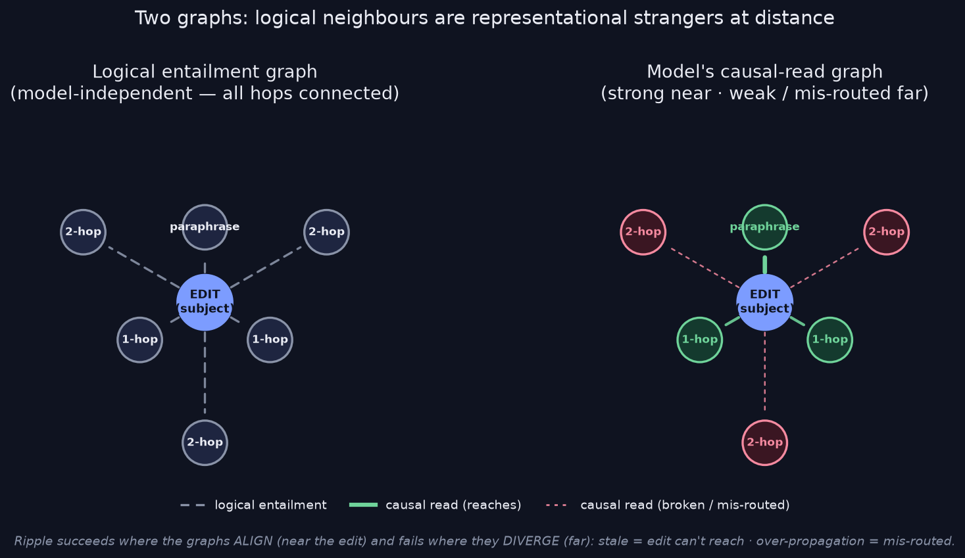
§5 · THE TWO GRAPHS (schematic)
⏱ 30s
Logical neighbours become representational strangers with hop
Left: logical entailment (all hops connected). Right: the model's read graph — strong near, weak/mis-routed far. Ripple fails where they diverge. (Behavioural + predictive picture; the causal leg is still open — E-016.)
Consistency seam · a trajectory
09 / 24
Notes:
30s. The thesis, visualized. HONEST label: this is the behavioural (E-014) + predictive (E-015) picture; the causal-read edges are the hypothesis E-016 probed but did NOT cleanly confirm. Draft schematic — refine styling rested.

Slide 10
CODA · where this goes — infrastructure for reliable editing
Notes:
Transition: the research says editing is unreliable in a characterizable way. As an infra engineer, here's the deployable consequence. Clearly forward-looking / less mature than the spine — say so.

Slide 11
CODA · THE REFRAME
⏱ 1m
I was grading editing on RAG's exam
● Two things collided: MEMIT holds ~90 editing-score at 10K edits (editing isn't broadly breaking models); the ripple failure is specifically multi-hop.
● Resolution `[T-017]`: editing = what the model believes (reasons from); RAG = what it reasons over at inference.
– Different functions, different metrics. Multi-hop is RAG's job.
● MEMIT succeeding at belief AND failing multi-hop are not a contradiction — two jobs.
Consistency seam · a trajectory
11 / 24
Notes:
1m — the pivot. Complementary, not competitors (Liu 2025, Zhang 2025). Deliver as 'where the evidence pushed me', ~70% conviction, not decided.

Slide 12
CODA · THE GAP IT OPENS
⏱ 1m
Hybrid systems use both stores — nobody checks they agree
● The research says editing is unreliable in a characterizable way. In deployment, you pair it with RAG: edit for belief, retrieve for reasoning. Do the two agree?
● They can silently contradict — model asserts its stale parametric belief while the RAG index holds the fix, or retrieves the fix and ignores it (edit skipping).
● No current metric catches this — editing benchmarks probe weights only; RAG benchmarks probe retrieval only. Nobody checks the seam.
Consistency seam · a trajectory
12 / 24
Notes:
1m. The deployment consequence of the research. Arnab's wheelhouse.

Slide 13
CODA · THE INFRASTRUCTURE
⏱ 1.5m
A consistency-certifier for reliable editing
● My angle: I build infrastructure. If editing is unreliable this way, the deployable fix is a reliability layer — so ordinary researchers can keep a model current without silently corrupting it.
● Probe both stores → detect contradictions → optionally reconcile → emit a scoped certificate.
● Honest `[T-018]`: DMM Gov specifies this loop; nobody builds/measures it — 'first to build + certify', never 'conceive'. Less mature than the spine above.
ROUTE
APPLY
PROBE
DETECT
novel
RECONCILE
v2
CERTIFY
novel
→
→
→
→
→
■ adopted (DMM Gov) ■ novel — build + measure RECONCILE = v2
Consistency seam · a trajectory
13 / 24
Notes:
1.5m. The pitch — motivated by the data, framed through the infra identity, honestly labeled forward-looking. Invite Arnab to attack it. First experiment = the significance gate (backup).

Slide 14
· WHAT I'M ASKING YOU
⏱ 45s
Four questions — research first, then the coda
● Is the interpretation sound? the two-graphs read — align near, diverge with hop — do you buy it?
● Is the causal design right? the E-016 interchange — anything you'd change before I scale it to GPT-J?
● The coda — is the reliability-layer direction worth pursuing, and unclaimed beyond DMM Gov? (adversarial review welcome)
● Compute — GPU for GPT-J to scale the causal test + a capable-model specificity check?
Consistency seam · a trajectory
14 / 24
Notes:
45s. Research first (is the science sound), then the coda pitch (is the infra worth it). End the spoken part here; hand off to the live demo.

Slide 15
→ LIVE · results/
Now — let me show you, empirically
● Everything under results/final/ — data, figures, tables + a README that regenerates it all (seed 1538).
● Distribution + predictor + causal: figures/{scale_distribution, predict_scale_auc, iia_by_hop}.png.
● Raw rows: data/{scale_study(397), iia_scale, rome_study, tb_rows}.json; numbers + CIs in tables/.
● Every run logged + reproducible (results/logs/).
– Because it's all reproducible, the effort scales: swap model/editor, add edits, or move to GPT-J for the causal + specificity tests. →
Consistency seam · a trajectory
15 / 24
Notes:
Transition to the live demo. Open results/, walk the blast-radius PNG, the 3-way json, the predictor arc. Emphasise reproducibility → scaling (GPU, bigger models, the certifier run). Backup slides below hold the exact tables if you'd rather show those.

Slide 16
Backup · detail on demand
Notes:
Everything past here is on-demand — pull a slide if asked, or show the live results/ artifacts instead.

Slide 17
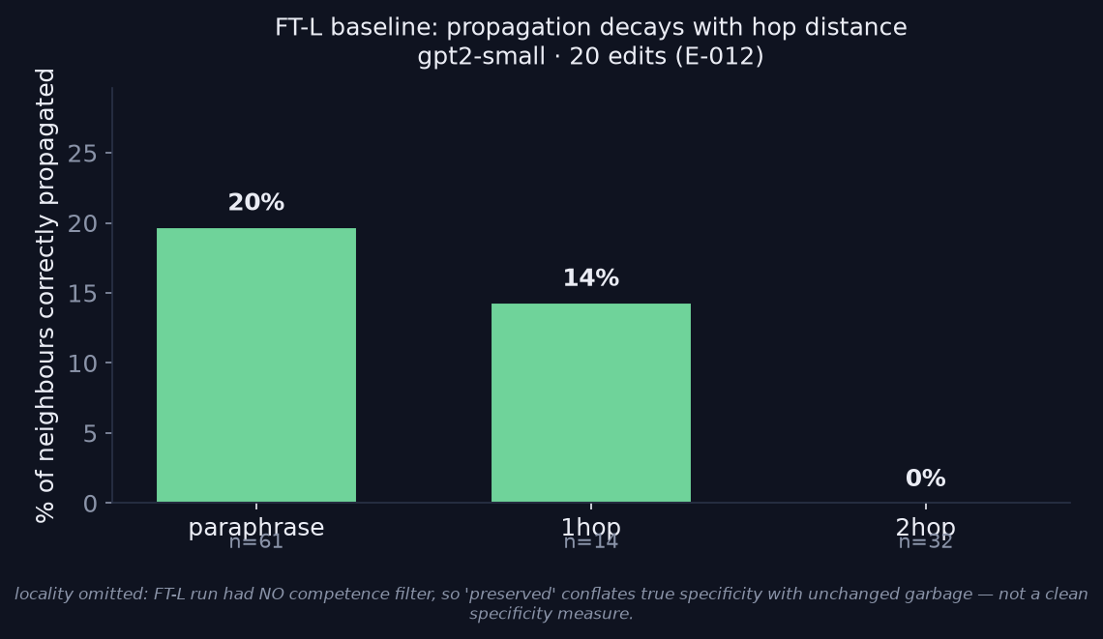
BACKUP · OUTCOME 1 (FT baseline)
FT-L baseline: propagation decays with hop `[E-012]`
FT-L · gpt2-small · 20 edits — 20% → 14% → 0% by hop. Locality omitted: no competence filter → not a clean specificity measure.
Consistency seam · a trajectory
17 / 24
Notes:
The FT wrecking-ball baseline, visualized (results/final/tables/propagation_table.txt). Corroborates the hop-decay shape. Do NOT claim locality — that run had no competence filter, so 'preserved' conflates specificity with unchanged garbage.

Slide 18
BACKUP · OUTCOME 2 (landmark — SUPERSEDED)
The 5 hand-picked landmarks — before the scale run corrected it
● The original n=5 (Eiffel/Louvre/…), SUPERSEDED by the n=397 random run (paraphrase 5/5 → 57%). Kept only to show the non-obvious patterns it first surfaced:
– non-monotone (1-hop breaks more than 2-hop); over-propagation (city → country slot); target-bleed into unrelated facts.
type | outcome (n=5 landmarks)
paraphrase | updated 5/5
1-hop | broken 4, stale 1
2-hop | updated 3, broken 2
locality | fine 4, broken 6 (~60% leak)
Consistency seam · a trajectory
18 / 24
Notes:
[T-015] — the LANDMARK set, superseded by E-014's random n=397. Do not cite 5/5 as a result; it's the cherry-pick baseline. Figure: rome_blast_radius.png.

Slide 19
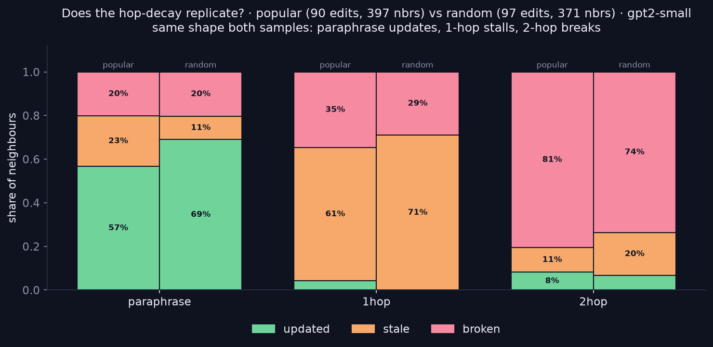
BACKUP · ROBUSTNESS (2nd sample)
The hop-decay replicates on a second RippleEdits split
popular (90 edits/397) vs random (97/371): same shape — paraphrase updates (57/69%), 1-hop stalls (61/71% stale), 2-hop breaks (81/74%) [T-022]. Two independent samples → not a cherry-picked distribution.
Consistency seam · a trajectory
19 / 24
Notes:
Robustness: the distribution holds across two independent RippleEdits samples. Strengthens the anti-cherry-pick point directly.

Slide 20
BACKUP · THE STRUCTURAL RUN
Structure did NOT beat distance (yet)
● sep = mean(cos, propagate-types) − cos(locality); sep > 0 ⇒ separates.
● Real-label test: raw cosine AUC 0.68 [E-013]; capacity helps — GPT-J last-token sep ≈ +0.06 [E-007].
setting | raw distance | structured
gpt2-small · mean-pool | +0.006 | −0.001
gpt2-medium · mean-pool | ~0 | ~0
gpt2-medium · last-token | +0.007 → +0.019 | ~0
Consistency seam · a trajectory
20 / 24
Notes:
[E-011/E-011b], 171 pairs. mean-pool washes out; last-token faint raw signal; structured sep~0 everywhere. Proxy (unedited-model type-separation), small n. Figures: results/predictor_arc.png, gpt2med_last_arc.png.

Slide 21
BACKUP · THE ENGINEERING
What those results cost
● NDIF regressed mid-work (whitelist bug) — isolated, reported, fixed. [E-006]
● NDIF can't do iterative weight edits → real editing must be local. [E-012]
● EasyEdit locally: device=cpu, num_workers=0; it silently rolls back the edit before you can query it — patched off → all 5 ROME edits flipped. [T-015]
● gpt2-medium NaNs at the logits on this Mac → gpt2-small (weak but real). [E-012]
Consistency seam · a trajectory
21 / 24
Notes:
Execution / sitting-with-it signal. Logs in results/.

Slide 22
BACKUP · THE FIRST EXPERIMENT
Significance gate — run this first
● Do realistic hybrid updates create silent contradictions that editing-only and RAG-only metrics MISS?
● One figure: silent-contradiction rate split — (i) editing-metrics miss, (ii) RAG-metrics miss, (iii) certifier catches.
● If real → (i)+(ii) tall, (iii) recovers them. If ~0 → publish the negative and stop.
● Setup: gpt2-xl/GPT-J + small FAISS store, ROME edits, constructed contradiction ground-truth (edit P→X, retrieval Y≠X; agree-pairs as negatives).
Consistency seam · a trajectory
22 / 24
Notes:
Design backward from one figure; pre-registered null branch.

Slide 23
SUMMARY
The data says entailment neighbours drift from representational neighbours as hops grow — editing reaches near facts, stalls or over-propagates on far ones. That's the science. And because it makes editing unreliable in a measurable way, it points to the infrastructure I want to build: a reliability layer that makes editing safe to ship.
Consistency seam · a trajectory
23 / 24
Notes:
One breath. Science first, then the infra it motivates. Then hard questions, floor.

Slide 24
THE HARDER QUESTIONS
What I'd want an adversarial reviewer to attack
● Why edit, not just RAG? Category error — systems use both; the question is 'do they agree?'.
● Zhang et al. (DMM Gov) specified this — what's new? They specify; I build + measure.
● Am I inventing a problem? That's the FIRST experiment, with a pre-registered null branch.
● Does reconcile converge, or is it whack-a-mole? Empirical (v2); if it fails → detect+certify+flag.
● Do you know what the model will answer? which_wins (edit-skipping); if not → narrow the claim.
● gpt2-small is a toy / can you measure specificity? Agreed — needs a capable model (GPU/GPT-J).
● Scale to 10K edits? No — v1 is small-batch high-assurance, not mass editing.
Consistency seam · a trajectory
24 / 24
Notes:
Closing slide — invite the attack (Arnab's adversarial-reviewer role). These are MY answers; I want them stress-tested. Silence is also feedback.

