Slide 1
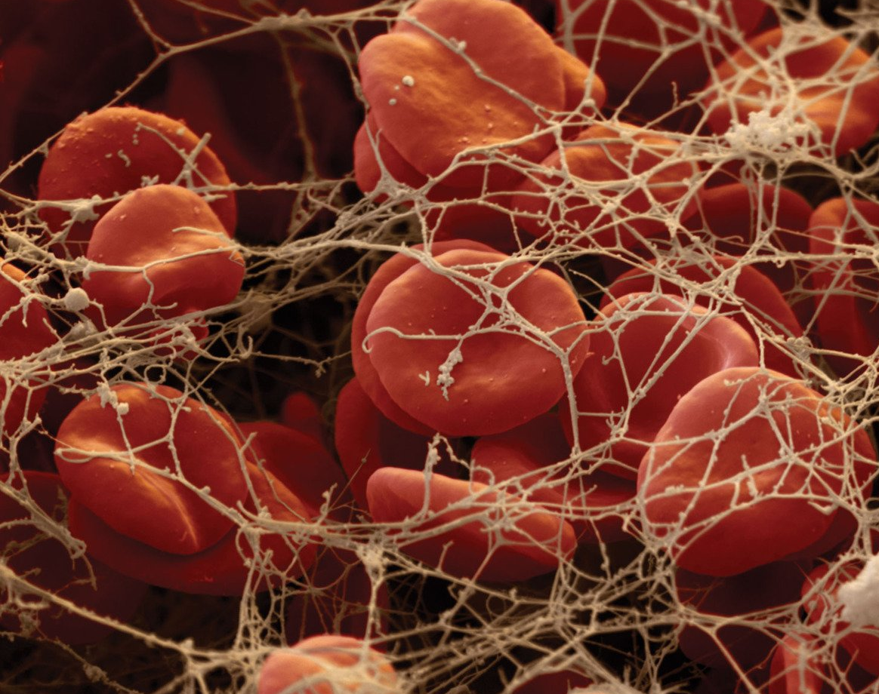
Extrinsic Pathway of Coagulation, Anticoagulants and Fibrinolytic system
Seminar Team B2

Slide 2
Subtopic 1: Extrinsic Pathway of Coagulation

Slide 3
Coagulation
GY
Coagulation is a complex mechanism aimed at preventing excessive blood loss following vascular injury.
It involves two pathways:
Extrinsic Pathway
Intrinsic pathway
which form a stable fibrin clot. The extrinsic pathway is primarily responsible for initiating cascade of reactions in responsible to external trauma

Slide 4
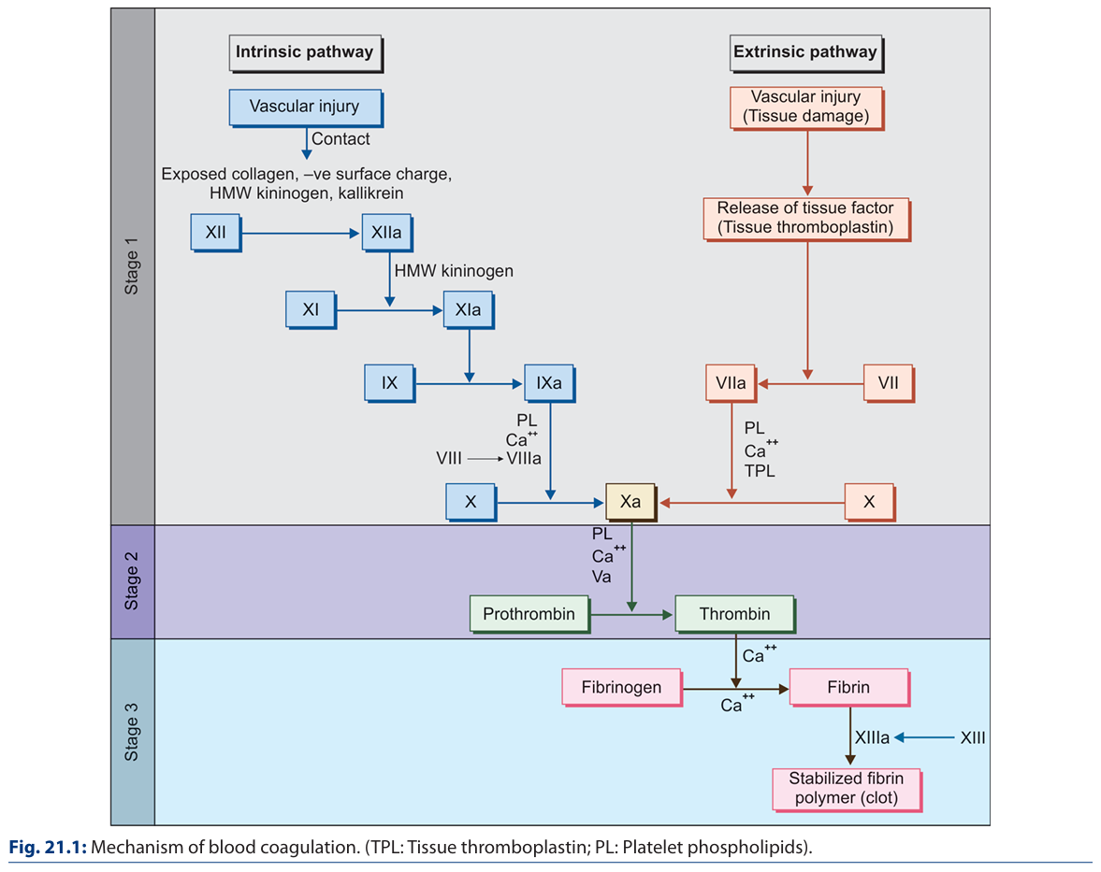
GK
(Factor III)
(Proconvertin)
(Prothrombin Activator)
(Stuart Prover Factor)
(Factor II)
(Factor I)

Slide 5
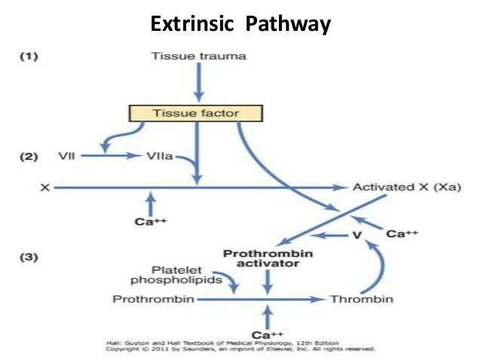
GY

Slide 6
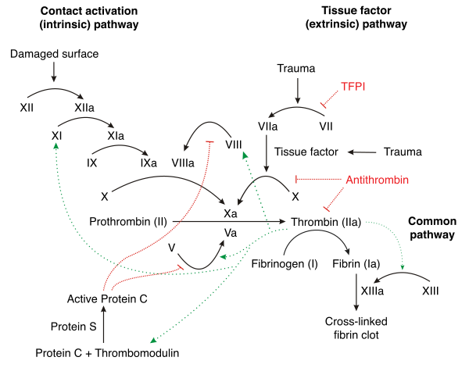
Common Pathway
GY

Slide 7
Formation of Fibrin from Fibrinogen
GK
Formation of Fibrin from Fibrinogen
This is the final stage of blood coagulation in which thrombin acts as an enzyme to convert fibrinogen to fibrin. In this process, first, the fibrin monomers are formed and afterward, they are polymerized to fibrin thread (blood clot).
This occurs in three steps:
Proteolysis of soluble fibrinogen
Polymerization of fibrin monomers
Stabilization of fibrin polymer

Slide 8
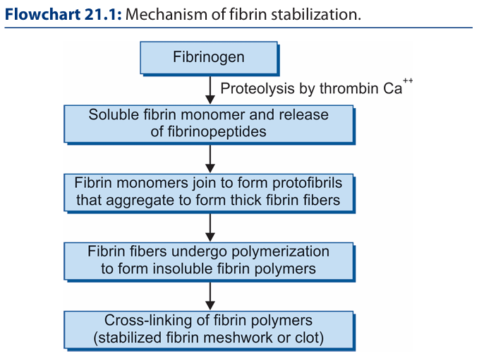
GK
XIIIa , Ca++

Slide 9
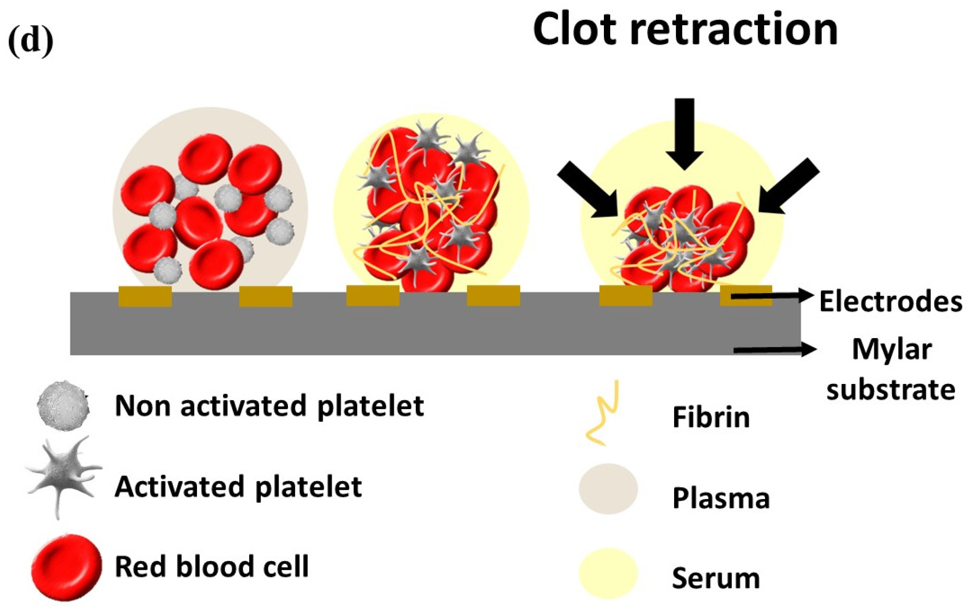
Clot Retraction
GK

Slide 10
Subtopic 2: Anticoagulants and Fibrinolytic System

Slide 11
Fibrinolytic System
GK
ANTICLOTTING MECHANISM (Fibrinolysis) Tendency of blood to clot in vivo is prevented by naturally occurring anticlotting mechanisms. Thus, there is a balance between clotting and anticlotting mechanisms.
Mechanism of Fibrinolysis The process of blood coagulation automatically initiates the anticlotting mechanisms so that intravascular clot does not spread beyond the site of injury. Fibrinolysis occurs in three steps: 1. Activation of protein C 2. Activation of plasmin 3. Fibrinolysis

Slide 12
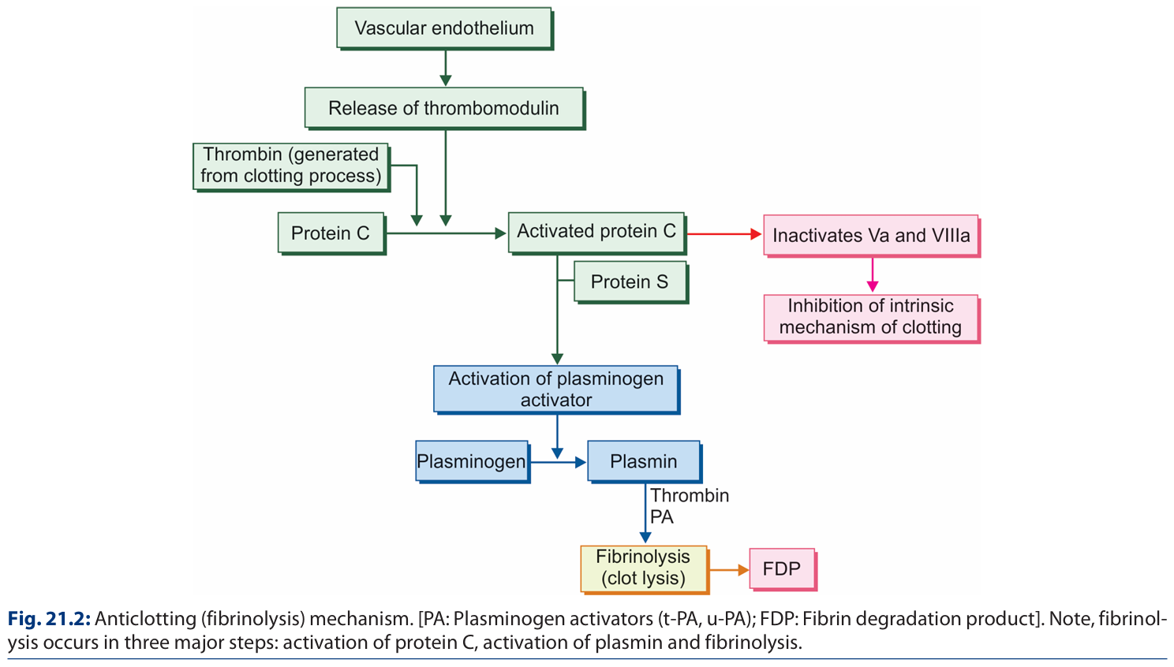
Fibrinolytic System
GK

Slide 13
Anticoagulants
GK
Anticoagulants prevent blood from clotting. They are mainly used:
For collection of blood sample for laboratory investigations
For preserving blood for transfusion
For anticoagulation therapy
Anticoagulants for Blood Collection
EDTA (Ethylenediamine Tetra-acetic Acid)
Sodium Citrate
Oxalates
Heparin
Anticoagulants for Anticoagulation Therapy
Vitamin K Antagonists
Warfarin
Dicoumarol
Glycosaminoglycans
Inhibitors of Thrombin
Intravenous or Subcutaneous Anticoagulants
Heparin
Hirudin

Slide 14
Anticoagulants
GK
A] Anticoagulants for Blood Collection
1. EDTA (Ethylenediamine Tetra-acetic Acid) Na & K salts of EDTA are used Most powerful anticoagulant Acts by chelating effect on blood Calcium Inactivates calcium by forming insoluble complex with it
2. Sodium Citrate (Trisodium Citrate) Inactivates Calcium ions
3. Oxalates The oxalates (Na, K, Li, NH4) form an insoluble complex with the calcium in the blood, and thereby prevent coagulation.
4. Heparin Heparin is a natural constituent of blood. Prevents coagulation for 24 hours by neutralizing thrombin. Facilitates action of anti-thrombin III. Prevents formation of fibrin from fibrinogen.

Slide 15
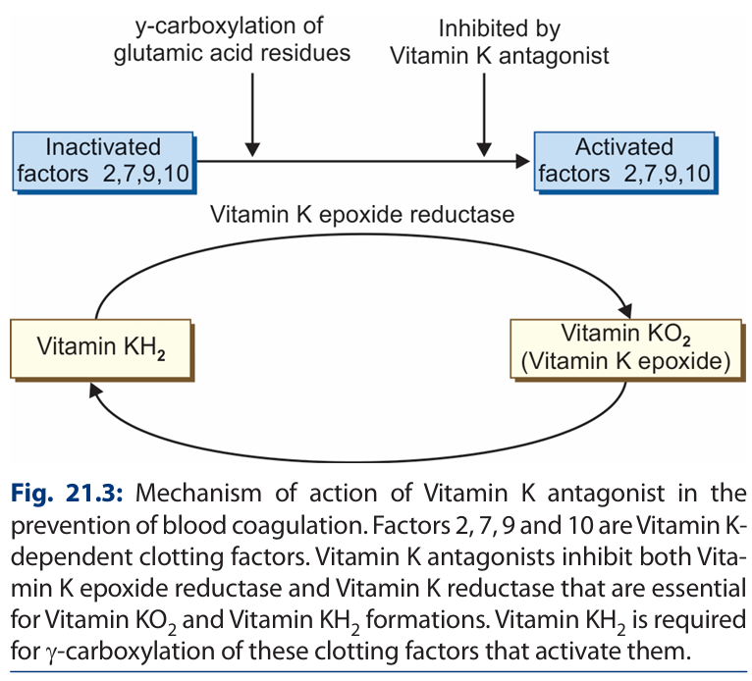
Anticoagulants
GK
B] Oral Anticoagulants
1. Vitamin K Antagonists Vitamin K dependent factors: 2, 7, 9 & 10 Undergo post translational ɣ-carboxylation that help them bind to calcium (appx. 10 glutamic acid residues added) These antagonists cause reduction in ɣ-carboxylation to 1-6 glutamic acid residues – cause their activity to be impaired
a. Warfarin: Common Vit-K Antagonist. Inhibits Vit-K2 formation by inhibiting Vit-K reductase enzyme (required for ɣ-carboxylation)
b. Dicoumarol: Similarly inhibits Vit-K epioxide reductase enzyme (required for ɣ-carboxylation)

Slide 16
Anticoagulants
GK
C] Intravenous/Subcutaneous Anticoagulants
1. Heparin (Discussed above)
2. Hirudin It is a naturally occurring most specific inhibitor of thrombin. Direct inactivation of thrombin by binding to active site.

Slide 17
Anticoagulants
GY
Anticoagulants in our body
Endothelial cells --> smooth endothelial cells --> Glycoclayx --> thrombodulin (removes thrombin) (thrombin + thrombodulin ----> protein C). It inactivates Factor V and VII
Fibrin Fibres & Antithrombin III --> fibrinogen ---> Fibrin fibers --> 85- 90% of thrombin trapped by fibrin --> Antithrombin III neutralizes thrombin in 12- 20 mins.
Heparin --> As alone, it's a natural weak. anticoagulant --> mast cells and basophils --> binds to antitheombin III, increase efficiency by 100- 1000 times --> inactivates factor XII , XI, X, IX --> Capillaries of lungs and liver.

Slide 18
Anticoagulants
GY
Anticoagulants for clinical use
Most useful - Heparin, Vitamin K antagonist Coumarin.
Also, thrombin and Factor Xa inhibitors
Commercial Heparin(LMW) --> from animals. --> 0.5- 1mg/kg of TBW injected, increases clotting tim from 6 to 30 mins. --> action lasts for about 1.5 - 4 hours. --> heparinase
Coumarins --> Ex.- Warfarin --> fall of prothrombin, Factors VII, IX & X. VKORC1 --> Inactive Vit K -------------> Active Vit K --> In 12 hrs, to 50% coagulant activity decreases, 24 hrs to 20%. --> coagulation returns 1-3 days later
Thrombin inhibitors Hirudin
Anticoagulation outside body --> siliconized containers- delay coagulation by 1 hr. --> Heparin- surgical procedures --> EDTA- chelating agent that bind to metal ions like Ca^2+ --> soluble oxalate compounds --> Citrate anticoagulants- sodium, ammonium, potassium citrate (excess- tetany and convulsive death)

Slide 19
Anticoagulants
GY
Anticoagulants are agents that inhibit the coagulation cascade to prevent excessive clot formation. These agents target various steps of the coagulation process, including the extrinsic pathway. Anticoagulants are categorized based on their mechanism of action:
Direct Oral Anticoagulants (DOACs)
Vitamin K Antagonists (VKAs)
Heparins
Tissue Factor Pathway Inhibitors (TFPIs)
Thrombin Inhibitors
Novel Agents

Slide 20
Direct Oral Anticoagulants (DOACs)
GY
MODE OF ACTION : Direct inhibition of Factor Xa or thrombin
Examples:
Rivaroxaban and Apixaban (Factor Xa inhibitors).
Dabigatran (direct thrombin inhibitor).
Relevance to the Extrinsic Pathway: Inhibit Factor Xa, a critical enzyme downstream in the coagulation cascade

Slide 21
Vitamin K Antagonists (VKAs)
GY
MODE OF ACTION: Inhibition of vitamin K-dependent clotting factors (Factors II, VII, IX, X).
Example: Warfarin, Pindone
Relevance to the Extrinsic Pathway: Reduces the synthesis of Factor VII, directly impacting the TF-VII complex.

Slide 22
Heparins
GY
MODE OF ACTION: Indirect inhibition of thrombin and Factor Xa via activation of antithrombin.
Examples:
Unfractionated Heparin (UFH).
Low Molecular Weight Heparin (LMWH) like Enoxaparin.
Relevance to the Extrinsic Pathway: Prevents activation of thrombin and its downstream effects.

Slide 23
Tissue Factor Pathway Inhibitor (TFPI)
GY
Tissue factor pathway inhibitor (or TFPI) is a single-chain polypeptide which can reversibly inhibit factor Xa (Xa)
MODE OF ACTION : Direct inhibition of the TF-VIIa complex and Factor Xa.
Relevance: Specifically inhibits the initiation phase of the extrinsic pathway.

Slide 24
Thrombin Inhibitors
GY
MODE OF ACTION: Direct inhibition of thrombin.
Examples: Dabigatran, Argatroban.
Relevance: Suppresses fibrin formation, limiting clot stability.

Slide 25
Novel Agents
GY
MODE OF ACTION: Inhibition of specific molecules such as TF or other cofactors.
Examples: Investigational agents like antibodies targeting TF.

Slide 26
Antiplatelet Agents
GY
Antiplatelet agents
1. Aspirin- Inhibit platelet cyclooxygenase
2. Dipyridamole- Inhibits platelet phosphodiesterase
3. Ticlopidine- Inhibits platelet aggregation, Prevent GP IIb- IIIa expression...

Slide 27
Clinical Significance
GY
Prophylaxis and Treatment of Thromboembolic Events: Deep vein thrombosis, pulmonary embolism, and atrial fibrillation.
Cardiovascular Procedures: Prevention of clot formation during surgeries and stent placements using statins.
Management of Hypercoagulable States: Disseminated intravascular coagulation (DIC) and antiphospholipid syndrome.

Slide 28
Challenges and Risks
GY
Bleeding Complications: The most significant risk associated with anticoagulant therapy.
Reversal Agents: Specific antidotes are available, such as:
Vitamin K for warfarin.
Idarucizumab for dabigatran.
Andexanet alfa for Factor Xa inhibitors.

Slide 29
Bleeding Disorders
GY
Von Willebrand’s disease: Bleeding disorder caused by the qualitative or quantitative deficiency of the pro von-Willebrand factor

Slide 30
Thank you! Slides by: Sriram, Navneeth, Neha V Bibliography: GK Pal and Guyton & Hall

