Slide 1
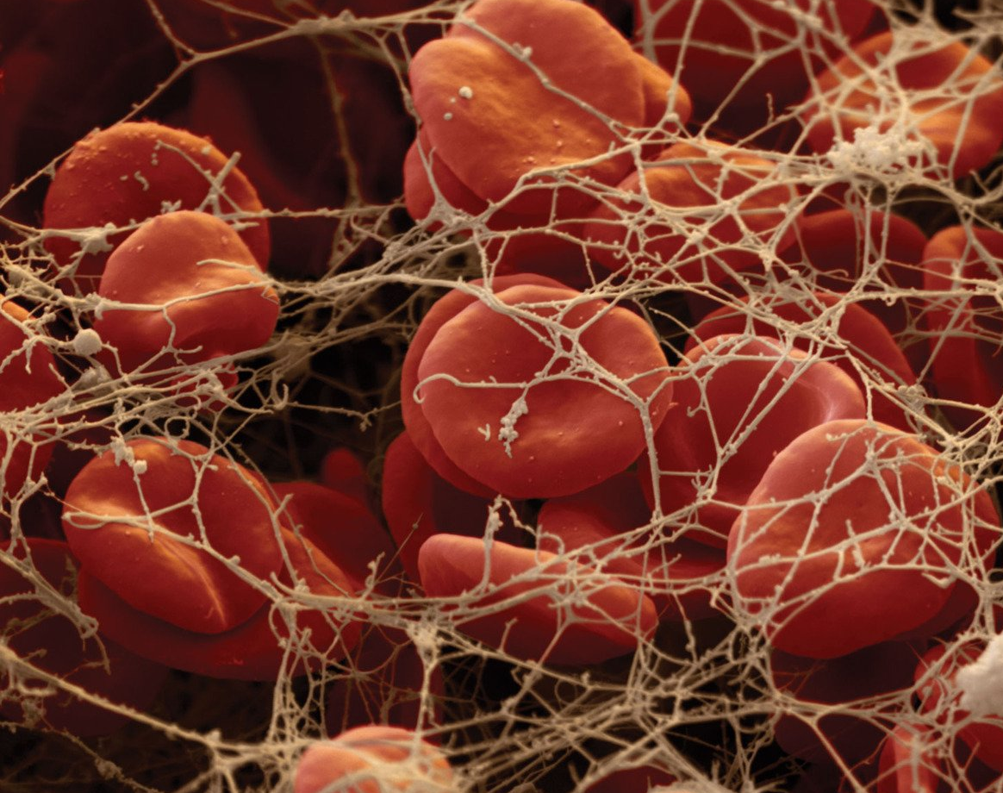
Extrinsic Pathway of Coagulation, Anticoagulants and Fibrinolytic system
Seminar Team B2

Slide 2
Subtopic 1: Extrinsic Pathway of Coagulation

Slide 3
Coagulation
Coagulation is a complex mechanism aimed at preventing excessive blood loss following vascular injury.
It involves two pathways:
Extrinsic Pathway
Intrinsic pathway
which form a stable fibrin clot. The extrinsic pathway is primarily responsible for initiating cascade of reactions in responsible to external trauma

Slide 4
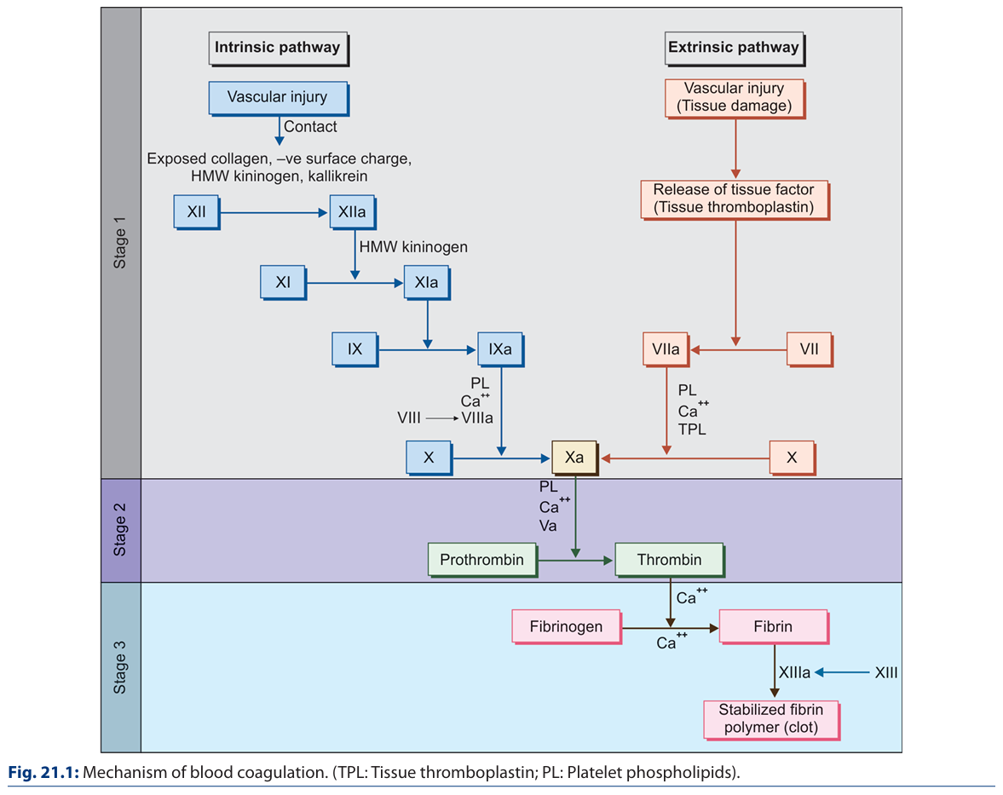
(Factor III)
(Proconvertin)
(Prothrombin Activator)
(Stuart Prover Factor)
(Factor II)
(Factor I)

Slide 5
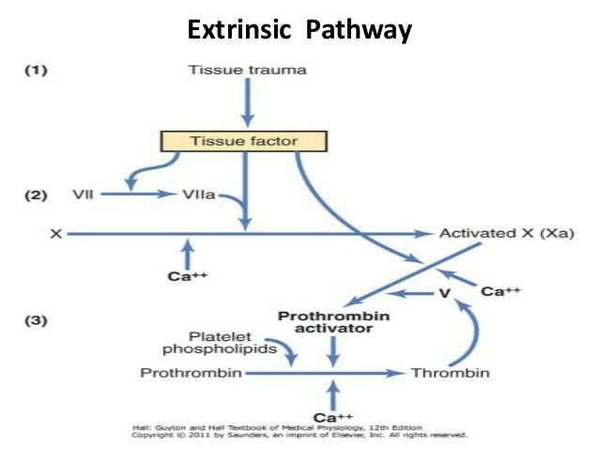

Slide 6
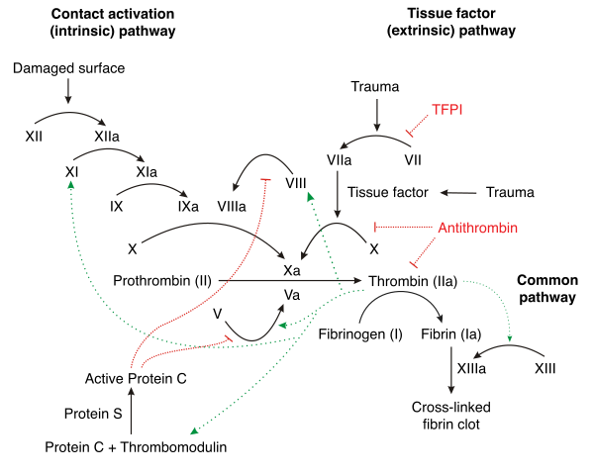
Common Pathway

Slide 7
Formation of Fibrin from Fibrinogen
Formation of Fibrin from Fibrinogen
This is the final stage of blood coagulation in which thrombin acts as an enzyme to convert fibrinogen to fibrin. In this process, first, the fibrin monomers are formed and afterward, they are polymerized to fibrin thread (blood clot).
This occurs in three steps:
Proteolysis of soluble fibrinogen
Polymerization of fibrin monomers
Stabilization of fibrin polymer

Slide 8
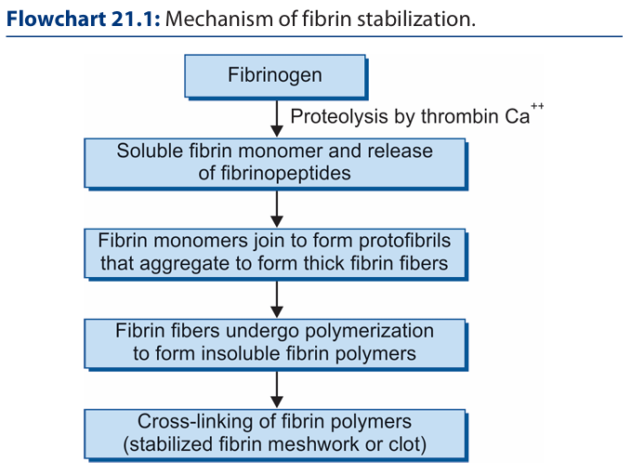
XIIIa , Ca++

Slide 9
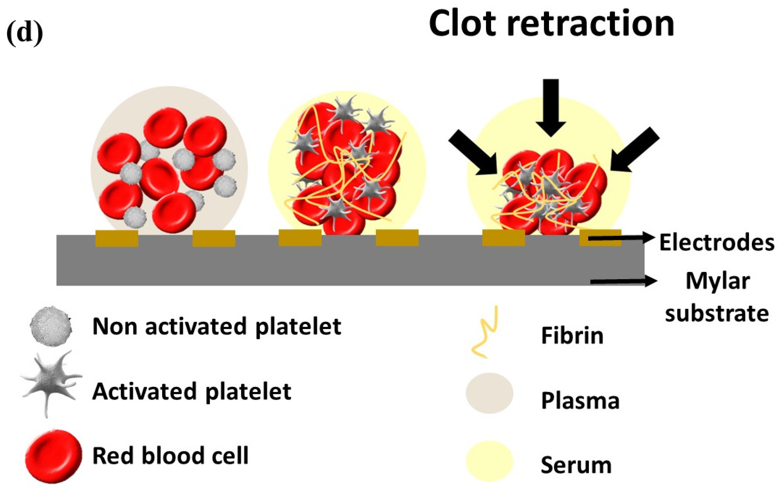
Clot Retraction

Slide 10
Subtopic 2: Anticoagulants and Fibrinolytic System

Slide 11
Fibrinolytic System
ANTICLOTTING MECHANISM (Fibrinolysis) Tendency of blood to clot in vivo is prevented by naturally occurring anticlotting mechanisms. Thus, there is a balance between clotting and anticlotting mechanisms.
Mechanism of Fibrinolysis The process of blood coagulation automatically initiates the anticlotting mechanisms so that intravascular clot does not spread beyond the site of injury. Fibrinolysis occurs in three steps: 1. Activation of protein C 2. Activation of plasmin 3. Fibrinolysis

Slide 12
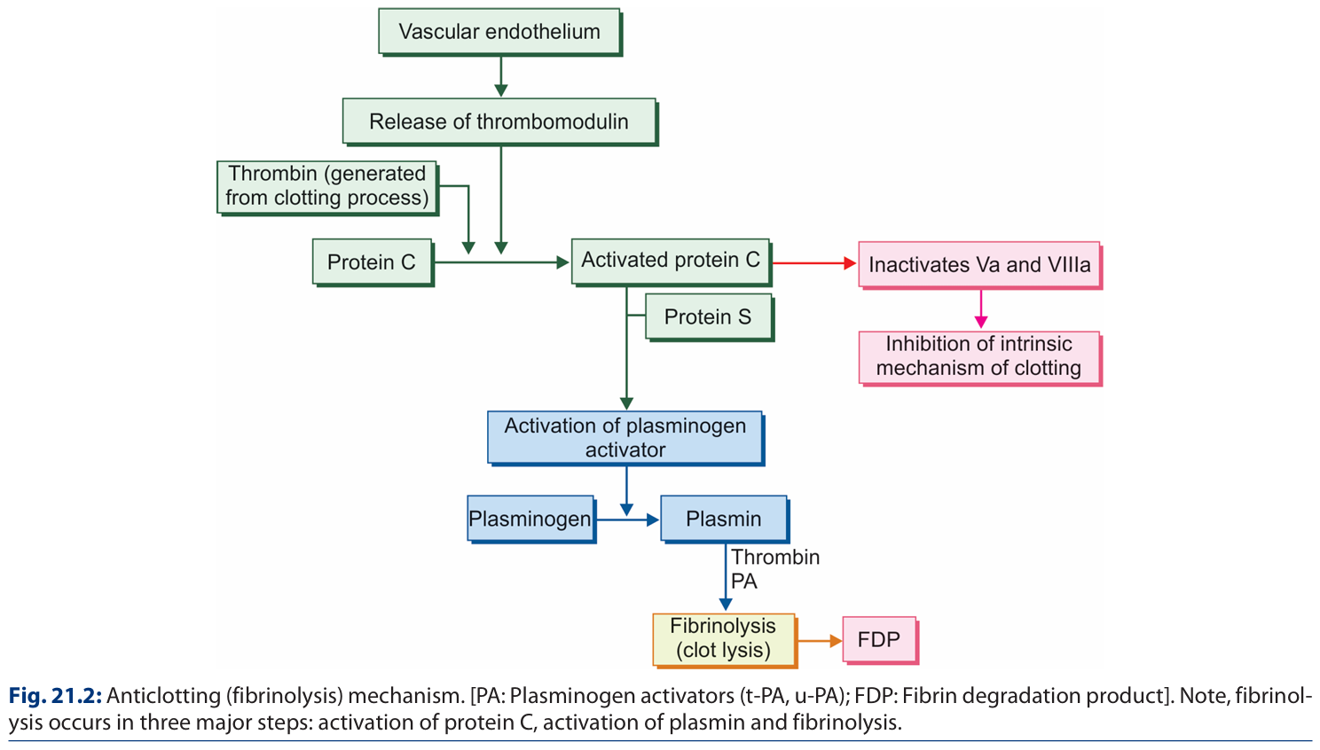
Fibrinolytic System

Slide 13
Anticoagulants
Anticoagulants prevent blood from clotting. They are mainly used:
For collection of blood sample for laboratory investiga tions
For preserving blood for transfusion
For anticoagulation therapy
Anticoagulants for Blood Collection
EDTA (Ethylenediamine Tetra-acetic Acid)
Sodium Citrate
Double Oxalate
Sodium Fluoride
Oxalates
Heparin
Anticoagulants for Anticoagulation Therapy
Vitamin K Antagonists
Warfarin
Glycosaminoglycans
Inhibitors of Thrombin
Intravenous or Subcutaneous Anticoagulants
Heparin
Hirudin

Slide 14
Anticoagulants
EDTA (Ethylenediamine Tetra-acetic Acid) It acts by its chelating effect on the blood calcium. It inactivates calcium by forming insoluble complex with it. As calcium is an important cofactor for blood coagulation, chelation of calcium prevents blood to clot.
Sodium Citrate Prevents coagulation by inactivating calcium ions.
Oxalate The oxalates form an insoluble complex with the calcium in the blood, and thereby prevent coagulation.
Heparin Heparin is a natural constituent of blood. It prevents coagulation for approximately 24 hours by neutralizing thrombin. It facilitates action of anti thrombin III. Thus, it prevents formation of fibrin from fibrinogen.
Vitamin K Antagonists The commonly used vitamin K antagonist is warfarin. This is a coumarin derivative.
Hirudin It is a naturally occurring most specific inhibitor of thrombin.

Slide 15
Anticoagulants
Anticoagulants are agents that inhibit the coagulation cascade to prevent excessive clot formation. These agents target various steps of the coagulation process, including the extrinsic pathway. Anticoagulants are categorized based on their mechanism of action:
Direct Oral Anticoagulants (DOACs)
Vitamin K Antagonists (VKAs)
Heparins
Tissue Factor Pathway Inhibitors (TFPIs)
Thrombin Inhibitors
Novel Agents

Slide 16
Direct Oral Anticoagulants (DOACs)
MODE OF ACTION : Direct inhibition of Factor Xa or thrombin
Examples:
Rivaroxaban and Apixaban (Factor Xa inhibitors).
Dabigatran (direct thrombin inhibitor).
Relevance to the Extrinsic Pathway: Inhibit Factor Xa, a critical enzyme downstream in the coagulation cascade

Slide 17
Vitamin K Antagonists (VKAs)
MODE OF ACTION: Inhibition of vitamin K-dependent clotting factors (Factors II, VII, IX, X).
Example: Warfarin, Pindone
Relevance to the Extrinsic Pathway: Reduces the synthesis of Factor VII, directly impacting the TF-VII complex.

Slide 18
Heparins
MODE OF ACTION: Indirect inhibition of thrombin and Factor Xa via activation of antithrombin.
Examples:
Unfractionated Heparin (UFH).
Low Molecular Weight Heparin (LMWH) like Enoxaparin.
Relevance to the Extrinsic Pathway: Prevents activation of thrombin and its downstream effects.

Slide 19
Tissue Factor Pathway Inhibitor (TFPI)
Tissue factor pathway inhibitor (or TFPI) is a single-chain polypeptide which can reversibly inhibit factor Xa (Xa)
MODE OF ACTION : Direct inhibition of the TF-VIIa complex and Factor Xa.
Relevance: Specifically inhibits the initiation phase of the extrinsic pathway.

Slide 20
Thrombin Inhibitors
MODE OF ACTION: Direct inhibition of thrombin.
Examples: Dabigatran, Argatroban.
Relevance: Suppresses fibrin formation, limiting clot stability.

Slide 21
Novel Agents
MODE OF ACTION: Inhibition of specific molecules such as TF or other cofactors.
Examples: Investigational agents like antibodies targeting TF.

Slide 22
Clinical Significance
Prophylaxis and Treatment of Thromboembolic Events: Deep vein thrombosis, pulmonary embolism, and atrial fibrillation.
Cardiovascular Procedures: Prevention of clot formation during surgeries and stent placements using statins.
Management of Hypercoagulable States: Disseminated intravascular coagulation (DIC) and antiphospholipid syndrome.

Slide 23
Challenges and Risks
Bleeding Complications: The most significant risk associated with anticoagulant therapy.
Reversal Agents: Specific antidotes are available, such as:
Vitamin K for warfarin.
Idarucizumab for dabigatran.
Andexanet alfa for Factor Xa inhibitors.

Slide 24
Bleeding Disorders
Von Willebrand’s disease: Bleeding disorder caused by the qualitative or quantitative deficiency of the pro von-Willebrand factor

Slide 25
Thank you! Slides by: Sriram & Navneeth

