Slide 1
IT 493 Detailed Plan
Team 2: Justin Chen, Karanvir Grewal, Romana Islam, Tae-Min Kim, Jehan Negash, JD Singh

Slide 2
Acceptance Requirements
Our Clients acceptance requirements are a refreshed website which is more appealing and easier to navigate for users. As well as making a new scheduler for scheduling moves on the website but also having moves that are booked through phone calls be shown on the scheduler. Another key requirement the client has brought to our attention is running google ads.
The client wants to look something along the lines of an example website the client had provided. We need to make it look as neat as the example and also making the scheduling process as easy as possible. Run google ads so there are more clients coming our way.

Slide 3
Quantitative Current AS IS Status
AS IS: The AS IS status of the company is not bad, but could be a lot better which would increase the profit margins. Right now there about 60-70 abandons per month of people trying to book through the website due to people just wanting it to be easier. The percentage of sales the website has monthly is about 40%. During Peak seasons there are about 10-12 looks on the website of potential clients. The company right now does not run any ads.
TO BE: By having a refresh of the current website the number of abandons will go down significantly. The percentage of sales will go up because people will find it easier to schedule a move through the site. The company is also looking to start advertising, which would increase customer flow astronomically.

Slide 4
Project Management Plan
We mainly use Discord and text messaging to discuss our action plans.
We mainly use email and phone calls as well as in person meetings to communicate with our client.
If changes want to be made to the initial plan, the team that is editing their plan must first propose their changes to the group, then the sponsor for verification.

Slide 5
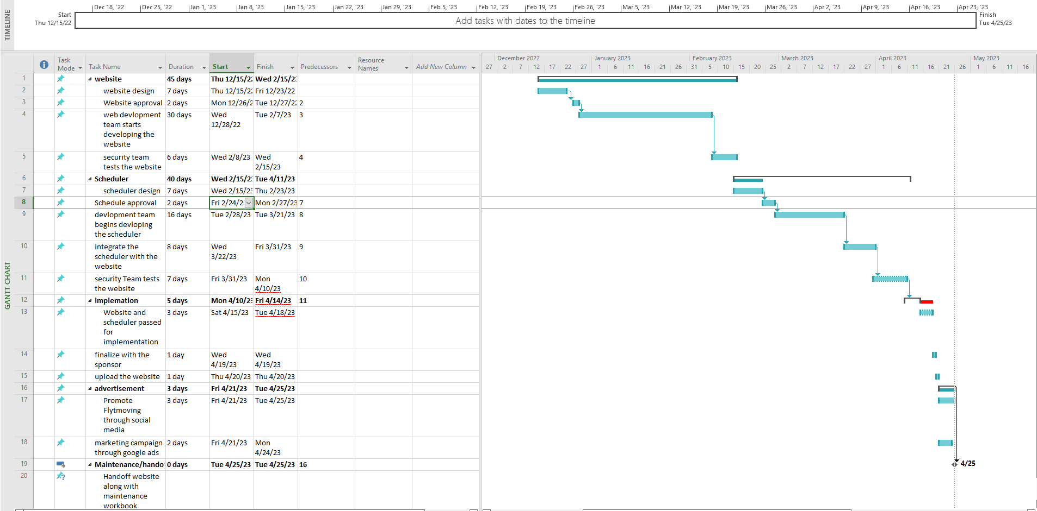
Work Breakdown Structure

