Slide 1
ONLINE JOB PORTAL - EASYJOBS
Submitted by,
RUBY C POOVELIL
MCA
Reg.No :SJC17MCA027

Slide 2
Description
Project is about the recruitment process which is done online
Companies can register by making payment, post jobs, view jobs, View applications,
Reject Applications, Send notifications to candidates, Manage profile, Search candidates etc
Candidates can register, view jobs, apply for jobs by making payment, view notifications,
remove notification, Search companies, Manage profile etc.
Admin manages the whole website
Thus this project will help the job seekers to get better jobs and the job providers to get
better employees
Technology – Python Django
Database - PostgreSQL

Slide 3
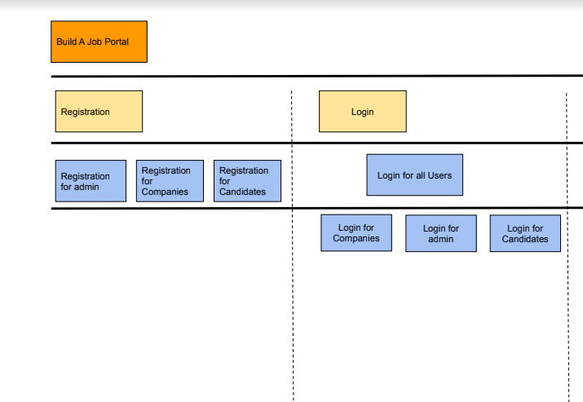
Userstory

Slide 4
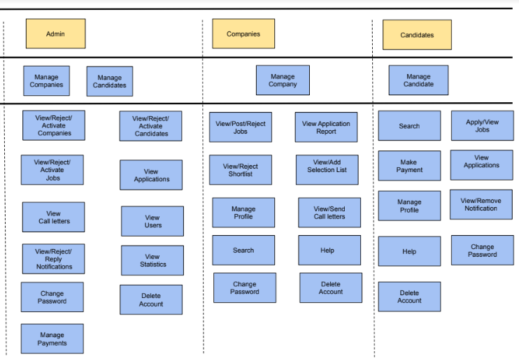

Slide 5
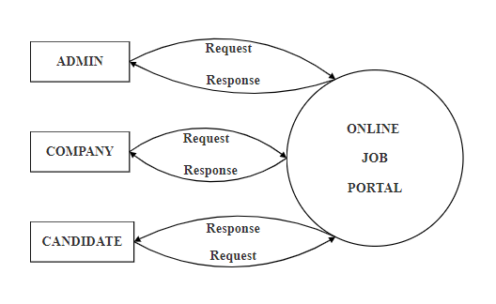
Data Flow Diagram (DFD)
Context Level DFD

Slide 6
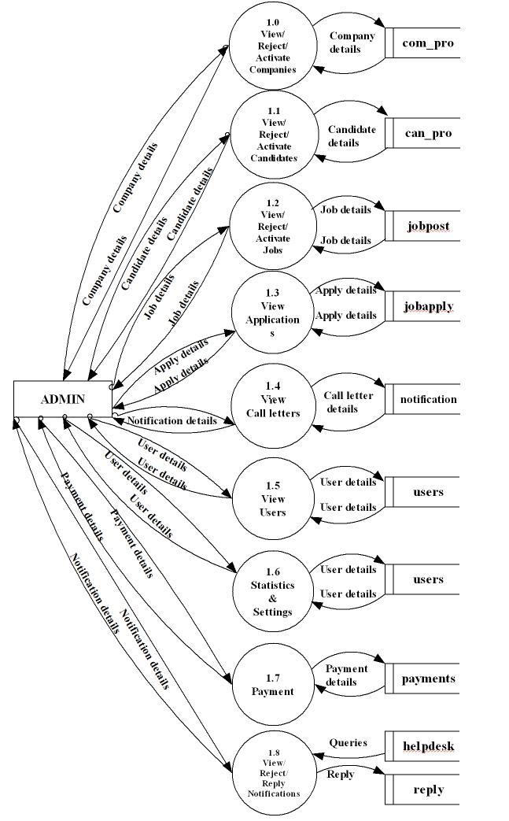
Level 1 Admin

Slide 7
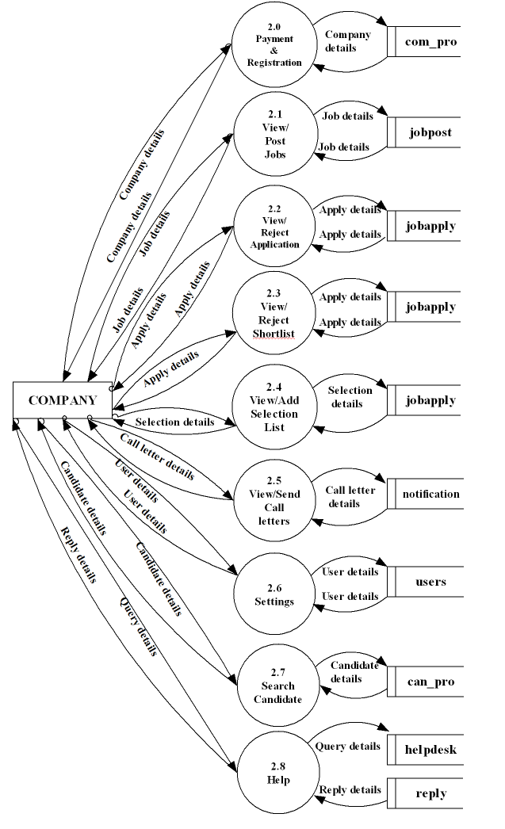
Level 1 Company

Slide 8
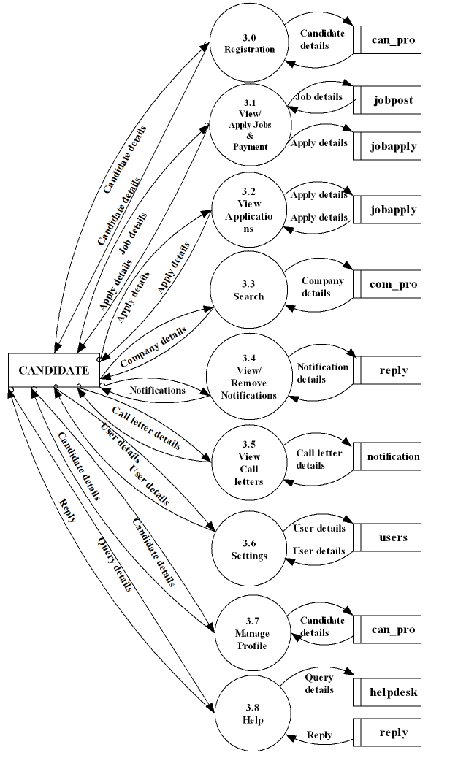
Level 1 Candidate

Slide 9
Database Design
1- User
Field | Data type | Description
id | Integer | id
username | String | username of users
First_name | String | first name of users
Last_name | String | last name of users
Password | String | password of users
Email | String | email id of users
Last_login | Timestamp | Last login details
Is_superuser | Boolean | Superuser status
Is_staff | Boolean | Staff status
Is_active | Boolean | Active status
Date_joined | Timestamp | Joined date
Primary Key : id
Unique Key : username

Slide 10
2-Com_pro
Field | Data type | Description
Id | Integer | id
com_username | String | username of company
com_name | String | name of company
com_desc | String | description about company
com_place | String | place of company
com_pincode | Integer | pin code of company
com_dt | String | district of company
com_state | String | state of company
com_country | String | country of company
com_mob | String | contact number
com_email | String | email address
status | integer | status
logo | file | Company Logo
Primary Key : id
Foreign Key : com_username(USER)

Slide 11
3- Notification
Field | Data type | Description
id | Integer | id
job_id | String | id of job
com_username | String | username of company
can_uname | String | name of candidate
in_desc | String | notification
call | String | call status
call_date | Date | date
status | Integer | notification status
Primary Key : id
Foreign Key : com_username(USER) , can_uname(USER), job_id (JOBPOST)

Slide 12
4-Jobpost
Field | Data type | Description
id | Integer | id
com_username | String | username of company
job_name | String | job title
job_desc | String | job description
job_qua | String | qualification
job_place | String | job location
job_pin | Integer | pincode
job_dt | String | district
job_st | String | state
job_email | String | email address
job_phn | Integer | contact number
job_con | String | country
shrtp_ten | Float | tenth percentage
shrtp_tlw | Float | plus two percentage
shrtp_ug | Float | UG percentage
shrtp_pg | Float | PG percentage
shrt_skill | String | skills
post_date | Date | date
last_date | Date | date
Status | Integer | Status of job
Primary Key : id
Foreign Key : com_username(USER)

Slide 13
5-Jobapply
Field | Data type | Description
id | Integer | id
job_id | Integer | job id
com_uname | String | company’s username
can_uname | String | candidate’s username
apply_date | Date | applied date
short | String | shortlist status
short_date | Date | shortlisted date
status | Integer | application status
Selected | String | Selection status
Primary Key : id
Foreign Key : com_uname(USER), can_uname(USER), job_id(JOBPOST)

Slide 14
6-can_pro
Field | Data type | Description
id | Integer | id
can_uname | String | username of candidate
can_name | String | name of candidate
can_house | String | house name
can_place | String | place
can_pincode | Integer | pincode
can_gender | String | gender
can_email | String | email address
can_mob | Integer | contact number
can_dt | String | district
can_state | String | state
school | String | name of school
sc_board | String | board of school
sc_percent | Float | percentage score
sc_yop | Integer | year of passing

Slide 15
hss | String | name of hss
hss_board | String | board of hss
hss_stream | String | stream of study
hss_percent | Float | percentage score
hss_yop | Integer | year of passing
ug | String | ug college name
ug_uni | String | university
ug_course | String | course name
ug_percent | Float | percentage score
ug_yop | Integer | year of passing
pg | String | pg college
pg_uni | String | university
pg_course | String | course name
pg_yop | Integer | year of passing
pg_percent | Float | percentage score
skills | String | skills
status | Integer | status
Primary Key : id
Foreign Key : can_uname(USER)

Slide 16
7-Helpdesk
Field | Data type | Description
id | Integer | id
username | String | username of users
message | String | Message
Help_date | Date | Date
status | Integer | status
Primary Key : id
Foreign Key : username (USER)
8-Reply
Field | Data type | Description
id | Integer | id
Help_id | Integer | id
message | String | Message
reply_date | Date | Date
status | Integer | status
Primary Key : id
Foreign Key : help_id (HELPDESK)

Slide 17
9-Payments
Field | Data type | Description
id | Integer | id
Apply_amount | Float | Application amount
Reg_amount | Float | Registration amount
Primary Key : id

Slide 18
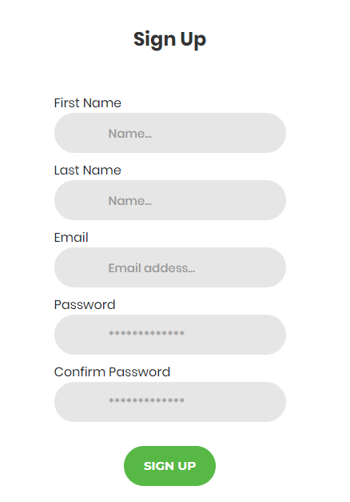
PROJECT SCREENSHOTS
Candidate-Signup

Slide 19
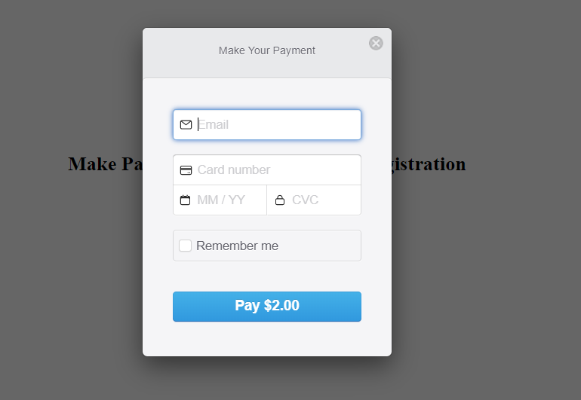
Company-Payment during registration

Slide 20
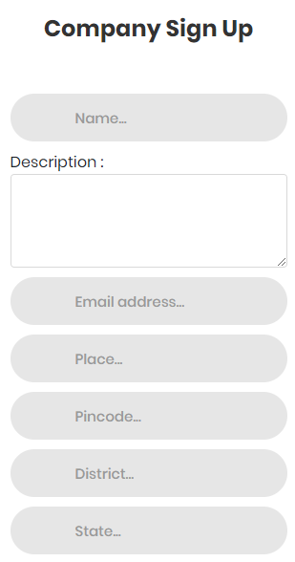
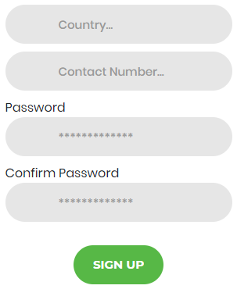
Company-Signup

Slide 21
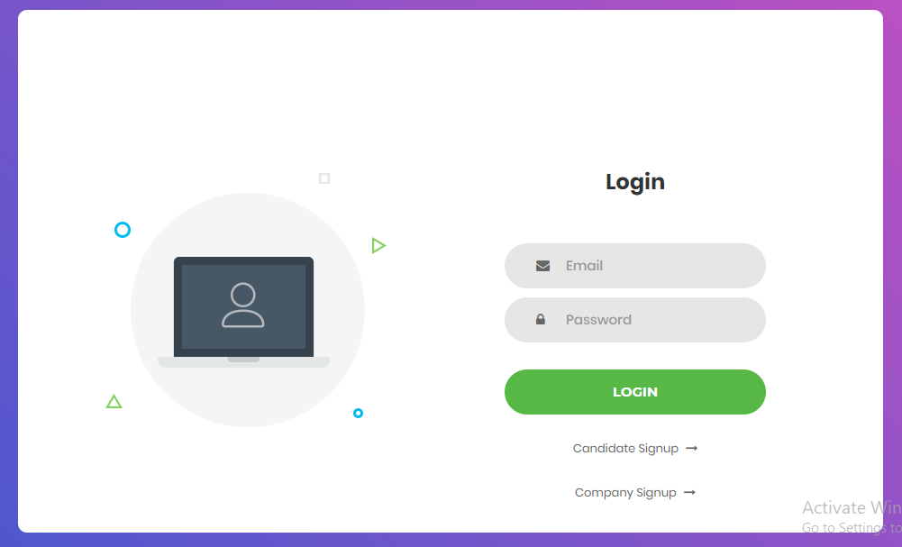
Login

Slide 22
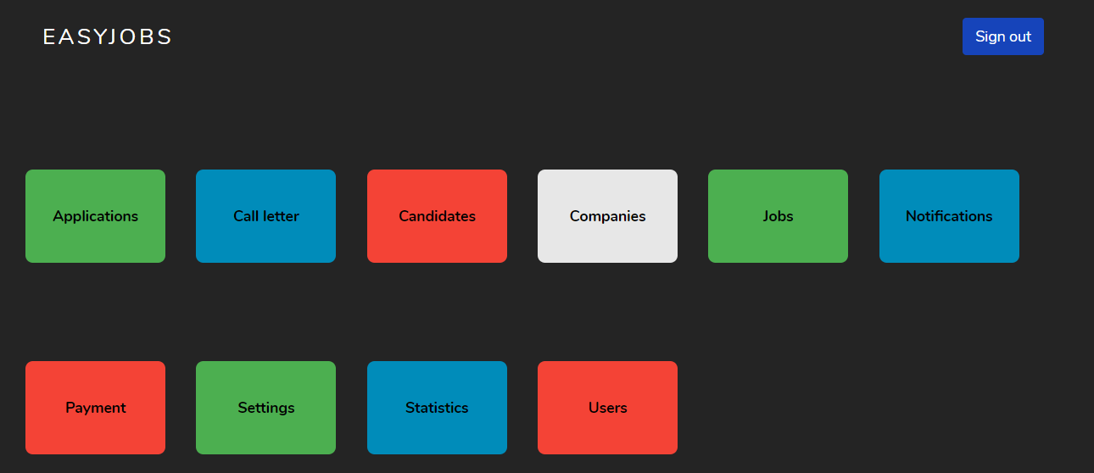
Admin -Home

Slide 23
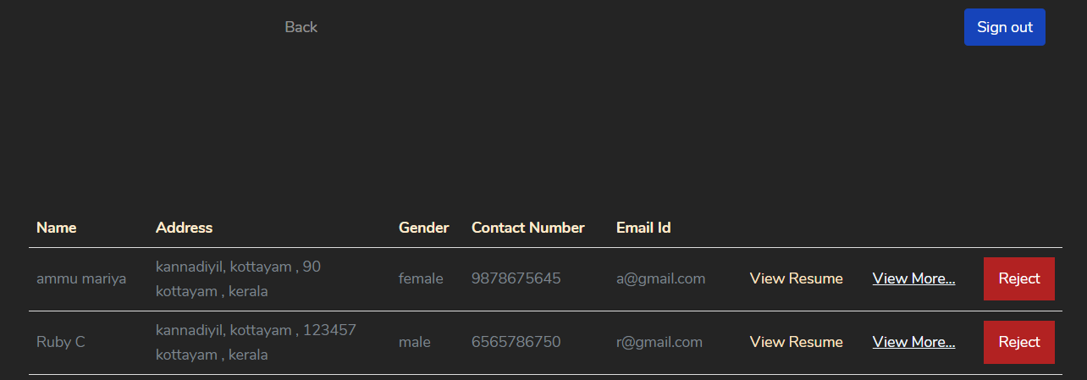
Admin –Accept/Reject Candidate

Slide 24
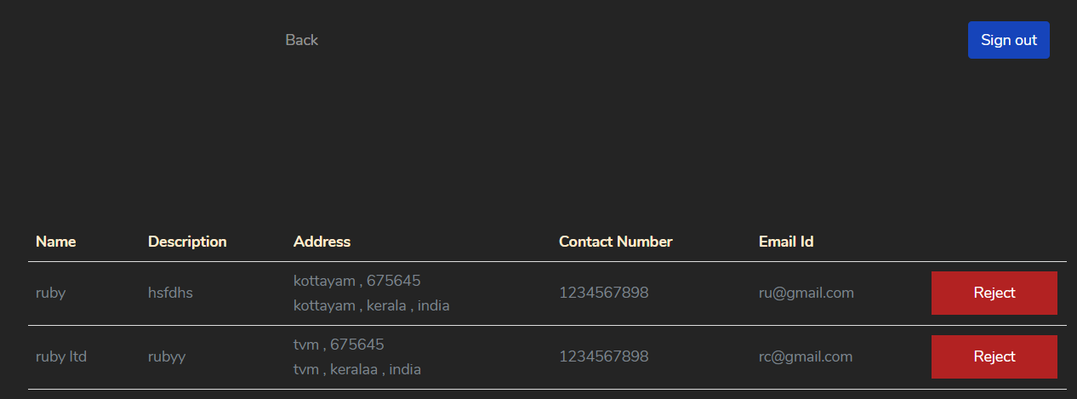
Admin –Accept/Reject Company

Slide 25
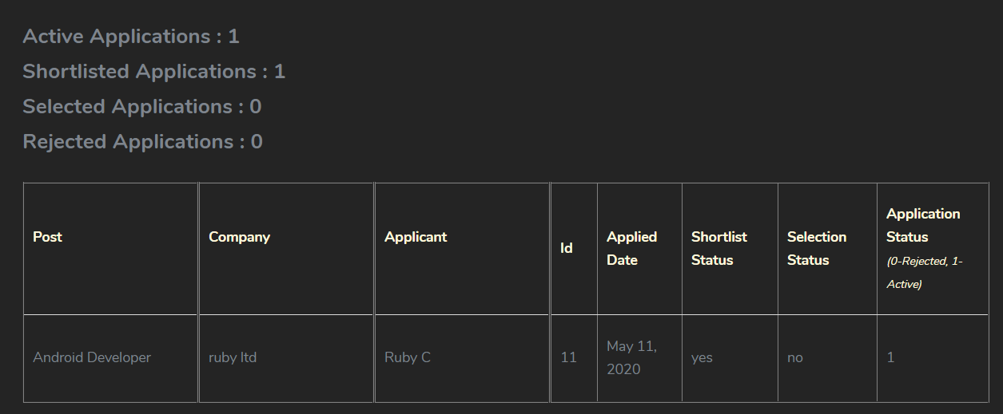
Admin –View Applications

Slide 26
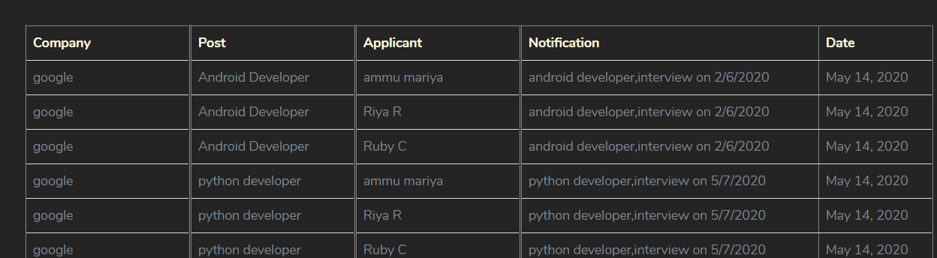
Admin –View Call Letters

Slide 27
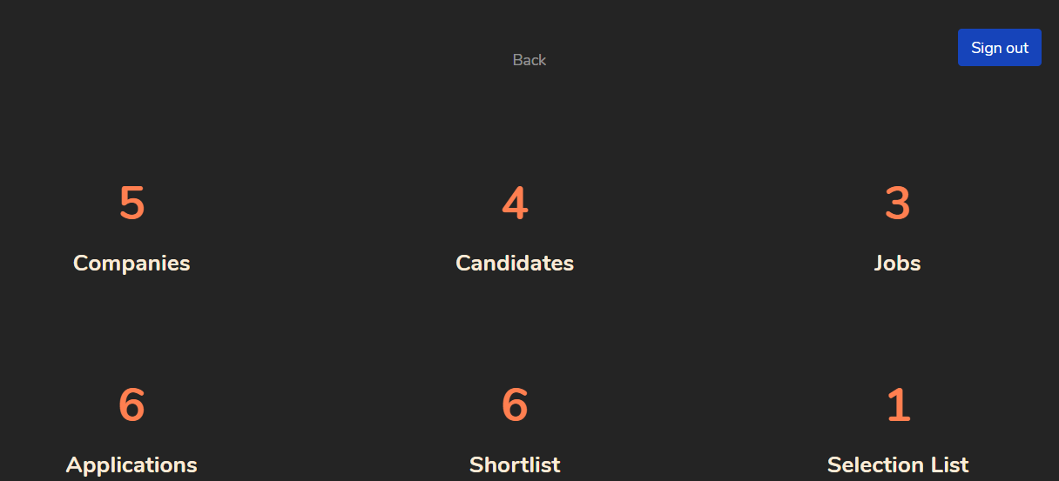
Admin –View Statistics

Slide 28
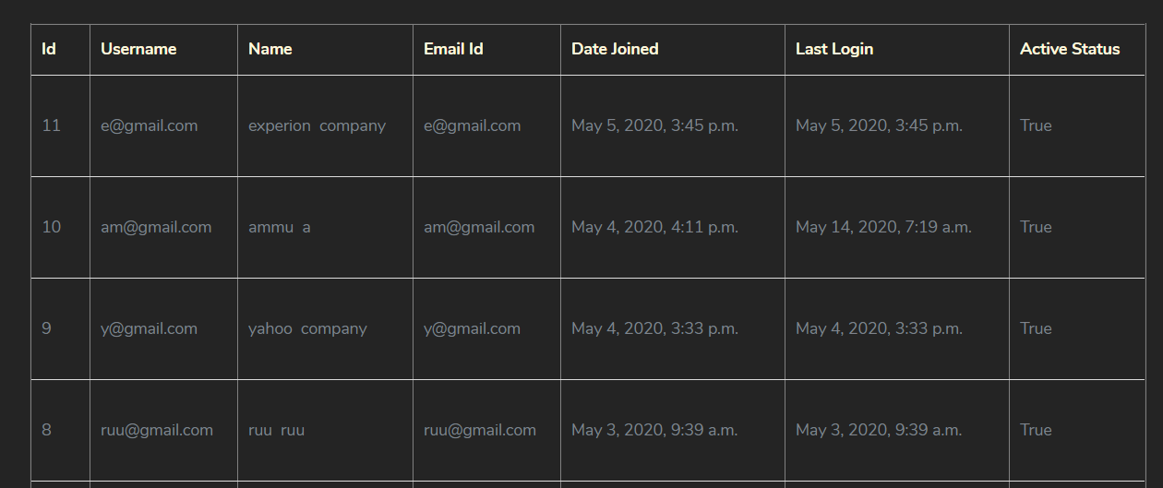
Admin –View Users

Slide 29
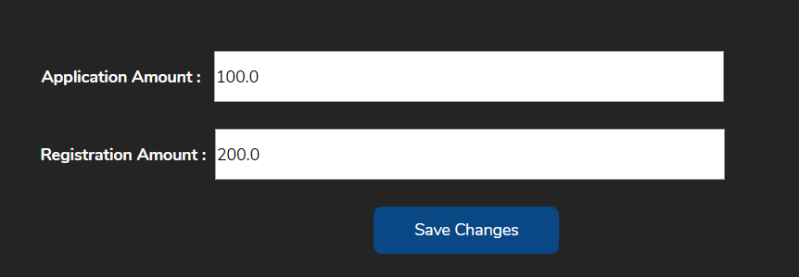
Admin –Manage Payment

Slide 30
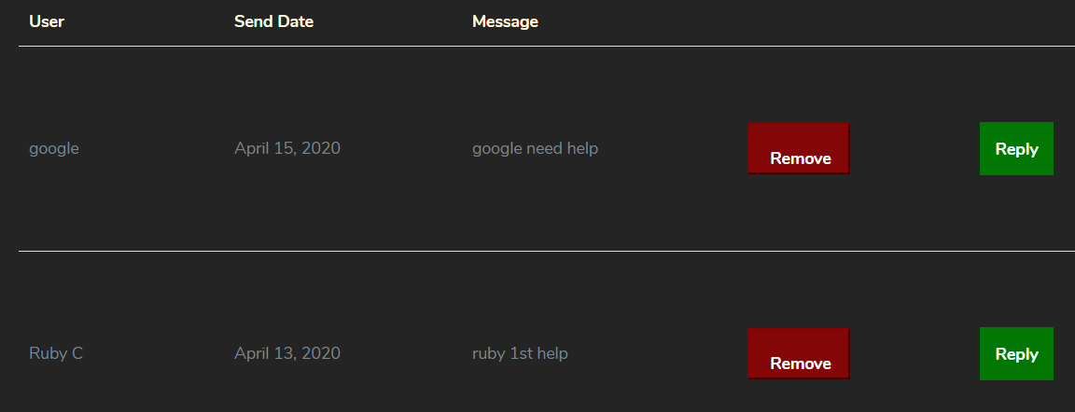
Admin –Manage Notification

Slide 31
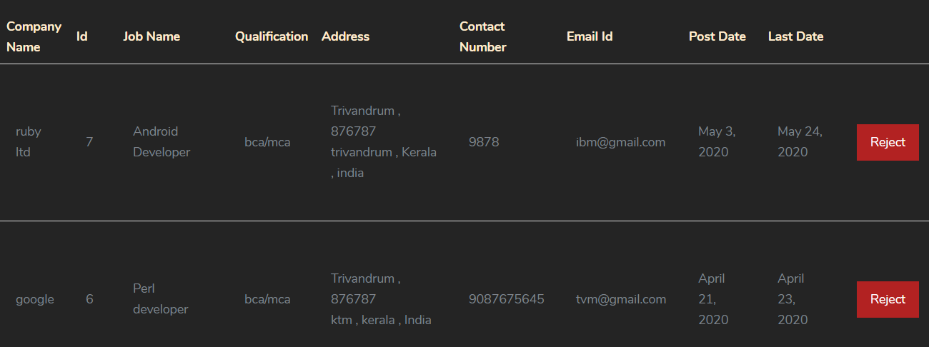
Admin –Manage Jobs

Slide 32
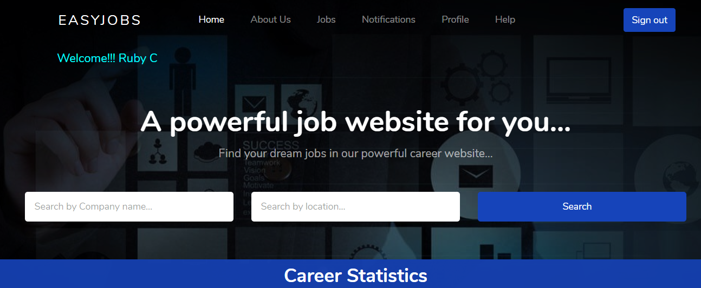
Candidate-Home

Slide 33
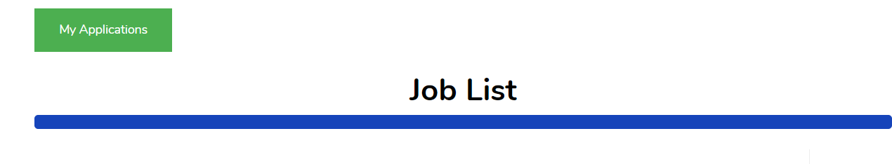
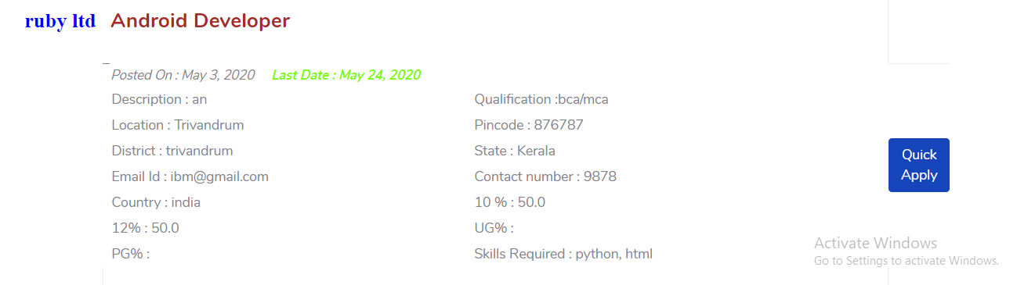
Candidate-View Jobs & Apply for Job

Slide 34
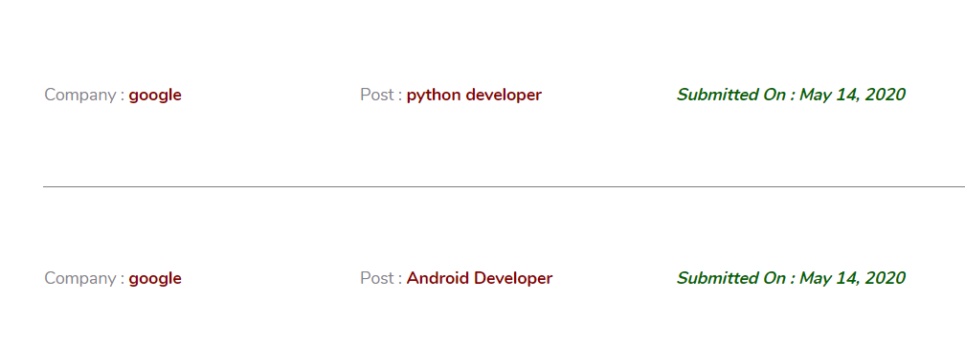
Candidate-Application History

Slide 35
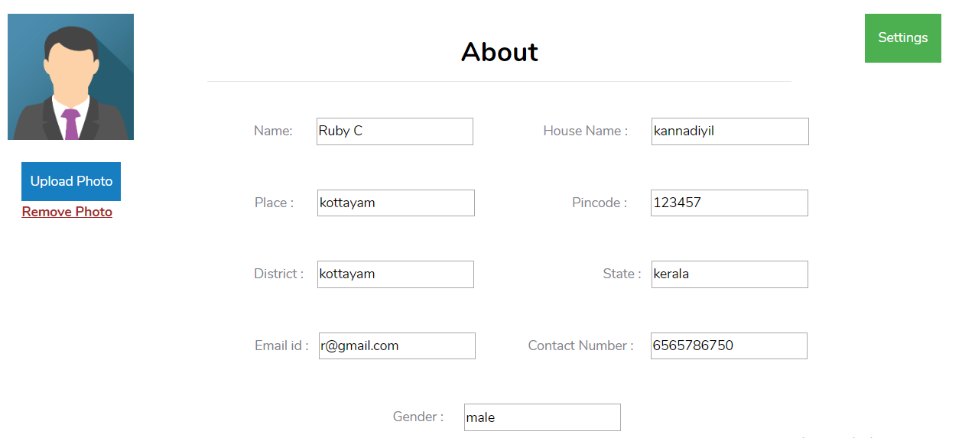
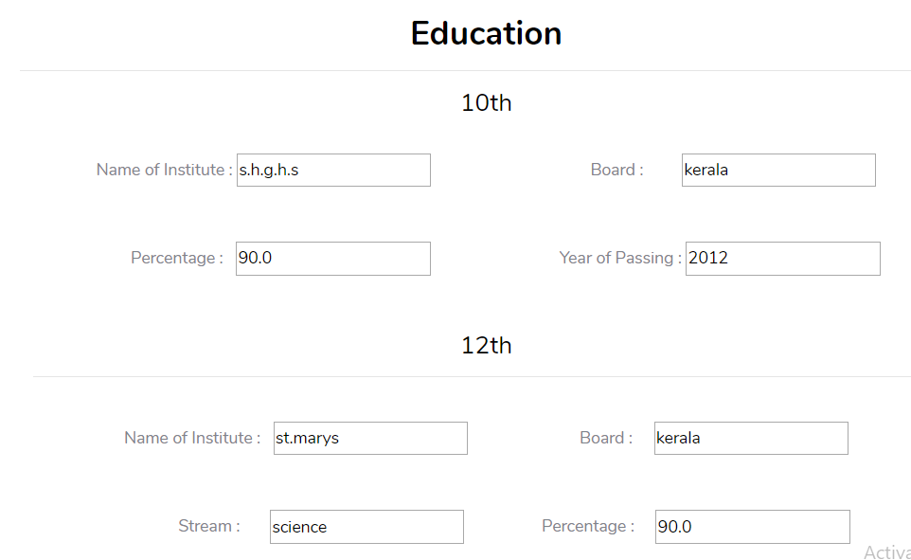
Candidate- Profile

Slide 36
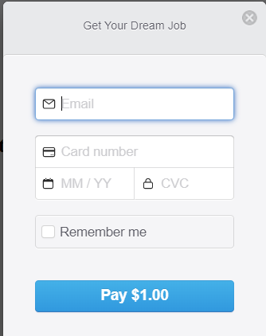
Candidate- Payment

Slide 37
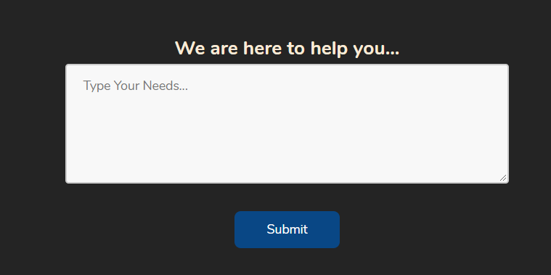
Candidate & Company - Helpdesk

Slide 38
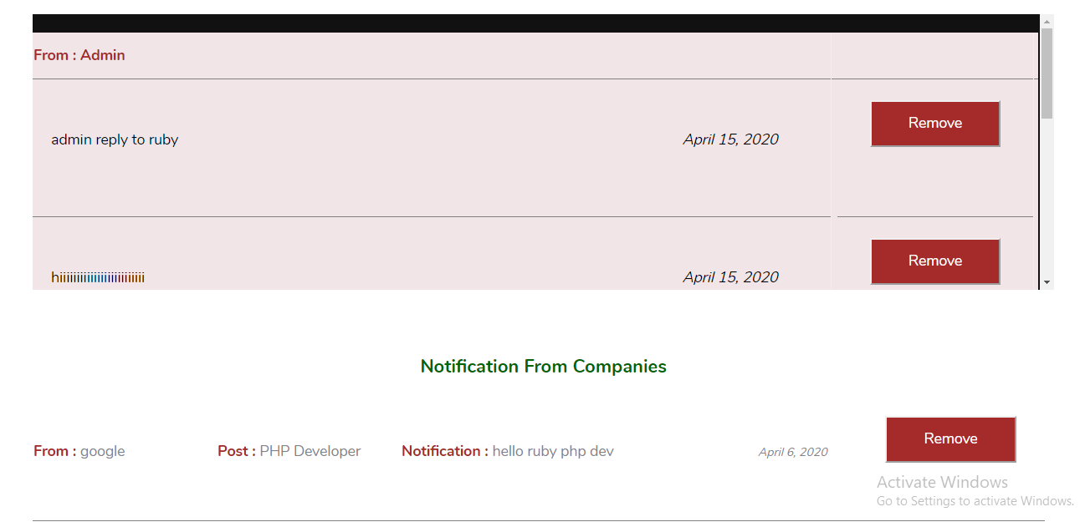
Candidate-Notifications

Slide 39
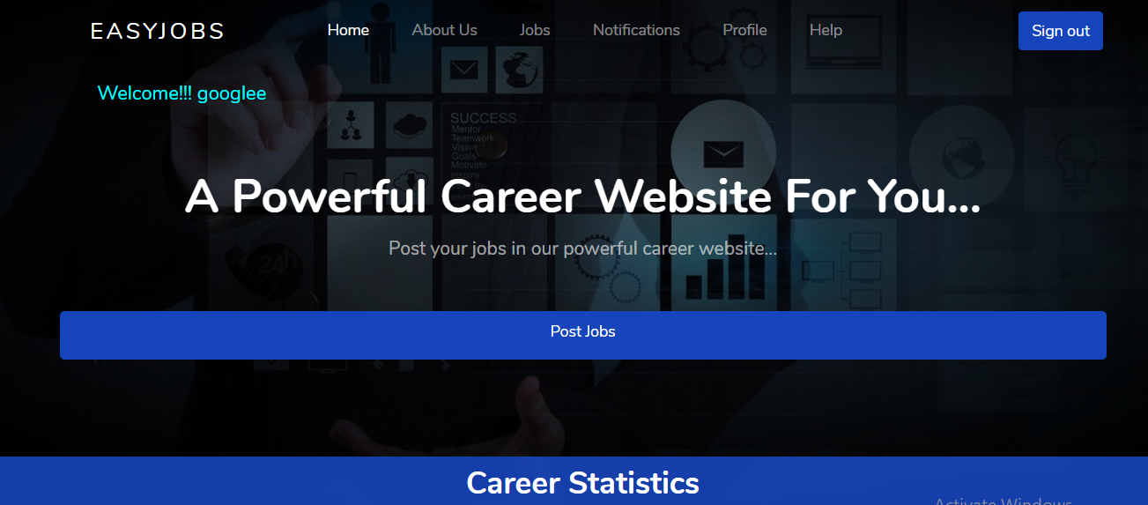
Company-Home

Slide 40

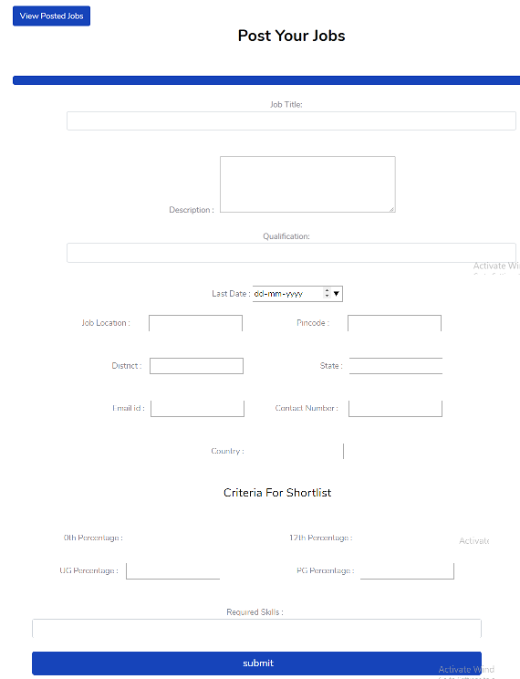
Company-Jobpost

Slide 41
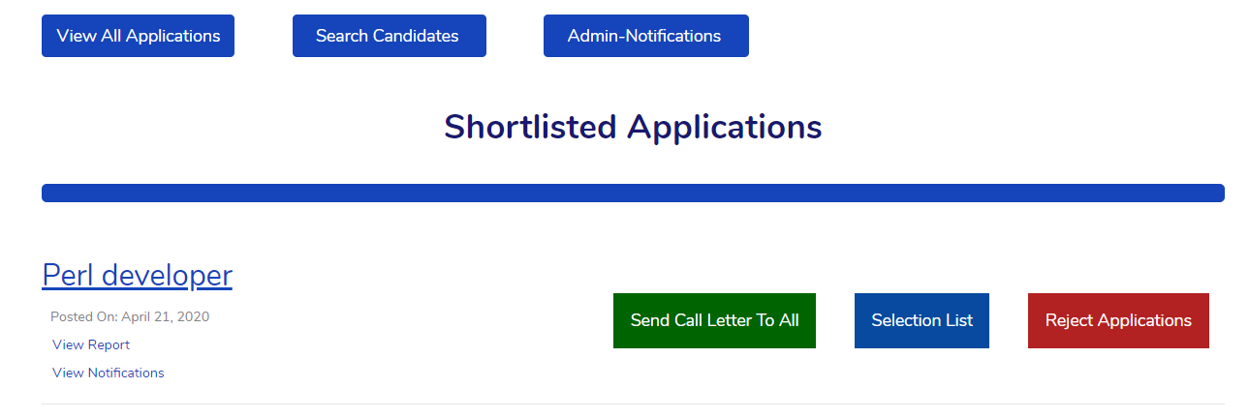
Company-Notifications

Slide 42
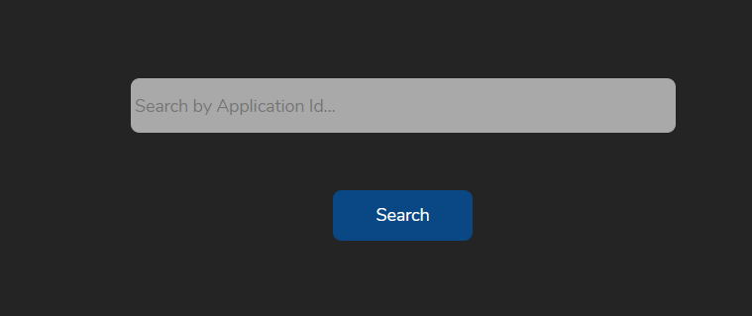
Company- Search Candidate

Slide 43
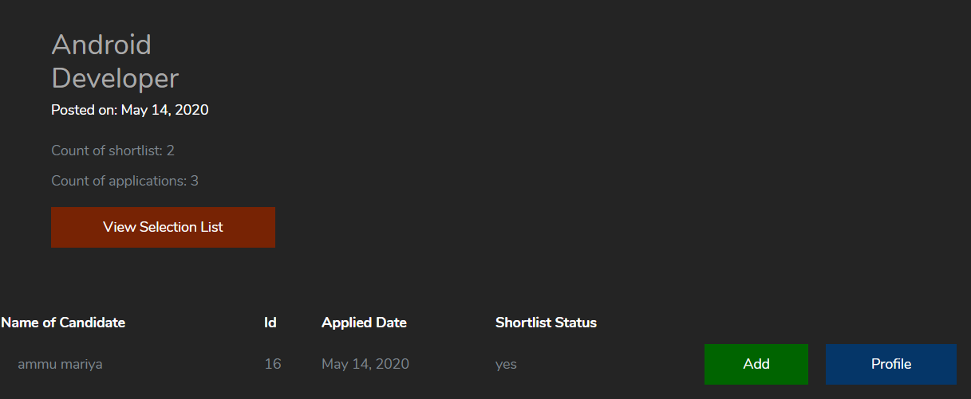
Company- Selection List

Slide 44
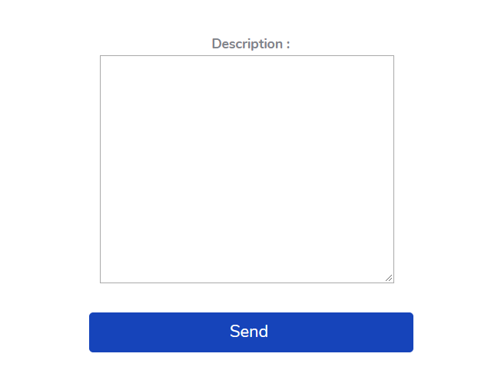
Company- Send Call Letter

Slide 45
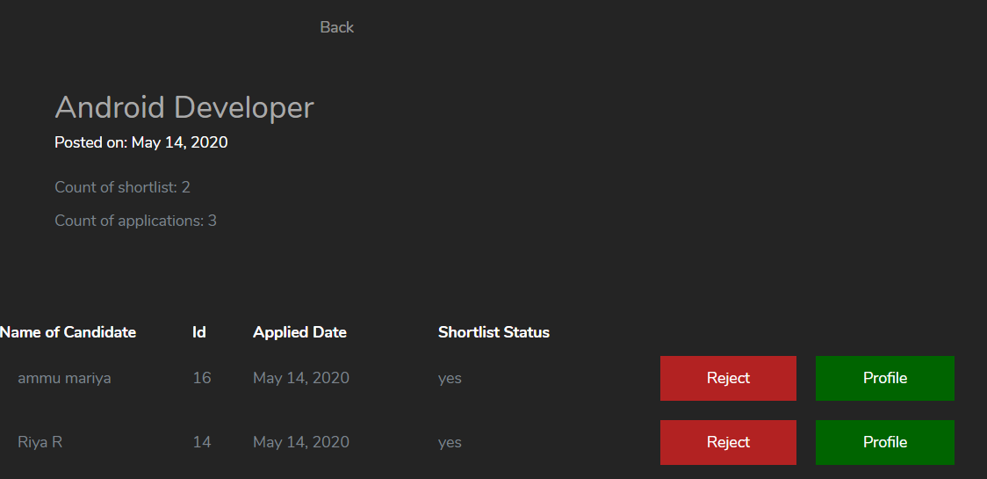
Company- Reject Applications

Slide 46
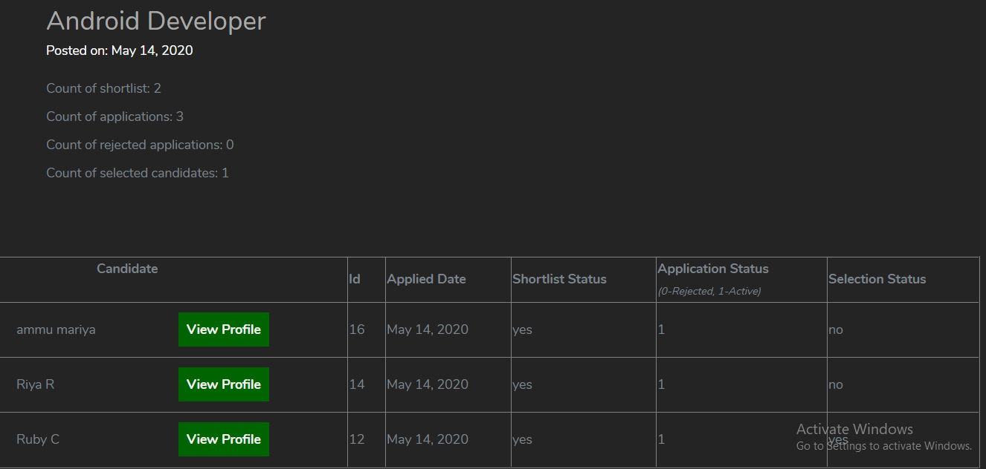
Company- Application Report

Slide 47
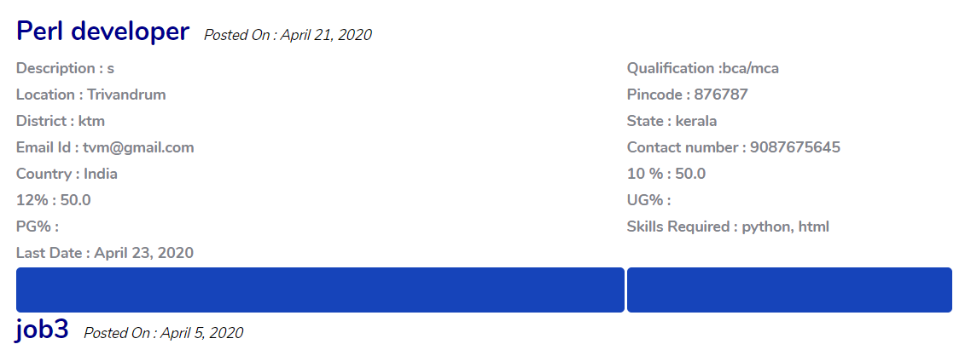
Company-View Jobs

Slide 48
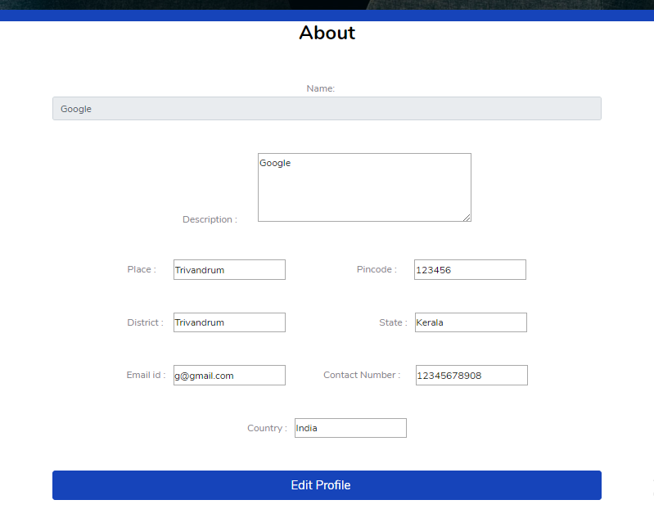
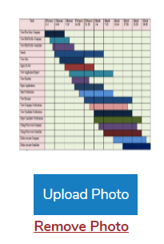
Company-Profile

Slide 49
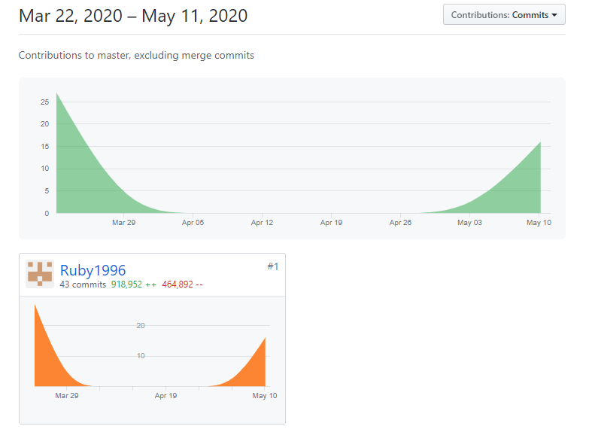
Git Contribution & Commit History

Slide 50

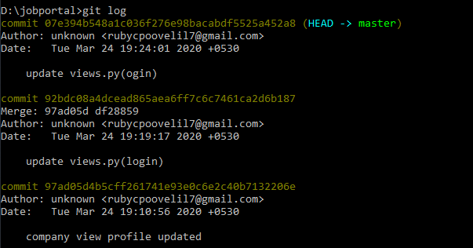

Slide 51
