Slide 1

© 2008 Nokia V1-Filename.ppt / YYYY-MM-DD / Initials

Slide 2
OBJECTIVE OF THE MATCH
TO DRIVE
MARKET SHARE
ASP
SERVICE ACTIVATIONS
© 2008 Nokia V1-Filename.ppt / YYYY-MM-DD / Initials

Slide 3
Match timings
15TH SEPTEMBER TO
31 OCTOBER
© 2008 Nokia V1-Filename.ppt / YYYY-MM-DD / Initials

Slide 4
Construct of the match
EVERY TL/ff asm to be one team with a team name and logo consists of players( promoters)
Each team is owned by one or multiple distributors
Every handset/service sold to get runs( DETAILS ATTACHED)
EVERY DAY IS ONE OVER
© 2008 Nokia V1-Filename.ppt / YYYY-MM-DD / Initials

Slide 5
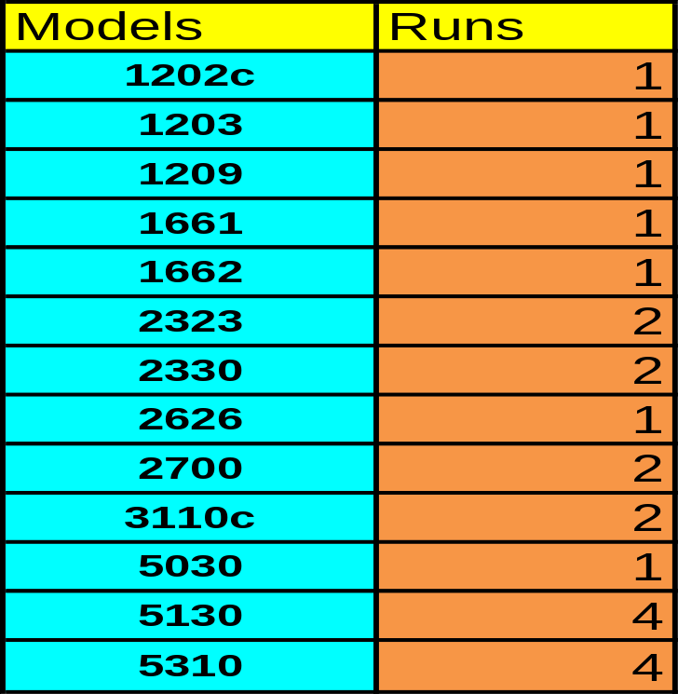
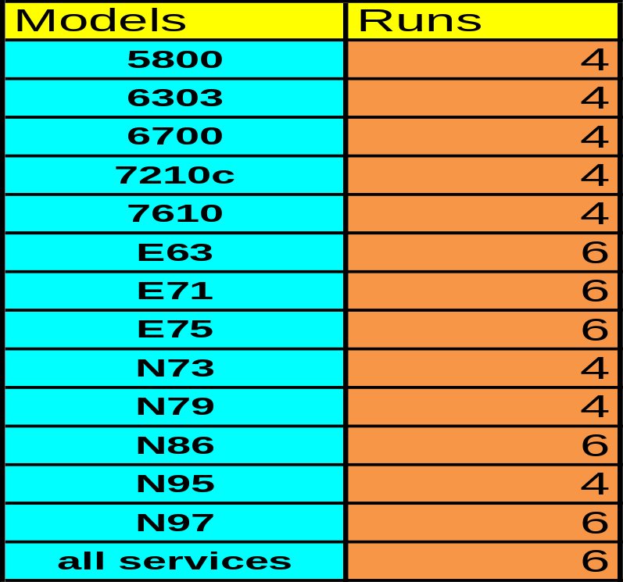
RUNS PER VOLUME/SERVICE ACTIVATION
© 2008 Nokia V1-Filename.ppt / YYYY-MM-DD / Initials

Slide 6
ROLLOUT
Each team will be launched in owners( distributor) office by giving Team T shirt with their logo
All team to wear this T shirt on the first over( day) the match
Every player to carry the tracker of his runs
Coach/manager/owner to carry team tracker
Umpire ( FF Head) to track every over
© 2008 Nokia V1-Filename.ppt / YYYY-MM-DD / Initials

Slide 7








team
© 2008 Nokia V1-Filename.ppt / YYYY-MM-DD / Initials

Slide 8
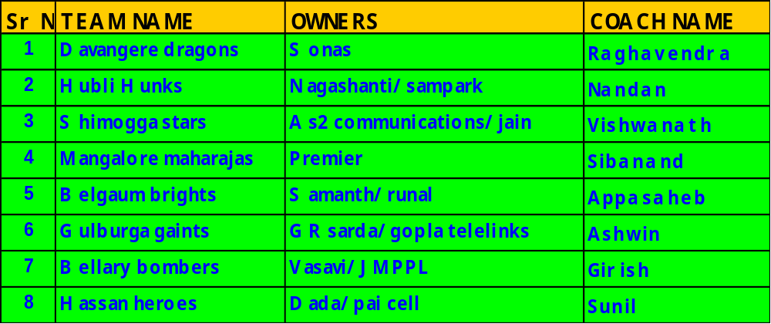
TEAM-MEMBERS
© 2008 Nokia V1-Filename.ppt / YYYY-MM-DD / Initials

Slide 9

TEAM-BELLARY
GIGISH-TL
RAGHAVENDRA DAMAN
ANWAR KHAN
KHAZA HUSSAIN
SANDEEP KUMAR
ISAAR AHEMAD
DURGA PRASAD
VENKAT SURESH
VINOD KUMAR AZARUDDIN.
MALLIKARJUN R. SHIVPRAKASH.
M.AZARUDDIN
© 2008 Nokia V1-Filename.ppt / YYYY-MM-DD / Initials

Slide 10
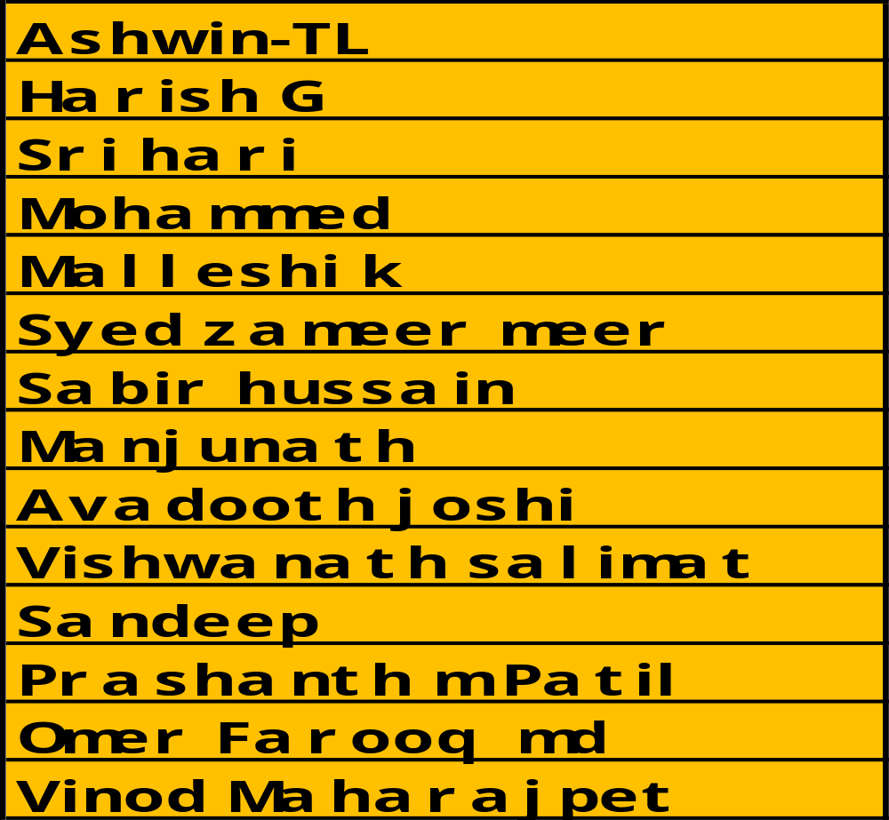
TEAM-GULBERGA
© 2008 Nokia V1-Filename.ppt / YYYY-MM-DD / Initials

Slide 11
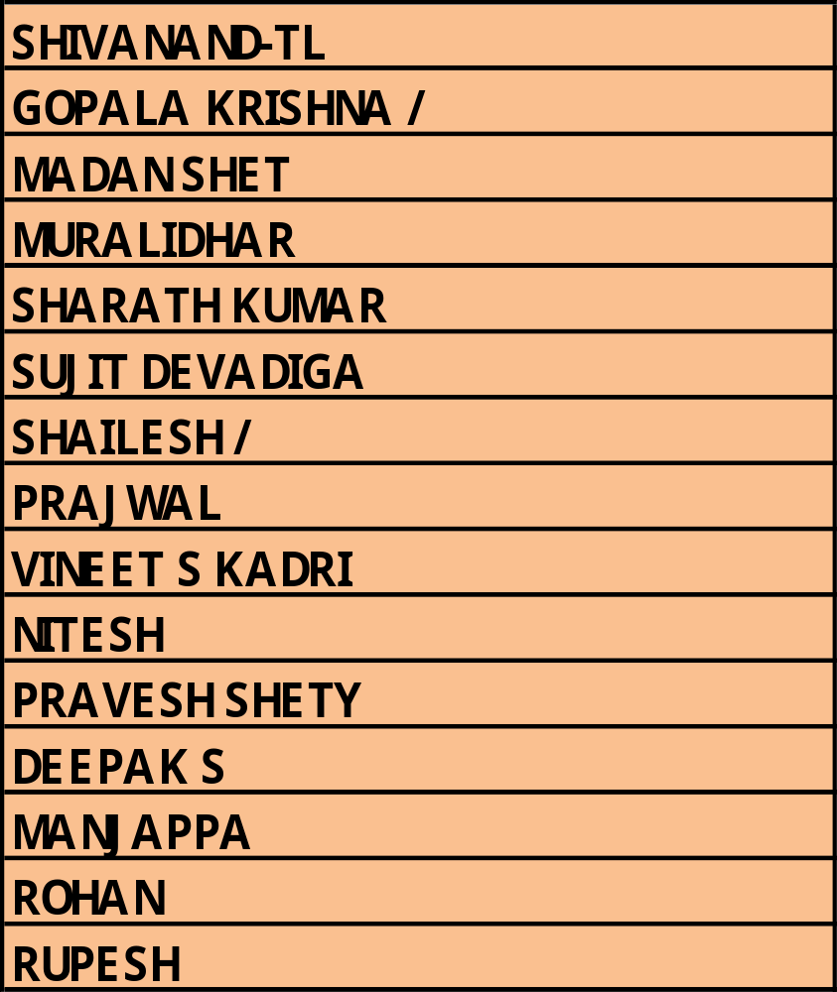
TEAM-MANGALORE A
© 2008 Nokia V1-Filename.ppt / YYYY-MM-DD / Initials

Slide 12
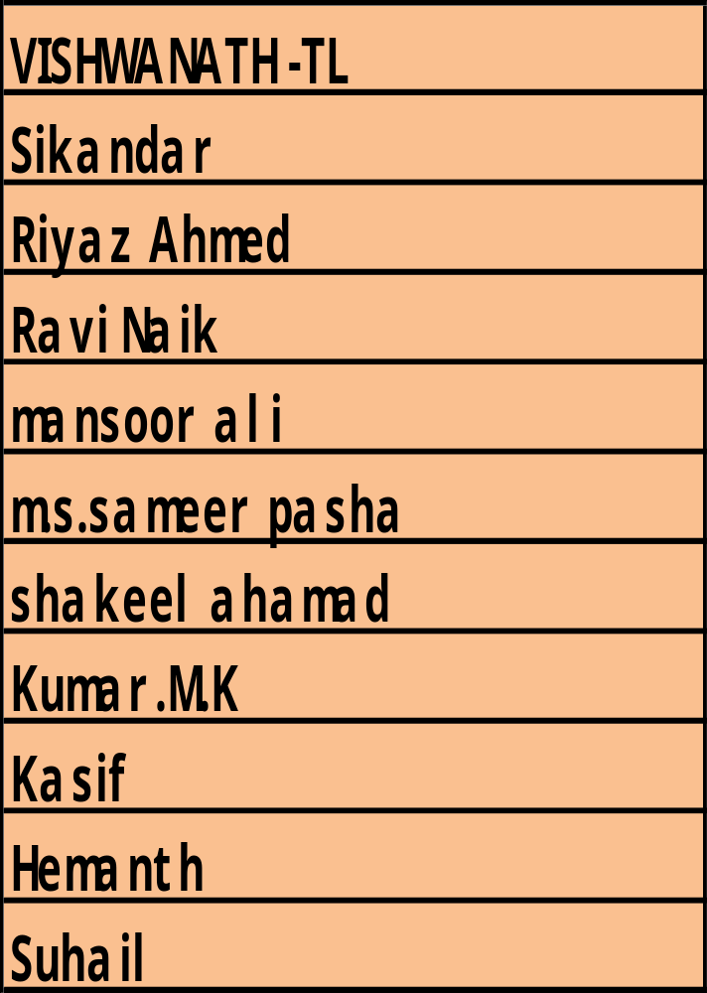
TEAM-SHIMOGA
© 2008 Nokia V1-Filename.ppt / YYYY-MM-DD / Initials

Slide 13
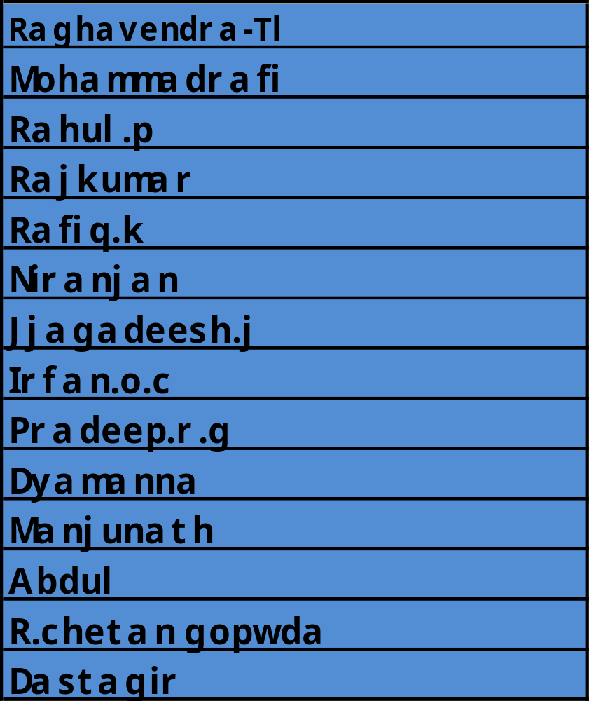

TEAM-DAVANGERE
© 2008 Nokia V1-Filename.ppt / YYYY-MM-DD / Initials

Slide 14
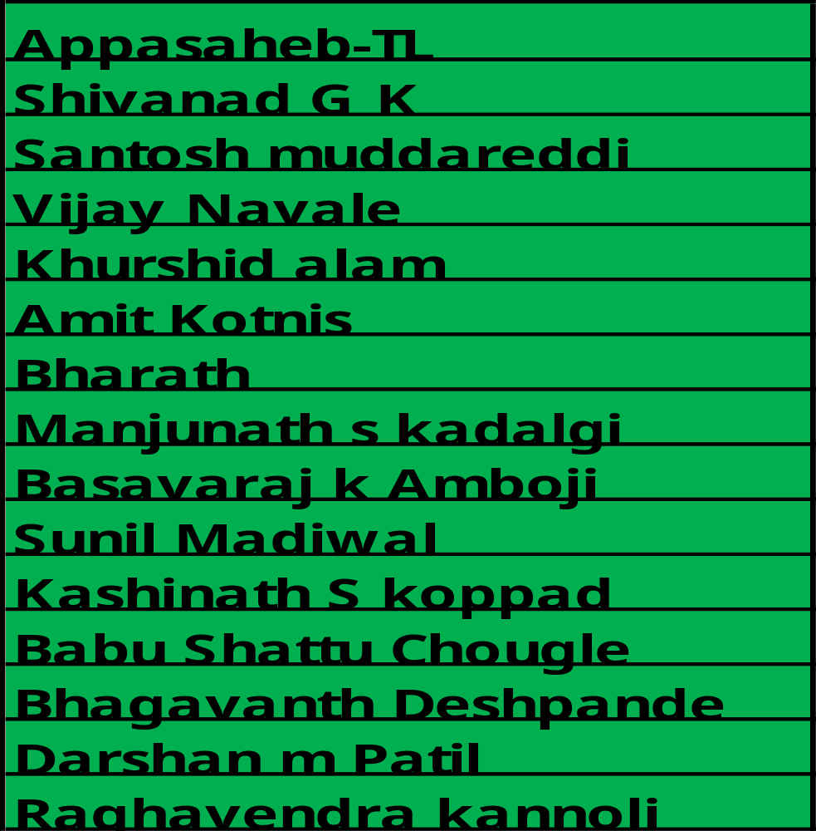
TEAM-BELGAUM
© 2008 Nokia V1-Filename.ppt / YYYY-MM-DD / Initials

Slide 15
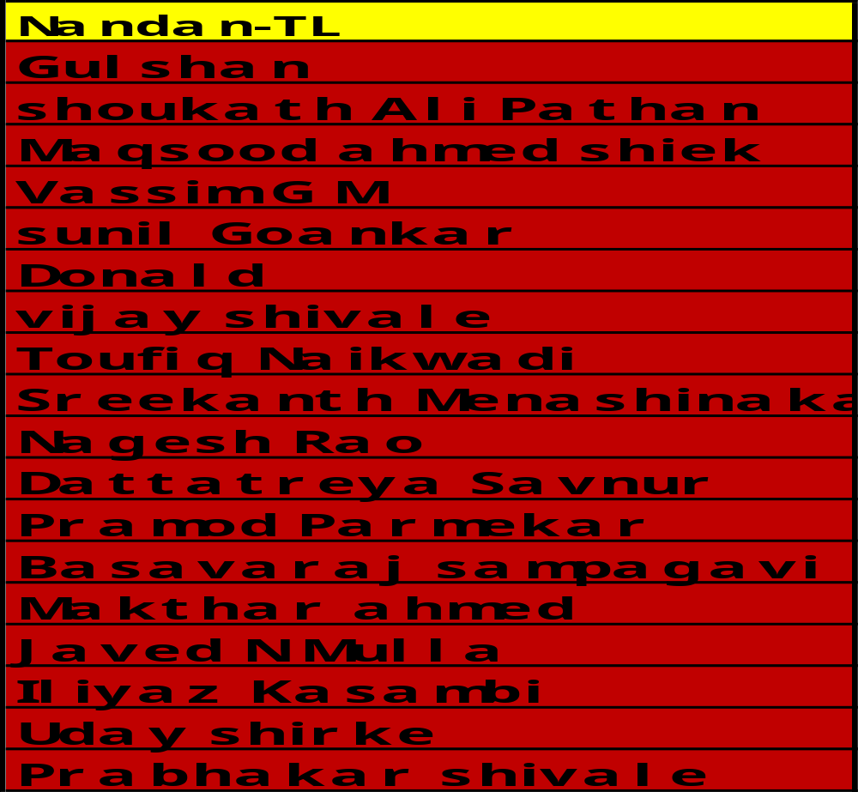

TEAM-HUBLI
© 2008 Nokia V1-Filename.ppt / YYYY-MM-DD / Initials

Slide 16
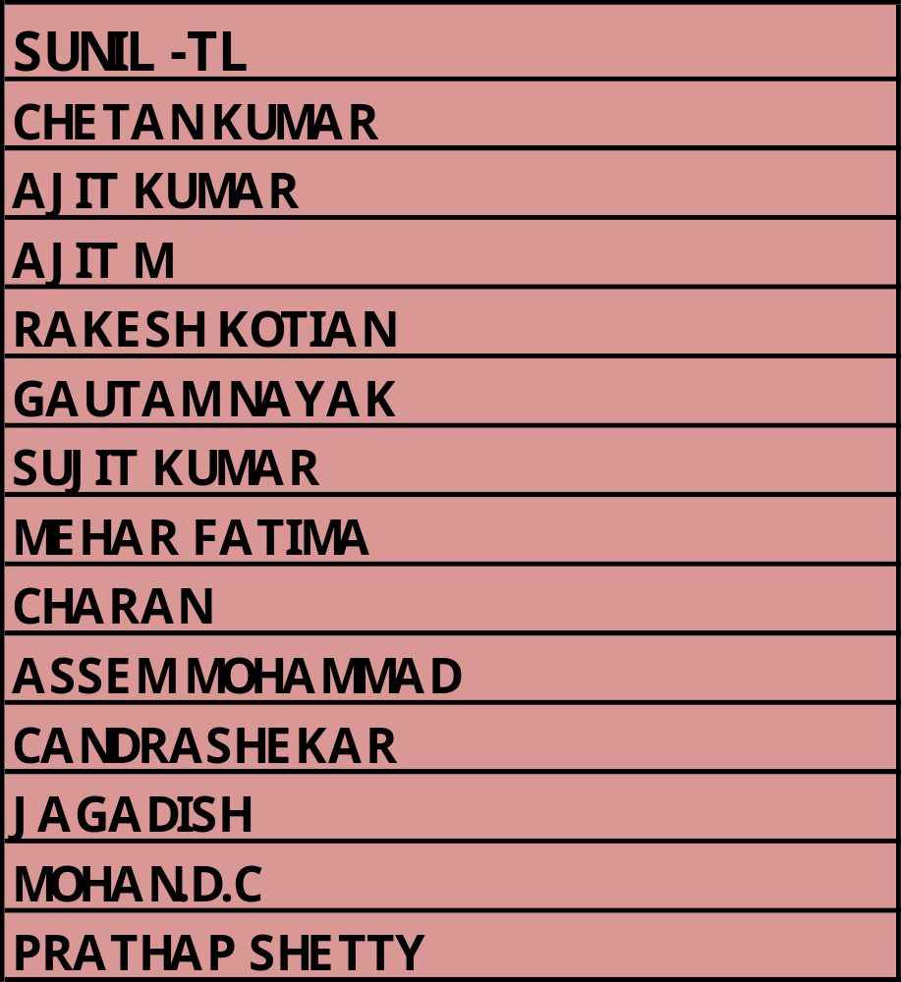
TEAM-HASSAN
© 2008 Nokia V1-Filename.ppt / YYYY-MM-DD / Initials

Slide 17
BANKERS
TO MEET THE VALUE TARGETS DURING
THE CONTEST PERIOD
ARRANGE DUMMYS IN NSP & SIS AS PER PLANOGRAM.
GROOMING.
NO ABSENTISM DURING CONTEST PERIOD.
Motivating AND BETTER COORDINATION WITH DISTRIBUTORS
© 2008 Nokia V1-Filename.ppt / YYYY-MM-DD / Initials

Slide 18
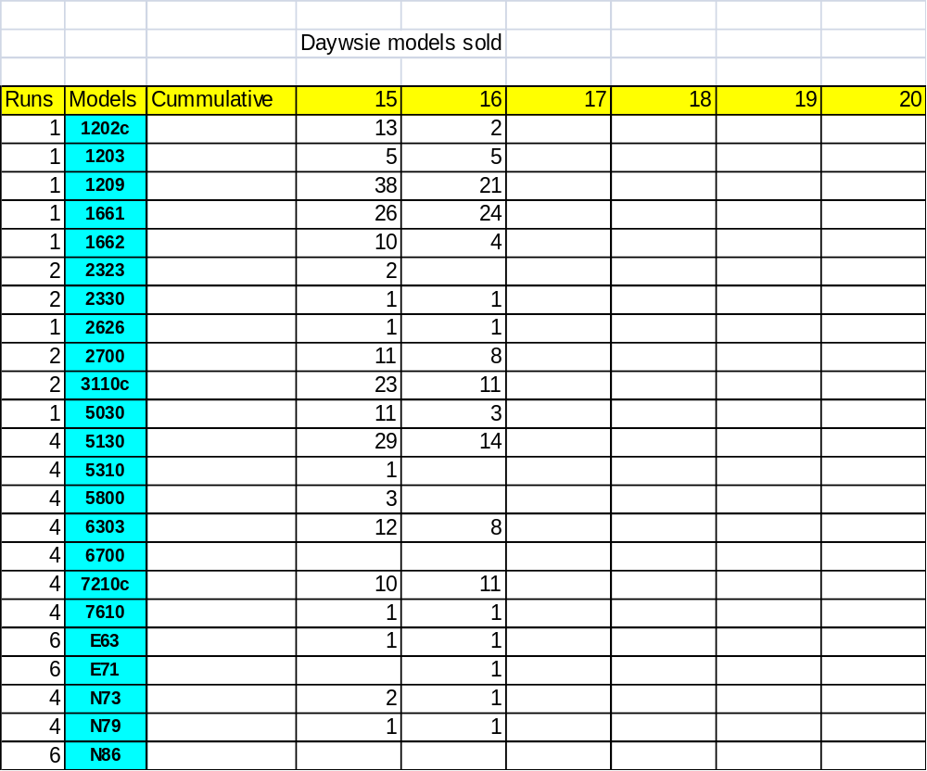
Over (day)WISE TRACKER
© 2008 Nokia V1-Filename.ppt / YYYY-MM-DD / Initials

Slide 19
REWARDS
WINNER TEAM ALONWITH OWNER WILL GO
TO GOA FOR 3 DAYS AND TWO NIGHT. WHAT YOU ARE WAITING FOR……………
TAKE THE BAT AND START HITTING RUNS
© 2008 Nokia V1-Filename.ppt / YYYY-MM-DD / Initials

Slide 20
REWARDS
BEST BATSMAN- INDIVIDUAL PLAYER ( PROMOTER) WHO HAS HIGHEST RUNS THROUGH VOLUME SALES
BEST ALLROUNDER-INDIVIDUAL PLAYER WHO HAS SCORED HIGHEST RUNS THROUGH VOLUME AND SERVICE ACTIVATIONS
© 2008 Nokia V1-Filename.ppt / YYYY-MM-DD / Initials

Slide 21

© 2008 Nokia V1-Filename.ppt / YYYY-MM-DD / Initials

Slide 22
MUCH MORE TO COME
© 2008 Nokia V1-Filename.ppt / YYYY-MM-DD / Initials

Slide 23
Masterbrand color palette
Note:
To prevent printing a hidden slide (like this), de-select “Printing hidden slides” option in print menu.
Core white & blue
Neutrals
Brights
R 255
G 255
B 255
R 000
G 051
B 204
R 004
G 004
B 119
R 002
G 076
B 028
R 224
G 219
B 202
R 175
G 212
B 240
R 249
G 242
B 006
R 068
G 165
B 028
R 228
G 014
B 098
The pink highlight color is to be used sparingly, not in large areas and can only be used as 100%, never as a tint.
4th Qtr
1st Qtr
100
90
2nd Qtr
80
70
East
60
West
50
North
40
South
30
3rd Qtr
20
10
0
1st Qtr
2nd Qtr
3rd Qtr
4th Qtr
© 2008 Nokia V1-Filename.ppt / YYYY-MM-DD / Initials

Slide 24
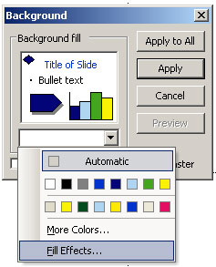
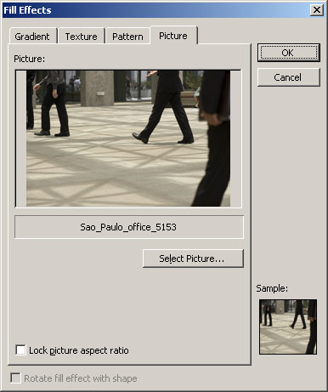
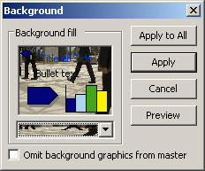
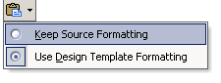
Working with images
Adding a background (full bleed) image
Right-click on a blank space on a slide
(or, Format > Background)
Select: Fill effects > Picture >Select picture, and browse to find wanted background picture > Apply (or Apply to all).
Note: ensure that the dimensions are according to PowerPoint page setup (A4 by default).
1.
2.
To delete existing background (picture or color),
select white color from “Background fill” color palette.
To save the background image, right-click the slide
outside of any placeholders and click “Save Background”.
To retain the slides' original formatting, click the “Paste Options” button which appears under the slides you pasted > on the button menu, click “Keep Source Formatting”.
If you decide you want the current design template styles to apply, click “Use Design template formatting” (this is the default).
For more info and advanced options go to “Consumer touch points” / “Corporate applications” / “Office templates” in Nokia Brand Book.
© 2008 Nokia V1-Filename.ppt / YYYY-MM-DD / Initials

