Slide 1
DATA FOR GOOD · QUESTION 2
When the patrols leave,
mining comes back for seconds.
Operation Mercurio, La Pampa, from February 2019 · what it means for FZS in Tambopata
Photo: giant anteater at a termite mound
TWO FACTS ABOUT OUR ANIMAL
35,000
1 minute
ants a day, with a 60 cm tongue flicking up to 150 times a minute
per mound. It never destroys the nest: it moves on and comes back later
Smithsonian's National Zoo; National Geographic
Notes:
About 30 seconds. Good morning, we are Group Giant Anteater. [Names.]
Two facts about our animal. One: the giant anteater eats up to 35,000 ants and termites a day, with a tongue about 60 centimetres long that flicks up to 150 times a minute (Smithsonian's National Zoo; National Geographic).
Two, the one to remember: it spends only about a minute at each mound, never destroys the nest, moves on, and comes back later to feed again (National Geographic).
Hold on to that habit. It describes what we found for gold mining in La Pampa: hence the title, mining comes back for seconds.

Slide 2



01 THE QUESTION
FZS pays for operations. What happens when one ends?
Net mining additions, ha/yr · Tambopata buffer zone, La Pampa, Madre de Dios · 2016–18 vs 2019–21 vs 2022–25
WHAT WE FOUND
1 · IT FELL, LOCALLY
2 · IT MOVED
3 · IT CAME BACK
1,640 → 163
60 → 395
1,829
ha/yr, Tambopata buffer zone. 25%–47% of the fall: pits going out of use
ha/yr just across the road, in the legal corridor
ha/yr in the later years (2022–25), much of it on old pits
All three: description. Net additions = new land + re-mined − stopped, from yearly 30-m satellite maps.
Notes:
About 40 seconds. FZS supports SERNANP's operations against illegal gold mining around Tambopata. Operations are expensive, and they end. So the practical question: what should FZS expect in the targeted area, and around it, once an operation is over?
Three possibilities: mining stops for good (deterrence), it moves next door (displacement), or it waits and comes back (delay). Inside the target alone these look the same, so we compare areas.
The answer up front, all description. One: net mining additions in the Tambopata buffer zone fell from about 1,640 to 163 hectares a year in 2019 to 2021. But a quarter to a half of that fall is pits going out of use, most of it in 2019; the rest is fewer new pits. Two: just across the road, in the legal corridor, net additions rose from about 60 to 395 hectares a year. Three: in the later years, 2022 to 2025, the buffer zone was back at about 1,829 hectares a year, much of it on old pits.

Slide 3
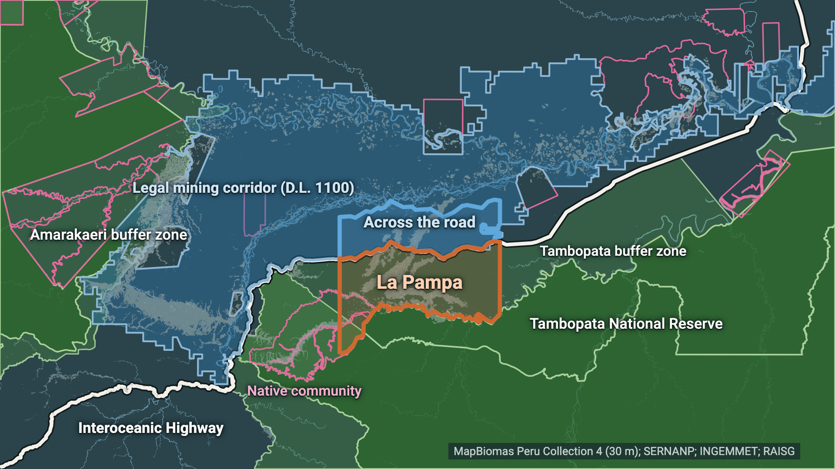
02 ONE MEASURE
DESCRIPTION
One measure on every slide: net mining additions
Net additions (ha/yr) = new land + re-mined − stopped · per 30-m pixel, year t vs the years before · MapBiomas Peru Collection 4, 1985–2025
YEAR
t − 1
t
+
New land
never mined before
forest
mined
+
Re-mined
mined years ago, not last year
old pit
mined
−
Stopped
mined last year, not this year
mined
water / regrowth
Net = new + re-mined − stopped
Same zones everywhere: Tambopata buffer zone (whole, incl. Kotsimba) · La Pampa sector (its 70.15–69.80° W part) · corridor across the road (D.L. 1100, ≤ 10 km north of the highway) · Amarakaeri buffer zone (less treated) · Madre de Dios.
= mining area this year − last year. Hectares are a proxy for mining activity, not for miners.
Notes:
About 40 seconds. One measure on every slide from here on: net mining additions, in hectares per year. It is simply the mining area this year minus last year, from the MapBiomas Peru satellite maps at 30 metres.
We split it into three parts, always in the same colours. Brown: new land, mined for the first time since 1985. Amber: re-mined, old pits mined again after a gap. Teal: stopped, pits that left the mining class, most often because they flooded or started to regrow. Net equals new plus re-mined minus stopped.
Why it matters: a fall in net additions can mean fewer new pits, or more pits going out of use. Those are different stories for FZS.
And the same zones everywhere: the Tambopata buffer zone as SERNANP draws it, La Pampa as its western part, the strip of legal corridor across the road, the Amarakaeri buffer zone as the less-treated comparison, and the whole department. Hectares measure mining activity, not the number of miners.

Slide 4
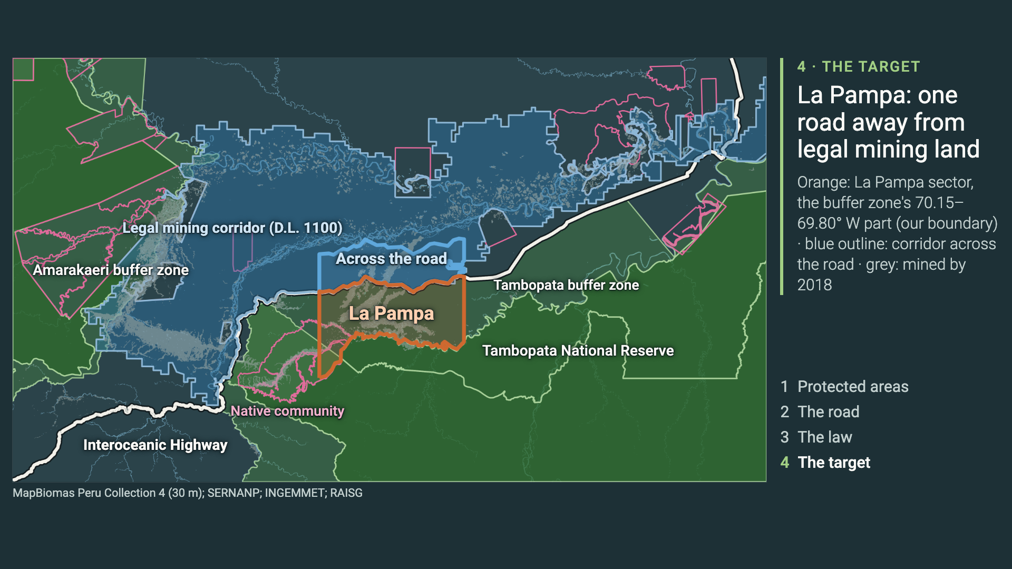
03 WHERE WE ARE
DESCRIPTION
La Pampa sits one road away from legal mining land
Madre de Dios, Peru · protected areas → Interoceanic Highway → D.L. 1100 mining corridor → La Pampa sector · click to play (21 s)
Notes:
About 50 seconds, click to play. Step 1: the protected areas. Tambopata National Reserve in the south, the core FZS helps protect, ringed by its buffer zone. West: the Amarakaeri buffer zone. Pink outlines: native communities.
Step 2: the Interoceanic Highway runs right along the buffer zone. Blue lines are rivers: the gold here is alluvial, in the floodplains.
Step 3: the blue area is the mining corridor created by decree in 2012, D.L. 1100, where small-scale mining can be permitted. South of the road, in the buffer zone, the same work is a crime. Legality is about location: the satellite maps themselves cannot tell legal from illegal.
Step 4: in orange, La Pampa, the target of Operation Mercurio from February 2019, which we define as the buffer zone's part between 70.15 and 69.80 degrees west; there is no official boundary. The blue box just across the road is the part of the legal corridor directly opposite. Watch these two boxes.

Slide 5
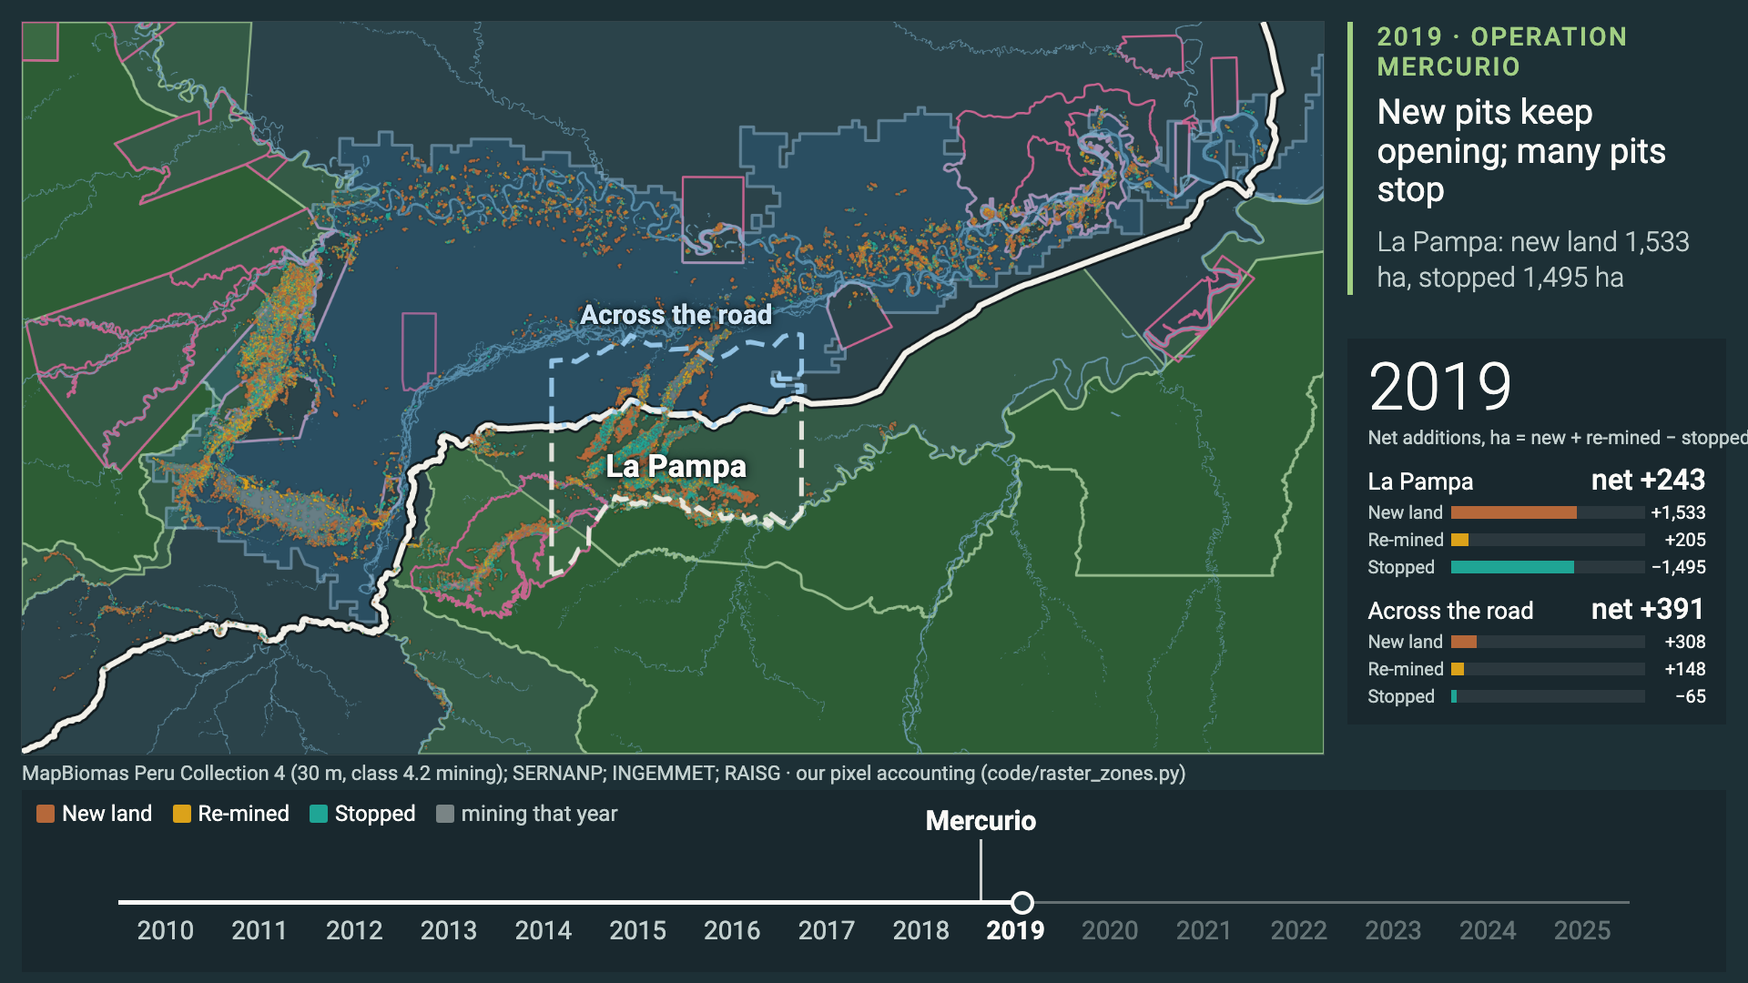
04 2010–2025 IN ONE MINUTE
DESCRIPTION
2010–2025: new pits, old pits re-mined, pits stopping
Net mining additions as three flows on the map: new land (brown), re-mined (amber), stopped (teal) · counter: net ha per year, La Pampa sector and corridor across the road
Notes:
About 60 seconds, click to play. Each year, brown pixels are land mined for the first time, amber are old pits mined again, teal are pits that stopped; grey is everything mapped as mining that year. On the right, the net additions per year for La Pampa and for the strip across the road, with the three parts.
Before 2019, brown dominates in La Pampa, south of the road. Watch 2019, the Mercurio year: new clearing did not fall in 2019 — about 1,533 hectares of new land in La Pampa, against 1,835 in 2018 — but land going out of use did: 1,495 hectares stopped. So net additions drop to 243.
In 2020 and 2021, La Pampa's net additions sit near zero while the strip across the road lights up. In the later years, amber appears: mining comes back, much of it on old pits. In 2025 the navy leaves the river posts.
The video ends with the caveat we repeat: satellites can't see river dredges or mercury.

Slide 6
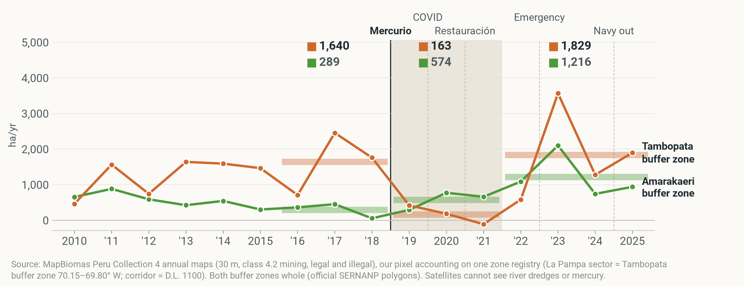
05 IT FELL, LOCALLY
DESCRIPTION
Net additions in the Tambopata buffer zone fell 90% in 2019–21
Net mining additions, ha/yr · Tambopata buffer zone (orange) vs Amarakaeri buffer zone (green) · 2010–2025 · Tambopata 1,640 → 163, Amarakaeri 289 → 574 (2016–18 → 2019–21). Thick bars and numbers at the top: period means.
Notes:
About 40 seconds. The first comparison, the course's: net mining additions in the Tambopata buffer zone, orange, and in the Amarakaeri buffer zone, green, our less-treated comparison.
In 2016 to 2018 Tambopata added about 1,640 hectares a year. In 2019 to 2021, Mercurio and what followed, only 163: a 90% fall. Amarakaeri went the other way, 289 to 574. The simple difference-in-differences is −1,762 hectares a year: a description, not yet a cause.
In the later years Tambopata was back at 1,829. The 2023 spike shows up in MapBiomas only, so we also report the later years without it: 1,251.

Slide 7
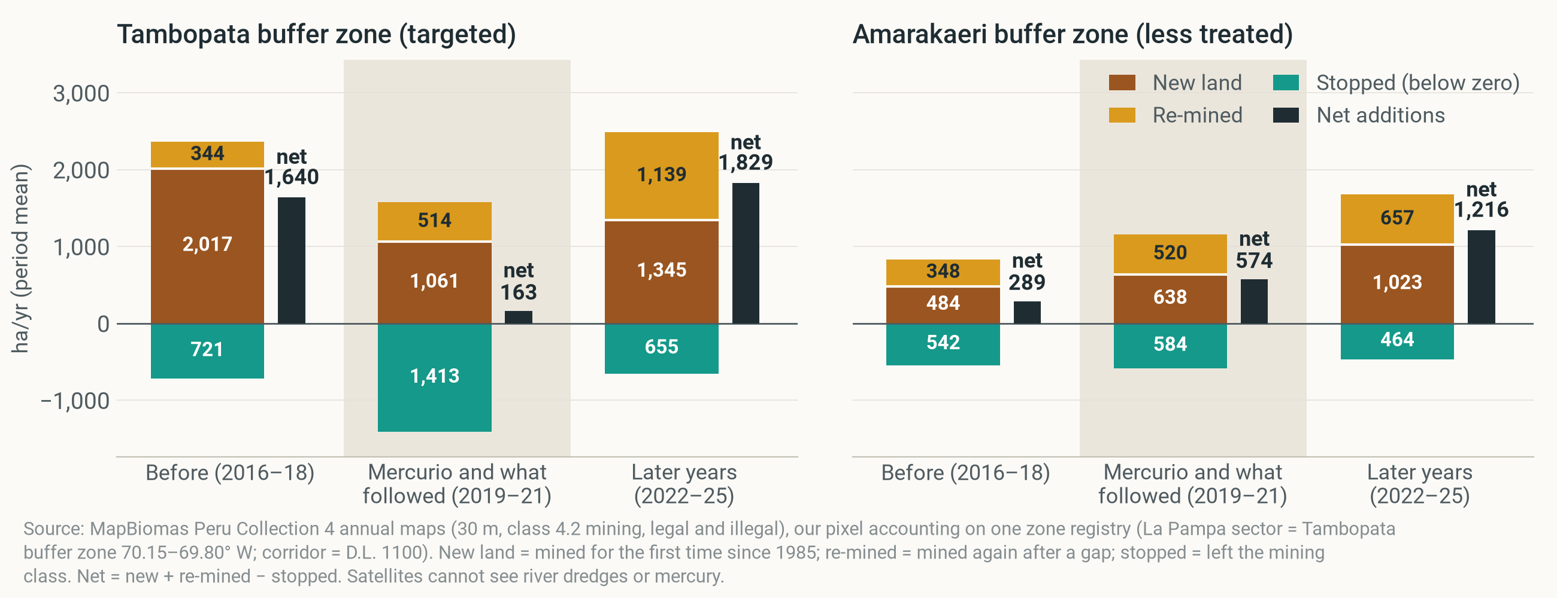
06 WHAT FELL
DESCRIPTION
Pits going out of use made 25%–47% of the fall, most of it in 2019
Net mining additions and their parts, ha/yr, period means · Tambopata buffer zone vs Amarakaeri buffer zone · Tambopata 2016–18 → 2019–21: new land 2,017 → 1,061, stopped 721 → 1,413 (2.0×). Stopped land makes 25%–47% of the fall (four ways of counting map flicker); 68% of the extra stopping is in 2019.
Notes:
About 50 seconds. Now the same zones, split into the three parts, as period averages. The black bar is net.
In Tambopata, new land fell from 2,017 to 1,061 hectares a year: it roughly halved. At the same time stopped land, pits going out of use, nearly doubled, from 721 to 1,413. Depending on how we count map flicker, between 25% and 47% of the fall in net additions is that extra stopping, and 68% of the extra stopping happened in 2019.
In Amarakaeri, stopped land stayed flat (542 to 584). Why it matters: a net fall is not the same as fewer new pits. Part of what fell is old pits leaving the mining class.

Slide 8
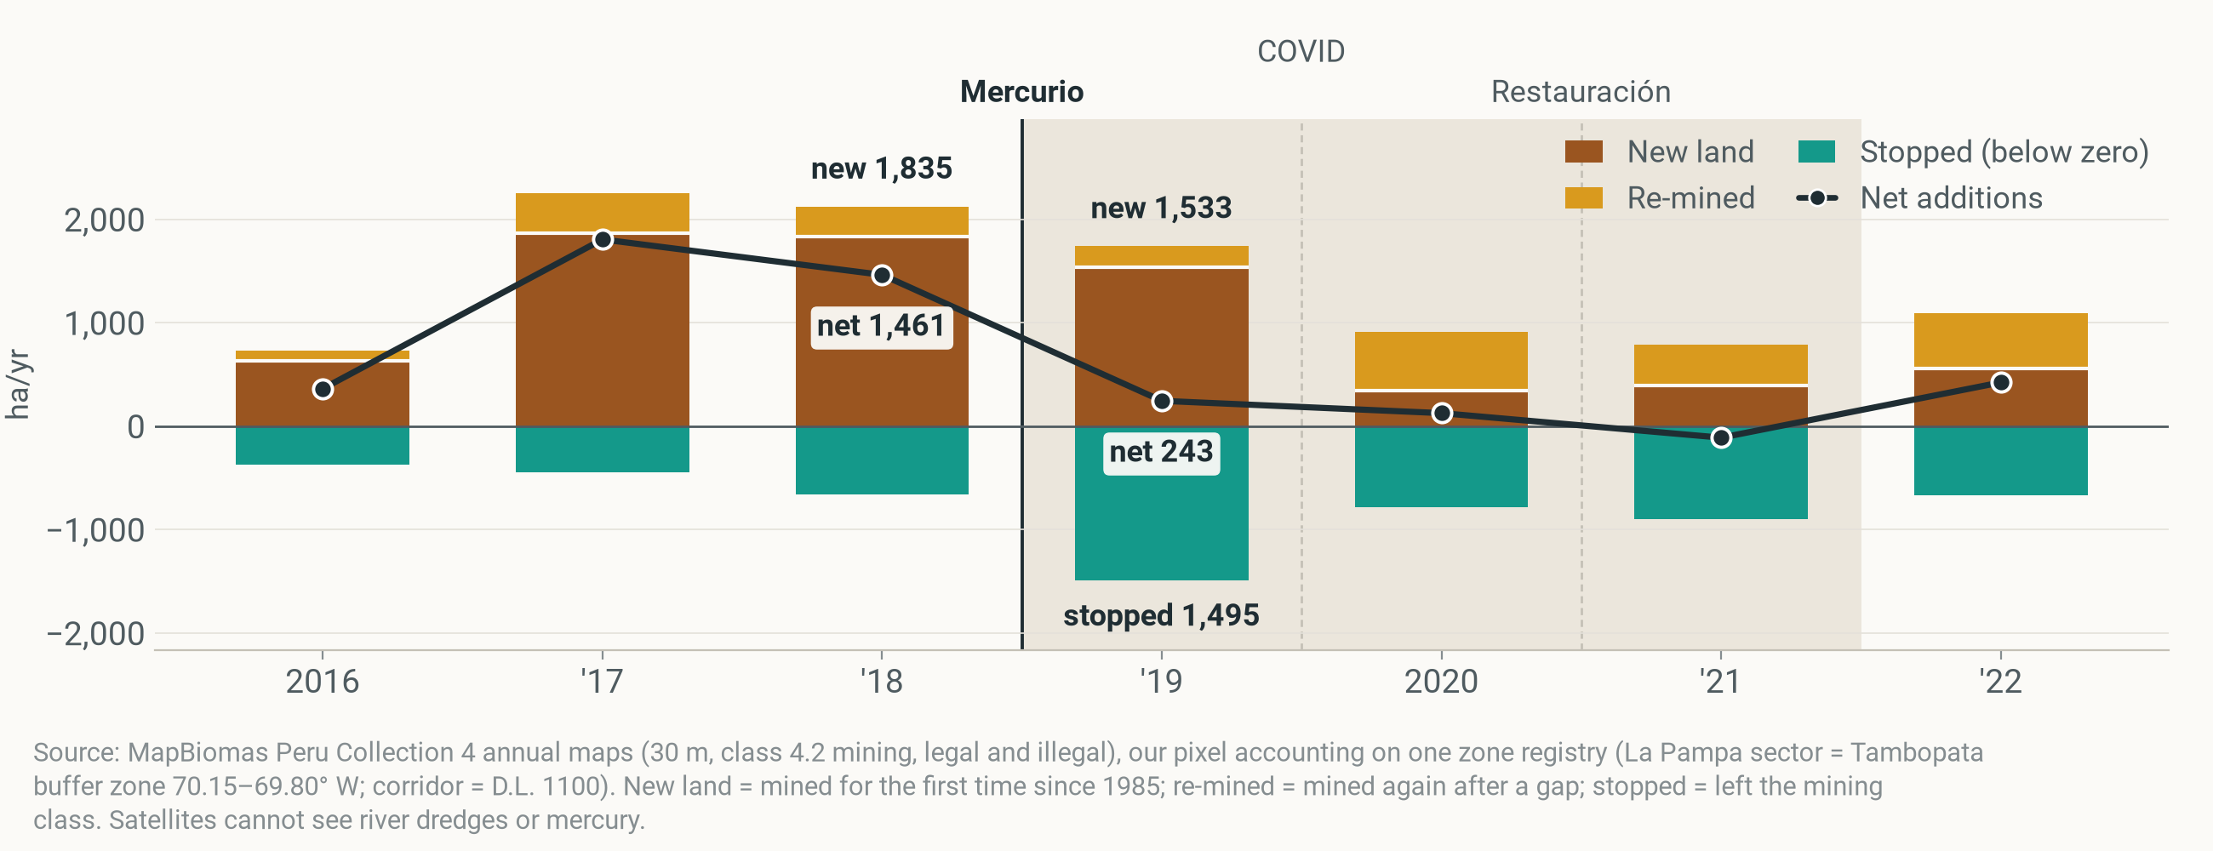
07 2019, YEAR BY YEAR
DESCRIPTION
New pits kept opening in 2019; pits stopped where the patrols were
Net mining additions and their parts, ha/yr · La Pampa sector (the target) · 2016–2022 · 2019: new land 1,533 (2018: 1,835), stopped 1,495, net 243. Shaded: 2019–21.
Notes:
About 40 seconds. Zoom into La Pampa itself, year by year. Brown up is new land, amber re-mined, teal down is stopped; the black line is net.
New clearing did not fall in 2019; land going out of use did. In 2019 La Pampa still added 1,533 hectares of new land, against 1,835 in 2018. But 1,495 hectares stopped, so net additions fell to 243. New land only drops from 2020, which is also the first COVID year.
Why it matters for FZS: in the first year of an operation, new pits keep opening at the edges while patrolled pits go quiet. That is why a monitoring ring around the operation matters, more on that in the recommendations.

Slide 9
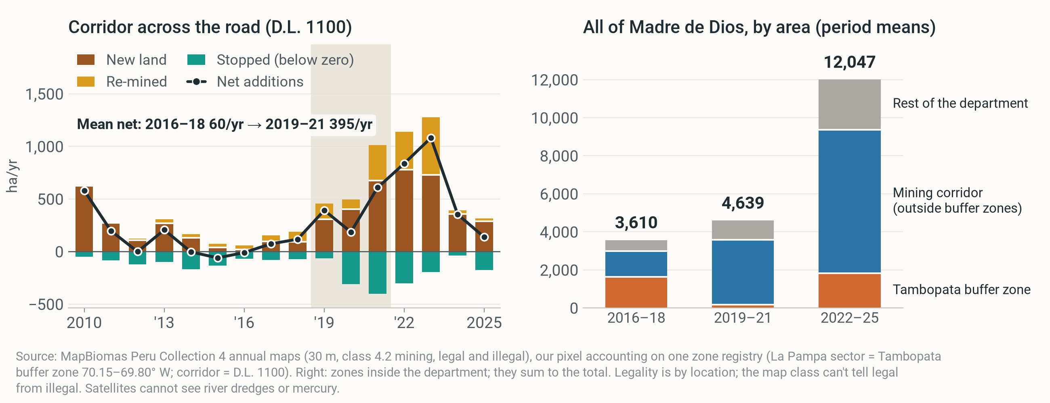
08 IT MOVED
DESCRIPTION
Mining moved across the road; the department never fell
Net mining additions (and parts), ha/yr · left: corridor across the road, 2010–2025, 60 → 395 (2016–18 → 2019–21) · right: Madre de Dios 3,610 → 4,639 → 12,047 (2016–18 → 2019–21 → 2022–25).
Notes:
About 50 seconds. Left: the strip of legal corridor directly across the road from La Pampa. Net additions rose from about 60 hectares a year in 2016 to 2018 to 395 in 2019 to 2021, mostly new land.
Right: the whole department. Madre de Dios never fell: 3,610 → 4,639 → 12,047 hectares a year across the three periods. The legal corridor's share of the department's net additions went from 42% to 80%, then 68% in the later years.
Careful: the rise elsewhere in the department was 1.8 times the size of Tambopata's fall, so this is not just the same miners moving; new entrants and the gold price play a part. We cannot show it was the same people.

Slide 10
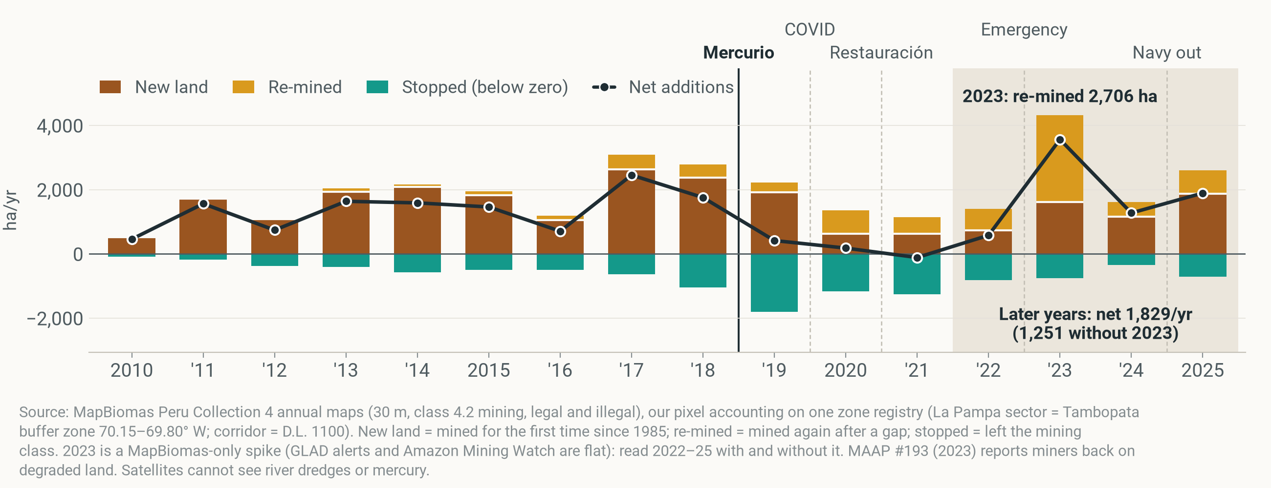
09 IT CAME BACK
DESCRIPTION
It came back on old pits: 46% of added land was re-mined
Net mining additions and their parts, ha/yr · Tambopata buffer zone · 2010–2025 · later years (2022–25): re-mined 1,139/yr, new land 1,345/yr; without the 2023 spike year re-mined 617/yr (33%).
Notes:
About 40 seconds. Back to the whole Tambopata buffer zone, 2010 to 2025. In the later years, 2022 to 2025, net additions were back at 1,829 hectares a year, 1,251 without the 2023 spike.
Much of it came back on old pits: re-mined land averaged 1,139 hectares a year, against 344 before. Forest-loss alerts do not see this, because there is no forest left to lose. MAAP #193 (2023) reports the same return to degraded land.
Note the wording: we call 2022 to 2025 the later years, because enforcement never simply stopped; it went on in waves: Plan Restauración in 2021 and a state of emergency from April 2023.

Slide 11
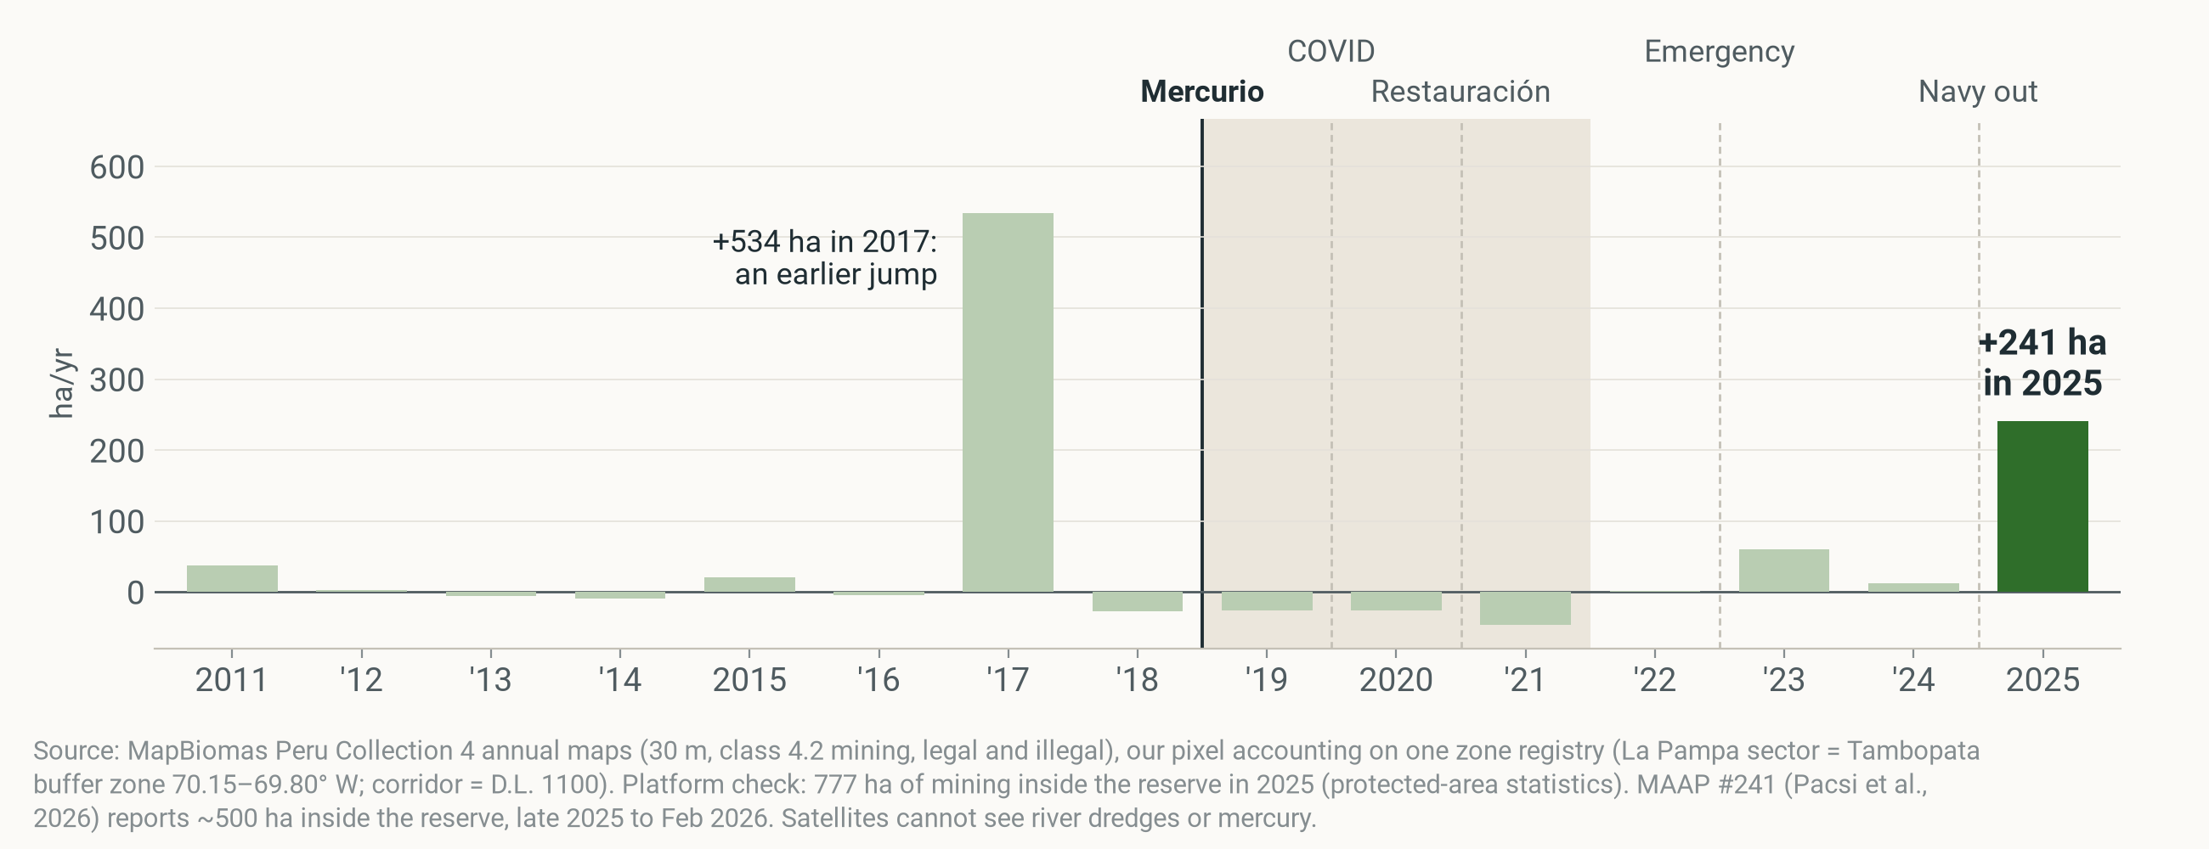
10 INSIDE THE RESERVE
DESCRIPTION
2025: mining inside the reserve jumped 241 ha after the navy left
Net mining additions, ha/yr · Tambopata National Reserve (inside the reserve, not the buffer zone) · 2011–2025 · 2019–21 mean −33/yr; mining area 2025: 777 ha. Navy left the Malinowski River posts in 2025 (MAAP #241, 2026).
Notes:
About 30 seconds. This is FZS's core area: the Tambopata National Reserve itself, not the buffer zone.
Net additions inside the reserve stayed small or negative for years; in 2019 to 2021 they averaged −33 hectares a year. In 2025 they jumped by 241 hectares, the year the navy left its river posts on the Malinowski for lack of funds. MAAP #241 (2026) reports about 500 hectares from late 2025 to February 2026.
The 2017 bar is an earlier jump; treat single years with care.

Slide 12
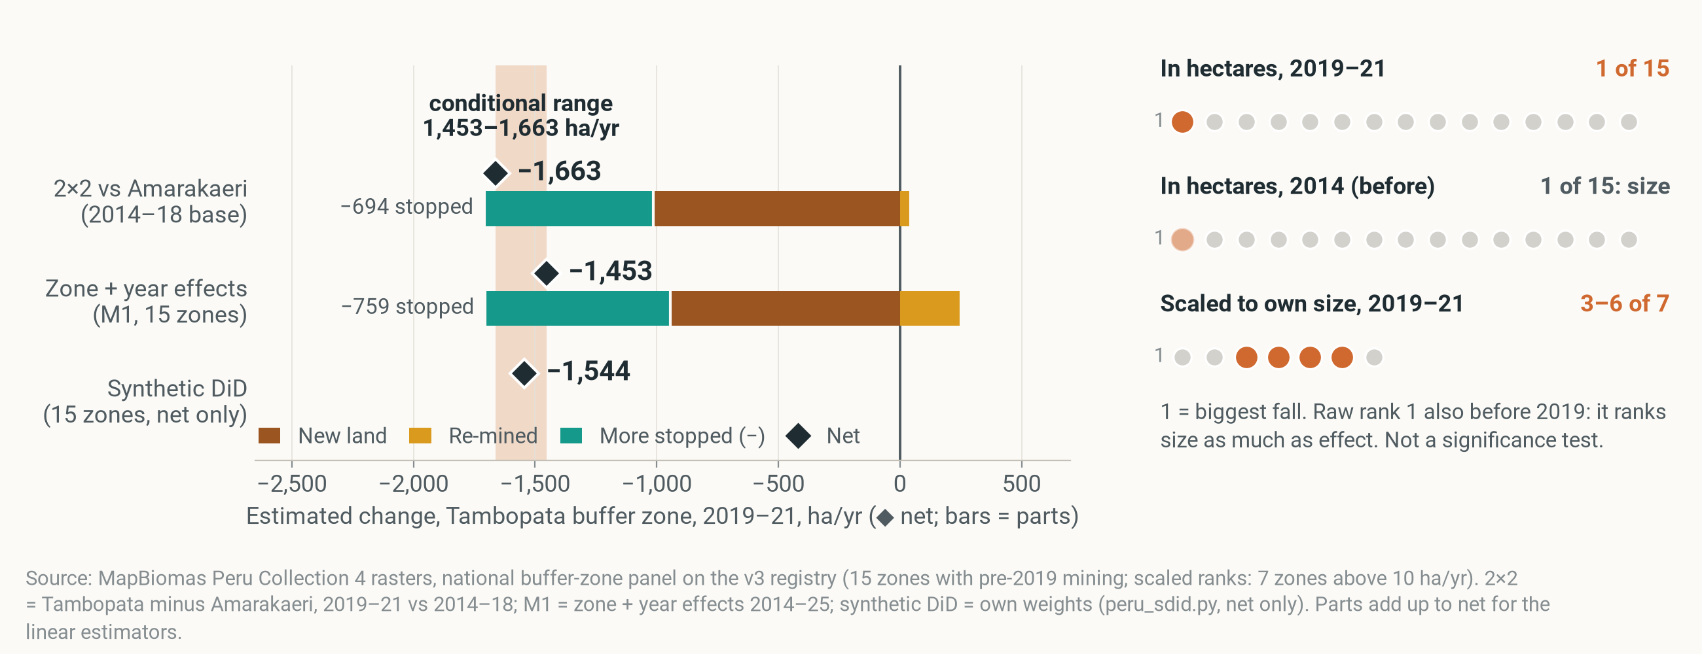
11 IS IT CAUSAL?
CAUSAL · CONDITIONAL
Did Mercurio cause the fall? Only conditionally, in hectares only
If the comparison zones show what Tambopata would have done, Mercurio and what followed lowered net additions by 1,453–1,663 ha/yr in 2019–21 (upper bound; part of it pits stopping; coincides with COVID) · Tambopata buffer zone · ha/yr
Notes:
About 60 seconds. The one causal sentence we are willing to make, and it has an 'if'. If the comparison zones show what Tambopata would have done without the operation, then Mercurio and what followed lowered net additions in the buffer zone by about 1,453 to 1,663 hectares a year in 2019 to 2021. The low end is the model with zone and year effects across 15 Peruvian buffer zones; the high end the two-by-two against Amarakaeri with 2014 to 2018 as the base. Synthetic difference-in-differences lands in between, −1,544.
The bars show what the estimate is made of: less new land, and more stopped land: about 759 hectares a year of the M1 estimate is extra stopping. So part of the 'effect' is pits going out of use.
Right side: the ranks are not a significance test. In hectares Tambopata has the biggest fall of 15 zones, but it also has the biggest change in 2014, before Mercurio: the raw rank measures size. Scaled to each zone's own size it ranks 3 to 6 of 7, nothing special.
Read it as an upper bound: La Pampa was targeted at its peak, miners moving into the comparison zones widen the gap, and the fall coincides with COVID.

Slide 13




12 LIMITS
DESCRIPTION
What satellites cannot see, and which way our biases push
Net mining additions measure land, not people, rivers or mercury · direction of each bias for the 2019–21 fall, Tambopata buffer zone
SATELLITES CAN'T SEE
EACH BIAS MAKES THE 2019–21 FALL LOOK…
smaller
bigger
Targeted at its peak
River dredges
Mercury
148 → 598 in La Pampa, 2021–23 (MAAP #193)
in rivers and fish
Miners moved into comparison zones
Big zones fall more in hectares
Pits stopping counted as less mining
Comparison zones had operations too
People
Map flicker
hectares, not miners
37% of land that stopped in 2019–21 was mined again within 2 years
Yearly maps blur Feb 2019
Read the fall as an upper bound, the return as a lower bound.
Notes:
About 30 seconds. Every brief must say what satellites can't see. River dredges: MAAP counted 148 rising to 598 in La Pampa between 2021 and 2023. Mercury in rivers and fish. People: hectares measure mining activity, not the number of miners. And map flicker: 37% of the land that 'stopped' in 2019 to 2021 was mapped as mining again within two years, so some stopping is the classifier, or miners returning.
On the right, the direction of each bias. Targeted at its record peak, miners moving into comparison zones, size, and counting pits that stop as less mining all make the fall look bigger. The comparison zones' own operations and yearly maps blurring a February start push the other way.
So: read our fall as an upper bound, and the return as a lower bound.

Slide 14



13 FOR FZS
PREDICTION
Stay after the sweep, and watch the ring around it
Informed expectations from one case (prediction), not proven rules · net mining additions, Tambopata buffer zone, reserve and corridor
Stay after the sweep
Watch the ring, in near real time
Hold the reserve's first km and the river
163 → 1,829
60 → 395
91%
ha/yr net additions, 2019–21 → later years. Fund presence, not one-off operations.
ha/yr just across the road. Forest-loss alerts on a few-km ring around each operation.
of first-time mining inside the reserve lies within 1 km of its edge. Staff the Malinowski posts.
Notes:
About 50 seconds. Three recommendations. They build on this one case, so treat them as informed expectations, not proven rules.
One, stay after the sweep. Net additions stayed low only in 2019 to 2021; in the later years the buffer zone was back at about 1,829 hectares a year, and the 2025 incursion into the reserve came right after a withdrawal. Fund presence, not one-off operations.
Two, watch the ring around the enforcement zone in near real time. In 2019 new pits kept opening in La Pampa while patrolled pits stopped, and new mining rose across the road, from about 60 to 395 hectares a year net. A forest-loss alert system like GLAD or MAAP on a ring of a few kilometres around each operation catches the next pit before it is dug out. Add old pits to the watch list: alerts miss re-mining.
Three, hold the reserve's first kilometre and the river. 91% of first-time mining inside the reserve lies within one kilometre of its edge. Staff the Malinowski posts, and push gold traceability in the corridor.
What would let us say more: dated patrol records per zone from SERNANP or FZS, dredge counts, and mercury sampling.

Slide 15

THANK YOU
Questions?
Like the anteater, mining comes back for seconds.
Photo: rangers / Tambopata river
Notes:
Thank you. Happy to take questions. Backup: six attempts, stopped land split, the road and cell designs, twins, Brazil, money and gold, definitions and data, map steps.

Slide 16
BACKUP
For questions
Six attempts · stopped land · road and cells · twins · Brazil · money and gold · definitions and data · map steps
Notes:
Backup slides, only if asked.

Slide 17
BACKUP · SIX ATTEMPTS
CAUSAL · CONDITIONAL
Six attempts at cause: two hold in hectares only
Net mining additions, Tambopata buffer zone, 2019–21 vs before, ha/yr unless stated · all conditional on the comparison
METHOD | COMPARES TAMBOPATA WITH | RESULT (NET) | VERDICT
1 Zone + year effects (M1–M3) | 14 Peruvian buffer zones | −1,453 to −1,859; scaled rank 4 of 7 | Holds in ha
2 Synthetic control | Weighted mix of zones | −411; no pre-2019 fit in hectares | Weak
3 Rule-based twins | Amanã, Tapajós, Munduruku (Brazil) | 16%–41% of their pace (AMW, other measure) | Weak
4 Spatial RD at the road | Either side of the highway | +2.2 pts of land/yr (p = 0.25) | Swing only
5 Matching (7 methods) | Areas picked by algorithm | All slower; placebo p 0.15–0.60 | Can't decide
6 Synthetic DiD | Weighted, trend-matched zones | −1,544; scaled rank 3 of 7 | Holds in ha
Notes:
Only the zone-level designs hold, and only in hectares: scaled to size Tambopata is ordinary. The raw rank 1 of 15 also appears in 2014, before Mercurio, so it measures size, not significance. Synthetic control cannot fit Tambopata's size before 2019; the twins grew differently before 2019 and use another measure (Amazon Mining Watch new area, not net additions); the road discontinuity measures a swing, an upper bound because displacement breaks its no-spillover assumption; matching never beats chance and has no common support.

Slide 18
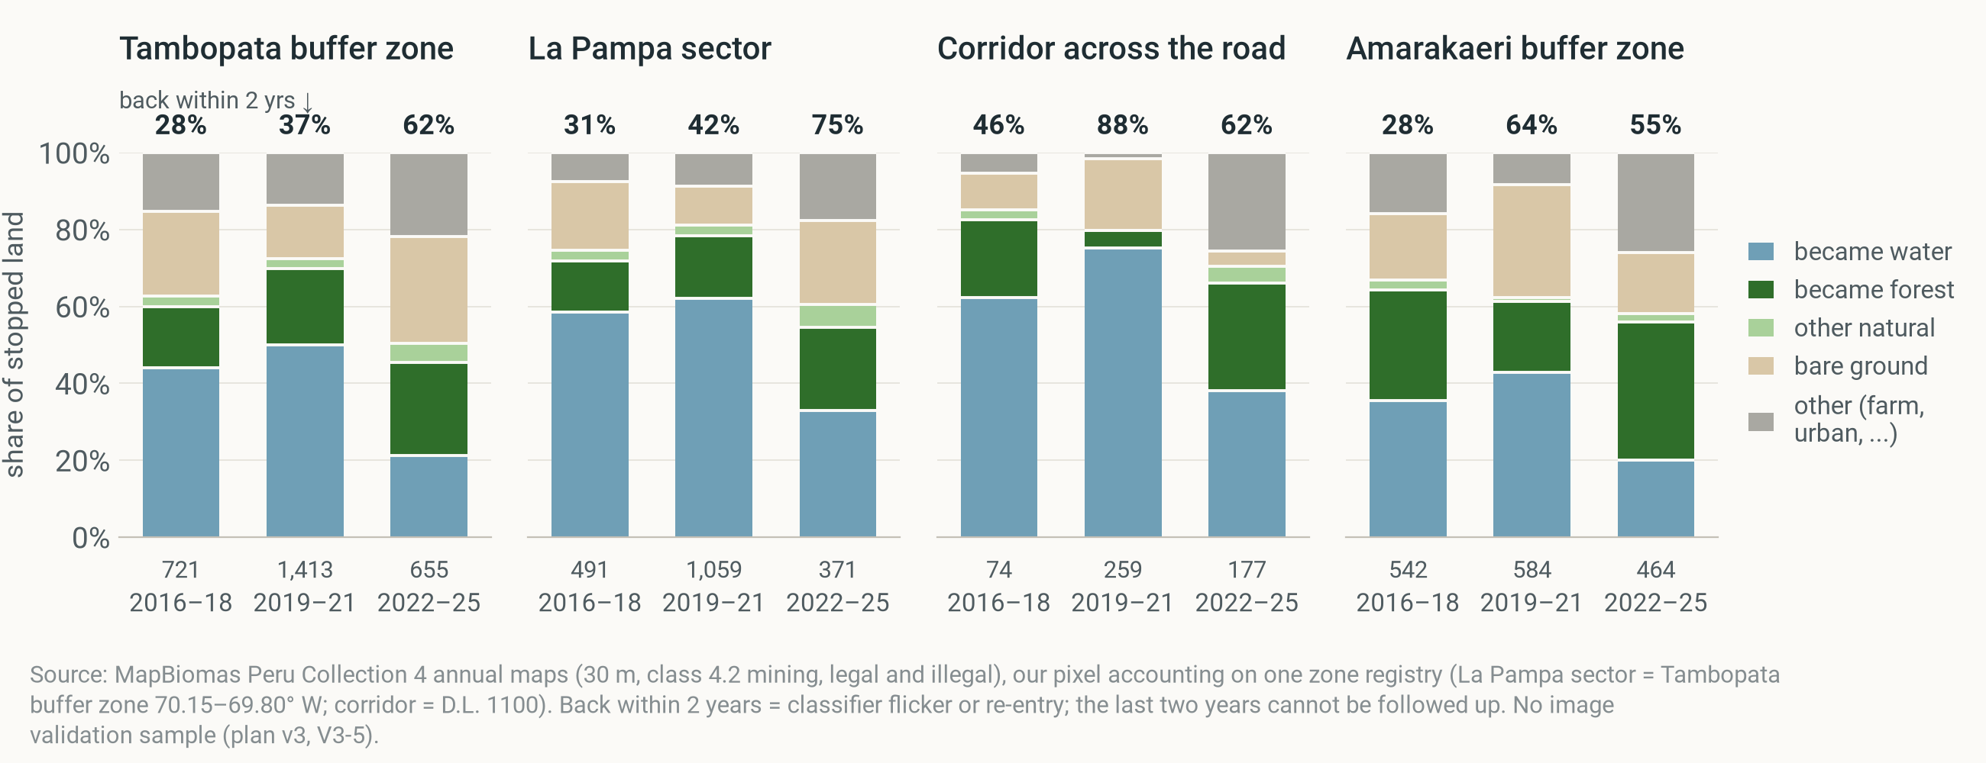
BACKUP · STOPPED LAND
DESCRIPTION
Stopped land: often water, often mined again within 2 years
Stopped land (left the mining class), share by what it became and share mining again within 2 years, period means · four zones · 2016–18, 2019–21, 2022–25 (small numbers under the bars: stopped ha/yr). Numbers on top: share mining again within 2 years.
Notes:
What 'stopped' means on the ground. Most stopped land becomes water (flooded pits) or regrows; a large share is mapped as mining again within two years: in the Tambopata buffer zone 37% for 2019–21. That is classifier flicker or miners returning; we have no image validation sample.

Slide 19
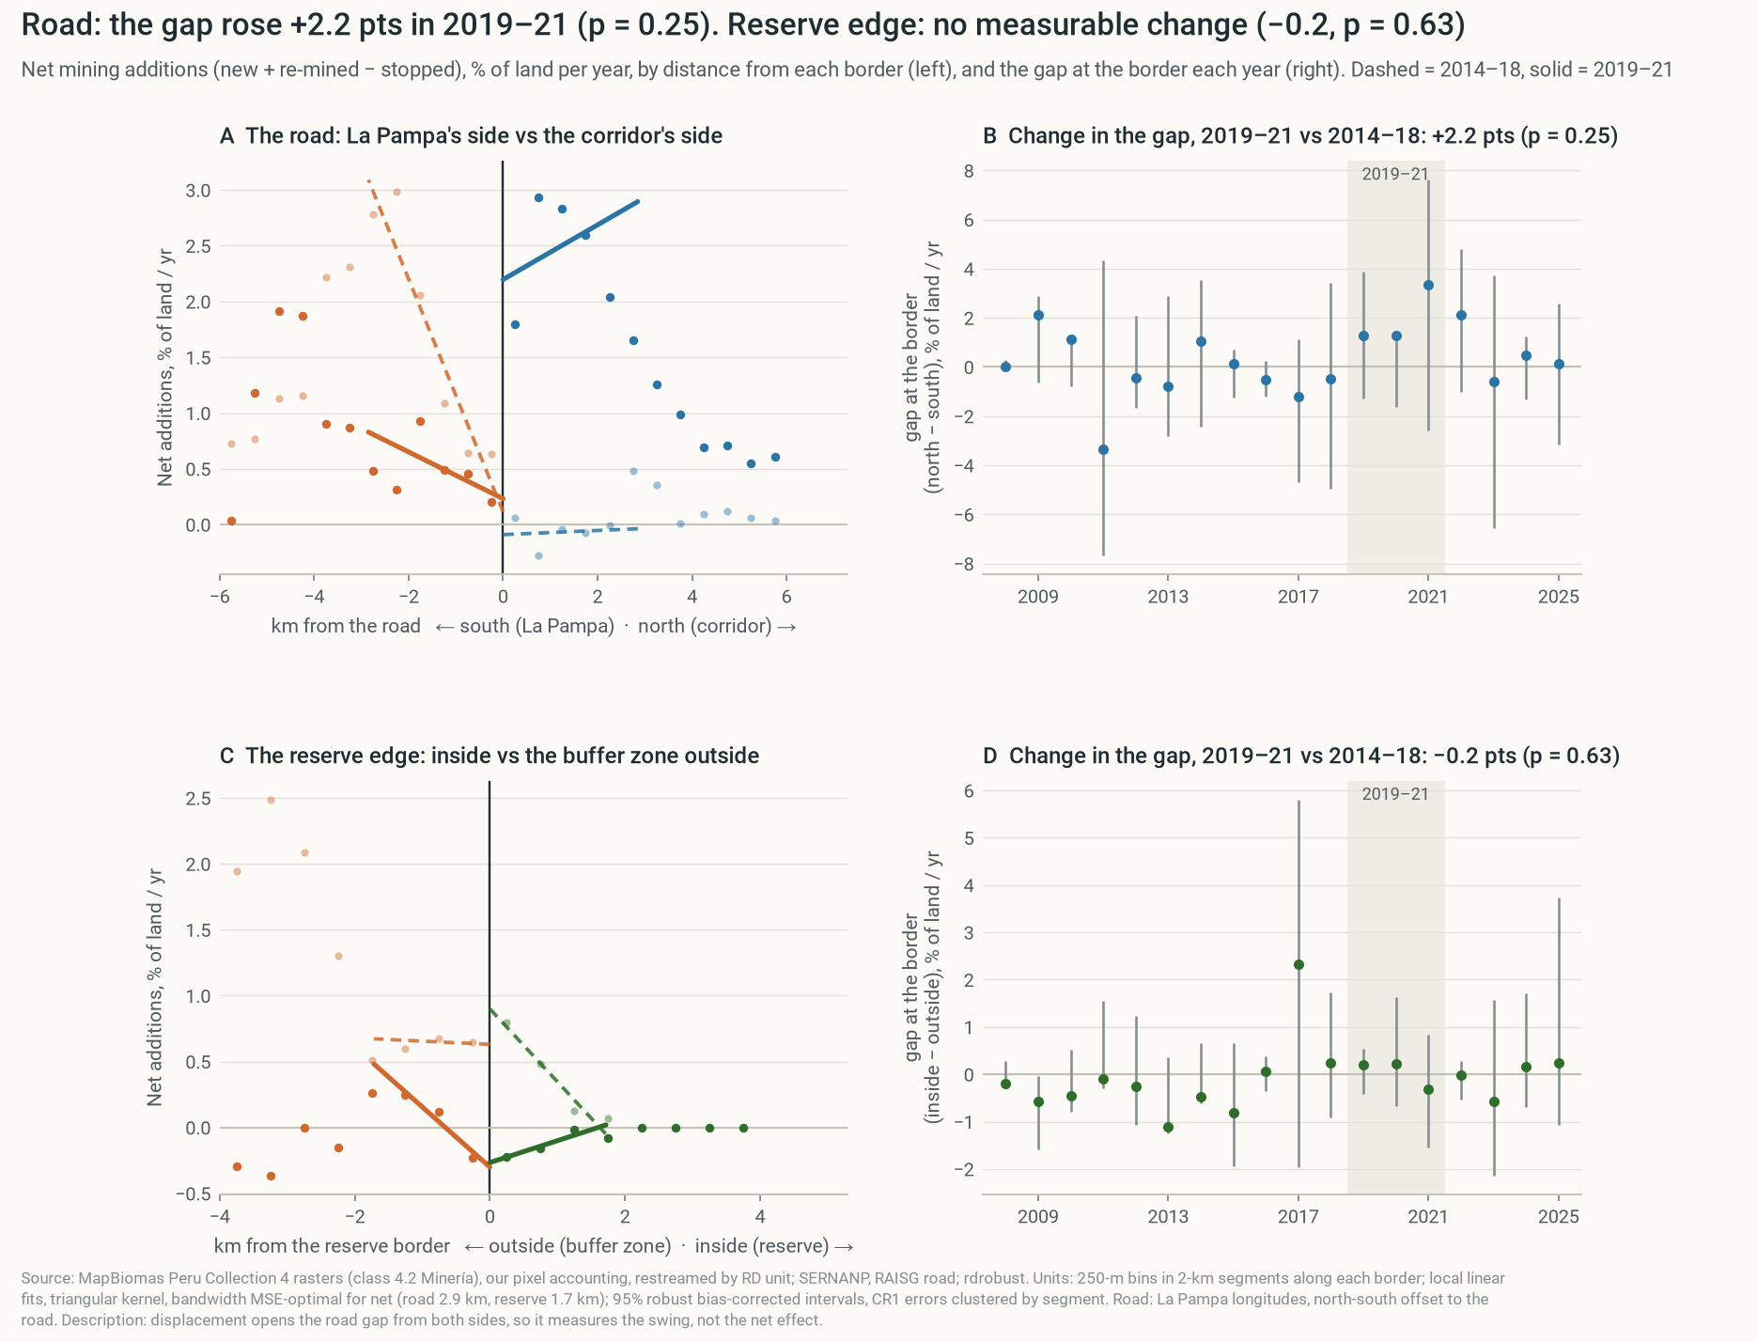
BACKUP · ROAD AND RESERVE EDGE
DESCRIPTION
At the road the gap swung north; at the reserve edge nothing
Net mining additions (and parts where linear) · La Pampa longitudes · 2014–25 · see the methods page for the full setup
Notes:
Spatial regression discontinuity on net additions, as a difference in discontinuities. The road estimate is a swing (north up, south down), an upper bound because displacement breaks the no-spillover assumption. Description.

Slide 20
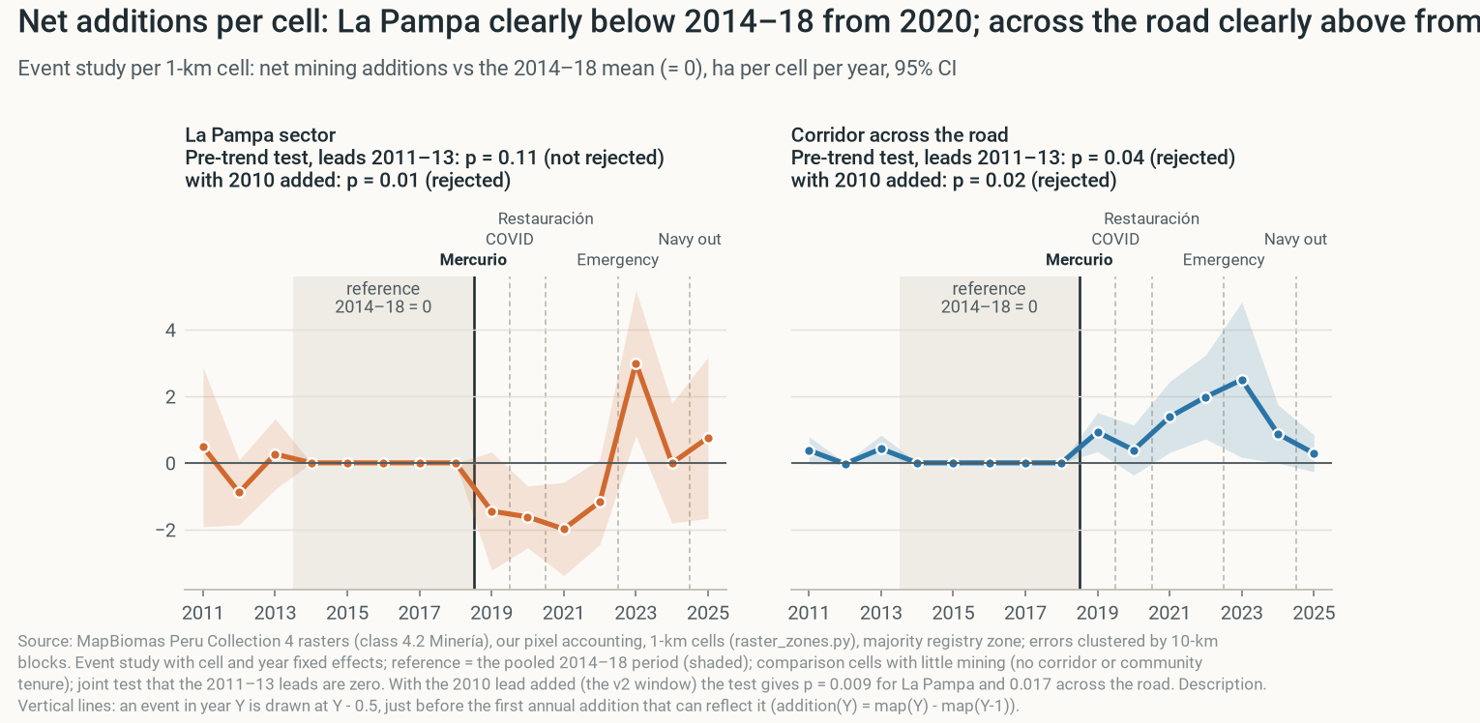
BACKUP · 1-KM CELLS
DESCRIPTION
Cell panel: close to a before/after, not a clean comparison
Net mining additions (and parts where linear) · La Pampa longitudes · 2014–25 · see the methods page for the full setup
Notes:
1-km cell panel on net additions. The comparison cells hold almost no mining, so this is close to a before/after comparison. Description.

Slide 21
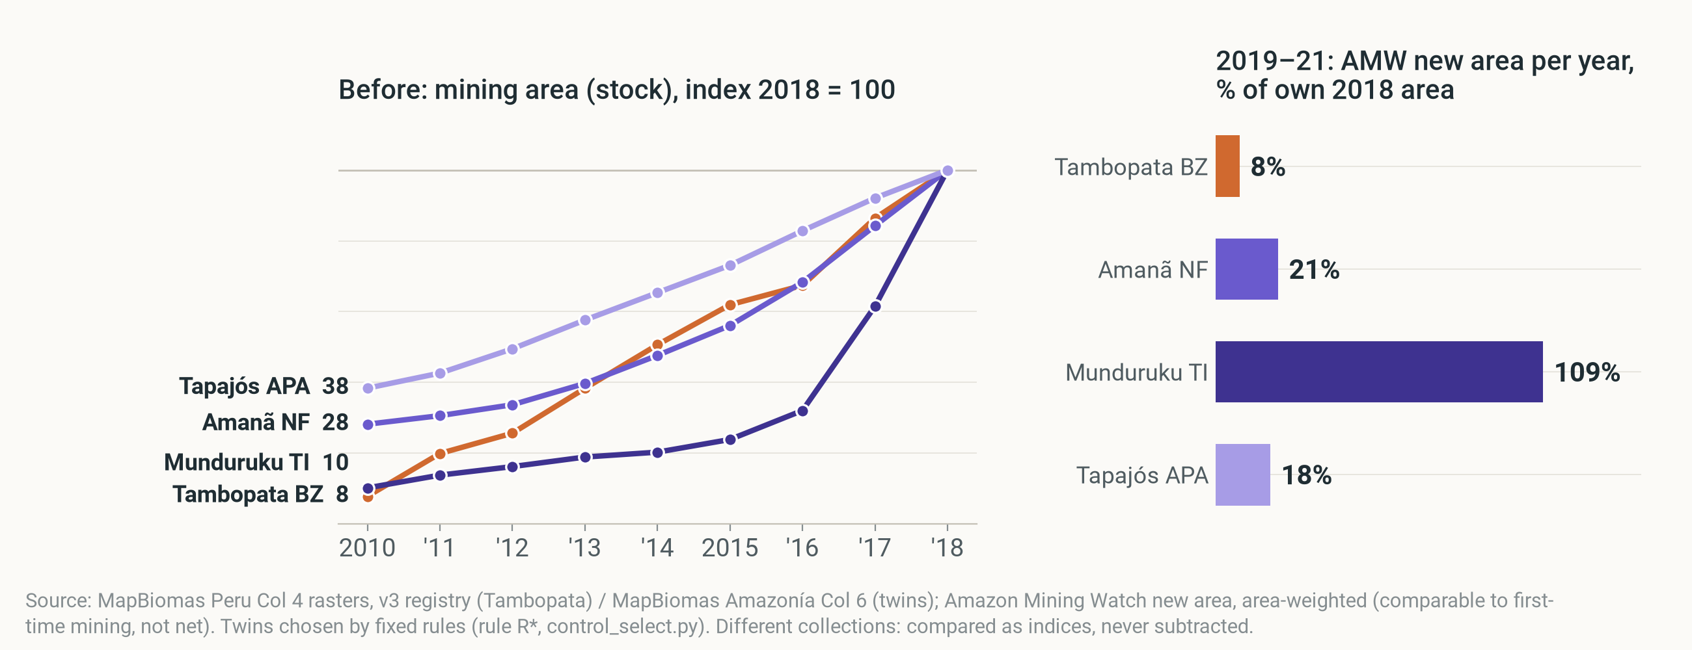
BACKUP · TWINS
DESCRIPTION
Twins: Tambopata at 16%–41% of their pace; trends differed before
Left: mining area (stock), index 2018 = 100, 2010–18 (pre-trends rejected, p < 0.001). Right: Amazon Mining Watch new area 2019–21 per year, % of own 2018 area: a different measure, not net additions.
Notes:
Rule-based twins (Ruby's design), all chosen by one dating rule. Tambopata added new mining at 16% of the twins' mean pace in 2019–21 (41% without Munduruku). Different measure: Amazon Mining Watch new area, comparable to first-time mining, not net additions. Before 2019 the twins grew differently (pre-trends rejected), so they can't show the counterfactual.

Slide 22
BACKUP · BRAZIL
DESCRIPTION
Brazil: a boom, then a fall; operations came at the peak
Net mining additions, ha/yr · MapBiomas Brazil (indigenous lands: Collection 11; staggered DiD: Collection 11 rasters, our pixel accounting)
ALL INDIGENOUS LANDS, ARTISANAL
YANOMAMI TERRITORY
STAGGERED DID, 9 TERRITORIES
1,332 → 4,319 → 2,978
500 → 482
+166
ha/yr net additions, 2016–18 → 2019–22 → 2023–25
ha/yr net additions, 2019–22 → 2023–25 (operation from Feb 2023)
ha/yr net, p = 0.37: cannot separate
Operations came at the peak of a boom, together with national gold-sale reforms (Jan 2023). Our design cannot separate them.
Notes:
Only if asked. Brazil is the mirror image: weaker federal enforcement in 2019–22, then targeted operations from 2023 (Yanomami from February 2023). Mining in indigenous lands boomed and then fell, but the operations came at the peak, and a national change in January 2023 (end of the gold 'good faith' rule, electronic invoices) hit all territories at once. A territory-level design cannot separate these, and the staggered estimate is not distinguishable from zero. Description.

Slide 23
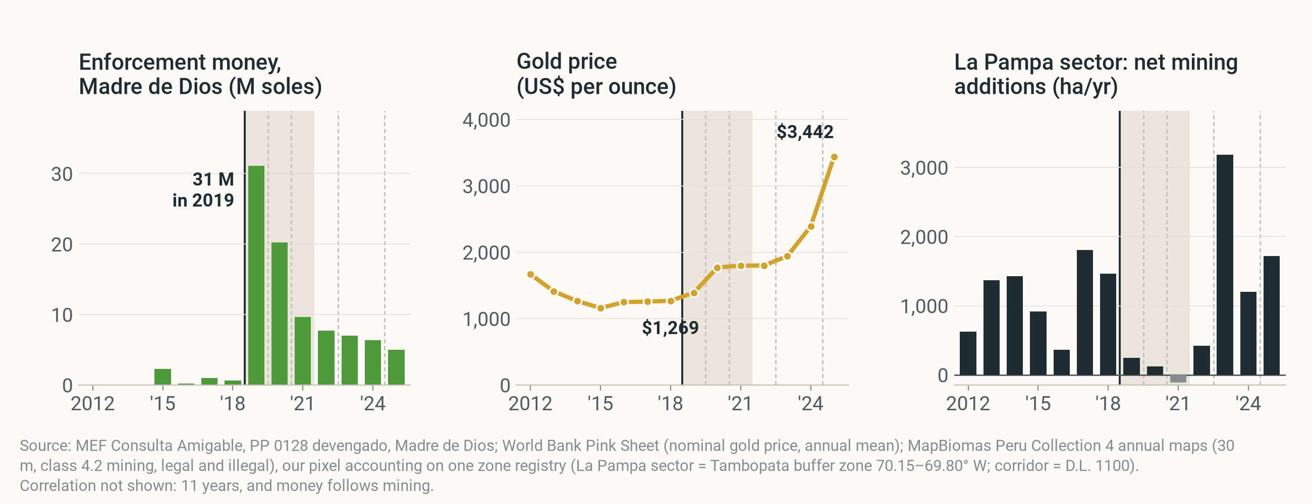
BACKUP · MONEY AND GOLD
DESCRIPTION
Enforcement money peaked in 2019 and faded; gold rose 2.7-fold
Same years in each panel · PP 0128 executed spending, Madre de Dios (lower bound) · gold price, nominal · net mining additions, La Pampa sector, ha/yr · 2012–2025. Shaded: 2019–21. Context, not a test.
Notes:
Context, not a test. The PP 0128 budget booked in Madre de Dios jumped in 2019 and shrank after (a lower bound: national units book in Lima). The gold price rose about 2.7-fold from 2018 to 2025. La Pampa's net additions came back as money faded and the price rose; with 11 years and money that follows mining, we do not test this.

Slide 24
BACKUP · DEFINITIONS AND DATA
DESCRIPTION
Definitions and data
One outcome, one zone registry, one treatment (plan v3) · every number in this deck comes from output/numbers.csv
ITEM | DEFINITION | SOURCE
Net mining additions | Mining area in year t − year t−1, ha/yr = new land + re-mined − stopped | MapBiomas Peru Collection 4 rasters (30 m, class 4.2)
New land / re-mined / stopped | First time since 1985 / mined again after a gap / left the mining class | Our pixel accounting (code/raster_zones.py)
Tambopata buffer zone | Official SERNANP polygon, whole (incl. Kotsimba) | SERNANP
La Pampa sector | Tambopata buffer zone between 70.15° and 69.80° W (no official line) | Our boundary
Corridor across the road | D.L. 1100 corridor ≤ 10 km north of the highway, La Pampa longitudes | INGEMMET, RAISG
Treatment | Operation Mercurio, Feb 2019; first treated year 2019; reference 2018 | MAAP #130; MINAM
Periods | 2016–18 before · 2019–21 Mercurio and what followed · 2022–25 later years (± 2023) | Course card
Notes:
Definitions for questions. The course's statistics workbook numbers (1,640 → 163 ha/yr) are reproduced as checks; our numbers come from the rasters on one zone registry and differ in the last digit.

Slide 25
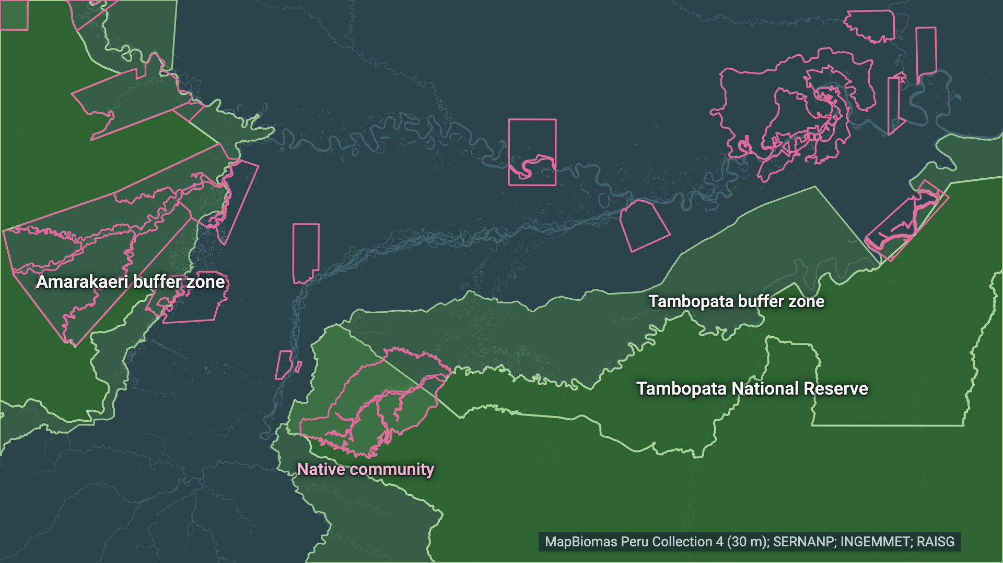
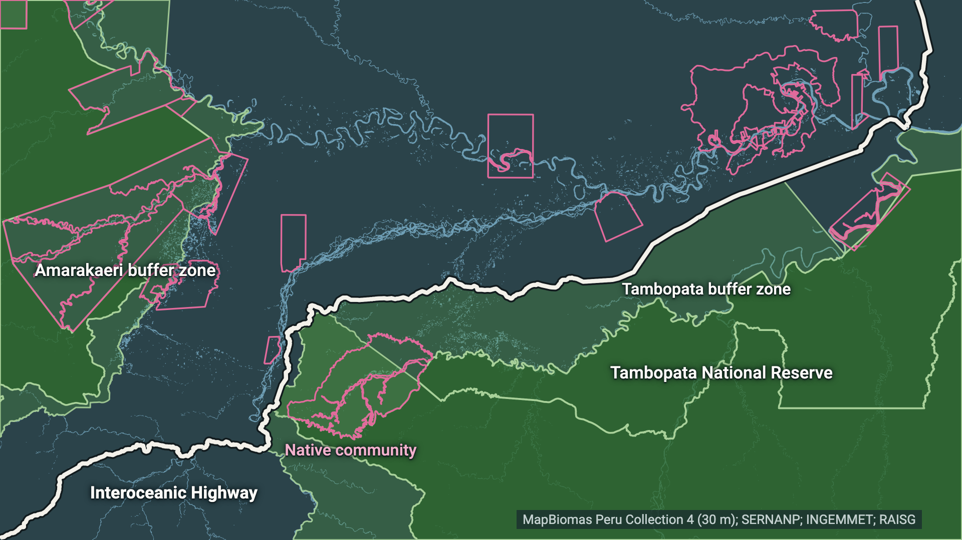
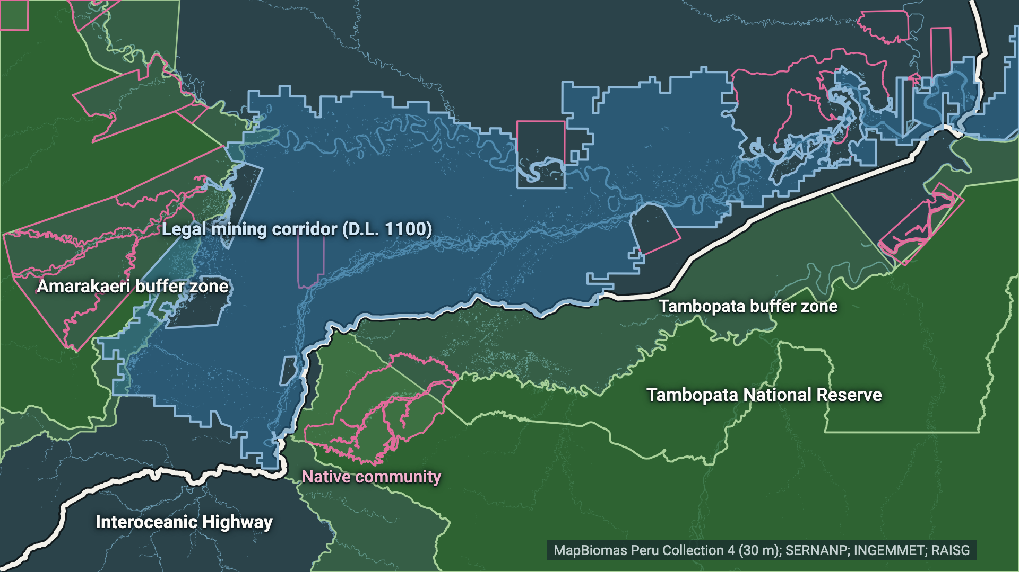
BACKUP · MAP STEPS
DESCRIPTION
The map build as four stills
Fallback if the video does not play · protected areas → highway → corridor → La Pampa
Notes:
Same four steps as the map video on slide 4, as stills.

