Slide 1
DATA FOR GOOD · QUESTION 2
When the patrols leave,
mining comes back for seconds.
Photo: giant anteater
What Operation Mercurio means for FZS's work in Tambopata.
Feb 2019
30 m
6
Operation Mercurio starts
satellite pixels since 1985
tests for cause
Notes:
About 30 seconds. Good morning, we are Group Giant Anteater. [Names.]
Our title is a small pun you'll understand in a minute: when enforcement leaves, mining comes back for seconds, the way our animal comes back to the same termite mound.
We looked at one question FZS faces every year: what do you get for the money you put into enforcement? Our case is Operation Mercurio, Peru's biggest operation against illegal gold mining, which started in February 2019 in La Pampa, right next to the Tambopata reserve where FZS works. We used 30-metre satellite maps for every year since 1985 and tested in six ways whether the operation caused what we see.

Slide 2
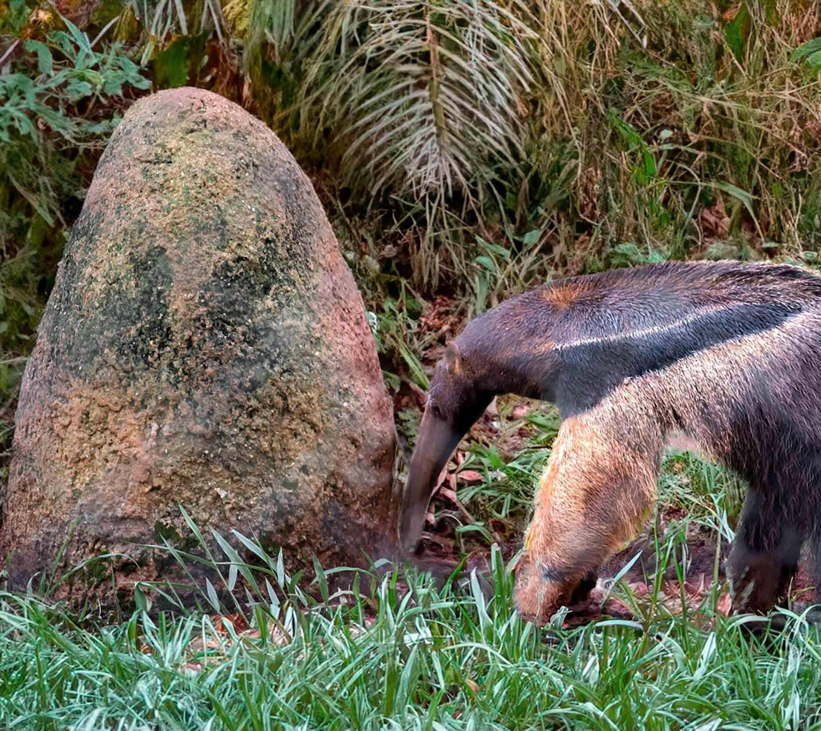

00 TWO FACTS ABOUT OUR ANIMAL
Anteaters eat 35,000 ants a day, and never destroy a nest
60 cm
1 minute
OF TONGUE
PER MOUND
Flicks up to 150 times a minute.
Then it moves on and comes back later.
Smithsonian's National Zoo; National Geographic
National Geographic
Photo: anteater at a termite mound
Mining in La Pampa did the same: it moved on, then came back.
Notes:
About 30 seconds. Two facts about the giant anteater.
One: its tongue is about 60 centimetres long and flicks in and out up to 150 times a minute. That's how it eats up to 35,000 ants and termites a day (Smithsonian's National Zoo; National Geographic).
Two, and this is the one to remember: it spends only about a minute at each mound, because the ants fight back. It never destroys the nest. It moves on and comes back later to feed again (National Geographic).
Hold on to that habit. It is a good description of what we found for gold mining in La Pampa.

Slide 3
THE QUESTION
What happens when an enforcement operation ends?
Operation Mercurio, La Pampa, Madre de Dios · from February 2019
WHAT WE FOUND
1 · IT FELL
2 · IT MOVED
3 · IT CAME BACK
1,640 → 163
23% → 65%
1,829
ha/yr net new mining, Tambopata buffer zone
of new mining near La Pampa north of the road
ha/yr in 2022–25, much of it on old pits
All three: description, 2016–18 vs 2019–21 vs 2022–25.
Notes:
About 45 seconds. FZS supports SERNANP's operations against illegal mining around Tambopata. Operations are expensive and they end. So the practical question is: what should FZS expect in the targeted area, and around it, once an operation is over?
There are three possibilities. Mining stops for good: deterrence. It moves next door: displacement. Or it waits and comes back: delay. Inside the target alone these look the same, which is why we compare areas.
The answer up front, all three are descriptions, not yet causes. One: net new mining in the buffer zone fell from about 1,640 to about 160 hectares a year. Two: new mining moved north of the highway, from about a quarter to two thirds. Three: it came back, to over 1,800 hectares a year in 2022 to 2025.

Slide 4
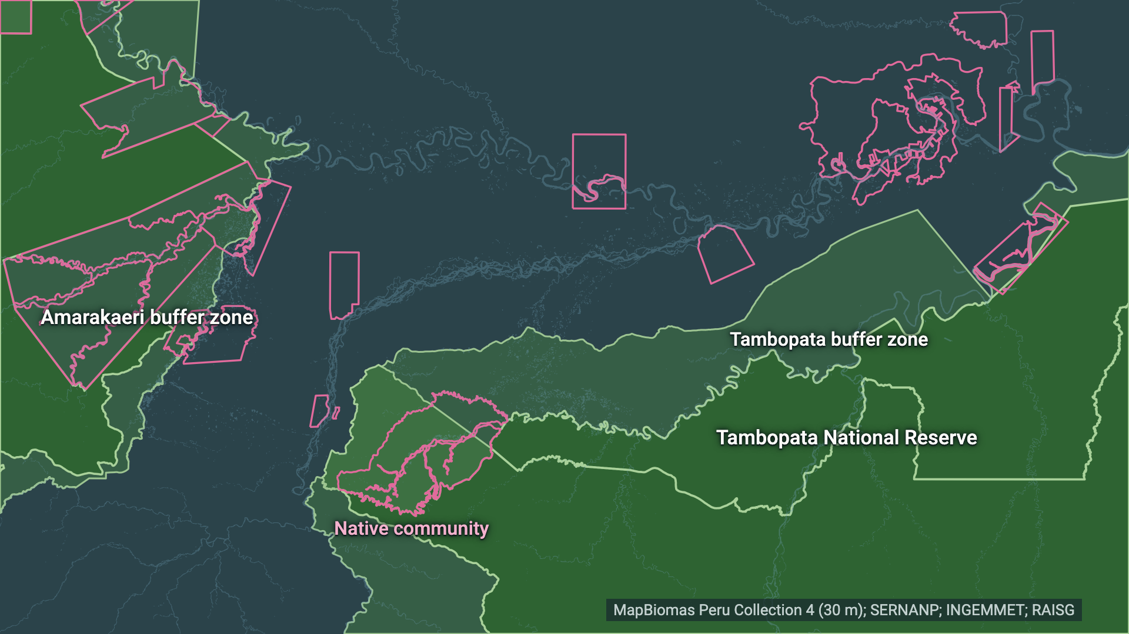
01 WHERE WE ARE
DESCRIPTION
La Pampa: one road away from land where mining is legal
1
Protected areas
Tambopata reserve, its buffer zone, Amarakaeri. Pink: native land.
2
The Interoceanic Highway
3
Rivers and old mining
4
Where mining can be legal
5
The target
Notes:
Step 1 of 5, about 12 seconds. This is Madre de Dios, in the south-east of the Peruvian Amazon. In green, the protected areas: Tambopata National Reserve in the south, the core area FZS helps protect, with its buffer zone around it. West of it the Amarakaeri buffer zone, east the Bahuaja-Sonene park. Pink outlines are native communities.

Slide 5
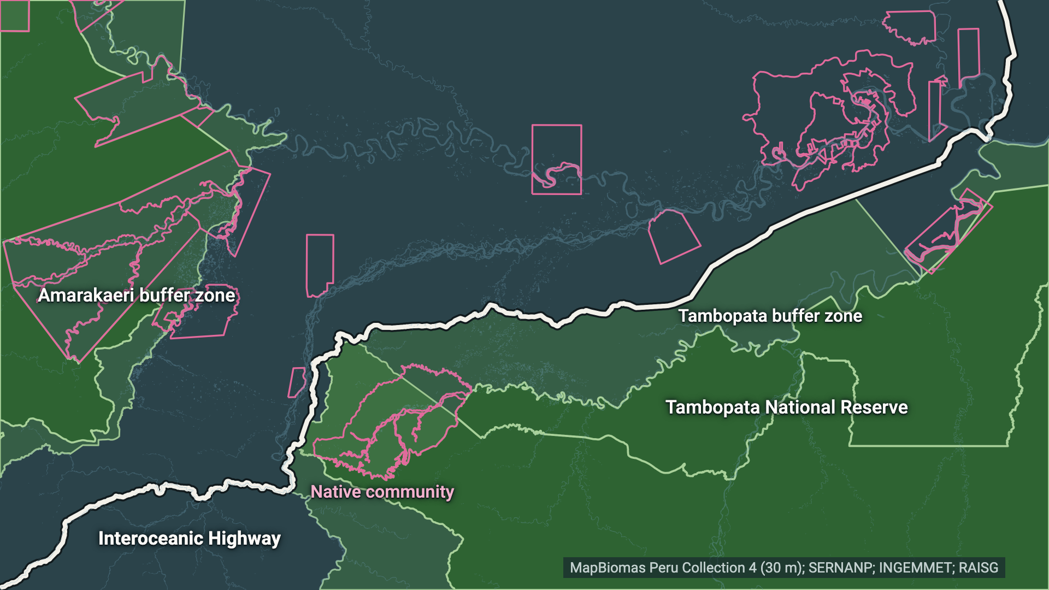
01 WHERE WE ARE
DESCRIPTION
La Pampa: one road away from land where mining is legal
1
Protected areas
2
The Interoceanic Highway
One road splits the buffer zone from the land to the north.
3
Rivers and old mining
4
Where mining can be legal
5
The target
Notes:
Step 2 of 5, about 12 seconds. The white line is the Interoceanic Highway, paved road from Brazil to the Pacific. It runs right along the edge of the buffer zone. Remember this road: it becomes the border in our story.

Slide 6
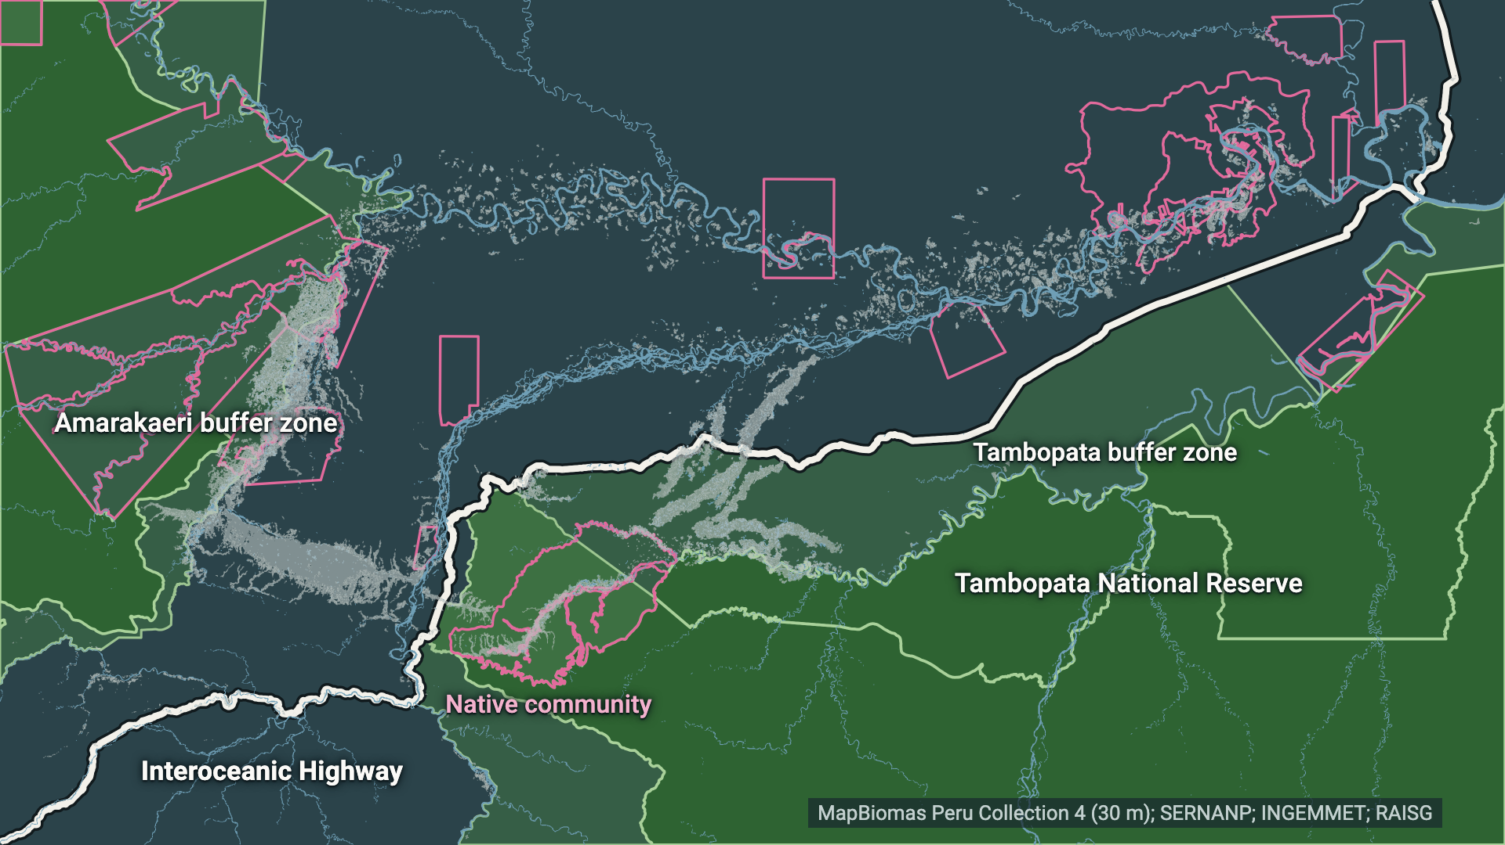
01 WHERE WE ARE
DESCRIPTION
La Pampa: one road away from land where mining is legal
1
Protected areas
2
The Interoceanic Highway
3
Rivers and old mining
Alluvial gold sits in floodplains. Grey: mined by 2018.
4
Where mining can be legal
5
The target
Notes:
Step 3 of 5, about 12 seconds. The blue lines are rivers. Gold here is alluvial: it sits in the sediments of river floodplains, so mining follows the rivers. The grey patches are land already mapped as mining by 2018: that is La Pampa, Peru's largest illegal mining area.

Slide 7
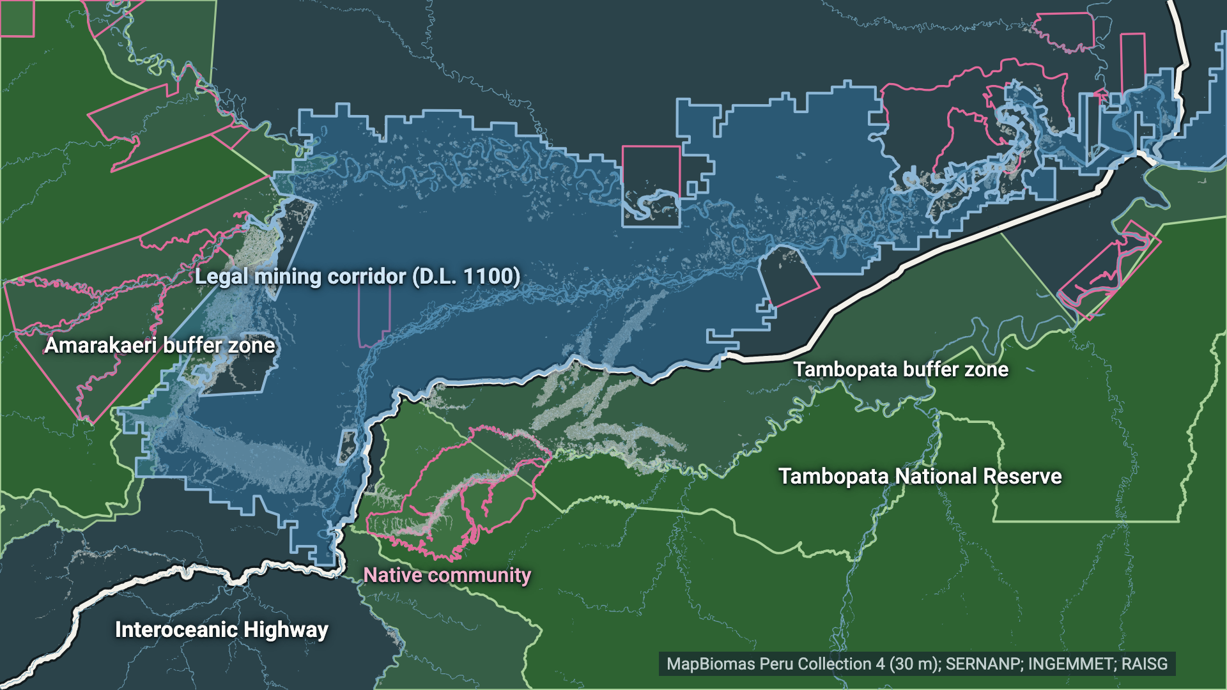
01 WHERE WE ARE
DESCRIPTION
La Pampa: one road away from land where mining is legal
1
Protected areas
2
The Interoceanic Highway
3
Rivers and old mining
4
Where mining can be legal
D.L. 1100 corridor, north of the road. South of it: a crime.
5
The target
Notes:
Step 4 of 5, about 12 seconds. The blue area is the mining corridor created by decree in 2012, D.L. 1100. Inside it small-scale mining can be permitted. South of the road, in the buffer zone, the same work is a crime. Important for later: legality is about location. The satellite maps themselves cannot tell legal from illegal mining.

Slide 8
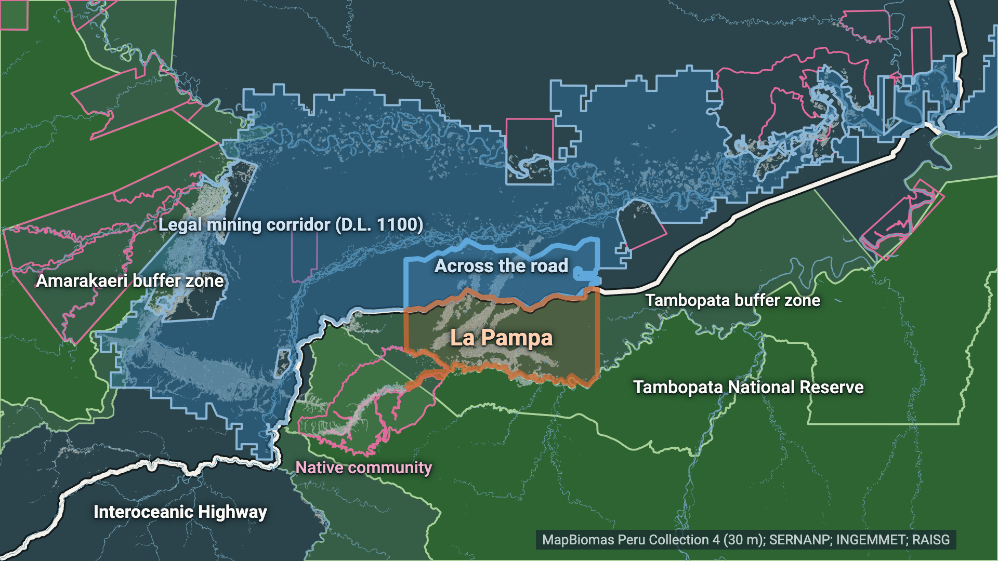
01 WHERE WE ARE
DESCRIPTION
La Pampa: one road away from land where mining is legal
1
Protected areas
2
The Interoceanic Highway
3
Rivers and old mining
4
Where mining can be legal
5
The target
La Pampa, target of Operation Mercurio from Feb 2019.
Notes:
Step 5 of 5, about 12 seconds. And this orange box is La Pampa, the target of Operation Mercurio from February 2019: over a thousand police and soldiers, with rotating commanders against corruption. The box is our boundary; there is no official one. The blue box just across the road is the part of the legal corridor directly opposite. Watch these two boxes.

Slide 9
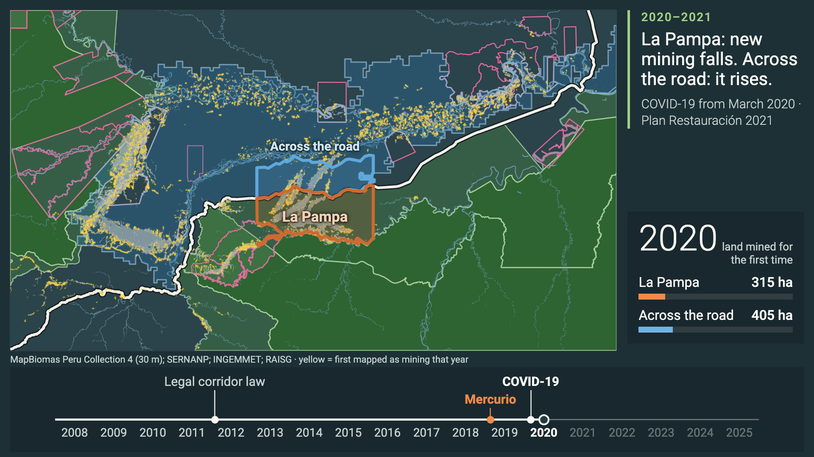
02 2008–2025 IN ONE MINUTE
DESCRIPTION
Where land was mined for the first time, 2008–2025
Notes:
About 75 seconds. Click to play. Each year, yellow pixels are land mapped as mining for the first time; they then fade to grey.
Before 2019 the yellow concentrates in La Pampa, south of the road. Watch the Mercurio pin in February 2019. In 2019 itself La Pampa is still busy; clearing went on that year. From 2020 La Pampa goes quiet and the yellow appears north of the road, in the corridor box. 2020 is also COVID: police and soldiers were pulled away.
From 2022 new mining returns in La Pampa, much of it on old, grey pits. 2023 brings a state of emergency; in 2025 the navy leaves its river posts.
The video ends with the caveat we'll repeat: satellites can't see river dredges or mercury.

Slide 10
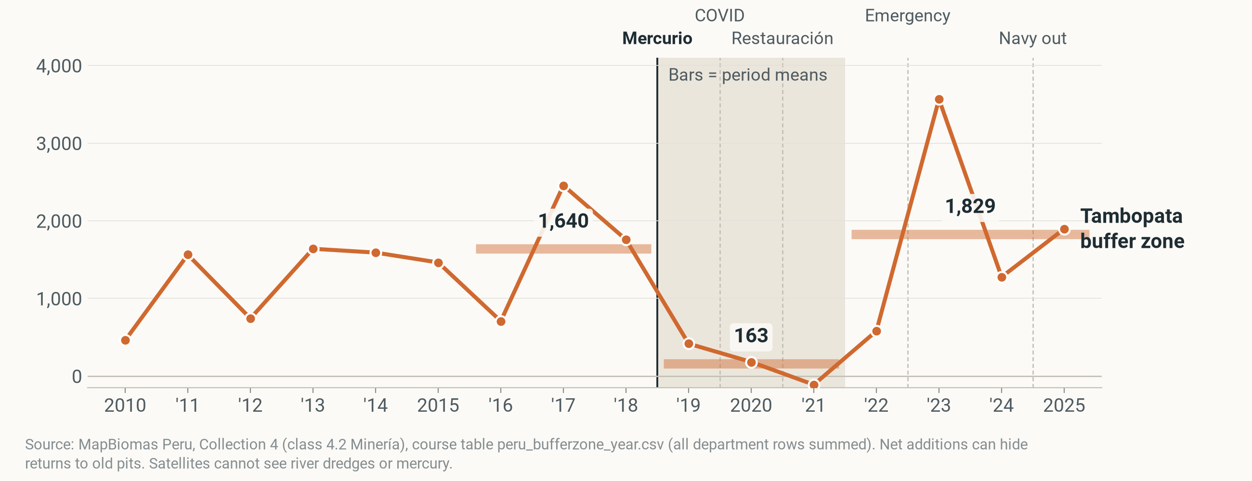
03 WHAT HAPPENED IN THE TARGET
DESCRIPTION
Net new mining in Tambopata fell 90%, then came back
Tambopata buffer zone · net new mining, ha per year · bars = period averages
Notes:
About 45 seconds. This is the course's measure: the mapped mining area this year minus last year, in the Tambopata buffer zone.
Before the operation, 2016 to 2018, it added about 1,640 hectares a year. In 2019 to 2021 only about 163: a 90 percent drop. In 2022 to 2025 it was back at about 1,829.
Two things to note. The timing: the fall shows from 2020, the first COVID year, not straight away in 2019. And 2023 spikes everywhere in the region, which may partly be a map artefact, so don't read too much into that single year.

Slide 11
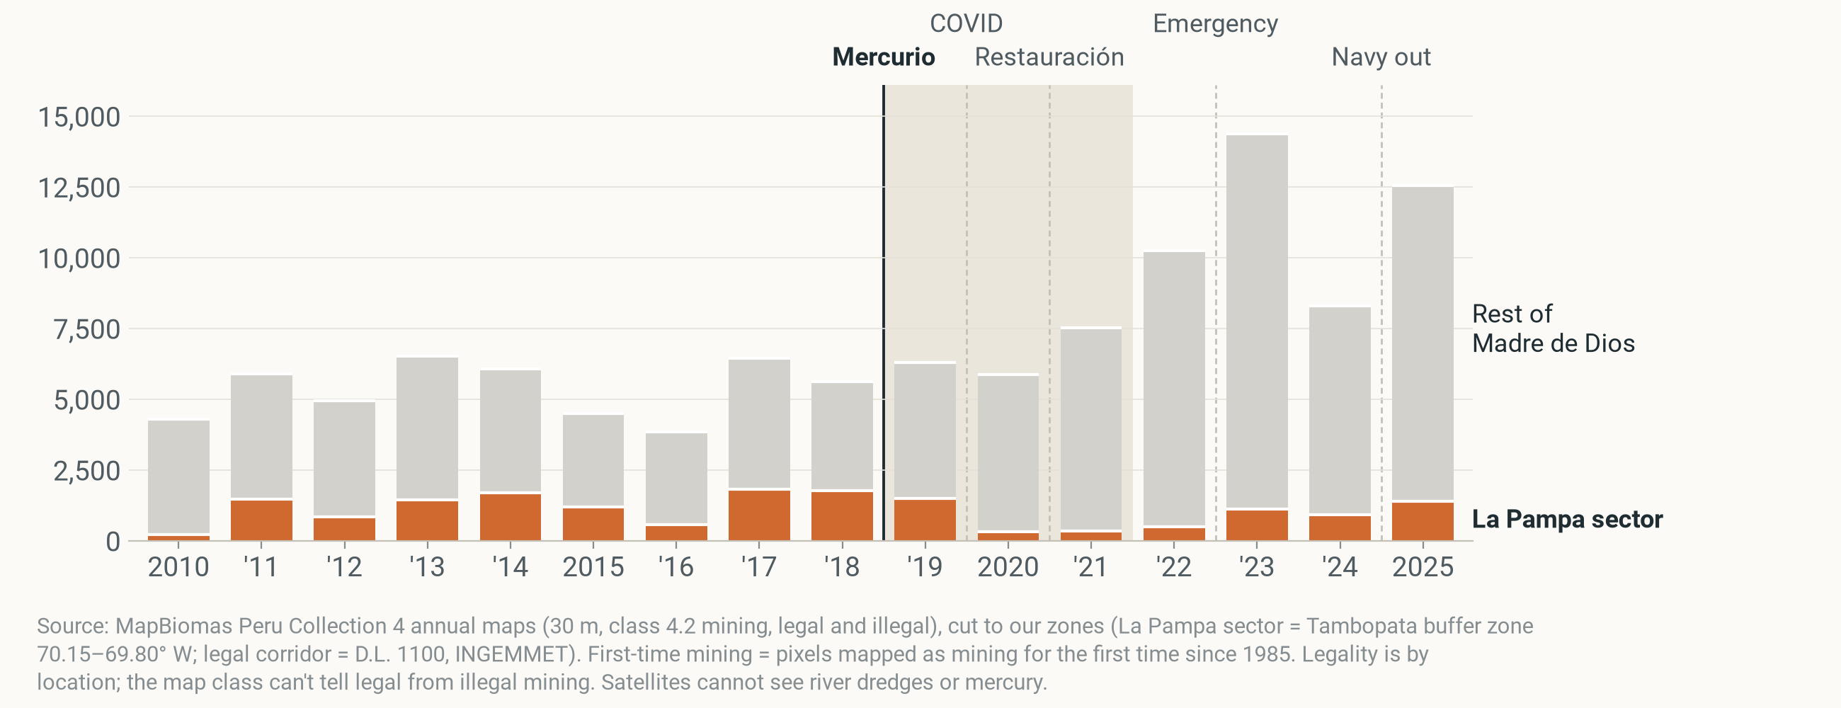
04 WHERE IT WENT
DESCRIPTION
La Pampa: first-time mining halved in 2019–21
Land mined for the first time, ha per year · orange = La Pampa, grey = rest of Madre de Dios
Notes:
About 20 seconds. From here we switch to a sharper measure from the pixel maps: land mined for the very first time. Net additions can hide miners returning to old pits; this measure can't.
In La Pampa, first-time mining went from about 1,395 to 722 hectares a year: it halved, not the 90 percent of the net measure. The grey is everything else in Madre de Dios. Next click: we colour it in.

Slide 12
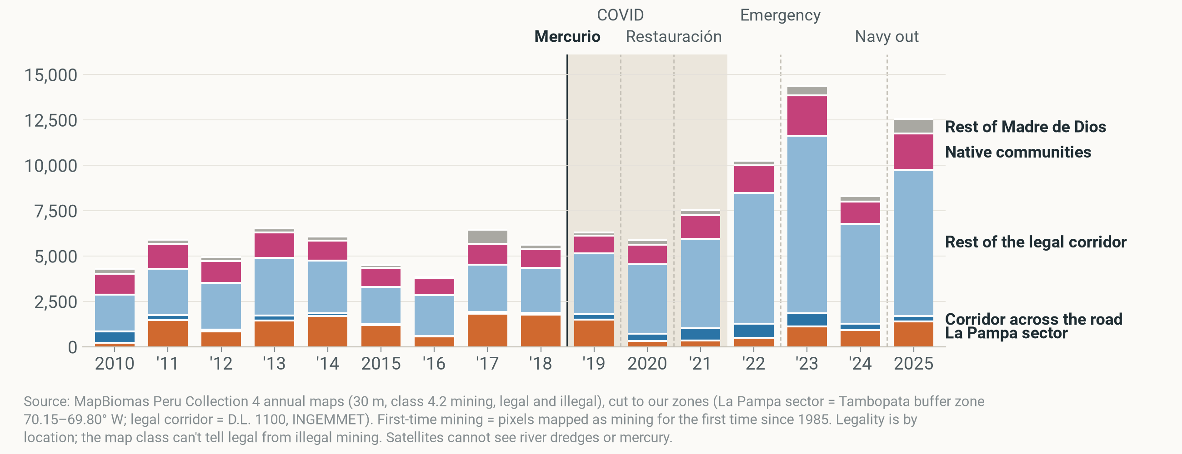
04 WHERE IT WENT
DESCRIPTION
The region kept growing, mostly in the legal corridor
All Madre de Dios, first-time mining: 5,317 → 6,571 → 11,373 ha/yr
Notes:
About 40 seconds. Same bars, now coloured by zone. Blue is the legal mining corridor; dark blue at the bottom is the part directly across the road from La Pampa.
The department as a whole did not fall at all: 5,317 hectares a year before, 6,571 during, 11,373 after. The legal corridor's share went from about half to almost three quarters.
Careful: the corridor grew by far more than La Pampa lost. So this is not just the same miners moving; new entrants and the gold price play a part. MAAP finds the same: 74 percent of mining deforestation in 2021 to 2024 was inside the corridor.

Slide 13
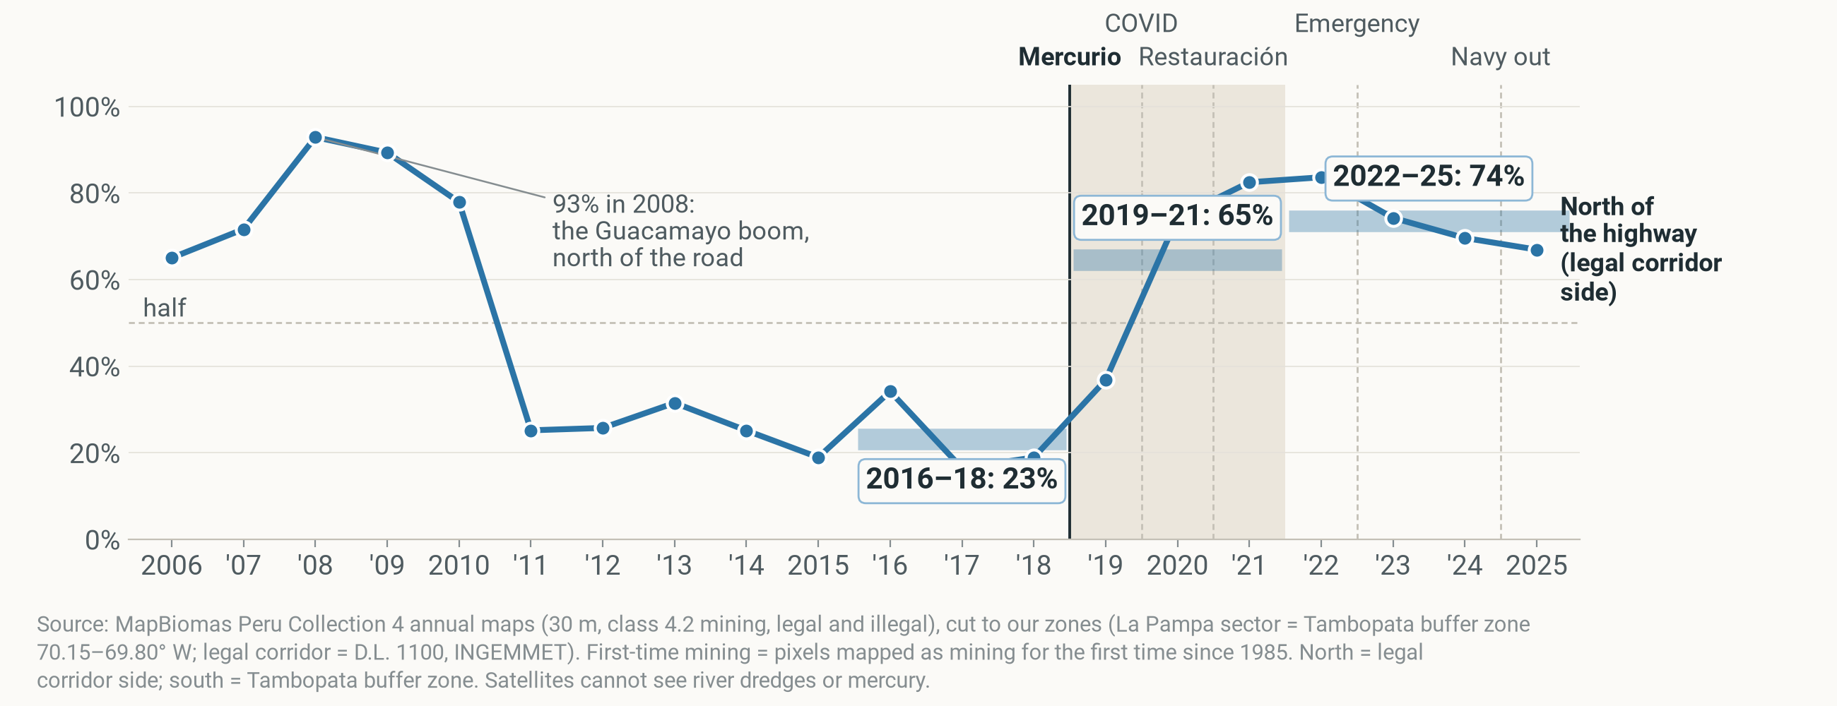
05 ACROSS THE ROAD
DESCRIPTION
New mining near La Pampa moved north of the road: 23% → 65%
Share of first-time mining north of the Interoceanic Highway, La Pampa's longitudes
Notes:
About 40 seconds. Now zoom in to La Pampa's stretch of the highway. The line is the share of new mining north of the road, on the legal side.
Before the operation, about 23%. During, 65%. No other start year gives a bigger jump north.
Honest history: the road was crossed before. In 2008, during the Guacamayo boom, 93% of new mining was north of it. Independent evidence agrees: Dethier and colleagues (2023) found that after Mercurio pond colour, a sign of active mining, faded across La Pampa except in its northwest, where it rose 43 percent. We can't show it was the same people who moved.

Slide 14
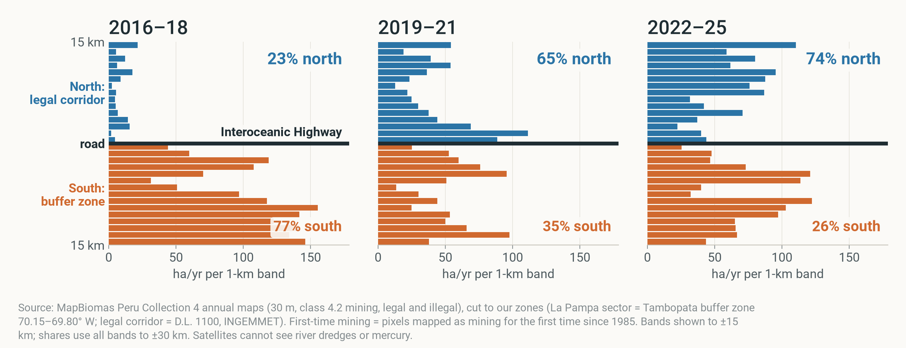
05 ACROSS THE ROAD
DESCRIPTION
In 2019–21 new mining piled up just north of the road
First-time mining per 1-km strip, ha/yr · blue = north (legal side), orange = south (buffer zone)
Notes:
About 30 seconds. The same story as a picture. Each bar is a one-kilometre strip parallel to the highway; the thick line is the road.
Before the operation the mass sits south, in the buffer zone. In 2019 to 2021 it sits in the first few kilometres north of the road. By 2022 to 2025 it has spread deeper into the corridor, and the south has partly come back.

Slide 15
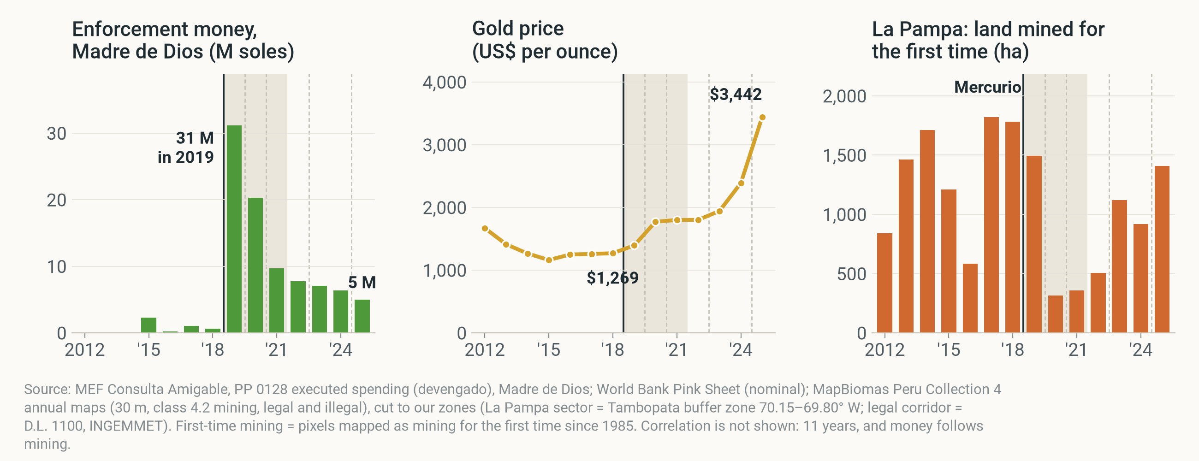
06 WHY IT CAME BACK
DESCRIPTION
Money faded after 2019, while gold rose 2.7-fold
Enforcement spending, Madre de Dios · gold price · La Pampa first-time mining
Notes:
About 45 seconds. Why did it come back? Three things line up.
Left: the anti-illegal-mining budget booked in Madre de Dios jumped in 2019 and then shrank year after year; it's a lower bound because national units book in Lima. Middle: the gold price, up 2.7-fold from 2018 to 2025. Right: La Pampa's first-time mining, which came back as the money faded and the price rose.
And La Pampa had not run out of gold: by 2018 only 21% of its gold-bearing land had been mined.
If asked about a correlation: the yearly gap and spending correlate at r = -0.31 over 11 years. That is weak, and money also follows mining, so it is not a causal test.

Slide 16
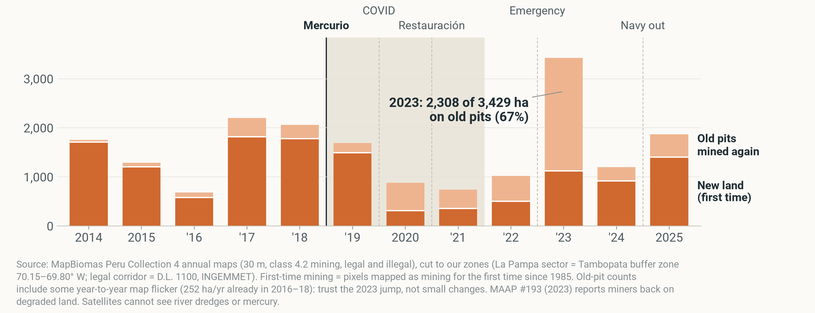
07 HOW IT CAME BACK
DESCRIPTION
In 2023, 67% of new mining in La Pampa was on old pits
La Pampa, ha per year · dark = new land · light = old pits mined again
Notes:
About 30 seconds. How it came back matters for monitoring. Dark orange is land mined for the first time; light orange is old pits that were abandoned and mined again.
In 2023, two thirds of La Pampa's new mining was on old pits. Forest-loss alerts never see this, because there is no forest left to lose. MAAP #193 reports the same return to degraded land. Small old-pit counts include some map flicker, so trust the 2023 jump, not small changes.

Slide 17
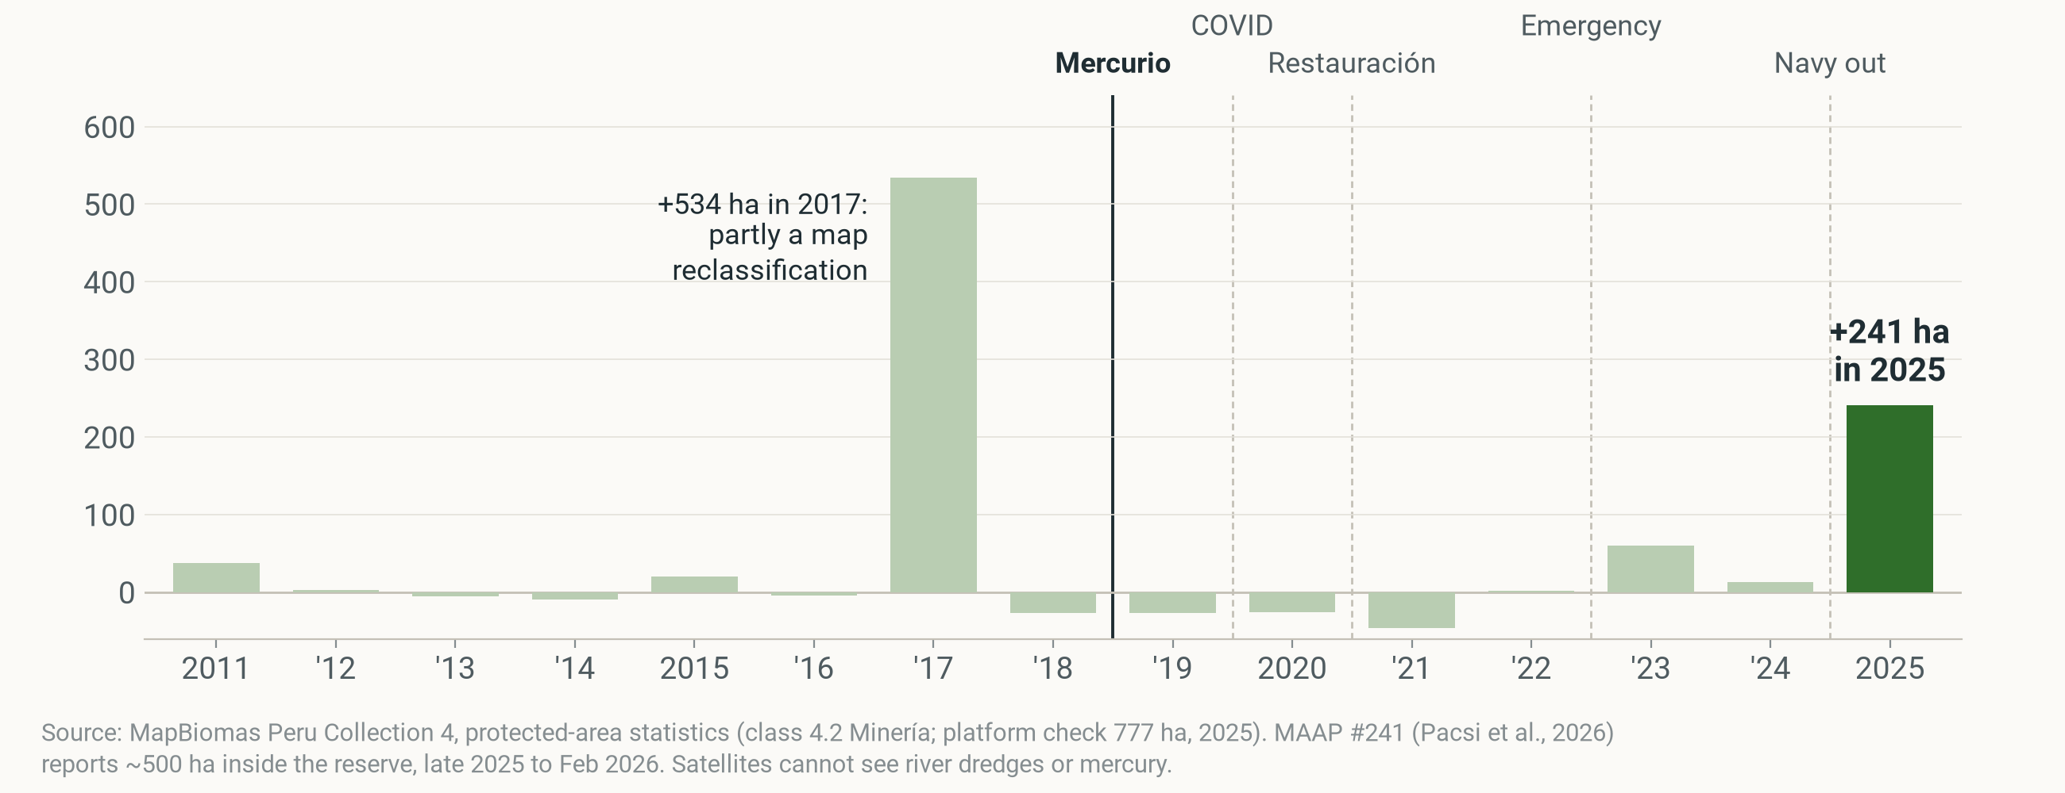
08 INSIDE THE RESERVE
DESCRIPTION
In 2025, mining inside the reserve jumped by 241 ha
Tambopata National Reserve · net new mining, ha per year
Notes:
About 40 seconds. This is FZS's core area. The course data stop at the buffer zone, so we downloaded the protected-area statistics ourselves.
Inside Tambopata National Reserve, mining stayed small for years. In 2025 it jumped by 241 hectares, to 777 in total. MAAP #241 reports about 500 hectares from late 2025 to February 2026, after the navy left its river posts on the Malinowski for lack of funds.
The 2017 bar is partly a map reclassification, not real mining.

Slide 18






09 IS IT CAUSAL?
CAUSAL · CONDITIONAL
We tried six methods. Two held up
Each builds a stand-in for Tambopata without Mercurio
Difference-in-differences
Synthetic control
Rule-based twins
vs 14 other Peruvian buffer zones
a weighted copy of Tambopata
look-alike areas in Brazil
HELD UP · IN HECTARES
NO GOOD COPY
DIFFERENT TRENDS BEFORE 2019
Spatial discontinuity
Matching, 7 ways
Synthetic DiD
just north vs just south of the road
areas picked by algorithm
weighted zones and years
BORDERLINE · P = 0.08
CAN'T BEAT CHANCE
HELD UP · IN HECTARES
Notes:
About 45 seconds. Only one area was targeted, so to ask 'did Mercurio cause the fall?' we need a stand-in: what would Tambopata have done without it? We built that stand-in six ways.
Two held up: difference-in-differences against the other 14 Peruvian buffer zones, and synthetic difference-in-differences, which weights zones and years to match Tambopata's past. Both find a fall far bigger than chance, but only in hectares.
The other four are weaker. A synthetic copy can't match a zone this big. The Brazilian twins grew at a different pace before 2019, so they fail the basic test. The road comparison is borderline. And seven matching methods all find Tambopata slower, but never beyond chance. Details are in the backup.

Slide 19
10 THE CAUSAL CLAIM
CAUSAL · CONDITIONAL
What we can say about cause
If the other zones show what Tambopata would have done, Mercurio and the operations after it cut net new mining by 411 to 1,859 ha a year in 2019–21.
Hectares only
p = 0.07
COVID overlaps
Largest fall of 15 zones; for its size, 3rd of 7.
The best possible with one target among 15.
Nothing fell in 2019. The fall came in 2020–21.
Notes:
About 40 seconds. This is the one causal sentence we are willing to make, and it has an 'if'. If the other buffer zones show what Tambopata would have done without the operation, then Mercurio and the operations that followed cut net new mining by roughly 400 to 1,900 hectares a year in 2019 to 2021. The low end comes from the synthetic control, the high end from the model with each zone's own trend.
Three limits. It holds in hectares, not relative to the zone's size: scaled, Tambopata is third of seven, nothing special. With one target among fifteen zones, 0.07 is the smallest p-value this test can produce. And the fall coincides with COVID: nothing fell in 2019 itself.

Slide 20
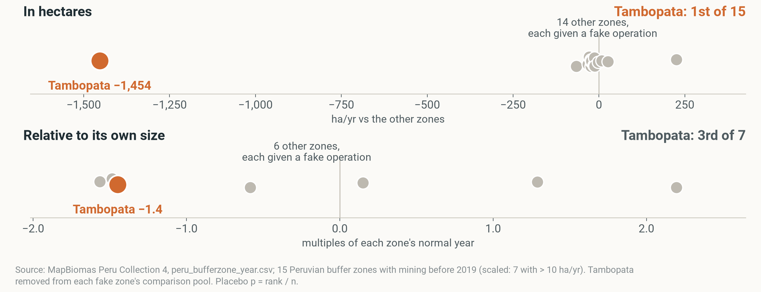
10 THE EVIDENCE
CAUSAL · CONDITIONAL
In hectares the fall stands out. For its size, it doesn't
Orange = Tambopata's real 2019–21 change · grey = other zones given a fake operation
Notes:
About 40 seconds. How the test works: we pretend each of the other zones was the one targeted, and compute the same number. If Mercurio mattered, Tambopata's real change should stand out from all the fake ones.
Top row, in hectares: Tambopata, the orange dot, is far to the left of every grey dot. First of 15.
Bottom row, the same thing scaled to each zone's normal year: Tambopata sits among the others, 3rd of 7. A big zone falls a lot in hectares just by being big. That is why our claim is in hectares only.

Slide 21




11 LIMITS
DESCRIPTION
Most biases make the fall look bigger
SATELLITES CAN'T SEE
EACH BIAS MAKES THE 2019–21 FALL LOOK…
smaller
bigger
Picked at its peak
River dredges
Mercury
Hectares, not people
148 → 598 in La Pampa, 2021–23 (MAAP #193)
in rivers and fish
Miners moved into comparison zones
Big zones fall more in hectares
Comparison zones had operations too
People
Legality
Yearly maps blur Feb 2019
hectares, not miners
legal and illegal look alike
Read the fall as an upper bound, the return as a lower bound.
Notes:
About 40 seconds. Every brief must say what satellites can't see. On the left: river dredges, which MAAP counted rising from 148 to 598 in La Pampa between 2021 and 2023; mercury in rivers and fish; people, because we count hectares, not miners; and legality, because legal and illegal mining look the same from space.
More useful for FZS is the direction of each bias, on the right. La Pampa was targeted at its record peak, so part of the fall may be a return to normal. Hectares understate activity on old pits and rivers. Miners moving into comparison zones widen the gap. A big zone falls more in hectares. All of these make the fall look bigger. Two push the other way: the comparison zones had their own operations, and yearly maps blur a February start.
So: read our fall as an upper bound, and the return as a lower bound.

Slide 22



12 FOR FZS
RECOMMENDATION
Plan for the months after the operation ends
Stay after the sweep
Guard the reserve's edge and river
Watch the legal side and old pits
2019–21
91%
69 → 463
the only years with a fall. Fund lasting presence, not one-off raids.
of new mining inside the reserve is within 1 km of its edge.
ha/yr of new mining just across the road.
Notes:
About 60 seconds. Three recommendations. They build on one case, so treat them as informed expectations, not proven rules.
One, stay after the sweep. The fall lasted only through 2021, and the 2025 incursion into the reserve came right after the navy left its river posts. A permanent presence protects more than another one-off operation.
Two, guard the reserve's edge and its river. 91% of all first-time mining inside the reserve lies within one kilometre of its edge. Staffed posts on the Malinowski river are a direct shield.
Three, watch the legal side of the boundary and the old pits. New mining just across the road jumped from about 70 to over 460 hectares a year. Old pits don't show up in forest-loss alerts. And push for proof of gold origin in the corridor; Brazil's 2023 reforms are a model.
What would let us say more: dated patrol records per zone from SERNANP or FZS, dredge counts, and mercury sampling.

Slide 23

THANK YOU
Questions?
Like the anteater, we'll come back for more.
Photo: rangers / Tambopata river
Notes:
Thank you. Happy to take questions. Backup slides: methods table, range of estimates, placebo tests, timing, depth, legality, declared gold, money, risk map, Brazil, and the map as one video.

Slide 24
BACKUP
For questions
Methods · estimates · placebos · timing · depth · legality · declared gold · money · risk map · Brazil · map video

Slide 25
BACKUP · SIX METHODS
CAUSAL · CONDITIONAL
Six methods in detail
METHOD | COMPARES TAMBOPATA WITH | RESULT | VERDICT
1 Difference-in-differences | 14 Peruvian buffer zones | -1,454 to -1,859 ha/yr; rank 1 of 15 | Held up
2 Synthetic control | Weighted mix of zones | -411 ha/yr; no pre-2019 fit | Weak
3 Rule-based twins | Amanã and Tapajós (Brazil) | 40% of the twins' pace; different pre-trends | Weak
4 Spatial discontinuity | Either side of the road | +2.1 pts north (p = 0.08) | Borderline
5 Matching (7 methods) | Areas picked by algorithm | All slower; placebo p 0.19–0.57 | Can't decide
6 Synthetic DiD | Weighted, trend-matched zones | -1,545 ha/yr; scaled rank 3 of 7 | Held up
Notes:
Only the zone-level designs clear their placebo floor, and only in hectares. Synthetic control can't fit Tambopata's size before 2019; the Brazilian twins fail the pre-trend test (p < 0.001); the road discontinuity is borderline across bandwidths; matching never beats chance and has no common support.

Slide 26
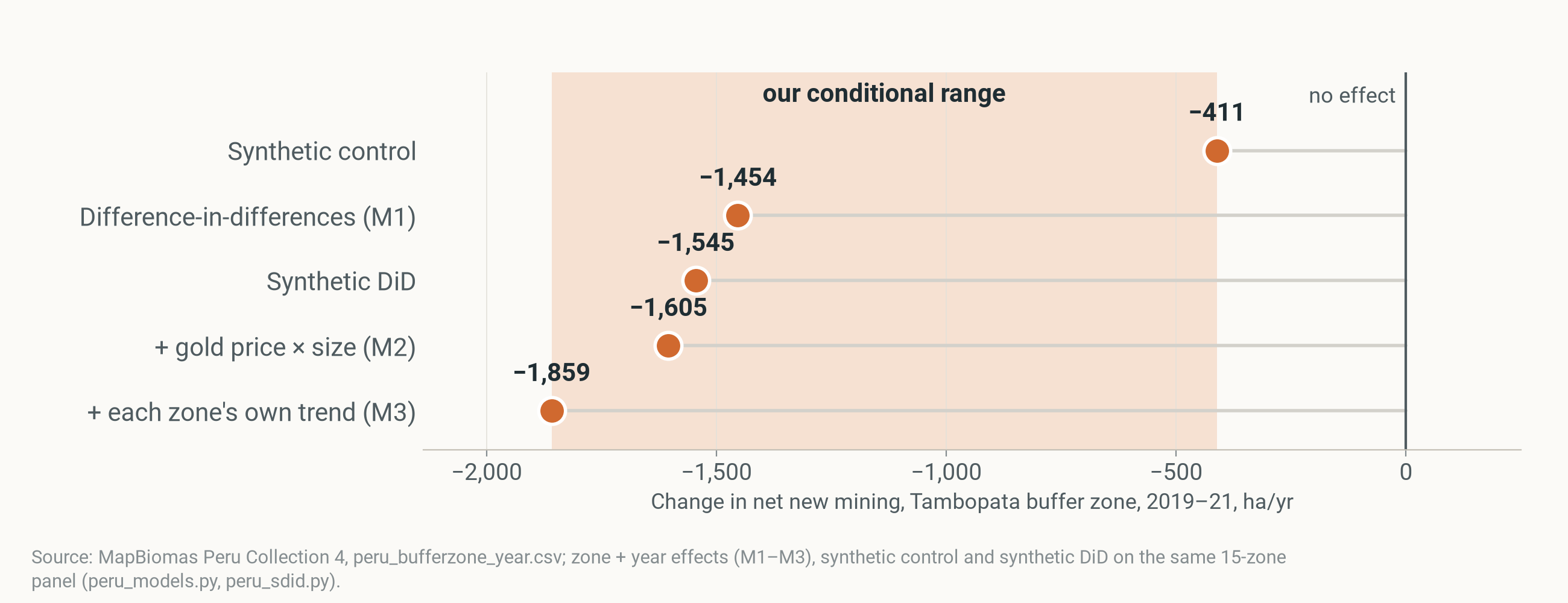
BACKUP · ESTIMATES
CAUSAL · CONDITIONAL
Five estimates, one conditional range
Change in net new mining, Tambopata buffer zone, 2019–21, ha/yr
Notes:
The conditional range runs from the synthetic control (low end) to the model with each zone's own trend (high end). All estimates are conditional on the comparison zones being a fair stand-in.

Slide 27
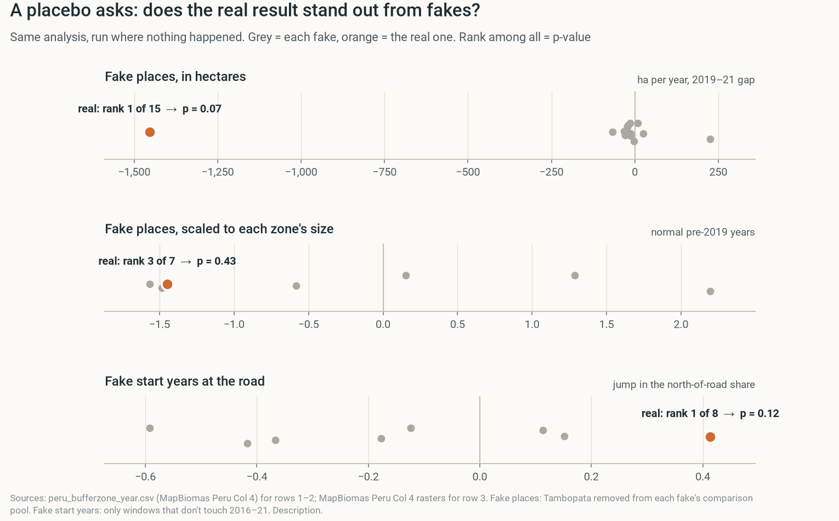
BACKUP · PLACEBO TESTS
DESCRIPTION
How a fake test shows if the real result stands out
Notes:
Each row runs one analysis many times. Grey dots: the fakes (another zone gets the "operation", or the operation "starts" in another year). Orange: the real result. The real result's rank among all of them is the p-value. In hectares, Tambopata's fall is far outside every fake. Scaled to size, two fake zones fall as much. At the road, the 2019 jump north beats every fake start year, but there are only a few.

Slide 28
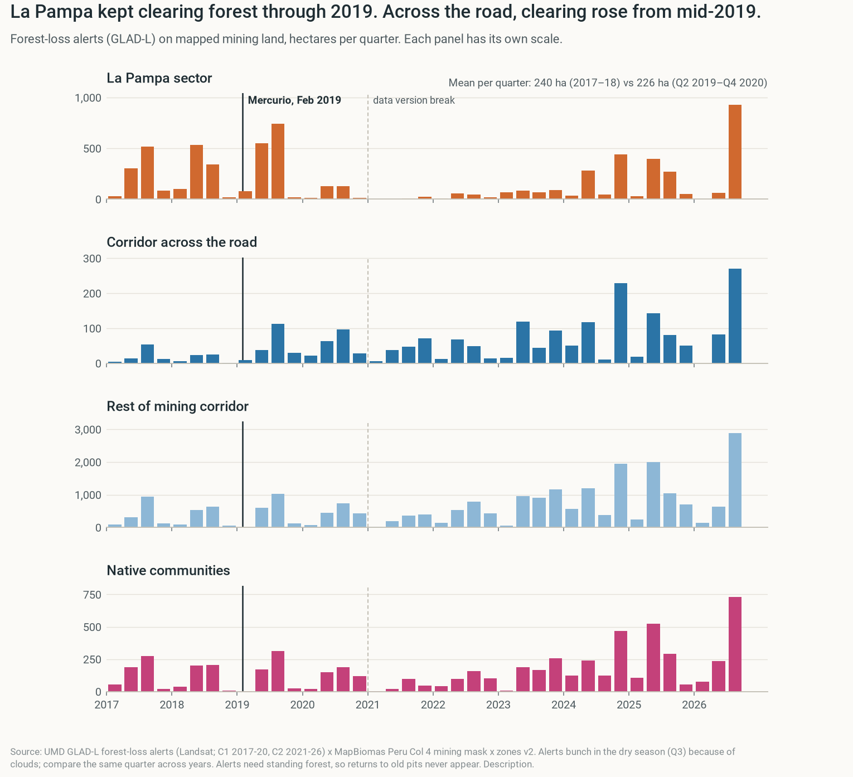
BACKUP · TIMING
DESCRIPTION
Clearing in La Pampa went on through 2019
Notes:
Forest-loss alerts per quarter (University of Maryland GLAD, Landsat, each pixel dated to the day), counted only on land MapBiomas maps as mining. La Pampa's alerts stayed high through 2019 and nearly stopped in 2021–23; across the road they rose from mid-2019.

Slide 29
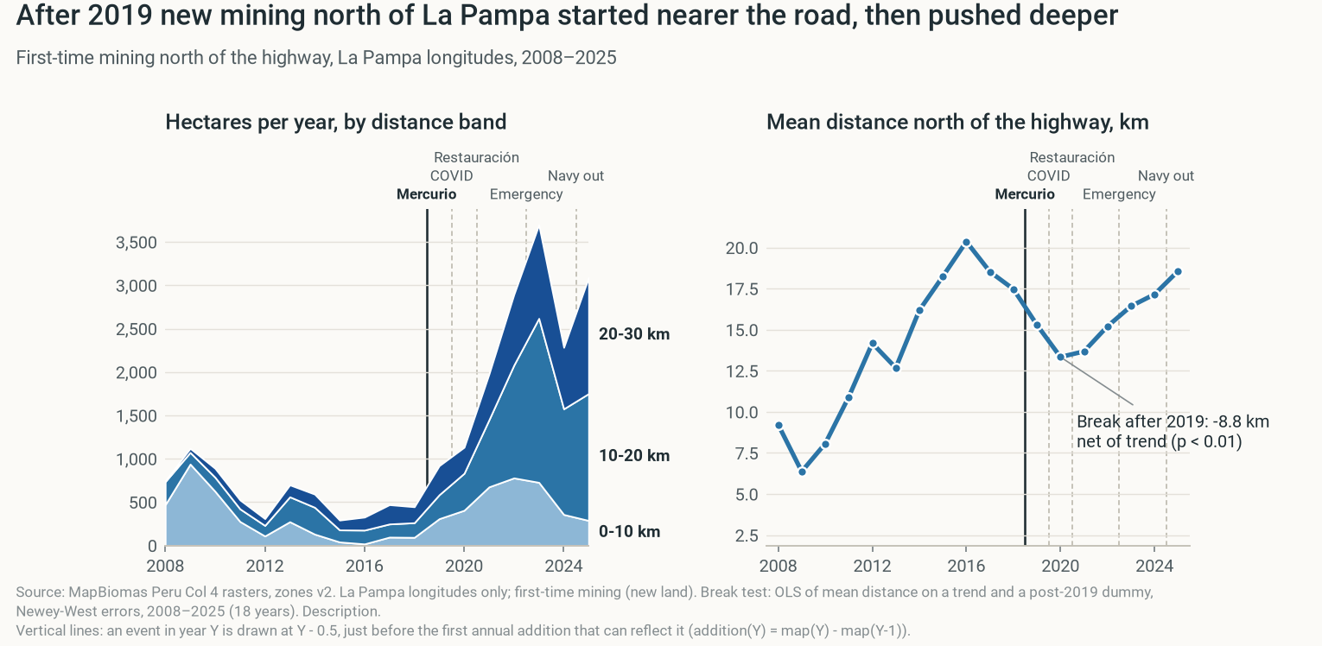
BACKUP · DEPTH
DESCRIPTION
New mining hugged the road, then spread deeper
Notes:
Mean distance north of the highway of each year's first-time mining, with the 0–10, 10–20 and 20–30 km bands. Right after Mercurio new mining hugged the road; then it spread deeper into the corridor.

Slide 30
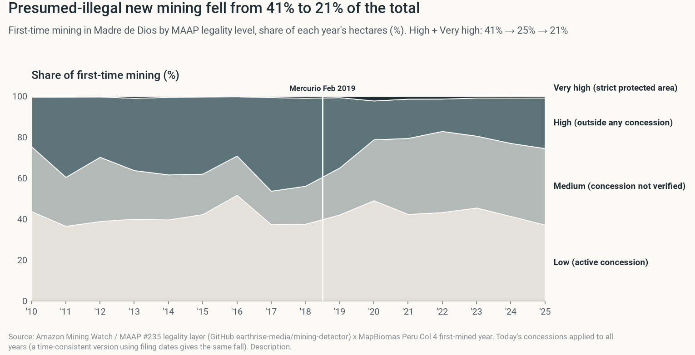
BACKUP · LEGALITY
DESCRIPTION
Presumed-illegal new mining fell; grey zones grew
Notes:
First-time mining in Madre de Dios split by MAAP's legality grade: Low = active concession, Medium = concession not verified as active, High = outside any concession, Very high = strict protected area. The presumed-illegal share fell, and the grey zone of unverified concessions grew.

Slide 31
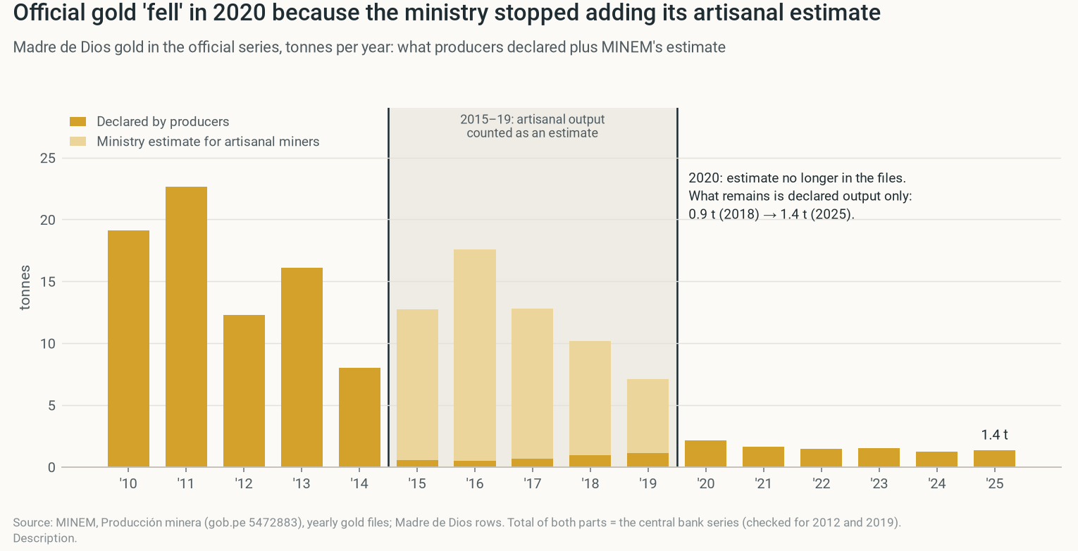
BACKUP · DECLARED GOLD
DESCRIPTION
The official gold drop is a definition change
Notes:
Madre de Dios gold in the ministry's yearly files, split into what producers declared and the artisanal estimate the ministry added. The "collapse" is the estimate disappearing in 2020; declared output rose.

Slide 32
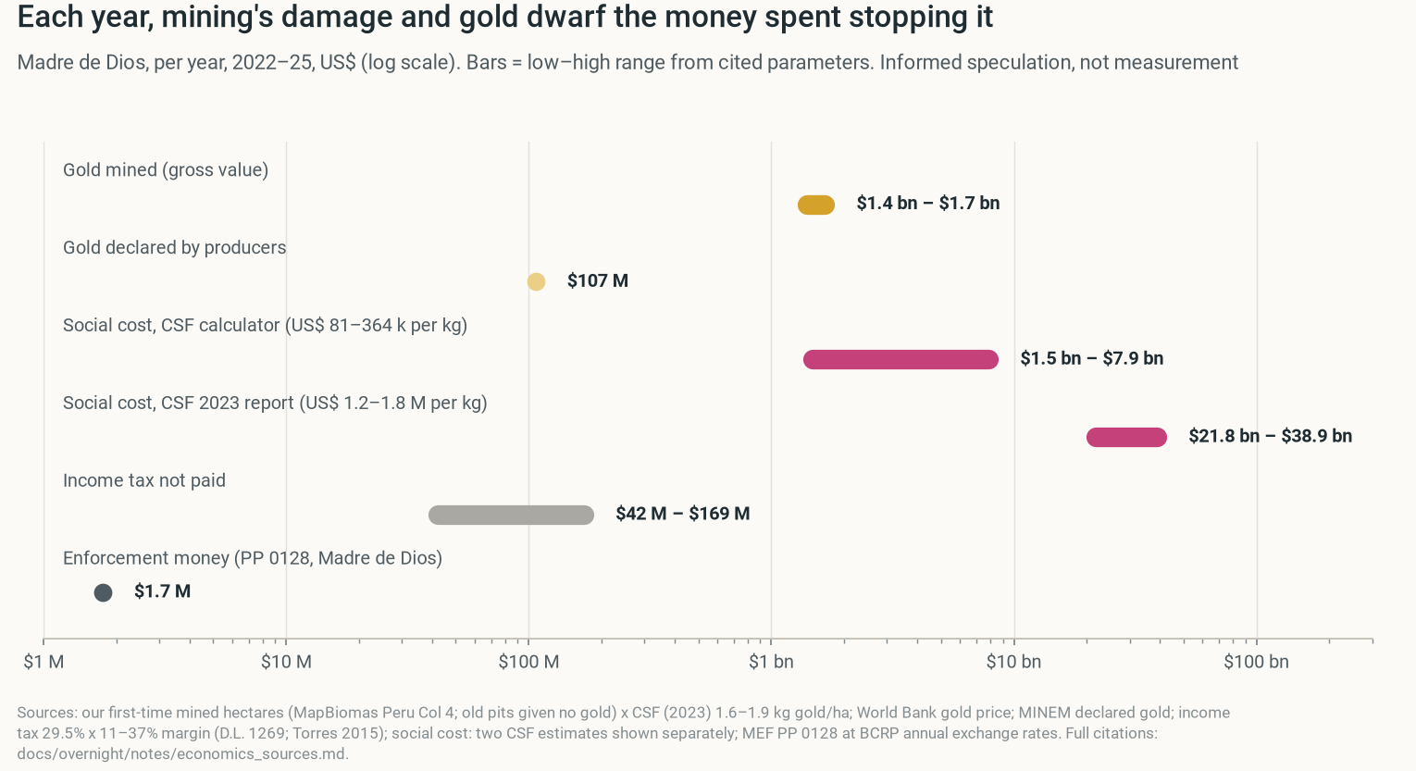
BACKUP · MONEY
PREDICTION
Gold and its damage dwarf enforcement money
Notes:
Five yearly amounts for Madre de Dios, 2022–25, on a log scale (each tick = 10×). Bars span the low–high range our cited parameters allow; a dot means one value. The gold mined and its social cost are hundreds of times the enforcement money booked in the region; the tax at stake is small next to both. Informed expectation from cited parameters, not a finding.

Slide 33
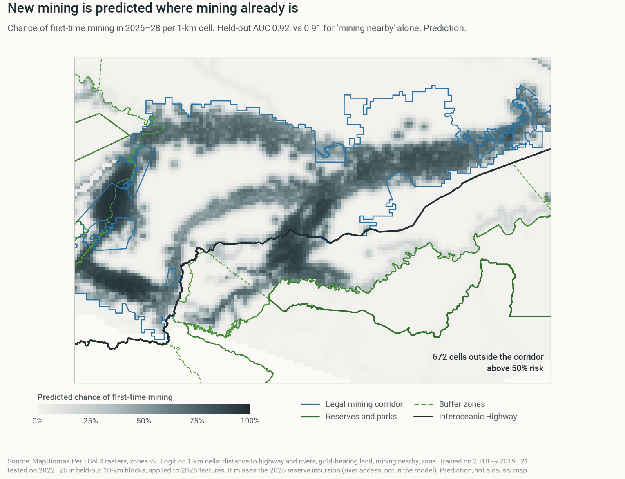
BACKUP · RISK MAP
PREDICTION
Next new mining is likely next to old mining
Notes:
Predicted chance that a 1-km cell gets first-time mining in 2026–28, from a model trained on 2019–21 and tested out of sample on 2022–25. Risk clusters next to old mining; the model adds little beyond "is there mining nearby?" and misses river-borne incursions. Informed expectation from cited parameters, not a finding.

Slide 34
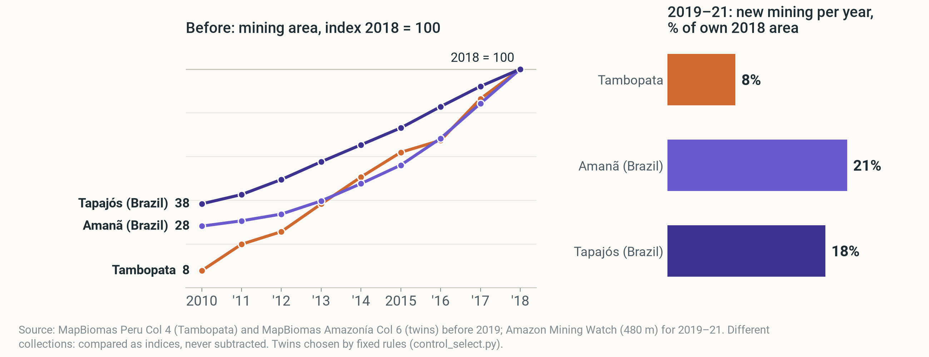
BACKUP · BRAZIL TWINS
DESCRIPTION
The Brazilian twins fail the pre-trend test
Mining area before 2019 (index 2018 = 100) · new mining 2019–21, % of 2018 area
Notes:
Rule-based twins (Ruby's design): Amanã and Tapajós. Tambopata grew faster than both before 2019 (pre-trend p < 0.001), so they can't show what Tambopata would have done. Description only.

Slide 35
BACKUP · BRAZIL
DESCRIPTION
Brazil: falls, but not after each operation
YANOMAMI, FIRST-TIME MINING
STAGGERED DID, 24 TERRITORIES
NATIONAL REFORMS, JAN 2023
518 → 458
+0.26
All at once
ha/yr, 2019–22 → 2023–25
log points, p = 0.44: wrong sign
new rules on gold sales hit every territory
Consistent with 'enforcement plus gold tracing goes with less mining'. Our test can't confirm it.
Notes:
Only if asked. MapBiomas Brazil Collection 11, same pixel method as Peru. A national change in January 2023 (new government, end of the gold 'good faith' rule, electronic gold invoices) hit all territories at once, which a territory-level design can't separate.

Slide 36
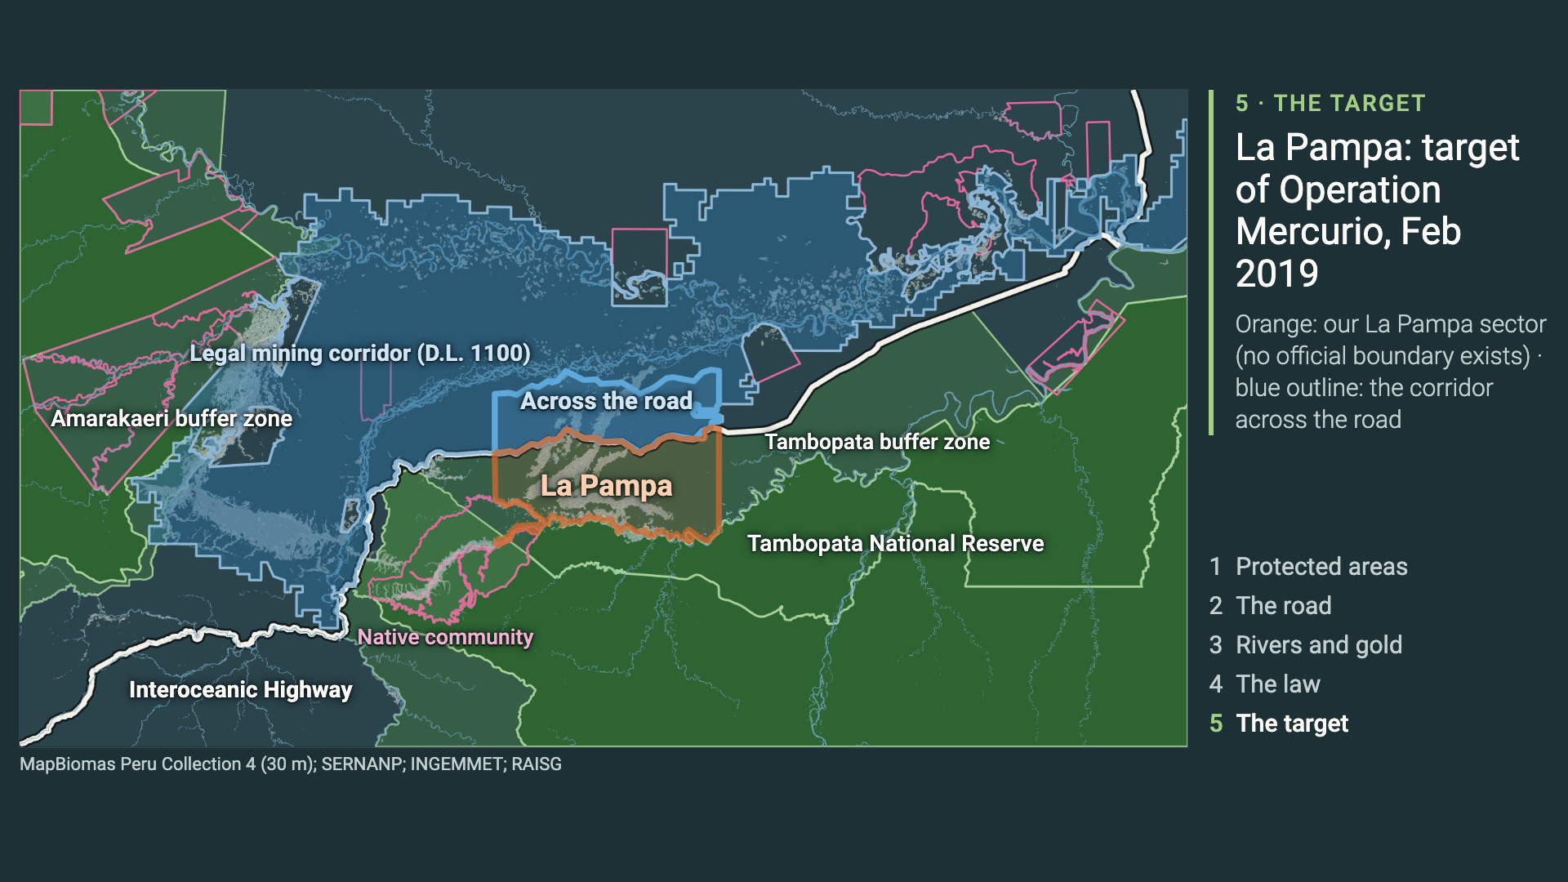
BACKUP · MAP VIDEO
DESCRIPTION
The five map layers as one video
Notes:
The same five layers as the 'Where we are' slides, as one 26-second video.

