Slide 1
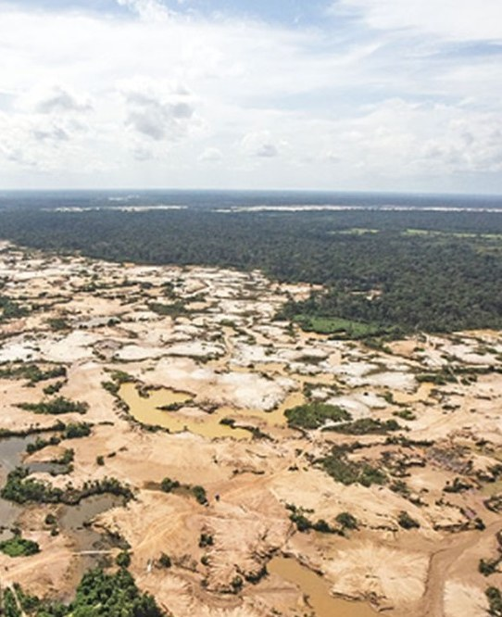
WHEN THE PATROLS LEAVE · DATA FOR GOOD · QUESTION 2
A pause, not an end:
mining after Operation Mercurio
What it means for FZS's work in Tambopata. Prepared for the Frankfurt Zoological Society.
Group Giant Anteater · Ruby Ann Grambauer, Sebastian Schmid, Laurens van der Lely, Omkar Mate, Dhruv Chaudhari
Feb 2019
30 m
6
Operation Mercurio starts
satellite pixels since 1985
ways we tested for cause
Photo: La Pampa, Madre de Dios, 2019 (army operation). Eliftoledo, Wikimedia Commons, CC BY-SA 4.0, cropped.
Notes:
About 20 seconds. Good morning, we are Group Giant Anteater. We are Ruby Ann Grambauer, Sebastian Schmid, Laurens van der Lely, Omkar Mate and Dhruv Chaudhari.
Our title is our main finding: Operation Mercurio bought a pause, not an end. The photo shows La Pampa from an army helicopter in 2019: everything brown and blue is mined land.
Our case is Operation Mercurio, Peru's biggest operation against illegal gold mining, which started in February 2019 in La Pampa, right next to the Tambopata reserve where FZS works. We used 30-metre satellite maps for every year since 1985 and tried six ways to test whether the operation caused what we see.

Slide 2
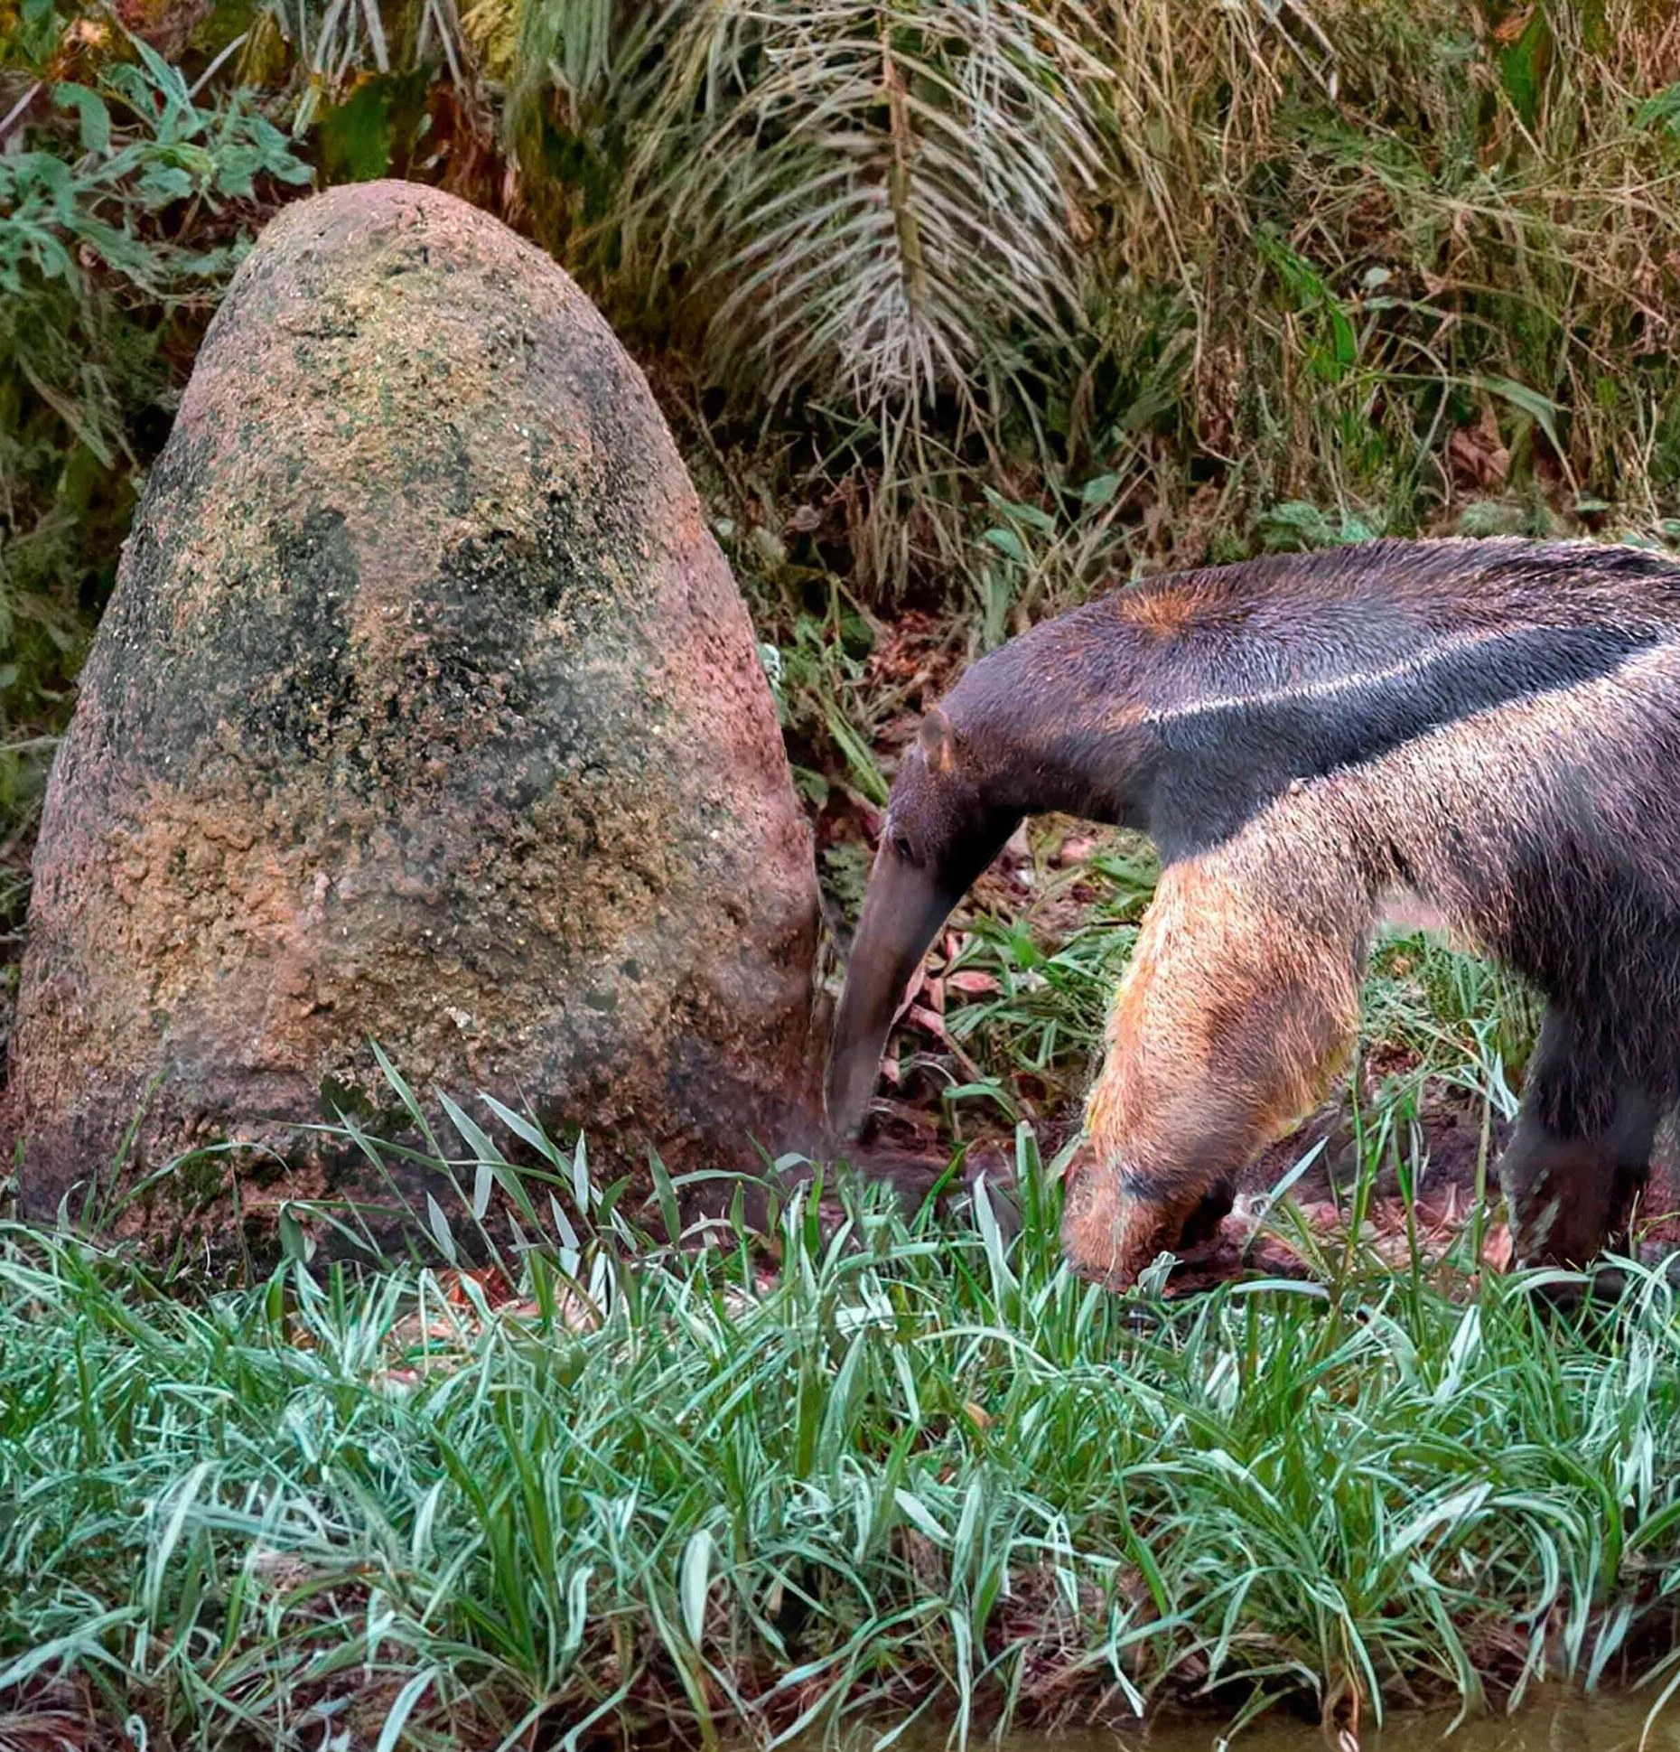

00 TWO FACTS ABOUT OUR ANIMAL
Anteaters eat 35,000 ants a day, and never destroy a nest
60 cm
1 minute
OF TONGUE
PER MOUND
Flicks up to 150 times a minute.
Then it moves on, and comes back later.
Smithsonian's National Zoo; National Geographic
National Geographic
Giant anteater at a termite mound
Mining in La Pampa did the same: it moved on, then came back.
Notes:
About 30 seconds. Two facts about the giant anteater.
One: its tongue is about 60 centimetres long and flicks in and out up to 150 times a minute. That's how it eats up to 35,000 ants and termites a day (Smithsonian's National Zoo; National Geographic).
Two, and this is the one to remember: it spends only about a minute at each mound, because the ants fight back. It never destroys the nest. It moves on and comes back later to feed again (National Geographic).
Hold on to that habit. It is a good description of what we found for gold mining in La Pampa.

Slide 3



01 THE QUESTION
FZS pays for operations. What happens when one ends?
Net mining additions, ha/yr · Tambopata buffer zone, La Pampa, Madre de Dios · 2016–18 vs 2019–21 vs 2022–25
WHAT WE FOUND
1 · IT FELL, LOCALLY
2 · IT MOVED
3 · IT CAME BACK
1,640 → 163
60 → 395
1,829
ha/yr, Tambopata buffer zone. 25%–47% of the fall: pits going out of use
ha/yr just across the road, in the legal corridor
ha/yr in the later years (2022–25), much of it on old pits
All three: description. Net additions = new land + re-mined − stopped, from yearly 30-m satellite maps.
Notes:
About 40 seconds. FZS supports SERNANP's operations against illegal gold mining around Tambopata. Operations are expensive, and they end. So the practical question: what should FZS expect in the targeted area, and around it, once an operation is over?
Three possibilities: mining stops for good (deterrence), it moves next door (displacement), or it waits and comes back (delay). Inside the target alone these look the same, so we compare areas.
The answer up front, all description. One: net mining additions in the Tambopata buffer zone fell from about 1,640 to 163 hectares a year in 2019 to 2021. But a quarter to a half of that fall is pits going out of use, most of it in 2019; the rest is fewer new pits. Two: just across the road, in the legal corridor, net additions rose from about 60 to 395 hectares a year. Three: in the later years, 2022 to 2025, the buffer zone was back at about 1,829 hectares a year, much of it on old pits.

Slide 4
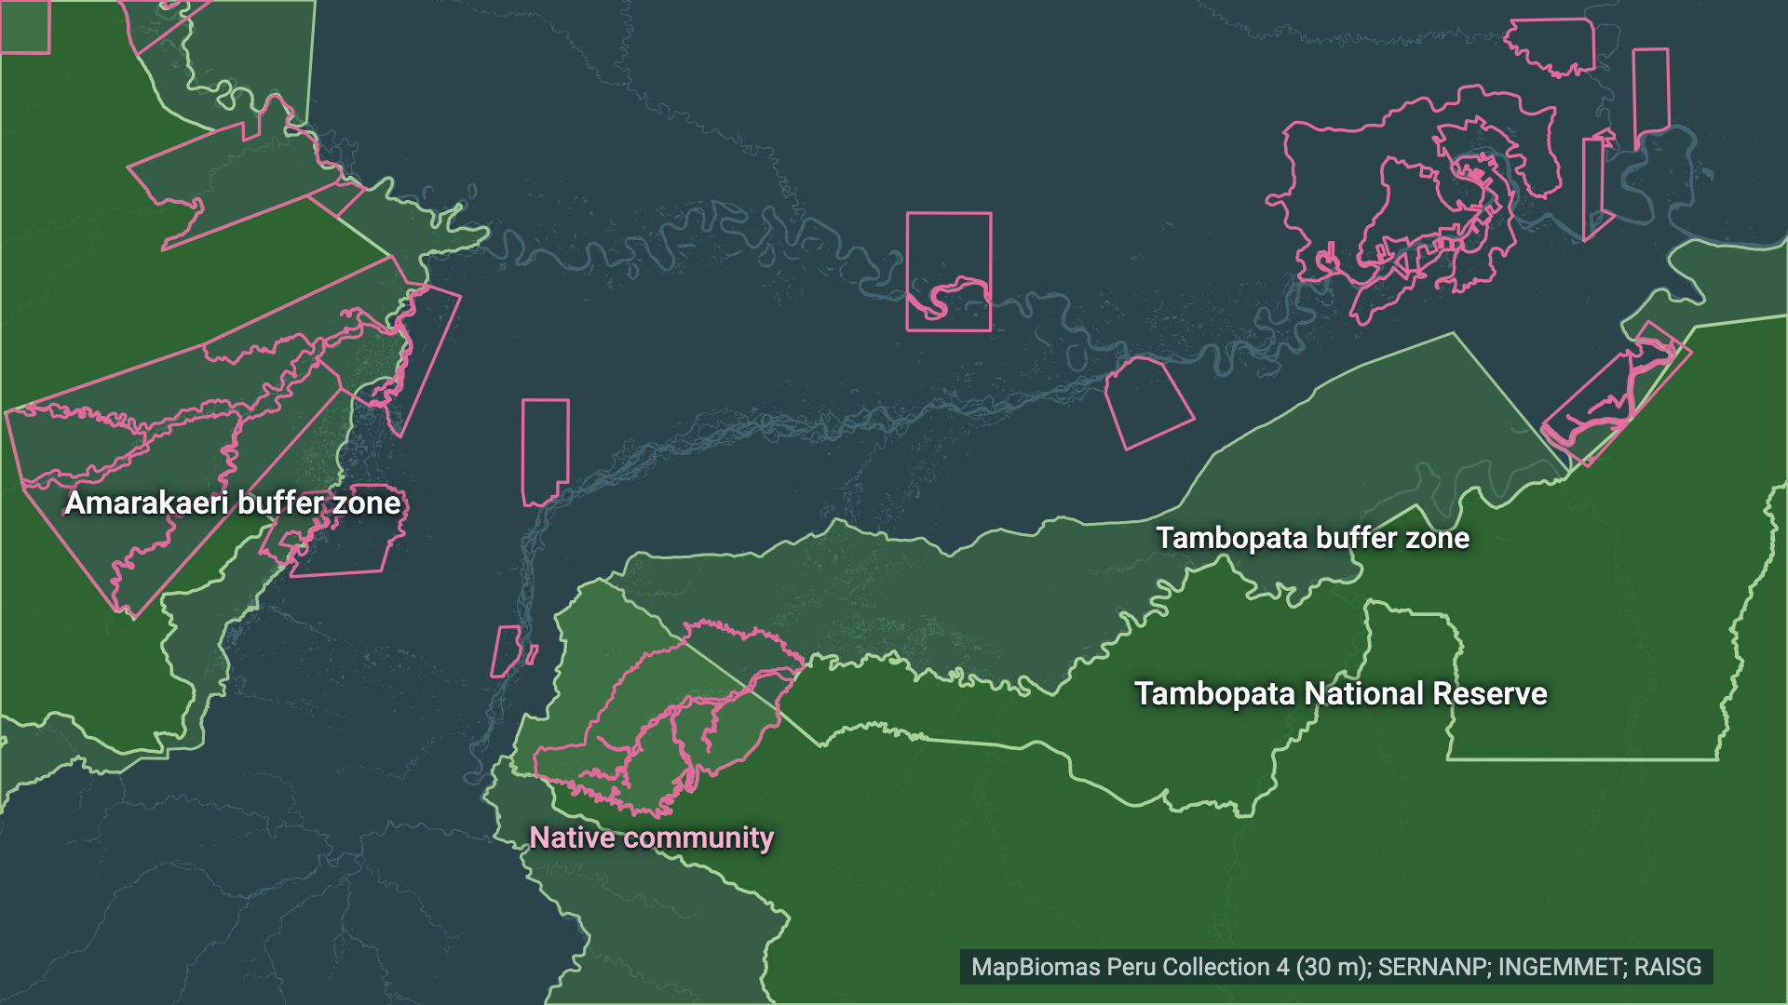
02 WHERE WE ARE
DESCRIPTION
La Pampa sits one road away from legal mining land
Madre de Dios, Peru · step 1 of 4 · zones as used on every slide
1
Protected areas
Tambopata reserve, its buffer zone and the Amarakaeri buffer zone. Pink: communities.
2
The Interoceanic Highway
3
Where mining can be legal
4
The target
Notes:
Step 1 of 4, about 12 seconds; click for the next step. This is Madre de Dios, in the south-east of the Peruvian Amazon. In green, the protected areas: Tambopata National Reserve in the south, the core FZS helps protect, ringed by its buffer zone. We use the buffer zone exactly as SERNANP draws it, including the Kotsimba native community inside it. West of it the Amarakaeri buffer zone, our less-treated comparison. Pink outlines are native communities.

Slide 5
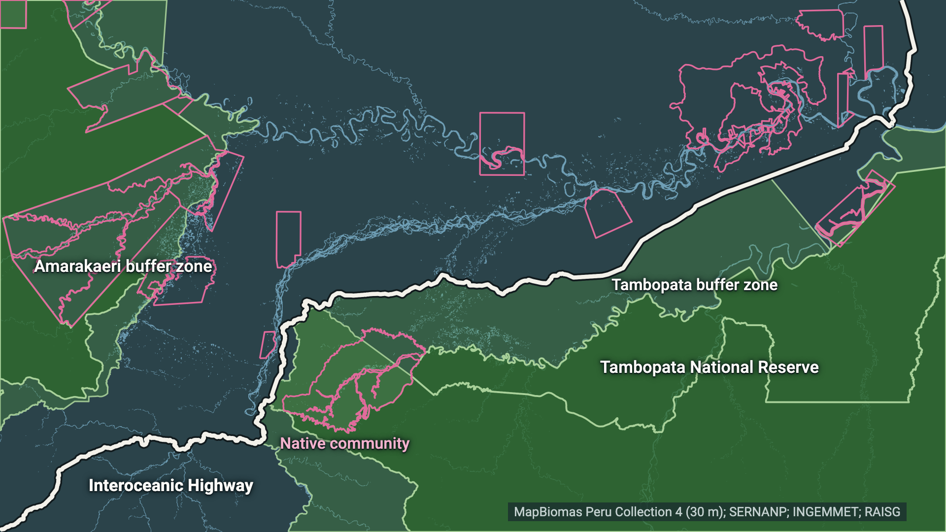
02 WHERE WE ARE
DESCRIPTION
La Pampa sits one road away from legal mining land
Madre de Dios, Peru · step 2 of 4 · zones as used on every slide
1
Protected areas
2
The Interoceanic Highway
One road runs along the buffer zone and splits it from the land to the north.
3
Where mining can be legal
4
The target
Notes:
Step 2 of 4, about 12 seconds; click for the next step. The white line is the Interoceanic Highway, the paved road from Brazil to the Pacific. It runs right along the edge of the buffer zone. Remember this road: it becomes the border in our story. Blue lines are rivers: the gold here is alluvial, in the floodplains.

Slide 6
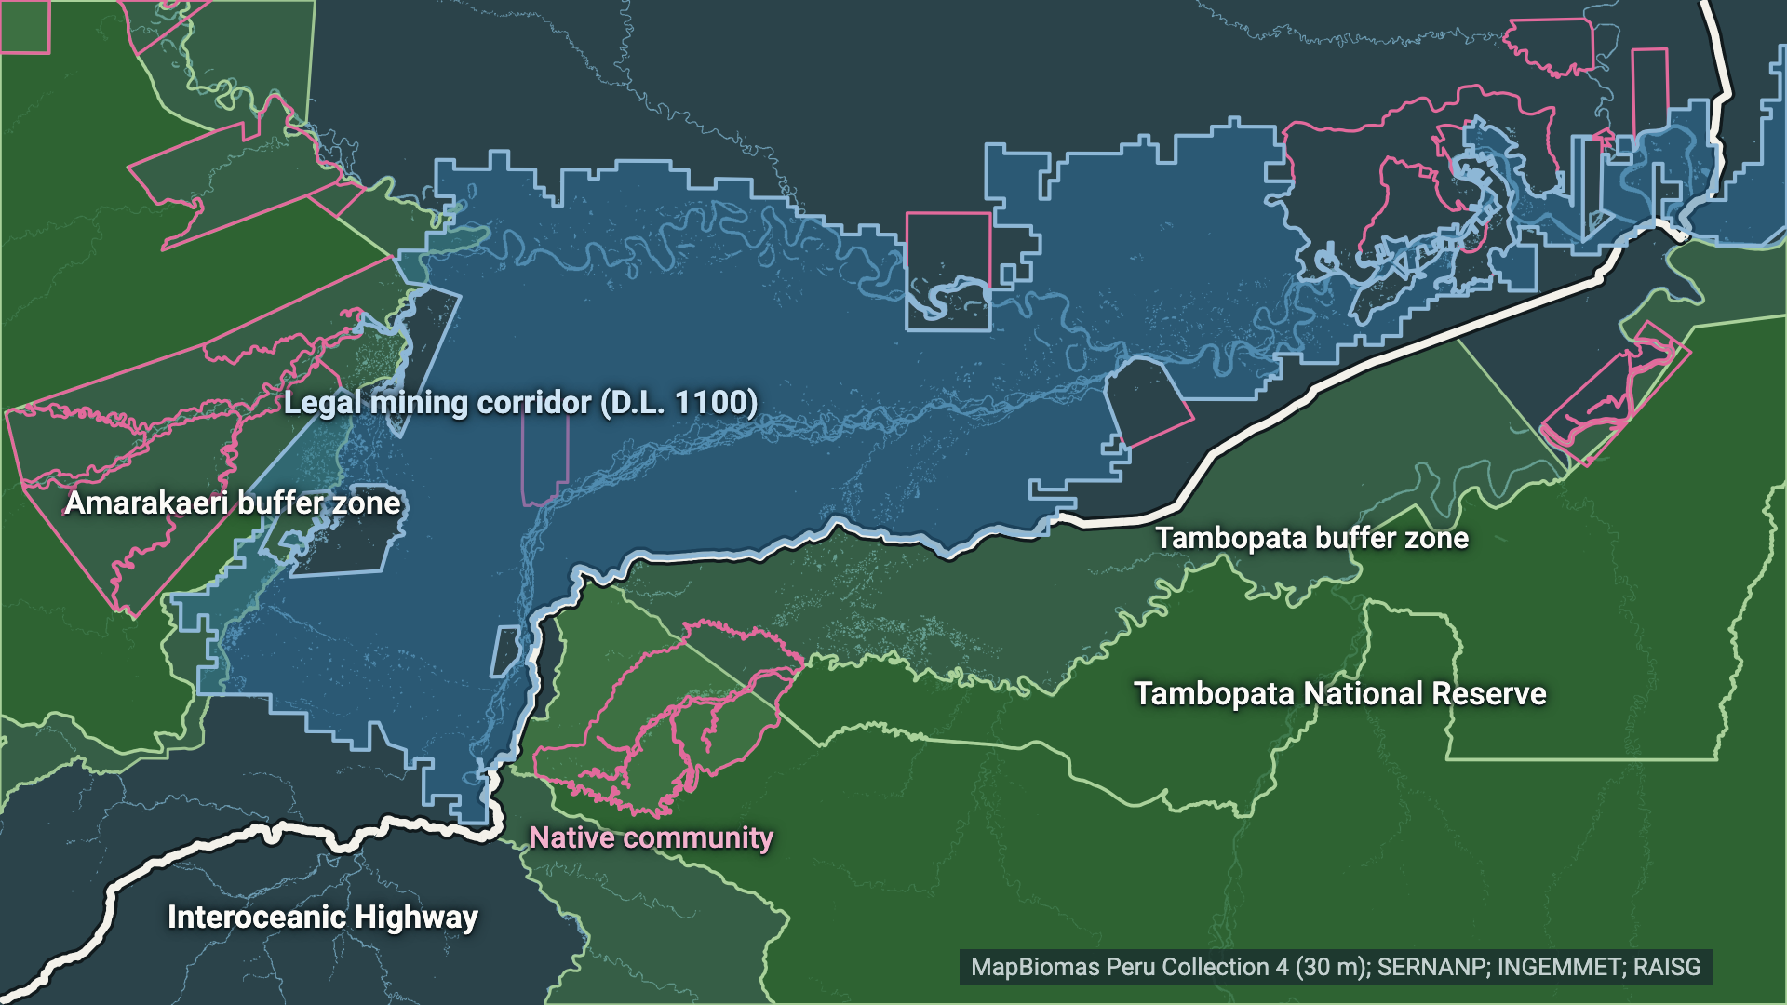
02 WHERE WE ARE
DESCRIPTION
La Pampa sits one road away from legal mining land
Madre de Dios, Peru · step 3 of 4 · zones as used on every slide
1
Protected areas
2
The Interoceanic Highway
3
Where mining can be legal
The legal mining corridor, north of the road. South of it, in the buffer zone: a crime.
4
The target
Notes:
Step 3 of 4, about 12 seconds; click for the next step. The blue area is the mining corridor created by decree in 2012, D.L. 1100. Inside it, small-scale mining can be permitted. South of the road, in the buffer zone, the same work is a crime. Legality is about location: the satellite maps themselves cannot tell legal from illegal mining.

Slide 7
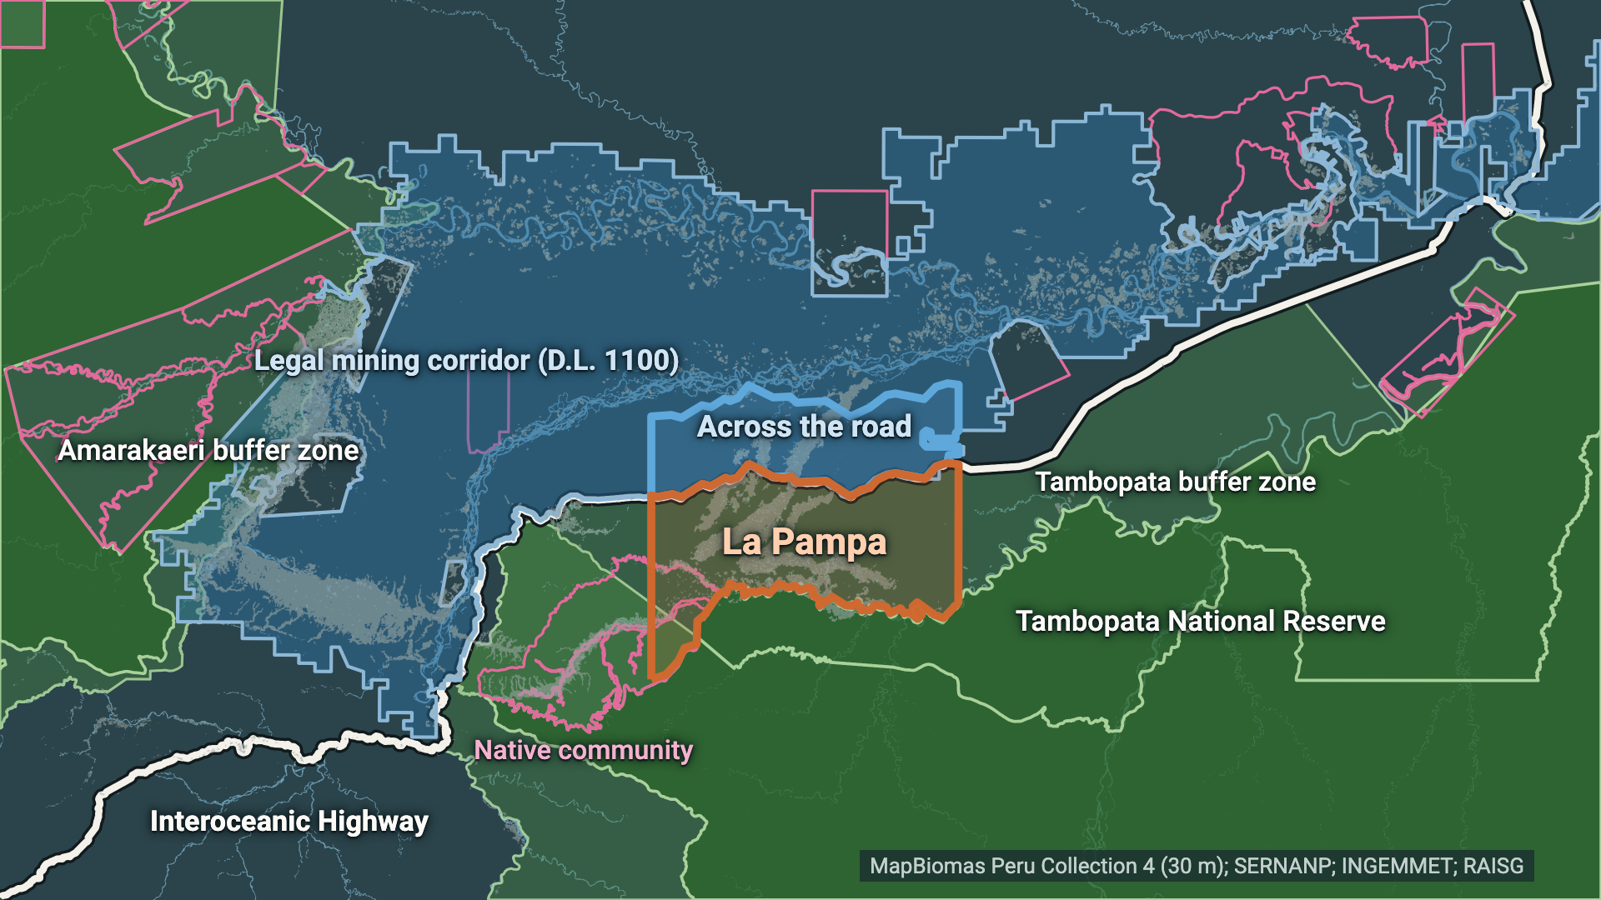
02 WHERE WE ARE
DESCRIPTION
La Pampa sits one road away from legal mining land
Madre de Dios, Peru · step 4 of 4 · zones as used on every slide
1
Protected areas
2
The Interoceanic Highway
3
Where mining can be legal
4
The target
La Pampa, Mercurio's target from Feb 2019, and the corridor strip across the road.
Notes:
Step 4 of 4, about 12 seconds; click for the next step. In orange, La Pampa, the target of Operation Mercurio from February 2019. We define it as the buffer zone's part between 70.15 and 69.80 degrees west; there is no official boundary. The blue box just across the road is the part of the legal corridor directly opposite. Watch these two boxes: every number on the next slides is net mining additions in these zones.

Slide 8
03 WHAT WE MEASURE
DESCRIPTION
One measure on every slide: net mining additions
Net additions (ha/yr) = new land + re-mined − stopped · per 30-m pixel, year t vs the years before · MapBiomas Peru Collection 4, 1985–2025
YEAR
t − 1
t
+
New land
never mined before
forest
mined
+
Re-mined
out of use a year or more, mined again
old pit
mined
−
Stopped
mined last year, not this year
mined
water / regrowth
Net = new + re-mined − stopped
Same zones everywhere: Tambopata buffer zone (whole, incl. Kotsimba) · La Pampa sector (its 70.15–69.80° W part) · corridor across the road (D.L. 1100, ≤ 10 km north of the highway) · Amarakaeri buffer zone (less treated) · Madre de Dios.
= mining area this year − last year. Hectares are a proxy for mining activity, not for miners.
Notes:
About 40 seconds. One measure on every slide from here on: net mining additions, in hectares per year. It is simply the mining area this year minus last year, from the MapBiomas Peru satellite maps at 30 metres.
We split it into three parts, always in the same colours. Brown: new land, mined for the first time since 1985. Amber: re-mined, old pits that were out of use for at least a year and are mined again. A pit worked in both years is in none of the three flows; it simply stays in the mining area. Teal: stopped, pits that left the mining class, most often because they flooded or started to regrow. Net equals new plus re-mined minus stopped.
Why it matters: a fall in net additions can mean fewer new pits, or more pits going out of use. Those are different stories for FZS.
And the same zones everywhere: the Tambopata buffer zone as SERNANP draws it, La Pampa as its western part, the strip of legal corridor across the road, the Amarakaeri buffer zone as the less-treated comparison, and the whole department. Hectares measure mining activity, not the number of miners.

Slide 9
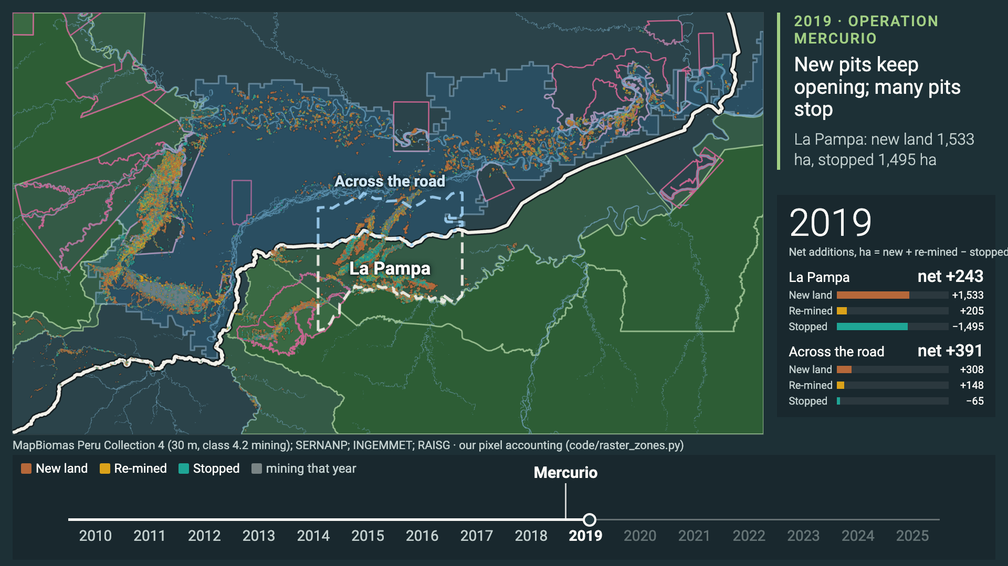
02 2010–2025 IN ONE MINUTE
DESCRIPTION
2010–2025: new pits, old pits re-mined, pits stopping
Net mining additions as three flows on the map: new land (brown), re-mined (amber), stopped (teal) · counter: net ha per year, La Pampa sector and corridor across the road
Notes:
About 60 seconds, click to play. Each year, brown pixels are land mined for the first time, amber are old pits mined again, teal are pits that stopped; grey is everything mapped as mining that year. On the right, the net additions per year for La Pampa and for the strip across the road, with the three parts.
Before 2019, brown dominates in La Pampa, south of the road. Watch 2019, the Mercurio year: new clearing did not stop in 2019 — about 1,533 hectares of new land in La Pampa, against 1,835 in 2018 — but a lot of land went out of use: 1,495 hectares stopped. So net additions drop to 243.
In 2020 and 2021, La Pampa's net additions sit near zero while the strip across the road lights up. In the later years, amber appears: mining comes back, much of it on old pits.
The video ends with the caveat we repeat: satellites can't see river dredges or mercury.

Slide 10
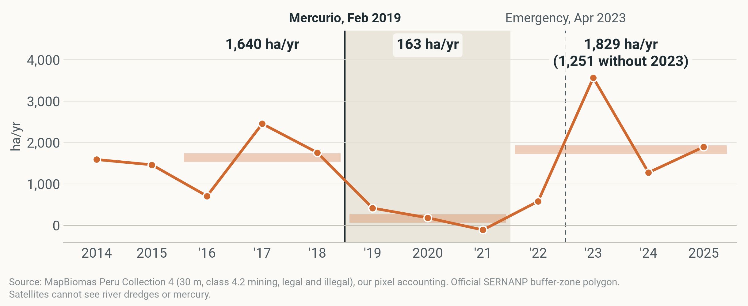
03 WHAT HAPPENED IN THE TARGET
DESCRIPTION
Net mining fell 90%, then came back
Net mining additions, ha/yr · Tambopata buffer zone · 2014–2025 · thick bars and numbers: means for 2016–18, 2019–21 (shaded) and 2022–25
Notes:
About 40 seconds. One measure on every chart from here: net mining additions, the mining area this year minus last year, in hectares per year. Zone: the Tambopata buffer zone, exactly as SERNANP draws it.
Before the operation, 2016 to 2018, it added about 1,640 hectares a year. In 2019 to 2021, Mercurio and what followed, only 163: a 90% fall. In the later years, 2022 to 2025, it was back at 1,829, or 1,251 without 2023, a spike only these maps show.
For comparison, the less-treated Amarakaeri buffer zone went the other way over the same years, 289 to 574. All description so far. Other events (COVID in 2020, Plan Restauración in 2021) are in the shaded years; we only mark Mercurio and the 2023 emergency on the charts.

Slide 11
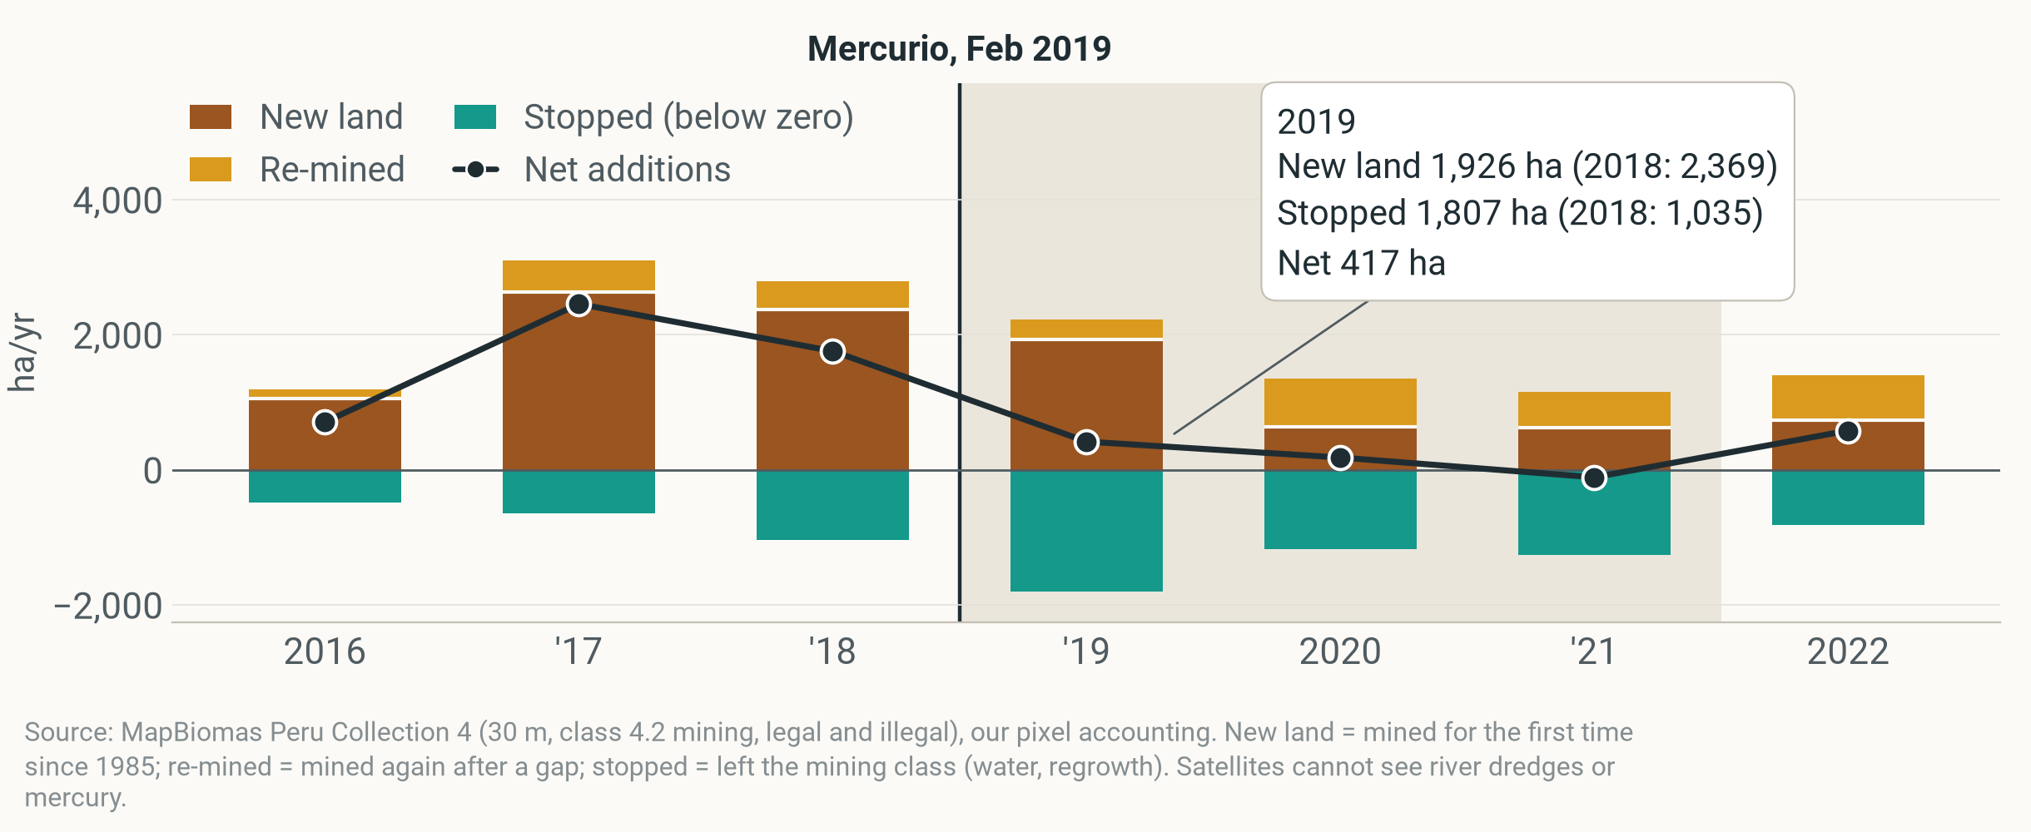
03 2019, YEAR BY YEAR
DESCRIPTION
2019: new pits kept opening, old ones went quiet
Net mining additions and parts, ha/yr · Tambopata buffer zone · 2016–2022 · more stopping explains 25%–47% of the 2016–18 → 2019–21 fall; in Amarakaeri stopped land stayed flat (542 → 584 ha/yr)
Notes:
About 50 seconds. Same zone, now split into its three parts, year by year. Brown up is new land, mined for the first time; amber is old pits mined again; teal below zero is stopped land, pits that left the mining class; the black line is net.
In 2019 new pits kept opening: 1,926 hectares of new land, against 2,369 in 2018. But 1,807 hectares stopped, against 1,035 in 2018, so net additions fell to 417. New land only drops from 2020, which is also the first COVID year.
Over 2019 to 2021, more stopping explains 25%–47% of the fall in net additions, depending on how we count map flicker; 68% of the extra stopping came in 2019. In Amarakaeri, stopped land stayed flat, 542 to 584 hectares a year.
Why it matters for FZS: in the first year of an operation, new pits keep opening at the edges while the targeted pits go quiet. That is why a ring around the operation matters.

Slide 12
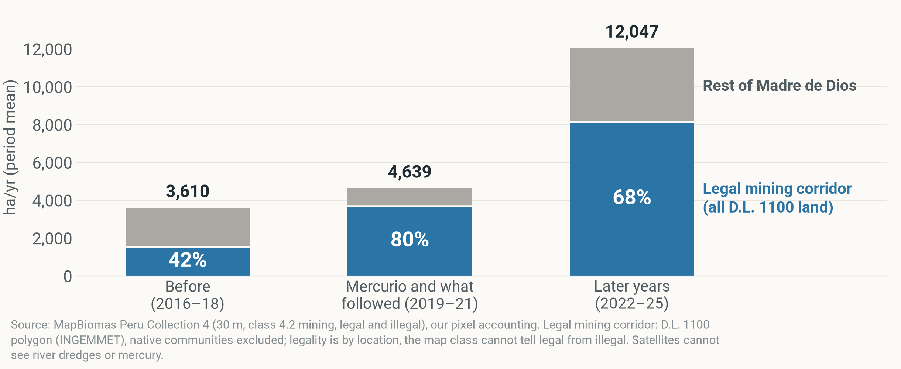
04 WHERE IT WENT
DESCRIPTION
The region kept growing, mostly in the legal corridor
Net mining additions, ha/yr, period means · Madre de Dios · % = the legal corridor's share of the department's net additions (period sums) · legal corridor = all D.L. 1100 land, not only the strip across the road
Notes:
About 40 seconds. Zoom out to the whole department. Net additions in Madre de Dios never fell: 3,610 → 4,639 → 12,047 hectares a year across the three periods.
Blue is the legal mining corridor: all the land in the D.L. 1100 decree, not only the strip across the road we show next. The percentage is the corridor's share of the department's net additions, summed over each period: 42%, then 80%, then 68%.
Careful: the rise elsewhere in the department was 1.8 times the size of Tambopata's fall, so this is not just the same miners moving; new entrants and the gold price play a part. MAAP #208 finds the same: most mining deforestation in 2021 to 2024 was inside the corridor.

Slide 13
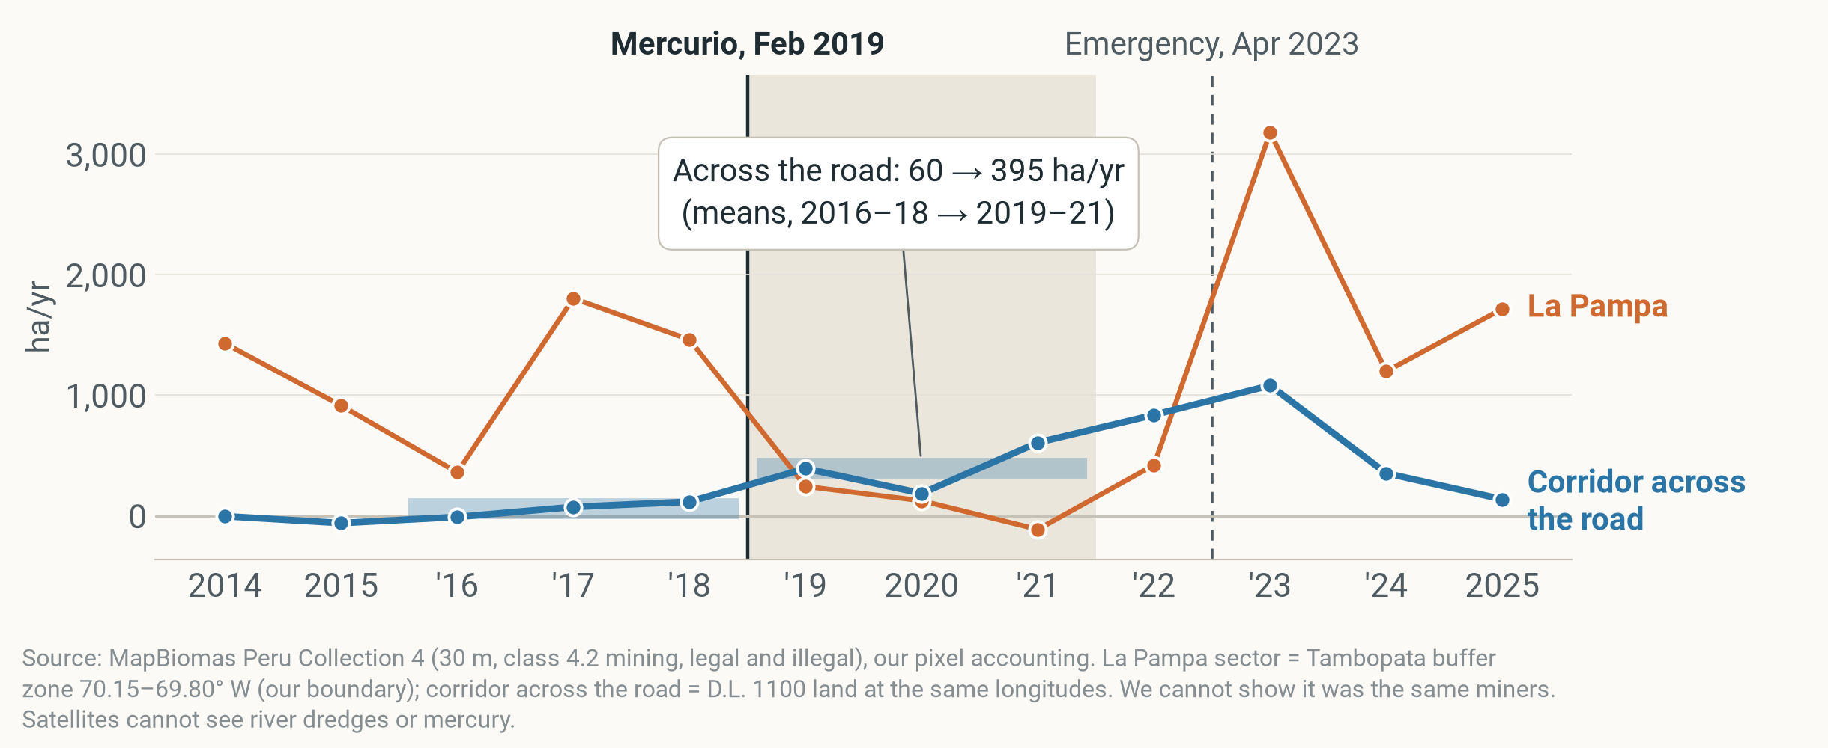
05 ACROSS THE ROAD
DESCRIPTION
Across the road, net mining rose more than six-fold
Net mining additions, ha/yr · corridor across the road (legal strip ≤ 10 km north of the highway) vs La Pampa sector (1,209 → 85 ha/yr) · 2014–2025 · thick bars: means
Notes:
About 40 seconds. Now the strip of legal corridor directly across the highway from La Pampa: up to 10 kilometres north of the road, at La Pampa's longitudes. Blue is that strip, orange is La Pampa itself.
Across the road, net additions rose from about 60 hectares a year in 2016 to 2018 to 395 in 2019 to 2021, while La Pampa fell from 1,209 to 85.
Independent evidence points the same way: Dethier and colleagues (2023) report most activity abandoned in the targeted zones and faster mining just outside them. But we cannot show it was the same people who crossed the road.

Slide 14
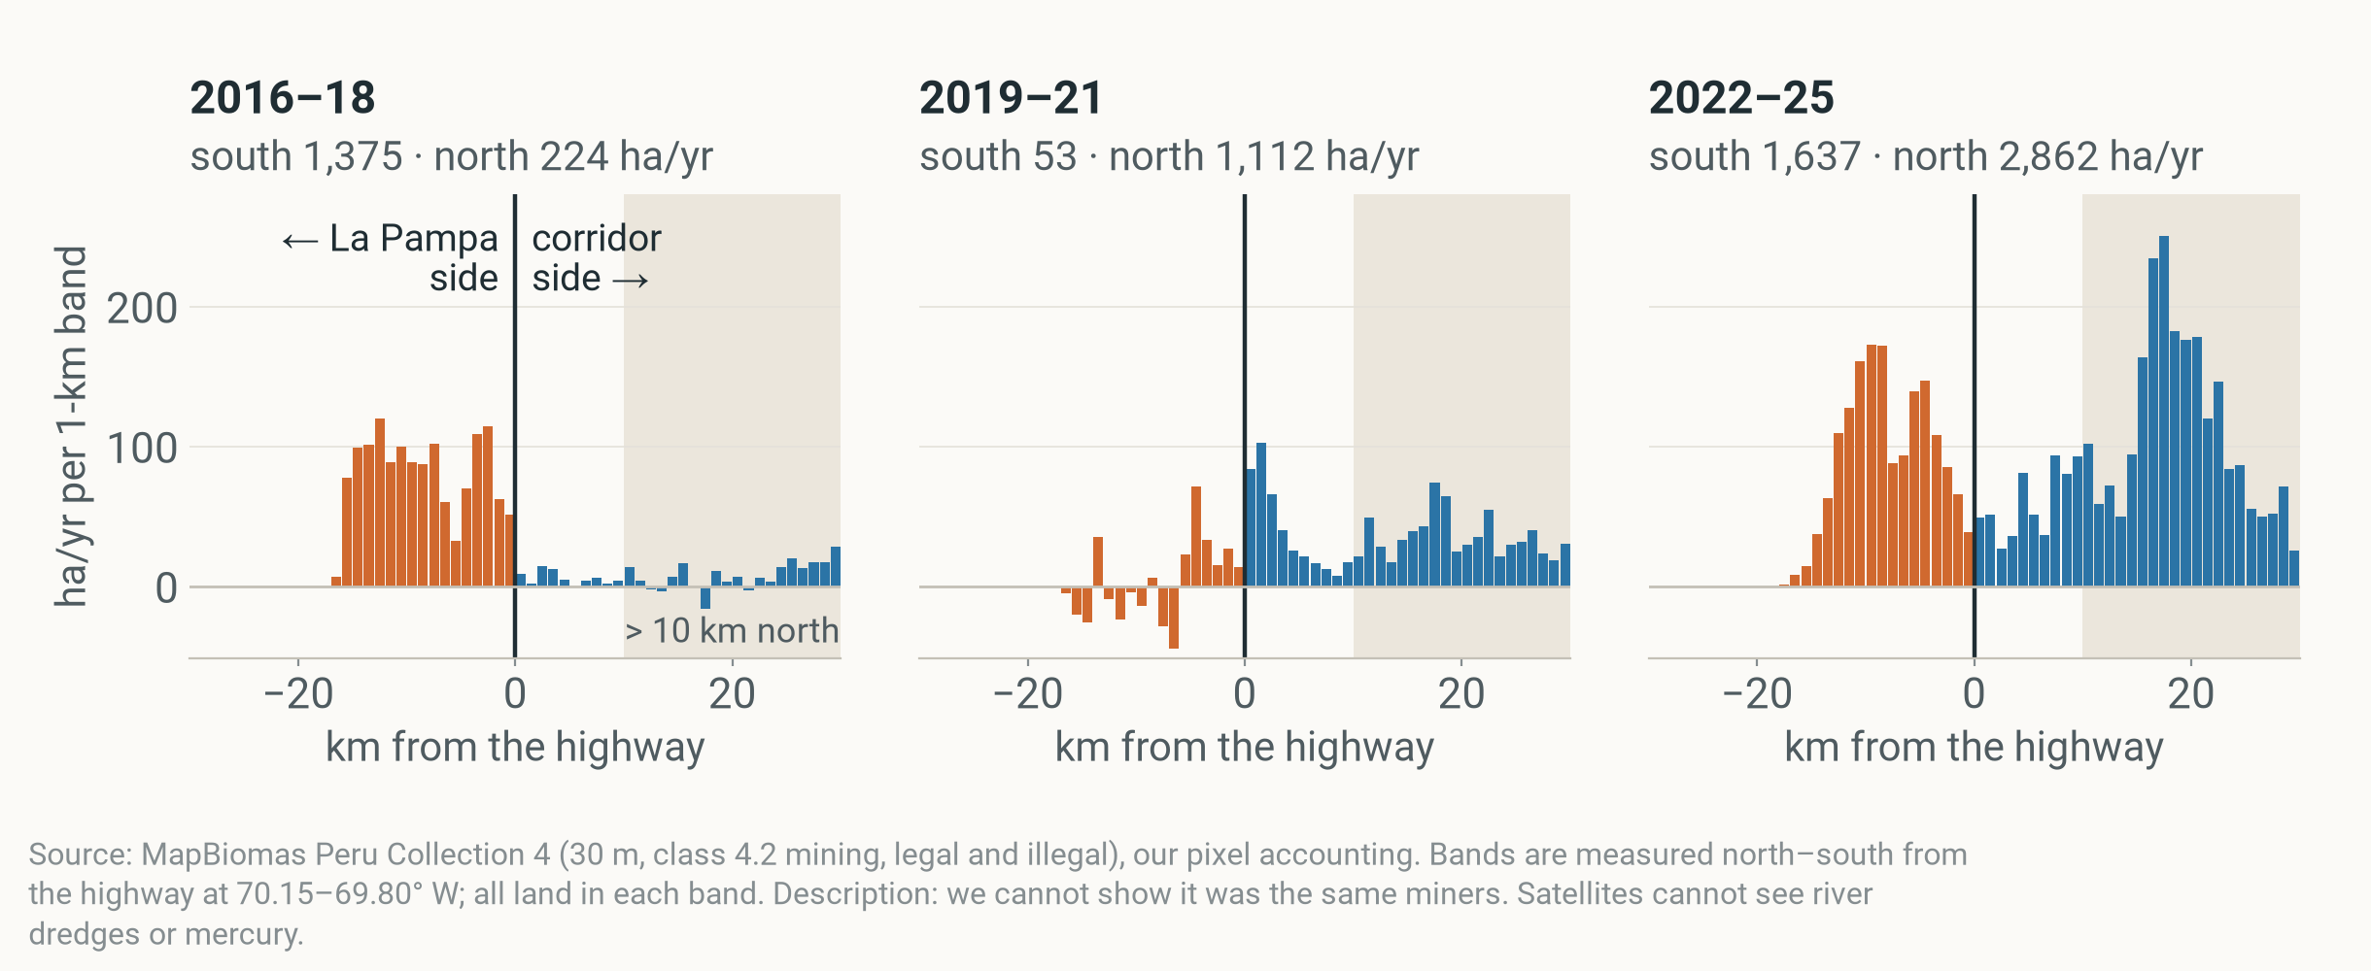
05 ACROSS THE ROAD
DESCRIPTION
2019–21: mining fell south of the highway, rose north
Net mining additions per 1-km band, ha/yr · La Pampa's longitudes, 30 km either side of the Interoceanic Highway · means for 2016–18, 2019–21, 2022–25 · shaded: more than 10 km north
Notes:
About 30 seconds. The same story in 1-kilometre bands, at La Pampa's longitudes: orange south of the highway, the La Pampa side; blue north, the corridor side.
In 2016 to 2018 nearly all net additions were south of the road: 1,375 hectares a year south against 224 north. In 2019 to 2021 the south dropped to 53 while the north rose to 1,112, first right next to the road, then deeper in. In the later years both sides grew.
Description only: the bands show where mining happened, not who did it.

Slide 15
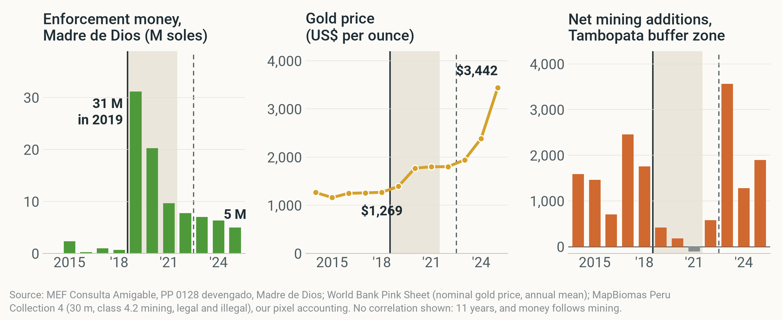
06 WHY IT CAME BACK
DESCRIPTION
Money faded after 2019, while gold rose 2.7-fold
Same years in each panel, 2014–2025 · PP 0128 executed spending booked in Madre de Dios (a lower bound) · gold price, nominal · net mining additions, Tambopata buffer zone · shaded: 2019–21 · context, not a test
Notes:
About 40 seconds. Why did it come back? Three things line up; this is context, not a test.
Left: the anti-illegal-mining budget booked in Madre de Dios, programme PP 0128, peaked at about 31 million soles in 2019 and fell to about 5 million in 2025; it's a lower bound because national units book in Lima. Middle: the gold price, up 2.7-fold from 2018 to 2025. Right: net additions in the Tambopata buffer zone, back up as the money faded and the price rose.
We don't show a correlation: eleven years is too few, and money also follows mining.

Slide 16
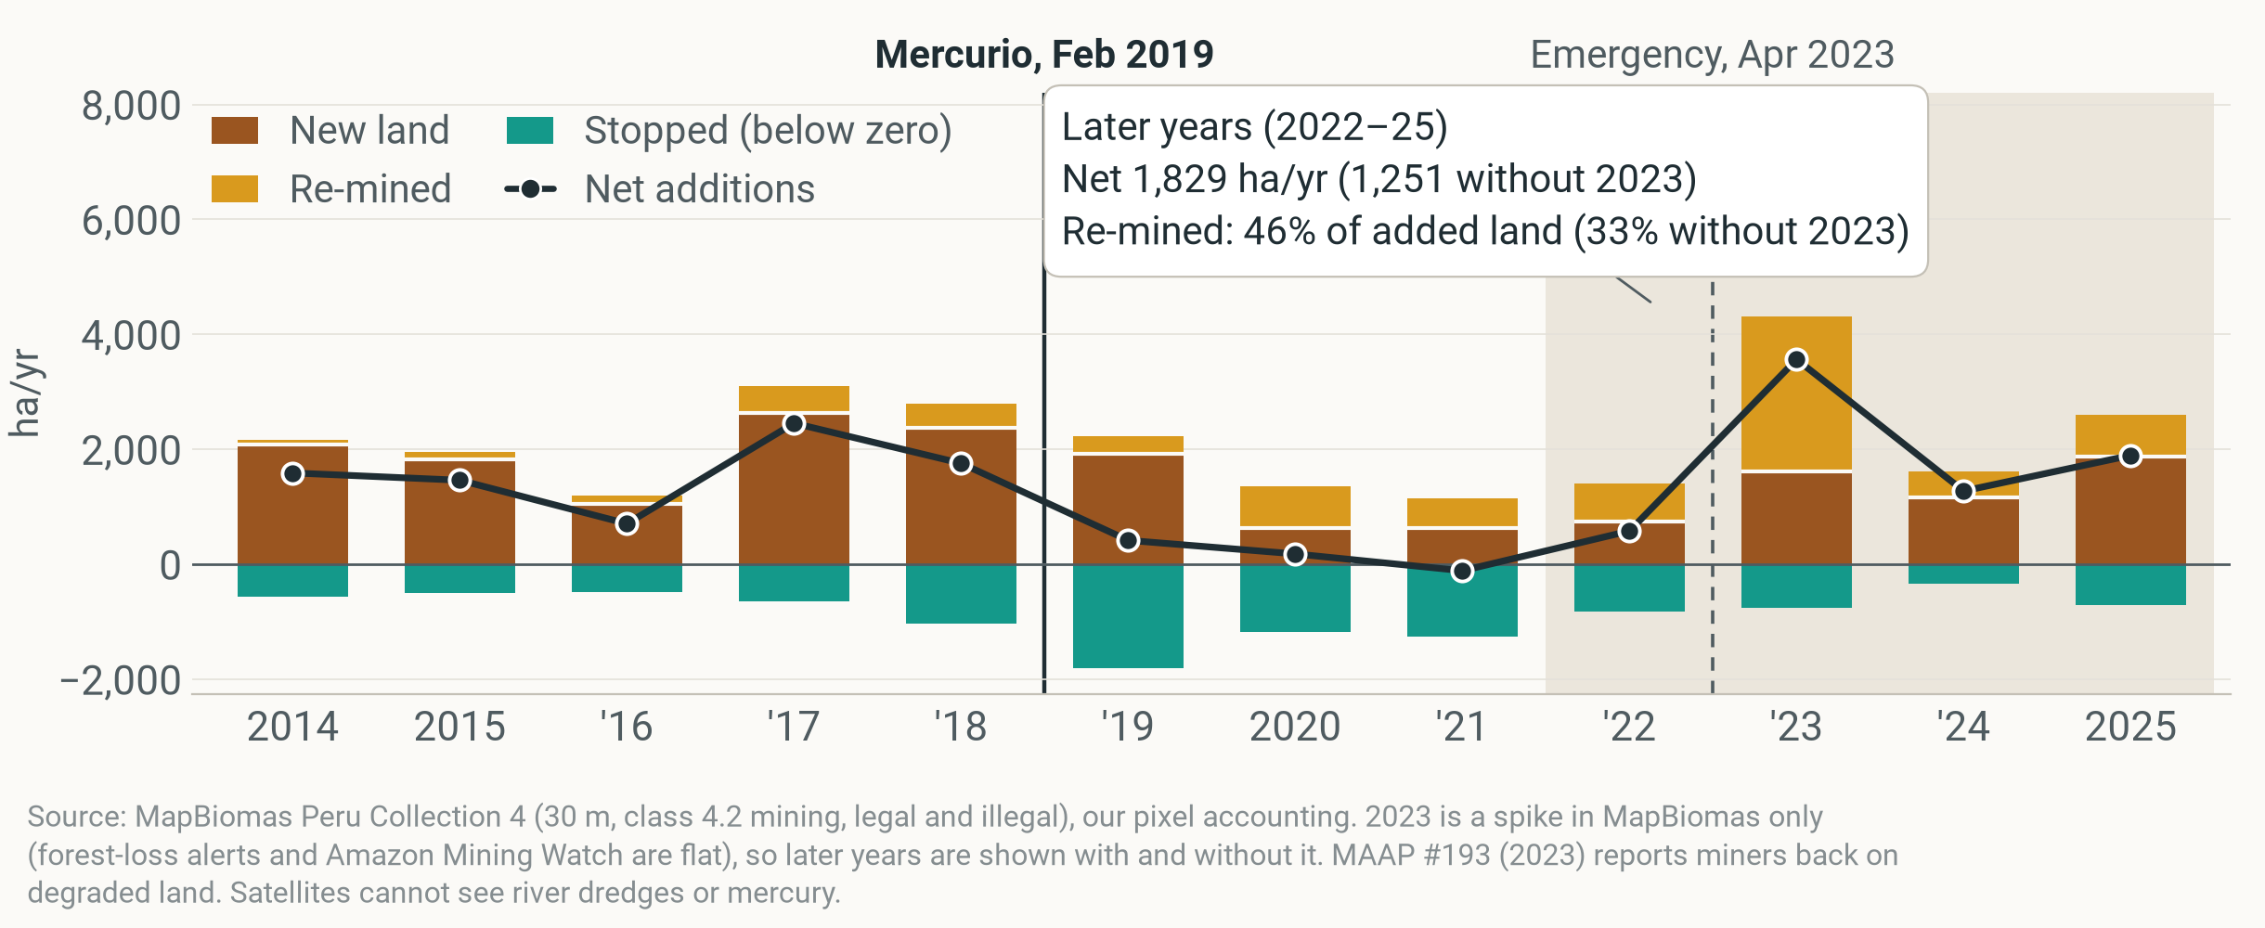
07 HOW IT CAME BACK
DESCRIPTION
It came back, partly on old pits (33–46%)
Net mining additions and parts, ha/yr · Tambopata buffer zone · 2014–2025 · shaded: later years (2022–25) · share = re-mined ÷ (new + re-mined)
Notes:
About 40 seconds. Back to the parts, 2014 to 2025. In the later years the buffer zone averaged 1,829 hectares a year net, 1,251 without the 2023 spike.
Much of it came back on old pits: re-mined land was 46% of the land added, or 33% without 2023 — a third to a half. Forest-loss alerts miss this, because there is no forest left to lose. MAAP #193 (2023) reports the same return to degraded land.
We call 2022 to 2025 'the later years', not 'after enforcement', because enforcement went on in waves: Plan Restauración in 2021 and a state of emergency from April 2023.

Slide 17
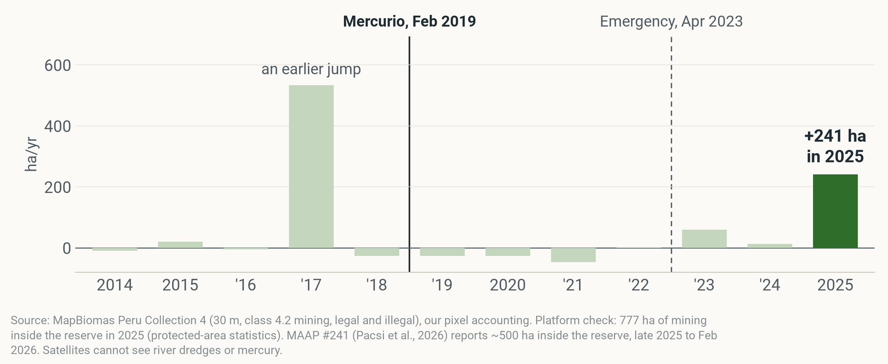
08 INSIDE THE RESERVE
DESCRIPTION
In 2025, mining inside the reserve jumped 241 ha
Net mining additions, ha/yr · Tambopata National Reserve (inside the reserve, not the buffer zone) · 2014–2025
Notes:
About 30 seconds. This is FZS's core area: the Tambopata National Reserve itself, not the buffer zone.
Net additions inside the reserve stayed small or negative for years; in 2019 to 2021 they averaged −33 hectares a year. In 2025 they jumped by 241 hectares. MAAP #241 (2026) reports about 500 hectares from late 2025 to February 2026, and that the navy withdrew from its Malinowski river posts in 2025 for lack of funds.
The 2017 bar, about 534 hectares, is an earlier jump; treat single years with care.

Slide 18






09 IS IT CAUSAL?
CAUSAL · CONDITIONAL
Six methods: two hold up, none is clean
Each builds a stand-in for the Tambopata buffer zone without Mercurio · all six point down · green = holds up, in net additions, in hectares only
Compare with other zones
A weighted copy
Twins in Brazil
Tambopata vs 14 other Peruvian buffer zones, before and after
a mix of zones built to track Tambopata before 2019
look-alike mining areas picked by fixed rules
HOLDS UP · IN HECTARES ONLY
NO GOOD COPY BEFORE 2019
DIFFERENT TRENDS BEFORE 2019
Either side of the road
Matching, 5 ways
Weighted zones and years
land just north vs just south of the highway
look-alike areas picked by algorithm
zones and years weighted to match Tambopata's past
TOO NOISY TO TELL
CAN'T BEAT CHANCE
HOLDS UP · IN HECTARES ONLY
Notes:
About 45 seconds. Only one area was targeted, so to ask 'did Mercurio cause the fall?' we need a stand-in: what would the Tambopata buffer zone have done without it? We built that stand-in six ways.
All six point down; two hold up: comparing with the 14 other Peruvian buffer zones (difference-in-differences with zone and year effects) and weighting zones and years to match Tambopata's past (synthetic difference-in-differences, −1,544 hectares a year). Both find a fall far bigger than any other zone's, but only in hectares; for its size Tambopata is ordinary.
None is clean. A weighted copy (synthetic control) can't track a zone this big before 2019. The Brazilian twins grew at a different pace before 2019, on another product. Either side of the road is too noisy (p = 0.25). Seven matching methods all find Tambopata slower, but never beyond chance. Details in the backup.

Slide 19
10 THE CAUSAL CLAIM
CAUSAL · CONDITIONAL
What we can say about cause
If the other zones show what Tambopata would have done, Mercurio and the operations that followed lowered net mining additions by 1,453 to 1,663 ha a year in 2019–21.
Hectares only
A quarter to a half is pits stopping
COVID overlaps
Largest fall of 15 zones; for its size, 3rd–6th of 7, depending on the scaling.
25%–47% of the fall is more land going out of use, most of it in 2019.
New land fell only from 2020, the first COVID year.
Notes:
About 40 seconds. This is the one causal sentence we are willing to make, and it has an 'if'. If the other buffer zones show what the Tambopata buffer zone would have done without the operation, then Mercurio and the operations that followed lowered its net mining additions by about 1,453 to 1,663 hectares a year in 2019 to 2021. The low end compares it with all 14 other Peruvian buffer zones; the high end with Amarakaeri alone, both against a 2014 to 2018 baseline.
Three limits. It holds in hectares, not relative to the zone's size: scaled, Tambopata is 3rd–6th of 7, nothing special. A quarter to a half of it is pits going out of use rather than fewer new pits. And it coincides with COVID: new land only fell from 2020. Read it as an upper bound.

Slide 20
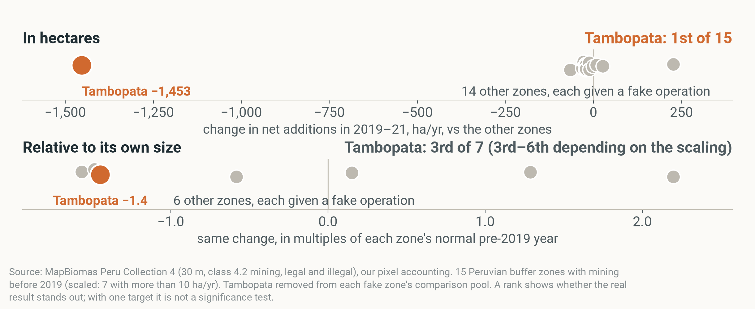
10 THE EVIDENCE
CAUSAL · CONDITIONAL
The fall stands out in hectares, not for its size
Each grey dot: one Peruvian buffer zone given a fake operation in 2019 · orange: the Tambopata buffer zone's real 2019–21 change · net mining additions, after each zone's level and each year's shared change
Notes:
About 40 seconds. How the test works: we pretend each of the other zones was the one targeted, and compute the same number. If Mercurio mattered, Tambopata's real change should stand out from all the fake ones.
Top row, in hectares: the Tambopata buffer zone, the orange dot, is far to the left of every grey dot: 1st of 15. But it was also first in 2014, before Mercurio: it is simply the biggest zone.
Bottom row, the same change scaled to each zone's normal pre-2019 year: Tambopata sits among the others, 3rd of 7 here, and 3rd–6th across the ways of scaling. A big zone falls a lot in hectares just by being big. That is why our claim is in hectares only, and a rank is not a significance test.

Slide 21




11 LIMITS
DESCRIPTION
Most biases make the fall look bigger
Net mining additions measure land, not people, rivers or mercury · direction of each bias for the 2019–21 fall, Tambopata buffer zone
SATELLITES CAN'T SEE
EACH BIAS MAKES THE 2019–21 FALL LOOK…
smaller
bigger
Targeted at its peak
River dredges
Mercury
148 → 598 in La Pampa, 2021–23 (MAAP #193)
in rivers and fish
Miners moved into comparison zones
Big zones fall more in hectares
Pits stopping counted as less mining
Comparison zones had operations too
People
Map flicker
hectares, not miners
37% of land that stopped in 2019–21 was mined again within 2 years
Yearly maps blur Feb 2019
Read the fall as an upper bound, the return as a lower bound.
Notes:
About 30 seconds. Every brief must say what satellites can't see. River dredges: MAAP counted 148 rising to 598 in La Pampa between 2021 and 2023. Mercury in rivers and fish. People: hectares measure mining activity, not the number of miners. And map flicker: 37% of the land that 'stopped' in 2019 to 2021 was mapped as mining again within two years, so some stopping is the classifier, or miners returning.
On the right, the direction of each bias. Targeted at its record peak, miners moving into comparison zones, size, and counting pits that stop as less mining all make the fall look bigger. The comparison zones' own operations and yearly maps blurring a February start push the other way.
So: read our fall as an upper bound, and the return as a lower bound.

Slide 22



12 FOR FZS
PREDICTION
Plan for the months after the operation ends
Informed expectations from one case, not proven rules · net mining additions, Tambopata buffer zone, corridor across the road, reserve
Stay after the sweep
Watch the ring around it
Guard the reserve's edge and river
163 → 1,829
60 → 395
91%
ha/yr, 2019–21 → later years, Tambopata buffer zone. Fund presence, not one-off sweeps.
ha/yr just across the road. Near-real-time forest-loss alerts on a ring of a few km; add old pits.
of first-time mining inside the reserve along its buffer-zone border (2000–25) lies within 1 km of the edge.
Notes:
About 60 seconds. Three recommendations. They build on this one case, so treat them as informed expectations, not proven rules.
One, stay after the sweep. Net additions stayed low only in 2019 to 2021; in the later years the buffer zone was back at about 1,829 hectares a year (1,251 without 2023). Fund lasting presence, not one-off operations.
Two, watch the ring around the operation. In 2019 new pits kept opening while old ones went quiet, and net additions across the road rose from about 60 to 395 hectares a year. Near-real-time forest-loss alerts, like GLAD or MAAP, on a ring of a few kilometres around each operation catch the next pit early. Add old pits to the watch list: alerts miss re-mining.
Three, guard the reserve's edge and its river. 91% of the first-time mining inside the reserve along its border with the buffer zone, 2000 to 2025, lies within one kilometre of the edge. Staffed posts on the Malinowski river are a direct shield; MAAP #241 reports that the navy left those posts in 2025.
What would let us say more: dated patrol records per zone from SERNANP or FZS, dredge counts, and mercury sampling.

Slide 23

THANK YOU
Questions?
Like the anteater: a pause, not an end.
Group Giant Anteater · Ruby Ann Grambauer, Sebastian Schmid, Laurens van der Lely, Omkar Mate, Dhruv Chaudhari
Notes:
Thank you. Happy to take questions. Backup: six methods in detail, the one causal range, stopped land, road and cells, legality, declared gold, money, risk map, twins, Brazil, the map video and definitions.

Slide 24
BACKUP
For questions
Six methods · one causal range · stopped land · road and cells · legality · declared gold · money · risk map · twins · Brazil · map video · one measure · definitions
Notes:
Backup slides, only if asked.

Slide 25
BACKUP · SIX METHODS
CAUSAL · CONDITIONAL
Six methods in detail
Net mining additions, Tambopata buffer zone, 2019–21 vs before, ha/yr unless stated · all conditional on the comparison
METHOD: WHAT IT DOES | RESULT | VERDICT
1 Difference-in-differences: Tambopata's change minus the comparison zones' change | −1,453 (vs 14 zones) to −1,663 (vs Amarakaeri), 2014–18 base; size rank 3rd–6th of 7 | Holds up in ha
2 Synthetic control: a weighted mix of zones that tracks Tambopata before 2019 | −411; all weight on Amarakaeri, no pre-2019 fit | No good copy
3 Rule-based twins: Brazilian areas picked by Ruby's four rules | Tambopata at 16%–41% of their pace (Amazon Mining Watch, another product) | Different trends
4 Spatial discontinuity: land just north vs just south of the road | +2.2 pts of land/yr (p = 0.25) | Too noisy
5 Matching, 5 ways: look-alike areas picked by algorithm | All slower; fake-test p 0.15–0.60; no common support | Can't decide
6 Synthetic DiD: zones and years weighted to match Tambopata's past | −1,544; size rank 3 of 7 | Holds up in ha
Notes:
Only the zone-level designs give a large, stable number, and only in hectares: scaled to size Tambopata is ordinary. The raw rank 1 of 15 also appears in 2014, before Mercurio, so it measures size, not significance. Synthetic control cannot fit Tambopata's size before 2019; the twins grew differently before 2019 and use another product (Amazon Mining Watch new area, not net additions); the road discontinuity measures a swing and is too noisy on net additions; matching never beats chance and has no common support.

Slide 26
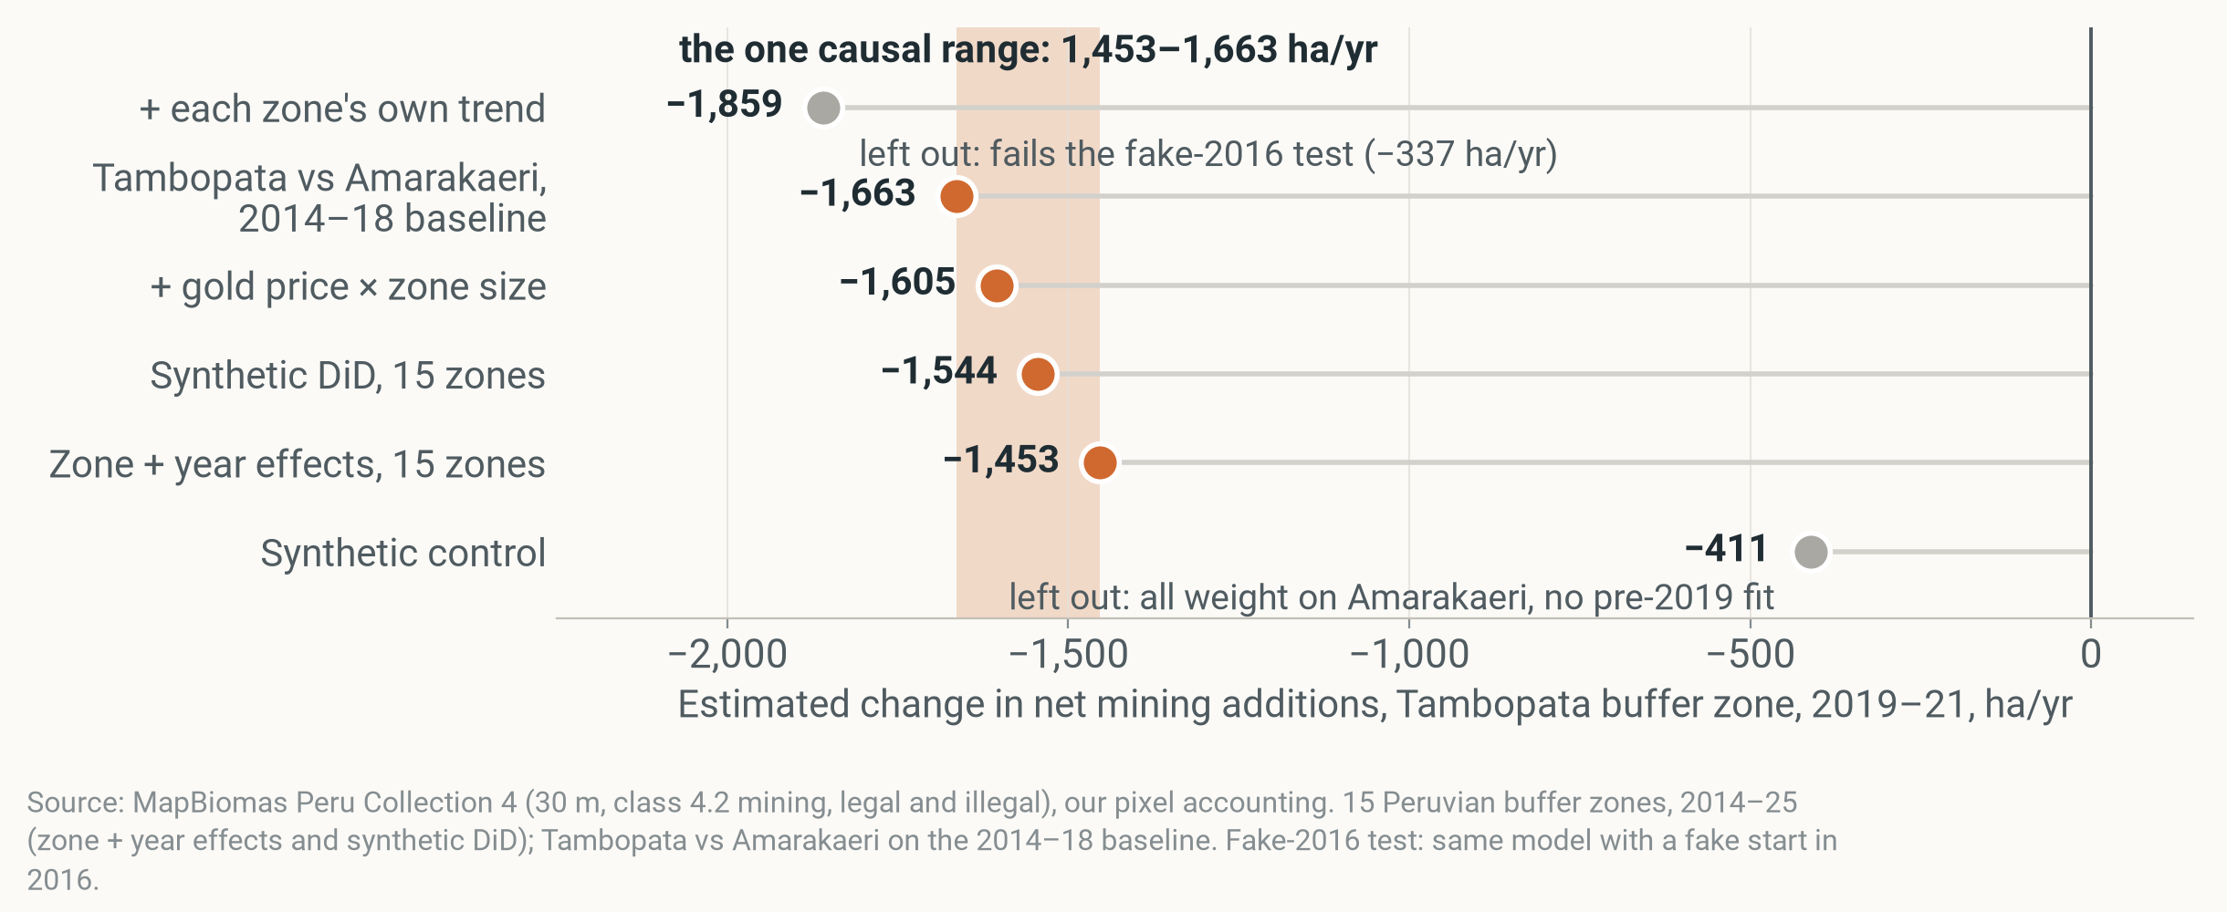
BACKUP · ONE CAUSAL RANGE
CAUSAL · CONDITIONAL
One causal range: 1,453–1,663 ha a year
Estimated change in net mining additions, ha/yr · Tambopata buffer zone · 2019–21 · causal only if the comparison zones show what Tambopata would have done; an upper bound; part of it is pits stopping
Notes:
The range runs from zone + year effects across all 15 zones (−1,453) to Tambopata vs Amarakaeri on the 2014–18 baseline (−1,663). Synthetic DiD and the gold-price model fall inside. Two estimates are left out: each zone's own trend (−1,859) fails the fake-2016 test, and synthetic control (−411) puts all weight on Amarakaeri without a pre-2019 fit. All conditional; an upper bound.

Slide 27
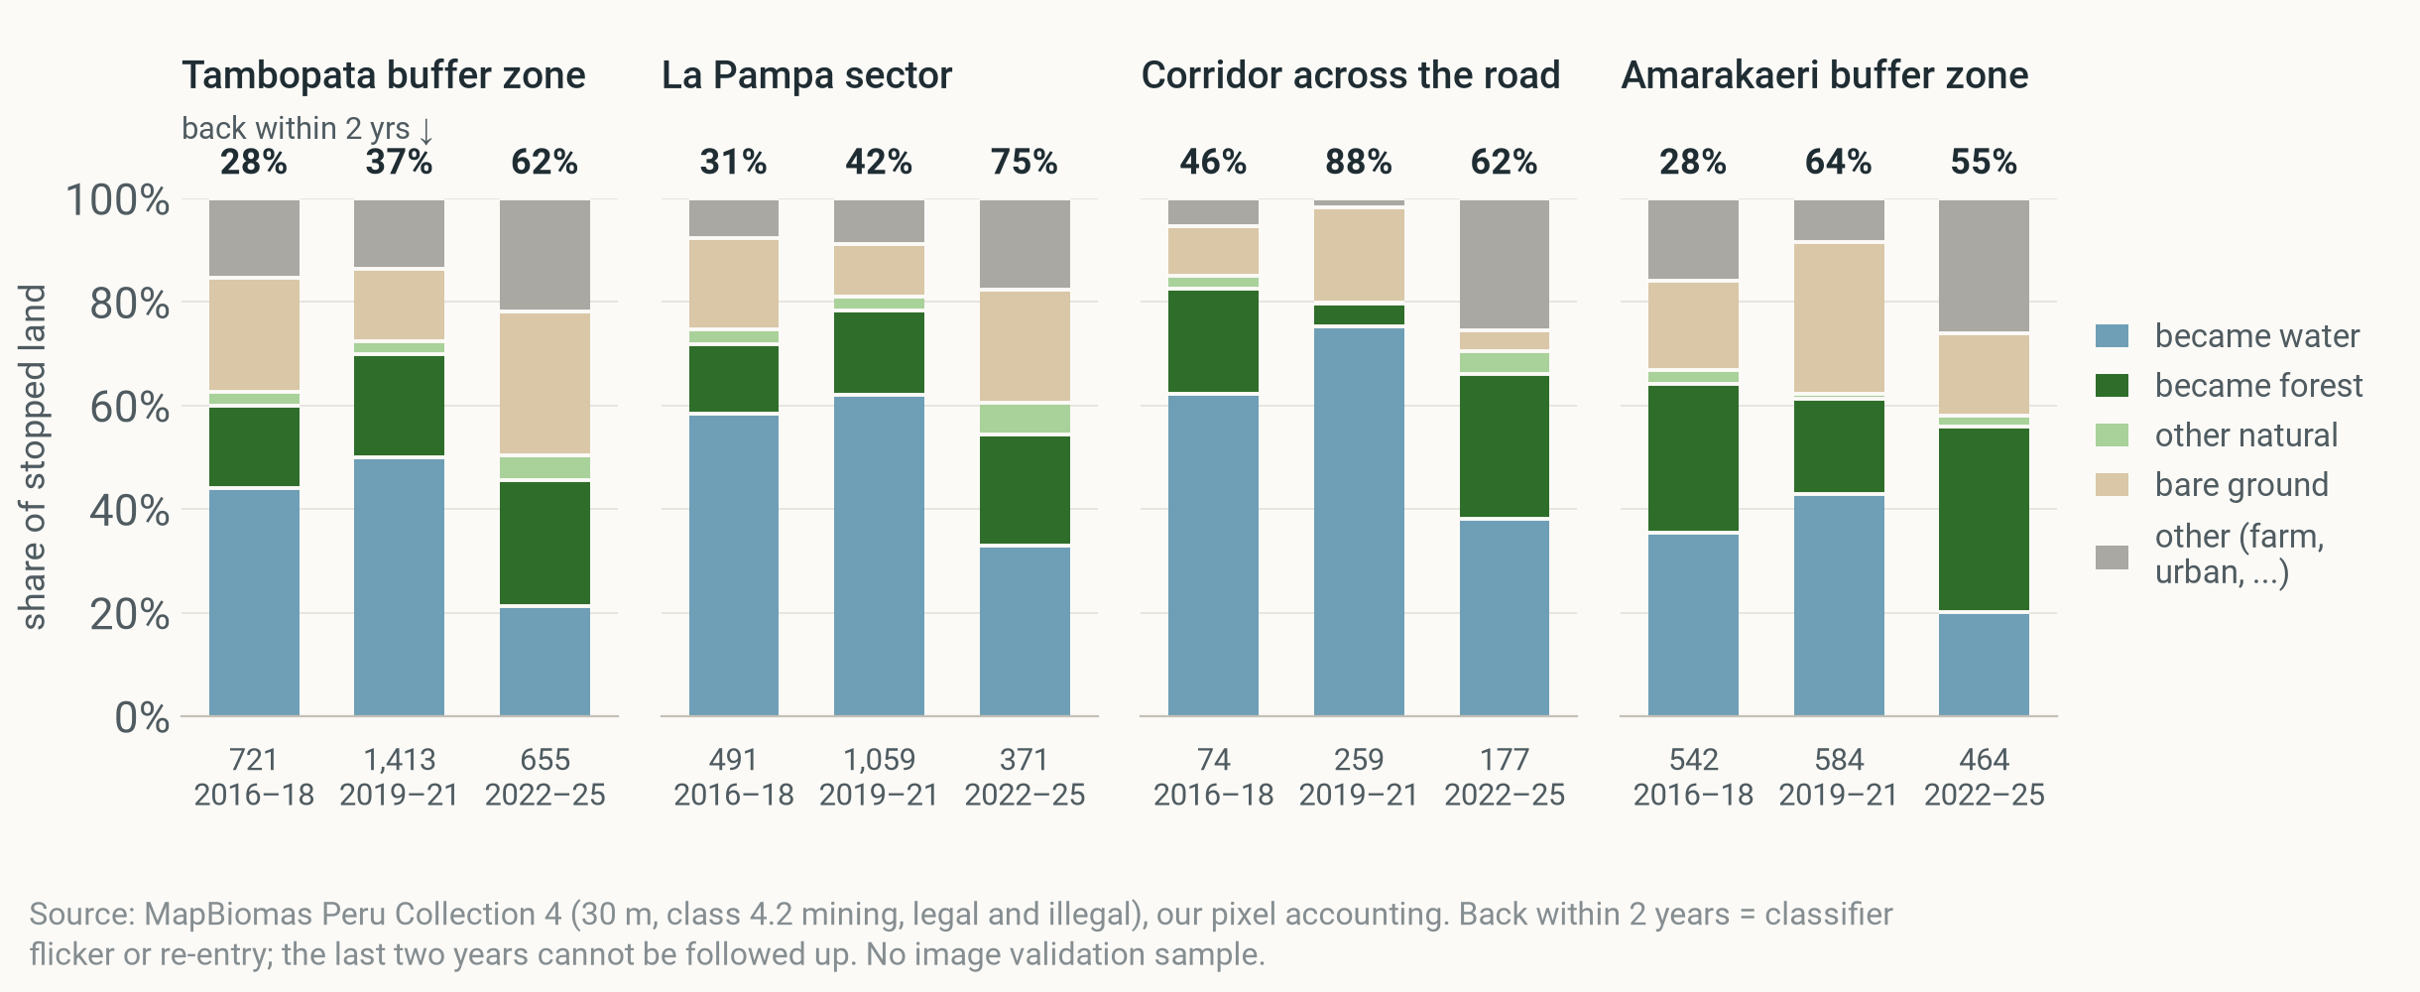
BACKUP · STOPPED LAND
DESCRIPTION
Stopped land: often water, often mined again within 2 years
Stopped land (left the mining class), share by what it became and share mining again within 2 years, period means · four zones · 2016–18, 2019–21, 2022–25 (small numbers under the bars: stopped ha/yr). Numbers on top: share mining again within 2 years.
Notes:
What 'stopped' means on the ground. Most stopped land becomes water (flooded pits) or regrows; a large share is mapped as mining again within two years: in the Tambopata buffer zone 37% for 2019–21. That is classifier flicker or miners returning; we have no image validation sample.

Slide 28
BACKUP · ROAD AND CELLS
DESCRIPTION
Road and 1-km cell designs: too noisy to tell
Net mining additions · La Pampa longitudes · 2019–21 vs 2014–18 · finer-grained designs, described in one line each
EITHER SIDE OF THE ROAD
AT THE RESERVE EDGE
1-KM CELLS
+2.2 pts
−0.2 pts
≈ before/after
of land per year swung north of the road (p = 0.25; 0.18–0.86 across distances). Compares land just either side of the highway; miners moving across break it, so it is an upper bound.
no measurable change (p = 0.63). Same comparison, inside vs outside the reserve's border.
Each 1-km cell compared with cells of the same year; the comparison cells hold almost no mining, so this is close to a simple before/after.
Notes:
Spatial regression discontinuity (rdrobust, difference in discontinuities) at the road and at the reserve edge, and a 1-km cell panel with cell and year effects. Neither is informative on net additions: the road swing is noisy and is an upper bound because displacement breaks the no-spillover assumption; the cell comparison holds almost no mining. Description.

Slide 29
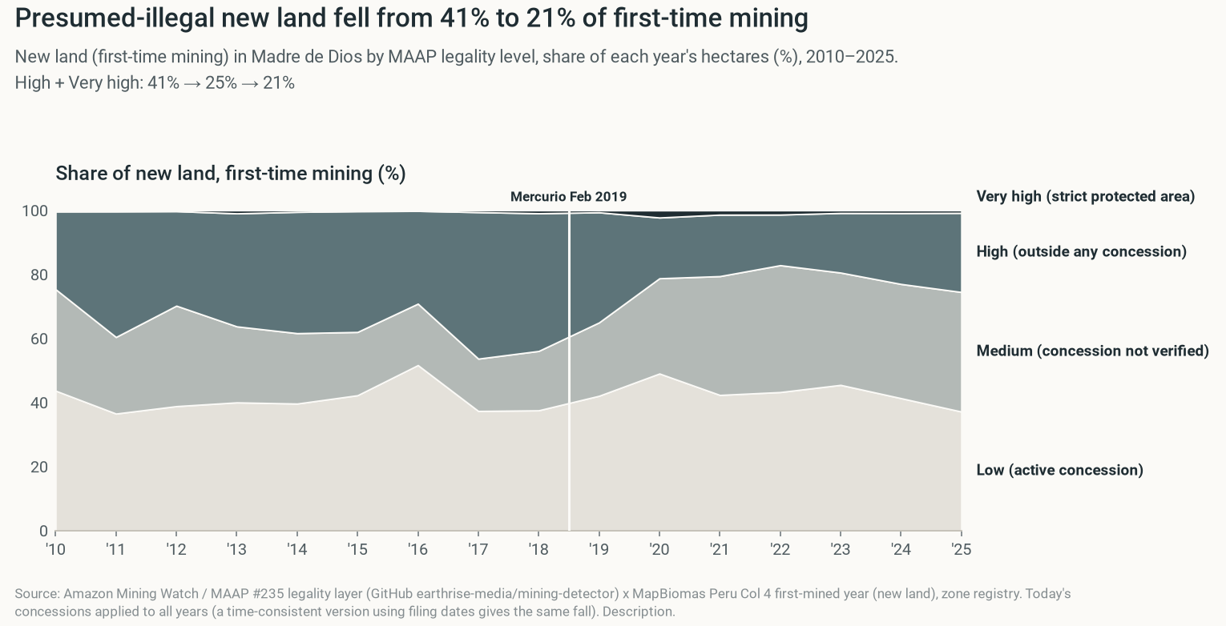
BACKUP · LEGALITY
DESCRIPTION
Presumed-illegal new land fell; grey zones grew
Notes:
Amazon Mining Watch / MAAP legality layer on first-time mining (new land), Madre de Dios. Another product; today's concessions applied to all years. Description.

Slide 30
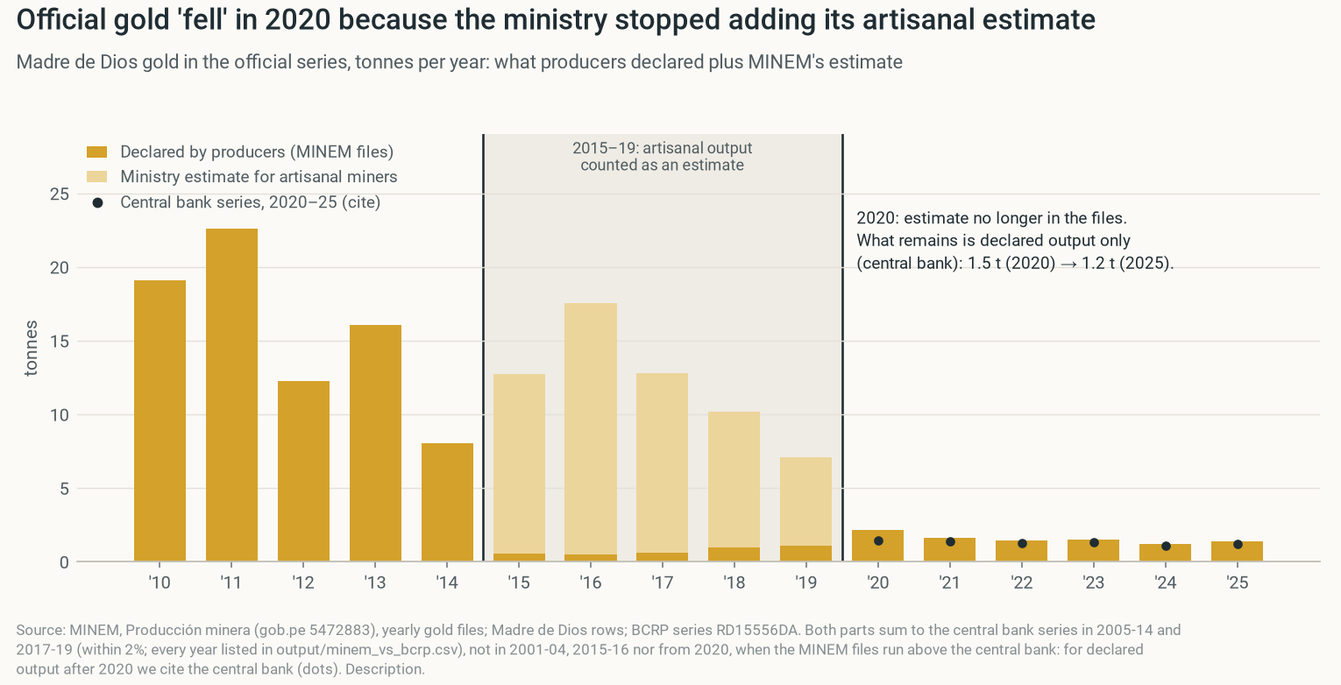
BACKUP · DECLARED GOLD
DESCRIPTION
The official gold drop is a definition change
Notes:
The official Madre de Dios gold series 'fell' in 2020 because the ministry stopped adding its artisanal estimate. Producer-declared gold did not fall. Do not cite it as a production fall. Description.

Slide 31
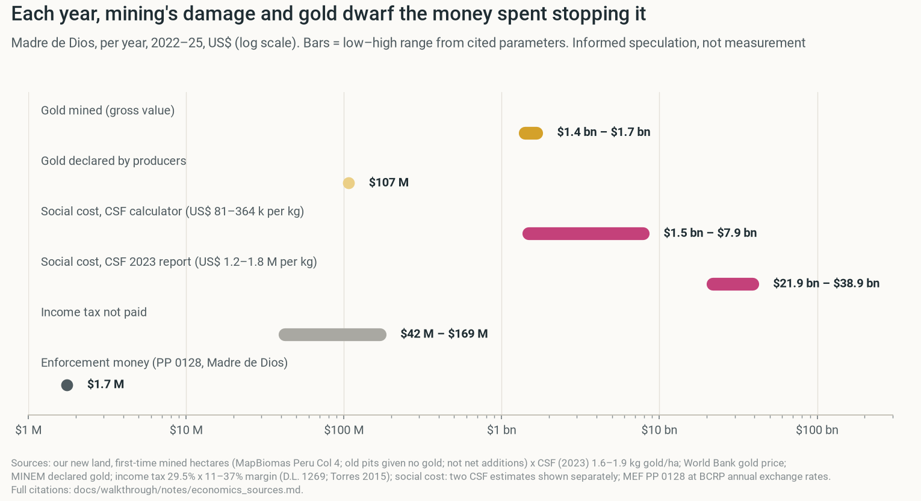
BACKUP · MONEY
PREDICTION
Gold and its damage dwarf enforcement money
Notes:
Informed speculation from cited parameters, not a finding: gold mined, declared gold, social cost estimates and enforcement money per year, 2022–25, log scale.

Slide 32
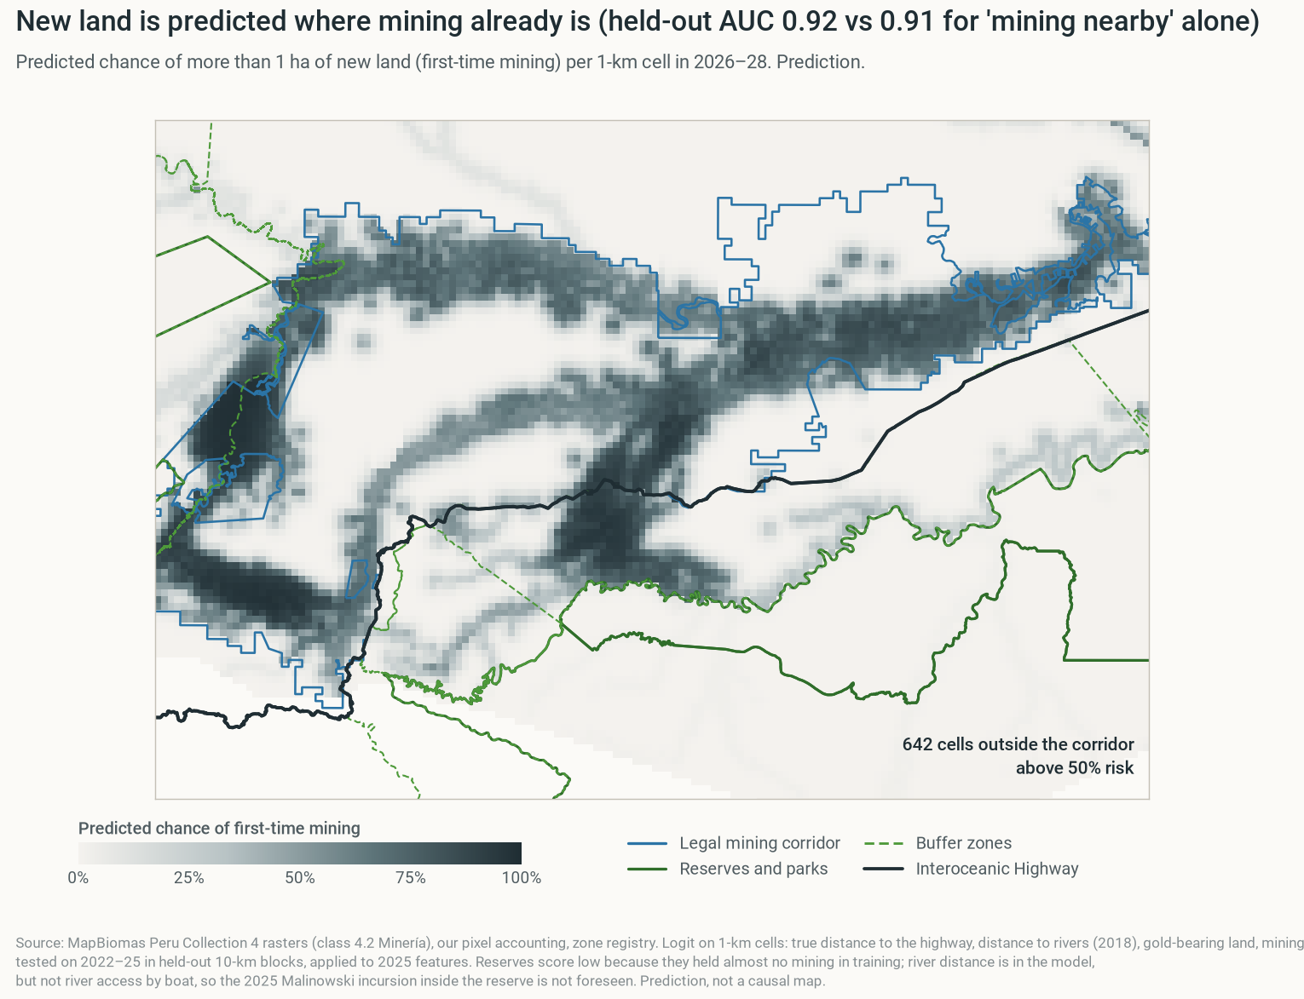
BACKUP · RISK MAP
PREDICTION
Next new mining is likely next to old mining
Notes:
Prediction, not a causal map: chance of new land per 1-km cell in the next years, from distance to the road, rivers, gold-bearing land and existing mining.

Slide 33
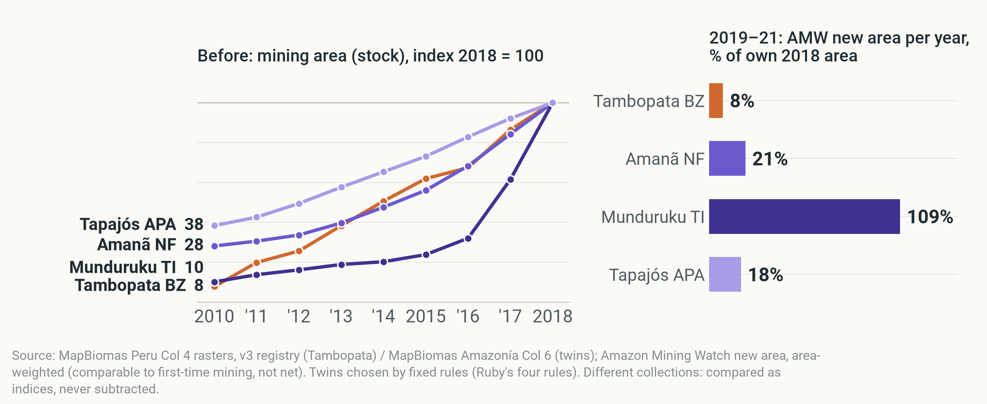
BACKUP · TWINS
DESCRIPTION
Twins: Tambopata at 16%–41% of their pace; trends differed before
Left: mining area (stock), index 2018 = 100, 2010–18 (pre-trends rejected, p < 0.001). Right: Amazon Mining Watch new area 2019–21 per year, % of own 2018 area: a different measure, not net additions.
Notes:
Rule-based twins (Ruby's design), all chosen by one dating rule. On another product (Amazon Mining Watch new area, comparable to new land, not net additions), the Tambopata buffer zone added new area in 2019–21 at 16% of the twins' mean pace (41% without Munduruku). Before 2019 the twins grew differently, so they can't show the counterfactual.

Slide 34
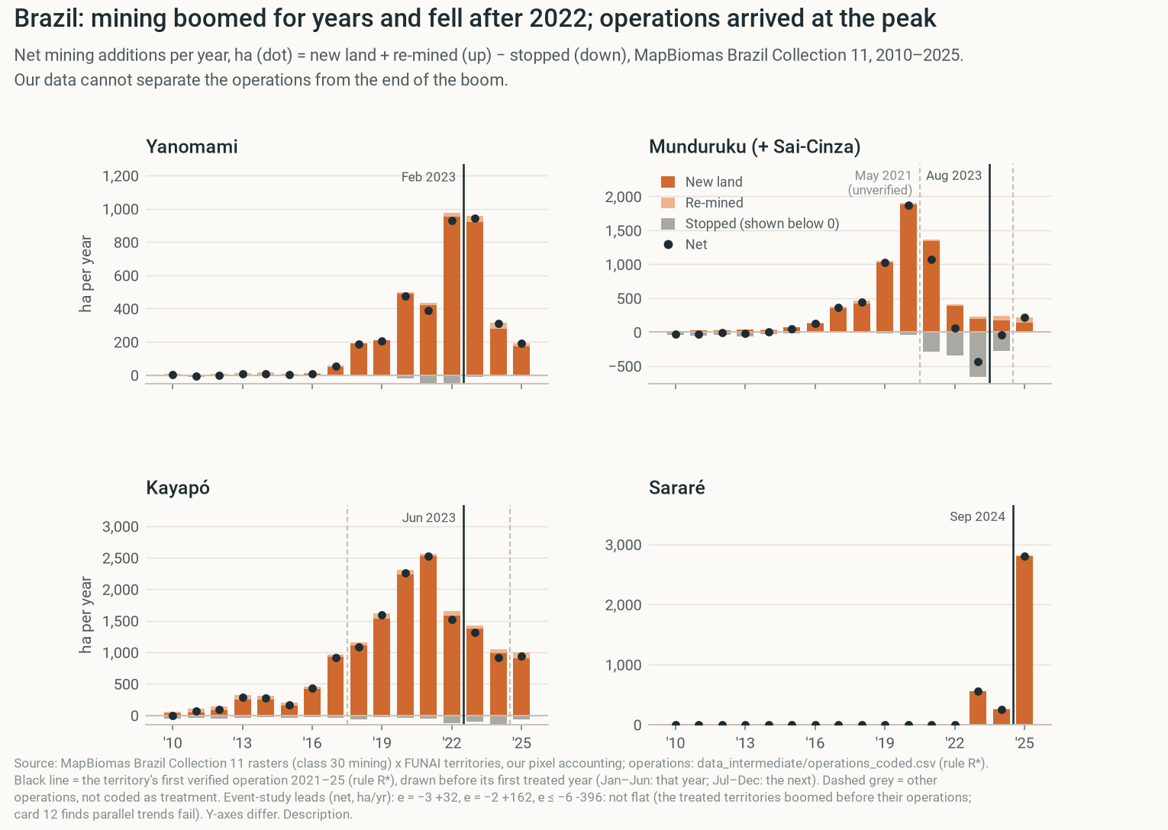
BACKUP · BRAZIL
DESCRIPTION
Brazil: mining boomed and fell; operations arrived at the peak
Notes:
Only if asked. In the Yanomami, Munduruku and Kayapó territories mining had boomed for years and fell after 2022. Federal operations arrived at the peak, and Munduruku was already falling before its operation, so our data cannot separate the operations from the end of the boom. A national change in January 2023 (end of the gold 'good faith' rule, electronic invoices) hit all territories at once. Net additions, MapBiomas Brazil Collection 11. Description.

Slide 35
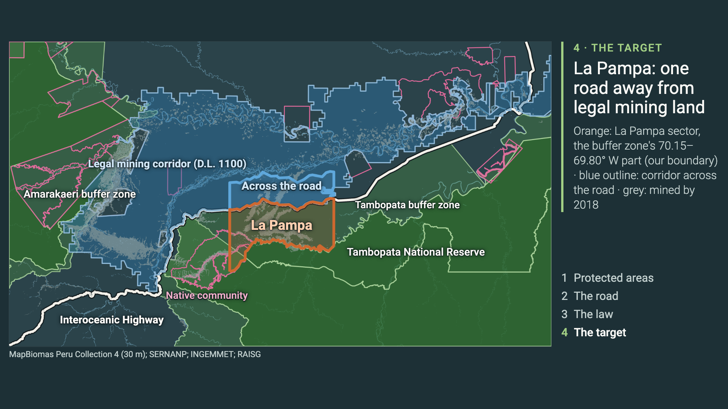
BACKUP · MAP VIDEO
DESCRIPTION
The map build as one animation
Same four steps as the click-through map slides · protected areas → highway → corridor → La Pampa · click to play
Notes:
Optional: the same four steps as the click-through map slides, as one video.

Slide 36
BACKUP · DEFINITIONS AND DATA
DESCRIPTION
Definitions and data
One outcome, one set of zones, one treatment · every number in this deck comes from our replication code
ITEM | DEFINITION | SOURCE
Net mining additions | Mining area in year t − year t−1, ha/yr = new land + re-mined − stopped | MapBiomas Peru Collection 4 (30 m, class 4.2)
New land / re-mined / stopped | First time since 1985 / mined again after a gap / left the mining class | Our pixel accounting
Tambopata buffer zone | Official SERNANP polygon, whole (incl. Kotsimba) | SERNANP
La Pampa sector | Tambopata buffer zone between 70.15° and 69.80° W (no official line) | Our boundary
Corridor across the road | D.L. 1100 land ≤ 10 km north of the highway, at La Pampa's longitudes | INGEMMET, RAISG
Legal mining corridor | All D.L. 1100 land in Madre de Dios (native communities excluded); its share = its net additions ÷ the department's, summed over each period | INGEMMET
Treatment and periods | Mercurio from Feb 2019 (first treated year 2019) · 2016–18 before · 2019–21 Mercurio and what followed · 2022–25 later years (± 2023) | MAAP #130; course card
Notes:
Definitions for questions. The course's statistics workbook numbers (1,640 → 163 ha/yr) are reproduced as checks; our numbers come from the rasters on one set of zones.

