Slide 1

WE HOPE YOU ENJOYED THE GAME!
IT WAS GREAT CODING IT ☺

Slide 2

IDEA
Point and click games
The main character is the user
Adding graphics to text-base game

Slide 3
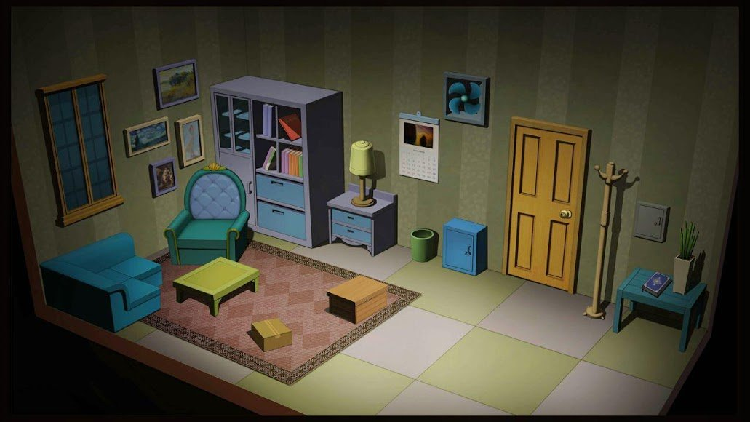
Behind the interface:

Slide 4
ISSUES
Tkinter looks different on different screens
Unable to create different “rooms”
Use objects in inventory
Static spots for objects in inventory
“Garbage collection”
Evaluate input text for if statements

Slide 5
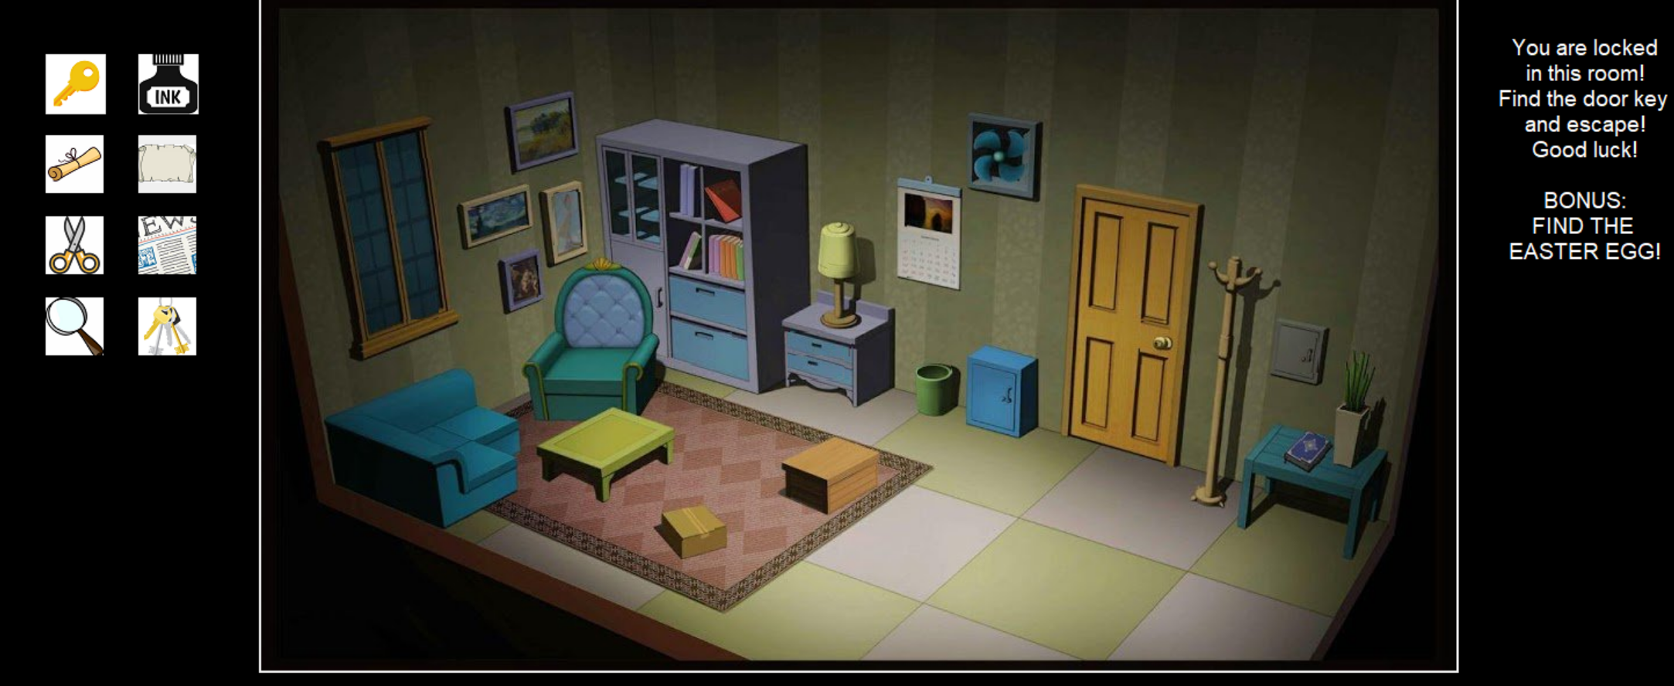
Inventory

Slide 6
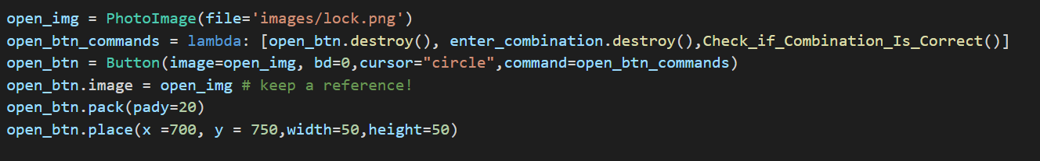
Garbage collection
Tkinter interface doesn’t handle references to Image objects properly.
The Tk widget will hold a reference to the internal object, but Tkinter does not.
Since the image is in use by a widget, when Python’s garbage collector discards the Tkinter object, it doesn’t get destroyed completely, it gets blanked (you will see a white square instead).
The solution is to keep a reference to the Tkinter object, for example by attaching it to a widget attribute, like in the example above.
Source: www.webarchive.org

Slide 7
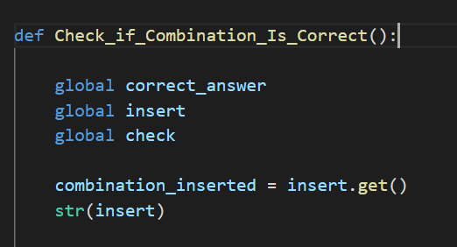
Entry text

Slide 8
BUGS
Disable checking combinations buttons while checking combinations is in progress

Slide 9
THANK YOU!

