Slide 1

WE HOPE YOU ENJOYED THE GAME!
WE ENJOYED CODING IT ☺

Slide 2

IDEA
Point and click games
The main character is the user
Adding graphics to text-base game

Slide 3
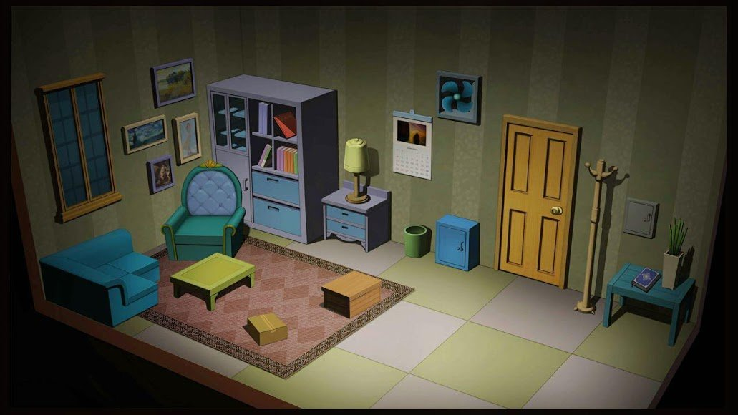
How we did it:

Slide 4
ISSUES
Tkinter looks different on different screens
Use objects in inventory
Object place static
“Garbage collection”
Use input text
Different “rooms”

Slide 5
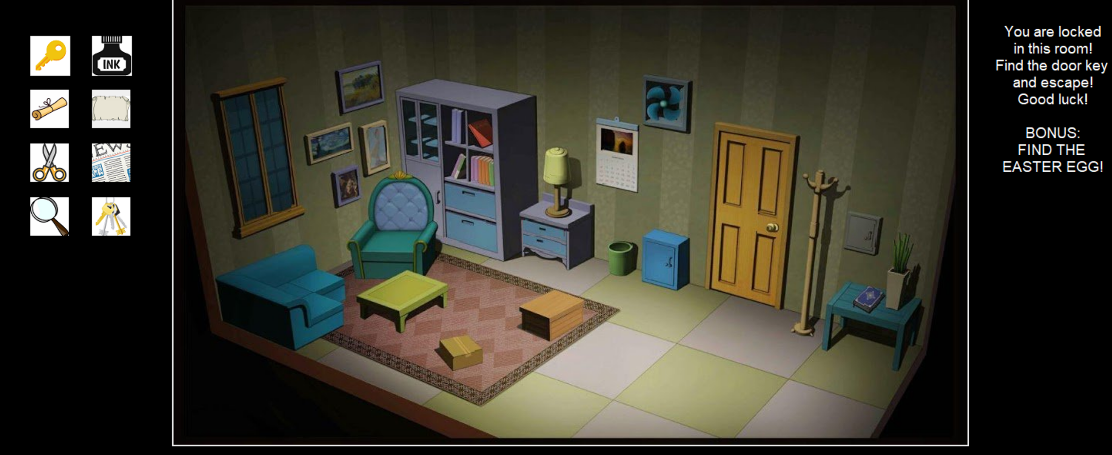
Inventory

Slide 6
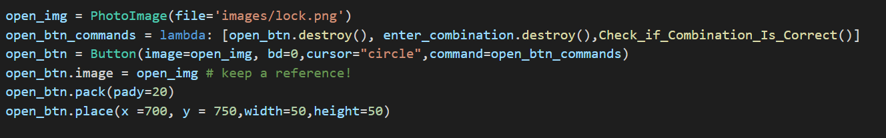
Garbage collection
Tkinter interface doesn’t handle references to Image objects properly.
The Tk widget will hold a reference to the internal object, but Tkinter does not.
Since the image is in use by a widget, when Python’s garbage collector discards the Tkinter object, it doesn’t get destroyed completely, it gets blanked (you will see a white square instead).
The solution is to keep a reference to the Tkinter object, for example by attaching it to a widget attribute, like in the example above.

Slide 7
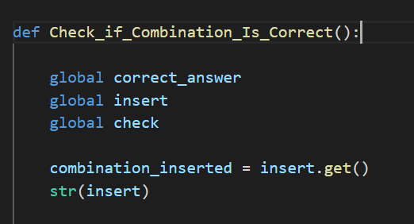
Entry text

Slide 8
BUGS
Disable checking combinations buttons while checking combinations is in progress

Slide 9
THANK YOU!

