Slide 1
Foundations of Data Science Lecture 3, Module 1
Rumi Chunara, PhD
CS6053
Fine Print: these slides are, and always will be a work in progress. The material presented herein is original, inspired, or borrowed from others’ work. Where possible, attribution and acknowledgement will be made to content’s original source. Do not distribute without the instructor’s permission.
Notes:
Piazza forum reminders, R today

Slide 2
Major Tasks in Data Preprocessing
Data cleaning
Fill in missing values, smooth noisy data, identify or remove outliers, and resolve inconsistencies
Data integration
Integration of multiple databases, data cubes, or files
Data reduction
Dimensionality reduction
Numerosity reduction
Data compression
Data transformation and data discretization
Normalization
Concept hierarchy generation
Notes:
Reduce data volume by choosing alternative, smaller forms of data representation
Parametric methods (e.g., regression)
Assume the data fits some model, estimate model parameters, store only the parameters, and discard the data (except possible outliers)
Ex.: Log-linear models—obtain value at a point in m-D space as the product on appropriate marginal subspaces
Non-parametric methods
Do not assume models
Major families: histograms, clustering, sampling, …

Slide 3
Data prep for modeling
Notes:
The goal of finding structure is to information from one source to reduce uncertainty about another source.
What does this mean? Conditional distribution example. I.e., carnival guy who guesses your weight. If I can see your height I can reduce uncertainty about weight.
Find some height/weight data.
Under supervised exploration:
How can we (automatically) obtain a selection of the more informative variables with respect to predicting the value of the target variable?
Even better, can we obtain the ranking of the variables?
Can think of importance as one that makes the target variable more pure. This leads to the notion of entropy.

Slide 4
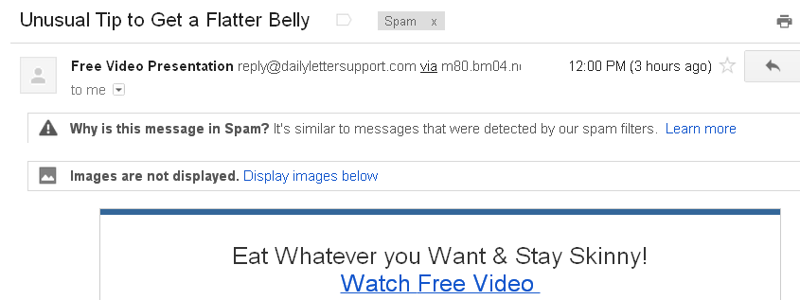
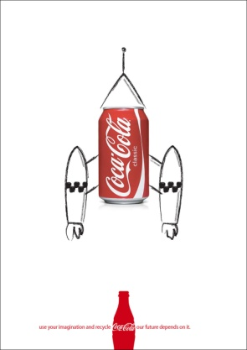
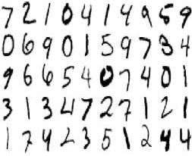

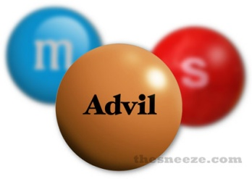
Choose the Target Variable
This should be directly determined by the problem. i.e., what are you trying to predict?
Will someone click on an ad?:
C=[No,Yes]
Is this e-mail spam?: C=[No,Yes]
What number is this?:
C=[0,1,2,3,4,5,6,7,8,9]
What is this news article about?:
C=[Politics, Sports, Finance …]
Is this pill good for headaches?:
C=[No,Yes]

Slide 5
Do Appropriate Data Transformations
This is also called Feature Engineering, and is a great skill to develop.
Examples of Feature Engineering
Binning
Non-linear transformations
Domain knowledge feature extraction

Slide 6
Binning
Taking categorical data with K values (also called a factor) and projecting them to K-1 binary features (also called ‘dummy indicators’).
Data can be numeric or categorical
If there are 4 categories/ranges, we have 3 binary variables.
User | Income | IncomeGrp
1 | $65,500 | [61k,80k]
2 | $81,041 | [81k,100k]
3 | $38,346 | [21k,40k]
4 | $47,072 | [41,60k]
5 | $30,812 | [21k,40k]
6 | $21,618 | [21k,40k]
7 | $97,872 | [81k,100k]
User | inc_41_60 | inc_61_80 | inc_81_100
1 | 0 | 1 | 0
2 | 0 | 0 | 1
3 | 0 | 0 | 0
4 | 1 | 0 | 0
5 | 0 | 0 | 0
6 | 0 | 0 | 0
7 | 0 | 0 | 1
Numeric (continuous) data can be binned based on a pre-defined range.
2. Categorical data can be binned based on category value.
3. If you make K indicators and not K-1, your X matrix will be degenerate/singular because because the Kth indicator will be a linear combination of the K-1 previous indicators. Many algorithms don’t like non-invertible matrices.

Slide 7
Non-linear transformations
Let’s say you want/have to build a linear model, so you need to express your dependency as:
E[Y]=α⁰+β⁰*X
But the phenomenon/data you are modeling is actually non-linear, so to get a better fit you want:
E[Y]=α¹+β¹*g(X)
In lieu of using more sophisticated non-linear algorithms (i.e., Random Forest, Neural Network), you can make clever feature transformations to get a non-linear fit out of a linear algorithm.

Slide 8
Example – non-linear transform
In this example we have a regression problem with the following model specification: E[Y]=α+β*X
The R² is pretty good, but visually, we can see a potentially better fit. What transformation might fit this data better?

Slide 9
Example – non-linear transform
Lets use the transformation g(X)=<X²,X>
We can then fit the model: E[Y]=α+β*g(X) = α+β₁X²+β₂X
We can often realize a non-trivial increase by making such transformations prior to modeling.

Slide 10
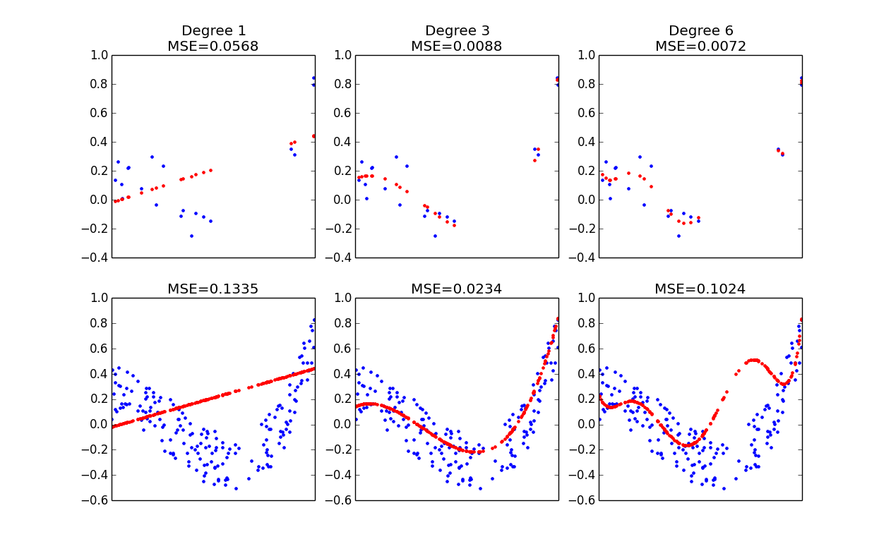
Nonlinear transformation: Noisy environment
If g(X) is a polynomial expansion of X (i.e., g^{d}(x)=<X^{d},..X²,X>), we can get a great fit by choosing the right degree of expansion. Too low and we get generally bad MSE everywhere…too high and we overfit.
Train
Test
Notes:
MSE (statistics recap): Mean square error
In statistics, the mean squared error (MSE) or mean squared deviation (MSD) of an estimator (of a procedure for estimating an unobserved quantity) measures the average of the squares of the errors or deviations—that is, the difference between the estimator and what is estimated. WILL TALK ABOUT BIAS VARIANCE TRADEOFF LATER

Slide 11
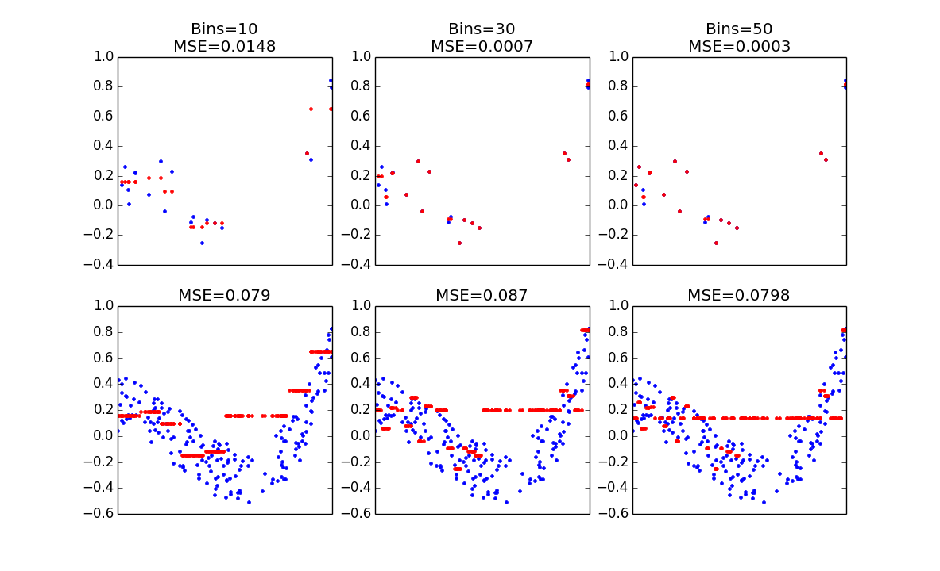
Binning: Noisy Environment
Binning a numeric feature also needs to be done carefully. Too few bins and you get a poor fit…too many bins and you overfit terribly.
Fit the training data nearly perfectly
Train
Bins don’t borrow information from neighbor bins
Test
Notes:
Bins don’t borrow information from neighbors - just overfit to training
*DO BINNING DEMO

Slide 12
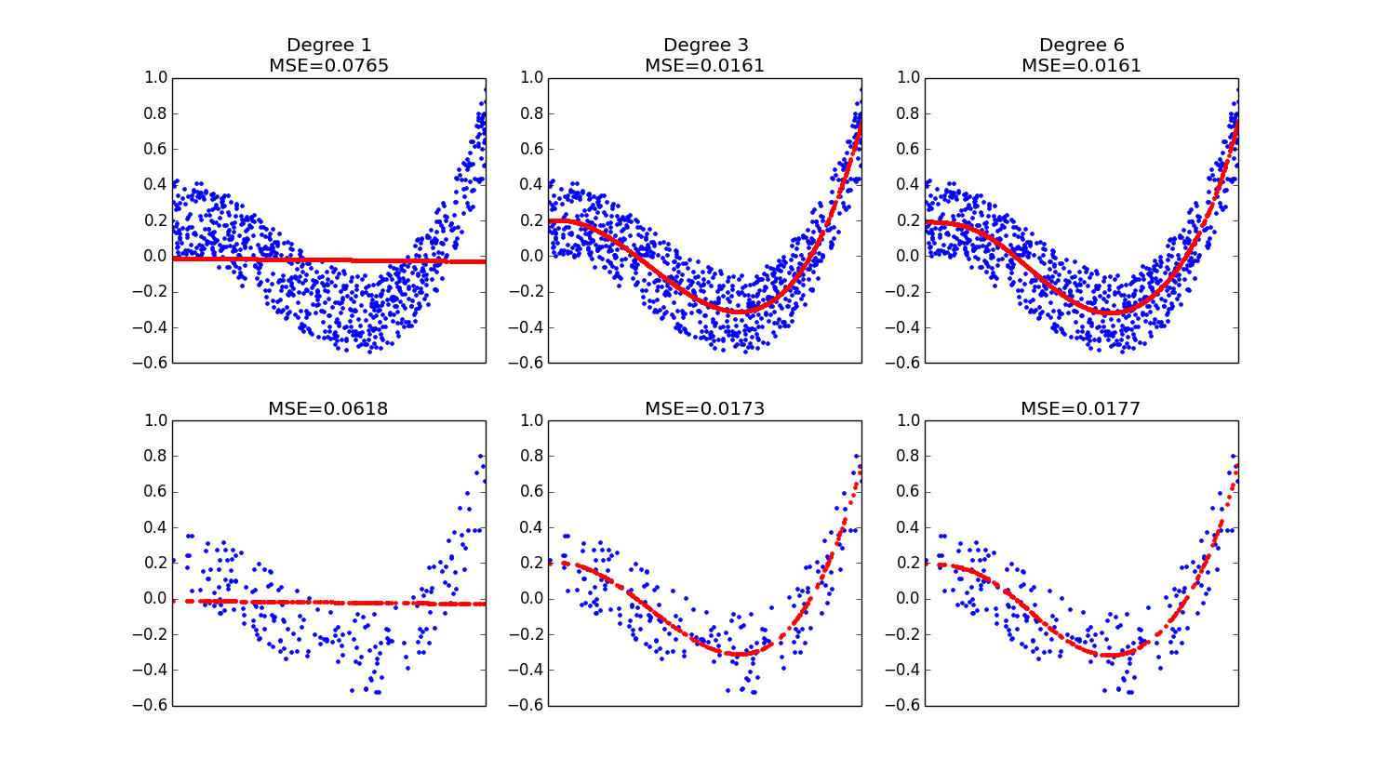
Nonlinear transformation: Information Rich Environment
When we have much more training data to fit, the highest order polynomial doesn’t help much, but is less likely to overfit. The data was generated using a degree 3 polynomial, and our regression has effectively learned that.
Train
Test
Notes:
When training data a lot, less likely to overfit since so much data
Less likely to overfit than in the information poor environment (less samples)

Slide 13
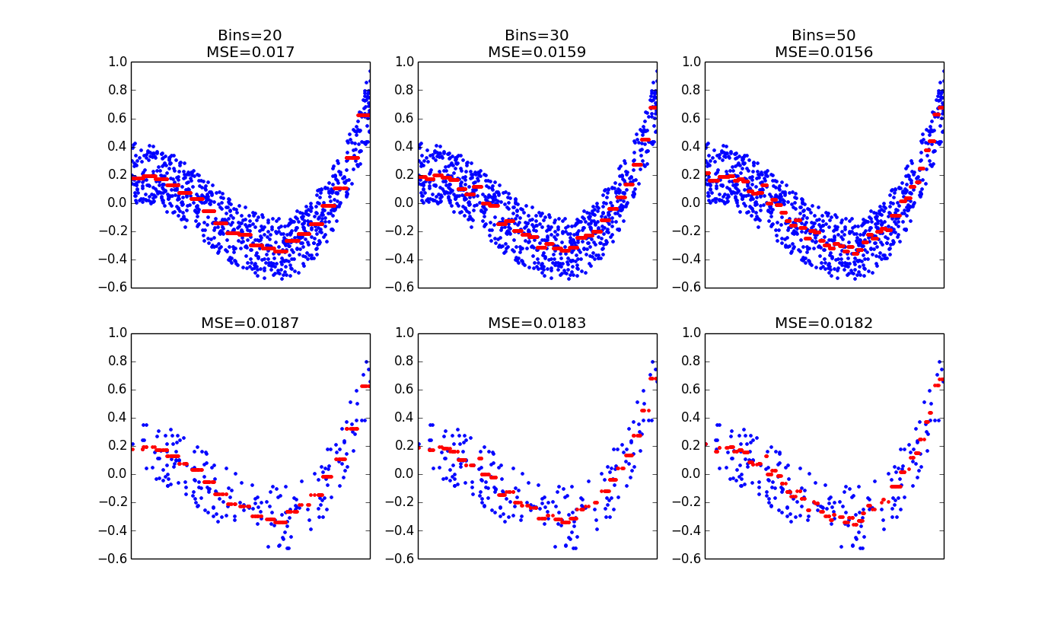
Binning: Information Rich Environment
With more data we can support a higher number of bins. This method can be competitive with the polynomial fit, but it is still easy to over fit. Careful consideration and testing must be done to choose the appropriate bin size.
Binning can approximate any arbitrary curve.
Train
But it is always at a high risk of overfitting.
Test
Notes:
Opposed to just using higher polynomial in information rich environment, binning more likely to overfit

Slide 14

Domain Knowledge Feature Extraction
Many industrial data collection processes store data in either primitive log formats or in schemas designed to support transactional systems.
These systems are usually built for speed, not analytics.
As a result, data scientists often need to design their own features to be used in analysis and modeling.

Slide 15

How to Design the Perfect Feature?
Unfortunately there are usually no text books or theoretical systems teaching us how to design good features
Intuition, creativity and knowledge of the application domain are needed.
Data scientists should consult with domain experts when doing this.
Notes:
The experimentation is part of the research process (e.g. tobacco/alcohol example)

Slide 16
Some Guidelines for Domain Knowledge Feature Engineering
Try to understand the physical (or biological, etc.) mechanism at work
Not all processes you model have theoretical models that define them. Nonetheless, you can put yourself in the user’s shoes. What are actions and events that you think might be correlated with the target variable.
Thoroughly review the underlying data system
The data is collected to support the product and transactional systems. These might lead clues as to what can or should be used as features.
Consult with domain area people
People with extensive knowledge of the area might have solid and experience driven intuition that can help you formulate a feature plan.
Put yourself in the user’s shoes
What would you do before: buying something, clicking on an ad, defaulting on your credit card, friending someone on FB? Try to encapsulate this behavior in the form of a feature.

Slide 17
Leakage
Target Variable Leakage - Having a feature that is caused by the outcome of the target variable.
Examples:
using the fact that a user saw a “Thank You” page to predict that the user will purchase (hint: if the feature happens after the outcome, it’s probably not a legitimate feature)
Positives and Negatives are stored in different log files, and each log uses a different range for the user id. The user id perfectly predicts the outcome!
Training/Testing Leakage – Having records in the training set also appear in the test set
Model performance that is too good to be true is a good reason to suspect leakage!

Slide 18
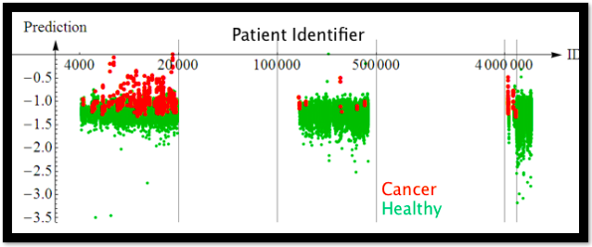
Leakage - example
Patients with Cancer were pulled from a different system and generally had a different distribution of IDs. But ID is a worthless artifact of the system, and not a true predictor of cancer. Leakage is usually caused by sloppy data prep!!!
From the KDD 2008 Cup Winning Solution, provided by Claudia Perlich.
Notes:
In this case NOT informative. (correlation that wasn’t linked)
Should have checked that training/test distributions same

Slide 19
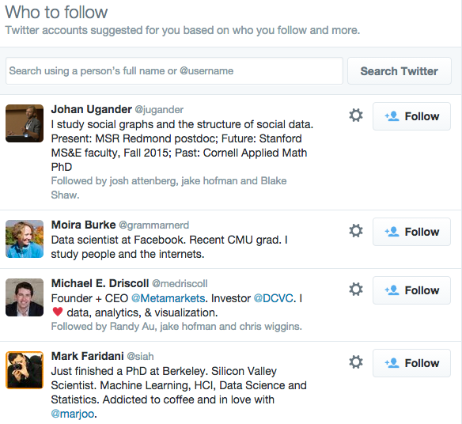
Lets build a dataset for Twitter recommendations

Slide 20


Data Instances
User i
User j
Label
Features
1
<X1, X2, .. Xk>
0
<X1, X2, .. Xk>
0
<X1, X2, .. Xk>
1
<X1, X2, .. Xk>
Notes:
What would some of the features be?

Slide 21
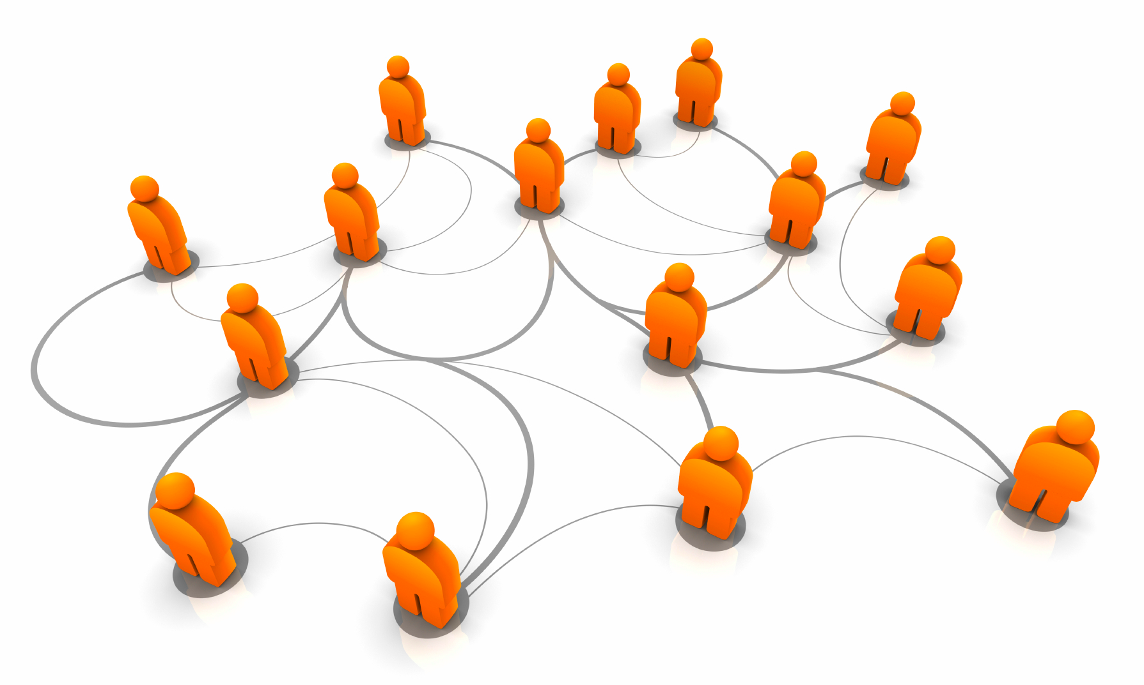
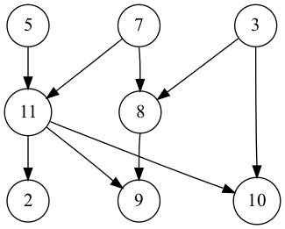
Generate Network Based Features
Notes:
#Does that person follow me?
#How many people do we both follow?
#How many people follow us both?
#How many people follow the person
#How many people does the person follow
#How active is the person
#Do we follow the same topics?
#Do we retweet the same people?

Slide 22
Sampling
Data is often big, and whether or not you need all of it is a case by case decision. Despite this, there are trends to guide you.
The most obvious sampling strategy is to take everything you have.
A common sampling strategy used in practice is called ‘down-sampling.’
Take 100% of the minority class,
Take K% of the dominant class
Notes:
Common sampling strategy to address balance issues
More data prep
Taking 100% of the minority class means that you retain more information for training to identify it. However this can lead to bias in the features.

Slide 23
A Case for Down-Sampling
Positive outcomes are often very rare, such that to get 1 positive outcome you need 1k-1MM negatives.
As N grows, data in the dominant class may have marginal decreasing utility. Thus, the cost of processing or storing it outweighs the benefit of using it.
Distribution of Conversion Rates for Display Ad Campaigns
Notes:
A small number of campaigns have really good conversion rate
For more campaigns the dominant class (no conversion) is plentiful

Slide 24
Should you down sample?
This is largely an empirical question.
Rule of thumb – less complex algorithms & models with information rich features require less data.
Example of the marginal decreasing utility of additional data.
Source: Tree Induction vs. Logistic Regression, a Learning Curve Analysis
http://pages.stern.nyu.edu/~fprovost/Papers/logtree.pdf
Notes:
Learning curve: how the performance increases with amount of data

Slide 25
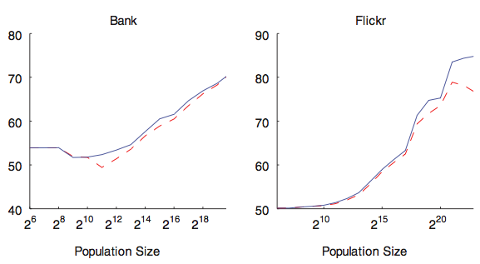
On the other hand…
Certain problems where the data contains many sparse and uninformative features fare much better when more data is present.
Source: Predictive Modeling with Big Data: Is Bigger Really Better?
http://online.liebertpub.com/doi/pdfplus/10.1089/big.2013.0037
Notes:
Learning curves for the multivariate (solid, blue) and multinomial (dashed, red) Naı¨ve Bayes variants. For all of the datasets, adding more data (x-axis) leads to continued improvement of predictive power (area under the curve [AUC]).
Flickr dataset: favorited pictures
Bank:, one year of fine-grained payment transaction data is provided in the banking dataset

Slide 26
If you down sample...
Use Learning Curve analysis to justify down-sampling rate
Be aware of the effect on probability estimates.
P(Y) and P(Y|X) changes when you down sample based on Y
Weighting the downsampled class by 1/k% can correct for this
Can adjust intercepts if applicable: where τ is the base rate of the population and ŷ is the sample base rate
Be aware of the effect of base rate on evaluation metrics
AUC is invariant to base rate
Accuracy, precision depend on the base rate
Source: Logistic Regression in Rare Events Data
http://dash.harvard.edu/bitstream/handle/1/4125045/relogit%20rare%20events.pdf?sequence=2
Notes:
Want to show that marginal gain at higher sample size amounts not useful
*weighting downsampled class to keep proportions similar (by some k)
Base rate: actual proportion of the class
*adjust the intercept, β0, from your downsampled regression after fitting the model

Slide 27
Summary
Data quality: accuracy, completeness, consistency, timeliness, believability, interpretability
Data cleaning: e.g. missing/noisy values, outliers
Data integration from multiple sources:
Entity identification problem
Remove redundancies
Detect inconsistencies
Data reduction
Dimensionality reduction
Numerosity reduction
Data compression
Data transformation and data discretization
Normalization
Concept hierarchy generation

