Slide 1
Foundations of Data Science Lecture 3, Module 2
Rumi Chunara, PhD
CS6053
Fine Print: these slides are, and always will be a work in progress. The material presented herein is original, inspired, or borrowed from others’ work. Where possible, attribution and acknowledgement will be made to content’s original source. Do not distribute without the instructor’s permission.
Notes:
Piazza forum reminders, R today

Slide 2
Attribute Creation (Feature Generation)
2
Create new attributes (features) that can capture the important information in a data set more effectively than the original ones
Three general methodologies
Attribute extraction
Domain-specific
Mapping data to new space (see: data reduction)
E.g., Fourier transformation, wavelet transformation, manifold approaches (not covered)
Attribute construction
Combining features
Data discretization
Notes:
2
Feature extraction a type of dimensionality reduction that efficiently represents interesting parts of an image as a compact feature vector. This approach is useful when image sizes are large and a reduced feature representation is required to quickly complete tasks such as image matching and retrieval. E.g. symptoms -> ILI
Construction could be pre-processing, or in the data prep stage.

Slide 3
Attribute (Feature) Subset Selection
Another way to reduce dimensionality of data
Redundant attributes
Duplicate much or all of the information contained in one or more other attributes
E.g., purchase price of a product and the amount of sales tax paid
Irrelevant attributes
Contain no information that is useful for the data mining task at hand
E.g., students' ID is often irrelevant to the task of predicting students' GPA

Slide 4
Why do feature selection?
The primary motivation for doing feature selection is to reduce model complexity, the benefits of which are:
Lower expected model variance
Easier interpretation of models
Better scalability (both in training and deployment)

Slide 5
Common feature selection techniques
“Naïve” methods – pre-filter features based on heuristics
Best subset selection – choose the best subset of k features from p features
Stepwise selection – incrementally add/subtract features until model performance stabilizes
Dimensionality Reduction – take rank-k approximations of X
Regularization – Implicit, based on adding complexity penalties to loss function

Slide 6
Naïve subset selection
Choose top k based on a rule:
Has highest Mutual Information/Correlation with Y
Has the most coverage
Choosing k can be learned, but generally, the feature subset is not learned via model selection methods.

Slide 7
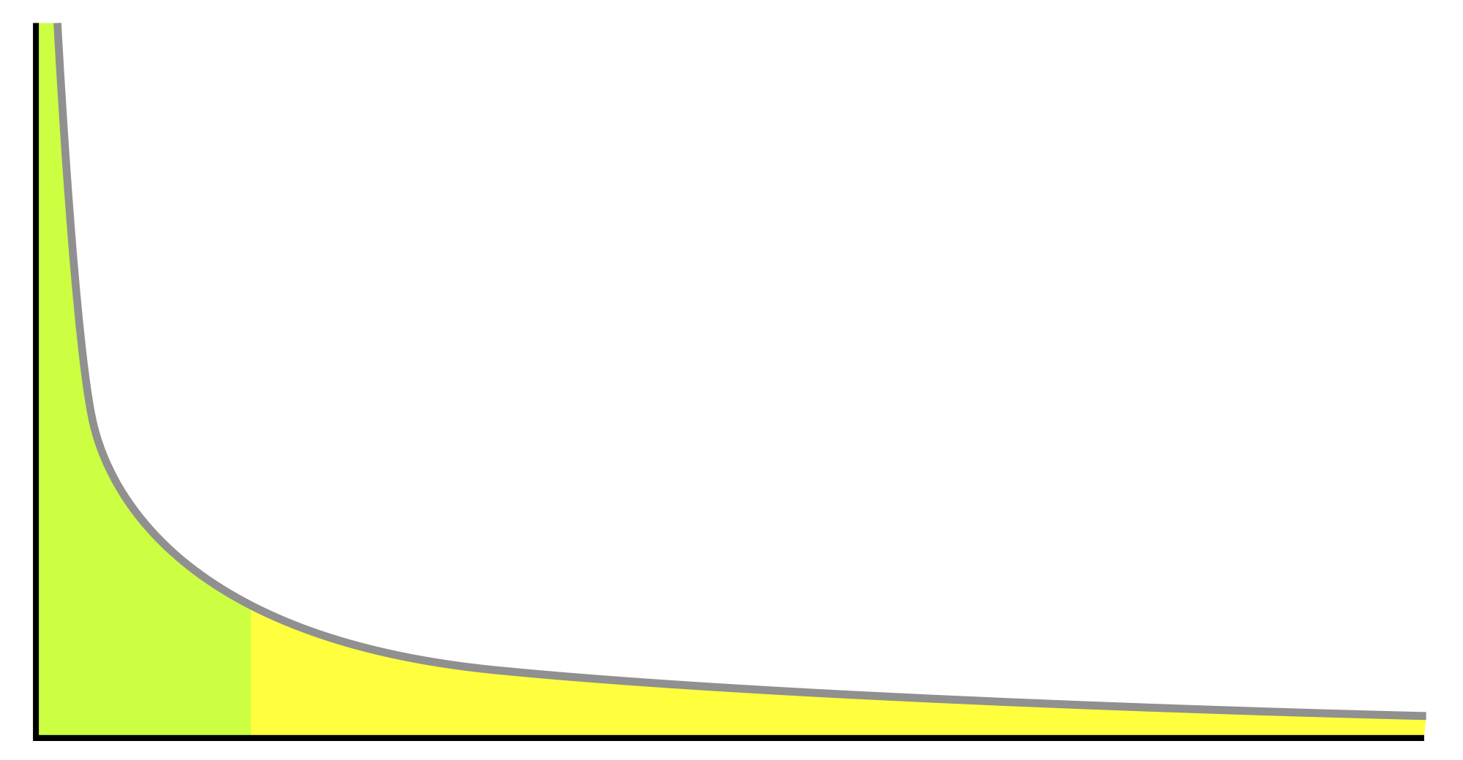
Naïve subset selection
Bag-of-words with long tail feature distributions
Some problems involve “the bag-of-words” representation. An instance can be characterized by a set of tokens U = {t₁, t₂, t₃, t₄, … t_{k}}. We often convert each token to a binary feature, where the token id is the feature name. This type of transformation often results in very high dimensional, but sparsely populated matrices.
Feature Selection: one can often build good models by just choosing the top k most populated feature (i.e, based on P(X_{i} = 1).
P(X_{i}=1)
Ordered Feature, ranked by P(X_{i}=1)
Notes:
In natural language processing token could be one word, or a combination of words
P(xi=1) means probability of this feature is there (e.g. most populated)

Slide 8
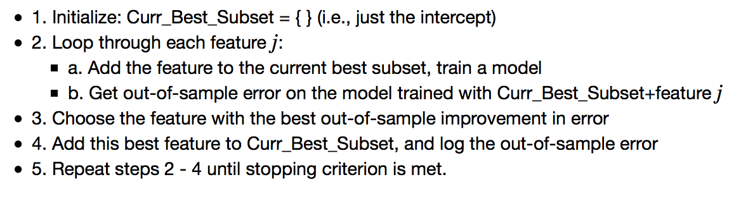
Forward stepwise selection
Forward stepwise selection is a greedy algorithm that incrementally selects the kth the feature that improves the model with k-1 features the most.
Algorithm
Notes:
Out of sample error? (eg. What’s the error on a test set)
Stopping criteria: can be model simplicity, time, etc.

Slide 9
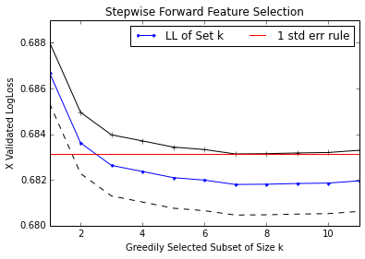
Forward stepwise selection
This plot shows the cross-validated LogLoss as we iteratively build the feature set, choosing the next best feature as the one that improves the cross-validated error the most. There are multiple ways to define a stopping criterion.
Notes:
Log loss, aka logistic loss or cross-entropy loss. This is the loss function used in (multinomial) logistic regression and extensions of it such as neural networks, defined as the negative log-likelihood of the true labels given a probabilistic classifier's predictions
The red line shows the min value of (mean+1 std error).

Slide 10
SVD Based feature selection
SVD can be used as a dimensionality reduction technique. Like subset methods, we choose k features, but the features are the transformed orthogonal columns of the rank-k approximation of X.
Compute rank-k SVD
X_{k}=U_{k}Σ_{k}V_{k}^{T}
X V_{k}
We can create an NxK reduced matrix with This effectively becomes our new “X” matrix, and we do any analysis (clustering, modeling, etc.) with the reduced matrix.
X’ V_{k}
We can project any new data into the reduced space by,
and then use this in our algorithms.
Notes:
Singular Value Decomposition

Slide 11
Targeted Exploration
If we have a Target variable in our dataset, we often wish to:
Determine whether a variable contains important information about the target variable (in other words, does a given variable reduce the uncertainty about the target variable).
Obtain a selection of the variables that are best suited for predicting the target variables.
Rank each variable on its ability to predict the target variable.
Notes:
Do the demo as well

Slide 12
Entropy
Reminder: comes from Information Theory, and is a measure of the unpredictability or uncertainty of information content.
Certainty => Closer to 0% or 100% sure that something will happen.
Entropy is fundamental concept used for Decision Trees and Feature Selection/Importance, and is a tool that can satisfy the demands stated on previous slide.
Notes:
Do the demo as well

Slide 13
Entropy
More formally…
X is a random variable with {x1, x2 … xN} possible values, the entropy is the expected “information” of an event, where “information” is defined as –log(P(X)).
Equation source: http://en.wikipedia.org/wiki/Entropy_(information_theory)
Notes:
where b is the base of the logarithm used. Common values of b are 2, Euler's number e, and 10, and the corresponding units of entropy are the bits for b = 2, nats for b = e, and bann for b = 10.^{[7]}

Slide 14
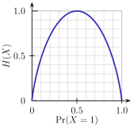

Entropy
Example: Coin Flip, X is a random variable with possible values {H,T}
Entropy of a coin: - [P(H)*log2(P(H)) + P(T)*log2(P(T))]
Fair Coin:
H(X)=-[0.5*Log2(0.5)+0.5*Log2(0.5)] = 1
Single Outcome Coin:
H(X)=-[1*Log2(1)] = 0
Weighted Coin (P(H)=0.2):
H(X)=-[0.2*Log2(0.2)+0.8*Log2(0.8)] = .72
Image source: http://en.wikipedia.org/wiki/Entropy_(information_theory)
Notes:
Image: entropy H(X0 the expected surprisal of a coin flip, where X=1 represents a result of heads.
Single outcome – so output will have no information
(The measure of information entropy associated with each possible data value is the negative logarithm of the probability mass function of the value). Thus, when the data source has a lower-probability value (i.e. when a low probability event occurs), the event carries more “information” (“surprisal”) than when the source data has a higher probability value. Entropy is maximized when the coin is fair (most difficult to predict the outcome)

Slide 15
Information Gain
The Information Gain of an attribute measures the change in conditional entropy if we split the data by a given attribute.
where
Information Gain tells us how pure can we make segments with respect to the target variable if we split the population by a certain attribute.
Each child node c is the result of splitting the data by the values of a certain attribute, and has its own associated Entropy H(Y|c) as well as a split proportion p(c).
Parent
H(Y)
…
Child 1
H(Y|C₁)
Child 2
H(Y|C₂)
Child k
H(Y|C_{k})
p(c₁)
p(c₂)
p(c_{k})
Notes:
C = attribute, small c is possible values
How pure we can make segments – are they differently informative

Slide 16
Using Information Gain
With Information Gain we can now define a way to compare features on their ability to segment the data in a way that reduces the uncertainty of our target variable.
H(Y)=1.0
H(Y)=1.0
Head Color
Body Color
H(Y|H=r)=0.65
P(H=r)=0.5
H(Y|H=b)=0
P(H=b)=0.5
H(Y|B=r)=0.92
P(B=r)=0.5
H(Y|B=b)=1
P(B=b)=0.5
We get a higher IG when splitting on Head
IG(Head)=1-(0.5*0.65+0.5*0)=0.68
IG(Body)=1-(0.5*0.92+0.5*1)=0.04
Notes:
Entropy and
Split proportion (probability) for each feature
Reminder of the proportions on next slide

Slide 17

Conditional Entropy
We want to explore whether the attributes (head and body colors) give us more information about our target variable (yes/no).
We use the Conditional Entropy
Yes
Yes
Yes
Yes
No
No
Where,
Y is binary target variable
X is the attribute
x is a value of an attribute
p(x) is the likelihood X=x
H(Y|X=x) is the entropy of Y where X=x
No
No
No
Yes
No
No
Notes:
With Information Gain we can now define a way to compare features on their ability to segment the data in a way that reduces the uncertainty of our target variable.

Slide 18
Example: Conditional Entropy
To compute conditional entropy of an attribute:
Compute P(X_{i}), P(Y|X_{i}), H(Y|X_{i}) for each attribute value X_{i}:
Attribute | Value | P(Xi) | P(Y=y|Xi) | P(Y=n|Xi) | H(Y|Xi)
Body | Red | 0.5 | 1/3 | 2/3 | 0.9
Body | Blue | 0.5 | 1/2 | 1/2 | 1
Head | Red | 0.5 | 5/6 | 1/6 | 0.65
Head | Blue | 0.5 | 0 | 1 | 0
Now apply the Conditional Entropy formula to the given attributes:
H(Y|Body) = 0.5*0.92 + 0.5*1 = 0.96
H(Y|Head) =0.5*0.65+0.5*0 = 0.33
Notes:
H(Y|Xi) = -(sum over all y=Y)(py|c)log2(p(y|c))
THIS SLIDE IS CORRECT

Slide 19
Recap
With Entropy, Conditional Entropy and Information gain, we now have tools that can help us:
Quantify the purity of a segment with respect to a Target variable
Measure and rank individual features by their ability to split the data in a way that reduces uncertainty about the target variable.
Next we’ll use these tools to build a classifier
Notes:
Do the demo as well

Slide 20
C4.5 – Towards a decision tree
Several algorithms exist that return a decision tree structure, but we’ll focus on C4.5, which utilizes the information theoretic tools learned so far.
Given a dataset D=<X,Y>, where Y is a target variable and X={X₁,X₂,..X_{k}} is a k-dimensional vector of predictor variables.
C4.5 pseudocode
1. For each feature x_{i} in X:
Compute split that produces highest Information Gain
Record Information Gain
2. Let X^{max} be the feature with the highest Information Gain
3. Create child nodes that split on the optimal splitting of X^{max}
4. Recurse on each child node from step 3 on the remaining features.
Notes:
C4.5 is an algorithm used to generate a decision tree developed by Ross Quinlan. C4.5 is an extension of Quinlan's earlier ID3 algorithm. The decision trees generated by C4.5 can be used for classification, and for this reason, C4.5 is often referred to as a statistical classifier. C4.5 builds decision trees from a set of training data (in the same way as ID3) using the concept of information entropy.

Slide 21
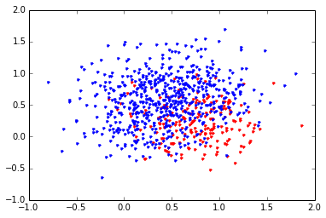
Lets Build a Tree
We have data generated as a mixture of 4 different bivariate distributions with means: mu=[[0.25,0.75],[0.75,0.75],[0.75,0.25],[0.25,0.25]], and all with the same covariance structure.
The distribution with mean [0.75,0.25] was given a ‘red’ label.
Notes:
Do the demo as well

Slide 22
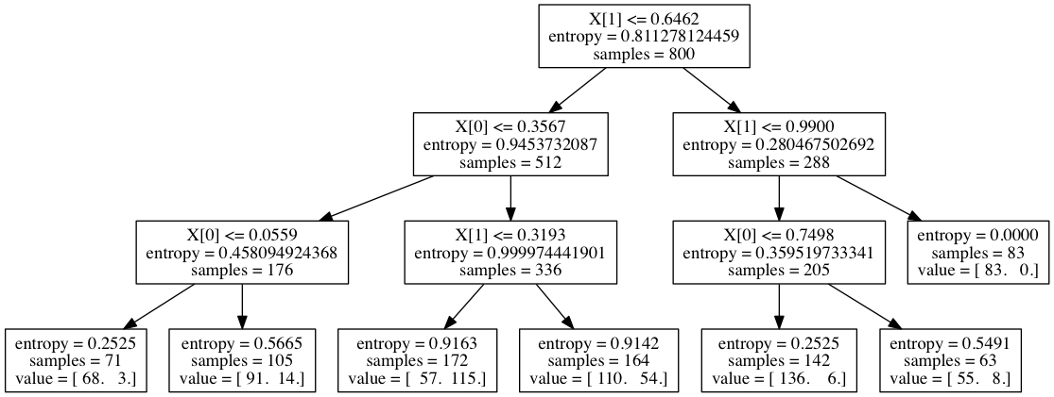
Trees with sci-kit learn
from sklearn.tree import DecisionTreeClassifier
clf = tree.DecisionTreeClassifier(args)
clf = clf.fit(X,y)
Note: with a lot of features and a lot of data, trees can be incredibly large. Its not always worth it to try and visualize them.
Notes:
Do the demo as well

Slide 23
Understanding the Tree
Each parent node references the feature chosen by the splitting algorithm.
The node specifies a boolean condition
If True, then move to the right
Else move to the left
The final child nodes (leaves) show the distribution of the target variable at that node
Prediction is by averaging the target variable at each leaf.
Notes:
Do the demo as well

Slide 24
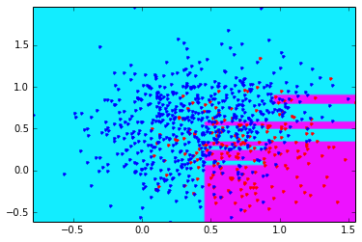
Partitioning X space
We can think of the Decision Tree as a rectangular partitioning of the feature space. Again, this is done with a series of boolean conditionals.
For classification tasks, the partition determines the predicted class. This chart shows the decision boundaries with the training data overlayed.
Notes:
SEE DEMO

Slide 25
Controlling Complexity
Like any classifier, when the ratio of features to data points shrinks, we risk overfitting.
Three parameters for controlling tree complexity are: to limit the depth of the tree limit the size of an internal node that can be split, and to specify the minimum number of instances that can be in a leaf.
Depth of tree measures how many layers of splits there can be.
Min split size limits how big an internal node can be to allow for splitting.
Min leaf size makes sure each final leaf has sufficient data.
Notes:
Parameters would be set in the code

Slide 26
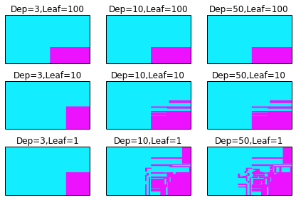
Controlling Complexity
Visualizing more complex trees is difficult, but we can see how the decision boundary changes once we let trees grow arbitrarily complex. Overfitting is likely if we don’t set any limits on the complexity.
Notes:
Partitions get hard to interpret once we have more leaves and depth

Slide 27
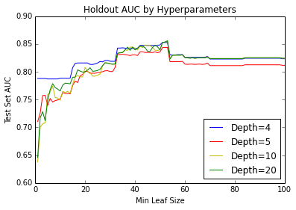
Learning Optimal Tree Size
We built a DT for the “Ads” dataset. In this case we have unbalanced class distribution so we choose Area Under ROC curve as our evaluation metric*
This region is safe, but clearly not optimal.
For most depths, we overfit when the leaves get too small
*Note: We haven’t taught this yet, but suffice it to say that AUC is better than accuracy when the classes are skewed.
Notes:
SEE DEMO

Slide 28
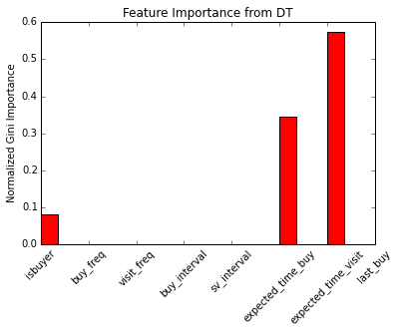
Feature Exploration
Often times the DT is useful as tool for testing for feature interactions as well as ranking features by their ability to predict the target variable. Scikit learn’s DecisionTree fit function automatically returns normalized information gain for each feature (also called the Gini Importance)
Notes:
Do the demo as well

Slide 29
Decision Trees in Practice
Advantages
Easy to interpret (though cumbersome to visualize)
Easy to implement – just a series of if-then rules
Prediction/scoring is cheap – total operations = depth of tree
No feature engineering necessary
Can handle categorical/text features as is
Automatically detect non-linearities and interactions
Note: We haven’t taught this yet, but suffice it to say that AUC is better than accuracy when the classes are skewed.

Slide 30
Decision Trees in Practice
Disadvantages/Issues
Easy to overfit – flexibility of algorithm requires careful tuning of parameters and leaf pruning
DT algorithms are greedy – not very stable and small changes in data can give very different solutions
Difficulty learning in skewed target distributions (think of how entropy might cause this).
Not well suited for problems as # of samples shrinks and # of features grows
Note: We haven’t taught this yet, but suffice it to say that AUC is better than accuracy when the classes are skewed.
Notes:
Do DEMO: Decision Trees
Greedy: A greedy algorithm is an algorithmic paradigm that follows the problem solving heuristic of making the locally optimal choice at each stage with the hope of finding a global optimum.

Slide 31
Summary
Data Prep: data quality, data cleaning, data integration
Data reduction, data transformation and data discretization
Feature Selection and generation

