Slide 1
Foundations of Data Science Lecture 3, Module 3
Rumi Chunara, PhD
CS6053
Fine Print: these slides are, and always will be a work in progress. The material presented herein is original, inspired, or borrowed from others’ work. Where possible, attribution and acknowledgement will be made to content’s original source. Do not distribute without the instructor’s permission.
Notes:
Piazza forum reminders, R today

Slide 2

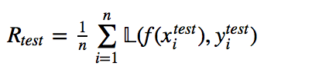
Goals of Evaluation
The goal of evaluation in model building can be put quite simply: achieve the best generalization performance while avoiding overfitting.
Remember, in ERM we seek a function f(X) that minimizes the training error (or risk) on our training data.
WE ALWAYS want to measure the error on a holdout, or test set, too.
We can only be certain our models generalize if we do a correct holdout evaluation. Theory helps us design good algorithms with strong generalization and convergence results, but empirical hold-out testing is always necessary.
Notes:
ERM: Empirical risk minimization
L: Loss function
n: n instances in our training or test data

Slide 3
Model Selection
When we model, we have many choices. We use holdout evaluation methodologies to optimize the following:
Feature Selection
Algorithm Selection
(i.e., RF vs. Decision Tree vs. Logistic Regression vs. SVM)
Hyper-parameter Selection, i.e.,
“k” in k-NN
“C” in SVM
MaxDepth, MinLeafSize in Decision Trees
Regularization Strength
The optimal configuration of these elements depends on the goals of the problem, which define an appropriate evaluation metric.

Slide 4
Basic Design
When doing any sort of model selection, one usually begins by creating 3 splits of the data.
Training: the training data is used to find the optimal function given the model structure (i.e., fixed algorithm, feature set, hyper-parameters).
Training Data
Validation: the validation data is used to evaluate the loss/risk for a given model configuration. The configuration with the best loss/risk is selected as the final model
Validation
Data
Test
Data
Test: test data is not used for any parameter or model selection. It is only used as a generalization measure.

Slide 5
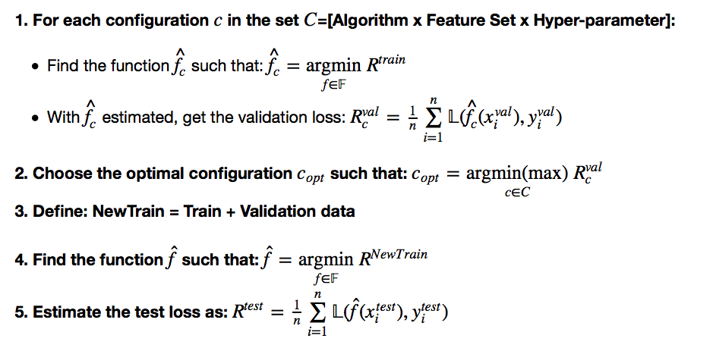
Example Model Selection Routine
Define: Training Data
Define: Validation Data
Define: Test Data
Notes:
Empirical risk minimization principle states that the learning algorithm should choose a which minimizes the empirical risk (argmin), solving that optimixation problem
-train
-assess loss on validation set
-then retrain include validation data
-assess loss on test set
Need validation set to understand trained loss, and then can compare to test loss
Loss function could be MSE or other function

Slide 6
Some Notes on Validation Risk
The validation loss metric does not have to be the same as the training loss.
Sometimes we need a loss metric for an application that is not very easy or even possible to directly minimize.
i.e., we use logistic-loss to find f but we really need a loss metric that enables optimal ranking (such as AUC)
We might want to minimize a training loss metric, but maximize the validation metric (again logistic-loss vs. AUC)

Slide 7
Cross-validation
Sometimes we don’t have enough data to do a single train/validation/test split.
We can “recycle” data by using k-fold cross validation as our validation scheme.
Fold 1
Fold 2
Fold 3
…
Fold k-1
Fold k

Slide 8
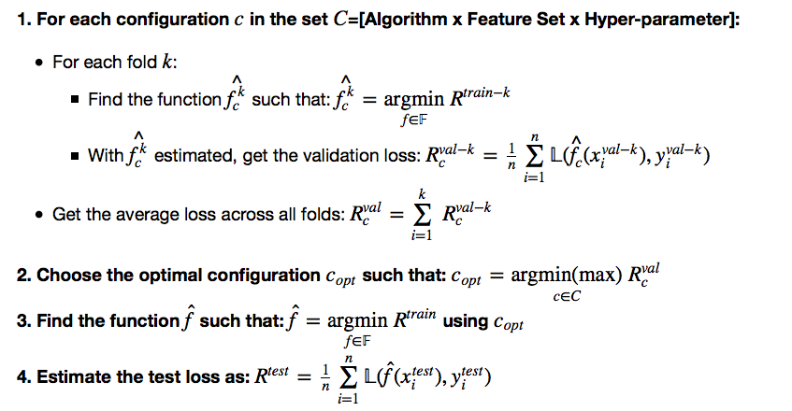
Example x-validation Scheme
Define: Training Data
Define: Test Data
Notes:
-train on subset k
-assess loss on validation set k
-get average loss, choose optimal configuration
-then generate function using that configuration on training data set
-assess loss on test set

Slide 9
Some x-val Notes
How should we choose split size or k?
There is no golden rule that defines how big training, validation and test sets should be.
You want each data set to be big enough to reduce the variance of your estimates.
Estimation variance comes in two flavors – variance of the function being fit to the training data and variance of the estimate of the validation/test risk.
Good heuristics are 50%/25%/25% for train/val/test splits and k=5 or 10 for x-validation.
Also, data should be randomly split with no overlap in instances between sets.

Slide 10
Estimation Variance
Care should always be taken to reduce the variance in the estimation of validation/test risk as well as the optimal function f.
Variance is driven by two factors.
Training/Fit:
As the ratio of the the complexity of the model to the size of the training data increases, the model is likely to overfit, and this increases the variance of the model.
Small Test/Validation Sets:
- The test/validation risk is a mean of the per-sample risk across the data set. The standard error of the mean estimator decreases proportional to sqrt(n).
Notes:
Variance in how well prediction fits with the true data

Slide 11
The Bootstrap Procedure
We can use the bootstrap procedure to empirically compute the variance of our estimators and incorporate the variance estimates into our selection mechanisms.
The Bootstrap Procedure:
Given original dataset Dº of size n, sample with replacement n times into a new dataset D^{b}.
2. Perform estimation process on D^{b}.
3. Repeat m times
4. Compute mean/variance over m estimation steps
Dº
D^{b}
Notes:
Ideally we would use new data to test variance, but that is not possible generally → hence use bootstrapping and data from within the set
Estimator: function for prediction
THIS EXAMPLE INCORPORATES THINGS WE WILL LEARN DOWNSTREAM
Re-visiting it later will help

Slide 12
Example Model Selection
We have a dataset with 14 features, roughly 10k examples and only 253 positive examples.
Goal: Build a classifier that has good ranking properties.
Solution
We’ll use Logistic Regression because it is robust in small-sample sizes and imbalanced classes, and also returns a score instead of just label predictions
With small data we expect high variance, so we need to use regularization (more on this later)
We’ll split data into 80/20 train/test and run 10-fold xvalidation on train.
We’ll use AUC (loss metric) to choose a regularization weight (parameters)
We’ll bootstrap the test set estimate of AUC to get an empirical measure of its variance
Notes:
Bootstraping to get confidence intervals on AUC

Slide 13
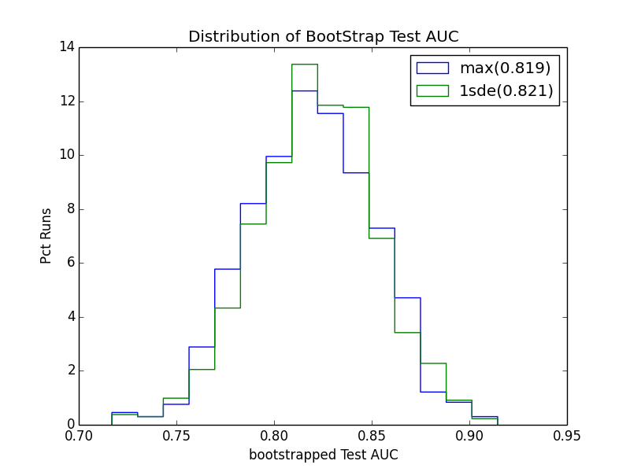
Bootstrapped Out-of-sample
Now that we’ve selected the model hyper-parameters, let’s look at the test error. To get a sense of the variance, we run bootstrap analysis. In real situations, we wouldn’t use the test set to choose which selection criteria is better, but we can use it to construct 95% confidence intervals of our test error.
Notes:
Bootstrapping to generate confidence about the AUC estimates

Slide 14
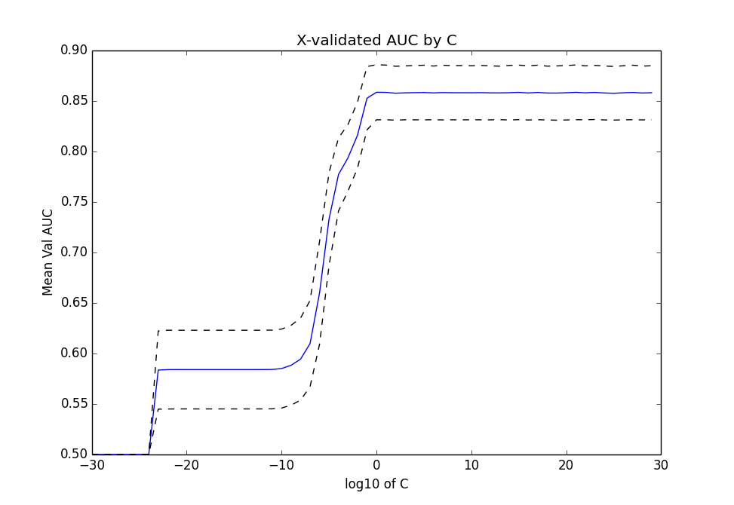
Results of xvalidation
With less regularization we actually do better here (strong signal in the features). But we still see that between 1 to 10³⁰ we get nearly the same results. It would be better if we can zoom into the region where performance is better.
Notes:
X-axis – decrease in regularization (constraint/prior information for parameters)
The larger one makes C, the larger the weight of the error term (actual function loss) becomes relative to that of the regularization term – less regularization. The smaller one makes C, the smaller the weight of the error term becomes relative to that of the regularization term. Consequently, C moderates the trade off between emphasizing model simplicity via regularization and model accuracy on training data

Slide 15
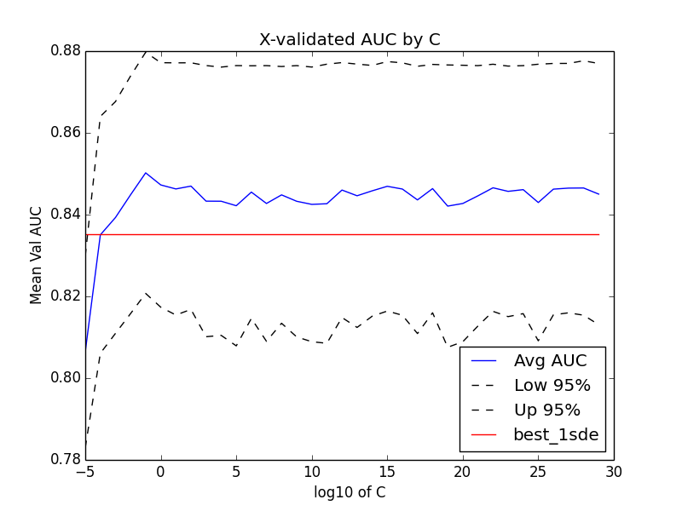
Results of xvalidation -zoomed
When we zoom in we can see that statistically speaking, everything above C=1 is essentially the same (i.e., strongly overlapping confidence intervals). There are two ways to choose C here.
Criteria 1:
Choose option with
max(Xval AUC)
Best Criteria 1
Criteria 2:
Find all options where
AUC>=mean(AUC) – 1stderror
Choose least complex option (highest regularization)
Best Criteria 2

Slide 16
Bias/Variance Tradeoff

Slide 17
Bias²
Low bias
linear regression applied to linear data
2nd degree polynomial applied to quadratic data
High bias
constant function
linear regression applied to non-linear data

Slide 18
Variance
Low variance
constant function
model independent of training data
model depends on stable measures of data
mean
median
High variance
high degree polynomial

Slide 19
Sources of Variation
• noise in targets or input attributes
• bias (model mismatch)
• training sample
• randomness in learning algorithm
• randomized subsetting of train set:
– cross validation, train and early stopping set

Slide 20
Bias/Variance Tradeoff
• Often:
– low bias => high variance
– low variance => high bias
• Tradeoff:
– bias² vs. variance

Slide 21
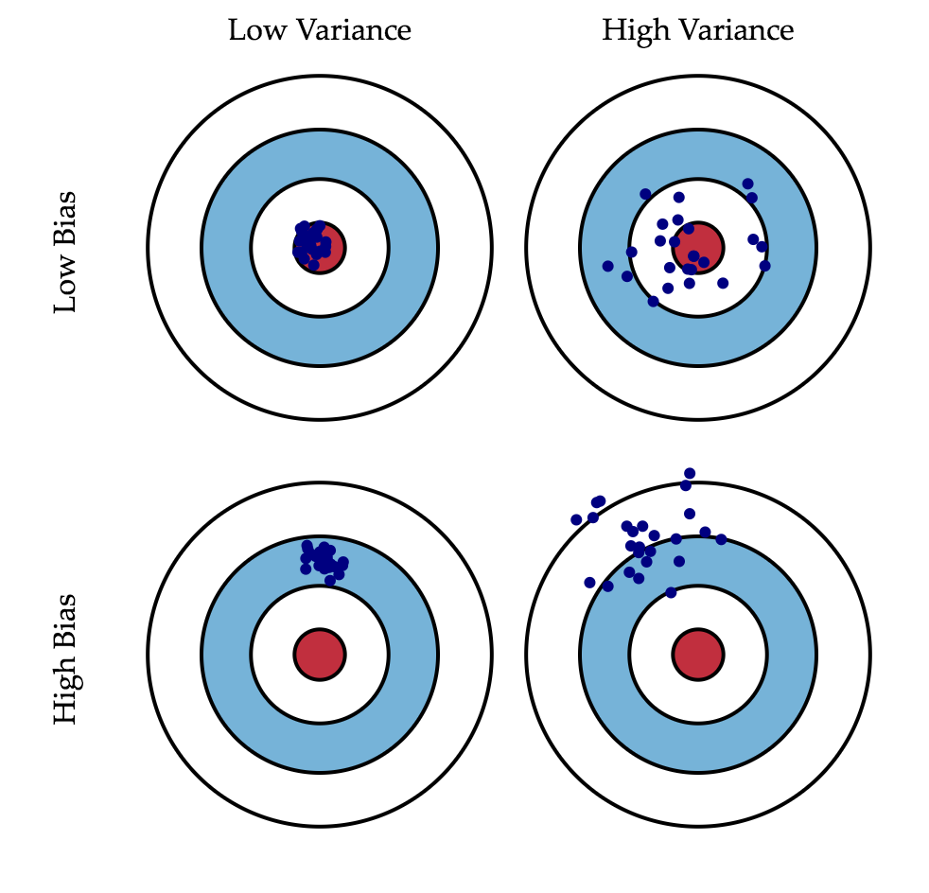
Notes:
We can create a graphical visualization of bias and variance using a bulls-eye diagram. Imagine that the center of the target is a model that perfectly predicts the correct values. As we move away from the bulls-eye, our predictions get worse and worse. Imagine we can repeat our entire model building process to get a number of separate hits on the target. Each hit represents an individual realization of our model, given the chance variability in the training data we gather. Sometimes we will get a good distribution of training data so we predict very well and we are close to the bulls-eye, while sometimes our training data might be full of outliers or non-standard values resulting in poorer predictions. These different realizations result in a scatter of hits on the target.

Slide 22
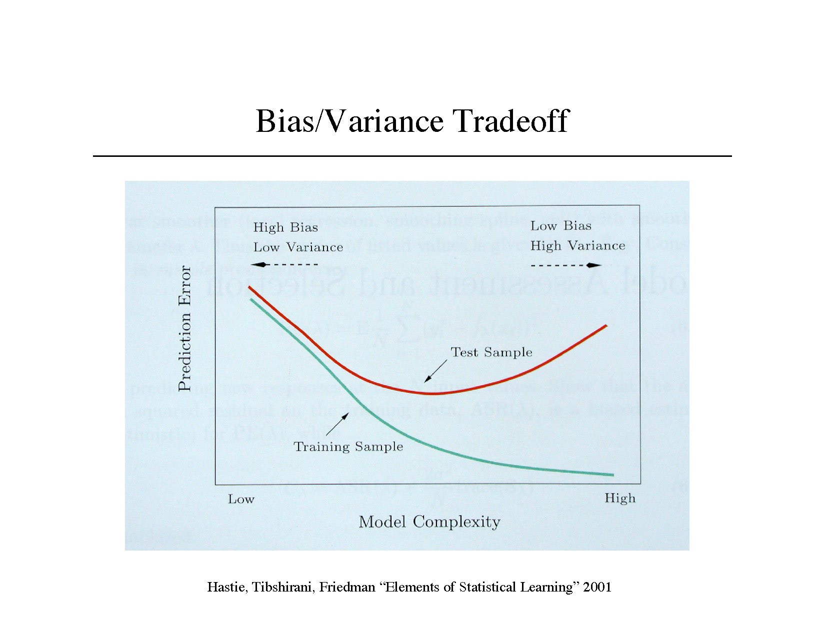
Notes:
As model complexity increases, error on the training set will decrese, but that will result in overfitting so error on the test sample will increase. That situation is low bias but high variance. When complexity is low, you have high bias but low variance (consistent guesses)

Slide 23
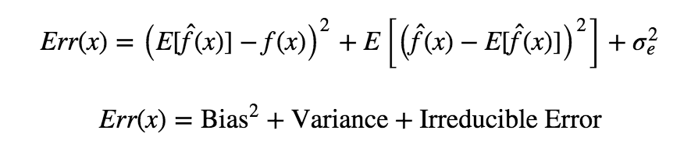
Mathematically..
Notes:
If we denote the variable we are trying to predict as Y and our covariates as X, we may assume that there is a relationship relating one to the other such as Y=f(X)+ϵ where the error term ϵ is normally distributed with a mean of zero like so ϵ∼is normal
Bias: difference from true value, variance, difference in estimates
That third term, irreducible error, is the noise term in the true relationship that cannot fundamentally be reduced by any model. Given the true model and infinite data to calibrate it, we should be able to reduce both the bias and variance terms to 0. However, in a world with imperfect models and finite data, there is a tradeoff between minimizing the bias and minimizing the variance.

Slide 24
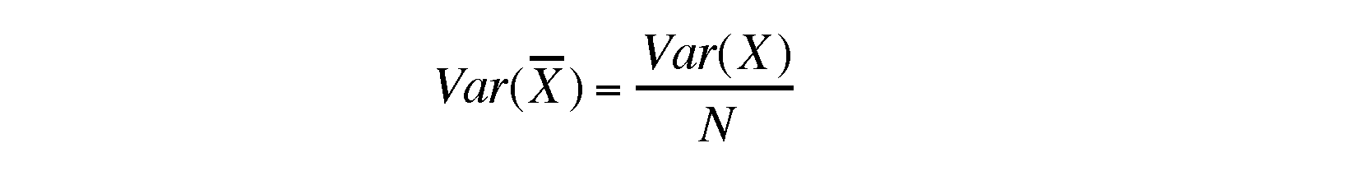
Reduce Variance Without Increasing Bias
• Averaging reduces variance:
• Average models to reduce model variance
• One problem:
– only one train set create different subset, select different features,change different model to train
– where do multiple models come from?

Slide 25
How do you know that you have a good classifier?
Is a feature contributing to overall performance?
Is classifier A better than classifier B?
Internal Evaluation:
Measure the performance of the classifier.
External Evaluation:
Measure the performance on a downstream task

