Slide 1
DS-GA 3001.007 Introduction to Machine Learning
Lecture 5
Regularization – Ridge and Lasso

Slide 2
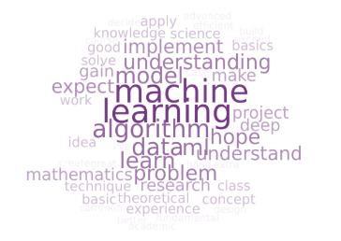
Reminders
Homework 3
Due on Sunday October 20
Midterm
In class on Wednesday October 23
Project
Proposal due October 31
Milestone due November 28
Report due December 15

Slide 3
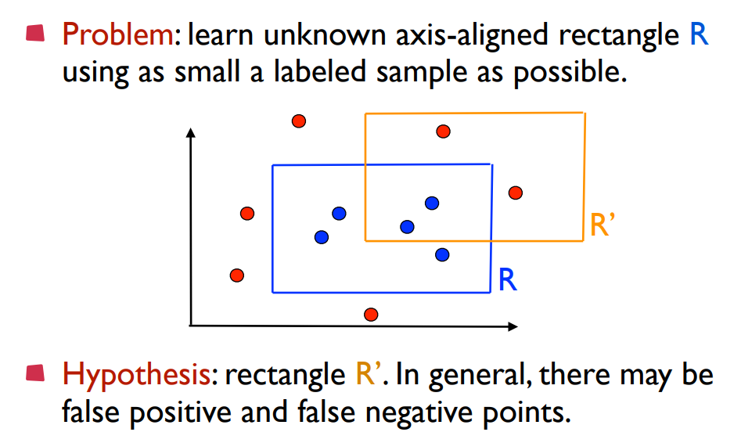
Bound Difference In Sample and Out of Sample
Notes:
Smallest
0, 1 P(Y|X)

Slide 4
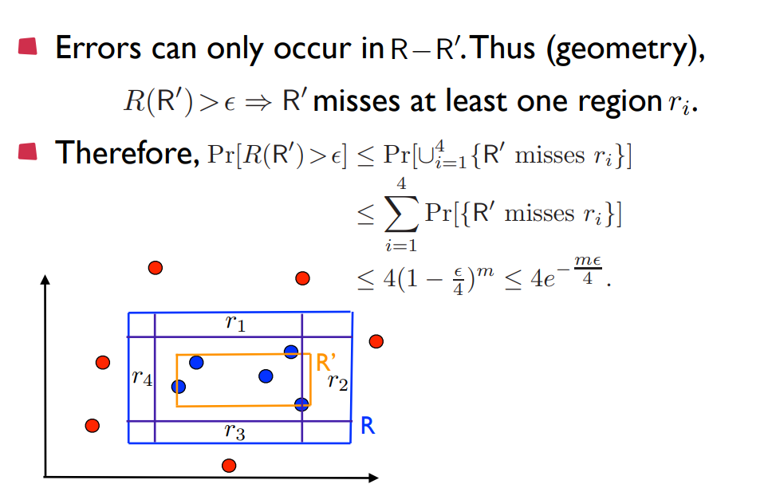
Bound Difference In Sample and Out of Sample

Slide 5
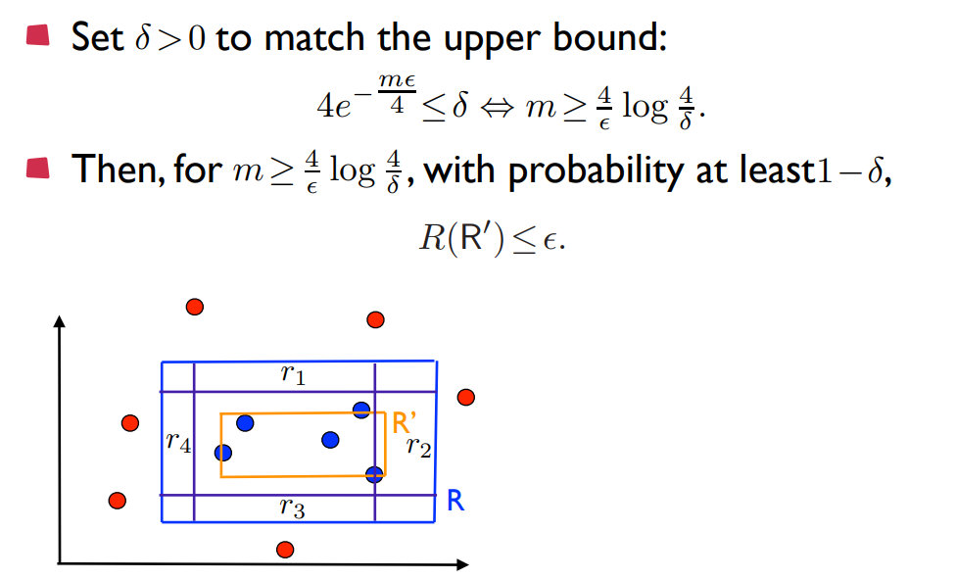
Bound Difference In Sample and Out of Sample
Notes:
Discretization trick
Measure complexity by number of parameters
Suppose d (think perceptron in dimension d-1 with one more for bias)
Think sign(x – b) for d = 1 b any number threshold (weight is 1)
2^64 numbers
Deficiency of machine specific

Slide 6
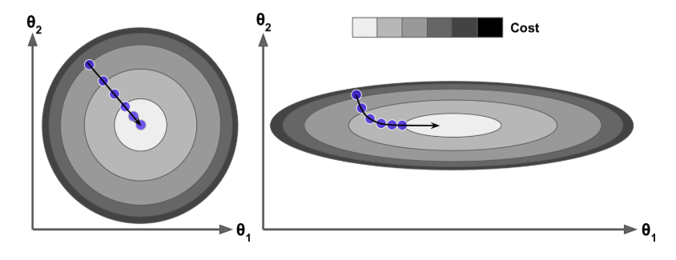
Gradient Descent
Notes:
Sensitive to scale
With regularization
Contour plot
Level sets
Rate of change greatest

Slide 7
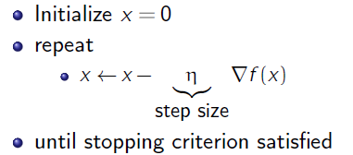
Gradient Descent
Notes:
Animations

Slide 8
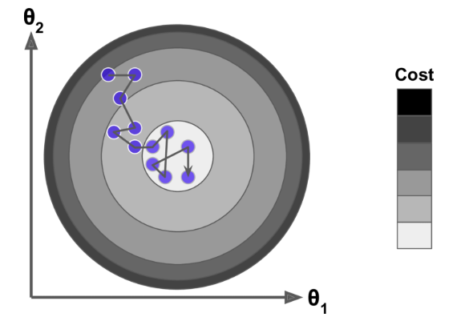
Stochastic Gradient Descent

Slide 9
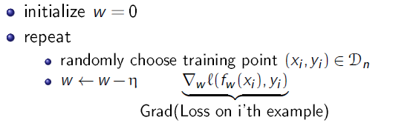
Stochastic Gradient Descent

Slide 10
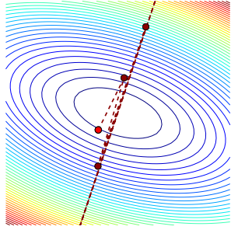
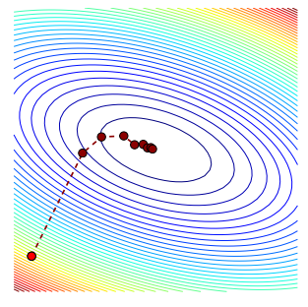
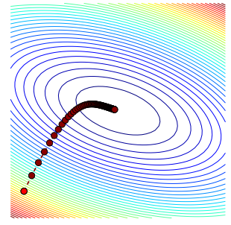
Convergence Analysis?
Notes:
Big O notation

Slide 11
Convergence Analysis?
Fixed Step Size
Learning rate 1/(max of derivative)
Number Iterations O(1/error)
Varying Step Size
Back-tracking Line Search
Number Iterations O(1/error) with
better constant
Strongly Convex Functions
Learning rate 1/(iteration)
Number Iterations O( log(1/error) )
LECTURE 7!
Notes:
Big O notation

Slide 12
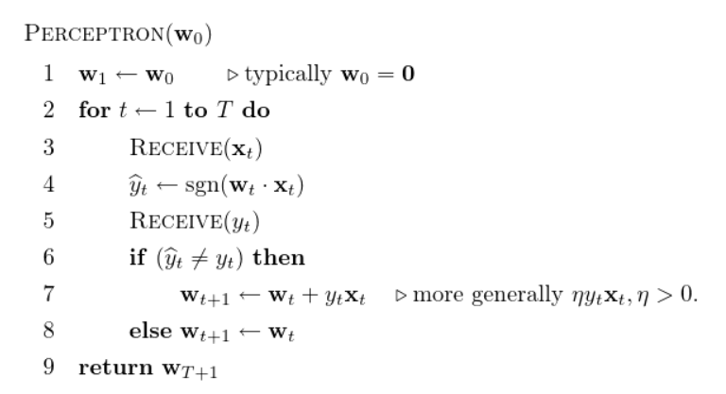
Perceptron Algorithm as SGD

Slide 13
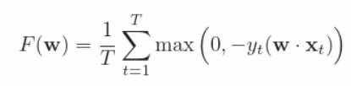
Perceptron Algorithm as SGD
Take

Slide 14

Perceptron Algorithm as SGD
Take
Set

Slide 15
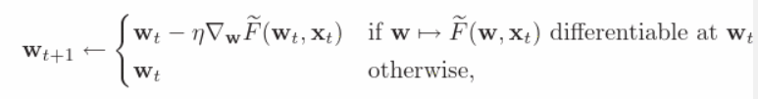
Perceptron Algorithm as SGD
Take
Set
Update Guess

Slide 16
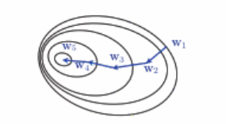
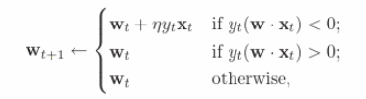
Perceptron Algorithm as SGD

Slide 17
Perceptron Algorithm as SGD

Slide 18
Perceptron Algorithm as SGD
Notes:
Subgradient duck typing
If it fulfills the Taylor expansion (the utility of gradient) then claim it is like a gradient
Convergence analysis in Lecture 7 after make sense of derivatives of kinked functions

Slide 19
Objectives
Overfitting
How to avoid overfitting by using regularization?
Regularization
Formulate a linear estimation problem with a regularization
Compute an L1-regularized or L2-regularized estimate
Compute optimal regularization level using cross validation
Compare and Contrast

Slide 20
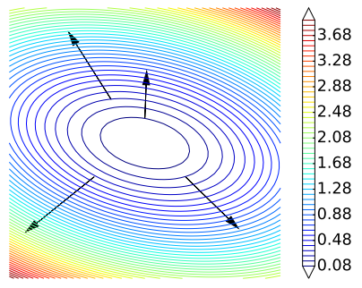
Agenda
Lesson
Ridge Regression and Normal Equations
Lasso Regression and Sparsity
Similarities and Differences
Demo
Implementing Ridge, Lasso and
Elastic Net

Slide 21
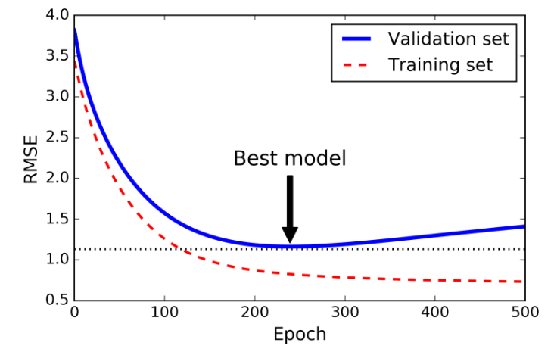
Why Regularize Loss Functions?
Notes:
Optimization (computational complexity)
Estimation (sampling complexity)
Approximation (model complexity)
Overfitting from model complexity
Too many parameters (this is a substitute for the size of the hypothesis – because some infinite!)

Slide 22
Why Regularize Loss Functions?
Notes:
Hyperparameters choose between
Think number of epochs like HW1…going back we could have included learning rate (possibly batch size though uncommon in practice)
Early stopping
Validation or cross validation means of choosing good hyperparameters
HW03 Q1 grid search provide you the code (more than starter as HW02)
With Stochastic and Mini-batch Gradient Descent, the curves are not so smooth, and it may be hard to know whether you have reached the minimum or not. One solution is to stop only after the validation error has been above the minimum for some time (when you are confident that the model will not do any better), then roll back the model parameters to the point where the validation error was at a minimum.

Slide 23



Ridge Regression and Normal Equations
Notes:
Normal equations
Small change input
Large change output
Stability is key to avoiding overfitting
PCA

Slide 24


Ridge Regression and Normal Equations
Notes:
Normal equations
Small change input
Large change output
Stability is key to avoiding overfitting
PCA

Slide 25

Ridge Regression and Normal Equations
Notes:
Normal equations
Small change input
Large change output
Stability is key to avoiding overfitting
PCA

Slide 26



How to Understand the Normal Equations?
Notes:
Normal equations
Small change input
Large change output
Stability is key to avoiding overfitting
PCA

Slide 27
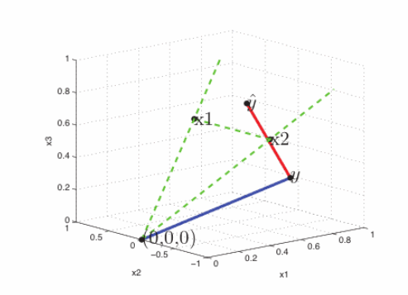
How to Understand the Normal Equations?
Notes:
Normal equations
Small change input
Large change output
Stability is key to avoiding overfitting
PCA

Slide 28


Why does Ridge Regression shrink weights?
Notes:
Small change input
Large change output
Stability is key to avoiding overfitting
Think about example 3 points
Large negative and positive

Slide 29

Why does Ridge Regression shrink weights?
Notes:
Small change input
Large change output
Stability is key to avoiding overfitting
Think about example 3 points
Large negative and positive

Slide 30
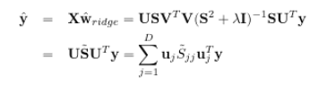

Why does Ridge Regression shrink weights?
Notes:
Small change input
Large change output
Stability is key to avoiding overfitting
Think about example 3 points
Large negative and positive

Slide 31



Why does Ridge Regression shrink weights?
vs
Notes:
Small change input
Large change output
Stability is key to avoiding overfitting
Think about example 3 points
Large negative and positive

Slide 32
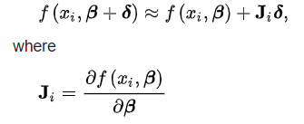
Question
Why can’t we just solve for the minimum in line search?
Actually we can…sort of…it’s the Levenberg-Marquardt algorithm
While it’s an iterative algorithm, the important step in the algorithm involves solving the normal equations.

Slide 33
Question
Why can’t we just solve for the minimum in line search?
Actually we can…sort of…it’s the Levenberg-Marquardt algorithm
While it’s an iterative algorithm, the important step in the algorithm involves solving the normal equations.
Notes:
Normal equations
Small change input
Large change output
Stability is key to avoiding overfitting
PCA

Slide 34

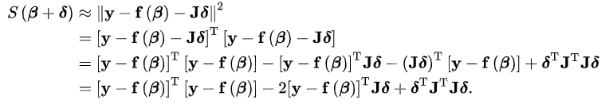
Question

Slide 35

Question

Slide 36

Question

Slide 37
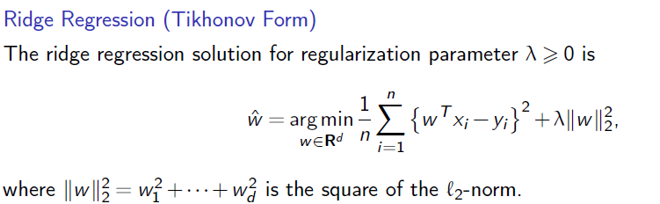
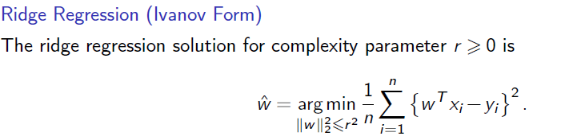
Regularization gives Stability
Notes:
Normal equations
Small change input
Large change output
Stability is key to avoiding overfitting
PCA

Slide 38

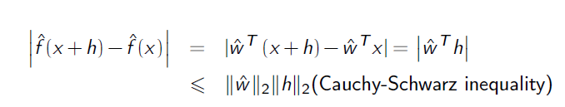

Regularization gives Stability
Question

Slide 39
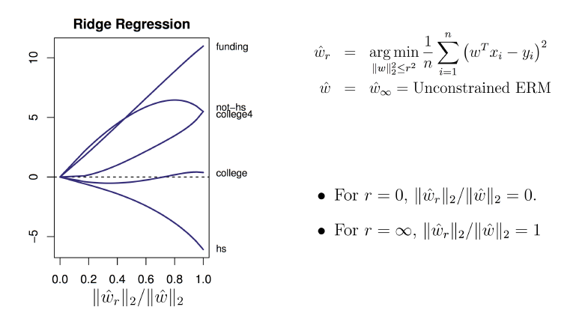
Regularization Path

Slide 40
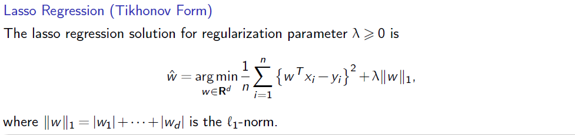
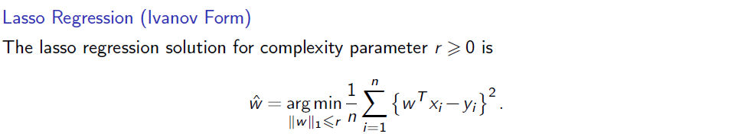
Lasso Regression

Slide 41
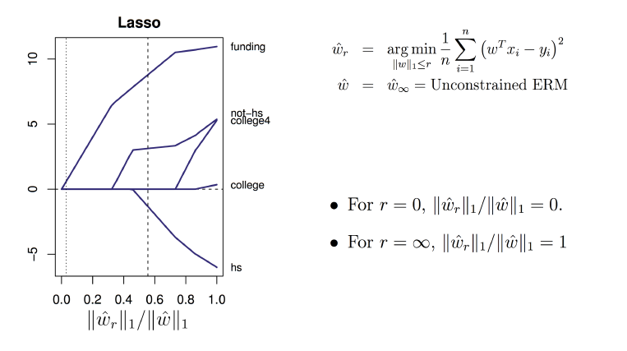
Lasso Regression

Slide 42
Lasso Regression and Sparsity
Coefficient are 0 = > don’t need those features. What’s the gain?
Time/expense to compute/buy features
Memory to store features (e.g. real-time deployment)
Identifies the important features
Better prediction? sometimes
As a feature-selection step for training a slower non-linear model
Notes:
Lasso sets to zero…optinal problem showing that too large then all zero
Coordinate descent and shooting algorithm (Q2)
Projected gradient descent (Q4)
Level sets for sparsity

Slide 43
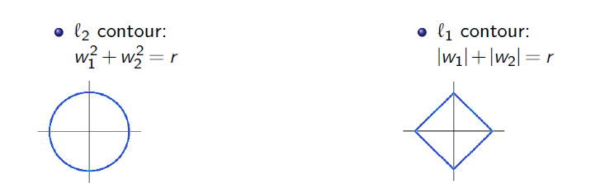
Why Sparse Solutions
Notes:
Lasso sets to zero…optinal problem showing that too large then all zero
Coordinate descent and shooting algorithm (Q2)
Projected gradient descent (Q4)
Level sets for sparsity

Slide 44
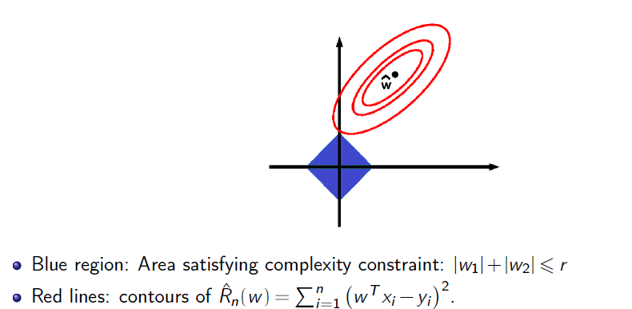
Why Sparse Solutions
Notes:
Lasso sets to zero…optinal problem showing that too large then all zero
Coordinate descent and shooting algorithm (Q2)
Projected gradient descent (Q4)
Level sets for sparsity

Slide 45
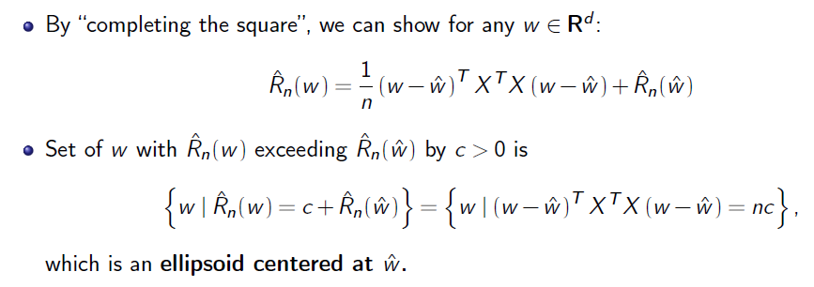
Why Sparse Solutions
Notes:
Lasso sets to zero…optinal problem showing that too large then all zero
Coordinate descent and shooting algorithm (Q2)
Projected gradient descent (Q4)
Level sets for sparsity

Slide 46
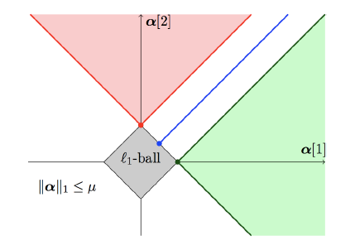
Why Sparse Solutions
Notes:
Contours circles

Slide 47
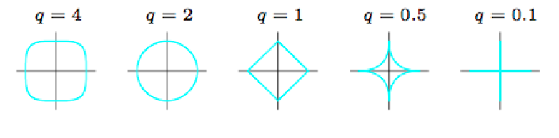
Why Sparse Solutions
Notes:
Contours circles

Slide 48
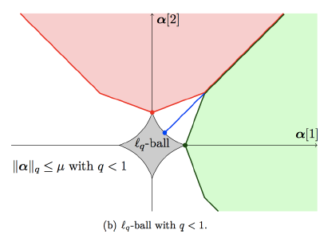
Why Sparse Solutions
Notes:
Contours circles

Slide 49
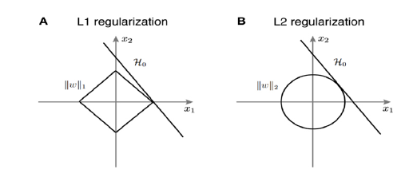
Question
Notes:
Contours circles

Slide 50
Take-Aways
Ridge
Explain the normal equations with a picture
How can you “invert” a matrix that has a different number of rows and columns
Lasso
Explain what coordinate descent is, and why it is of particular interest for the Lasso.
Lasso optimization problem does not have a differentiable objective function. Give an equivalent formulation that has a differentiable objective function by dividing the weight vector into positive and negative parts.
Give reasons why we might want the sparsity that L1 regularization often provides.

Slide 51
Take-Aways
Ridge versus Lasso
Explain what happens when we do linear, lasso, and ridge regression with 2 identical features.
Explain what happens when x1 and x2 are highly correlated, but not exactly linearly related.
Why does Elastic Net provide us benefits of both L1 and L2 regularization?

