Slide 1

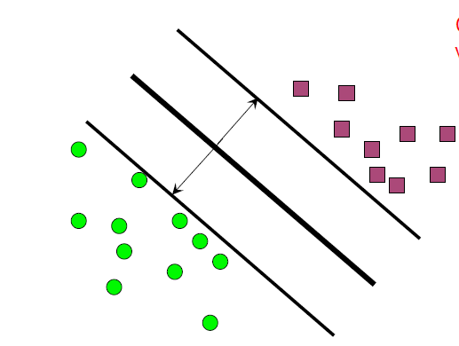
Lesson
Notes:
1. Hypothese takes inputs and outputs namely features and labels
Set of functions mapping features to leables
Algo runs over collection of hypo’s to determine optimal subject to criteria (more next slide…)
2. Input to the algo is hyperparameter output is parameter of hypothesis
this point estimator of parameteric model parameter.
Ex.
Spam number of features…want to have fewer to have quick runtime that generalizes.

Slide 2

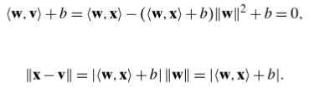
Lesson
Determine
Set
Note
Notes:
1. Hypothese takes inputs and outputs namely features and labels
Set of functions mapping features to leables
Algo runs over collection of hypo’s to determine optimal subject to criteria (more next slide…)
2. Input to the algo is hyperparameter output is parameter of hypothesis
this point estimator of parameteric model parameter.
Ex.
Spam number of features…want to have fewer to have quick runtime that generalizes.

Slide 3
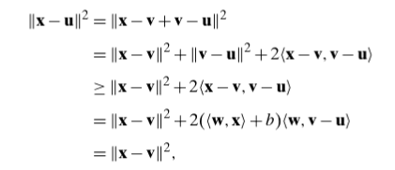
Lesson
For an u such that
have
Notes:
1. Hypothese takes inputs and outputs namely features and labels
Set of functions mapping features to leables
Algo runs over collection of hypo’s to determine optimal subject to criteria (more next slide…)
2. Input to the algo is hyperparameter output is parameter of hypothesis
this point estimator of parameteric model parameter.
Ex.
Spam number of features…want to have fewer to have quick runtime that generalizes.

