Slide 1

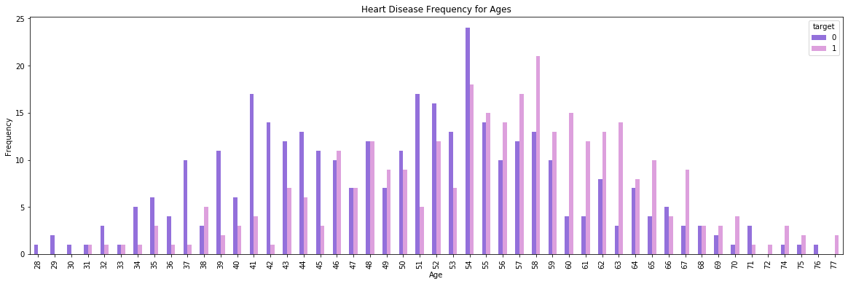
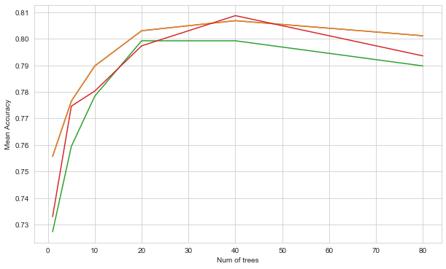
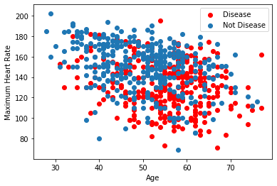
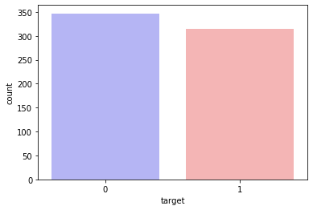
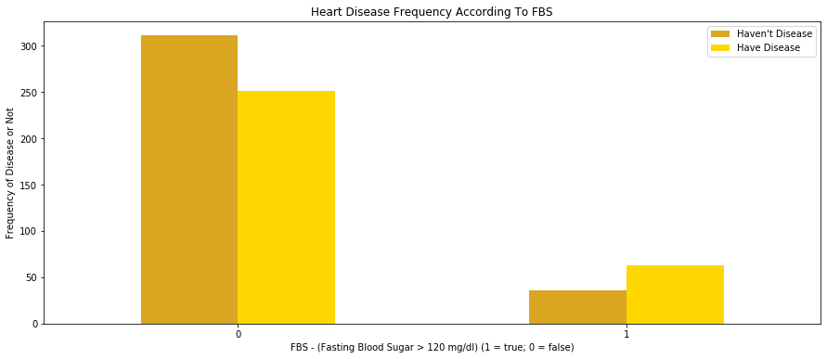
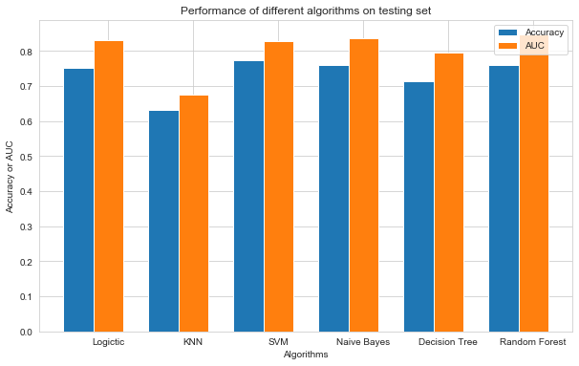
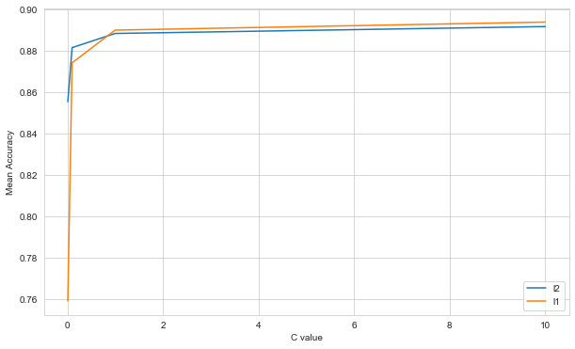
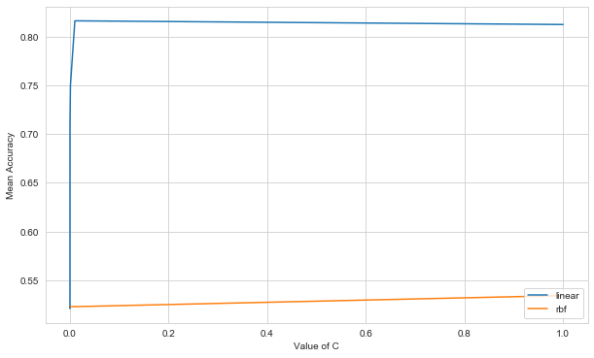
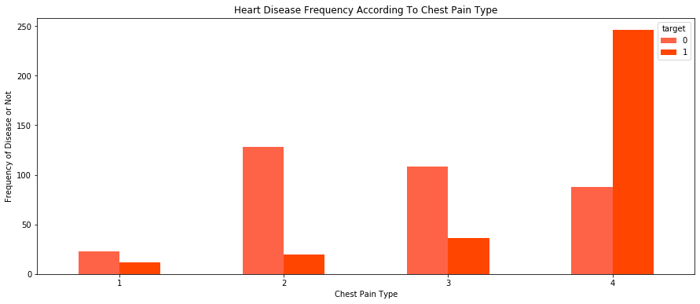
Heart Disease Prediction: Machine Learning for Good
Xiaoxuan Liu( xl2590), Yeqian Yang( yy1240)
New York University
DATA SET
INTRODUCTION
DATA ANALYSIS
MACHINE LEARNING MODEL
1. age: age in years
2. sex: sex (1 = male; 0 = female)
3. cp: chest pain type
-- Value 1: typical angina
-- Value 2: atypical angina
-- Value 3: non-anginal pain
-- Value 4: asymptomatic
4. trestbps: resting blood pressure (in mm Hg on admission to the hospital)
5. chol: serum cholestoral in mg/dl
6. fbs: (fasting blood sugar > 120 mg/dl) (1 = true; 0 = false)
7. restecg: resting electrocardiographic results
-- Value 0: normal
-- Value 1: having ST-T wave abnormality (T wave inversions and/or ST
elevation or depression of > 0.05 mV)
-- Value 2: showing probable or definite left ventricular hypertrophy
by Estes' criteria
8. thaldur: duration of exercise test in minutes
9. exang: exercise induced angina (1 = yes; 0 = no)
10. oldpeak = ST depression induced by exercise relative to rest
11. slope: the slope of the peak exercise ST segment
-- Value 1: upsloping
-- Value 2: flat
-- Value 3: downsloping
12. ca: number of major vessels (0-3) colored by flourosopy
13. thal: 3 = normal; 6 = fixed defect; 7 = reversable defect
14. num: diagnosis of heart disease (angiographic disease status)
-- Value 0: < 50% diameter narrowing
-- Value 1: > 50% diameter narrowing
(in any major vessel: attributes 59 through 68 are vessels)
Heart disease is the leading cause of death for people of most ethnicities in the United States. About 610,000 people die of heart disease in the United States every year–that’s 1 in every 4 deaths. Every year about 735,000 Americans have a heart attack. Of these, 525,000 are a first heart attack and 210,000 happen in people who have already had a heart attack.
Medical organizations such as hospitals and clinics generate huge amount of healthcare data during their daily operations. However, unfortunately these data has not been fully exploited to discover the hidden patterns and relationships between patient's medical profiles such as age, gender and blood pressure etc. and the risk of heart disease. In this project, we plan to use data mining techniques to understand the relevant causes of heart disease and exploit machine learning algorithms to predict it. Better prediction hopefully leads to better prevention of heart disease.
To analysis the distribution of the heart disease with the patients’ age, it increase from 40, and the non-disease always in the range from 30 to 50, and hardly decrease since 50.
Combine with maximum heart rate, the scatter plot shows the maximum heart is range in (80,200) and decrease with the age increases. But people older than 50, has higher probability has the heart disease.
The random forest model, the best parameter we find are max_depth:5, n_estimators:80, with the training accuracy 0.81 and testing set 0.76.
Other model we use in this project are: KNN, Naïve Bayes, Decision Tree.
KNN: the best parameter we find are n_neighbors = 20, weights = ‘distance’ with the training accuracy 0.69 and testing set 0.63.
Naïve Bayes: the best parameter we find is var_smoothing = 1e-05 with the training accuracy 0.82 and testing set 0.76.
Decision Tree: the best parameter we find is max_depth = 3 with the training accuracy 0.71 and testing set 0.76.
DATA ANALYSIS
In project, we analysis the whether the data is well-balanced in sex, and whether patients have heart disease or not.
The relation between blood sugar with the heart disease. When the blood sugar higher than120 mg/dl, it shows more higher probability that people has heart disease.
Four types of the chest pain: typical angina, atypical angina, non-anginal pain and asymptomatic. The last one will lead higher rate of heart disease.
CONCLUSIONS
According to the experiment results, SVM has the best performance on the testing set. Logitic regression, SVM, Naive Bayes and random forest classifers perform relatively better than other models. This could be attributed to the fact that the accuracy of the k-NN algorithm can be severely degraded by the presence of noisy or irrelevant features. Khourdifi et al.[1] adopted the FCBF's reliable method [2] to select a subset of discriminatory features prior to classification, by eliminating attributes with little or no effect. The performance of KNN classifier improved significantly. Therefore, in future work, we are interested to investigate deeper into feature selection to optimize our models.
MACHINE LEARNING MODEL
The logistic model is usually used to model the probability of a certain class or event existing such as pass/fail, win/lose, alive/dead or healthy/sick. Logistic regression is a statistical model that in its basic form uses a logistic function to model a binary dependent variable. Logistic Regression: the best parameters we find are c = 10, penalty = ‘l1’ with the training accuracy of 0.89 and testing set 0.75.
A Support Vector Machine (SVM) is a discriminative classifier formally defined by a separating hyperplane.SVMs maximize the margin around the separating hyperplane. The best parameter for SVM is c = 0.01, kernel =‘ linear’ with the training accuracy of 0.82 and testing set 0.77.
CONTACT
<your name>
<your organization>
Email:
Phone:
Website:
REFERENCES
[1] Khourdifi, Youness, and Mohamed Bahaj. "Heart Disease Prediction and Classification Using Machine Learning Algorithms Optimized by Particle Swarm Optimization and Ant Colony Optimization."

