Slide 1
IPsec/IKE
Thanks to Vitaly Shmatikov
for slides

Slide 2
Administrative
Lab 2 Due next week before class
Extra Credit talk assignment
Giulia Fanti
Compounding of Wealth in Proof-of-Stake Cryptocurrencies
March 8th at 11:00 a.m.
2 MetroTech Center, 10th floor, room 10.099

Slide 3
Security at different layers
Link layer: WEP / 802.11i
Application layer: PGP
Transport layer: SSL
Network layer: IPsec
IPsec approach:
HTTP/SMTP/IM
TCP/UDP/ICMP
IPsec

Slide 4
IP Security Issues
Eavesdropping
Modification of packets in transit
Identity spoofing (forged source IP addresses)
Denial of service
Many solutions are application-specific
TLS for Web, S/MIME for email, SSH for remote login
IPsec aims to provide a framework of open standards for secure communications over IP
Protect every protocol running on top of IPv4 and IPv6

Slide 5
IPsec: Network Layer Security
IPsec = AH + ESP + IPcomp + IKE
Protection for IP traffic
AH provides integrity and
origin authentication
ESP also confidentiality
Compression not going to cover
Sets up keys and algorithms
for AH and ESP
AH and ESP rely on an existing security association
Parties must share a set of secret keys and agree on each other’s IP addresses and crypto algorithms
Internet Key Exchange (IKE) is one of the ways to establish a security association for AH and ESP

Slide 6
IPsec Security Services
Authentication and integrity for packet sources
Connectionless integrity (for a single packet) and partial sequence integrity (prevent packet replay)
Confidentiality (encapsulation) for packet contents
Also partial protection against traffic analysis
Authentication and encapsulation can be used separately or together
Either provided in transport or tunnel mode
These services are transparent to applications above transport (TCP/UDP) layer

Slide 7
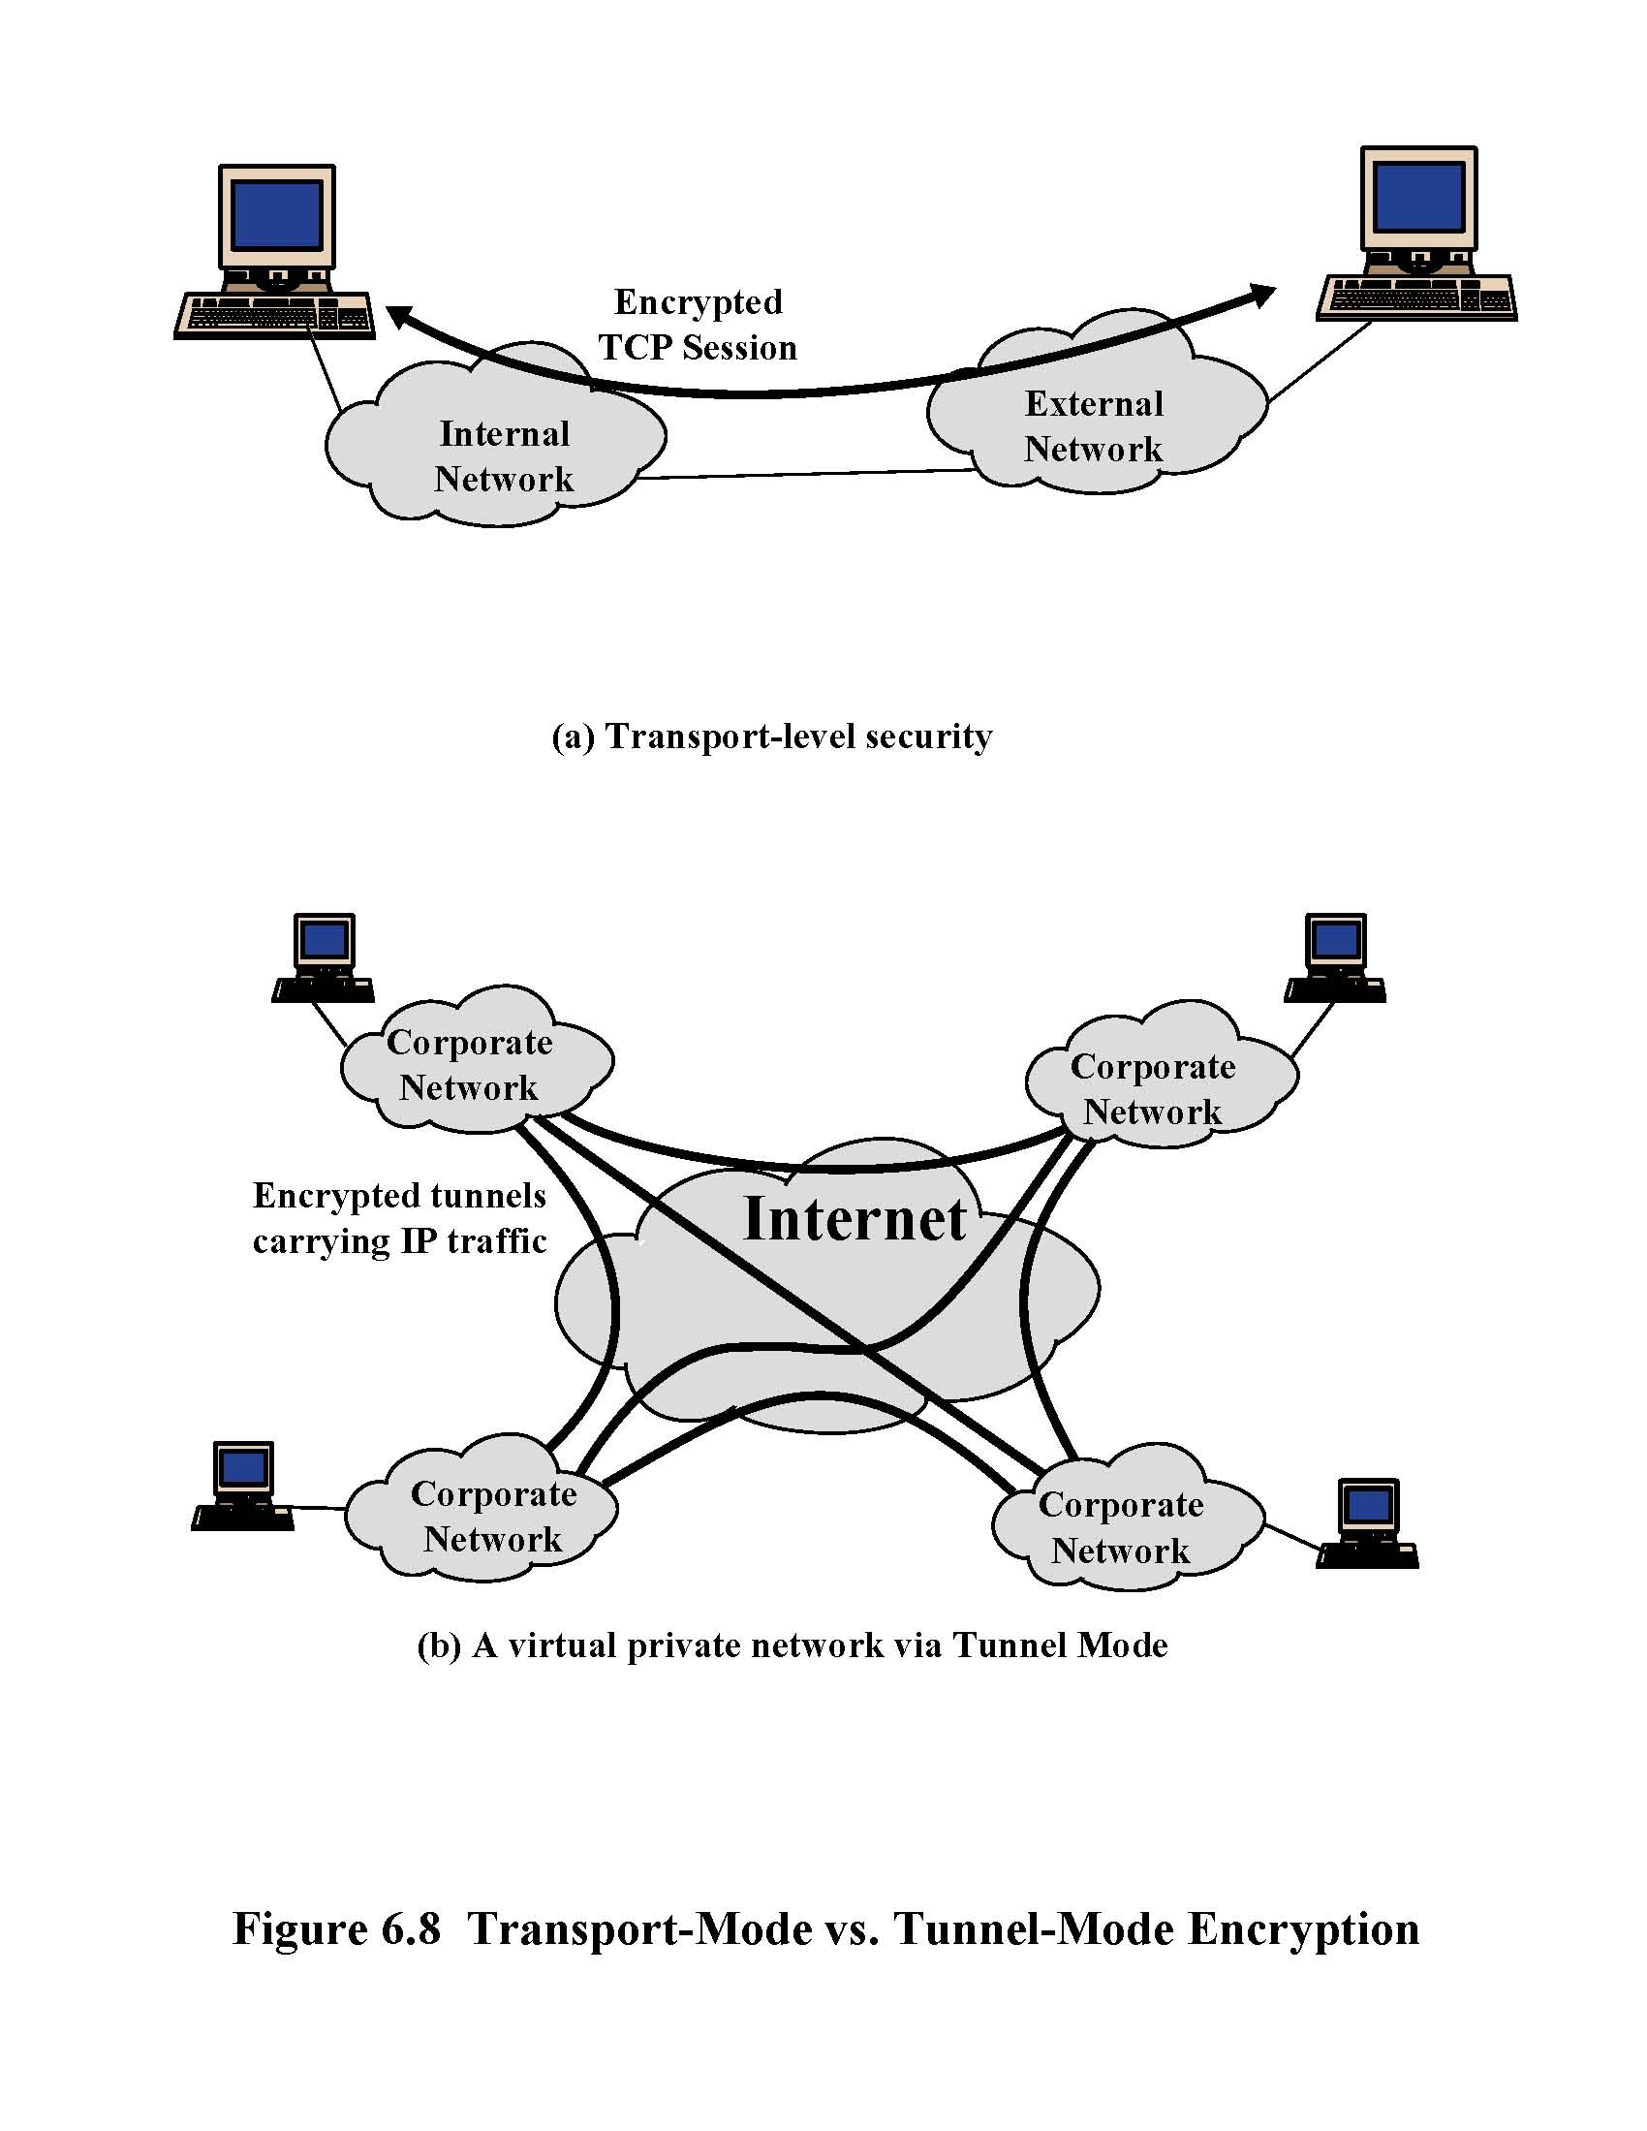
IPsec in Transport Mode
End-to-end security between two hosts
Typically, client to gateway (for example, laptop to corporate gateway)
Requires IPsec support at each host

Slide 8
IPsec in Tunnel Mode
Gateway-to-gateway security
Internal traffic behind gateways not protected
Only requires IPsec support at gateways

Slide 9
Virtual Private Network (VPN subset of IPsec)
Public Internet
laptop
w/ IPsec
IP
header
IPsec
header
Secure
payload
salesperson in hotel
IP
header
IPsec
header
Secure
payload
IP
header
IPsec
header
Secure
payload
Router w/
IPv4 and IPsec
Router w/
IPv4 and IPsec
IP
header
payload
IP
header
payload
branch office
headquarters

Slide 10
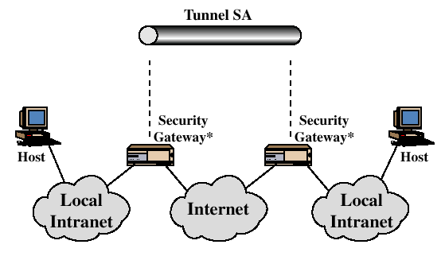
Tunnel Mode Illustration
Implements
IPsec
Implements
IPsec
IPsec protects communication on the insecure part of the network

Slide 11
Transport Mode vs. Tunnel Mode
Transport mode secures packet payload and leaves IP header unchanged
Tunnel mode “wraps” (encapsulates) entire IP packet (header and payload) into IPsec packet
IP header
(real dest)
IPsec header
TCP/UDP header + data
IP header
(gateway)
IPsec header
IP header
(real dest)
TCP/UDP header + data

Slide 12
Security Association (SA)
SA determines how packets are processed
Cryptographic algorithms, keys, IVs, lifetimes, sequence numbers, mode (transport or tunnel) – read textbook!
One-way sender-recipient relationship, thus two SAs required for a two-way conversation
SA is uniquely identified by SPI (Security Parameters Index)…
Each IPsec implementation keeps a database of SAs
SPI is sent with packet, tells recipient which SA to use
…destination IP + protocol identifier (AH or ESP)

Slide 13
IP Headers
Version
Header
Length
TOS
Packet
length
Packet Id
Flags
Mutable
Immutable
Predictable
Fragment
offset
TTL
Protocol
number
Checksum
Source IP
address
Destination
IP address
Options
AH (Authentication Header) sets mutable fields to zero and predictable fields to final value and then uses this header plus packet contents as input to HMAC

Slide 14
AH: Authentication Header
Authentication for the source of the packet
Integrity for payload and parts of IP header
Anti-replay service (to counter denial of service)
No confidentiality
Next header
(TCP)
Payload length
Reserved
Identifies security
association (shared
keys and algorithms)
Security parameters index (SPI)
Sequence number
Anti-replay
ICV: Integrity Check Value
(HMAC of parts of IP header, TCP payload)
Authenticates source,
verifies integrity of
payload and header

Slide 15
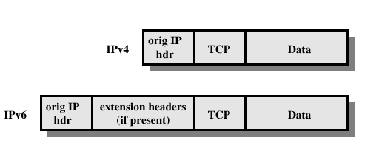
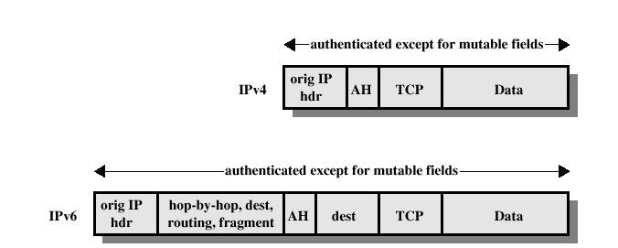
AH in Transport Mode
Before AH is applied

Slide 16
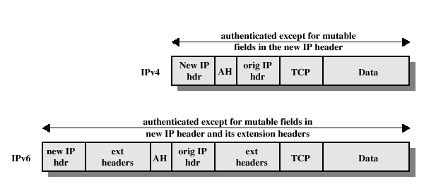
AH in Tunnel Mode
Before AH is applied
No confidential

Slide 17
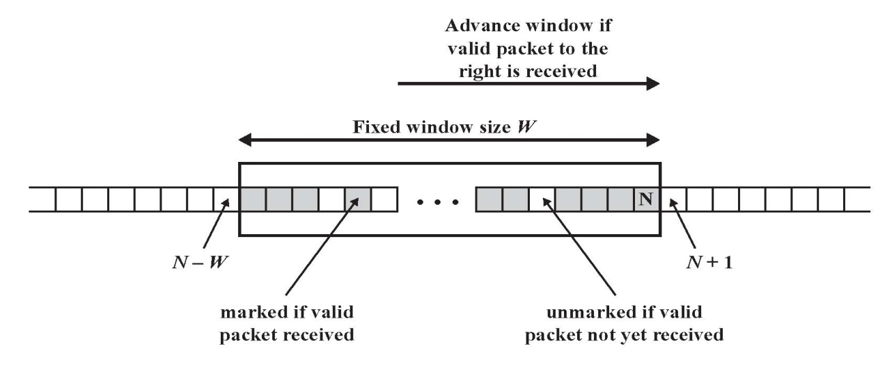
Prevention of Replay Attacks
When SA is established, sender initializes 32-bit counter to 0, increments by 1 for each packet
If wraps around 2³²-1, new SA must be established
Recipient maintains a sliding 32-bit window
If a packet with high sequence number is received, do not advance window until packet is authenticated

Slide 18
ESP: Encapsulating Security Payload
Confidentiality and integrity for packet payload
Symmetric cipher negotiated as part of security assoc
Optionally provides authentication (similar to AH)
Can work in transport…
…or tunnel mode
encrypted
Original IP
header
ESP header
TCP/UDP segment
ESP trailer
ESP auth
authenticated
New IP
header
ESP header
Original IP
header
TCP/UDP segment
ESP trailer
ESP auth

Slide 19
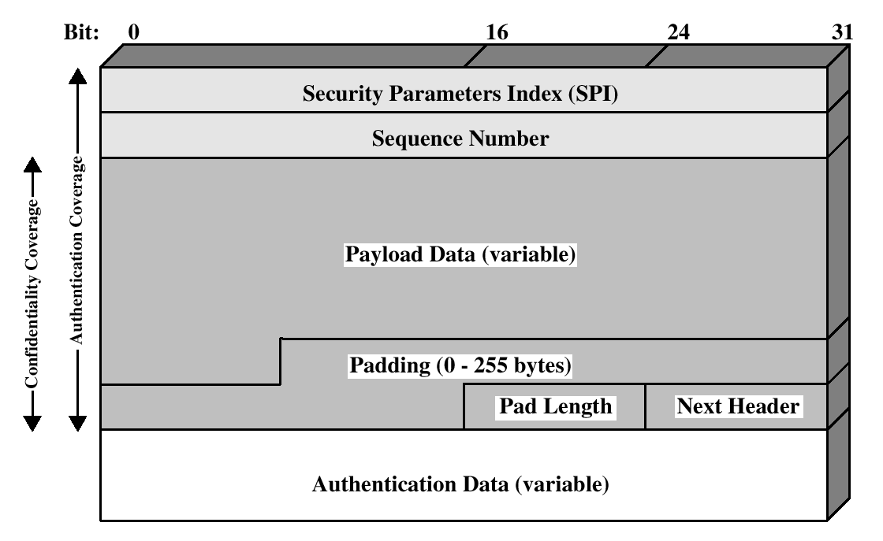
ESP Packet
Identifies security
association (shared
keys and algorithms)
Anti-replay
TCP segment (transport mode)
or
entire IP packet (tunnel mode)
Pad to block size for cipher,
also hide actual payload length
Type of payload
HMAC-based Integrity
Check Value (similar to AH)

Slide 20
Virtual Private Networks (VPN)
ESP is often used to implement a VPN
Packets go from internal network to a gateway with TCP / IP headers for address in another network
Entire packet hidden by encryption
Including original headers so destination addresses are hidden
Receiving gateway decrypts packet and forwards original IP packet to receiving address in the network that it protects
This is known as a VPN tunnel
Secure communication between parts of the same organization over public untrusted Internet

Slide 21
Secure Key Establishment
Goal: generate and agree on a session key using some public initial information
What properties are needed?
Authentication (know identity of other party)
Secrecy (generated key not known to any others)
Forward secrecy (compromise of one session key does not compromise keys in other sessions)
Prevent replay of old key material
Prevent denial of service
Protect identities from eavesdroppers
Agreement (both parties agree on the value of key)

Slide 22
Key Management in IPsec
Manual key management
Keys and parameters of crypto algorithms exchanged offline (for example, by phone), security associations established by hand
Pre-shared symmetric keys
New session key derived for each session by hashing pre-shared key with session-specific nonces
Standard symmetric-key authentication and encryption
Online key establishment
Internet Key Exchange (IKE) protocol
Use Diffie-Hellman to derive shared symmetric key

Slide 23
Diffie-Hellman Key Exchange
Assume finite group G = ⟨S, •⟩
Choose generator g so every x∈S is x = g^{i} for some i
Example: squares modulo prime p (even i)
Protocol
gª mod p
g^{b} mod p
A
B
Alice, Bob share g^{ab} mod p not known to anyone else

Slide 24
IKE Genealogy
Diffie-Hellman
Station-to-Station
1976
+ authentication,
identity protection
Diffie, van Oorschot, Wiener 1992
+ defense against
denial of service
ISAKMP
NSA 1998
Photuris
“generic” protocol for
establishing security associations
+ defense against replay
Karn, Simpson 1994-99
+ compatibility with ISAKMP
IKE
Oakley
Cisco 1998
Orman 1998
IKEv2
Internet standard December 2005

Slide 25
Design Objectives
Shared secret
Create and agree on a secret which is known only to protocol participants
Authentication
Participants need to verify each other’s identity
Identity protection
Eavesdropper should not be able to infer participants’ identities by observing protocol execution
Protection against denial of service
Malicious participant should not be able to exploit the protocol to cause the other party to waste resources

Slide 26
Ingredient 1: Diffie-Hellman
A → B: gª
B → A: g^{b}
Shared secret is g^{ab}, compute key as k=hash(rand,g^{ab})
Diffie-Hellman guarantees perfect forward secrecy( someone break the pervious key, they cannot break the future one.)
Authentication
Identity protection
DoS protection

Slide 27
Ingredient 2: Challenge-Response
A → B: m, A
B → A: n, sig_{B}(m, n, A)
A → B: sig_{A}(m, n, B)
Shared secret
Authentication
A receives his own number m signed by B’s private key and deduces that B is on the other end; similar for B
Identity protection
DoS protection

Slide 28
DH + Challenge-Response
ISO 9798-3 protocol:
A → B: gª, A
B → A: g^{b}, sig_{B}(gª, g^{b}, A)
A → B: sig_{A}(gª, g^{b}, B)
Shared secret: g^{ab}
Authentication
Identity protection
DoS protection
m := gª
n := g^{b}

Slide 29
Ingredient 3: Encryption
Encrypt signatures to protect identities:
A → B: gª, A
B → A: g^{b}, Enc_{PK(A)}(sig_{B}(gª, g^{b}, A))
A → B: Enc_{PK(B)}(sig_{A}(gª, g^{b}, B))
Shared secret: g^{ab}
Authentication
Identity protection (for responder only!)
DoS protection

Slide 30
Refresher: Anti-DoS Cookie
Denial of service due to resource clogging
If responder opens a state for each connection attempt, attacker can initiate thousands of connections from bogus or forged IP addresses
Cookies ensure that the responder is stateless until initiator produced at least two messages
Responder’s state (IP addresses and ports) is stored in an unforgeable cookie and sent to initiator
After initiator responds, cookie is regenerated and compared with the cookie returned by the initiator
The cost is two extra messages in each execution

Slide 31
Refresher: DoS Prevention
Typical protocol:
Client sends request (message #1) to server
Server sets up connection, responds with message #2
Client may complete session or not (potential DoS)
Cookie version:
Client sends request to server
Server sends hashed connection data back
Send message #2 later, after client confirms his address
Client confirms by returning hashed data
Need an extra step to send postponed message #2

Slide 32
Ingredient 4: Anti-DoS Cookie
“Almost-IKE” protocol:
A → B: gª
B → A: g^{b}, hash_{Kb}(g^{b}, gª)
A → B: gª, g^{b}, hash_{Kb}(g^{b}, gª)
Enc_{K}(sig_{A}(gª, g^{b}, B))
B → A: g^{b}, Enc_{K}(sig_{B}(gª, g^{b}, A))
Shared secret: g^{ab}
Authentication
Identity protection
DoS protection?
Doesn’t quite work: B must
remember his DH exponent b
for every connection
k=hash(g^{ab})

Slide 33
Medium-Term Secrets and Nonces
Idea: use the same Diffie-Hellman value g^{ab} for every session, update every 10 minutes or so
Helps against denial of service
To make sure keys are different for each session, derive them from g^{ab} and session-specific nonces
Nonces guarantee freshness of keys for each session
Re-computing gª, g^{b}, g^{ab} is costly, generating nonces (fresh random numbers) is cheap
This is more efficient and helps with DoS, but no longer guarantees forward secrecy (why?)

Slide 34
(Simplified) Photuris
[Karn and Simpson]
Random number
(identifies connection)
Hash(source & dest IP addrs,
Cookie_{I}, ports, R’s local secret)
Cookie_{I}
I
R
Cookie_{I}, Cookie_{R}, offer crypto
Cookie_{I}, Cookie_{R}, gª mod p, select crypto
Cookie_{I}, Cookie_{R}, g^{b} mod p
switch to K=h(g^{ab} mod p)
switch to K=h(g^{ab} mod p)
Alice is called
“Initiator” for
consistency with
IKE terminology
Cookie_{I}, Cookie_{R}, Enc_{K}(“I”, sig_{I}(previous msgs))
Bob is called
“Responder”
Cookie_{I}, Cookie_{R}, Enc_{K}(“R”, sig_{R}(previous msgs))

Slide 35
IKE Genealogy Redux
Diffie-Hellman
Station-to-Station
1976
+ authentication,
identity protection
Diffie, van Oorschot, Wiener 1992
+ defense against
denial of service
ISAKMP
NSA 1998
Photuris
“generic” protocol for
establishing security associations
+ defense against replay
Karn, Simpson 1994-99
+ compatibility with ISAKMP
IKE
Oakley
Cisco 1998
Orman 1998
IKEv2
Internet standard December 2005

Slide 36
Cookies in Photuris and ISAKMP
Photuris cookies are derived from local secret, IP addresses and ports, counter, crypto schemes
Same (frequently updated) secret for all connections
ISAKMP requires unique cookie for each connect
Add timestamp to each cookie to prevent replay attacks
Now responder needs to keep state (“cookie crumb”)
Vulnerable to denial of service (why?)
Inherent conflict: to prevent replay, need to remember values that you’ve generated or seen before, but keeping state allows denial of service

Slide 37
IKE Overview
Goal: create security association between 2 hosts
Shared encryption and authentication keys, agreement on crypto algorithms
Two phases: 1st phase establishes security association (IKE-SA) for the 2nd phase
Always by authenticated Diffie-Hellman (expensive)
2nd phase uses IKE-SA to create actual security association (child-SA) to be used by AH and ESP
Use keys derived in the 1st phase to avoid DH exchange
Can be executed cheaply in “quick” mode
To create a fresh key, hash old DH value and new nonces

Slide 38
Why Two-Phase Design?
Expensive 1st phase creates “main” SA
Cheap 2nd phase allows to create multiple child SAs (based on “main” SA) between same 2 hosts
Example: one SA for AH, another SA for ESP
Different conversations may need different protection
Some traffic only needs integrity protection or short-key crypto
Too expensive to always use strongest available protection
Avoid multiplexing several conversations over same SA
For example, if encryption is used without integrity protection (bad idea!), it may be possible to splice the conversations
Different SAs for different classes of service

Slide 39
IKE: Phase One
Optional: refuse 1st message and
demand return of stateless cookie
gª mod p, crypto proposal, N_{i}
I
R
Cookie_{R}
Cookie_{R}, gª mod p, crypto proposal, N_{i}
g^{b} mod p, crypto accepted, N_{r}
switch to K=f(N_{i} ,N_{r} ,crypto, g^{ab} mod p)
Enc_{K}(“I”, sig_{I}(m₁₋₄), [cert], child-SA)
Enc_{K}(“R”, sig_{R}(m₁₋₄), [cert], child-SA)
Initiator reveals identity first
Prevents “polling” attacks where
attacker initiates IKE connections
to find out who lives at an IP addr
Instead of running 2nd phase,
“piggyback” establishment of
child-SA on initial exchange

Slide 40
IKE: Phase Two (Create Child-SA)
After Phase One, I and R share key K
I
R
Enc_{K}(proposal, N_{i}, [gª mod p], traffic)
Crypto suites, protocol
(AH, ESP or IPcomp)
Optional re-key
using old DH
value and fresh
nonces
IP address range,
ports, protocol id
Enc_{K}(proposal, N_{r} , [g^{b} mod p], traffic)
Can run this several times to create multiple SAs

Slide 41
Other Aspects of IKE
Interaction with other network protocols
How to run IPsec through NAT (Network Address Translation) gateways?
Protocol management
Dead peer detection, rekeying, etc.
Complex
VPN Tunnels simpler and more commonly used.

