Slide 1
Certificates and
Public-Key Infrastructure
Thanks to Vitaly Shmatikov and Moxie Marlinspike for slides
slide <number>

Slide 2
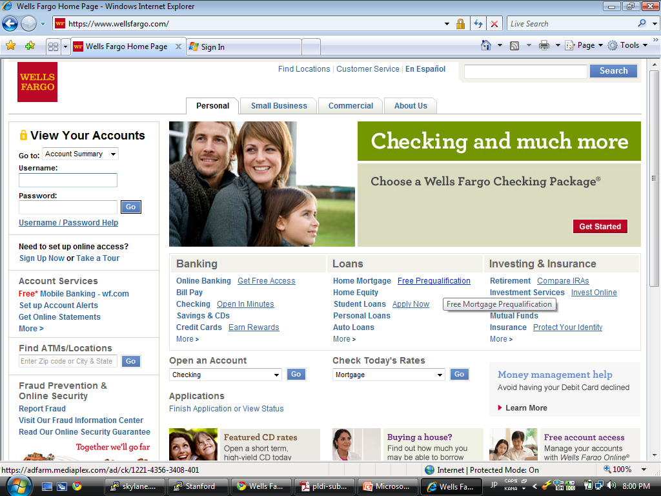

Motivation
https://
What cryptographic keys are used
to protect communication?
slide <number>

Slide 3
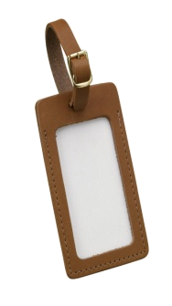
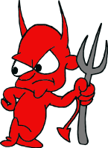

Authenticity of Public Keys
Bob’s key
?
private key
Bob
Alice
public key
Problem: How does Alice know that the public key
she received is really Bob’s public key?
slide <number>

Slide 4
Distribution of Public Keys
Public announcement or public directory
  Risks: forgery and tampering
Public-key certificate
  Signed statement specifying the key and identity
    sig_{Alice}(“Bob”, PK_{B})
Common approach: certificate authority (CA)
  An agency responsible for certifying public keys
  Browsers are pre-configured with 100s of trusted CAs
  A public key for any website in the world will be accepted by the browser if certified by one of these CAs
slide <number>

Slide 5
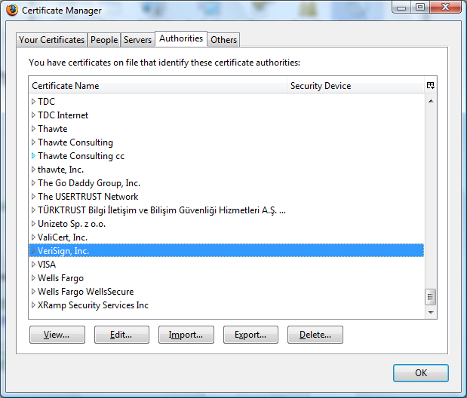
Trusted Certificate Authorities
slide <number>

Slide 6
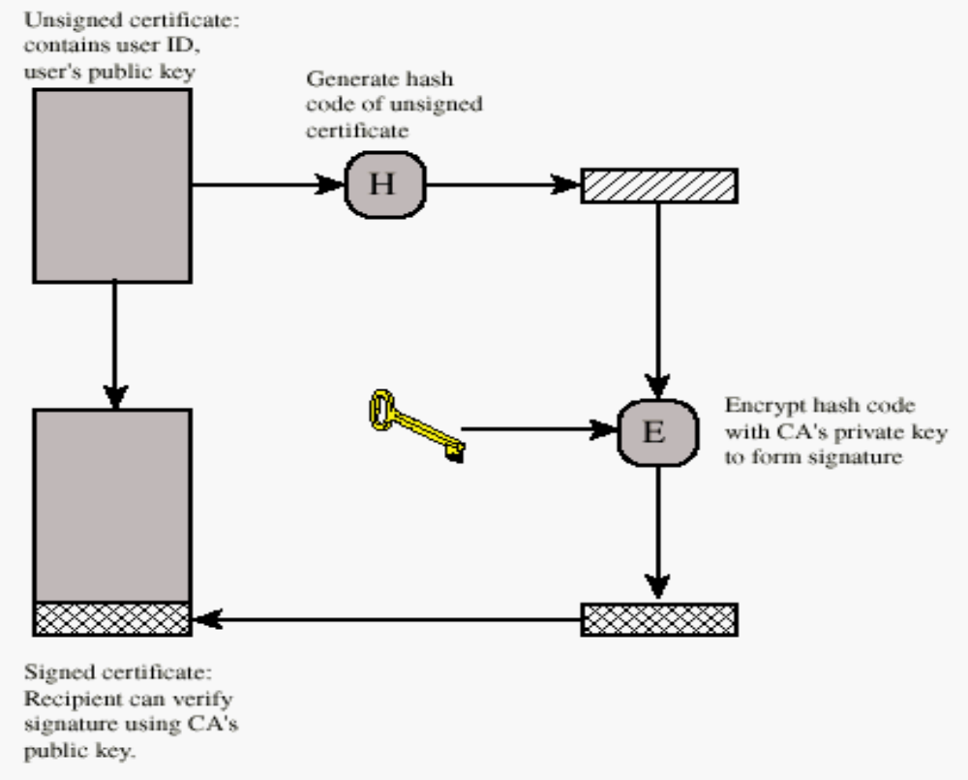
Generating a Public-Key Certificate
Authenticity of many public keys is reduced to
authenticity of CA’s public key
slide <number>

Slide 7
CA Hierarchy
Single CA certifying every public key is impractical
Instead, use trusted root authorities
  Firefox 3 includes certificates of 135 trusted root CAs
Root CA signs certificates for intermediate CAs, they sign certificates for lower-level CAs, etc.
  Certificate “chain of trust”
    sig_{Verisign}(“GMU”, PK_{gmu}), sig_{gmu}(“Damon M.”, PK_{damon})
CA is responsible for verifying identity of certificate requestors, domain ownership
What if someone could forge a CA certificate?
slide <number>

Slide 8
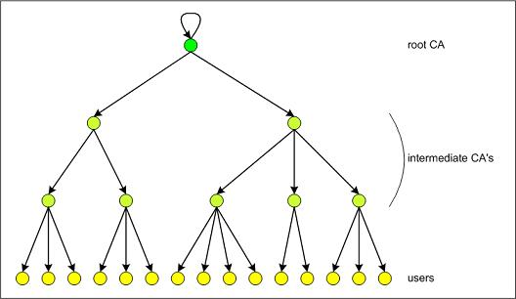
Certificate Hierarchy
slide <number>

Slide 9
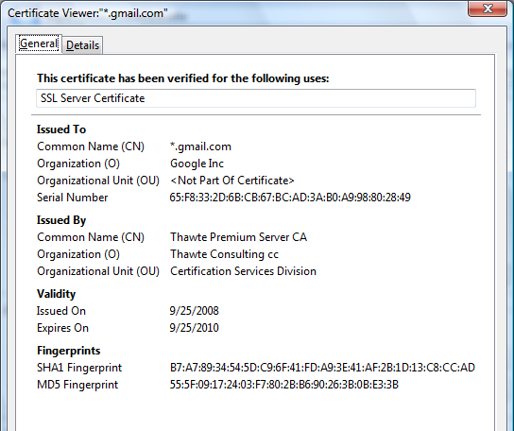
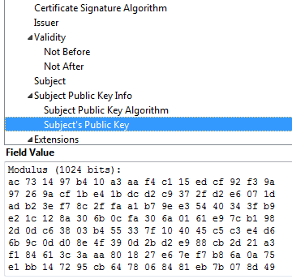
Example of a Certificate
Important fields
slide <number>

Slide 10
Common Name
Explicit name: www.foo.com
Wildcard: *.foo.com or www*.foo.com
Matching rules
  Firefox 3: * matches anything
  Internet Explorer 7: * must occur in the leftmost component, does not match ‘.’
    *.foo.com matches a.foo.com, but not a.b.foo.com
slide <number>

Slide 11
International Domain Names
Rendered using international character set
Chinese character set contains characters that look like “/” and “?” and “=” and “.”
Can buy a certificate for *.foo.cn, create any number of domain names that look like
www.bank.com/accounts/login.php?q=me.foo.cn
  What does the user see?
  *.foo.cn certificate works for all of them!
slide <number>

Slide 12
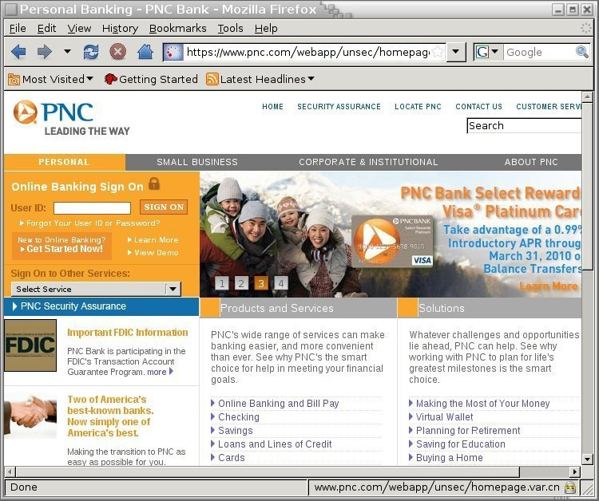
Example
[Moxie ‘08]
slide <number>

Slide 13
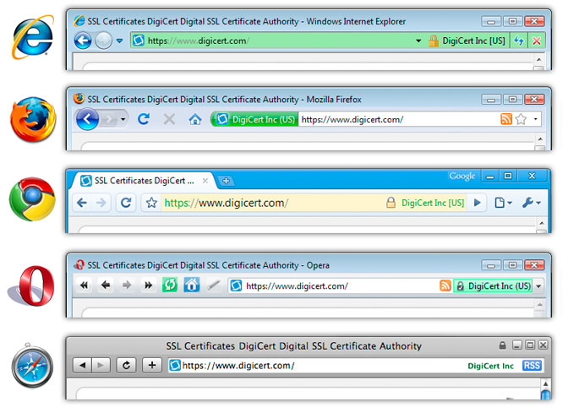
Extended Validation (EV) Certificates
Certificate request must be approved by a human lawyer at the certificate authority
slide <number>

Slide 14
Questions about EV Certificates
What does EV certificate mean?
What is the difference between an HTTPS connection that uses a regular certificate and an HTTPS connection that uses an EV certificate?
If an attacker has somehow obtained a non-EV certificate for bank.com, can he inject a script into https://bank.com content?
  What is the origin of the script? Can it access or modify content that arrived from actual bank.com via HTTPS?
What would the browser show – blue or green?
slide <number>

Slide 15
X.509 Authentication Service
Internet standard (1988-2000)
Specifies certificate format
  X.509 certificates are used in IPsec and SSL/TLS
Specifies certificate directory service
  For retrieving other users’ CA-certified public keys
Specifies a set of authentication protocols
  For proving identity using public-key signatures
Can use with any digital signature scheme and hash function, but must hash before signing
Remember MD5?
slide <number>

Slide 16
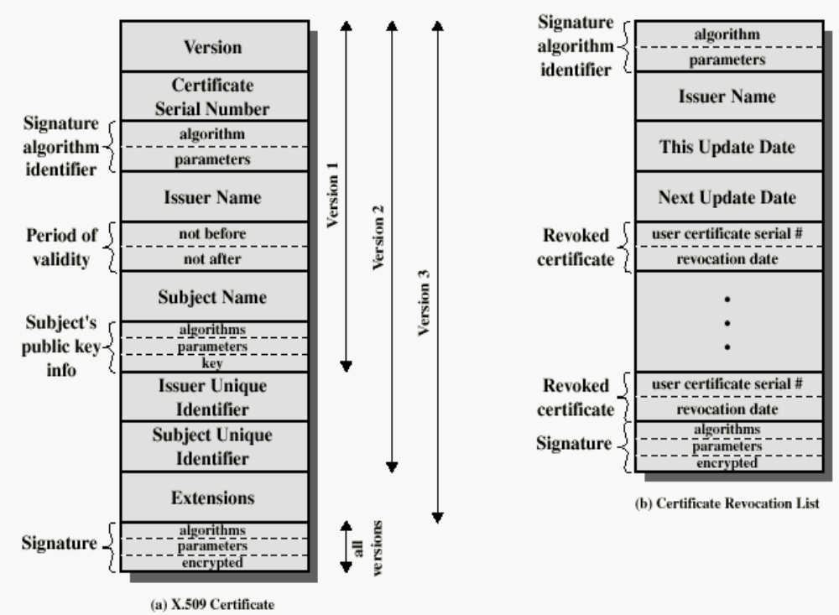
X.509 Certificate
Added in X.509 versions 2 and 3 to address
usability and security problems
hash
slide <number>

Slide 17
Certificate Revocation
Revocation is very important 是需要撤销的，原因如下
Many valid reasons to revoke a certificate
  Private key corresponding to the certified public key has been compromised
  User stopped paying his certification fee to this CA and CA no longer wishes to certify him
  CA’s certificate has been compromised!
Expiration is a form of revocation, too
  Many deployed systems don’t bother with revocation
  Re-issuance of certificates is a big revenue source for certificate authorities
slide <number>

Slide 18
Certificate Revocation Mechanisms
Online revocation service
  When a certificate is presented, recipient goes to a special online service to verify whether it is still valid
    Like a merchant dialing up the credit card processor
Certificate revocation list (CRL)
  CA periodically issues a signed list of revoked certificates
    Credit card companies used to issue thick books of canceled credit card numbers
  Can issue a “delta CRL” containing only updates
Q: Does revocation protect against forged
certificates?
slide <number>

Slide 19
X.509 Certificate Revocation List
Because certificate serial numbers
must be unique within each CA, this is
enough to identify the certificate
hash
slide <number>

Slide 20
Important Questions
Does your browser check whether the site’s certificate has been revoked?
What do you do when your browser warns you that the site’s certificate has expired?
  Most users click through, enter credentials
Over 40% of certs are self-signed – means what?
How do CAs verify identities of domains to whom they issue certificates (domain validation)?
slide <number>

Slide 21
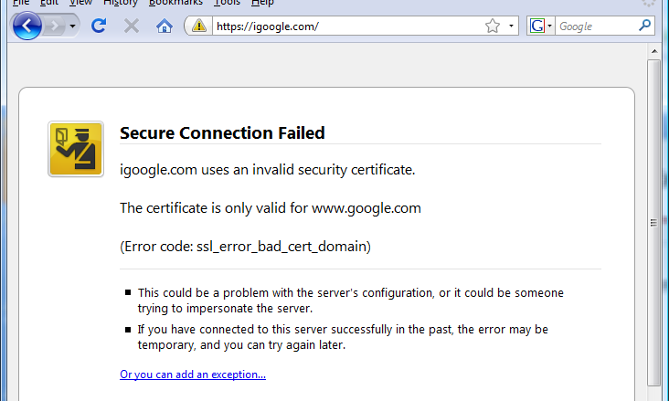
Invalid Certificate Warning
Four clicks to get Firefox 3 to accept certificate
Page is displayed with full HTTPS indicators
slide <number>

Slide 22
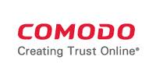
Comodo
Comodo is one of the trusted CAs
  Its certificates for any website in the world are accepted by every browser
Comodo accepts certificate orders submitted through resellers
  Reseller uses a program to authenticate to Comodo and submit an order with a website name and public key, Comodo automatically issues a certificate for this site
slide <number>

Slide 23
Comodo Break-In
Iranian hacker broke into instantSSL.it and globalTrust.it resellers, decompiled their certificate issuance program, learned credentials of their reseller account and Comodo API
  username: gtadmin, password: globaltrust
Wrote his own program for submitting orders and obtaining Comodo certificates
On March 15, 2011, got Comodo to issue 9 rogue certificates for popular sites
  mail.google.com, login.live.com, login.yahoo.com, login.skype.com, addons.mozilla.org, “global trustee"
slide <number>

Slide 24
Consequences
Attacker needs to divert users to an attacker-controlled site instead of Google, Yahoo, Skype (connection hijacking), but then…
  For example, use DNS to poison the mapping of mail.yahoo.com to an IP address
… “authenticate” as the real site
… decrypt all data sent by users
  Email, phone conversations, Web browsing
Q: Does HTTPS help? How about EV certificates?
slide <number>

Slide 25

DigiNotar Break-In
In June 2011, same “ComodoHacker” broke into a Dutch certificate authority, DigiNotar
  Message found in scripts used to generate fake certificates:
  “THERE IS NO ANY HARDWARE OR SOFTWARE IN THIS WORLD EXISTS WHICH COULD STOP MY HEAVY ATTACKS MY BRAIN OR MY SKILLS OR MY WILL OR MY EXPERTISE"
Security of DigiNotar servers
  All core certificate servers in a single Windows domain, controlled by a single admin password (Pr0d@dm1n)
  Software on public-facing servers out of date, unpatched
  Tools used in the attack would have been easily detected by antivirus… if it had been present
slide <number>

Slide 26
Consequences of DigiNotar Hack
Break-in not detected for a month
Rogue certificates issued for *.google.com, Skype, Facebook, www.cia.gov, and 527 other domains
99% of revocation lookups for these certificates originated from Iran
  Evidence that rogue certificates were being used, most likely by Iranian government or Iranian ISPs to intercept encrypted communications
    Man-in-the-middle attack using DNS poisoning
  300,000 users were served rogue certificates
slide <number>

Slide 27
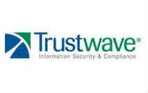
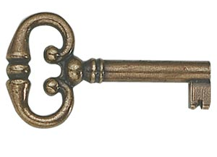
TrustWave
In Feb 2012, admitted issuance of a root certificate to a corporate customer
  Purpose: “re-sign” certificates for “data loss prevention”
    Translation: forge certificates of third-party sites in order to spy on employees’ encrypted communications with outside world
    What if a “re-signed” certificate leaks out?
  Customer can now forge certificates for any site in world… and they will be accepted by any browser!
Do other CAs do this? How common are these “skeleton key” certificates?
slide <number>

Slide 28
Mitigation for Compromised CA
TSL method to revoke certificates
  CA publishes Certificate Revocation List (CRL)
  Client checks list before validating certificate
Rumors Iran blocked access to revocation list
  Known weakness against TLS revocation [Moxie 2009]
Nothing happened to Comodo
  They issued 20% for the TLS Certificates
  We are stuck trusting them

Slide 29







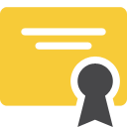
TLS Man-in-the-Middle Attack
Does C_{e} validate?
S_{e}
S_{BofA}
e
BofA
ClientHello
ClientHello
e
BofA
If C_{e} is self-signed, the user will be shown a warning
If the attacker steals C_{BofA} and S_{BofA}, then this attack will succeed unless:
  Bank of America revokes the stolen cert
  The client checks to see if the cert has been revoked
If the attacker manages to buy a valid BofA cert from a CA, then the only defense against this attack is certificate pinning

Slide 30
Certificate Pinning
Certificate pinning is a technique for detecting sophisticated MitM attacks
  Browser includes certs from well-known websites in the trusted key store by default
  Usually, only certs from root CAs are included in the trusted key store
Example: Chrome ships with pinned copies of the *.google.com certificate
Trusted Key Store
Verisign
BofA
Google

Slide 31
Questions to Think About Trust
Who do I have to trust?
  Every CA in your Browsers list
  Yes even Bermuda
For how long?
  Forever
slide <number>

Slide 32
DNS: Domain Name Service
DNS maps symbolic names to numeric IP addresses
(for example, www.engineering.nyu.edu ↔ 129.174.93.161)
root & edu
DNS server
www.engineering.nyu.edu
www. engineeringnyu.edu
NS nyu.edu
nyu.edu
DNS server
Local
DNS recursive
resolver
NS engineering.nyu.edu
Client
www=IPaddr
engineering.nyu.edu
DNS server
slide <number>

Slide 33
Operation of DNSSEC
DNSSEC = standardized DNS security extensions currently being deployed
1. Suppose we look up mail.google.com
  We get an answer from google.com nameserver (NS)
  Plus: signature for answer (in Additional section) purportedly signed by google.com NS
2. Look up public key for google.com NS
  That answer is signed by .com NS
3. Look up public key for .com NS
– That answer is signed by root (‘.’) NS
4. Root NS’s public key is wired into our resolver
All of these keys are cacheable

Slide 34
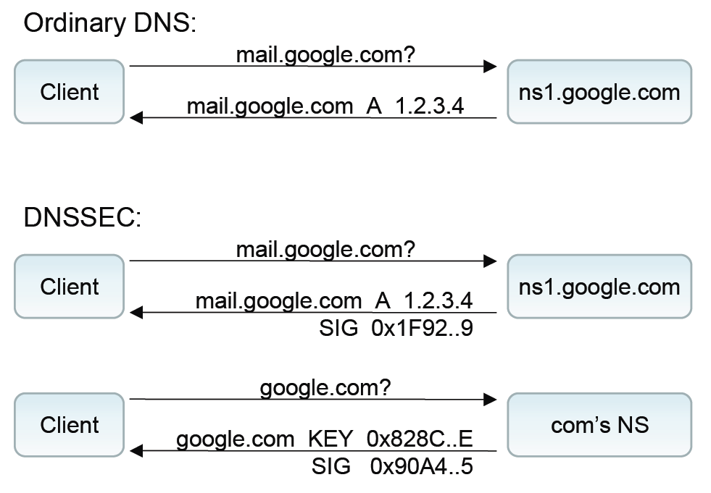

Validates this
signature
This key

Slide 35
Finally, we can validate the .com key supposedly returned by the root using our hardwired knowledge of the root’s public key this signature
Similarly, the root will return .com’s key, which will validates this signature

Slide 36
Upon completing all of these signatures validation, we have strong confidence in the chain of signatures and thus in the correctness of the mail.google.com result

Slide 37
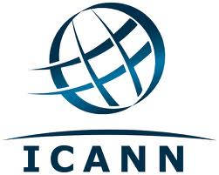
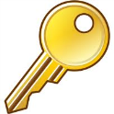
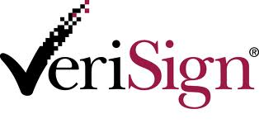
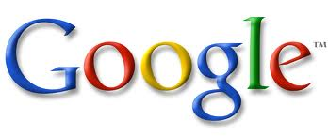
DNSSEC Chains of Trust
Root “.”
ICANN
.com
Versign
google.com
Google

Slide 38
DNSSEC Summary
DNSSEC: provides object security for DNS results
  Just integrity & authentication, not confidentiality
  No client/server setup “dialog”
  Tailored to be caching-friendly
  Underlying security dependent on trust in Root Name Server’s key …
  … plus support provided by every level of DNS hierarchy from Root to final name server… and local resolver!

Slide 39
PKI Trust Model
HTTPS
  Any CA can sign a valid cert for any domain
  CA keys are chiseled into browsers
  Revoking cert for heavily used CA would break things
DNSSEC
  Scope of trust limited
    Versign can only sign keys for domains it manages
      This is two of the root servers, .com, .net and 13 other TLDs
  Root keys are chiseled into resolvers
  Transitioning away from ICANN as root of trust would break things

Slide 40
Interesting Further Reading
Moxie Marlinspike - SSL And The Future Of Authenticity
https://en.wikipedia.org/wiki/Transport_Layer_Security
  http://convergence.io/
EFF SSL Observatory
  https://www.eff.org/observatory
slide <number>

