Slide 1

BGP Routing Security
Slides from Michael Schapira, Vitaly Shmatikov, Cristo Wilson, and David Wetherall

Slide 2
Admin
Midterm Stats
Average and Median 86
STDDEV 6
Lab 3 due next week

Slide 3
IP Routing
Routing of IP packets is based on IP addresses
32-bit host identifiers (128-bit in IPv6)
Routers use a forwarding table
Entry = destination, next hop, network interface, metric
Table look-up for each packet to decide how to route it
Routers learn routes to hosts and networks via routing protocols
Host is identified by IP address, network by IP prefix
BGP (Border Gateway Protocol) is the core Internet protocol for establishing inter-AS routes

Slide 4
Network Layer, Control Plane
Function:
Set up routes between networks
Key challenges:
Implementing provider policies
Creating stable paths
Data Plane
Application
Presentation
Session
Transport
Network
RIP
OSPF
BGP
Control Plane
Data Link
Physical

Slide 5
BGP
Border Gateway Protocol
De facto inter-domain protocol of the Internet
Policy based routing protocol
Uses a Bellman-Ford path vector protocol
Relatively simple protocol, but…
Complex, manual configuration
Policies driven by economics
How much $$$ does it cost to route along a given path?
Not by performance (e.g. shortest paths)
Entire world sees advertisements
Errors can screw up traffic globally
No authentication of announcements :(

Slide 6
Path Vector Protocol
AS-path: sequence of ASs a route traverses
Like distance vector, plus additional information
Used for loop detection and to apply policy
Default choice: route with fewest # of ASs
AS 4
120.10.0.0/16
AS 3
130.10.0.0/16
AS 5
AS 2
110.10.0.0/16
120.10.0.0/16: AS 2 → AS 3 → AS 4
130.10.0.0/16: AS 2 → AS 3
110.10.0.0/16: AS 2 → AS 5
AS 1

Slide 7


BGP Operations (Simplified)
Establish session on TCP port 179
AS-1
Exchange active routes
BGP Session
AS-2
Exchange incremental updates

Slide 8
Four Types of BGP Messages
Open: Establish a peering session.
Keep Alive: Handshake at regular intervals.
Notification: Shuts down a peering session.
Update: Announce new routes or withdraw previously announced routes.
announcement = IP prefix + attributes values

Slide 9
BGP Attributes
Attributes used to select “best” path
LocalPREF
Local preference policy to choose most preferred route
Overrides default fewest AS behavior
Multi-exit Discriminator (MED)
Specifies path for external traffic destined for an internal network
Chooses peering point for your network
Import Rules
What route advertisements do I accept?
Export Rules
Which routes do I forward to whom?

Slide 10
Route Selection Summary
Highest Local Preference
Enforce relationships
Shortest AS Path
Lowest MED
Traffic engineering
Lowest IGP Cost to BGP Egress
When all else fails,
break ties
Lowest Router ID

Slide 11
BGP Authentication
How are BGP sessions authenticated?
Shared secrets
BGP relies on transitive trust
You trust your neighbor’s routers…
Your neighbor trusts some other routers…
Etc.
Are there any guarantees that:
An advertised route is "real"?
Advertised routes aren't tampered with when forwarded?
No.
Manually configured shared secrets between routers
AS-1
BGP Session
AS-2

Slide 12
BGP Misconfiguration
Domain advertises good routes to addresses it does not know how to reach
Result: packets go into a network “black hole”
April 25, 1997: “The day the Internet died”
AS7007 (Florida Internet Exchange) de-aggregated the BGP route table and re-advertised all prefixes as if it originated paths to them
In effect, AS7007 was advertising that it has the best route to every host on the Internet
Huge network instability as incorrect routing data propagated and routers crashed under traffic

Slide 13
Goals of Today’s Lecture
BGP security vulnerabilities
Improving BGP security
Difficulty of upgrading BGP

Slide 14
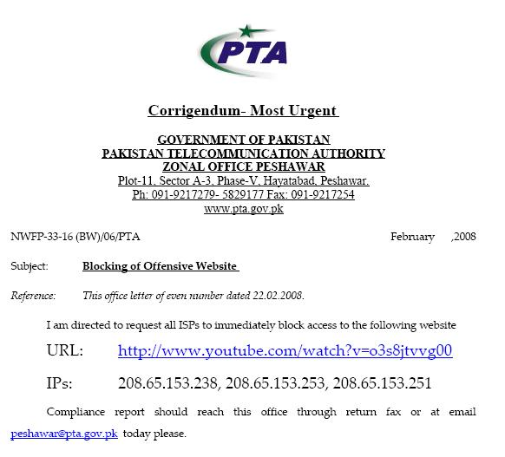
How Secure is Today’s Internet Routing?
February 2008: Pakistan Telecom hijacks YouTube!
The Internet
Pakistan
Telecom
YouTube
I’m YouTube:
IP 208.65.153.0/22
Multinet
Pakistan
Telnor
Pakistan
Aga Khan
University
Notes:
-level of autonomous systems
-e.g., YouTube, AT&T, pakistan telecom
-routing is done on IP addresses, so when someone wants to go to YouTube they get YouTube’s IP address and YouTube announces to the world that they have the ip address and traffic is forwarded towards them. So here multinet would route to it’s provider pakistan telecom that then forwards the traffic on to youtube.
-these networks chosen for a specific reason which is that there was an incident in february 2008 pakistan telecom actually high jacked traffic going to youtube (misconfiguration).
-they announced to the world that they’re youtube and traffic destined to youtube was routed to them
-youtube was unavailable for a couple of hours as operators phone each other to figure out what was going on.

Slide 15
How Secure is Today’s Internet Routing?
What should have happened…
drop packets
Pakistan
Telecom
X
YouTube
I’m YouTube:
IP 208.65.153.0/22
Multinet
Pakistan
Telnor
Pakistan
Aga Khan
University
Notes:
-level of autonomous systems
-e.g., YouTube, AT&T, pakistan telecom
-routing is done on IP addresses, so when someone wants to go to YouTube they get YouTube’s IP address and YouTube announces to the world that they have the ip address and traffic is forwarded towards them. So here multinet would route to it’s provider pakistan telecom that then forwards the traffic on to youtube.
-these networks chosen for a specific reason which is that there was an incident in february 2008 pakistan telecom actually high jacked traffic going to youtube (misconfiguration).
-they announced to the world that they’re youtube and traffic destined to youtube was routed to them
-youtube was unavailable for a couple of hours as operators phone each other to figure out what was going on.

Slide 16
How Secure is Today’s Internet Routing?
What did happen…
No, I’m YouTube!
IP 208.65.153.0/24
Pakistan
Telecom
Pakistan
Telecom
YouTube
I’m YouTube:
IP 208.65.153.0/22
Multinet
Pakistan
Telnor
Pakistan
Aga Khan
University
Notes:
-level of autonomous systems
-e.g., YouTube, AT&T, pakistan telecom
-routing is done on IP addresses, so when someone wants to go to YouTube they get YouTube’s IP address and YouTube announces to the world that they have the ip address and traffic is forwarded towards them. So here multinet would route to it’s provider pakistan telecom that then forwards the traffic on to youtube.
-these networks chosen for a specific reason which is that there was an incident in february 2008 pakistan telecom actually high jacked traffic going to youtube (misconfiguration).
-they announced to the world that they’re youtube and traffic destined to youtube was routed to them
-youtube was unavailable for a couple of hours as operators phone each other to figure out what was going on.

Slide 17
How Secure is Routing on the Internet Today? (2)
Verizon
66.174.161.0/24
Verizon
China Telecom
London Internet
Exchange
UK ISP

Slide 18

How Secure is Routing on the Internet Today? (2)
April 2010 : China Telecom intercepts traffic
This packet is destined for Verizon.
Verizon
66.174.161.0/24
Verizon
China Telecom
London Internet
Exchange
Verizon
66.174.161.0/24
(and 50k other networks)
UK ISP

Slide 19
Why Hijack?
Hijacks happen all the time, but why?
Human or software errors
Routers leak internal routes to the world
People fat finger routing entries
Censorship
Many ASs are obliged block access to specific IP ranges (e.g. Facebook, YouTube)
Sometimes these black hole routes leak to world
Spying
Easy to monitor or MiTM traffic once it’s routed through your network :)
Cybercrime
Recent incident where a prefix hijack was used to steal Bitcoins from a large mining operation

Slide 20
Hijacking Techniques
Prefix hijack
Most basic attack
Announce a prefix that the attacker doesn’t actually own
Neighbors may route traffic for the prefix to the attacker, depending on preferences and AS topology
Subprefix hijack
Most devastating type of hijack
Announce a very specific prefix (e.g. a /24)
Routing is based on longest prefix matching, so the attackers route is likely to be selected by all ASes globally
Path shortening
Announce a bogus update with very few ASes on the path
Neighbors are likely to select the bogus path because it has a short AS path

Slide 21
Prefix Hijack Example
Prefix hijacking is successful at drawing in some, but not all, of the victim’s traffic
B chooses the new, short route
A→B:
A
8.0.0.0/22
AS B
AS D
AS A
AS C
AS E
8.0.0.0/22
C continues to use the old route, since D is a customer
8.0.0.0/22
A→C:
A
8.0.0.0/22

Slide 22
Short Path Hijack
As we’ll see later, this attack is particularly useful in certain situations
B chooses the new, short route
A→B:
E, A
8.0.0.0/22
AS B
AS D
AS A
AS C
AS E
8.0.0.0/22
A→C:
E, A
8.0.0.0/22

Slide 23
Subprefix Hijack Example
Announcement for a novel subprefix is likely to propagate
/24 is more specific than /22, successfully hijacks all traffic destined for the subprefix
A→B:
A
8.0.0.0/24
AS B
AS D
AS A
AS C
AS E
8.0.0.0/24
8.0.0.0/22
A→C:
A
8.0.0.0/24
C→D:
A, C
8.0.0.0/24
D→E:
A, C, D
8.0.0.0/24

Slide 24
Mechanisms to Secure BGP
Many mechanisms have been proposed over the years
We’ll discuss three
Secure BGP (S-BGP)
RPKI and ROAs
Anomaly Detection

Slide 25
Secure BGP
Use PKI to authenticate BGP
Dual hierarchies of certificates bind prefix ownership to ASes and routers to ASes
Certificate hierarchy distributed and validated out-of-band
Routers only accept updates that are covered by valid certificates
Route attestations using “onion” signatures
Each BGP update is signed by the announcer
These signatures accumulate as the update propagates
Any AS receiving the announcement can verify the signature added by each AS back to the source

Slide 26


S-BGP vs. Subprefix Hijack Example
E → 8.0.0.0/22
PKI Server
A→B:
A
8.0.0.0/24
AS A does not own
8.0.0.0/24
AS B
AS D
AS A
AS C
AS E
8.0.0.0/24
8.0.0.0/22
A→C:
A
8.0.0.0/24
In practice, ASes download, validate, and cache the certs in the PKI ahead of time

Slide 27
S-BGP vs. Short Path Hijack
A→B:
E, A
8.0.0.0/22
{H(E’s update)}_{SEvil}
E → 8.0.0.0/22
PKI Server
AS B
AS E does own
8.0.0.0/24
AS D
AS A
AS C
AS E
8.0.0.0/22
A→B:
E, A
8.0.0.0/22
{H(E’s update)}_{SEvil}
Route attestations are forged!

Slide 28
(The Lack of) S-BGP Deployment
S-BGP was proposed at least a decade ago, and implementations were available soon afterwards
But, it was never deployed. Why?
Trust rooted in ICANN, a US organization
Other countries are wary of centralizing power in the US
Verification of signed attestations is costly in terms of CPU
Routers are expensive and resource constrained
Entire chain of attestations must be cryptographically validated for each received update
In contrast, PKI validation can be done out of band and applied using simple filters

Slide 29
Resource PKI
Resource Public Key Infrastructure (RPKI) achieves some of what S-BGP does – i.e., origin validation
RPKI prevents prefix and subprefix hijacking
But, security is optional and can be incrementally deployed
Regional Internet Registries (RIRs) publish signed attestations of prefix ownership and how those prefixes can be announced
Five RIRs: ARIN (North America), LACNIC (Latin America), APNIC (Asia and Australia), RIPE (Europe, Russia, Middle East), AfriNIC (Africa)
Attestations called Route Origin Authorizations (ROAs)
By default, RPKI does not include path attestations
Thus, RPKI is vulnerable to short path hijacks
BGPSEC is an RPKI extension that adds cryptographic path attestation back in

Slide 30
Route Origin Attestations
Route origin authorizations (ROA) bind ownership of network prefixes to ASes
ROAs also define the minimum specificity of a route announcement
e.g., 192.168.0.0/16 (min=22) → AS 7007
AS 7007 "owns" 192.168.0.0/16
Route announcements within this prefix cannot be more specific than /22

Slide 31
RPKI Hierarchy Example
ARIN
American Registry of Internet Numbers
Verizon Wireless
66.174.0.0/16
ROAs
AS 3356
8.0.0.0/9
Level 3
8.0.0.0/8
AS 6167
66.174.0.0/16
AS 22394
66.174.0.0/24
AS 15169
8.8.8.8/24
Google
8.8.8.8/24
ROAs

Slide 32
RPKI Deployment
As of January 13, 2014, 20K prefix-to-origin pairs were RPKI secured
Out of 488K prefixes that were announced that day
Roughly 4% of routes
After years of efforts we are still a long way away from cryptographically secured BGP

Slide 33
Routing Anomalies
Cryptographic attestation and verification is one approach to securing BGP (i.e. S-BGP and RPKI)
Out-of-band monitoring is another – e.g., detection of routing anomalies
Route announcements collected at many different Internet vantage points
Use heuristics to filter updates that seem suspicious
Do route announcements make sense with respect to...
Geography?
Internet topology?
AS classifications?

Slide 34
Anomalous Features
Geography
Routes should not advertise paths that "jump" across large geographical distances
e.g., a route from CA to NY that transits Russia
Topology / AS classifications
Routes should not enter and exit the Internet core (i.e., transit ASes) multiple times
Origin authenticity
Multiple ASes should not announce ownership of the same prefix

Slide 35
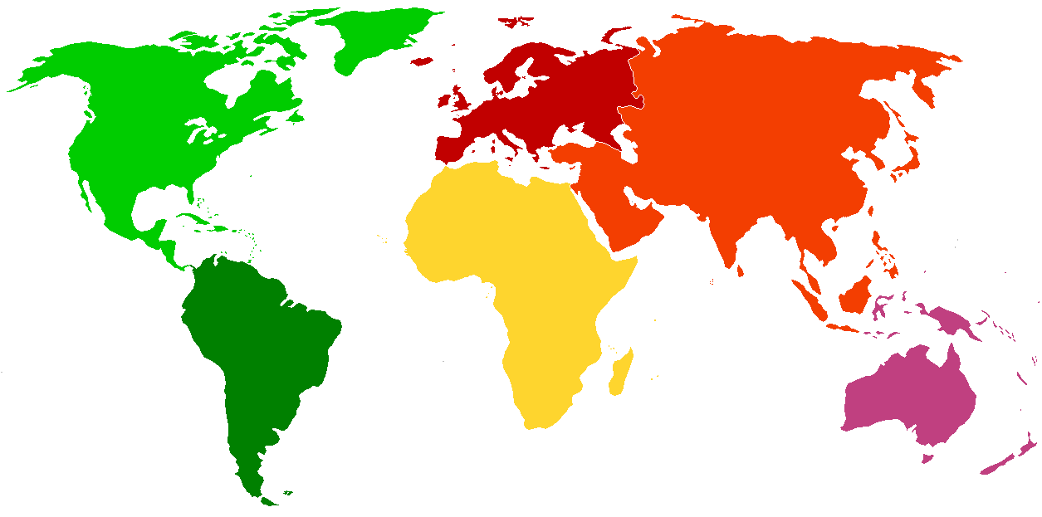

Geographic Anomaly Example
AS 17557
Pakistan Telecom
208.65.152.0/24
7700 miles
AS 36561
YouTube
208.65.152.0/22

Slide 36
Topology Anomaly Example
The A, E route doesn’t make sense
It violates the typical customer, provider relationship
It also enters the core multiple times
Transit (Tier 1) ASes
AS D
AS A
AS E
8.0.0.0/22
A→D:
A, E
8.0.0.0/22

Slide 37
Final Thoughts
DNS and BGP are crucial to the security of the Internet
Both are fundamentally insecure
Protocols lack strong (or any, in the case of BGP) authentication
Solutions exist for both, but they are not yet fully deployed
DNS is doing better than BGP, but not by much

Slide 38
One last thing… Harming Internet Routing Without Attacking BGP

Slide 39
Attacks on TCP and Data-Plane Attacks
Attack TCP!
A BGP session runs over TCP.
Do not forward traffic as advertised!
Drop packets!
Route packets along unannounced routes!

Slide 40

Control Plane Vs. Data Plane
Control plane build the table
BGP is a routing protocol
BGP security concerns validity of routing messages
I.e., did the BGP message follow the sequence of ASes listed in the AS-path attribute
Data plane
Routers forward data packets
Supposedly along the path chosen in the control plane
But what ensures that this is true?

Slide 41
Data-Plane Attacks, Part 1
Drop packets in the data plane
While still sending the routing announcements
Easier to evade detection
Especially if you only drop some packets
Like, oh, say, BitTorrent or Skype traffic
Even easier if you just slow down some traffic （no drop)
How different are normal congestion and an attack?
Especially if you let ping/traceroute packets through?

Slide 42
Data-Plane Attacks, Part 2
Send packets in a different direction to another direction, how to detect that?
Disagreeing with the routing announcements
Direct packets to a different destination
E.g., one the adversary controls
What to do at that bogus destination?
Impersonate the legitimate destination (e.g., to perform identity theft, or promulgate false information)
Snoop on the traffic and forward along to real destination
How to detect?
Traceroute? Longer than usual delays?
End-to-end checks, like site certificate or encryption?

Slide 43
Fortunately, Data-Plane Attacks are Harder
Adversary must control a router along the path
So that the traffic flows through him
How to get control a router
Buy access to a compromised router online
Guess the password
Exploit known router vulnerabilities
Insider attack (disgruntled network operator)
Malice vs. greed
Malice: gain control of someone else’s router
Greed: Verizon DSL blocks Skype to gently encourage me to pick up my landline phone to use Verizon long distance $ervice ☺

