Slide 1
Network Penetration Testing
Slides from Yatin Wadhawan, Clifford Neuman

Slide 2
DISCLAIMER
DO NOT USE THESE TOOLS AND METHODOLOGY FREELY OVER THE INTERNET. IT MAY CAUSE DAMAGE TO SOME ORGANIZATION’S CYBER INFRASTRUCTURE WHICH IS A CRIMINAL OFFENCE.THIS TUTORIAL IS JUST FOR LEARNING PURPOSE.
AUTHORS DO NOT ENCOURAGE ANY MALICIOUS ACTIVITIES.

Slide 3
Scanning
Find information about the specific IP addresses that can be accessed over the Internet, OS, accessible ports, network architecture, services running etc.
Types of scanning:
Network
Port
Vulnerability

Slide 4
Scanning (cont.)
Network Scanning
Tool to find out active host on the network
You select the range of IP addresses and start scanning over the network.
It provides the information Network devices including FTP servers and workstations.
Tools:
Advance IP scanner (Windows, Mac and Linux)
Network Mapper (Nmap, ZMap)
Nessus

Slide 5
Scanning (cont.)
Port Scanning
Tool to find out which number of ports are accessible on a server or a host.
Port scanning identifies open doors to a hosts.
Nmap classifies port in these States:
Open
Closed
Filtered
Unfiltered

Slide 6
Scanning (cont.)
Commands:
nmap ipaddress
nmap -PN ipaddress
nmap -6 ipaddress
nmap -sP ipaddress (ping scan)
nmap –open ipaddress
nmap -p T:80 ipaddress
nmap -o ipaddress

Slide 7
Scanning (cont.)
Scan examples:
TCP SYN (-sS)
Half TCP connection
UDP Scan (-sU)
Send UDP packets
TCP NULL (-sN)
Does not set any bits (TCP flag header is 0)
TCP FIN (-sF)
Sets just the TCP FIN bit
TCP Xmas (-sX)
Sets the FIN, PSH, and URG flags
OS Detection (–o)

Slide 8
Scanning (cont.)
TCP NULL (-sN)
Attacker
1. Null Packet
Victim
2. No Reply
Port Closed
Attacker
1. Null Packet
Victim
Port Open
2. RST

Slide 9
Scanning (cont.)
TCP XMAS (-sX)
1. URG + PSH + FIN
Attacker
Victim
2. No Reply
Port Open
Attacker
1. URG + PSH + FIN
Victim
Port Closed
2. RST

Slide 10
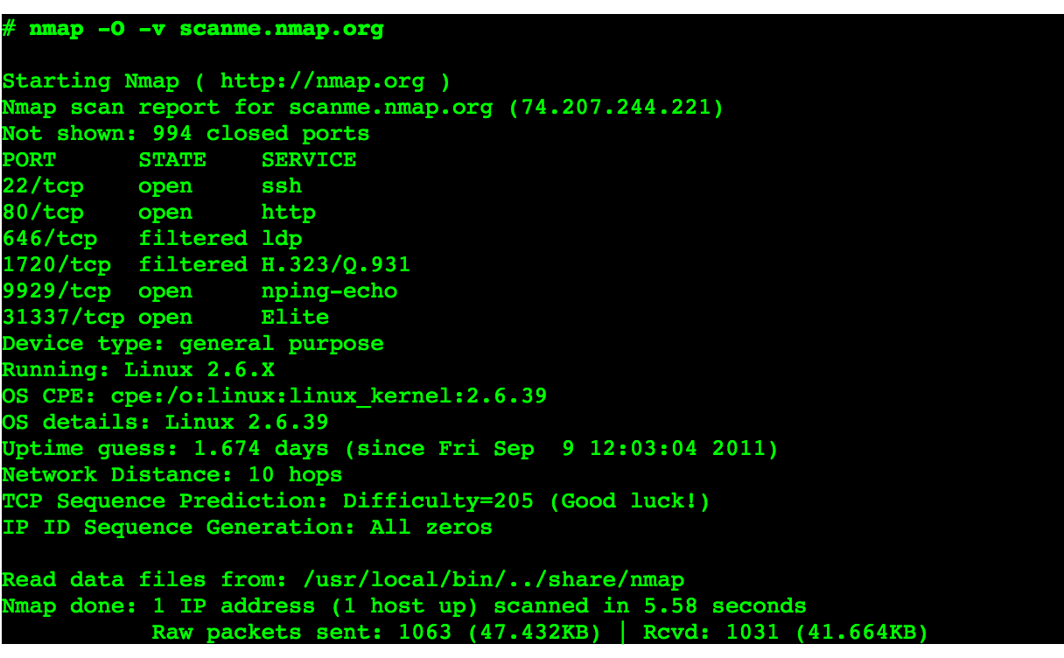
Scanning (cont.)
-O Scan
Source: https://nmap.org/book/osdetect-usage.html

Slide 11
Scanning (cont.)
Vulnerability Scanning
Once we have identified the accessible ports and services running on them, now we need to find the vulnerabilities associated with those applications.
Tools:
Web Application Acunetix, BurpSuite etc.
Network Security Nessus
Mobile Security Veracode, Tenable Security etc.
Web Goat
Insecure web application maintained by OWASP designed to teach web application security lessons.

Slide 12
Scanning (cont.)
CMS (Content Management Servers)
Popular ones are:
Drupal
WordPress
Joomla
Platforms rich in features and vulnerabilities
Open source
Some of the vulnerabilities are:
SQL Injection
Default and weak passwords
Errors reveal sensitive information
By default Directory listing

Slide 13
Scanning (cont.)
Attackers maintain a dictionary of vulnerabilities and corresponding exploits.
For example, if they find an application and its version running on a port. They know whether this version of the application is vulnerable or not. They use their dictionary to verify it.
Now we understand how to exploit the vulnerabilities.

