Slide 1
SSL/TLS
Thanks to Vitaly Shmatikov and Vern Paxson for slides

Slide 2
Admin
Lab 2 due today
Lab 3 posted soon
Midterm 1 pickup
slide <number>

Slide 3
What Is SSL / TLS?
Secure Sockets Layer and
Transport Layer Security protocols
  Same protocol design, different crypto algorithms
De facto standard for Internet security
  “The primary goal of the TLS protocol is to provide privacy and data integrity between two communicating applications”
Deployed in every Web browser; also VoIP, payment systems, distributed systems, etc.
slide <number>

Slide 4
SSL / TLS Guarantees
End-to-end secure communications in the presence of a network attacker
  Attacker completely 0wns the network: controls Wi-Fi, DNS, routers, his own websites, can listen to any packet, modify packets in transit, inject his own packets into the network
Scenario: you are reading your email from an Internet café connected via a r00ted Wi-Fi access point to a dodgy ISP in a hostile authoritarian country
slide <number>

Slide 5
History of the Protocol
SSL 1.0 – internal Netscape design, early 1994?
  Lost in the mists of time
SSL 2.0 – Netscape, Nov 1994
  Several weaknesses
SSL 3.0 – Netscape and Paul Kocher, Nov 1996
TLS 1.0 – Internet standard, Jan 1999
  Based on SSL 3.0, but not interoperable (uses different cryptographic algorithms)
TLS 1.1 – Apr 2006
TLS 1.2 – Aug 2008
slide <number>

Slide 6
SSL Basics
SSL consists of two protocols
Handshake protocol
  Uses public-key cryptography to establish several shared secret keys between the client and the server
Record protocol
  Uses the secret keys established in the handshake protocol to protect confidentiality, integrity, and authenticity of data exchange between the client and the server
slide <number>

Slide 7
SSL Handshake Protocol
Runs between a client and a server
  For example, client = Web browser, server = website
Negotiate version of the protocol and the set of cryptographic algorithms to be used
  Interoperability between different implementations
Authenticate server and client (optional)
  Use digital certificates to learn each other’s public keys and verify each other’s identity
  Often only the server is authenticated
Use public keys to establish a shared secret
slide <number>

Slide 8
Handshake Protocol Structure
ClientHello
S
C
ServerHello,
[Certificate],
[ServerKeyExchange],
[CertificateRequest],
ServerHelloDone
[Certificate],
ClientKeyExchange,
[CertificateVerify]
Finished
switch to negotiated cipher
switch to negotiated cipher
Record of all sent and
received handshake messages
Finished
slide <number>

Slide 9
ClientHello
ClientHello
S
C
Client announces (in plaintext):
Protocol version he is running
Cryptographic algorithms he supports
Fresh, random number(defend replay attack)
slide <number>

Slide 10
ClientHello (RFC)
struct {
ProtocolVersion client_version;
Random random;
SessionID session_id;
CipherSuite cipher_suites;
CompressionMethod compression_methods;
} ClientHello
Highest version of the protocol supported by the client
Session id (if the client wants to resume an old session)
Set of cryptographic algorithms supported by the client (e.g., RSA or Diffie-Hellman)
slide <number>

Slide 11
ServerHello
C, version_{c}, suites_{c}, N_{c}
S
C
ServerHello
Server responds (in plaintext) with:
Highest protocol version supported by
both the client and the server
Strongest cryptographic suite selected
from those offered by the client
Fresh, random number
slide <number>

Slide 12
ServerKeyExchange
C, version_{c}, suites_{c}, N_{c}
S
C
version_{s}, suite_{s}, N_{s},
ServerKeyExchange
Server sends his public-key certificate
containing either his RSA, or
his Diffie-Hellman public key
(depending on chosen crypto suite)
slide <number>

Slide 13
ClientKeyExchange
C, version_{c}, suites_{c}, N_{c}
S
C
version_{s}, suite_{s}, N_{s},
certificate,
“ServerHelloDone”
ClientKeyExchange
The client generates secret key material
and sends it to the server encrypted with
the server’s public key (if using RSA)
slide <number>

Slide 14
ClientKeyExchange (RFC)
struct {
select (KeyExchangeAlgorithm) {
case rsa: EncryptedPreMasterSecret;
case diffie_hellman: ClientDiffieHellmanPublic;
} exchange_keys
} ClientKeyExchange
struct {
ProtocolVersion client_version;
opaque random[46];
} PreMasterSecret
Where do random
bits come from?
Random bits from which
symmetric keys will be derived
(by hashing them with nonces)
slide <number>

Slide 15

Debian Linux (2006-08)
A line of code commented out from md_rand
  MD_Update(&m,buf,j); /* purify complains */
Without this line, the seed for the pseudo-random generator is derived only from process ID
  Default maximum on Linux = 32768
Result: all keys generated using Debian-based OpenSSL package in 2006-08 are predictable
  “Affected keys include SSH keys, OpenVPN keys, DNSSEC keys, and key material for use in X.509 certificates and session keys used in SSL/TLS connections”
slide <number>

Slide 16
“Core” SSL Handshake
C, version_{c}=3.0, suites_{c}, N_{c}
C
S
version_{s}=3.0, suite_{s}, N_{s},
certificate for PK_{s},
“ServerHelloDone”
{Secret_{c}}_{PKs} if using RSA
C and S share
secret key material (secret_{c}) at this point
switch to keys derived
from secret_{c} , N_{c} , N_{s}
switch to keys derived
from secret_{c} , N_{c} , N_{s}
Finished
Finished
slide <number>

Slide 17
SSL 2.0 Weaknesses (Fixed in 3.0)
Cipher suite preferences are not authenticated
  “Cipher suite rollback” attack is possible
Weak MAC construction, MAC hash uses only 40 bits in export mode
SSL 2.0 uses padding when computing MAC in block cipher modes, but padding length field is not authenticated
  Attacker can delete bytes from the end of messages
No support for certificate chains or non-RSA algorithms
slide <number>

Slide 18
Version Rollback Attack
C, version_{c}=2.0, suites_{c}, N_{c}
S
C
Server is fooled into thinking he is communicating with a client who supports only SSL 2.0
version_{s}=2.0, suite_{s}, N_{s},
certificate for PK_{s},
“ServerHelloDone”
{Secret_{c}}_{PKs}
C and S end up communicating using SSL 2.0
(weaker earlier version of the protocol that
does not include “Finished” messages)
slide <number>

Slide 19
Version Check in SSL 3.0
C, version_{c}=3.0, suites_{c}, N_{c}
S
C
version_{s}=3.0, suite_{s}, N_{s},
certificate for PK_{s},
“ServerHelloDone”
“Embed” version number into secret
Check that received version is equal to the version in ClientHello
{version_{c}, secret_{c}}_{PKs}
C and S share
secret key material secret_{c} at this point
switch to key derived
from secret_{c}, N_{c}, N_{s}
switch to key derived
from secret_{c}, N_{c}, N_{s}
slide <number>

Slide 20
TLS Version Rollback
POODLE attack
(October 2014)
C, version_{c}=3.0, suites_{c}, N_{c}
S
C
Server is fooled into thinking he is communicating with a client who supports only SSL 3.0
version_{s}=3.0, suite_{s}, N_{s},
certificate for PK_{s},
“ServerHelloDone”
C and S end up communicating using SSL 3.0 (deprecated but supported by everyone for backward compatibility)
Attack exploits “padding oracle” in CBC encryption mode as used by SSL 3.0 to infer the value of encrypted cookies
Many “padding oracle” attacks over the years: BEAST, CRIME, …
slide <number>

Slide 21
“Chosen-Protocol” Attacks
Why do people release new versions of security protocols? Because the old version got broken!
New version must be backward-compatible
  Not everybody upgrades right away
Attacker can fool someone into using the old, broken version and exploit known vulnerabilities
  Similar: fool victim into using weak crypto algorithms
Defense is hard: must authenticate version early
Many protocols had “version rollback” attacks
  SSL, SSH, GSM (cell phones)
slide <number>

Slide 22

Diffie-Hellman Key Establishment
Alice and Bob never met and share no secrets
Public information: p and g, where p is a large prime number, g is a generator of Z*_{p}
  Z*_{p}={1, 2 … p-1}; ∀a∈Z*_{p} ∃i such that a=g^{i} mod p
Pick secret, random X
g^{x} mod p
Pick secret, random Y
g^{y} mod p
Alice
Bob
Compute k=(g^{y})^{x}=g^{xy} mod p
Compute k=(g^{x})^{y}=g^{xy} mod p
slide <number>

Slide 23
Why Is Diffie-Hellman Secure?
Discrete Logarithm (DL) problem:
given g^{x} mod p, it’s hard to extract x
  There is no known efficient algorithm for doing this
  This is not enough for Diffie-Hellman to be secure!
Computational Diffie-Hellman (CDH) problem:
given g^{x} and g^{y}, it’s hard to compute g^{xy} mod p
  … unless you know x or y, in which case it’s easy
Decisional Diffie-Hellman (DDH) problem:
given g^{x} and g^{y}, it’s hard to tell the difference between g^{xy} mod p and g^{r} mod p where r is random
slide <number>

Slide 24
Security of Diffie-Hellman Protocol
Assuming the DDH problem is hard, Diffie-Hellman protocol is a secure key establishment protocol against passive attackers
  Eavesdropper can’t tell the difference between the established key and a random value
  Can use the established key for symmetric cryptography
    Approx. 1000 times faster than modular exponentiation
Basic Diffie-Hellman protocol is not secure against an active, man-in-the-middle attacker
  Need signatures or another authentication mechanism
slide <number>

Slide 25
TLS/SSL with Diffie-Hellman
Ciphersuite not signed
crypto suites (incl. DHE), N_{c}
C
S
DHE, N_{s},
certificate for RSA public key,
p, g, gª, sign_{RSAkey}(gª)
g^{b}
C and S share secret g^{ab} at this point
switch to derived keys
switch to derived keys
Finished
Finished
slide <number>

Slide 26
DH Downgrade by MITM
LOGJAM attack
“Export-grade” DHE, N_{c}
C
S
DHE, N_{s},
certificate for RSA public key,
p, g, gª, sign_{RSAkey}(gª)
g^{b}
C and S share secret g^{ab} at this point
“Export-grade” Diffie-Hellman:
97% of hosts use one of three 512-bit primes
With 1 week of precomputation, takes 70 seconds of real time to compute discrete log
slide <number>

Slide 27
Isn’t the Dialog Verified?
crypto suites (incl. DHE), N_{c}
C
S
DHE, N_{s},
certificate for RSA public key,
p, g, gª, sign_{RSAkey}(gª)
Do these authentication messages help?
g^{b}
C and S share secret g^{ab} at this point
switch to derived keys
switch to derived keys
Finished
Finished
slide <number>

Slide 28
More Fun With Diffie-Hellman
crypto suites (incl. DHE), N_{c}
C
S
DHE, N_{s},
certificate for RSA public key,
p, g, gª, sign_{RSAkey}(gª)
g^{b}
C and S share secret g^{ab} at this point
switch to derived keys
switch to derived keys
Validate the certificate
… then verify the signature on the DH value using the public key from the certificate
Finished
Finished
slide <number>

Slide 29



MITM Presenting Valid Certificate
Hello
I am PayPal.com
(or whoever you want me to be)
Here is PayPal’s certificate for
its RSA signing key
And here is my signed Diffie-Hellman value
Validate the certificate
… then verify the signature on the DH value using the public key from the certificate
slide <number>

Slide 30
Goto Fail
Here is PayPal’s certificate
And here is my signed Diffie-Hellman value
… verify the signature on the DH value using the public key from the certificate
if ((err = SSLHashSHA1.update(&hashCtx, &clientRandom)) != 0)
goto fail;
if ((err = SSLHashSHA1.update(&hashCtx, &serverRandom)) != 0)
goto fail;
if ((err = SSLHashSHA1.update(&hashCtx, &signedParams)) != 0)
goto fail;
goto fail;
if ((err = SSLHashSHA1.final(&hashCtx, &hashOut)) != 0)
goto fail; …
err = sslRawVerify(...);
…
fail: … return err …
???
Signature is verified here
slide <number>

Slide 31
TLS/SSL Authentication Issues
“Commercial certificate authorities protect you from anyone from whom they are unwilling to take money” – Matt Blaze, circa 2001
So how many CAs do we have to worry about, anyway?
slide <number>

Slide 32
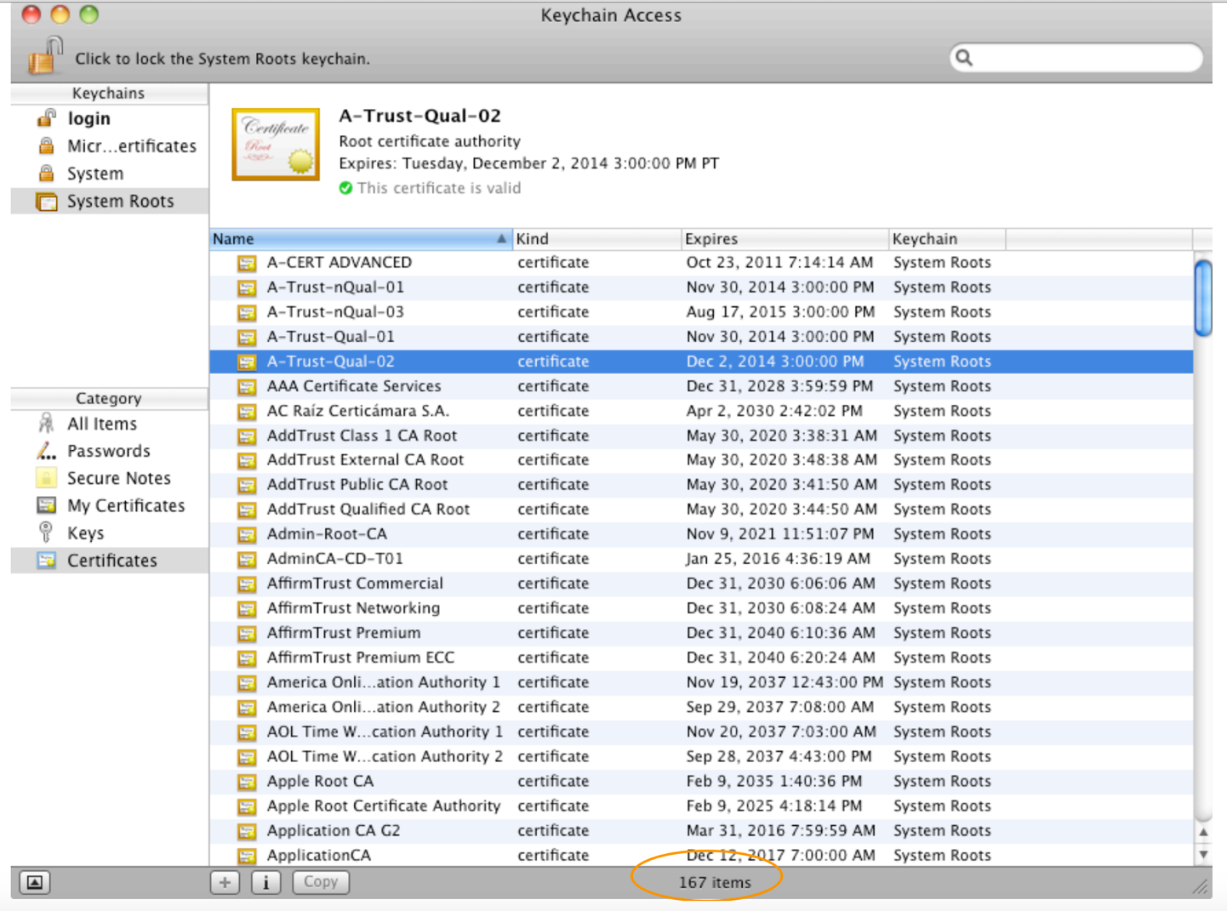
slide <number>

Slide 33
TLS/SSL Authentication Cont.
“Commercial certificate authorities protect you from anyone from whom they are unwilling to take money” – Matt Blaze, circa 2001
So how many CAs do we have to worry about, anyway?
Of course, it’s not just their greed that matters …
slide <number>

Slide 34
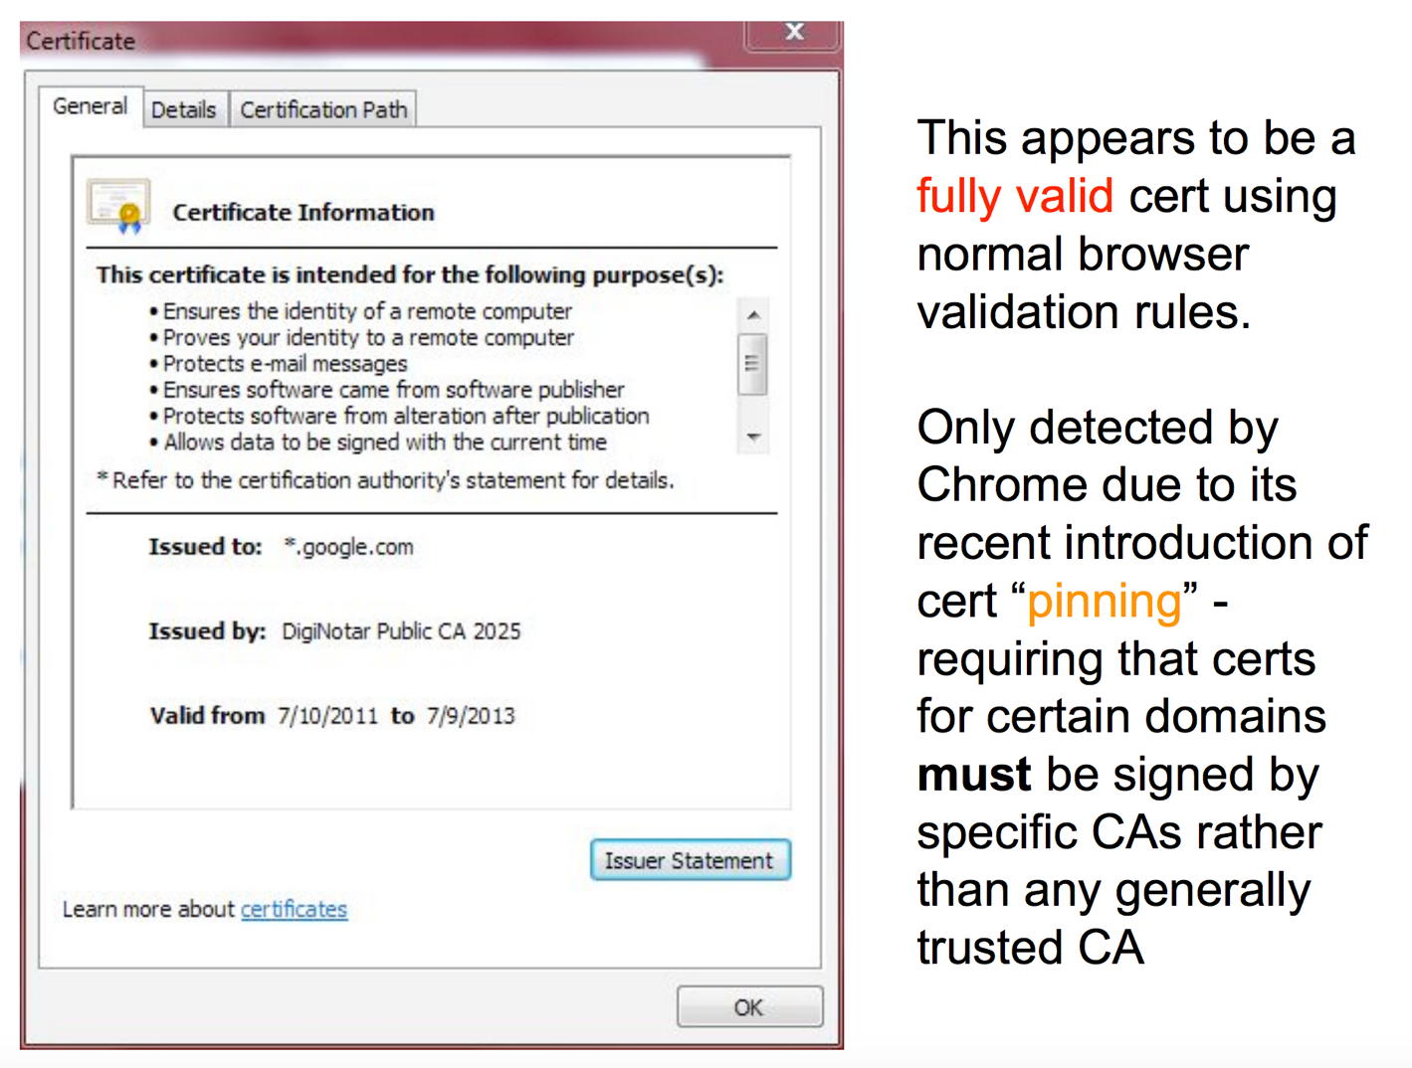
slide <number>

Slide 35
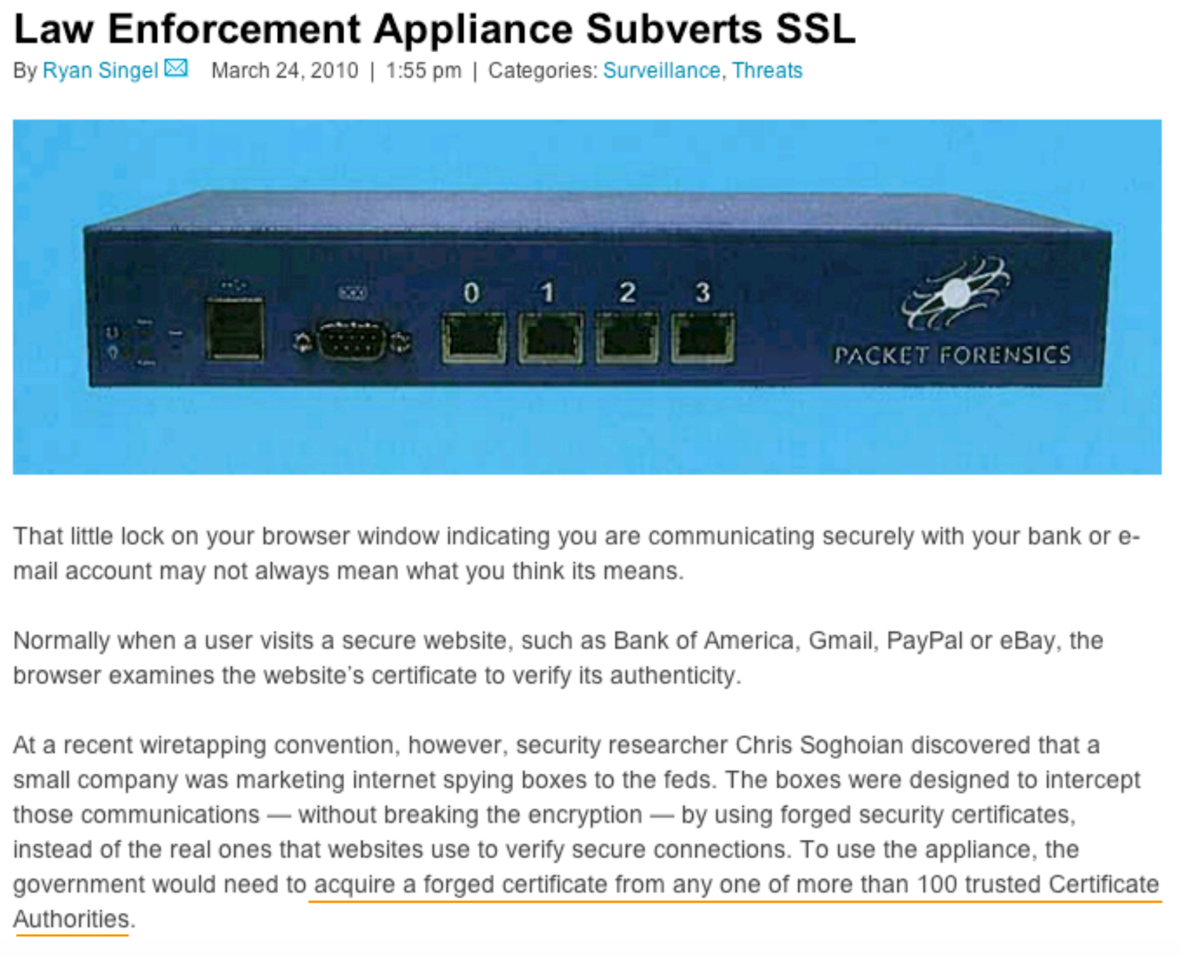
slide <number>

Slide 36
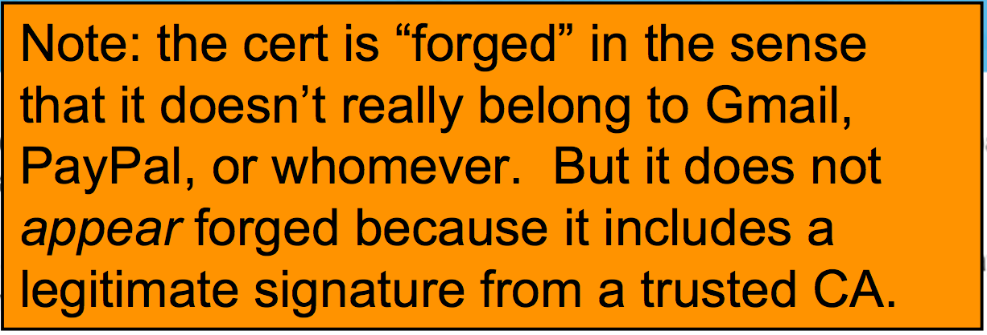
slide <number>

Slide 37
TLS/SSL Authentication Cont.
… and it’s not just their diligence & security that matters …
  “A decade ago, I observed that commercial certificate authorities protect you from anyone from whom they are unwilling to take money. That turns out to be wrong; they don't even do that much.” - Matt Blaze, circa 2010
slide <number>

Slide 38
TLS Summary
TLS: provides channel security for communication over TCP (confidentiality, integrity, authentication)
  Client & server agree on crypto, session keys
  Underlying security dependent on trust in Certificate Authorities (as well as implementors)
slide <number>

