Slide 1
802.11i Overview
Slides from Jesse Walker
Intel Corporation
jesse.walker@intel.com

Slide 2
Admin
Labs 4 and 5 will be posted soon
We will try to have the midterm graded by next week.

Slide 3
Presentation Objectives
Outline security problems in 802.11-1999
Communicate what IEEE 802.11i is and how it works

Slide 4
Agenda
What’s Wrong with WEP?
Architecture
Data Transfer
Key Management
Authentication
Security Capabilities Discovery
Other Features

Slide 5
What is it?
What’s wrong with WEP?
IEEE Std 802.11-1999 defines Wireless Equivalent Privacy (WEP)
  Protocol intended to effect “privacy”…
  …because anyone with a radio receiver can eavesdrop!
WEP’s Goals:
  Create the “privacy achieved by a wired network”
  Not a well-defined, testable goal
WEP vulnerabilities discovered; WEP broken!
  Walker (Oct 2000), Borisov et. al. (Jan 2001), Fluhrer-Mantin-Shamir (Aug 2001)

Slide 6
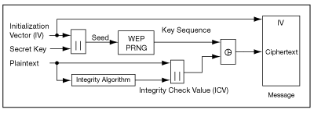
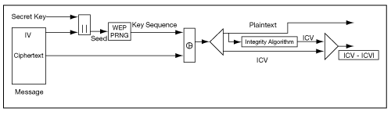
WEP
Encryption
RC4 Stream Cipher
CRC-32 Integrity checking
40 or 104-bit key
Decryption

Slide 7
WEP Insecurities
-- Initial Vector (IV) problem
RC4 Encryption = E(...), C = ciphertext, P = plaintext, k = key
C1 = P1 ⊕ E(IV, k)
C2 = P2 ⊕ E(IV, k)
then XOR ciphertext together,
C1 ⊕ C2 = (P1 ⊕ E(IV, k)) ⊕ (P2 ⊕ E(IV, k))
= P1 ⊕ P2 so knowing one plaintext will get you the other
- but usually just having the XOR of two plaintexts is good enough
XOR cancels keystream
Notes:
Can guess, eventually get all plaintext, collapsing building analogy

Slide 8
WEP Insecurities
-- Initial Vector (IV) problem
Why is IV reused?
IV only 24-bits in WEP, IV must repeat after 2^24 or ~ 16.7M packets
-practical?
-IV sent in clear with ciphertext, easy collision detection
yes, since WEP key rarely changes
yes, usually less than 16 million packets (some keys filtered)
yes, implementations make it worse
IV reset, multi-user shared key
Notes:
IV filtering can cut IV space in half

Slide 9
WEP Insecurities
-- Checksum (ICV)
CRC-32 is NOT a hash function!
Still can be malicious
Already a CRC in network stack to detect errors
Linear Properties: CRC-32(P ⊕ C) = CRC-32(P) ⊕ CRC-32(C)
- Bit flipping

Slide 10
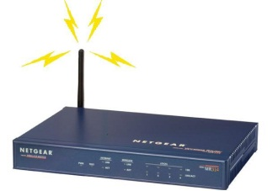
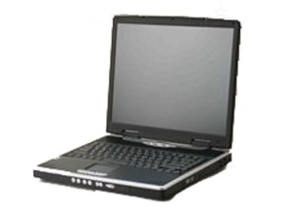
WEP Insecurities
Combining Ideas
Leads to message injection (math omitted)
WEP authentication: Challenge supplicant that they really know k.
M
(IV || M || CRC-32(M)) ⊕ E(IV,k))
-- Worthless, unless Oscar only one using network

Slide 11
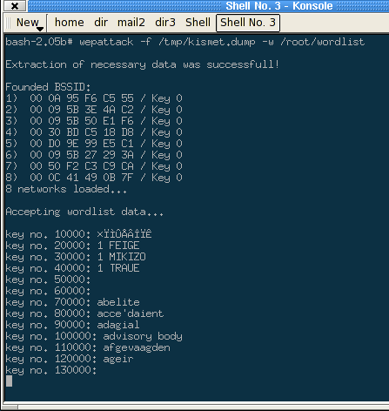
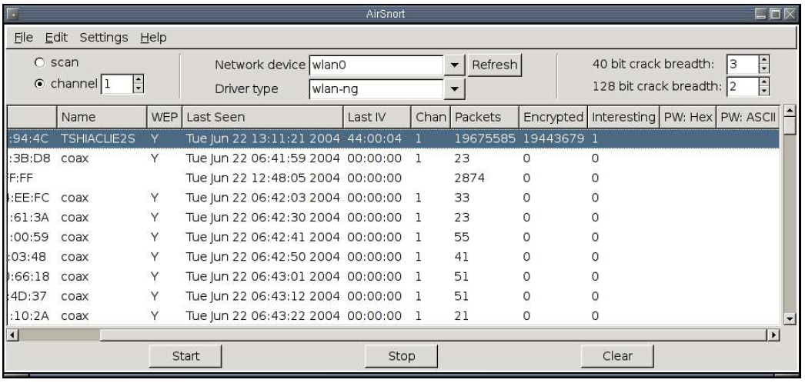
WEP Insecurities
Don’t even have to understand how WEP works!
Airsnort, WEPcrack, kismet, dwepcrack, aircrack, many others

Slide 12

Ill-defined goals = attacker success
What’s wrong with WEP?
Aims must be translated into measurable technical objectives
Doesn’t solve the right problems to achieve goals
Securing a WLAN is like securing a submarine: closing only a few of the hatches doesn’t help
If you’re not a professional, don’t indulge in crypto design
Weak Keys
IV Collisions
Message Forgery
Replay
S.S. WEP

Slide 13
Architectural Components
Architecture
Goals
EAP/802.1X/RADIUS
Operational Phases
  Discovery, Authentication, Key Management, Data transfer

Slide 14
Goals
Architecture
Replace WEP by protocol that properly uses encryption
Add data authenticity and integrity
  Decrypted data doesn’t mean anything if you don’t know who sent it
Add proper authentication
Manufacture “fresh” keys
  Can’t efficiently defeat replay without fresh keys
  Encryption harder to get right without fresh keys
Tie data link keys to the authentication
  Must prove each packet received is authorized

Slide 15

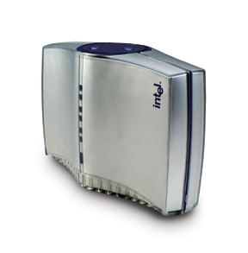

Authentication and Key Management Architecture
Architecture
Out of scope of 802.11i standard
Wireless Station
Access Point
Authentication Server
EAP-TLS
EAP
802.1X (EAPoL)
RADIUS
802.11
UDP/IP

Slide 16
802.11 Operational Phases
Architecture
Station
Access Point
Authentication Server
Security capabilities discovery
802.1X authentication
802.1X key management
RADIUS-based key distribution
Data protection

Slide 17
Purpose of each phase (1)
Architecture
Discovery
  Determine promising parties with whom to communicate
  AP advertises network security capabilities to STAs
802.1X authentication
  Centralize network admission policy decisions at the AS
  STA determines whether it does indeed want to communicate
  Mutually authenticate STA and AS
  Generate Master Key as a side effect of authentication
  Use master key to generate session keys = authorization token

Slide 18
Purpose of each phase (2)
Architecture
RADIUS-based key distribution
  AS moves (not copies) session key (PMK) to STA’s AP
802.1X key management
  Bind PMK to STA and AP
  Confirm both AP and STA possess PMK
  Generate fresh operational key (PTK)
  Prove each peer is live
  Synchronize PTK use

Slide 19
Data Transfer Overview
Data Transfer
802.11i defines 2 protocols to protect data transfer
  TKIP – for legacy devices only
  CCMP – better security for new devices
Two protocols instead of one due to politics

Slide 20
Data Transfer Requirements
Data Transfer
Never send or receive unprotected packets
Message origin authenticity — prevent forgeries
Sequence packets — detect replays
Avoid rekeying — 48 bit packet sequence number
Eliminate per-packet key – don’t misuse encryption
Protect source and destination addresses
Use one strong cryptographic primitive for both confidentiality and integrity
Interoperate with proposed quality of service (QoS) enhancements (IEEE 802.11 TGe)

Slide 21

Filtering
Data Transfer
STA
AP
Association Request
Begin filtering non-802.1X data MPDUs
Association Response
Begin filtering non-802.1X data MPDUs
EAP type specific mutual authentication
4-Way Handshake
Group Key Handshake
Allow data MPDUs protected by pairwise, group keys
Allow data MPDUs protected by pairwise, group keys

Slide 22
Replay Mechanisms
Data Transfer
48-bit IV used for replay detection
  First four bits of IV indicate QoS traffic class
  Remaining 44 bits used as counter
  Decryption/integrity check fail if traffic class bits are altered
  Sender uses single counter space, but receiver needs one for each traffic class
AES with CCM or OCB authenticated encryption
  CCM is mandatory, and OCB is optional
  Header authentication
  Payload authentication and confidentiality

Slide 23
CCMP
Data Transfer
Mandatory to implement: the long-term solution
Based on AES in CCM mode
  CCM = Counter Mode Encryption with CBC-MAC Data Origin Authenticity
  AES overhead requires new AP hardware
  AES overhead may require new STA hardware for hand-held devices, but not PCs
An all new protocol with few concessions to WEP
Protects MPDUs = fragments of 802.2 frames

Slide 24
Counter Mode with CBC-MAC
Data Transfer
Authenticated Encryption combining Counter (CTR) mode and CBC-MAC, using a single key
  Assumes 128 bit block cipher – IEEE 802.11i uses AES
Designed for IEEE 802.11i
  By D. Whiting, N. Ferguson, and R. Housley
  Intended only for packet environment
  No attempt to accommodate streams

Slide 25
CCM Mode Overview
Data Transfer
Encrypted
Header
Payload
MIC
Authenticated
Use CBC-MAC to compute a MIC on the plaintext header, length of the plaintext header, and the payload
Use CTR mode to encrypt the payload
  Counter values 1, 2, 3, …
Use CTR mode to encrypt the MIC
  Counter value 0

Slide 26
CCM Properties
Data Transfer
CTR + CBC-MAC (CCM) based on a block cipher
CCM provides authenticity and privacy
  A CBC-MAC of the plaintext is appended to the plaintext to form an encoded plaintext
  The encoded plaintext is encrypted in CTR mode
CCM is packet oriented
CCM can leave any number of initial blocks of the plaintext unencrypted
CCM has a security level as good as other proposed combined modes of operation, including OCB
  In particular, CCM is provably secure

Slide 27
CCM Usage by CCMP
Data Transfer
Needs one fresh 128-bit key
  Same 128-bit Temporal key used by both AP and STA
  CBC-MAC IV, CTR constructions make this kosher
Key configured by 802.1X
CCMP uses CCM to
  Encrypt packet data payload
  Protect packet selected header fields from modification

Slide 28
Long-term Solution Summary
Data Transfer
Builds on the lessons learned from IEEE 802.10 and IPsec packet protocol designs
  Relies on proper use of strong cryptographic primitives
Strong security against all known attacks
Requires new hardware

Slide 29
802.1X Key Management
Key Management
802.11i data protocols fail without “fresh” keys
Want to use 802.1X framework
Original 802.1X key management hopelessly broken, so redesigned by 802.11i
New model:
  Derive a Pairwise Master Key (PMK)
  AP and STA use PMK to derive Pairwise Transient Key (PTK)
  Use PTK to protect the link
Limitations:
  No explicit binding to earlier association, authentication
    Relies on temporality, PMK freshness for security
  Keys are only as good as back-end allows

Slide 30
Pairwise Key Hierarchy
Key Management
Master Key (MK)
Pairwise Master Key (PMK) = TLS-PRF(MasterKey, “client EAP encryption” | clientHello.random | serverHello.random)
Pairwise Transient Key (PTK) = EAPoL-PRF(PMK, AP Nonce | STA Nonce | AP MAC Addr | STA MAC Addr)
Analog of the WEP key
Key Confirmation Key (KCK) – PTK bits 0–127
Key Encryption Key (KEK) – PTK bits 128–255
Temporal Key – PTK bits 256–n – can have cipher suite specific structure

Slide 31
Key Management Overview
Key Management
STA
AS
AP
Step 1: Use RADIUS to push PMK from AS to AP
Step 2: Use PMK and 4-Way Handshake to derive, bind, and verify PTK
Step 3: Use Group Key Handshake to send GTK from AP to STA

Slide 32
Step 1: Push PMK to AP
Key Management
RADIUS: not worth talking about…

Slide 33
Step 2: 4-Way Handshake
Key Management
AP
STA
PMK
PMK
Pick Random ANonce
EAPoL-Key(Reply Required, Unicast, ANonce)
Pick Random SNonce, Derive PTK = EAPoL-PRF(PMK, ANonce | SNonce | AP MAC Addr | STA MAC Addr)
EAPoL-Key(Unicast, SNonce, MIC, STA RSN IE)
Derive PTK
EAPoL-Key(Reply Required, Install PTK, Unicast, ANonce, MIC, AP RSN IE)
EAPoL-Key(Unicast, MIC)
Install TK
Install TK

Slide 34
Step3: Group Key Handshake
Key Management
AP
STA
PTK
PTK
Pick Random GNonce, Pick Random GTK
Encrypt GTK with KEK
EAPoL-Key(All Keys Installed, ACK, Group Rx, Key Id, Group , RSC, GNonce, MIC, GTK)
Decrypt GTK
EAPoL-Key(Group, MIC)
unblocked data traffic
unblocked data traffic

Slide 35
Key Management Summary
Key Management
4-Way Handshake
  Establishes a fresh pairwise key bound to STA and AP for this session
  Proves liveness of peers
  Demonstrates there is no man-in-the-middle between PTK holders if there was no man-in-the-middle holding the PMK
  Synchronizes pairwise key use
Group Key Handshake provisions group key to all STAs

Slide 36
Authentication Requirements
Authentication
Want key tied back to authorization decision
Establish a session between AS and STA
Establish a mutually authenticated session key shared by AS and STA
  Session ⇒ key is fresh
  Mutually authenticated ⇒ bound only to AS and STA
Defend against eavesdropping, man-in-the-middle attacks, forgeries, replay, dictionary attacks against either party
  Cannot expose non-public portions of credentials
Identity protection not a goal
  Can’t hide the MAC address

Slide 37
Authentication Components
Authentication
Wireless Station
Access Point
Authentication Server
EAP-TLS
EAP
802.1X (EAPoL)
RADIUS
802.11
UDP/IP

Slide 38
Authentication Overview
Authentication
STA
AP
AS
STA 802.1X blocks port for data traffic
AP 802.1X blocks port for data traffic
802.1X/EAP-Request Identity
802.1X/EAP-Response Identity (EAP type specific)
RADIUS Access Request/Identity
EAP type specific mutual authentication
Derive Pairwise Master Key (PMK)
Derive Pairwise Master Key (PMK)
RADIUS Accept (with PMK)
802.1X/EAP-SUCCESS
802.1X
RADIUS

Slide 39
Digging Deeper: EAP (1)
Authentication
EAP = Extensible Authentication Protocol
  Defined in RFC 2284
  Being revised due to implementation experience and poor specification (rfc2284bis)
Developed for PPP, but 802.1X extends EAP to 802 LANs
Design goal: allow “easy” addition of new authentication methods
  AP need not know about new authentication method
  Affords great flexibility
EAP is a transport optimized for authentication, not an authentication method itself
  Relies on “concrete” methods plugged into it for authentication

Slide 40
Digging Deeper: EAP (2)
Authentication
Eases manageability by centralizing
  Authentication decisions
  Authorization decisions
Well matched economically to 802.11:
  Minimizes AP cost by moving expensive authentication to AS
  AP unaware of the authentication protocol
EAP supports “chained” authentications naturally
  First do mutual authentication of devices, then user authentication, etc…
  … so well suited to multi-factor authentication

Slide 41
Digging Deeper: EAP (3)
Authentication
AS initiates all transactions
  Request/Response protocol
  STA can’t recover from AS or AP problems
  This affords AS with limited DoS attack protection
AS tells the STA the authentication protocol to use
  STA must decline if asked to use weak methods it can support
AS sends EAP-Success to STA if authentication succeeds
  STA breaks off if AS authentication fails
AS breaks off communication if authentication fails

Slide 42
Digging Deeper: EAP (4)
Authentication
EAP provides no cryptographic protections
  No defense against forged EAP-Success
  Relies on concrete method to detect all attacks
  No cryptographic binding of method to EAP
No strong notion of AS-STA binding
  “Mutual” authentication and binding must be inherited from concrete method
Legacy 802.1X has no strong notion of a session
  EAP’s notion of session problematic, very weak, implicit
  Relies on session notion within concrete method
  Key identity problematic
  802.11i fixes some of this (see key management discussion below)

Slide 43
802.1X
Authentication
Defined in IEEE STD 802.1X-2001
Simple
  Simple transport for EAP messages
  Runs over all 802 LANs
  Allow/deny port filtering rules
Inherits EAP architecture
  Authentication server/AP (aka “Authenticator”)/STA (aka “Supplicant”)

Slide 44
Digging Deeper: EAP-TLS
Authentication
EAP-TLS is not part of 802.11i; neither is any other specific authentication method
But EAP-TLS is the de facto 802.11i authentication method
  Can meet all 802.11i requirements
  Other widely deployed methods do not
EAP-TLS = TLS Handshake over EAP
  EAP-TLS defined by RFC 2716
  TLS defined by RFC 2246
Always requires provisioning AS certificate on the STA
Mutual authentication requires provisioning STA certificates

Slide 45
Example –EAP-TLS (1)
Authentication
STA
AP
AS
AP-RADIUS Key
802.1X/EAP-Request Identity
802.1X/EAP-Response Identity (My ID)
RADIUS Access Request/EAP-Response Identity
RADIUS Access Challenge/EAP-Request
802.1X/EAP-Request(TLS)
802.1X/EAP-Response(TLS ClientHello(random₁))
RADIUS Access Request/EAP-Response TLS ClientHello
802.1X/EAP-Request(TLS ServerHello(random₂) || TLS Certificate || TLS CertificateRequest || TLS server_key_exchange || TLS server_done)
RADIUS Access Challenge/EAP-Request

Slide 46
Example – EAP-TLS (2)
Authentication
AS
STA
AP
AP-RADIUS Key
MasterKey = TLS-PRF(PreMasterKey, “master secret” || random₁ || random₂)
802.1X/EAP-Response(TLS client_key_exchange || TLS || TLS certificate || TLS certificateVerify || TLS change_cipher_suite || TLS finished
RADIUS Access Request/EAP-Response
802.1X/EAP-Request(TLS change_cipher_suite || TLS finished)
RADIUS Access Challenge/EAP-Request
802.1X/EAP-Response
RADIUS Access Request/EAP-Response Identity
PMK = TLS-PRF(MasterKey, “client EAP encryption” || random₁ || random₂)
RADIUS Accept/EAP-Success, PMK
802.1X/EAP-Success

Slide 47
Authentication Summary
Authentication
At the end of authentication
  The AS and STA have established a session if concrete EAP method does
  The AS and STA possess a mutually authenticated Master Key if concrete EAP method does
    Master Key represents decision to grant access based on authentication
  STA and AS have derived PMK
    PMK is an authorization token to enforce access control decision
  AS has distributed PMK to an AP (hopefully, to the STA’s AP)

Slide 48
Discovery Overview
Security Capabilities Discovery
Security no good unless you can find networks with “right” characteristics
AP advertises capabilities in Beacon, Probe Response
  SSID in Beacon, Probe provides hint for right authentication credentials
    Performance optimization only; no security value
  RSN Information Element advertises
    All enabled authentication suites
    All enabled unicast cipher suites
    Multicast cipher suite
STA selects authentication suite and unicast cipher suite in Association Request

Slide 49
Discovery
Security Capabilities Discovery
Station
Access Point
Probe Request
Probe Response + RSN IE (AP supports CCMP Mcast, CCMP Ucast, 802.1X Auth)
802.11 Open System Auth
802.11 Open Auth (success)
Association Req + RSN IE (STA requests CCMP Mcast, CCMP Ucast, 802.1X Auth)
Association Response (success)

Slide 50
Discovery Summary
Security Capabilities Discovery
At the end of discovery
  STA knows
    The alleged SSID of the network
    The alleged authentication and cipher suites of the network
    These allow STA to locate correct credentials, instead of trial use of credentials for every network
  The AP knows which of its authentication and cipher suites the STA allegedly chose
  A STA and an AP have established an 802.11 channel
  The associated STA and AP are ready to authenticate

Slide 51

Pre-shared Key
Other Features
Wireless Station
PSK, used directly as a PMK
AP
802.11 security capabilities discovery
Enhanced 802.1X key mgmt (no authentication)
CCMP, WRAP, or TKIP

Slide 52
802.11i Summary
New 802.11i data protocols provide confidentiality, data origin authenticity, replay protection
These protocols require fresh key on every session
Key management delivers keys used as authorization tokens, proving channel access is authorized
Architecture ties keys to authentication

