Slide 1

PhD Application Review System
Ruby off the Rails
Meetansh Gupta
Shreyas Kasetty
Brian Munoz
Tanay Patankar
Francesco Romano
Ruofei Xu
CSCE 606

Slide 2
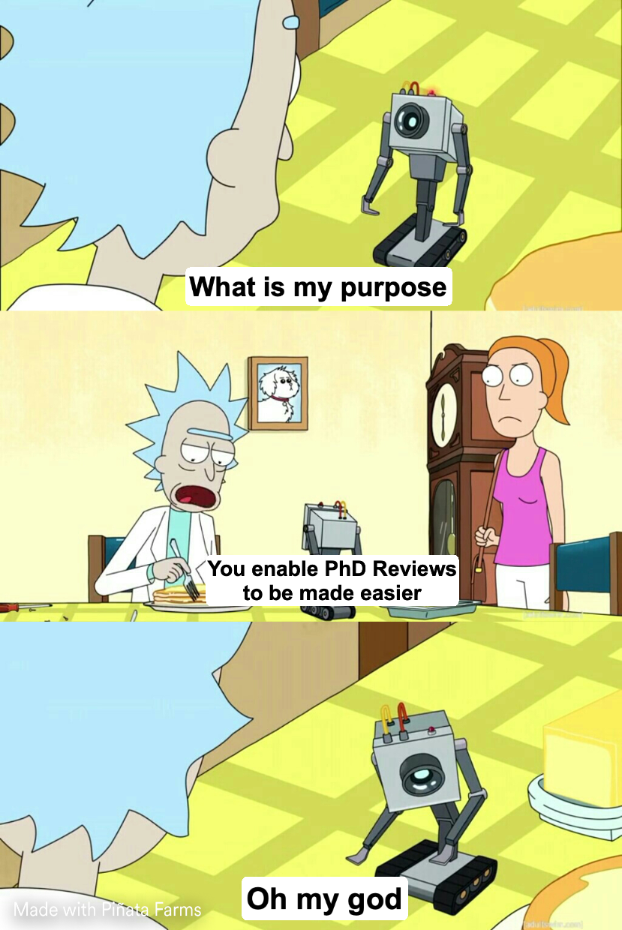
What Problem Did We Solve?
Our client is Dr. K Nguyen on behalf of the Department of Computer Science and Engineering at Texas A&M University.
The current PhD Application Review Process is done using Google Sheets, which is embarrassing.
Thus, a professional system for tracking, searching, and reviewing applicants was requested.

Slide 3
Design Specifications
The ideal system enables:
Login using TAMU credentials via google.
View and search for any Phd Applications with any of the applicant’s information.
Review all information for a given applicant
Submit reviews including a rating (1-5) and recommendation for assistantship.
The Committee chair to
Assign applications to faculty members automatically
Revise assignments as they see fit

Slide 4
Challenges Faced and Overcome
Ferpa Compliance
Restricted personal information needs to be encrypted.
Solution was to create back end app to be run on secure server.
Front and back end communicate via authenticated API calls.
Database Flexibility
Need to support variable headers in uploaded data files
If there were ambiguous conflicts, the upload needs to request user clarification.
Entire code base had to be refactored

Slide 5
Our Learning Experience
Ruby on Rails
Use for web development
Extensive Testing on Rails
Test driven development
Secure API Design
JWT authentication
Database Design
Enabling flexibility without repeated migrations
Heroku Deployment
Live app and scalable deployment

