Slide 1
Cyclistic Bike-Share
Comparing Memberships & Casual Riders
Presented By: Ruby Smith
Last Updated: 10/09/2024
Notes:
Good Morning, my name is Ruby, I am a junior analyst for the marketing team here at Cyclistic Bike-Share. We are meeting to discuss some marketing ideas to increase the annual memberships. Today we will be looking at my findings after analyzing the data from September 2023 - August 2024.

Slide 2
Table of Contents
Introduction
Objective
Periodically Analyzed
Difference in Trip Times
Popular Bike Stations
Conclusion
Recommendations
Appendix
Notes:
Here is a quick overview of what we will be talking about today. At the end of each slide, if you have any questions, please feel free to ask.

Slide 3
Introduction
Cyclistic Ride-Share would like to increase revenue by maximizing the number of annual memberships. Can we compare and contrast Cyclistic riders to see any trends that are beneficial in this goal?
Notes:
Maximizing annual memberships will help with the success of the company. If we want to maximize our memberships, we need to understand casual riders and their trends to market to them properly. I’ve been tasked to analyze the differences between Cyclistic bike riders – annual membership riders and casual riders. I’ve spent the last week analyzing over 5.5 million rows of data. I’ve come up with a few ideas based on what I have found and I’m here to share that with you.

Slide 4
Objective
Compare and contrast membership riders with casual riders periodically.
Aggregate and analyze the number of riders and their trip times.
Compare popular stations geographically.
Notes:
When thinking about the question “How do annual members and casual riders use Cyclistic bikes differently?”, I knew since I had a years worth of data, I could break it down periodically. I wondered if there would be any trends in different months, especially since Chicago has a harsher winter with cold temperatures and snow right along the Great Lakes. This made me think of seasonal trends or different days of the week. I broke it down into a few different periodical categories.
I began aggregating my data separating the annual membership riders from the casual riders and looking at total numbers and breaking those down. I calculated the time of every trip taken to analyze any trends. I had latitude and longitude values so I wanted to map out different popular bike stations and see if there were any trends as well.

Slide 5
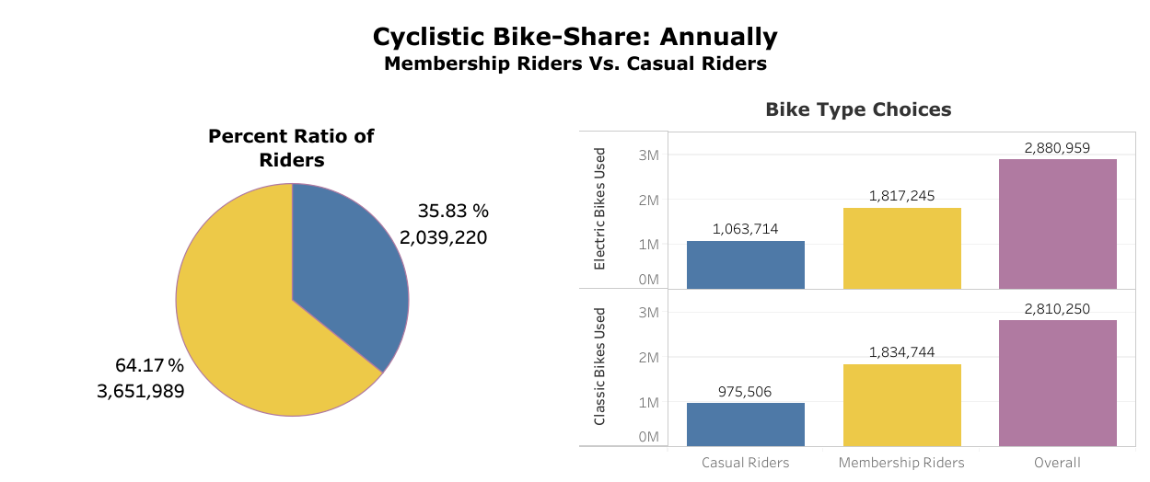
September 2023 - August 2024
Riders with annual memberships account for about 65% of all rides
No correlation with bike types
Notes:
(Wait 5 seconds to take in visual then talk about chart) I wanted to start by breaking down those 5.5 million trips into who took those trips. I saw that during Sept - Aug, 65% of Cyclistic riders had an annual membership and about 35% were casual users who rented bikes each time they used them. There are two bike choice options, the classic, manual bike, and the electric bike. There was no significant difference in choice but a slight preference in electric bikes for casual riders. I did break down bike type more periodically but the results were the same.

Slide 6
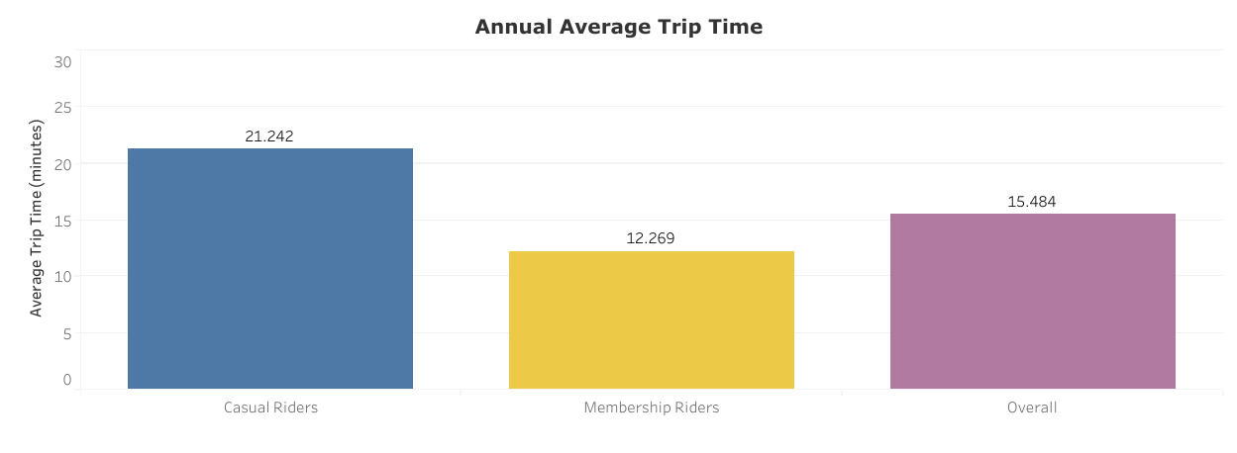
Average Minutes per Trip
Casual riders annually have a 9 minute higher average than riders with annual memberships.
Notes:
(Wait 5 seconds to take in visual then talk about chart) I wanted to understand if there were any trends in the length of time of each trip. I looked at the average time of each trip and notice that on an annual basis casual riders rode their bikes an average of 9 minutes more each trip compared to membership riders. Riders with annual memberships only rode for a little over 10 minutes whereas casual riders tend to ride 20 min at a time on average. (I feel that if members are averaging only a little over 10 minutes, then more riders are using it for shorter distance destinations. I think of jobs possibly, visiting people, running errand, school, etc. Casual riders are averaging a little over 20 minutes so they take longer bike rides. I think of exercising, site-seeing, school, visiting people, etc.)

Slide 7
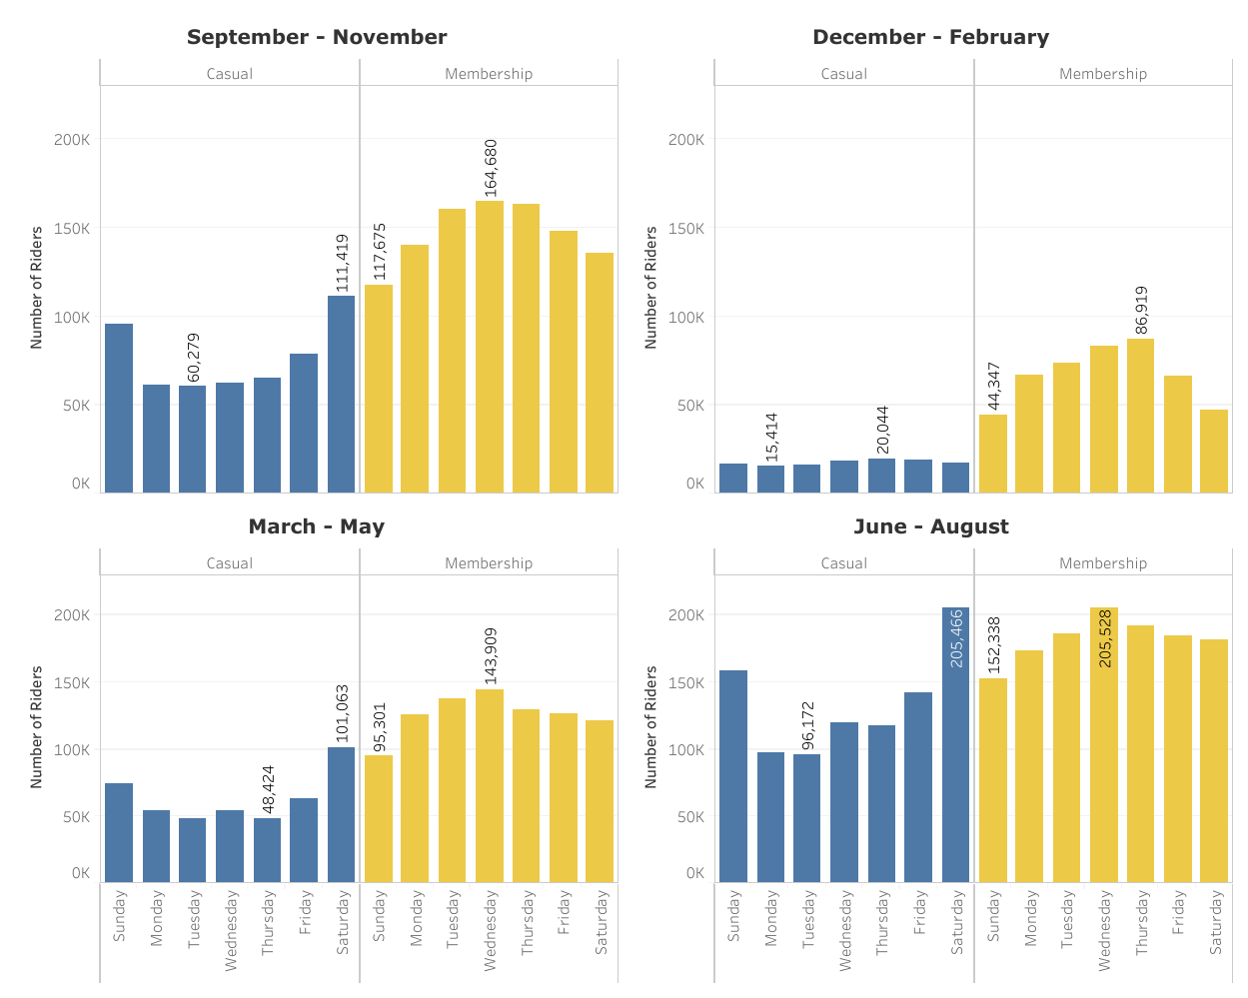
Quarterly
Counts
Each Quarter breaks down seasonally
Why is there a drastic drop in casual riders in winter months?
Members use bikes more on the weekdays, not the weekends.
Notes:
(Wait 5 seconds to take in visual then talk about chart) When separating my year into quarters, I noticed each quarter nicely fit into each season for the most part – Fall, Winter, Spring, and Summer. I have organized each quarter into days of the week as well to see if there were any differences. I noticed throughout the year riders with annual memberships use Cyclistic Bike-Share service throughout the week more and casual riders keep the weekends busier. December - February, during the coldest months, is the slowest quarter with the least amount of trips taken. Casual trips taken are very low and there is a decrease in annual membership trips as well. June - August , the warmest months, are when most riders take trips. Casual trips are a very high during the weekends and higher during the weekdays. Membership trips taken are at the highest during the summer quarter. (After looking at some geographic data, I wanted to break things down into quarters, I was able to organize by season too and I am glad I did. Fall seems busy, Winter is DEAD, Spring its picking back up, and summer if full blown busy. I wonder why its dead in the winter for casuals and why its extra busy on weekends for casuals. It being busier on weekdays also solidifies members using services more for job or school needs. Something more routine. I wonder if less people exercise outdoors in the winter or if its something else that has numbers way down in casuals)

Slide 8
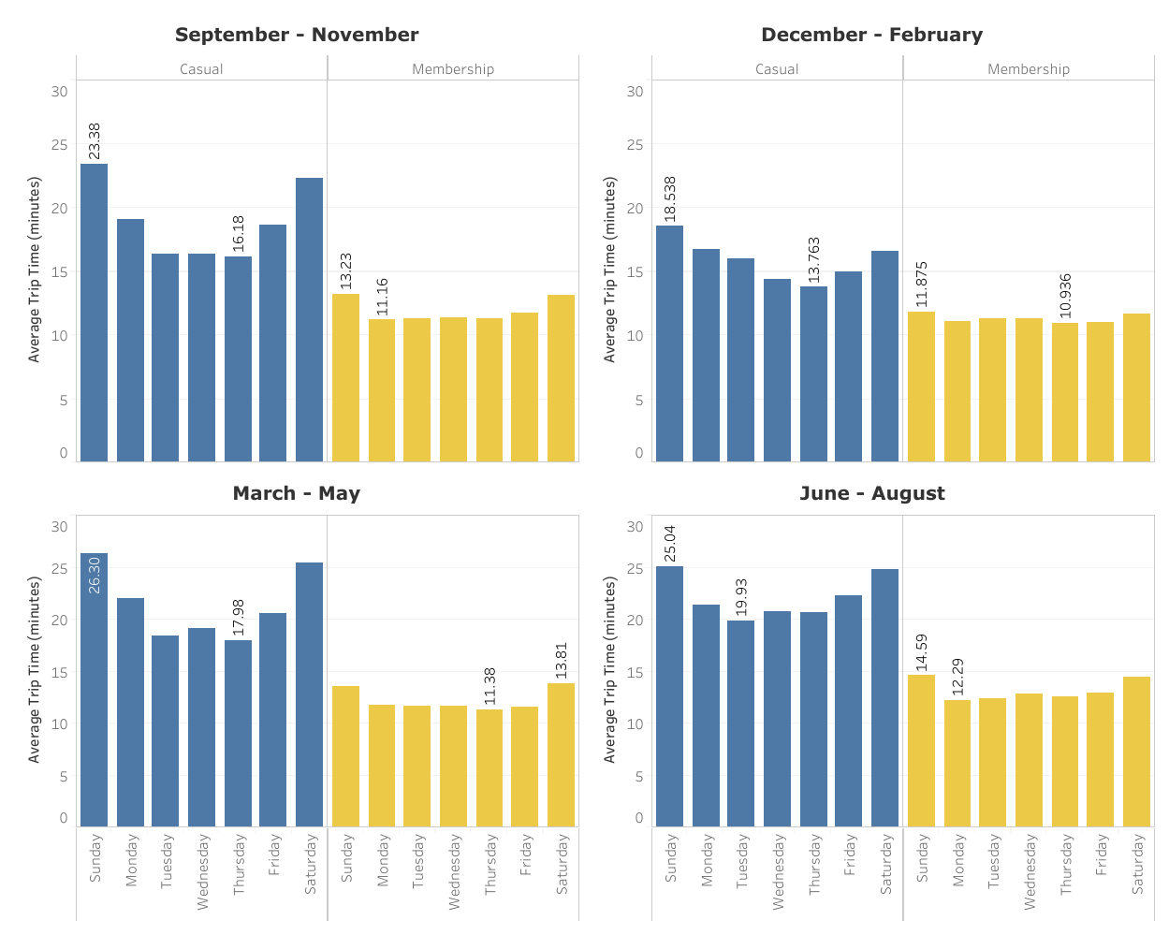
Quarterly
Average
Each Quarter breaks down seasonally
Riders with annual memberships have a steady average
Casual riders use bikes longer periods of time.
Notes:
(wait 5 seconds to take in visual then talk about chart) Also quarterly, I again looked at average length of time of each trip. Knowing that Dec - Feb was the least busy quarter and June - August was the most busy quarter, I wanted to see if there were any differences in trip time. Membership riders average trip time stays about the same throughout the whole year whereas casual riders decrease trip time in the winter months and increase trip time in the summer months. (Seeing quarterly average broken down again solidifies my feel for members using the bikes for more routine things, it remains the same all year long. Casuals basically stays the same with a slight decrease in average in the winter months)

Slide 9
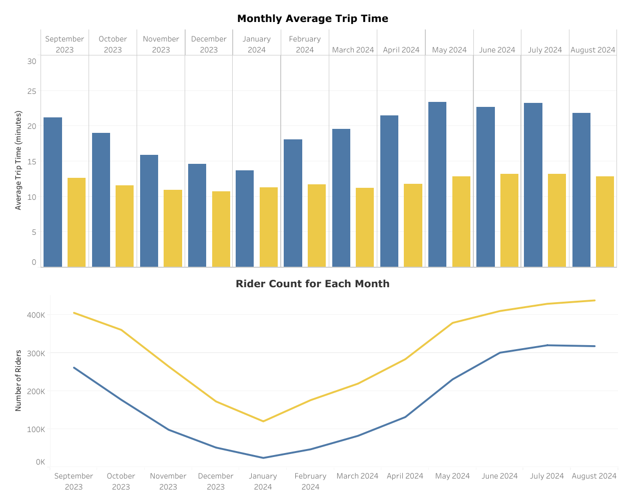
Monthly
Differences
Riders with annual memberships ride on average ~12 min throughout the year
Bike rentals follow the seasons, decrease in winter months.
Is there anything different about casuals in the winter?
Notes:
(wait 5 seconds to take in visual then talk about chart) We are looking at each month separately here. As you can see riders with annual memberships on average take trips that are about ~12 min throughout the year, it doesn’t fluctuate too much. Casual riders on average take longer bike trips than membership riders. Their average starts around 20 min or above most of the year. It does drop down Nov - Feb, but we did notice that when broke it down by quarter as well. We also noticed that there were more trips taken in the summer and less in the winter. We can see that the trend follows through smoothly when broken down each month. (I feel bike rentals follow the seasons whether riders have a membership or not. I still feel that people with memberships are using bike rentals more on a routine and going less distance and casuals use bikes less on routine or for exercise and go longer distances.)

Slide 10
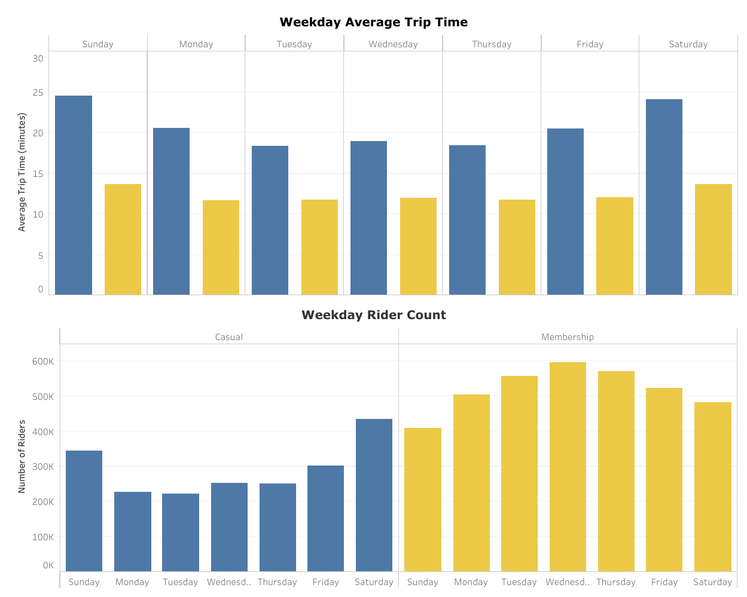
By the
Weekday
Membership riders maintain average time all week and take more trips during weekdays
Casual riders have a higher average than members, are busier on the weekend, and take more trips on the weekend.
Notes:
(Wait 5 seconds to take in visuals then talk about chart) I separated data on a weekly basis and right away noticed that no matter the day, annual membership riders maintain their average trip time. They keep to between 10 - 15 minutes but their are significantly more riders during the weekday than compared to the weekend. Casual riders, on the other hand, have a higher average trip time on the weekend and maintain a higher average trip time every day of the week when compared to members. Casual riders are more prominent on the weekend and less active on weekdays. (When I look at the data over a weekly basis, I feel that membership riders cover the weekdays and the weekends pretty fully. I hypothesize that these membership riders use rentals to get to work or school on weekdays and use it on the weekends for jobs or exercise. I hypothesize that casual riders use rentals more for exercising or doing things that are further distances away.)

Slide 11
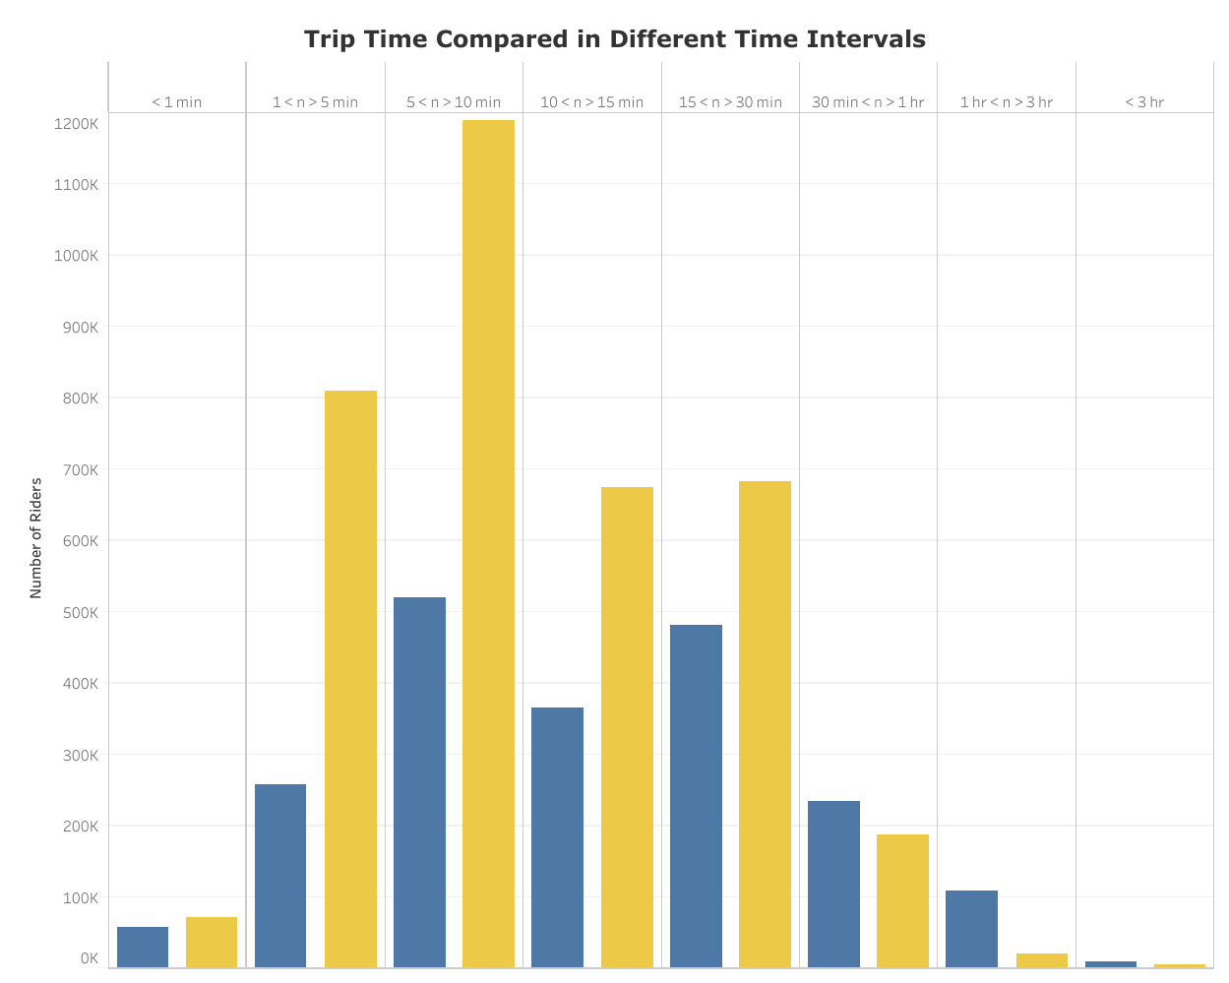
Comparing Trip Time
Most membership riders take quick trips
Casual riders take quick trips and longer trips
More casual riders ride longer than an hour than membership riders
Notes:
(Wait 5 seconds to take in visuals then talk about chart) I decided to separate the ride count into different time intervals. The majority of membership ride time is between 1-5 min and 5-10 min whereas the majority of casual ride time is between 5-10 min and 15-30 min. There is also a larger number of casual riders who have taken bike rides over 1 hr than member riders. (When breaking it down like this, you can see that majority of riders with memberships use if for short periods of time. There are a good amount of casuals that have the same ~10 min average, but why are there more casuals percentage wise having longer trip times?)

Slide 12
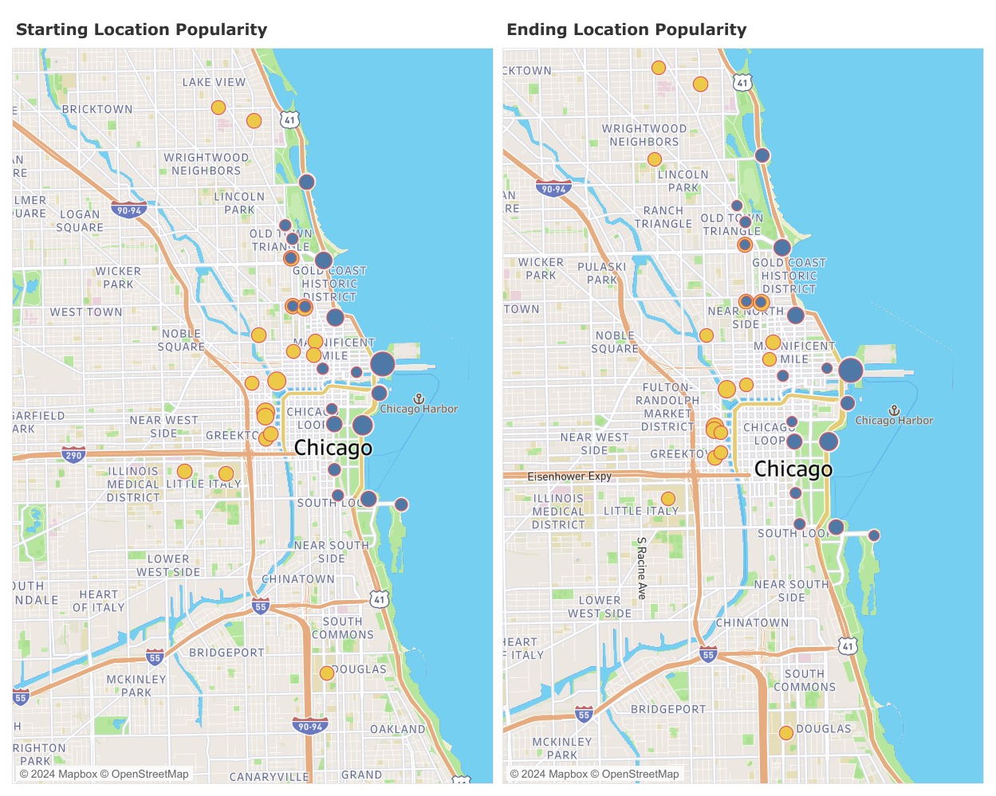
Geographically:
Top 20 Bike Stations
Casual riders are mostly going to places of leisure
Membership riders going to the metra train station, business and residential areas
Notes:
(Give 5 seconds to take in visual then talk about chart) Lastly, I wanted to compare popular station locations and see if I could map them out. I noticed that riders with annual memberships and casual riders did not share a lot of starting and ending locations. Most membership riders stay more inland. Popular locations are around residential areas, businesses, train station, hospitals, and colleges. Most casual riders stay closer to Lake Michigan. Popular casual stations are around things to do such as, beaches, theaters, museums, Millennium Park, Navy Pier, Soldier Field, etc. ( Looking at the data geographically, I can see that casual riders are going to fun places all along the lake. Casual riders are less frequent than membership riders so i assume its for more of an outing or special occasion. I would assume then that most casual riders are tourist who are siteseeing or people who are going out for a special occasion or something.)

Slide 13
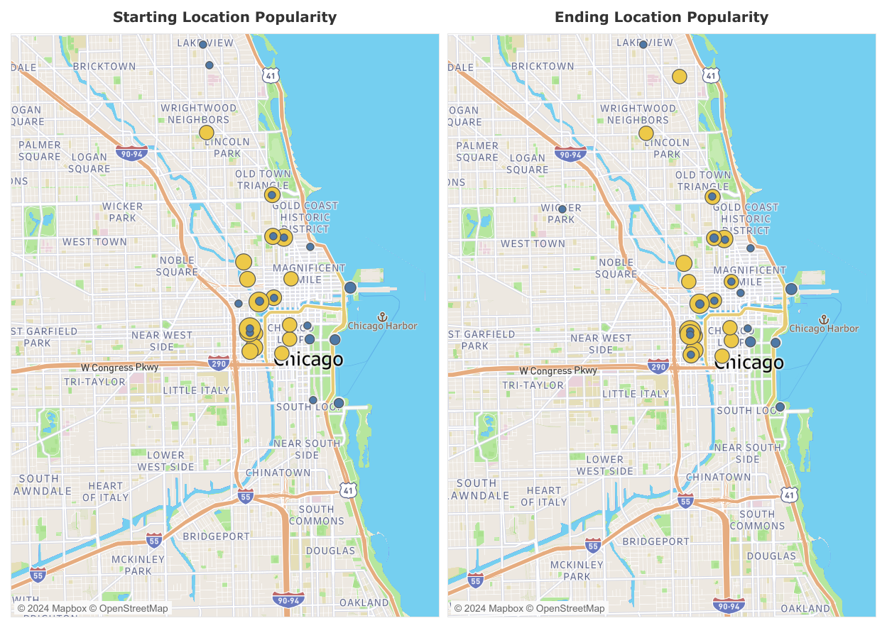
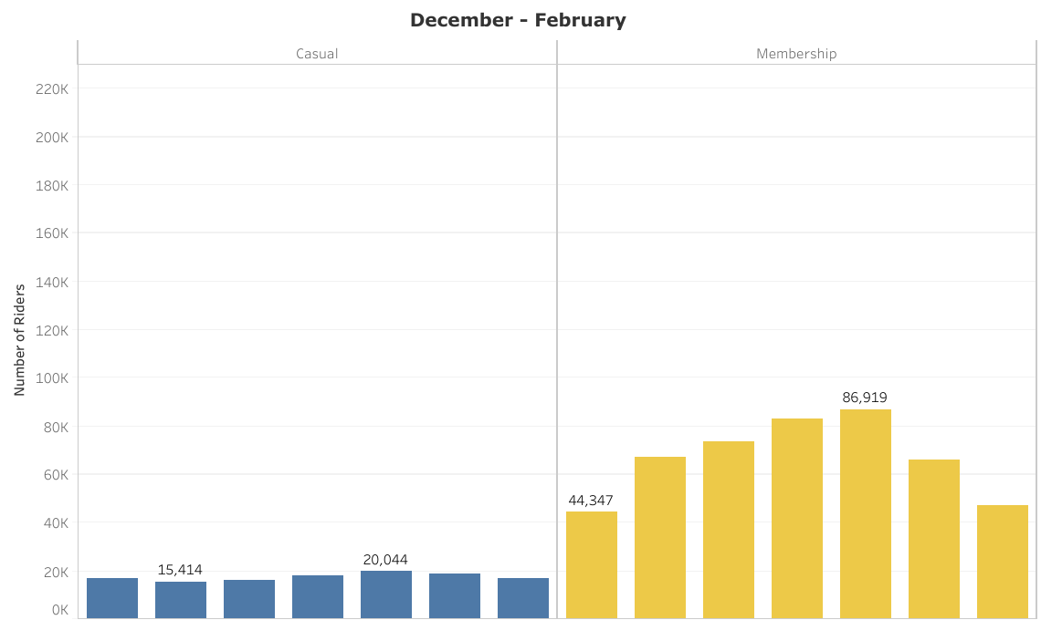
Quarter 2
December -
February
Winter casual riders are more likely to be routine bike riders
Notes:
(Give 5 seconds to take in visualizations then talk about chart) Remember the winter months with really bad numbers? I wanted to look into that a little more. I was able to get the most popular station locations during the 2nd quarter, December - February and I noticed that casual riders have a lot of similar station locations to membership riders during this time period. Casual trip time average was a little higher but more similar to membership riders during quarter 2 as well. (After going back and looking at Q2 geographically separately, I feel it makes more sense for most casual riders to be tourists or people getting on on special outings. During the winter the about the same number of trips occur everyday and its a small number closer to member average in trip time. Also, geographically, routes are more similar than in the other months. I feel these casual people are more likely to be Chicago residents or people that use Cyclistic Bike-Share more on a normal basis.)

Slide 14
Conclusion
1
2
3
Majority of casual riders are tourists or people out site-seeing
By looking at the Winter months, we can focus on casual riders that are more likely to use bike rentals routinely
We can look at casual rider popular station locations NOT in leisure areas to market annual memberships throughout the year
Notes:
To wrap it up, most casual riders use Cyclistic Bike-Share to site-see around Chicago and use different routes than riders with annual memberships. I feel most casual riders are tourists or people that only get out in the warmer months for a special occasion and are not looking for an annual membership because they will not be using it. Through finding a break in the trend through the winter months, we were able to see how many casuals still use Cyclistic Bike-Share and see that casuals more resemble membership riders in the winter months. Seeing which stations are the most popular, we should be able to come up with a few marketing strategies around those locations throughout the year.

Slide 15
Recommendations
Look into stations that are not located at ‘sight seeing’ or ‘leisure areas’ to market to casual riders.
Promote marketing around metra train station for new casual riders and potential annual memberships.
Offer annual memberships as a gift idea during winter holiday months.
Notes:
After analyzing Cyclistic bike riders and looking at differences in how they use the Bike-Share, I have a few possible recommendations. By analyzing our data we can see that casual riders frequent leisure areas and are most likely people going out on special occasion or tourists visiting a big city. We can separate those riders from our other casual riders that more closely resemble annual membership riders and market to them. We can see what are the most popular station locations and advertise to casual riders in those areas. The metra train station is also a very popular area. When we looked at the geographic data for Q2, we can see it is popular for casual riders as well. I feel advertising near here will help create more annual memberships and also casual riders as well who wish to try out Cyclistic Bike-Share. Lastly, my last recommendation to possibly advertise and offer during the slow, winter months the gift of an annual membership. Anyone can pay for a membership ahead of time and gift it to someone to use for the year. This could be helpful for parents looking for a gift to make their kids life easier in college or a spouse helping their other spouse be able to get to work more efficiently. I feel all of these ideas could lead to an increase in casual riders to become annual membership riders.

Slide 16
Questions?
Notes:
Are there any questions?

Slide 17
Thank you!

