Slide 1
MIS571
Events And Clubs
Database Group Project
Aashish Bagul
Neel Gehlot
Prachi Dandekar
Mengyi Qiu
Zhiyao Zuo
Shanhao Li

Slide 2
Contents
01
Introduction
02
02
Problem Statement
03
Proposed Solution
04
Database Design
05
Future Scope
06
User Experience
07
Q & A

Slide 3
01
Events & Clubs
Introduction

Slide 4
Introduction
WPI has 200 clubs which conduct various events throughout the year.
These clubs have several categories such as sports, dance, arts, etc.
These Clubs organize various events on daily basis.

Slide 5
02
Problem Statement

Slide 6
Problem Statement
Harder for the students to keep track of the relevant club and events.
Confusing User Interface
Lacks a proper filter function

Slide 7
03
Proposed Solution

Slide 8
Proposed Solution
User Friendly Interface
Helps student to join any clubs or events which they desire.
Notification of the event

Slide 9
04
Database Design

Slide 10
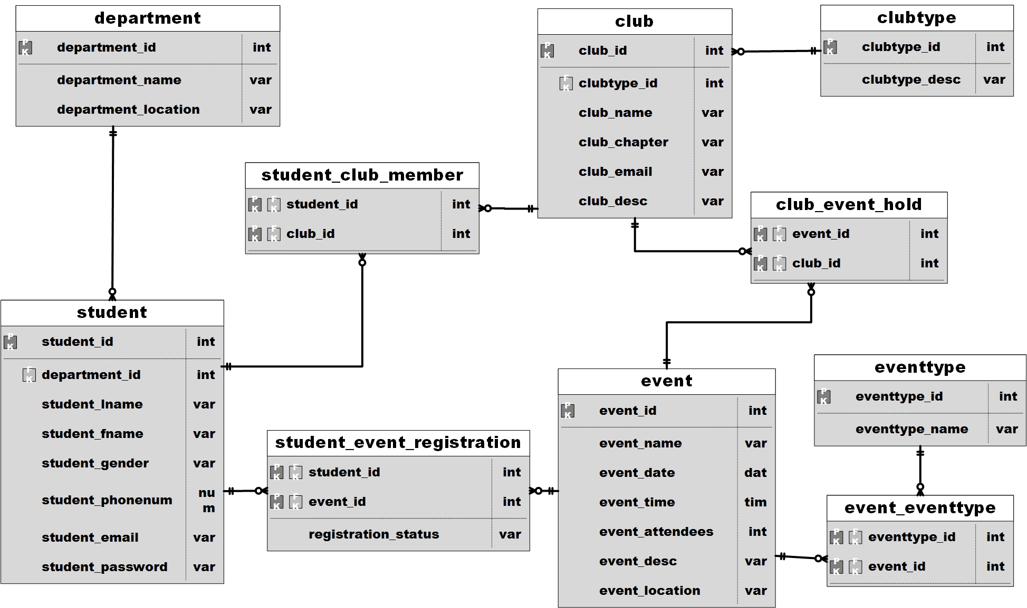
E-R Diagram

Slide 11
Database design Assumption and space estimate
A event can be held by more than one clubs
A event can be belonging to more than one type
Every student belongs to a department
Space estimate: For the First Year
15 departments
6000 students
200 clubs
500 events
9.6 MB
No changes in five years.

Slide 12
05
Future Scope

Slide 13
Future Scope
Adding a GPS functionality
Dynamic Event Pages
Directly joining social networking pages of clubs
Easily check in Students by scanning their ID’s
Event organizers can also use this event app to print badges, or create wristbands.

Slide 14
06
User Experience

Slide 15
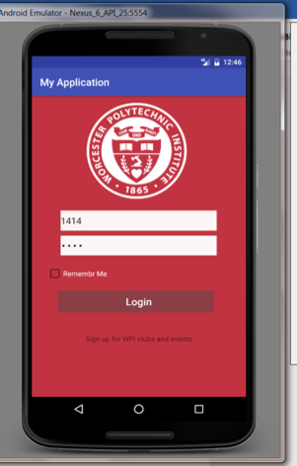
App Demo
select * from student where student_id=? and student_password=?;

Slide 16
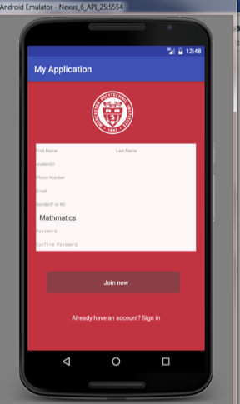
App Demo
insert into student(student_id,student_fname,student_lname,student_phonenum, student_email, student_gender, student_password, department_id) values (?,?,?,?,?,?,?,?)

Slide 17
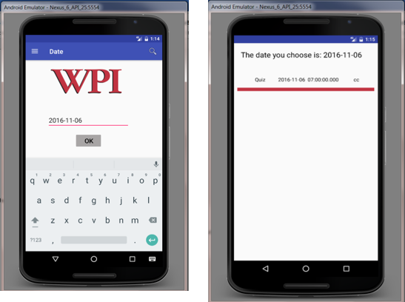
App Demo
select event.event_id as _id, event_name, event_date, event_time, event_location, event_desc,event_attendees from event where event_date= ?”;

Slide 18
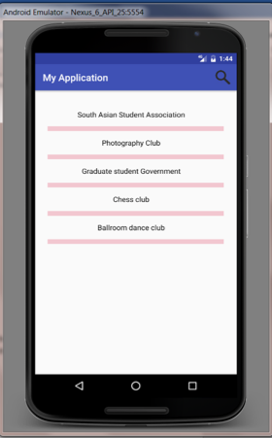
App Demo
select club_id as _id,club_name from club order by club_name desc

Slide 19
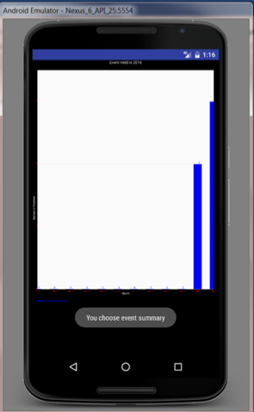
App Demo
select strftime('%m',event_date) as month,count(*) as total from event where strftime('%Y',event_date)='2016' group by month order by total desc

Slide 20
THANK YOU
Q&A
谢 谢
धन्यवाद

