Slide 1
Hi, we are team Ruby’s Secret
working on {x}
Hi, we are team {x}
working on {x}

Slide 2
Our Team
Introduce yourselves

Slide 3
Our Project
Showcase your project

Slide 4
Rails Girls Summer of Code is a scholarship program that enables women to work on Open Source projects
Hi, we are team {x}
working on {x}

Slide 5
This year
Showcase your project

Slide 6
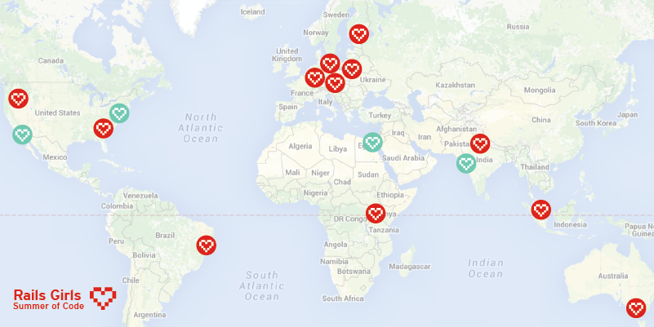
… all around the world!
Hi, we are team {x}
working on {x}

Slide 7
Some of the projects
Hoodie Speakerinnen GitLab Exercism.io Discourse Servo Keystone Open Source Event Manager

Slide 8


Partners
Showcase your project

Slide 9







Sponsors
Showcase your project

Slide 10

Thank you!
Hi, we are team {x}
working on {x}

