Slide 1
Hi, we are team Ruby’s secret
working on Exception Notification gem

Slide 2
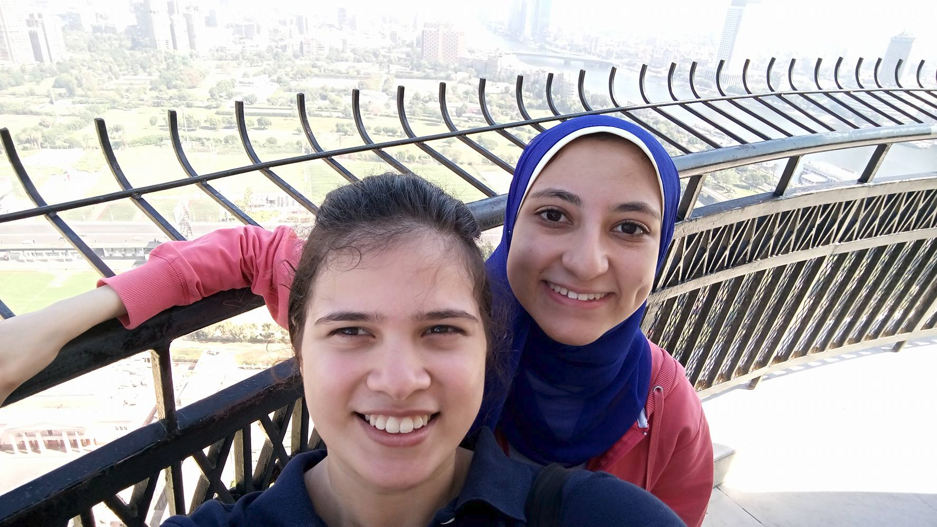
Our Team
Mayar Saleh and Nada Salama
Computer Engineering and
RGSoC students 2016.
Twitter:@MayarAlaa122
Twitter:@Nada_Ashraf96
Github:MayarAlaa
Github:Nada1996

Slide 3

The Journey

Slide 4

Learning Ruby on Rails

Slide 5
Exception Notification gem
Dashboard
TESTING
Engines
Open source projects
Rspec & Minitest
Generators
Errors , Errors,Errors

Slide 6
Thank you !

