Slide 1
Multibank holding company and bank stability
By Radoslav Raykov and Consuelo Silva-Buston
王莹
2020103672

Slide 2
Concept
Bank holding company(BHC)
the majority shareholder in one or more banks
Holding-company bank
part of a holding company or affiliated with a holding company
Independent bank
the opposite of holding-company bank

Slide 3
Introduction
The impacts of holding company affiliation on bank performance:
Positive:
Holding-company banks can enjoy the support of their parent when overcoming adverse shocks via resource transfers etc.
Negative:
Holding-company banks can suffer from negative spillover effects from other banks in the holding when the latter become affected.

Slide 4
Introduction
Compare how holding-company banks and independent banks react to an exogenous negative shock to net equity.
How the systemic and individual risk of banks respond to the shock?
Whether holding company affiliation affects this reponse?
Whether holding company characteristcs play a role in shaping stability at holding-company banks?
How this effect may take place and examine how banks rebalance their portfolios once hit by the shock?

Slide 5
Background and Data
Background
The 2005 hurricane season in US(Hurricanes Katrina, Rita and Wilma)
It reduced bank’s net equity by destroying the collateral on mortgage loans.
Data
Daily stock return data(2002Q1-2007Q4)
Treatment definition
A bank is as treated if it had mortgage lending to a treated country during 2002-2004
Sample: 159 independent(38 treated and 121 non-treated) and 78 holding-company-owned banks(23 treated and 55 non-treated)

Slide 6

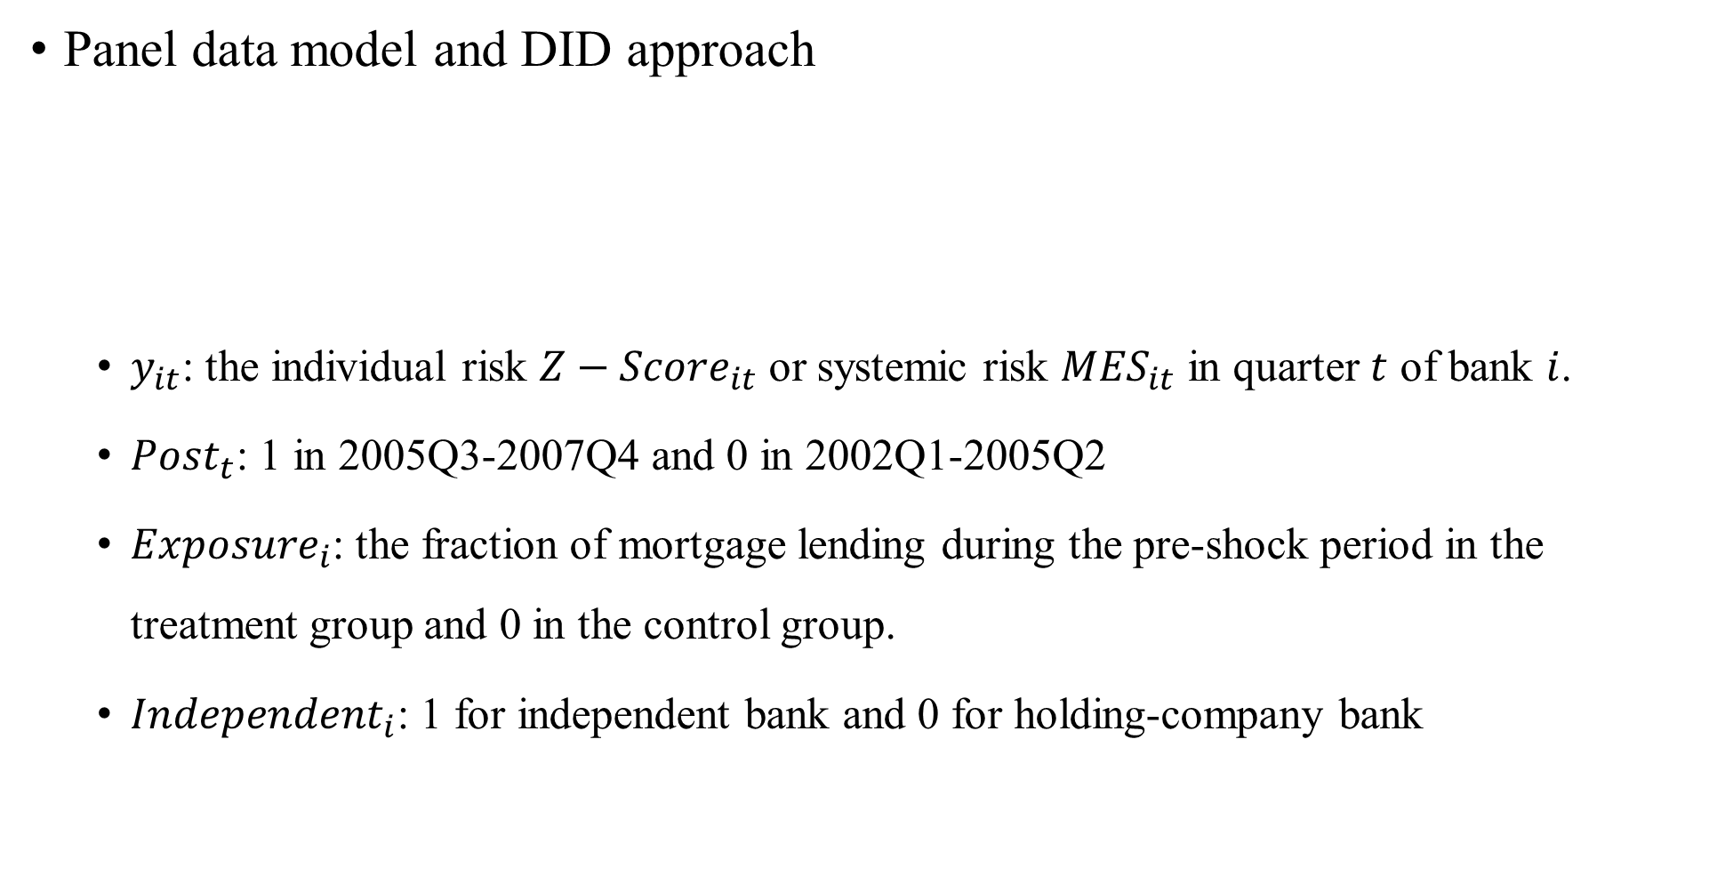
Empirical strategy
Panel data model and DID approach
$y_{it}$: the individual risk ${Z−Score}_{it}$ or systemic risk ${MES}_{it}$ in quarter $t$ of bank $i$.
${Post}_{t}$: 1 in 2005Q3-2007Q4 and 0 in 2002Q1-2005Q2
${Exposure}_{i}$: the fraction of mortgage lending during the pre-shock period in the treatment group and 0 in the control group.
${Independent}_{i}$: 1 for independent bank and 0 for holding-company bank
$$y_{it}=α_{0}+\sum_{i}{α_{1,i}d_{i}}+α_{2}{Post}_{t}+β_{1}{Post}_{t}∗{Exposure}_{i}+β_{2}{Post}_{t}∗{Independent}_{i}$$
$${+β}_{3}{Post}_{t}∗{Exposure}_{i}∗{Independent}_{i}+\sum_{k}{γ_{k}X_{k,i,t}}+ε_{it}$$

Slide 7
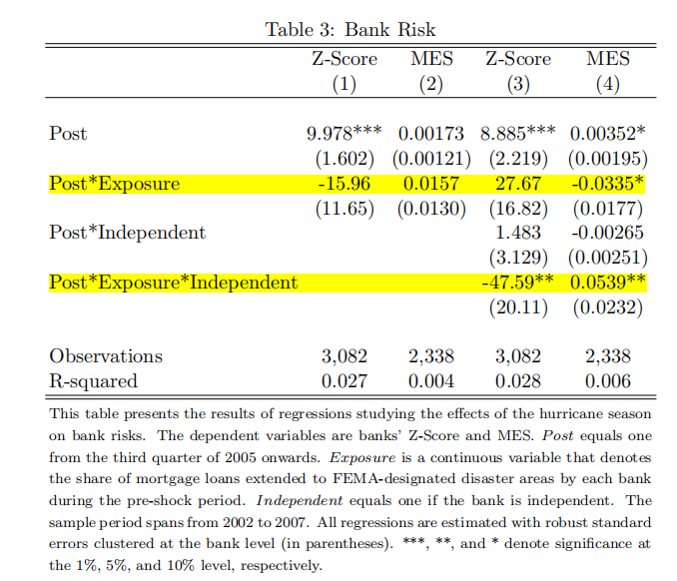
Result
Main results(table 3)
Banks that are part of a holding company are more resilient to shocks than independent banks.
Robustness(table 4-5)
Placebo test
Endogeneity
Alternative measures

Slide 8
Result
Understanding holding-company bank’s resiliency(table 6-9)
Holding company dynamics(table 6-7)
The liquidity of the BHC plays a role in shaping the resiliency of holding-company banks.
No evidence of spillover effects across banks in the same holding.
Portfolio rebalancing(table 8-9)
Independent banks
Household loans↓, Real estate loans and bold holdings↑
Take longer to recover from the shock
Holding-company banks
Household loans don’t reduced.

Slide 9
Conclusion
This paper studies the relationship between bank holding company affiliation and the individual and systemic risk of banks.
Using the 2005 hurricane in the US as an exogenous shock, we show that banks that are part of a holding parent company are more resilient than independent banks.
Examining the impact of the liquidity of the holding on resiliency shows that banks are more fragile when the liquidity of the holding is lower, consistent with internal capital markets playing a role in stabilizing banks.
Banks whose holdings display low liquidity levels rebalance their portfolios towards riskier activities, such as non-traditional banking activities.

