Slide 1
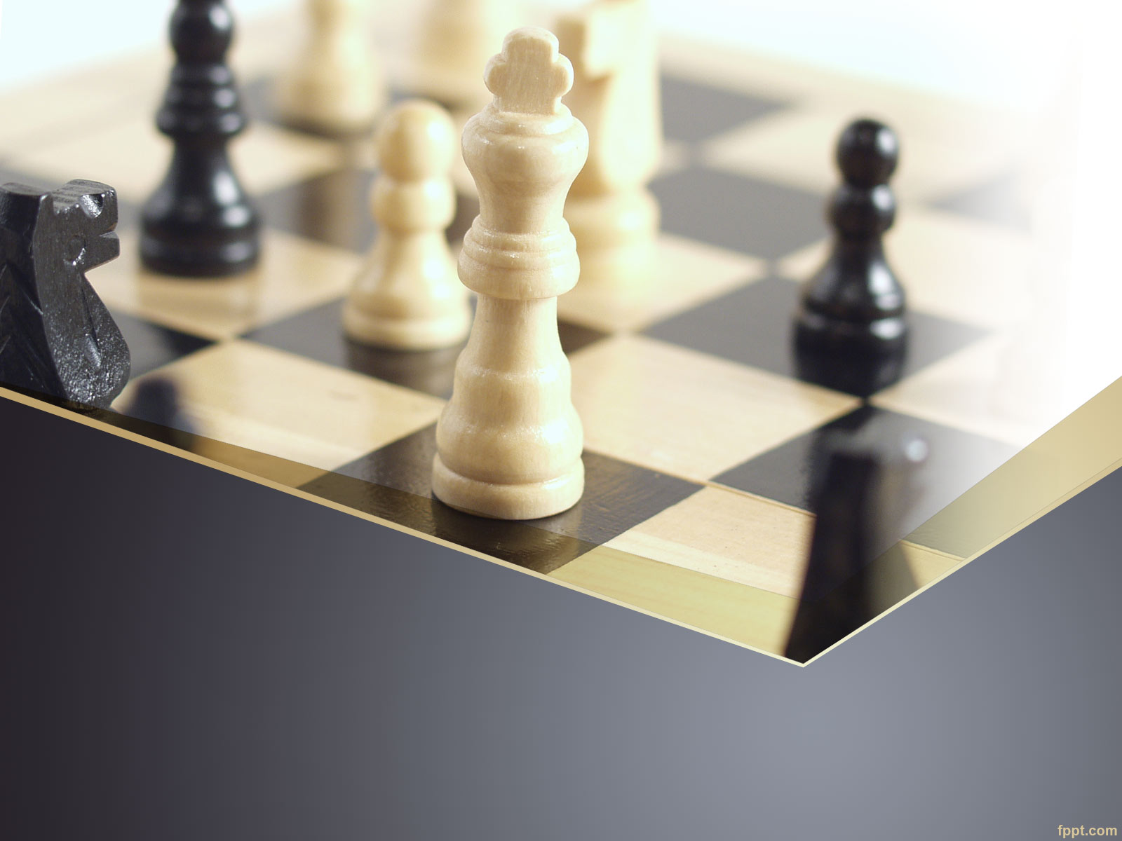
Trio-Chess
SSW690 Software Engineering Studio

Slide 2
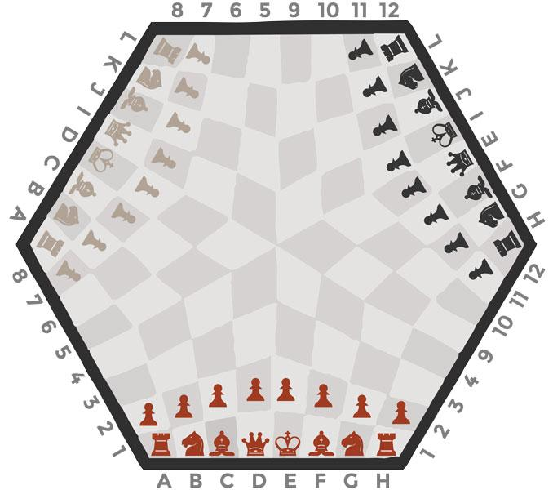
Problem Statement
To validate the moves played by all the three players on a hexagonal chessboard in order to lead a legitimate game.

Slide 3

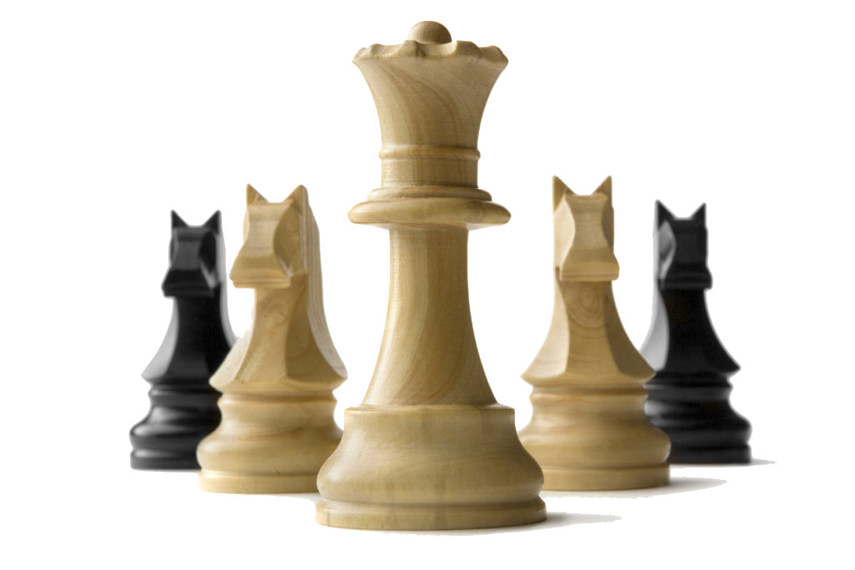
Development Plan
Roles and Responsibilities
 | Ogadinma | Rucha
Developer
Tester
Documentation
Designer
Customer Representative

Slide 4
Development Plan
Environment
Process
Agile Scrum
Tools, Libraries
Python 3.7
turtle
unittest
math
pylint
Coverage
radon
Visual Studio Code
GitHub
https://github.com/RuchaCB/Trio_Chess

Slide 5
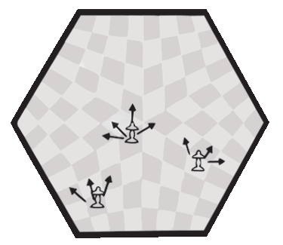
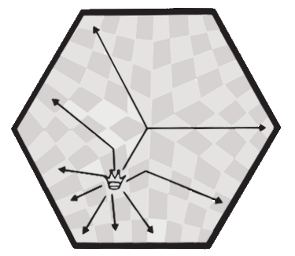
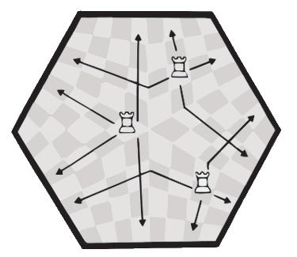
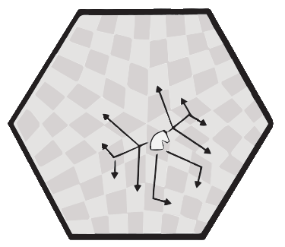
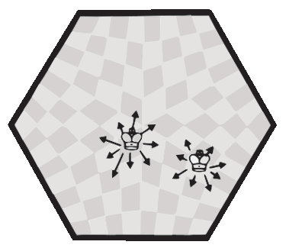
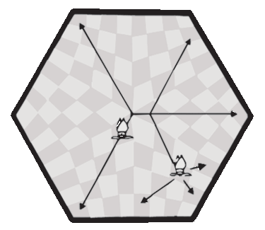
Requirements Gathering

Slide 6
Functional Requirements
UC 01: The system shall display hexagonal chess board.
UC 02: The system shall display pieces on the chess board
UC 03: The system shall take chess standard level user inputs
UC 04: The system shall define player turns
UC 05: The system shall identify pieces and their location on the board
UC 06: The system shall validate pieces moves
UC 07: The system shall move pieces on the board

Slide 7
Non-Functional Requirements
The system shall be:
UC N01: Usable
UC N02: Testable
UC N03: Reliable
UC N04: Maintainable

Slide 8
Estimations
1. Unadjusted Actor’s Weight = UAW = 3
2. Unadjusted Use Cases Weight = UUCW = 50
3. Unadjusted Use Case point(UCP) = UAW+UUCW = 53
4. Total Technical Factor(TTF) = 33
5. Environmental Total Factor (ETF) = 15
4. Technical Complexity Factor (TCF) = 0.6 + .01 * TTF =0.93
5. Environmental Complexity Factor (ECF) = 1.4 - (0.03 *ETF) = 0.95
6. Calculate the Adjusted UCP
i.e. AUCP = UUCP * TCF * EF = 46.8
7. Productivity Factor = 14
8. Hours = UCP*PF = 656
9. Effort in weeks = 16

Slide 9
Architecture
4+1 Model
Use-case View
Process View
Implementation View
Logical View
Physical View

Slide 10

Architecture
Process View
Design
Development
Testing
Maintain
Planning
+
Demo
Requirement Gathering

Slide 11
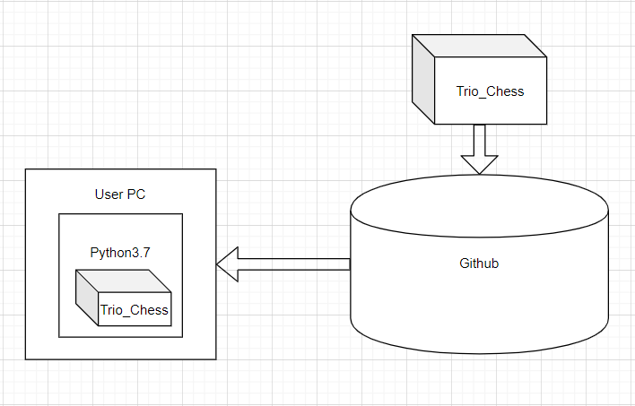
Architecture
Physical View

Slide 12
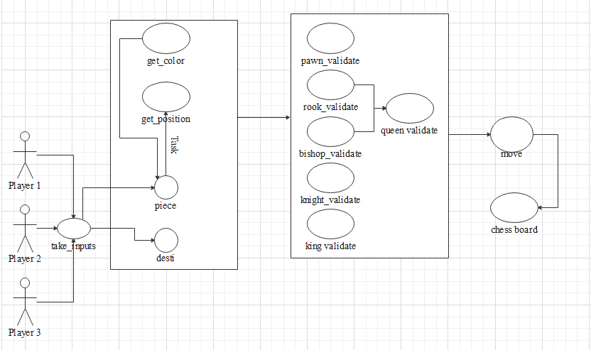
Architecture
Use Case View

Slide 13
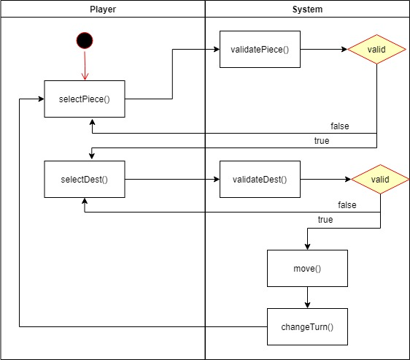
Architecture
Logical View

Slide 14
Architecture
Implementation View

Slide 15

Use Case Scenario
REQ 1 | UC01 | UC02 | UC03 | UC04 | UC05 | UC06 | UC07 | UC08
REQ 2
REQ 3
ROQ 4
REQ 5
REQ 6
REQ 7
REQ 8

Slide 16

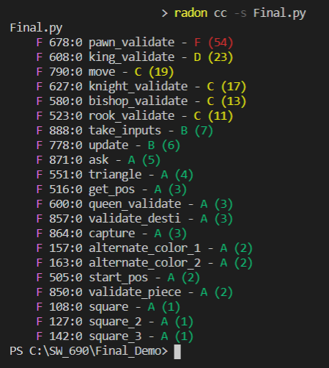
Cyclomatic Complexity

Slide 17
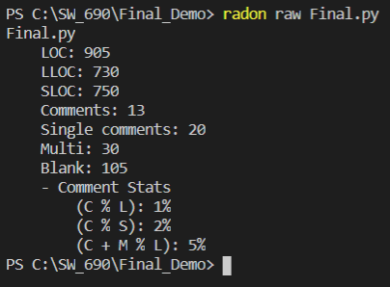
LOC Stats

Slide 18
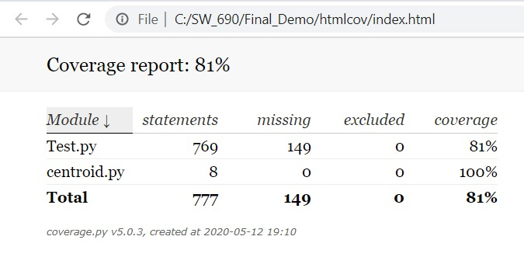
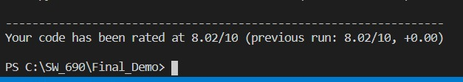
Static Code Analysis
Code Coverage Analysis
Code Standard Analysis

Slide 19
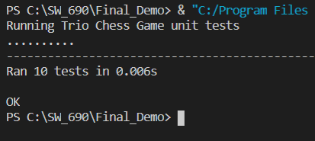
Unit Testing

Slide 20
Trio-Chess Game -Metrics
Method used: Goal Question Metrics:
Goal: To design a Trio-Chess board for players that meets standard Chess game functionality Question: Does the project meets Chess standard functionality? Metric: Design and developed software met the standard required.

Slide 21
Post Morten
What would you do different?
Piece recognition using game-tracking software tools
Cross Entropy of the Trio-Chess game. It is intended as a more descriptive form of classification accuracy, because it takes into account the margin of probability scores (results) of the game.

Slide 22
Post Morten
What would you do same?
More on team collaboration and communication on sub-projects.
Feature extraction using scale-invariant feature transform (SIFT) and histogram of oriented gradients (HOG)

Slide 23
Future Work
Tracking movements of pieces within a specified area with the application Machine Learning and Artificial intelligent
Improvement on Corner-based using corner detection and board recognition software.

Slide 24
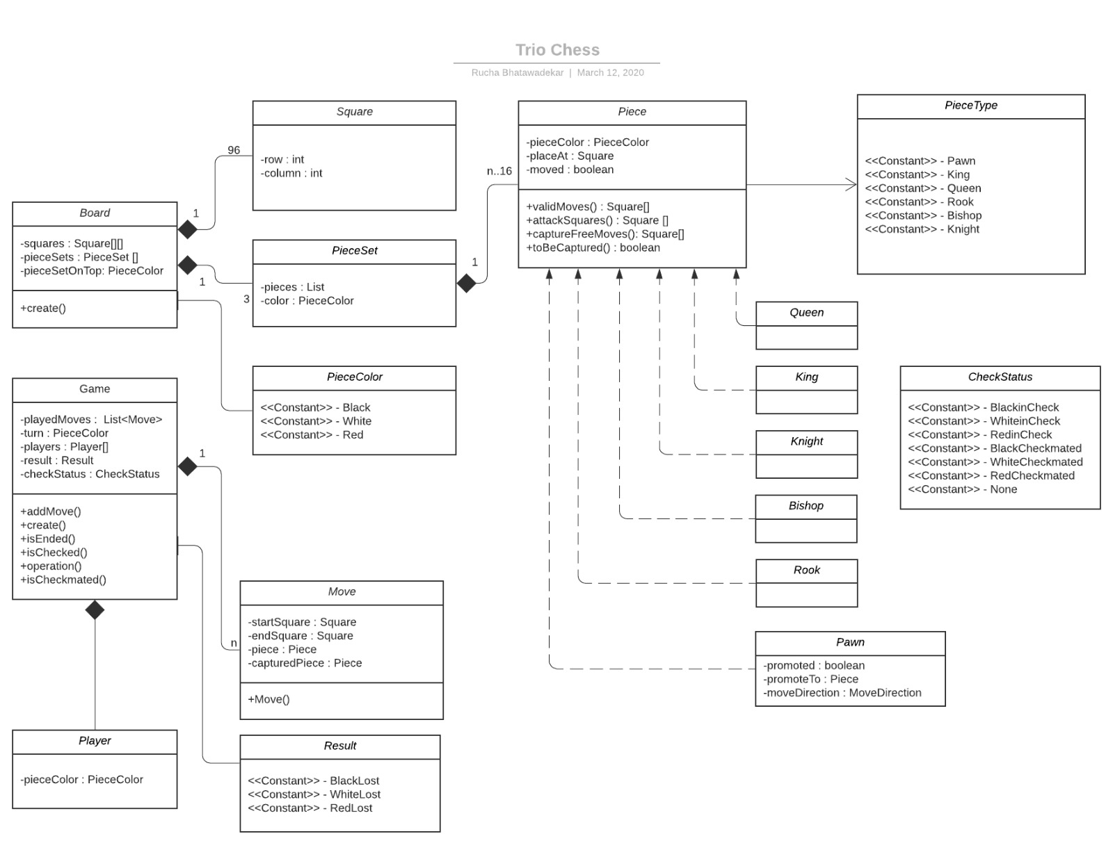
Future Work

Slide 25
Conclusions
This project presented a proof of concepts of Trio-Chess game for corner detection which is more robust to real life game scenarios.
The major problem encountered was the lack of comprehensive data set of pieces images on the board.

Slide 26
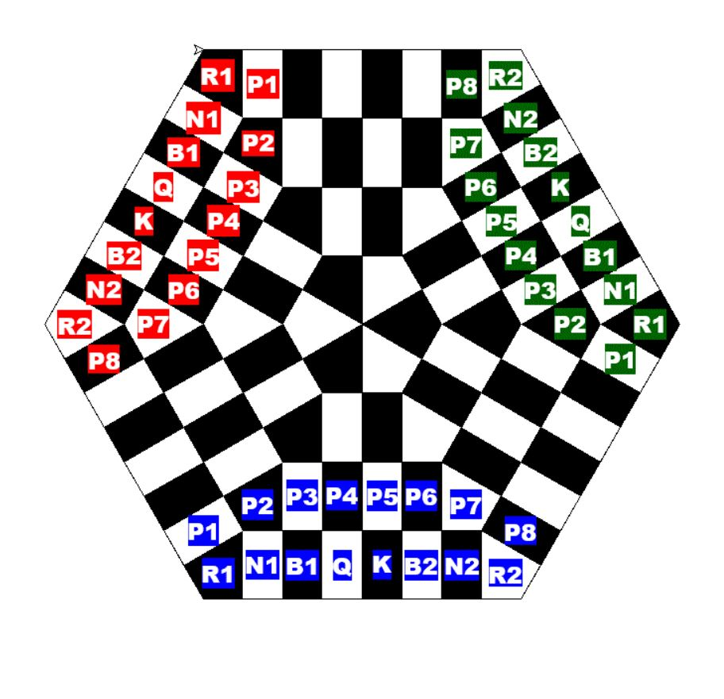
Conclusions

Slide 27
References
https://web.stanford.edu/class/cs231a/prev_projects_2016/CS_231A_Final_Report.pdf
N. Dalal and B. Triggs, ”Histograms of Oriented Gradientsfor Human Detection”, inProc. IEEE Conf. Computer Visionand Pattern Recognition, 2005
N. Loewke. (2015).Depth-based image segmentation[Online]. Available:http://stanford.edu/class/ee367/Winter2015/reportloewke.pdf
https://tallyfy.com/uml-diagram/#activity-diagram

