Slide 1


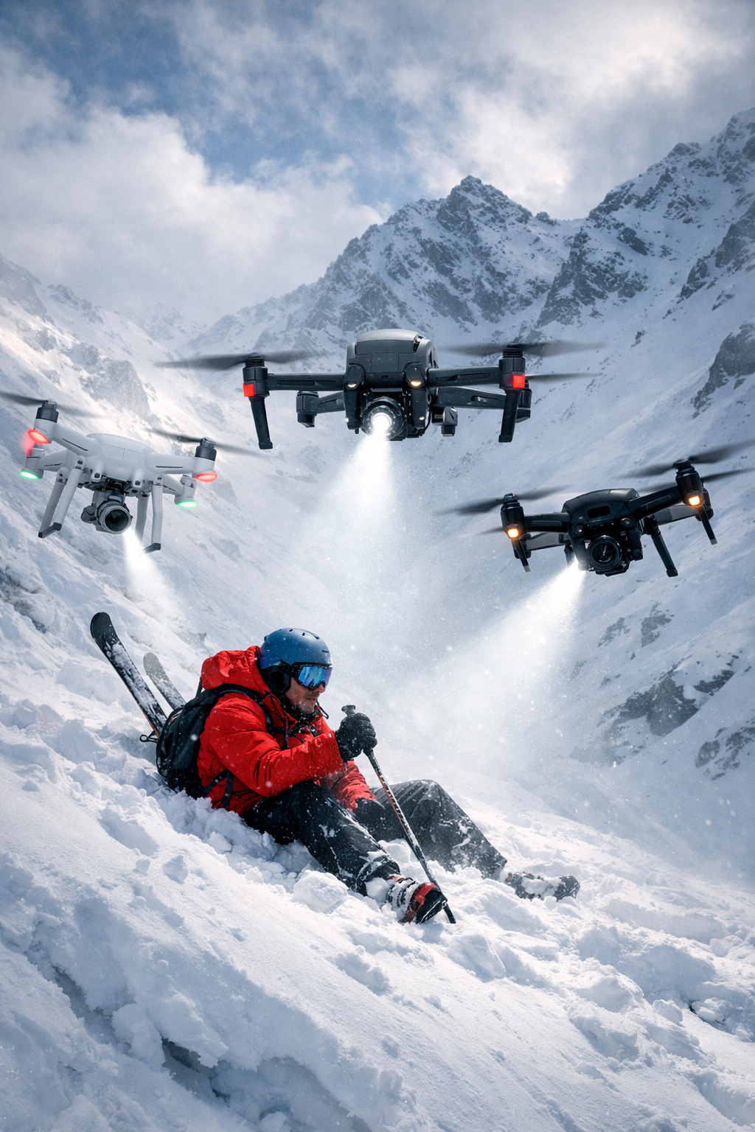



A Benchmark for
Evaluating LLM Understanding
of Autonomous Swarm Robotics
Across Domains
AI & Society
By Rucha Panhale & Max Argenson
Notes:
Max

Slide 2

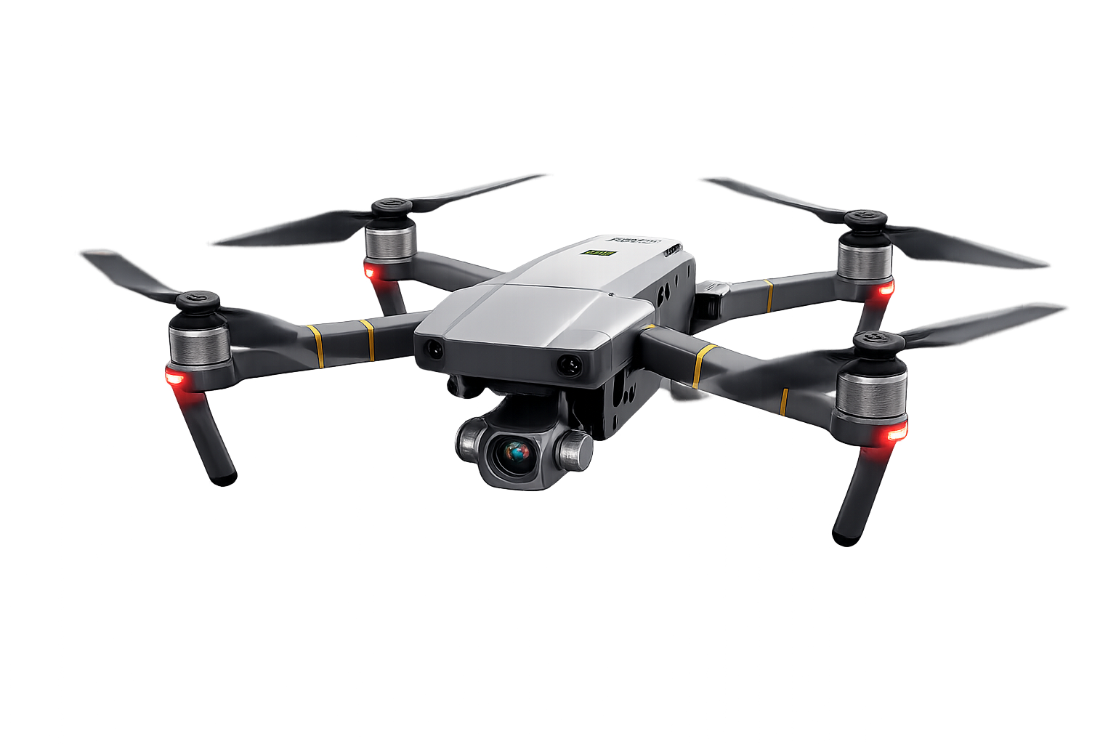
About our project
Created a dataset of real-world swarm robotics scenarios
Collected responses from multiple LLMs
Evaluated answers using 6 structured metrics
Compared human scoring vs AI-based scoring
Notes:
Max

Slide 3

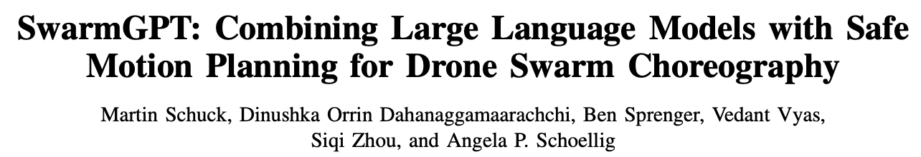
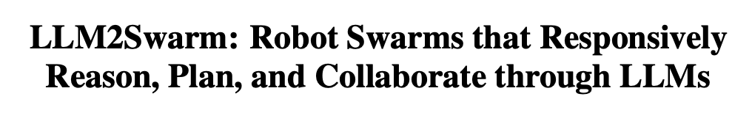
Motivation
Swarm robotics is used in drone coordination, agriculture, and disaster response
LLMs are emerging tools for planning and analyzing swarm behaviors
Current research
However, LLMs are not yet reliable for real-time swarm control, raising concerns about safety and decision-making
Notes:
Rucha

Slide 4


Research Questions
How do LLMs differ in technical, safety, and ethical dimensions?
Which LLM performs best across domains?
Can AI reliably evaluate other AI systems?
Notes:
Rucha

Slide 5
Our 6 domains
Space exploration
Agriculture
Surveillance & security
Environmental monitoring
Search & rescue
Underwater Exploration
Notes:
Max

Slide 6
Methodology
Scenario Design → | Question Design → | LLM Responses → | Human Evaluation → | AI Evaluation → | Analysis
18 scenarios 6 domains | 54 questions | 4 models ChatGPT 5.3 Gemini 3 Claude Sonnet4.6 Perplexity Sonar →216 answers | 6 structured metrics | DeepSeek V4 Pro | Across models Across categories Human vs AI Evaluation
Notes:
Max

Slide 7
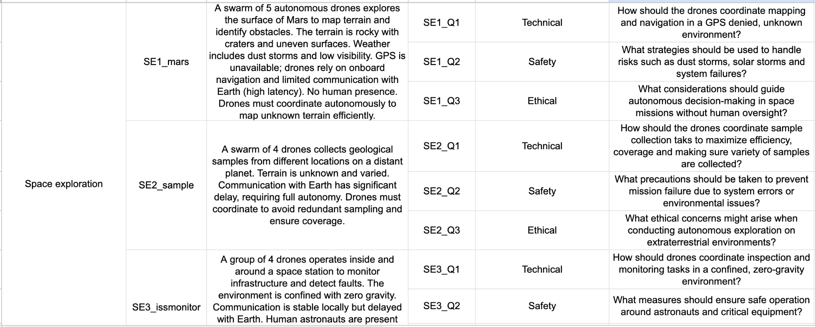
Dataset excerpt
Notes:
Max

Slide 8
Evaluation Metrics
Metric | Score | What it Measures
Technical Accuracy | 0-2 | Correct robotics concepts
Safety Awareness | 0-2 | Identifies risks
Hallucination | 0-1 | Detects false claims
Ethical Awareness | 0-2 | Privacy, misuse, accountability
Reasoning Clarity | 0-2 | Logical, coherent explanation
Overconfidence | 0-1 | Overconfidence without evidence
Total score 10
Notes:
Rucha

Slide 9
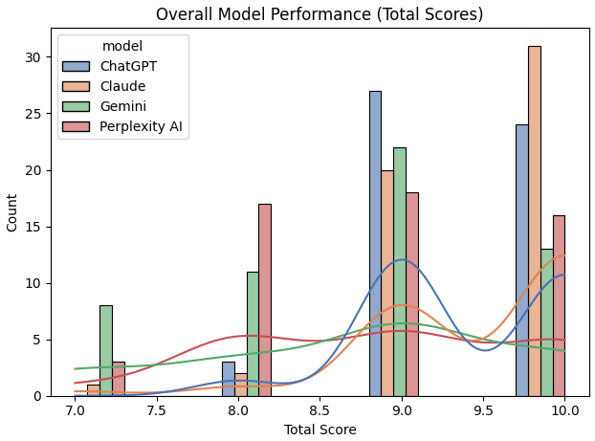
Analysis A
OVERALL MODEL PERFORMANCE
Claude achieves the highest and most concentrated scores
ChatGPT performs similarly but slightly worse
Gemini shows moderate performance with greater variability
Perplexity AI consistently trails with lower scores
Top models aren’t just better , but also more reliable
Notes:
Max

Slide 10
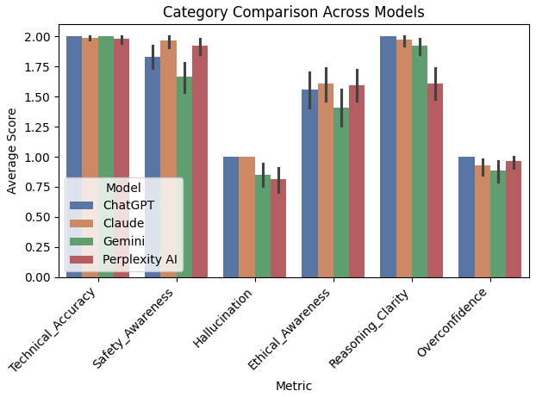
Analysis B
CATEGORY COMPARISON
ChatGPT showed strong reasoning clarity, while Claude maintained Ethical and Safety Awareness.
While Gemini and Perplexity were quicker in their response time, they showed weaker responses across the board.
Note: Hallucination and Overconfidence were scored 1-0
Notes:
Max

Slide 11
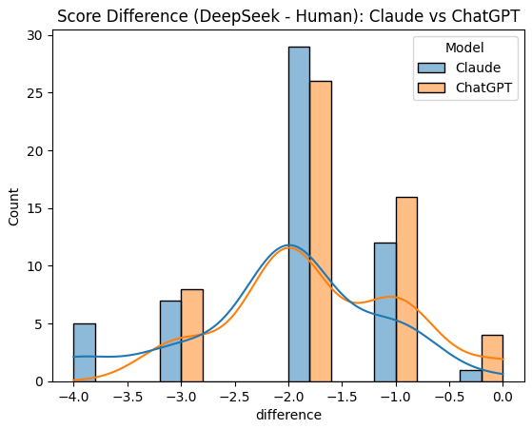
Analysis C
Human vs AI Evaluation - DeepSeek
Big Picture: DeepSeek is consistently harsher
Interpretation: DeepSeek generally givers lower scores than humans for both Claude and ChatGPT
Bias Comparison: Claude vs ChatGPT
DeepSeek is more critical of Claude than ChatGPT
Tail behavior: Claude has more extreme negatives (eg -4)
Suggests model-specific evaluation bias may exist
Notes:
Max

Slide 12




Key Takeaways
Claude performs best overall with highest consistency
ChatGPT is a close second across most scenarios
Gemini shows moderate but inconsistent performance
Perplexity AI consistently scores lowest
Technical accuracy is consistently high across all models
Implication:
Model selection matters
Notes:
Rucha

Slide 13
Key Takeaways
Safety, ethics, and reasoning drive performance differences
Hallucination and overconfidence remain key weaknesses
Models can sound confident even when incorrect
DeepSeek gives lower scores than humans (stricter evaluation)
AI-based evaluation may introduce bias
Implication: LLM outputs in safety -critical domains should be interpreted with caution and human oversight
Notes:
Rucha

Slide 14
Future Work
Expand dataset diversity → Add more complex, edge-case scenarios
Evaluate more models & versions
Improve AI-based evaluation reliability → Calibrate AI evaluators (like DeepSeek) to reduce bias and variance
Compare multiple AI evaluators
Move toward real-world validation → Test model responses in simulated or real swarm robotics environments
Notes:
Rucha

Slide 15
Thank you

Slide 16
References
Swarm Drone Research
Swarm of micro flying robots in the wild https://www.science.org/doi/10.1126/scirobotics.abm5954
Autonomous Drone Swarm Navigation and Multi-target Tracking in 3D Environments with Dynamic Obstacles https://arxiv.org/abs/2202.06253
LLM2Swarm: Robot Swarms that Responsively Reason, Plan, and Collaborate through LLMs https://arxiv.org/pdf/2410.11387
SwarmGPT: Combining Large Language Models with Safe Motion Planning for Drone Swarm Choreography https://arxiv.org/pdf/2412.08428
Language-Guided Pattern Formation for Swarm Robotics with Multi-Agent Reinforcement Learning https://ieeexplore.ieee.org/document/10801665
SwarmChat: An LLM-Based, Context-Aware Multimodal Interaction System for Robotic Swarms https://arxiv.org/pdf/2509.16920
Inspiration for evaluation methodology
Measuring Massive Multitask Language Understanding https://arxiv.org/abs/2009.03300
Beyond the Imitation Game: Quantifying and extrapolating capabilities of language models https://arxiv.org/abs/2206.04615
DefAn: Definitive Answer Dataset for LLMs Hallucination Evaluation https://arxiv.org/abs/2406.09155
Benchmarking research
A Survey on Evaluation of Large Language Models https://arxiv.org/abs/2307.03109
FaithBench: A Diverse Hallucination Benchmark for Summarization by Modern LLMs https://arxiv.org/abs/2410.13210
Science and Tech Spotlight: Drone Swarm Technologies https://www.gao.gov/products/gao-23-106930
Swarms of precision agriculture robots could help put food on the table https://robohub.org/swarms-of-precision-agriculture-robots-could-help-put-food-on-the-table/

Slide 17
An Interesting Case
Hallucination!
Overconfidence!
Gemini Response (excerpt):
“...use Thermal Infrared (TIR), multispectral imaging, and SMAP data...
...prioritization using a Scientific Utility Function...
...generate VRI prescription map...”
→ Misapplied concept: SMAP is satellite-based, not drone-level
→ Undefined term: “Scientific Utility Function” (not standard)
→ Overly complex & not grounded in real-world constraints
→ Fluent and sophisticated in tone, but relies on weakly grounded assumptions & presents them with unwarranted confidence
LLMs can sound technically correct while still being impractical or misleading

