Slide 1

Global retail pvt Ltd.
Sales, Product and Customer Analysis
-Ruchi Asthana

Slide 2
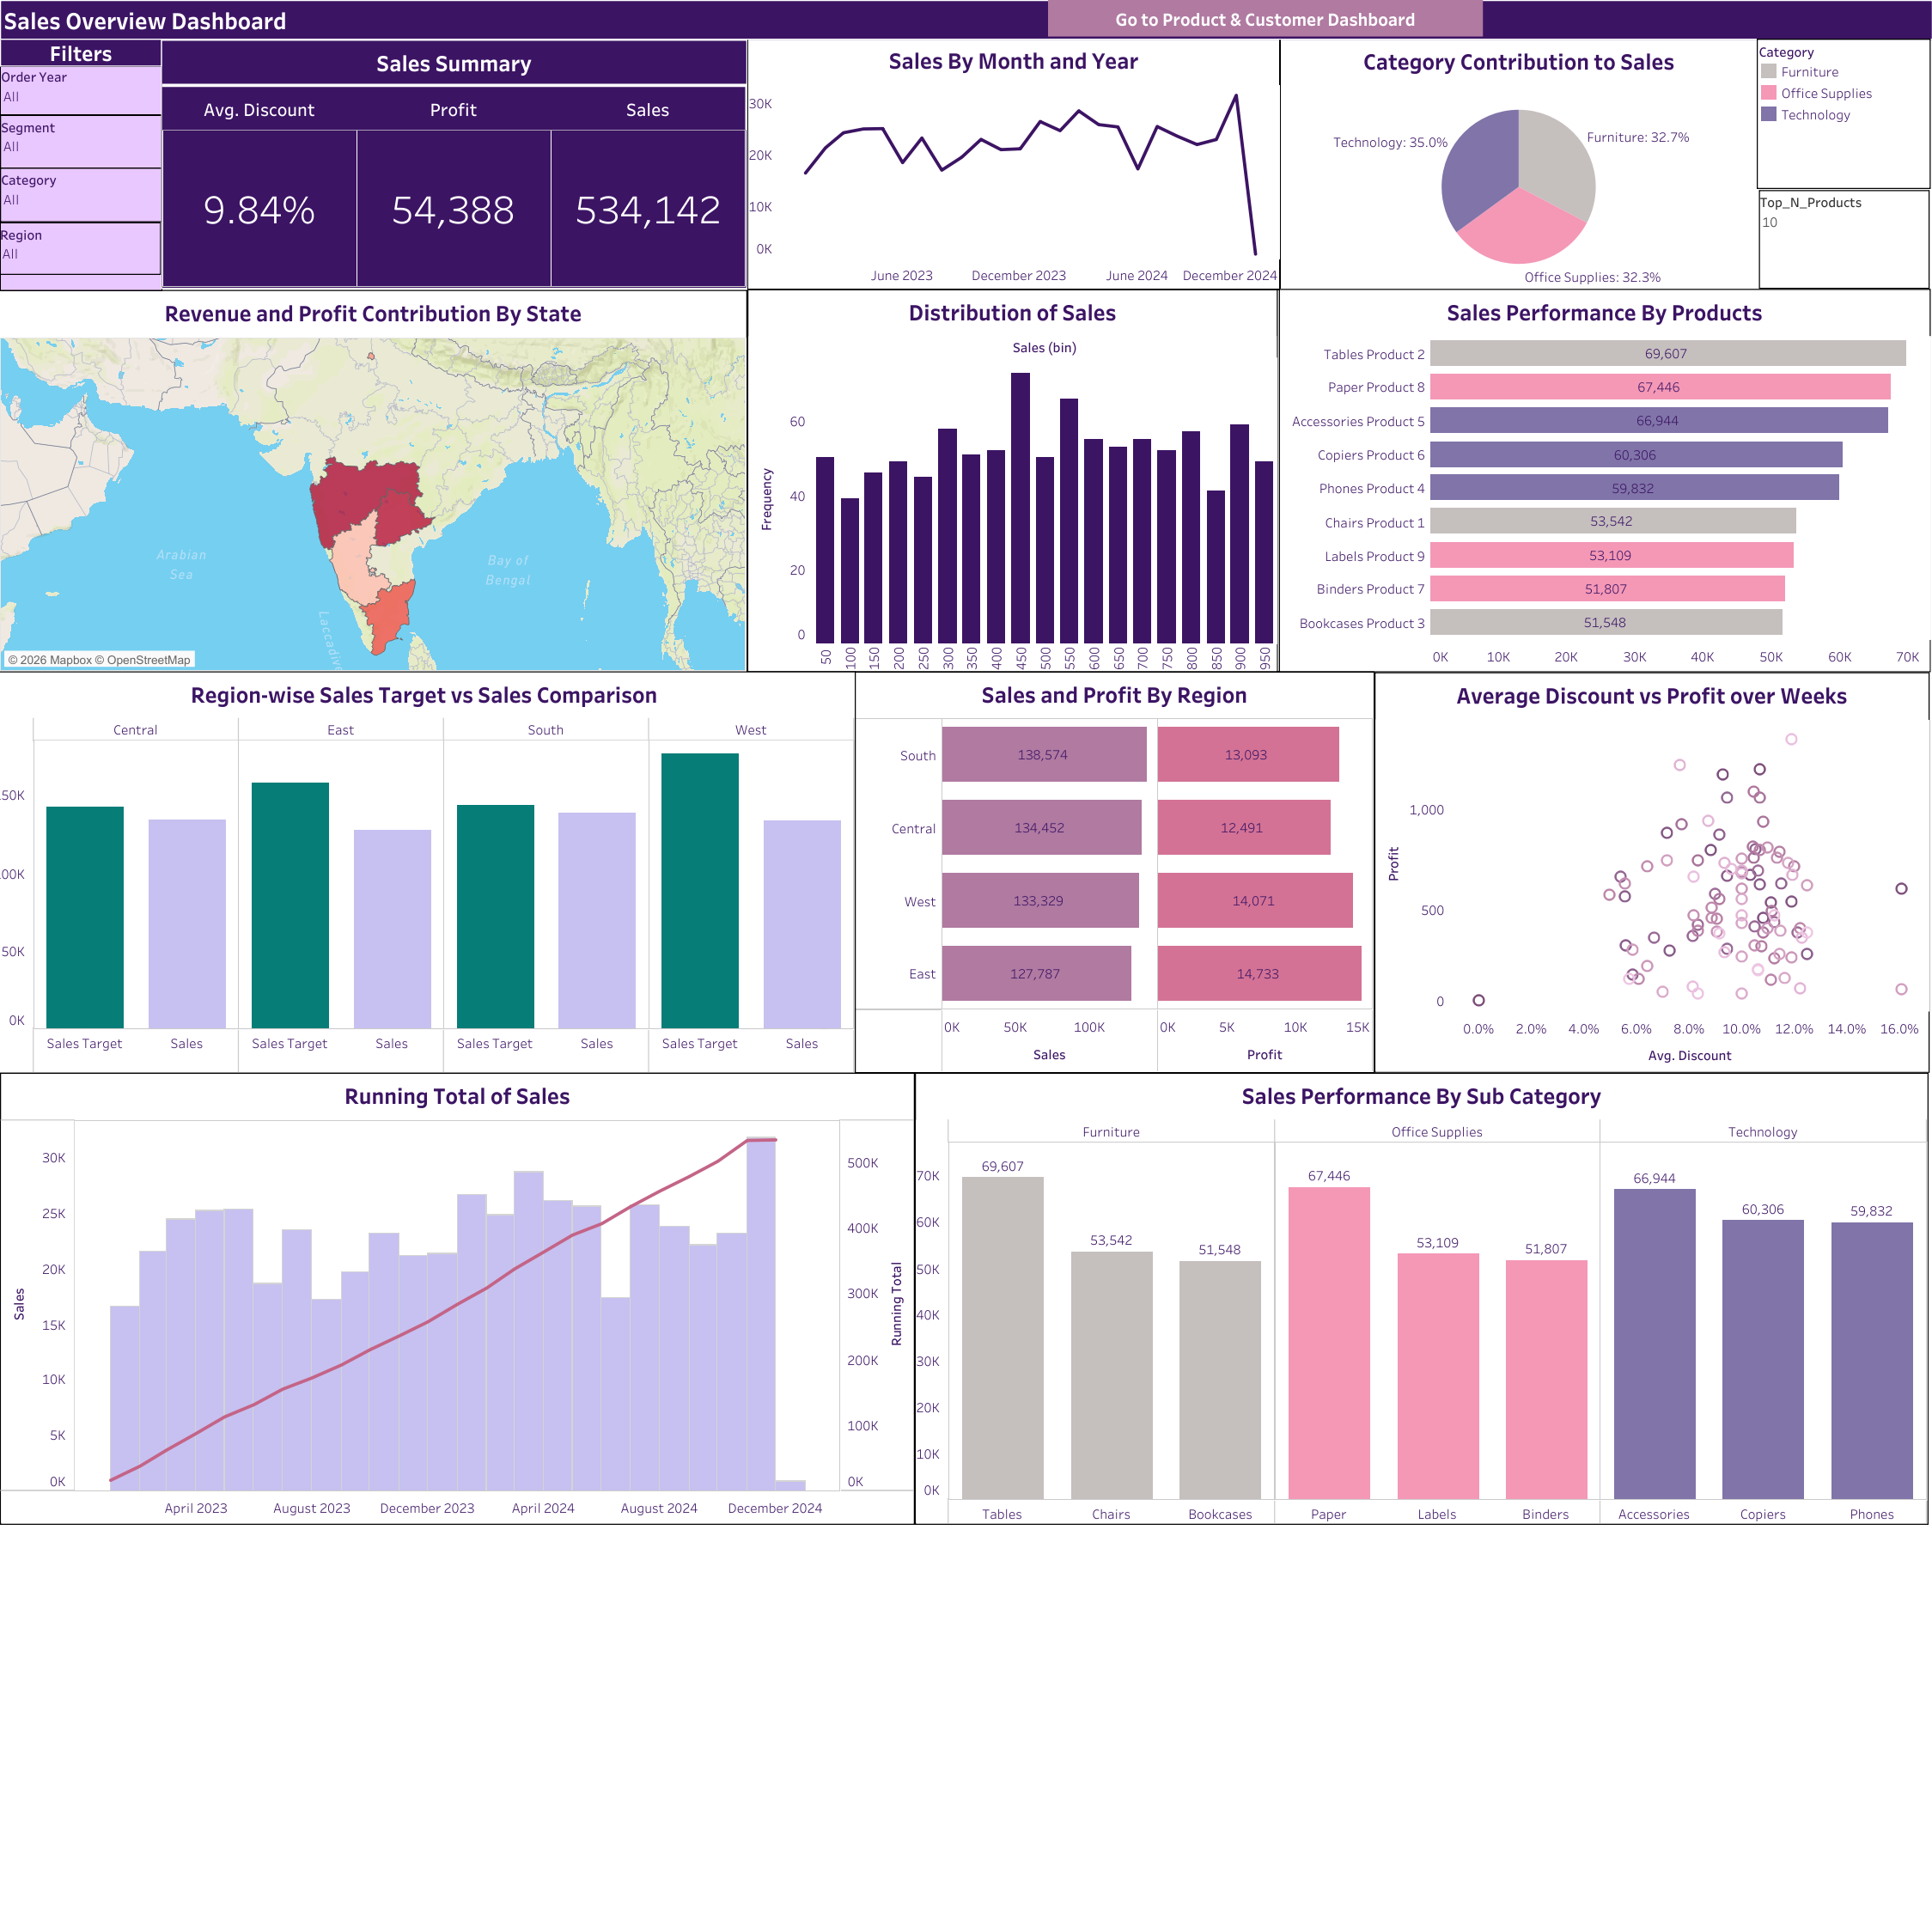
Sales Insights:
Monthly sales trend is consistent over the years except for a steep decline in December 2024.
Highest sales occur in November 2024, just before the sharp fall.
All three categories contribute to sales almost equally (35, 33 and 32% each); Technology being the highest contributor.
South generates highest revenue and profit.
Maharashtra is the highest revenue generating state.
Higher discounts tend to reduce profitability.
Tables, Paper and Accessories are the highest revenue generating sub categories.
Most orders have sales in the range of 400-450.

Slide 3
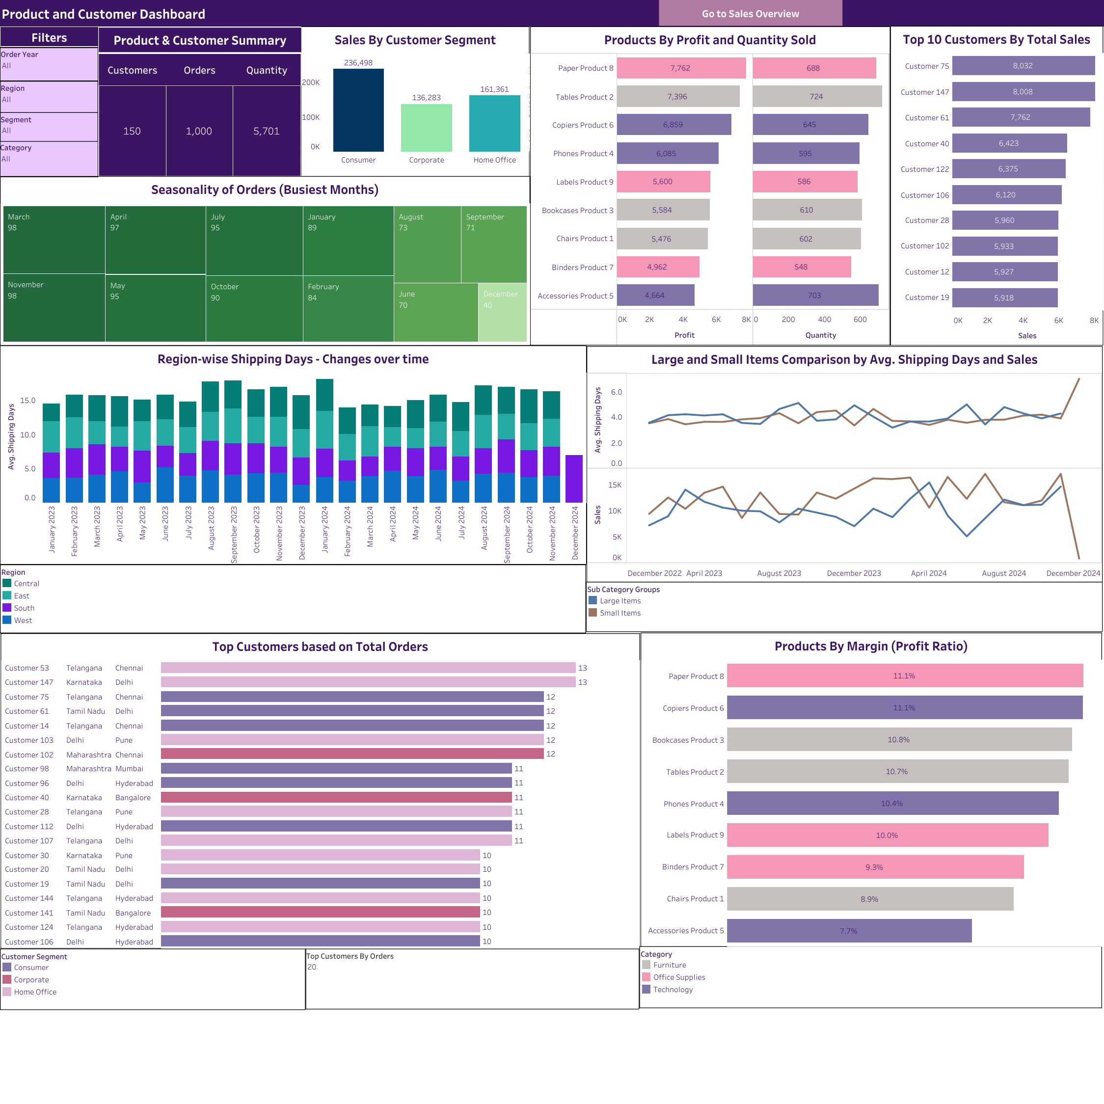
Product and Customer Insights:
The most revenue generating customer segment is Consumer, followed by Home Office.
March and November are the busiest months in terms of Orders placed.
Customer 75 and Customer 147 are the top two customers in terms of revenue, each having more than 8k of total order value.
East Region has a higher Shipping Days Average (4-5 days) compared to the other three (3-4 days).
Large items take more time to be shipped than Small items.
Paper is the most profitable sub category with the highest profit ratio.
The highest number of orders made by an individual customer is 13.

Slide 4
Thankyou

