Slide 1

Analysis of Video Games Sales data

Slide 2
WHY WAS THE DATASET CHOSEN
Video games is one of the most popular entertainment devices not only for kids but for adults as well thereby generating good revenues.
We chose this dataset to analyze the Video Game market with regards to the trend in sales in order to put forward our views on questions like :
1. How the video game market is actually performing;
2. What type of genre is preferred in respective parts of the country;
3. Predicting annual global sales and so on.
These questions with regards to the data set will help us analyze the customer perceptions and preferences which is of utmost important for a business.

Slide 3
LITERATURE REVIEW
Gulsah Demiryurek has used this dataset for ‘Video game sales exploratory data analysis. The dataset contains a list of video games with sales greater than 100,000 copies. She has examined the sale of video games in terms of genre, platform, region, title and top sales(annually, quantity-based, etc) using just data visualization tools.
We are using the dataset to draw inferences by understanding the trends and patterns. We have build models using linear and multiple regression. The model built using multiple regression is suitable to predict the sales pertaining to any genre, producer, platform, region and so on. On the other hand, the model built with the help of linear regression is suitable to predict the annual global sales.

Slide 4
BUSINESS INSIGHTS FROM THE PAST ANALYSIS
Game sales peaked in 2008 and has been decreasing ever since. However, the data is not a representation of overall gaming scene. Modern games focus on free to play platform, dominated by PC games.
The data is flawed since it only takes into account game sales where most revenue from games comes from microtransactions. Again, we did not have the data to show PC games on the rise.
EA, Nintendo, Sony are the last few big companies can manage to survive
Most bad games die out instantly in the last few years which signify the rise in standard of games.
The analysis focuses on consoles due to the data structure.

Slide 5
EXPLORATORY DATA ANALYSIS
Imported the required libraries
Read the CSV file of the Video games sales data
Pre-processing of data which includes handling missing data
Removing the outlier.
Identified unique column names.
Identified unique count of each value in the columns.
Computation of data with median and mode.
Data visualization with scatter plot matrix.
Prediction of future trend using regression model.

Slide 6
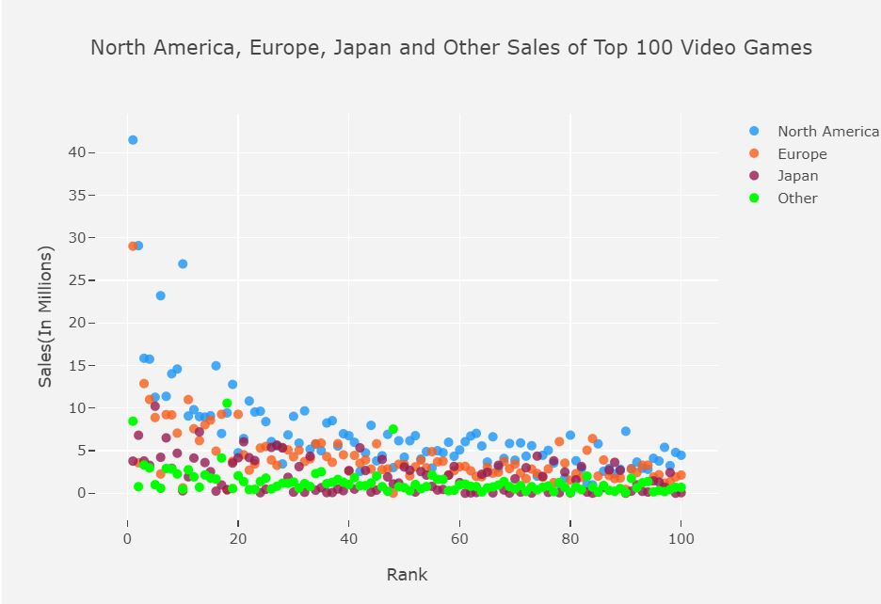
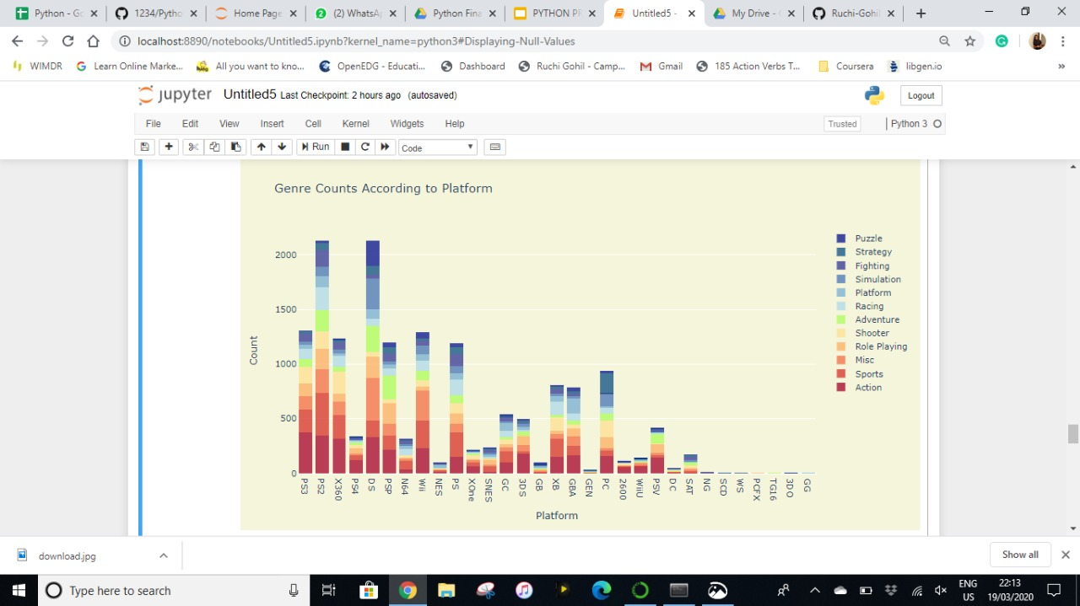
Data Visualization

Slide 7
BIBLIOGRAPHY
https://www.theesa.com/esa-research/2019-essential-facts-about-the-computer-and-video-game-industry/
https://www.wepc.com/news/video-game-statistics/
https://www.statista.com/topics/868/video-games/
https://www.kaggle.com/gregorut/videogamesales

