Slide 1
Lucene Based Java Swing Application for Similar Image Search
Ruchira Patil
001672032

Slide 2
ABSTRACT
Purpose of this project is to find similar images from the large databases (or from internet). For an uploaded candidate image, visually similar images are displayed as a result.
Indexing and Querying: Lucene
Image preprocessing: Python and OpenCV
Color Histogram, shape,SIFT detection.
Sorting the result images based on similarity score.
Dynamically resizing the images to fit in resultant images in 400x400 square.

Slide 3
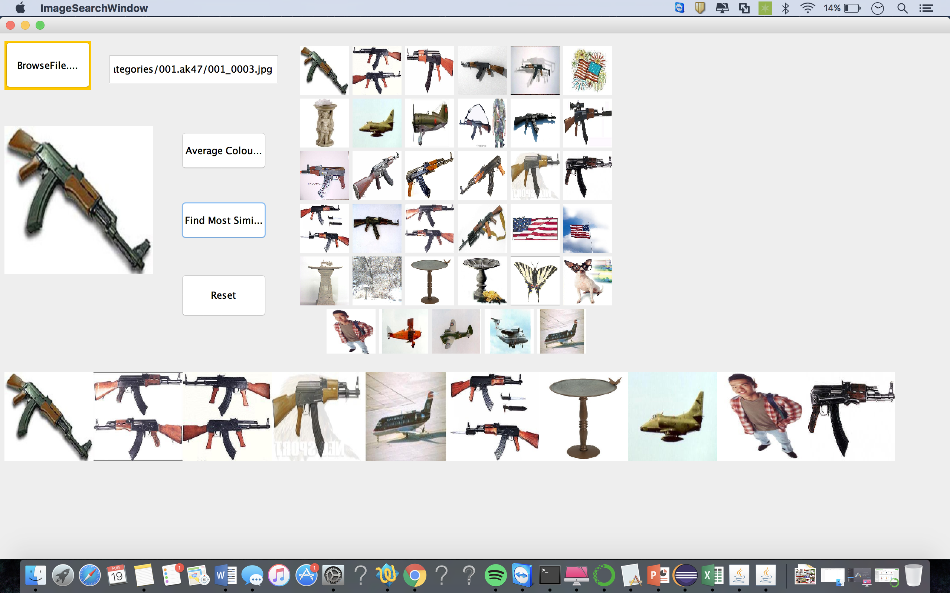
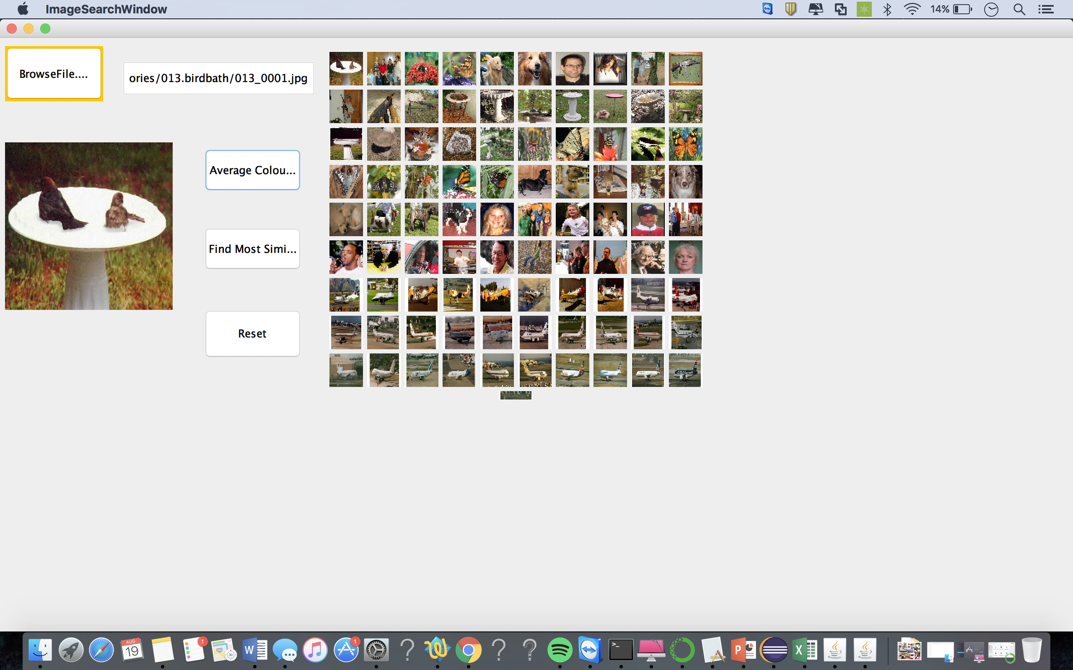
This is how it looks

Slide 4
Defining Image Descriptor
Calculated average color [R G B] vector using OpenCV library in Python.
img = cv2.imread(sys.argv[1], -1)
average_color_per_row = np.average(img, axis=0)
average_color = np.average(average_color_per_row, axis=0)
print(average_color)

Slide 5
Defining Image Descriptor
A vector for shape property of an image can be calculated using following Python code.
img = cv2.imread(sys.argv[1], -1)
shapeArray=img.shape
shapeString=""
for digit in shapeArray:
shapeString += str(digit)+" "
print(shapeString)
This gives an output vector [ht w bpp] where ht is height , w is width and bpp is bits per pixel value.

Slide 6
Indexing your dataset
Lucene is a full-text search library in Java which makes it easy to add search functionality to an application or website. It does so by adding content to a full-text index. It then allows you to perform queries on this index. This type of index is called an inverted index, because it inverts a page-centric data structure (page->words) to a keyword-centric data structure (word->pages).
Here built an index over six float values which are nothing but each vector value in 3 dimensional average color vector and a shape vector.
doc.add(new FloatField("shapeA", shapeA , Field.Store.NO));
doc.add(new FloatField("shapeB", shapeB , Field.Store.NO));
doc.add(new FloatField("shapeC", shapeC , Field.Store.NO));
doc.add(new FloatField("green",green,Field.Store.NO));
doc.add(new FloatField("red",red,Field.Store.NO));
doc.add(new FloatField("blue",blue,Field.Store.NO));
Indexing involves adding Documents to an IndexWriter
writer.updateDocument(new Term("path", file.toString()), doc);

Slide 7
Building Queries
As we have 6 float indices which are used to query the dataset. I have used a RangeQuery which matches documents with terms between beginning and ending terms, including or excluding the end points. Searching involves retrieving Documents from an index via an IndexSearcher
BooleanQuery finalQuery = new BooleanQuery();
finalQuery.add(redQuery, Occur.MUST);
Once an image is uploaded first it is preprocessed to calculate average R,G,B and height, wodth and bpp values. Once they are calculated indexed data set is searched in a range greater than or less that the calculated values as follows.
Query redQuery = NumericRangeQuery.newFloatRange("red", red-15.03f, red+15.10f, true, true);

Slide 8
Calculating a similarity score and sorting.
Images are then sorted from left to right from Maximum similarity to minimum. Similarity between the images obtained after querying over indexed images considering average RGB color distribution and shape. And then they are sorted in the Ascending order of their similarity score which is calculated using SIFT detector and BFMatcher in OPenCV in python.
SIFT: Distinctive Image Features from Scale-Invariant Keypoints, which extract keypoints and compute its descriptors. Brute-Force matcher is simple. It takes the descriptor of one feature in first set and is matched with all other features in second set using some distance calculation. And the closest one is returned.
sift =cv2.xfeatures2d.SIFT_create()

Slide 9
Calculating a similarity score and sorting.
Similarity score is stored as a value for image name as key and the this hashmap is sorted considering keys.
img1 = cv2.imread(sys.argv[1],-1) # queryImage
img2 = cv2.imread(sys.argv[2],-1) # trainImage
sift =cv2.xfeatures2d.SIFT_create() the keypoints and descriptors with SIFT
kp1, des1 = sift.detectAndCompute(img1,None)
kp2, des2 = sift.detectAndCompute(img2,None)
# BFMatcher with default params
bf = cv2.BFMatcher()
matches = bf.knnMatch(des1,des2, k=2)

Slide 10
Accuracy Analysis
Accuracy of searching application can be measured in terms of precision, recall and f1 score.
precision=((float)totalRetrivedRelevantInstances)/((float)totalRetrivedInstances);
recall=(float)totalRetrivedRelevantInstances/(float)totalRelevan Instances;
f1Score=(precision*recall)/(precision+recall);

Slide 11
Accuracy Analysis
Precision | Recall | F1 Score | Time(ms) | Images
0.14285715 | 0.13402061 | 0.069148935 | 3309 | 013_0001.jpg
0.75 | 0.0075 | 0.007425742 | 3071 | 251_0002.jpg
1 | 0.02 | 0.019607844 | 3142 | 251_0001.jpg
1 | 0.017857144 | 0.01754386 | 3355 | 024_0009.jpg
1 | 0.02 | 0.019607844 | 3142 | 251_0330.jpg
0.8 | 0.040816326 | 0.03883495 | 3115 | 002_0001.jpg
0.65909094 | 0.03625 | 0.03436019 | 3036 | 251_0001.jpg
0.23809524 | 0.05102041 | 0.042016808 | 3093 | 002_0002.jpg
0.51428574 | 0.18367347 | 0.13533837 | 3032 | 001_0003.jpg
0.12087912 | 0.09821428 | 0.05418719 | 3078 | 024_0045.jpg
From the graph for ninth search for image 001_0003.jpg, execution time is least and F1 score is maximum. For searching fourth image 024_0009.jpg , it takes maximum time F1 score being less.

Slide 12
Accuracy for varying R, G,B range for single image.
F1 Score | Time | Range difference
0.01010101 | 3599 | 5
0.01010101 | 3363 | 10
0.03883495 | 3731 | 15
0.06666667 | 3666 | 20
0.07428571 | 3491 | 25
0.064516135 | 3571 | 30
0.08389261 | 3563 | 35

Slide 13
Dynamically fitting all the result images in a square of 400X400 square
Each time number of image search vary. So in order that all images fit inside the 400x400 matrix, a simple algorithm is used as follows:-
Height=400/square root of no. of result images;
numberOfSquaresInOneRow=Math.sqrt(totalDocumentResults);
absoluteNumberOfSquaresInOneRow = 1+Math.abs(numberOfSquaresInOneRow);
height=400/absoluteNumberOfSquaresInOneRow;

Slide 14
Thank You

